Slide 1
A Sieving Algorithm for Approximate Integer Programming
Daniel Dadush, CWI

Slide 2
Talk Outline
Integer Programming:
  General discrete optimization model.
  Relaxing the model (approximate IP).
Lattice algorithms:
  Closest & Shortest Vector Problems.
  Approximate CVP => Approximate IP.

Slide 3



Integer Programming (IP)
$\min{ctx}$
$\text{s}\text{.}\text{t}\text{. }Ax≥b$
$x ε ℤn$
$n$ variables, $m$ constraints
$$c$$
$$K$$
Classic Problem in Discrete Optimization:
Danzig, Fulkerson, Johnson `54
Gomory `58, Lenstra `82, Kannan `87, …

Slide 4
Complexity & Algorithms
IP is NP-Complete (even with just binary variables).
We do not expect polynomial time algorithms.
Question:
What is worst case complexity of IP?

Slide 5
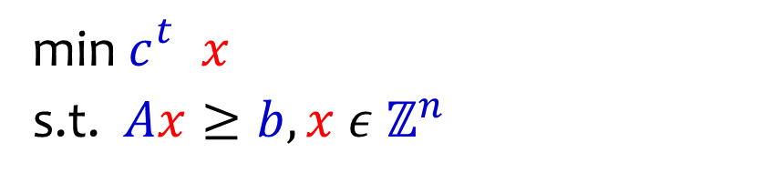
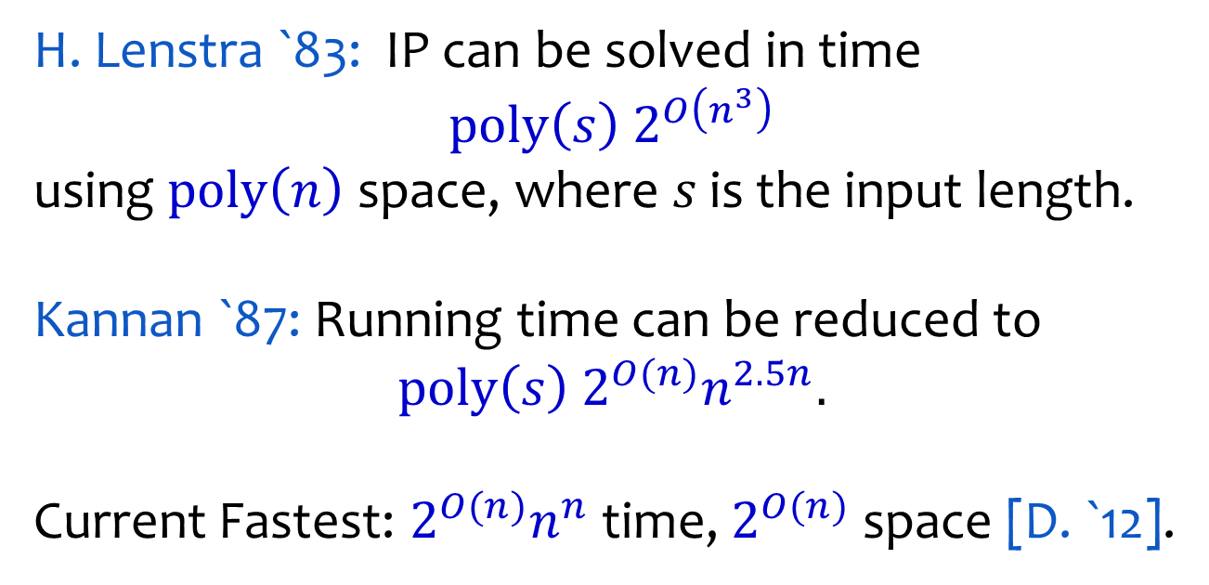
Complexity & Algorithms
min⁡ $c_{}^{t} x$
s.t. $Ax≥b, x ε ℤ^{n}$
H. Lenstra `83: IP can be solved in time
$$\text{poly}\left(s\right) 2^{O\left(n^{3}\right)}$$
using $\text{poly}\left(n\right)$ space, where $s$ is the input length.
Kannan `87: Running time can be reduced to
$$\text{poly}\left(s\right) 2^{O(n)}n^{2.5n}.$$
Current Fastest: $2^{O(n)}n^{n}$ time, $2^{O(n)}$ space [D. `12].

Slide 6
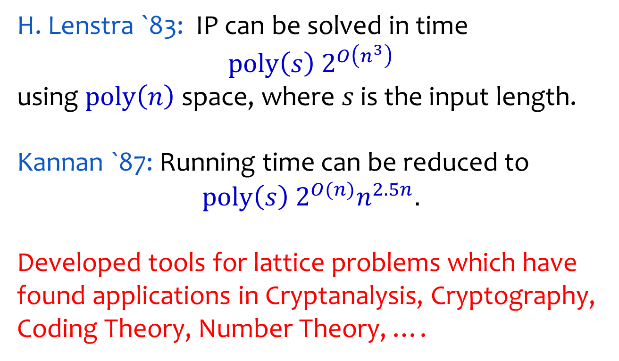
Complexity & Algorithms
min⁡ $c_{}^{t} x$
s.t. $Ax≥b, x ε ℤ^{n}$
H. Lenstra `83: IP can be solved in time
$$\text{poly}\left(s\right) 2^{O\left(n^{3}\right)}$$
using $\text{poly}\left(n\right)$ space, where $s$ is the input length.
Kannan `87: Running time can be reduced to
$$\text{poly}\left(s\right) 2^{O(n)}n^{2.5n}.$$
Developed tools for lattice problems which have found applications in Cryptanalysis, Cryptography, Coding Theory, Number Theory, ….

Slide 7



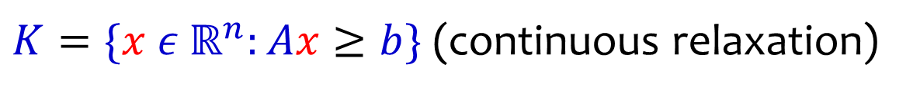
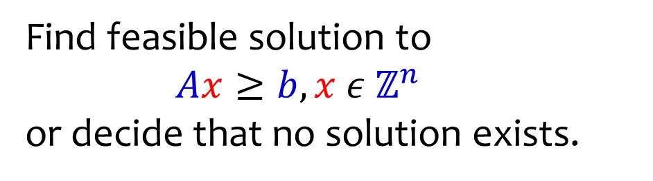

Integer Programming Feasibility
Find feasible solution to
$Ax≥b, x ε ℤ^{n}$
or decide that no solution exists.
$K=\{x ε ℝ^{n}:Ax≥b\}$ (continuous relaxation)
$$y$$
$$K$$
$$0$$
$$ℤ^{n}$$

Slide 8
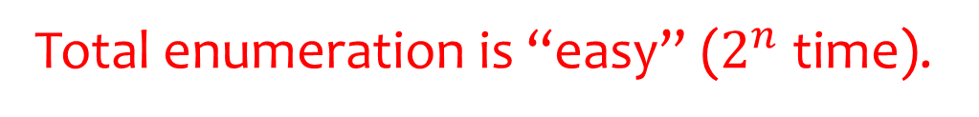
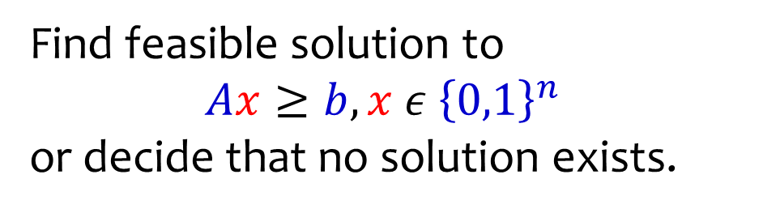
Binary vs General Integer
Find feasible solution to
$Ax≥b, x ε {\left\{0,1\right\}}^{n}$
or decide that no solution exists.
Total enumeration is “easy” ($2^{n}$ time).
$$K$$
$$0$$
$$ℤ^{n}$$

Slide 9
Binary vs General Integer
Find feasible solution to
$Ax≥b, x ε ℤ^{n}$
or decide that no solution exists.
No easy analog of total enumeration.
$$y$$
$$K$$
$$0$$
$$ℤ^{n}$$

Slide 10

Binary vs General Integer
Find feasible solution to
$Ax≥b, x ε ℤ^{n}$
or decide that no solution exists.
Need to adapt to the geometry of $K$.
$$y$$
$$K$$
$$0$$
$$ℤ^{n}$$

Slide 11

Binary vs General Integer
Find feasible solution to
$Ax≥b, x ε ℤ^{n}$
or decide that no solution exists.
Question: Is there a $2^{O(n)}$ time algorithm for IP?
$$y$$
$$K$$
$$0$$
$$ℤ^{n}$$

Slide 12


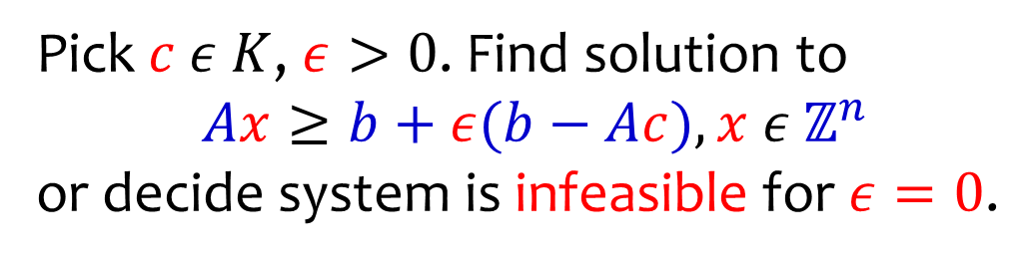

Relaxing the Model
Pick $c ε K$, $ε>0$. Find solution to
$Ax≥b+ε(b−Ac), x ε ℤ^{n}$
or decide system is infeasible for $ε=0$.
$$\left(1\text{+}ε\right) \text{scaling} \text{of} K \text{about} c$$
$$y′$$
$$K$$
$$c$$
$$0$$
$$ℤ^{n}$$

Slide 13

Relaxing the Model
Pick $c ε K$, $ε>0$. Find solution to
$Ax≥b+ε(b−Ac), x ε ℤ^{n}$
or decide system is infeasible for $ε=0$.
$$\left(1\text{+}ε\right) \text{scaling} \text{of} K \text{about} c$$
$$y′$$
$$K$$
$$c$$
$$0$$
$$ℤ^{n}$$

Slide 14

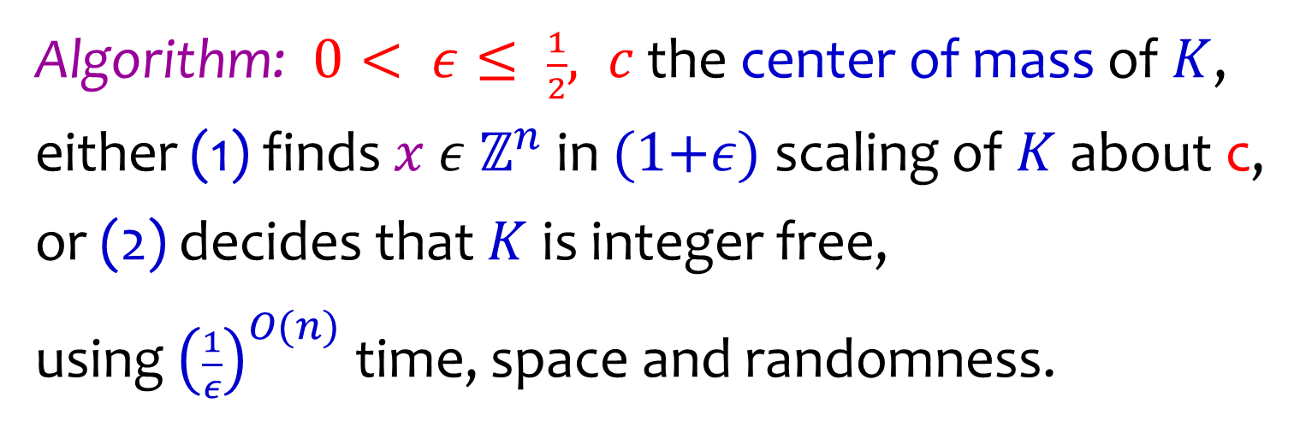


Result: Approximate Feasibility
Algorithm: $0< ε≤ \frac{1}{2}, c$ the center of mass of $K$,
either (1) finds $x ε ℤ^{n}$in $(1\text{+}ε)$ scaling of $K$ about c,
or (2) decides that $K$ is integer free,
using ${\left(\frac{1}{ε}\right)}^{O(n)}$ time, space and randomness.
$$x$$
$$K$$
$$c$$

Slide 15
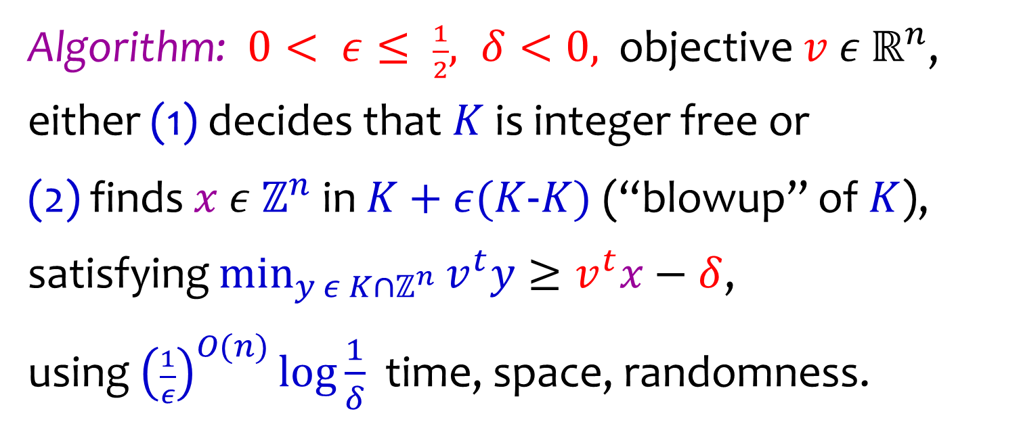

Result: Approximate Optimization
Algorithm: $0< ε≤ \frac{1}{2}, δ<0,$ objective $v ε ℝ^{n}$,
either (1) decides that $K$ is integer free or
(2) finds $x ε ℤ^{n}$in $K+ε(K\text{−}K)$ (“blowup” of $K$),
satisfying $\min_{y ε K∩ℤ^{n}}{v^{t}y}≥v^{t}x−δ$,
using ${\left(\frac{1}{ε}\right)}^{O(n)}\log{\frac{1}{δ}}$ time, space, randomness.
$$x$$
$$K$$
$$v$$

Slide 16




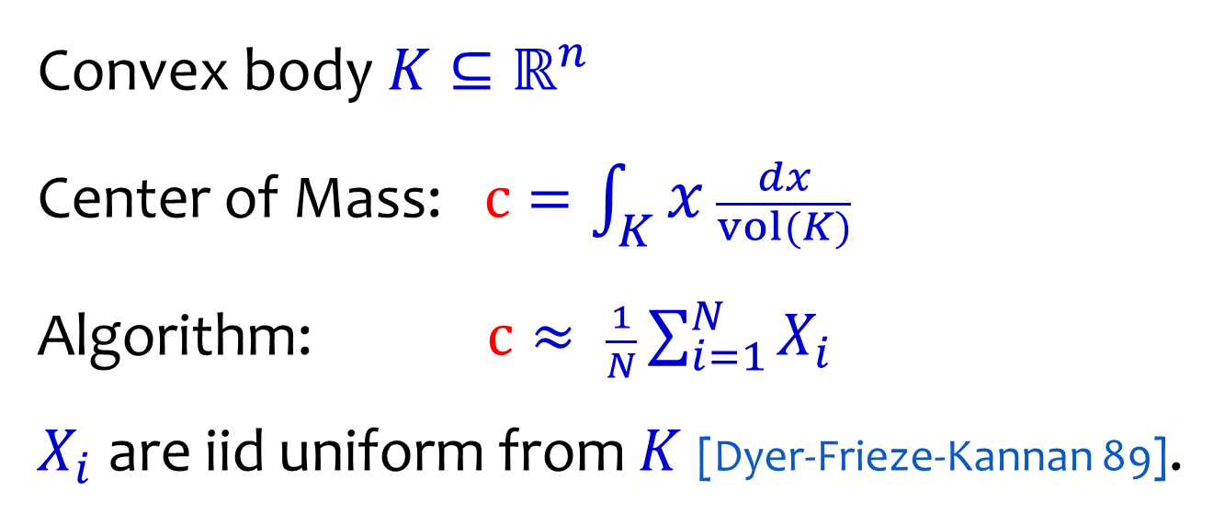





Center of Mass
Convex body $K⊆ℝ^{n}$
Center of Mass:$c=\int_{K}{x}\frac{dx}{vol(K)}$
Algorithm: $c≈ \frac{1}{N}\sum_{i=1}^{N}{X_{i}}$
$X_{i}$ are iid uniform from $K$ [Dyer-Frieze-Kannan 89].
$$x_{7}$$
$$x_{5}$$
$$x_{2}$$
$$x_{3}$$
$$K$$
$$c$$
$$x_{4}$$
$$x_{1}$$
$$x_{6}$$

Slide 17
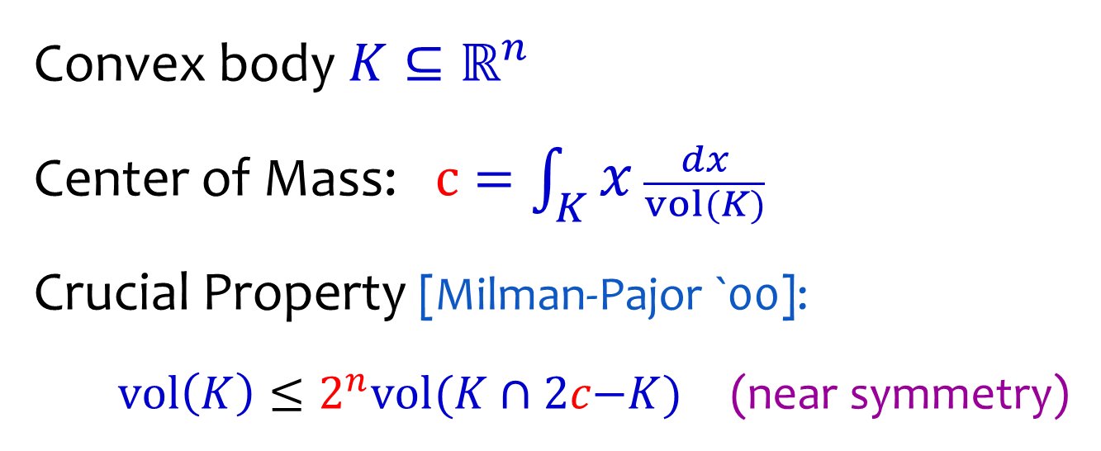

Center of Mass
Convex body $K⊆ℝ^{n}$
Center of Mass:$c=\int_{K}{x}\frac{dx}{vol(K)}$
Crucial Property [Milman-Pajor `00]:
$vol\left(K\right)≤2^{n}vol(K∩2c\text{−}K)$ (near symmetry)
$$K$$
$$c$$
$$2c\text{−}K$$

Slide 18

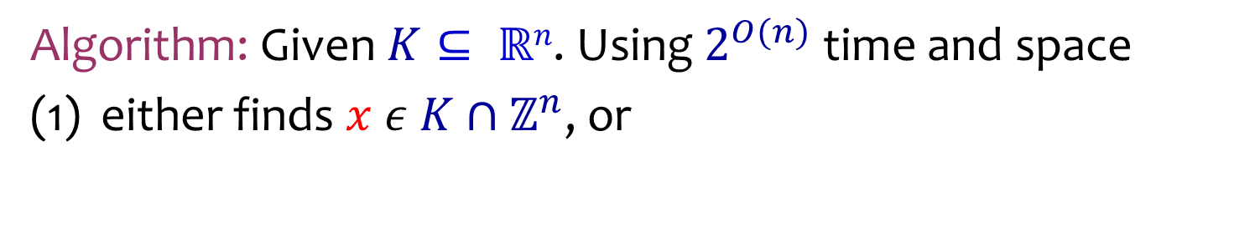

Kinchine’s Flatness Theorem
Algorithm: Given $K⊆ ℝn$. Using $2^{O(n)}$ time and space
either finds $x ε K∩ℤ^{n}$, or
$$x$$
$$K$$

Slide 19
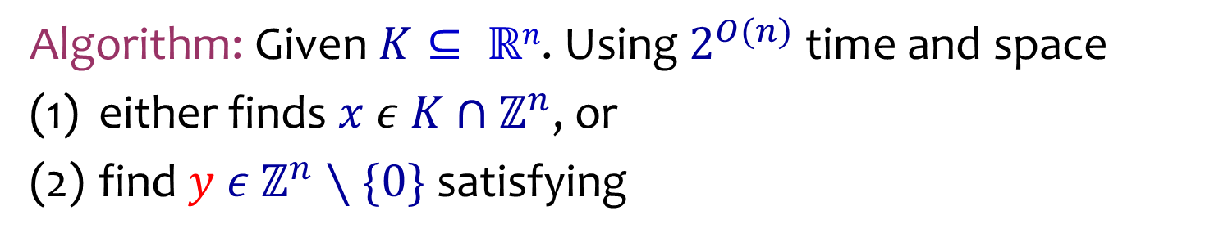

Kinchine’s Flatness Theorem
Algorithm: Given $K⊆ ℝn$. Using $2^{O(n)}$ time and space
either finds $x ε K∩ℤ^{n}$, or
find $y ε ℤ^{n}∖\{0\}$ satisfying
$w\text{idth}K\left(y\right)= {\text{max}}_{x ε K} \left\langle y,x\right\rangle −{\text{min}}_{x ε K} \left\langle y,x\right\rangle ≤Õ(n^{4/3})$
[Kinchine 48, Babai 86, Lenstra-Lagarias-Schnorr 87, Hastad 88, Kannan-L0vasz 88,
Banasczyk 96, Rudelson 00]
$$y$$
$$K$$
y^{t}x=0
y^{t}x=1
y^{t}x=2

Slide 20

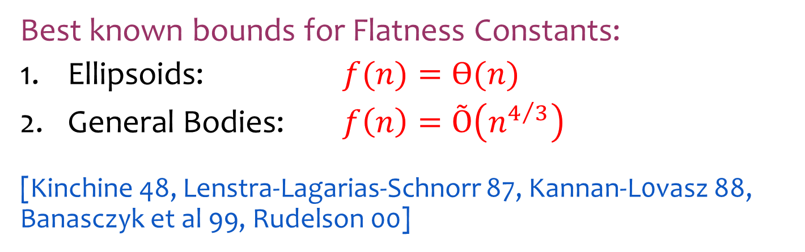

Kinchine’s Flatness Theorem
Best known bounds for Flatness Constants:
Ellipsoids: $f(n)=Ѳ(n)$
General Bodies: $f\left(n\right)=\text{Õ}\left(n^{4/3}\right)$
[Kinchine 48, Lenstra-Lagarias-Schnorr 87, Kannan-L0vasz 88, Banasczyk et al 99, Rudelson 00]
$$E$$
$$K$$

Slide 21
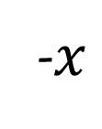
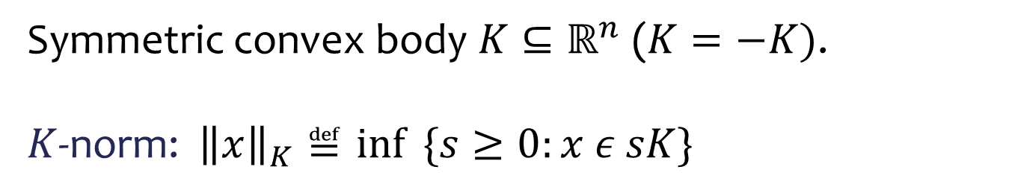



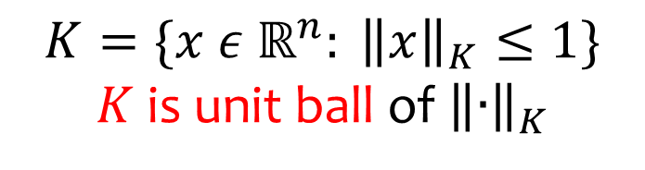

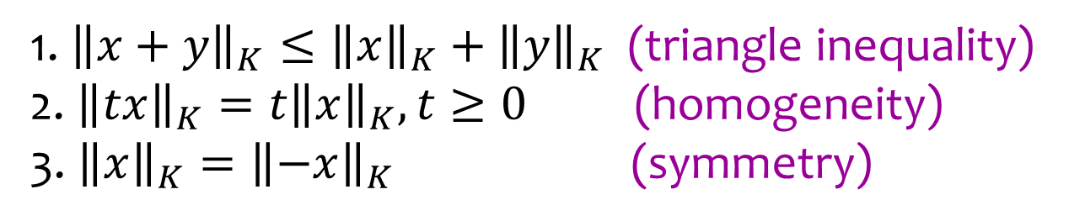
Norms and Convex Bodies
Symmetric convex body $K⊆ℝ^{n}$ ($K=−K)$.
$K$-norm: ${\left\|x\right\|}_{K}≝\inf{ \{s≥0:x ε sK\}}$
$$x$$
$$sK$$
$$K$$
$$K=\{x ε ℝ^{n}: {\left\|x\right\|}_{K}≤1\}$$
$K$ is unit ball of ${\left\|∙\right\|}_{K}$
$$0$$
-$x$
1. ${\left\|x+y\right\|}_{K}≤{\left\|x\right\|}_{K}+{\left\|y\right\|}_{K}$ (triangle inequality)
2.${\left\|tx\right\|}_{K}=t{\left\|x\right\|}_{K}, t≥0$ (homogeneity)
3. ${\left\|x\right\|}_{K}={\left\|−x\right\|}_{K}$ (symmetry)

Slide 22

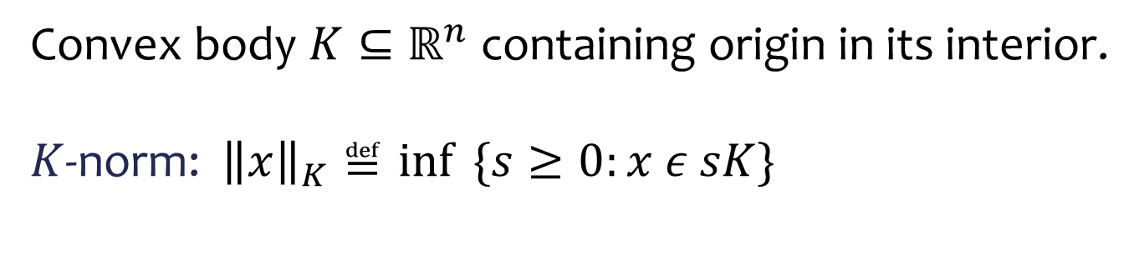



Norms and Convex Bodies
Convex body $K⊆ℝ^{n}$ containing origin in its interior.
$K$-norm: ${\left\|x\right\|}_{K}≝\inf{ \{s≥0:x ε sK\}}$
$$x$$
$$sK$$
$$K$$
$$K=\{x ε ℝ^{n}: {\left\|x\right\|}_{K}≤1\}$$
$K$ is unit ball of ${\left\|∙\right\|}_{K}$
$$0$$
1. ${\left\|x+y\right\|}_{K}≤{\left\|x\right\|}_{K}+{\left\|y\right\|}_{K}$ (triangle inequality)
2.${\left\|tx\right\|}_{K}=t{\left\|x\right\|}_{K}, t≥0$ (homogeneity)
3. ${\left\|x\right\|}_{K}={\left\|−x\right\|}_{K}$ (symmetry)

Slide 23
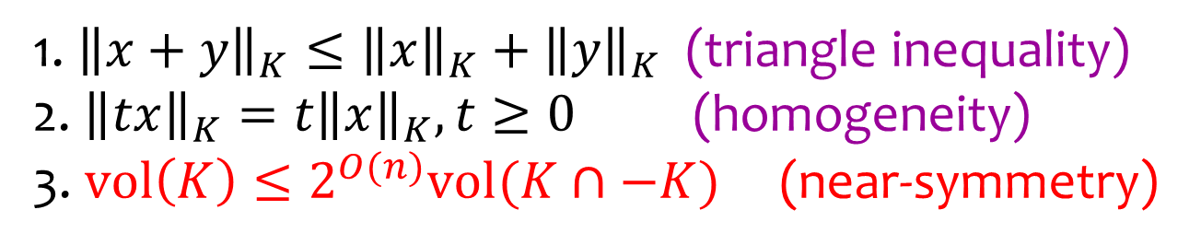

Norms and Convex Bodies
Convex body $K⊆ℝ^{n}$ containing origin in its interior.
$K$-norm: ${\left\|x\right\|}_{K}≝\inf{ \{s≥0:x ε sK\}}$
$$x$$
$$sK$$
$$K$$
$$K=\{x ε ℝ^{n}: {\left\|x\right\|}_{K}≤1\}$$
$K$ is unit ball of ${\left\|∙\right\|}_{K}$
$$0$$
1. ${\left\|x+y\right\|}_{K}≤{\left\|x\right\|}_{K}+{\left\|y\right\|}_{K}$ (triangle inequality)
2.${\left\|tx\right\|}_{K}=t{\left\|x\right\|}_{K}, t≥0$ (homogeneity)
3. $\text{vol}\left(K\right)≤2^{O(n)}vol(K∩\text{−}K)$ (near-symmetry)

Slide 24
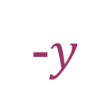

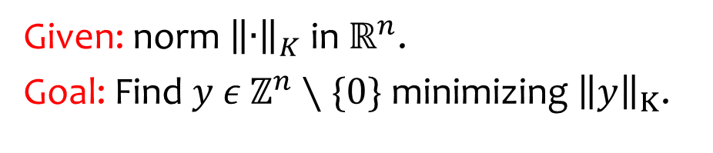



Shortest Vector Problem (SVP)
Given: norm ${\left\|∙\right\|}_{K}$ in $ℝ^{n}$.
Goal: Find $y ε$ $ℤ^{n}∖\{0\}$ minimizing ${\left\|y\right\|}_{K}$.
$$y$$
$$K$$
$$0$$
$$ℤ^{n}$$
-$y$

Slide 25

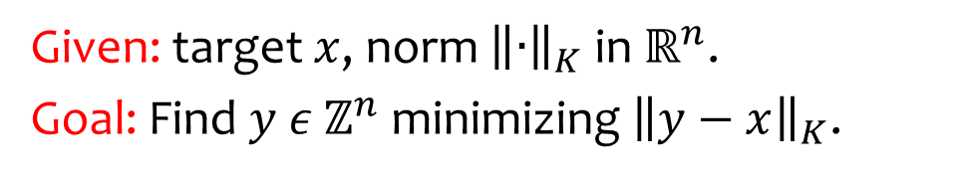


Closest Vector Problem (CVP)
Given: target $x$, norm ${\left\|∙\right\|}_{K}$ in $ℝ^{n}$.
Goal: Find $y ε$ $ℤ^{n}$ minimizing ${\left\|y−x\right\|}_{K}$.
$$K$$
$$y$$
$$x$$
$$ℤ^{n}$$

Slide 26
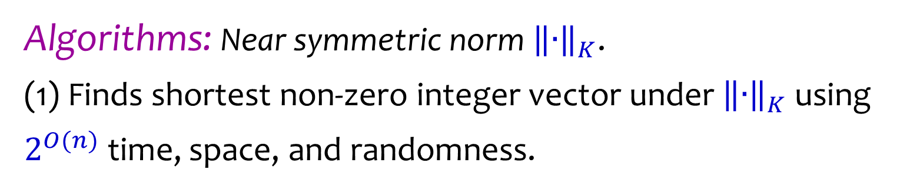


Main Tools
Algorithms: Near symmetric norm ${\left\|∙\right\|}_{K}$.
(1) Finds shortest non-zero integer vector under ${\left\|∙\right\|}_{K}$ using $2^{O(n)}$ time, space, and randomness.
$$K$$
$$y$$
$$0$$

Slide 27
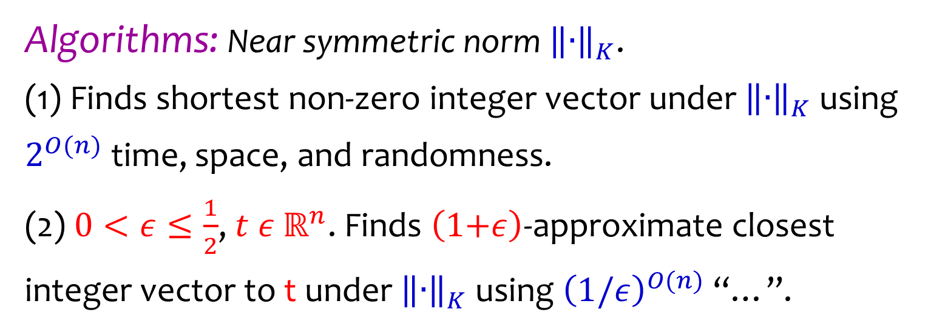


Main Tools
Algorithms: Near symmetric norm ${\left\|∙\right\|}_{K}$.
(1) Finds shortest non-zero integer vector under ${\left\|∙\right\|}_{K}$ using $2^{O(n)}$ time, space, and randomness.
(2) $0<ε≤\frac{1}{2}$, $t ε ℝ^{n}$. Finds $\left(1\text{+}ε\right)$-approximate closest integer vector to t under ${\left\|∙\right\|}_{K}$ using ${\left(1/ε\right)}^{O(n)}$ “…”.
$$y$$
$$K$$
$$t$$

Slide 28
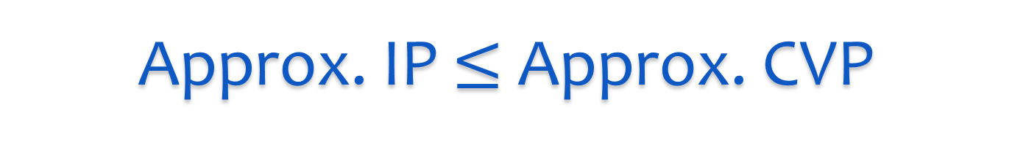

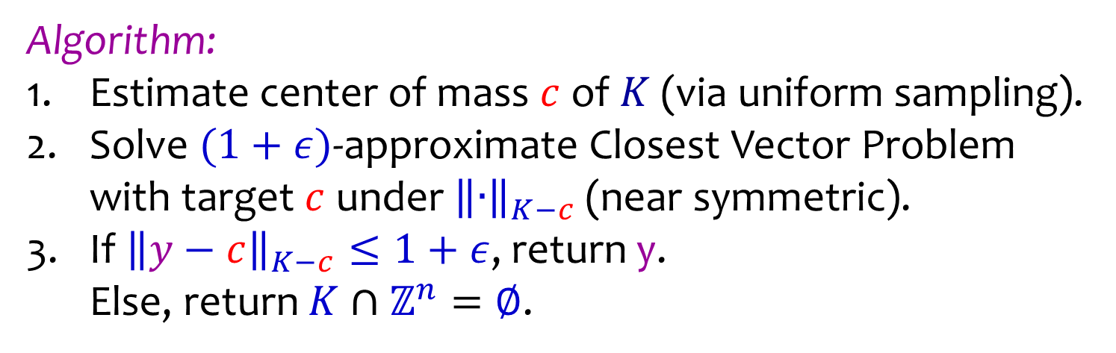



Approx. IP $≤$ Approx. CVP
Algorithm:
Estimate center of mass $c$ of $K$ (via uniform sampling).
Solve $(1+ε)$-approximate Closest Vector Problem
with target $c$ under ${\left\|∙\right\|}_{K−c}$ (near symmetric).
If ${\left\|y−c\right\|}_{K−c}≤1+ε$, return y.
Else, return $K∩ℤ^{n}=∅$.
$$K$$
$$ℤ^{n}$$
$$c$$
$$y$$

Slide 29
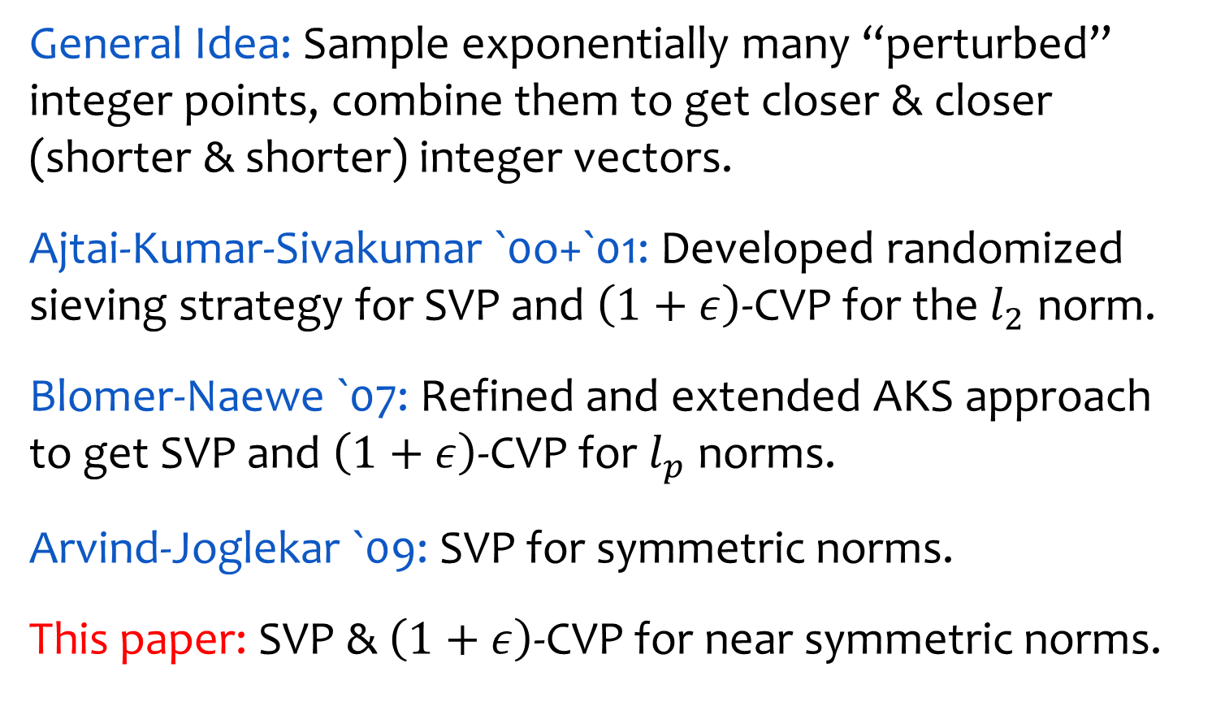
The Randomized Sieve
General Idea: Sample exponentially many “perturbed” integer points, combine them to get closer & closer (shorter & shorter) integer vectors.
Ajtai-Kumar-Sivakumar `0o+`01: Developed randomized sieving strategy for SVP and $\left(1+ε\right)$-CVP for the $l_{2}$ norm.
Blomer-Naewe `07: Refined and extended AKS approach to get SVP and $\left(1+ε\right)$-CVP for $l_{p}$ norms.
Arvind-Joglekar `09: SVP for symmetric norms.
This paper: SVP & $\left(1+ε\right)$-CVP for near symmetric norms.

Slide 30
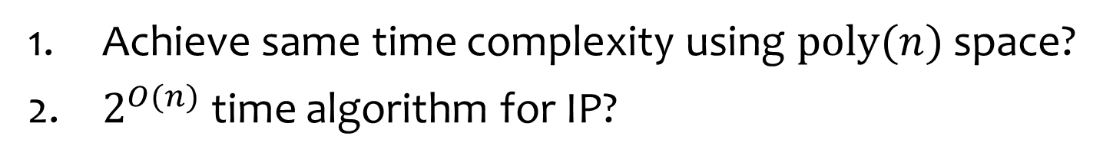
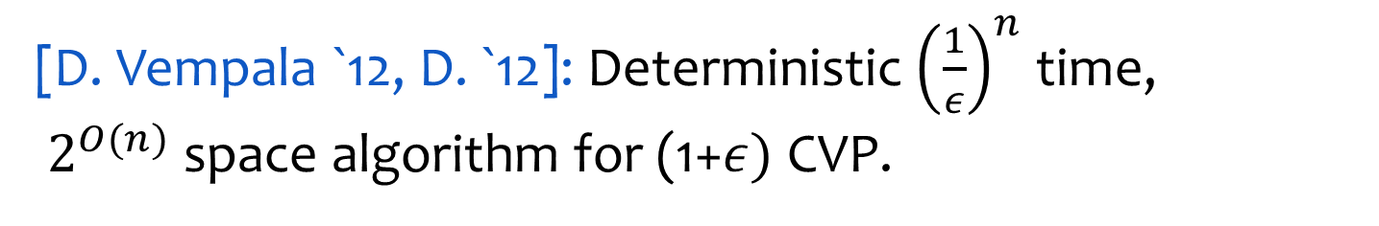
Recent work
[D. Vempala `12, D. `12]: Deterministic ${\left(\frac{1}{ε}\right)}^{n}$ time,
$2^{O(n)}$ space algorithm for (1+$ε)$ CVP.
Conclusions
Presented approximate IP model and gave single exponential time algorithm to solve it.
Generalized the AKS randomized sieve to nearly all norms.
Open Problems
Achieve same time complexity using $\text{poly}(n)$ space?
$2^{O(n)}$ time algorithm for IP?

Slide 31
Thank You!

