Slide 1
Lattice Sparsification and the Approximate Closest Vector Problem
Daniel Dadush
Centrum Wiskunde en Informatica
Joint work with Gabor Kun (Renyi Institute)

Slide 2
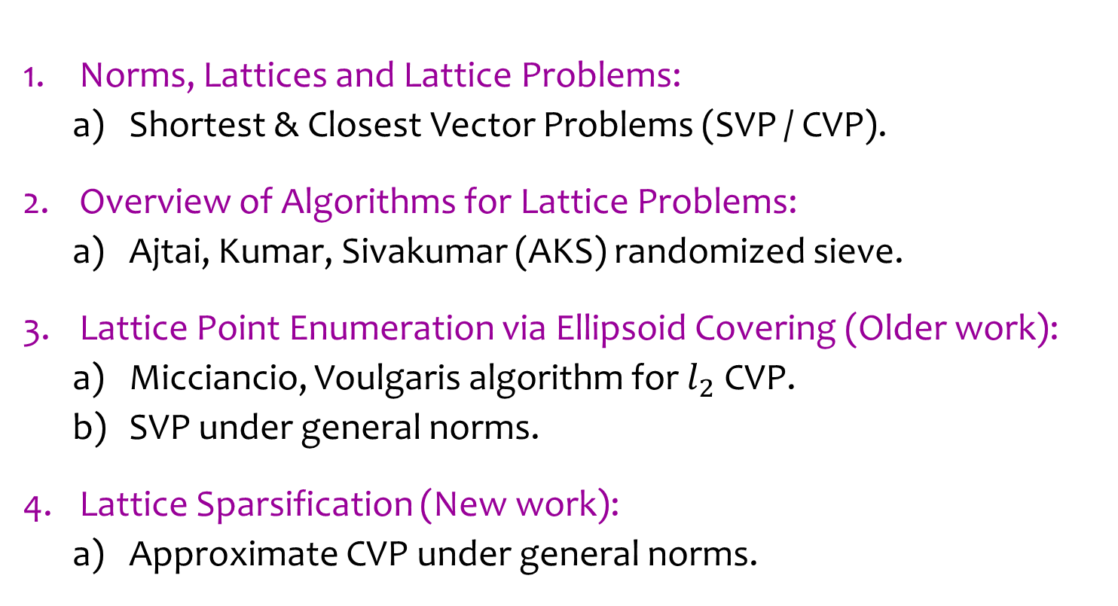
Outline
Norms, Lattices and Lattice Problems:
  Shortest & Closest Vector Problems (SVP / CVP).
Overview of Algorithms for Lattice Problems:
  Ajtai, Kumar, Sivakumar (AKS) randomized sieve.
Lattice Point Enumeration via Ellipsoid Covering (Older work):
  Micciancio, Voulgaris algorithm for $l_{2}$ CVP.
  SVP under general norms.
Lattice Sparsification (New work):
  Approximate CVP under general norms.

Slide 3



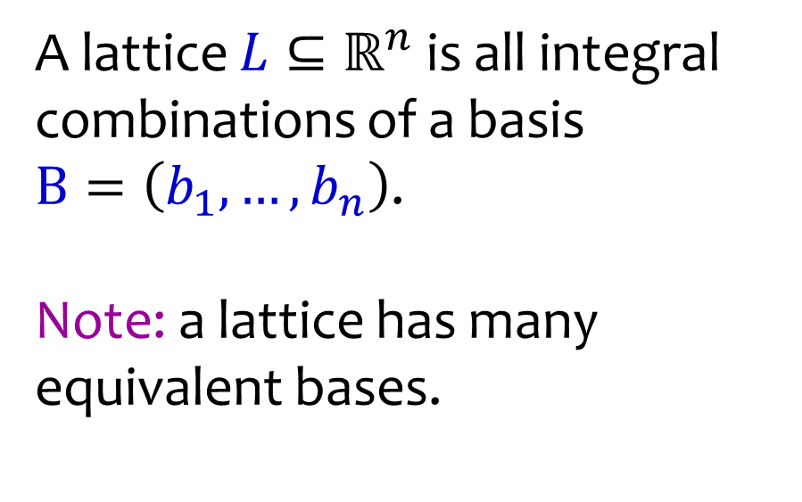



Lattices
A lattice $L⊆ℝ^{n}$ is all integral combinations of a basis
$B=\left(b_{1},…,b_{n}\right)$.
Note: a lattice has many equivalent bases.
$$b_{2}$$
$$b_{1}$$
$$b_{2}$$
$$b_{1}$$
$$b_{2}$$
$$L$$

Slide 4
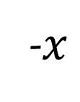
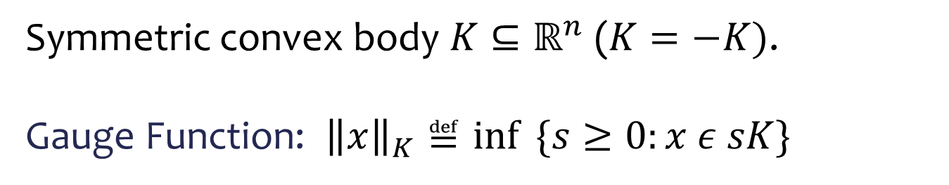



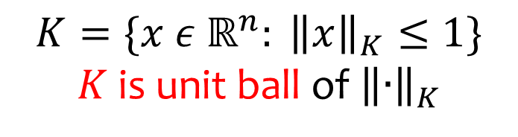

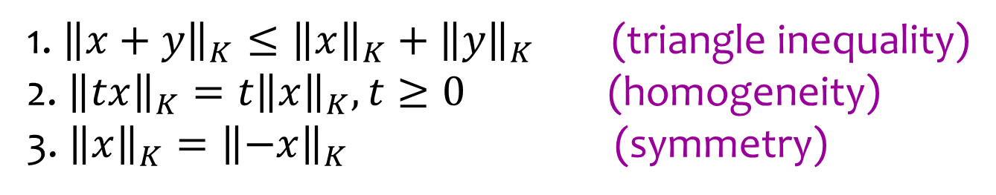
Norms and Convex Bodies
Symmetric convex body $K⊆ℝ^{n}$ ($K=−K)$.
Gauge Function: ${\left\|x\right\|}_{K}≝\inf{ \{s≥0:x ε sK\}}$
$$x$$
$$sK$$
$$K$$
$$K=\{x ε ℝ^{n}: {\left\|x\right\|}_{K}≤1\}$$
$K$ is unit ball of ${\left\|∙\right\|}_{K}$
$$0$$
-$x$
1. ${\left\|x+y\right\|}_{K}≤{\left\|x\right\|}_{K}+{\left\|y\right\|}_{K}$ (triangle inequality)
2.${\left\|tx\right\|}_{K}=t{\left\|x\right\|}_{K}, t≥0$ (homogeneity)
3. ${\left\|x\right\|}_{K}={\left\|−x\right\|}_{K}$ (symmetry)

Slide 5


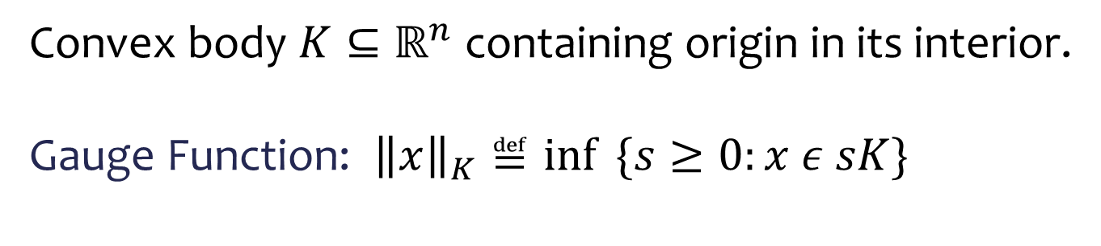



Norms and Convex Bodies
Convex body $K⊆ℝ^{n}$ containing origin in its interior.
Gauge Function: ${\left\|x\right\|}_{K}≝\inf{ \{s≥0:x ε sK\}}$
$$x$$
$$sK$$
$$K$$
$$K=\{x ε ℝ^{n}: {\left\|x\right\|}_{K}≤1\}$$
$K$ is unit ball of ${\left\|∙\right\|}_{K}$
$$0$$
1. ${\left\|x+y\right\|}_{K}≤{\left\|x\right\|}_{K}+{\left\|y\right\|}_{K}$ (triangle inequality)
2.${\left\|tx\right\|}_{K}=t{\left\|x\right\|}_{K}, t≥0$ (homogeneity)
3. ${\left\|x\right\|}_{K}={\left\|−x\right\|}_{K}$ (symmetry)

Slide 6
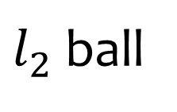

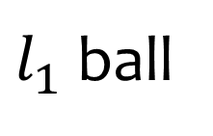






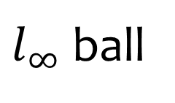
Norms and Convex Bodies
$l_{p}$ norms, $p≥1$: ${\left\|x\right\|}_{p}={\left(∑{|x_{i}|}_{}^{p}\right)}^{1/p}$
$l_{1}$ ball
$l_{2}$ ball
$l_{∞}$ ball
$$0$$
$$0$$
$$0$$
$$B_{1}^{n}$$
$$B_{2}^{n}$$
$$B_{∞}^{n}$$

Slide 7
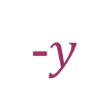

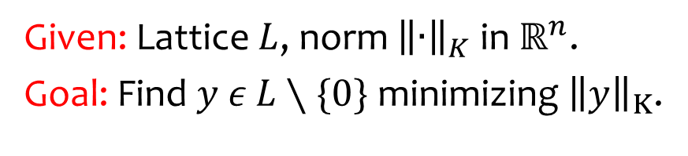



Shortest Vector Problem (SVP)
Given: Lattice $L$, norm ${\left\|∙\right\|}_{K}$ in $ℝ^{n}$.
Goal: Find $y ε$ $L∖\{0\}$ minimizing ${\left\|y\right\|}_{K}$.
$$y$$
$$K$$
$$0$$
$$L$$
-$y$

Slide 8

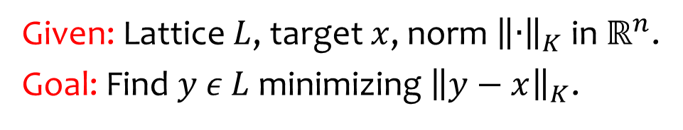


Closest Vector Problem (CVP)
Given: Lattice $L$, target $x$, norm ${\left\|∙\right\|}_{K}$ in $ℝ^{n}$.
Goal: Find $y ε$ $L$ minimizing ${\left\|y−x\right\|}_{K}$.
$$K$$
$$y$$
$$x$$
$$L$$

Slide 9
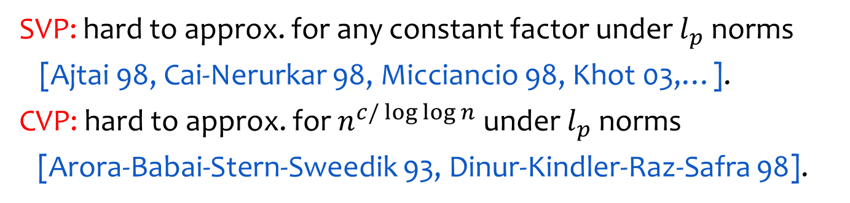
Applications of SVP and CVP
Optimization: Integer and Linear Programming
Number Theory: Factoring Polynomials, Number Field Sieve
Communication Theory: Decoding Gaussian Channels
Cryptanalysis: RSA with Small Exponent, Knapsack Crypto Systems
Cryptography: Lattice based crypto systems (hardness of LWE / SIS)
Hardness
SVP: hard to approx. for any constant factor under $l_{p}$ norms
[Ajtai 98, Cai-Nerurkar 98, Micciancio 98, Khot 03,…].
CVP: hard to approx. for $n^{c/\log{\log{n}}}$ under $l_{p}$ norms
[Arora-Babai-Stern-Sweedik 93, Dinur-Kindler-Raz-Safra 98].

Slide 10
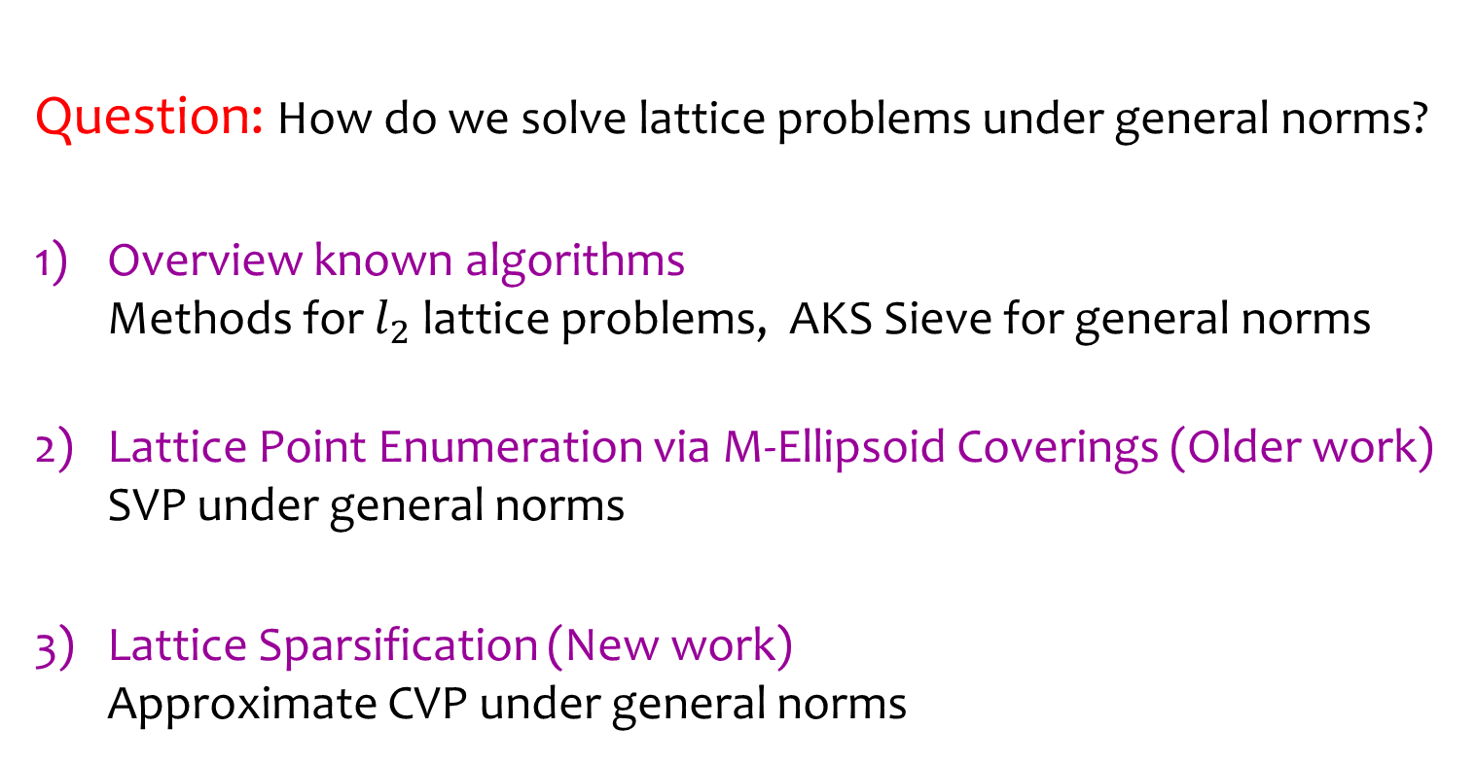
Outline
Question: How do we solve lattice problems under general norms?
Overview known algorithms
Methods for $l_{2}$ lattice problems, AKS Sieve for general norms
Lattice Point Enumeration via M-Ellipsoid Coverings (Older work)
SVP under general norms
Lattice Sparsification (New work)
Approximate CVP under general norms

Slide 11


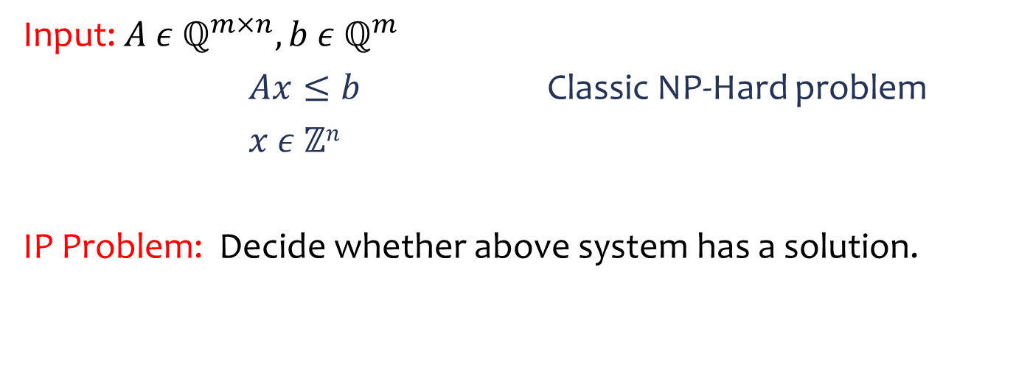
1. Integer Programming Problem (IP):
Why General Norms?
$$K_{1}$$
$$K_{2}$$
$$ℤ^{n}$$
Input: $A ε ℚ^{m×n},b ε ℚ^{m}$
$Ax≤b$ Classic NP-Hard problem
$x ε ℤn$
IP Problem: Decide whether above system has a solution.

Slide 12
1. Integer Programming Problem (IP):
Why General Norms?
$$K_{1}$$
$$K_{2}$$
$$ℤ^{n}$$
Lattice Sub-Problems:
Heuristic Rounding: try to find integer point near center of feasible region (Approximate CVP)
Decompose IP: break up into lower dimensional slices (SVP)

Slide 13

1. Integer Programming Problem (IP):
Why General Norms?
subproblems
$$y$$
$$K_{1}$$
$$K_{2}$$
$$ℤ^{n}$$
Lattice Sub-Problems:
Heuristic Rounding: try to find integer point near center of feasible region (Approximate CVP)
Decompose IP: break up into lower dimensional slices (SVP)

Slide 14
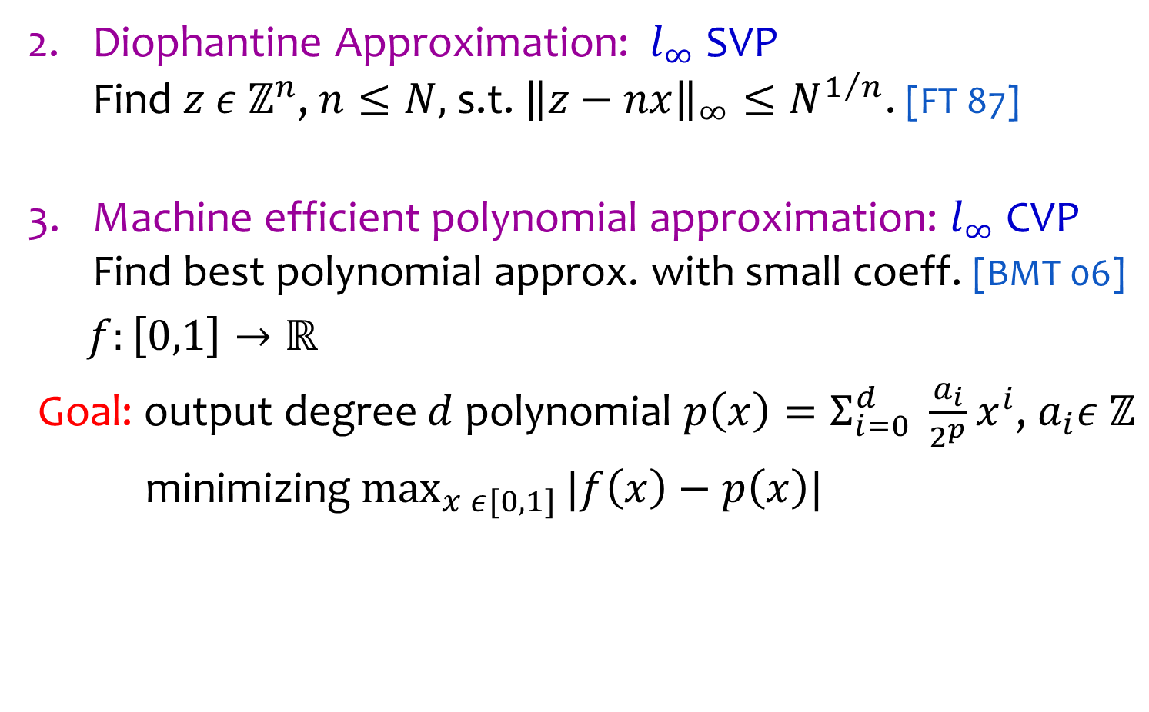
Why General Norms?
Diophantine Approximation: $l_{∞}$SVP
Find $z ε ℤ^{n}$, $n≤N,$ s.t. ${\left\|z−nx\right\|}_{∞}≤N^{1/n}$. [FT 87]
Machine efficient polynomial approximation: $l_{∞}$CVP
Find best polynomial approx. with small coeff. [BMT 06]
$f:\left[0,1\right]→ℝ$
Goal: output degree $d$ polynomial ${p\left(x\right)=Σ}_{i=0}^{d} \frac{a_{i}}{2^{p}}x^{i}$, $a_{i}ε ℤ$
minimizing $\max_{x ε[0,1]}{|f\left(x\right)−p\left(x\right)|}$

Slide 15
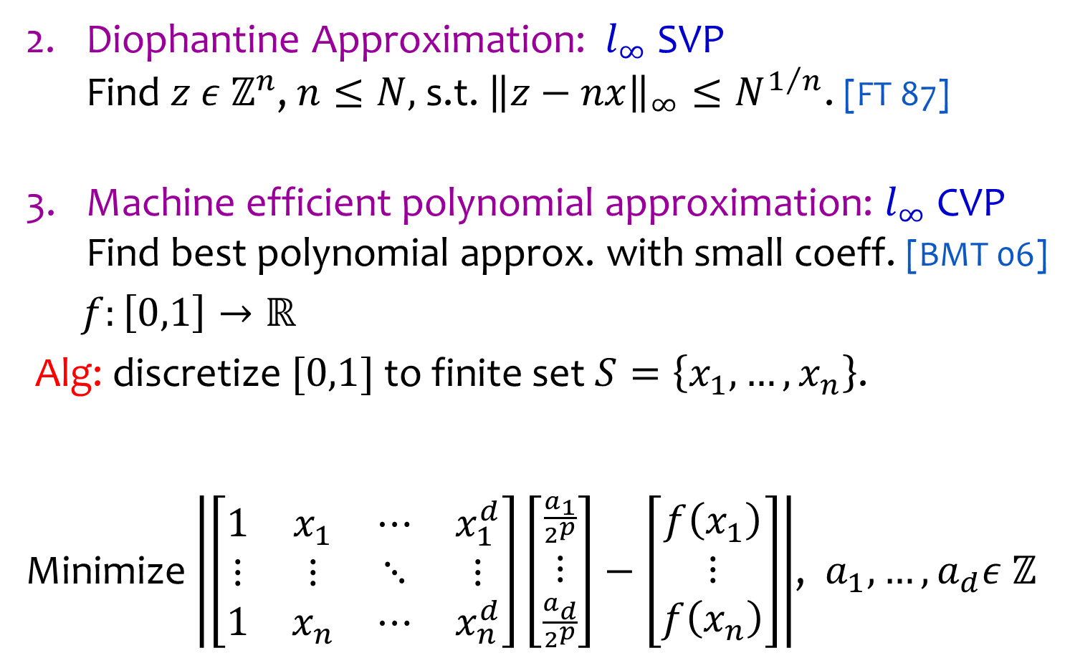
Why General Norms?
Diophantine Approximation: $l_{∞}$SVP
Find $z ε ℤ^{n}$, $n≤N,$ s.t. ${\left\|z−nx\right\|}_{∞}≤N^{1/n}$. [FT 87]
Machine efficient polynomial approximation: $l_{∞}$CVP
Find best polynomial approx. with small coeff. [BMT 06]
$f:\left[0,1\right]→ℝ$
Alg: discretize $[0,1]$ to finite set $S=\left\{x_{1},…,x_{n}\right\}$.
Minimize $\left|\left[\begin{matrix}1 & x_{1} & ⋯ & x_{1}^{d} \\ ⋮ & ⋮ & ⋱ & ⋮ \\ 1 & x_{n} & ⋯ & x_{n}^{d}\end{matrix}\right]\left[\begin{matrix}\frac{a_{1}}{2^{p}} \\ ⋮ \\ \frac{a_{d}}{2^{p}}\end{matrix}\right]−\left[\begin{matrix}f\left(x_{1}\right) \\ ⋮ \\ f\left(x_{n}\right)\end{matrix}\right]\right|$, $a_{1},…, a_{d}ε ℤ$

Slide 16



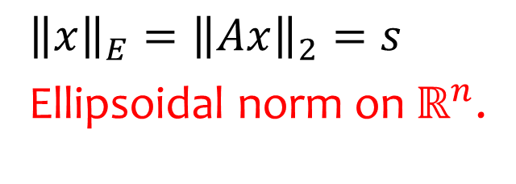




Ellipsoids
Ellipsoid $E=TB_{2}^{n}$ is linear transformation of a ball .
$$B_{2}^{n}$$
$$E$$
$$T$$
$$E=\left\{x ε ℝ^{n}:{\left\|Ax\right\|}_{2}≤1\right\} \text{for} A=T^{−1}.$$
$$x$$
$${\left\|x\right\|}_{E}={\left\|Ax\right\|}_{2}=s$$
Ellipsoidal norm on $ℝ^{n}$.
$$E$$
$$sE$$
$$0$$

Slide 17


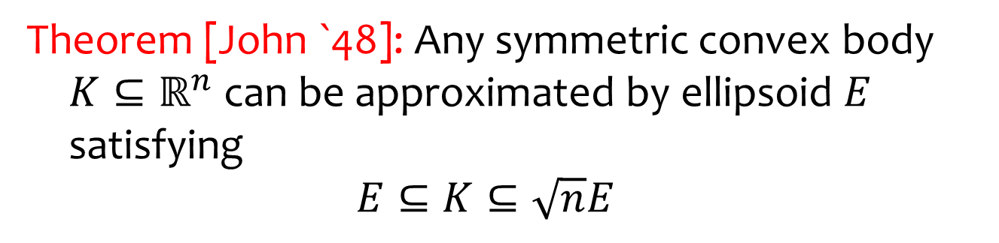



Ellipsoids
Theorem [John `48]: Any symmetric convex body
$K⊆ℝ^{n}$ can be approximated by ellipsoid $E$ satisfying
$$E⊆K⊆\sqrt{n}E$$
$$\sqrt{n}E$$
$$K$$
$$E$$
$$0$$
General norm problems become “interesting” when
approximation factor is much less than $\sqrt{n}$.

Slide 18
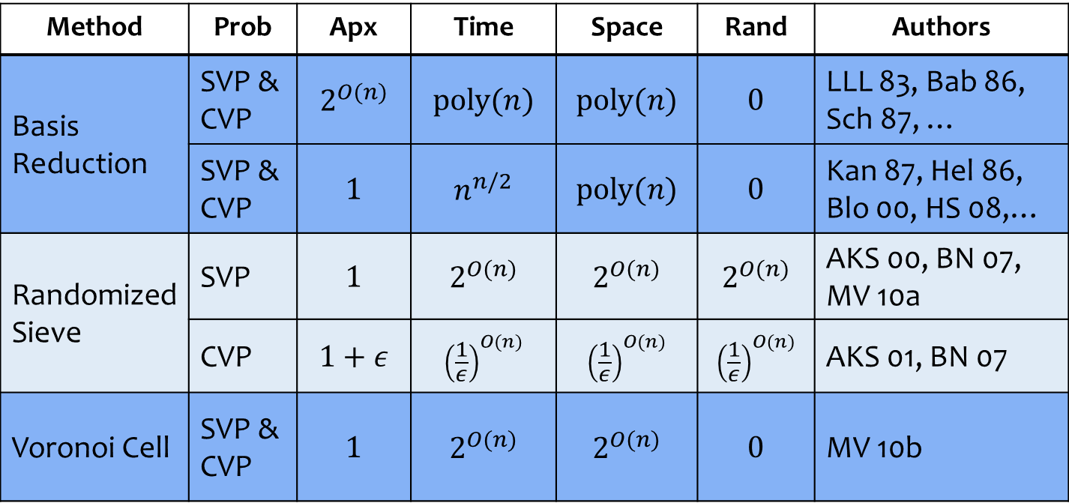

SVP & CVP under $l_{2}$ norm
Method | Prob | Apx | Time | Space | Rand | Authors
Basis Reduction | SVP & CVP | $$2^{O(n)}$$ | $$poly(n)$$ | $$poly(n)$$ | $$0$$ | LLL 83, Bab 86, Sch 87, …
 | SVP & CVP | $$1$$ | $$n^{n/2}$$ | $$poly(n)$$ | $$0$$ | Kan 87, Hel 86, Blo 00, HS 08,…
Randomized Sieve | SVP | $$1$$ | $$2^{O(n)}$$ | $$2^{O(n)}$$ | $$2^{O(n)}$$ | AKS 00, BN 07, MV 10a
 | CVP | $$1+ε$$ | $${\left(\frac{1}{ε}\right)}^{O(n)}$$ | $${\left(\frac{1}{ε}\right)}^{O(n)}$$ | $${\left(\frac{1}{ε}\right)}^{O(n)}$$ | AKS 01, BN 07
Voronoi Cell | SVP & CVP | $$1$$ | $$2^{O(n)}$$ | $$2^{O(n)}$$ | $$0$$ | MV 10b

Slide 19
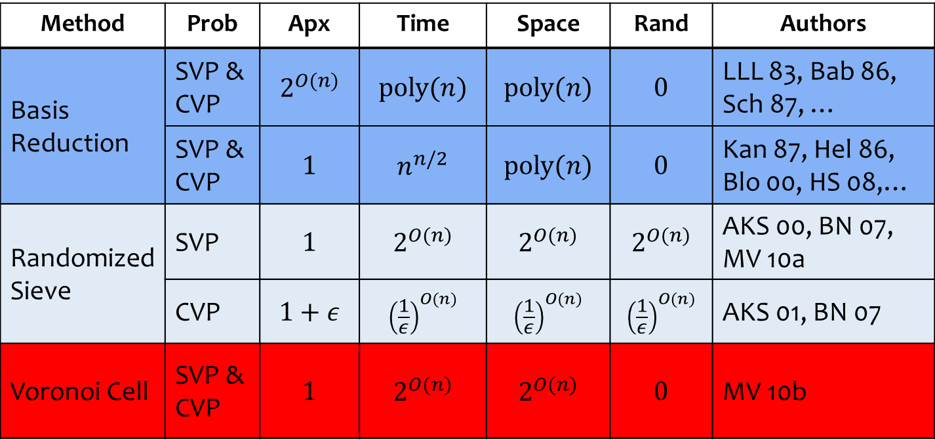

SVP & CVP under $l_{2}$ norm
Method | Prob | Apx | Time | Space | Rand | Authors
Basis Reduction | SVP & CVP | $$2^{O(n)}$$ | $$poly(n)$$ | $$poly(n)$$ | $$0$$ | LLL 83, Bab 86, Sch 87, …
 | SVP & CVP | $$1$$ | $$n^{n/2}$$ | $$poly(n)$$ | $$0$$ | Kan 87, Hel 86, Blo 00, HS 08,…
Randomized Sieve | SVP | $$1$$ | $$2^{O(n)}$$ | $$2^{O(n)}$$ | $$2^{O(n)}$$ | AKS 00, BN 07, MV 10a
 | CVP | $$1+ε$$ | $${\left(\frac{1}{ε}\right)}^{O(n)}$$ | $${\left(\frac{1}{ε}\right)}^{O(n)}$$ | $${\left(\frac{1}{ε}\right)}^{O(n)}$$ | AKS 01, BN 07
Voronoi Cell | SVP & CVP | $$1$$ | $$2^{O(n)}$$ | $$2^{O(n)}$$ | $$0$$ | MV 10b
Reduce to $\text{poly}\left(n\right)?$

Slide 20
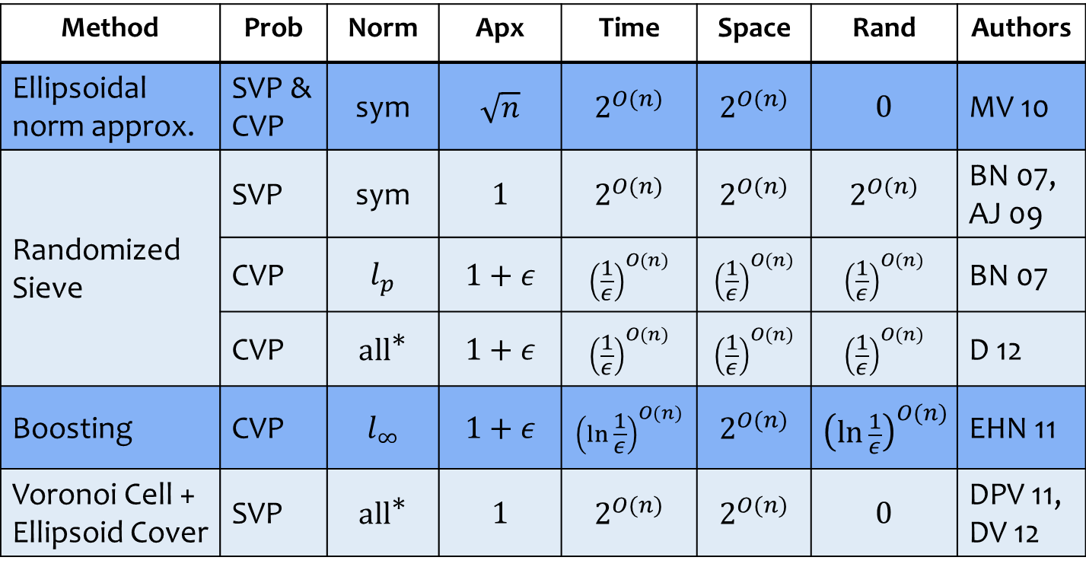
SVP & CVP under General Norms
Method | Prob | Norm | Apx | Time | Space | Rand | Authors
Ellipsoidal norm approx. | SVP & CVP | sym | $$\sqrt{n}$$ | $$2^{O(n)}$$ | $$2^{O(n)}$$ | $$0$$ | MV 10
Randomized Sieve | SVP | sym | $$1$$ | $$2^{O(n)}$$ | $$2^{O(n)}$$ | $$2^{O(n)}$$ | BN 07, AJ 09
 | CVP | $$l_{p}$$ | $$1+ε$$ | $${\left(\frac{1}{ε}\right)}^{O(n)}$$ | $${\left(\frac{1}{ε}\right)}^{O(n)}$$ | $${\left(\frac{1}{ε}\right)}^{O(n)}$$ | BN 07
 | CVP | $$\text{al}{\text{l}}^{\text{∗}}$$ | $$1+ε$$ | $${\left(\frac{1}{ε}\right)}^{O(n)}$$ | $${\left(\frac{1}{ε}\right)}^{O(n)}$$ | $${\left(\frac{1}{ε}\right)}^{O(n)}$$ | D 12
Boosting | CVP | $$l_{∞}$$ | $$1+ε$$ | $${\left(\ln{\frac{1}{ε}}\right)}^{O(n)}$$ | $$2^{O(n)}$$ | $${\left(\ln{\frac{1}{ε}}\right)}^{O(n)}$$ | EHN 11
Voronoi Cell + Ellipsoid Cover | SVP | $$\text{al}{\text{l}}^{\text{∗}}$$ | $$1$$ | $$2^{O(n)}$$ | $$2^{O(n)}$$ | $$0$$ | DPV 11, DV 12
* near-symmetric norms: $\text{vol}\left(K\right)≤2^{O(n)}vol(K∩\text{−}K)$

Slide 21
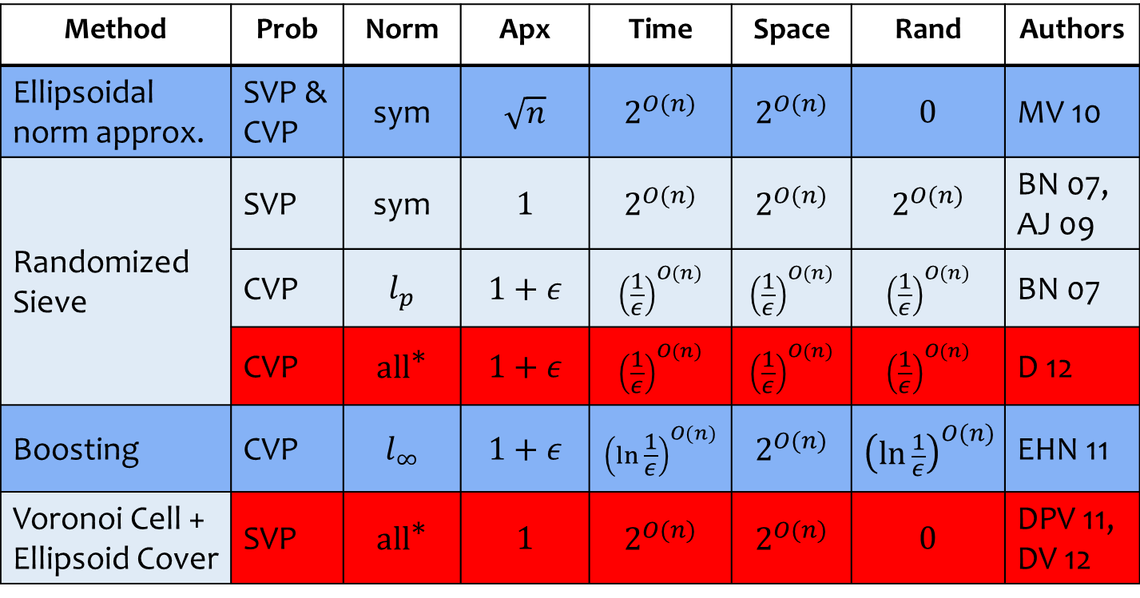
SVP & CVP under General Norms
Method | Prob | Norm | Apx | Time | Space | Rand | Authors
Ellipsoidal norm approx. | SVP & CVP | sym | $$\sqrt{n}$$ | $$2^{O(n)}$$ | $$2^{O(n)}$$ | $$0$$ | MV 10
Randomized Sieve | SVP | sym | $$1$$ | $$2^{O(n)}$$ | $$2^{O(n)}$$ | $$2^{O(n)}$$ | BN 07, AJ 09
 | CVP | $$l_{p}$$ | $$1+ε$$ | $${\left(\frac{1}{ε}\right)}^{O(n)}$$ | $${\left(\frac{1}{ε}\right)}^{O(n)}$$ | $${\left(\frac{1}{ε}\right)}^{O(n)}$$ | BN 07
 | CVP | $$\text{al}{\text{l}}^{\text{∗}}$$ | $$1+ε$$ | $${\left(\frac{1}{ε}\right)}^{O(n)}$$ | $${\left(\frac{1}{ε}\right)}^{O(n)}$$ | $${\left(\frac{1}{ε}\right)}^{O(n)}$$ | D 12
Boosting | CVP | $$l_{∞}$$ | $$1+ε$$ | $${\left(\ln{\frac{1}{ε}}\right)}^{O(n)}$$ | $$2^{O(n)}$$ | $${\left(\ln{\frac{1}{ε}}\right)}^{O(n)}$$ | EHN 11
Voronoi Cell + Ellipsoid Cover | SVP | $$\text{al}{\text{l}}^{\text{∗}}$$ | $$1$$ | $$2^{O(n)}$$ | $$2^{O(n)}$$ | $$0$$ | DPV 11, DV 12
* near-symmetric norms: $\text{vol}\left(K\right)≤2^{O(n)}vol(K∩\text{−}K)$

Slide 22
SVP & CVP under General Norms
Method | Prob | Norm | Apx | Time | Space | Rand | Authors
Ellipsoidal norm approx. | SVP & CVP | sym | $$\sqrt{n}$$ | $$2^{O(n)}$$ | $$2^{O(n)}$$ | $$0$$ | MV 10
Randomized Sieve | SVP | sym | $$1$$ | $$2^{O(n)}$$ | $$2^{O(n)}$$ | $$2^{O(n)}$$ | BN 07, AJ 09
 | CVP | $$l_{p}$$ | $$1+ε$$ | $${\left(\frac{1}{ε}\right)}^{O(n)}$$ | $${\left(\frac{1}{ε}\right)}^{O(n)}$$ | $${\left(\frac{1}{ε}\right)}^{O(n)}$$ | BN 07
 | CVP | $$\text{al}{\text{l}}^{\text{∗}}$$ | $$1+ε$$ | $${\left(\frac{1}{ε}\right)}^{O(n)}$$ | $${\left(\frac{1}{ε}\right)}^{O(n)}$$ | $${\left(\frac{1}{ε}\right)}^{O(n)}$$ | D 12
Boosting | CVP | $$l_{∞}$$ | $$1+ε$$ | $${\left(\ln{\frac{1}{ε}}\right)}^{O(n)}$$ | $$2^{O(n)}$$ | $${\left(\ln{\frac{1}{ε}}\right)}^{O(n)}$$ | EHN 11
Voronoi Cell + Ellipsoid Cover | SVP | $$\text{al}{\text{l}}^{\text{∗}}$$ | $$1$$ | $$2^{O(n)}$$ | $$2^{O(n)}$$ | $$0$$ | DPV 11, DV 12
Missing: Deterministic $\left(1+ε\right)$-CVP? (Focus of talk)

Slide 23
SVP & CVP under General Norms
Method | Prob | Norm | Apx | Time | Space | Rand | Authors
Ellipsoidal norm approx. | SVP & CVP | sym | $$\sqrt{n}$$ | $$2^{O(n)}$$ | $$2^{O(n)}$$ | $$0$$ | MV 10
Randomized Sieve | SVP | sym | $$1$$ | $$2^{O(n)}$$ | $$2^{O(n)}$$ | $$2^{O(n)}$$ | BN 07, AJ 09
 | CVP | $$l_{p}$$ | $$1+ε$$ | $${\left(\frac{1}{ε}\right)}^{O(n)}$$ | $${\left(\frac{1}{ε}\right)}^{O(n)}$$ | $${\left(\frac{1}{ε}\right)}^{O(n)}$$ | BN 07
 | CVP | $$\text{al}{\text{l}}^{\text{∗}}$$ | $$1+ε$$ | $${\left(\frac{1}{ε}\right)}^{O(n)}$$ | $${\left(\frac{1}{ε}\right)}^{O(n)}$$ | $${\left(\frac{1}{ε}\right)}^{O(n)}$$ | D 12
Boosting | CVP | $$l_{∞}$$ | $$1+ε$$ | $${\left(\ln{\frac{1}{ε}}\right)}^{O(n)}$$ | $$2^{O(n)}$$ | $${\left(\ln{\frac{1}{ε}}\right)}^{O(n)}$$ | EHN 11
Voronoi Cell + Ellipsoid Cover | SVP | $$\text{al}{\text{l}}^{\text{∗}}$$ | $$1$$ | $$2^{O(n)}$$ | $$2^{O(n)}$$ | $$0$$ | DPV 11, DV 12
Missing: Exact CVP in $2^{O(n)}$ time? (best current: $n^{n}$ time)

Slide 24



Randomized Sieve [Ajtai-Kumar-Sivakumar `00]
Main option for solving lattice problems in more general norms than $l_{2}$.
$$K$$
$$0$$

Slide 25
Randomized Sieve [Ajtai-Kumar-Sivakumar `00]
How it works for SVP.
$$K$$
$$0$$

Slide 26










Randomized Sieve [Ajtai-Kumar-Sivakumar `00]
How it works for SVP.
Algorithm Outline:
Sample $2^{O\left(n\right)}$ “perturbed” lattice points.
$$x_{5}$$
$$x_{2}$$
$$x_{8}$$
$$x_{7}$$
$$0$$
$$rK$$
$$x_{9}$$
$$x_{3}$$
$$x_{6}$$
$$x_{4}$$
$$x_{1}$$

Slide 27


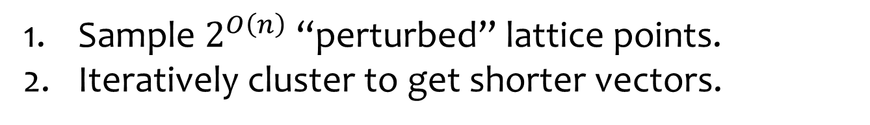

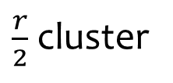
Randomized Sieve [Ajtai-Kumar-Sivakumar `00]
How it works for SVP.
Algorithm Outline:
Sample $2^{O\left(n\right)}$ “perturbed” lattice points.
Iteratively cluster to get shorter vectors.
$\frac{r}{2}$ cluster
$$x_{5}$$
$$x_{2}$$
$$x_{8}$$
$$x_{7}$$
$$0$$
$$rK$$
$$x_{9}$$
$$x_{3}$$
$$x_{6}$$
$$x_{4}$$
$$x_{1}$$

Slide 28






Randomized Sieve [Ajtai-Kumar-Sivakumar `00]
How it works for SVP.
Algorithm Outline:
Sample $2^{O\left(n\right)}$ “perturbed” lattice points.
Iteratively cluster to get shorter vectors.
$$x_{7}$$
$$x_{5}$$
$$x_{4}$$
$$x_{3}$$
$$x_{8}$$
$$x_{2}$$
$$x_{9}$$
$$0$$
$$rK$$
$$x_{6}$$
$$x_{1}$$
Lost vectors
Bounded number lost
(packing argument)

Slide 29
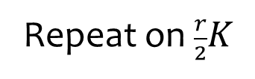

Randomized Sieve [Ajtai-Kumar-Sivakumar `00]
How it works for SVP.
Algorithm Outline:
Sample $2^{O\left(n\right)}$ “perturbed” lattice points.
Iteratively cluster to get shorter vectors.
$$x_{7}$$
Repeat on $\frac{r}{2}K$
$$x_{5}$$
$$x_{4}$$
$$x_{2}$$
$$x_{9}$$
$$0$$
$$\frac{r}{2}K$$
$$x_{1}$$

Slide 30

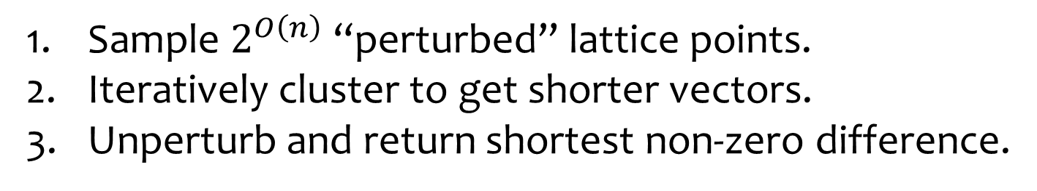
Randomized Sieve [Ajtai-Kumar-Sivakumar `00]
How it works for SVP.
Algorithm Outline:
Sample $2^{O\left(n\right)}$ “perturbed” lattice points.
Iteratively cluster to get shorter vectors.
Unperturb and return shortest non-zero difference.
$$x_{7}$$
$$x_{5}$$
$$x_{4}$$
$$x_{2}$$
$$x_{9}$$
$$K$$
$$0$$
$$x_{1}$$

Slide 31
Randomized Sieve [Ajtai-Kumar-Sivakumar `00]
How it works for SVP.
Algorithm Outline:
Sample $2^{O\left(n\right)}$ “perturbed” lattice points.
Iteratively cluster to get shorter vectors.
Unperturb and return shortest non-zero difference.
$$x_{5}$$
$$x_{7}$$
$$x_{4}$$
$$x_{9}$$
$$K$$
$$x_{2}$$
$$x_{1}$$
$$0$$

Slide 32
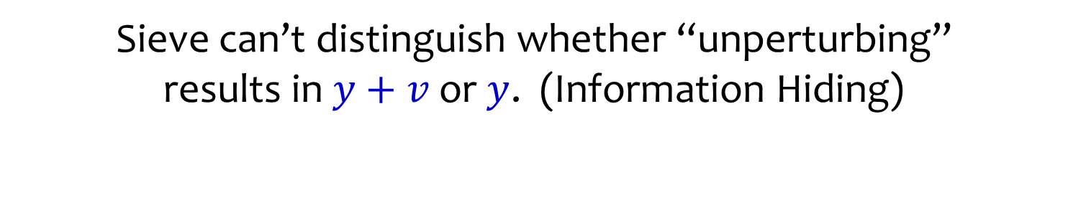


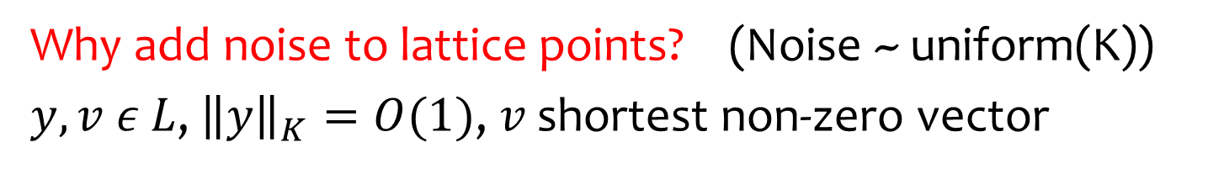




Randomized Sieve [Ajtai-Kumar-Sivakumar `00]
Why add noise to lattice points? (Noise ~ uniform(K))
$y,v ε L$, ${\left\|y\right\|}_{K}=O(1)$, $v$ shortest non-zero vector
$$K$$
$$y\text{+}v$$
$$y$$
$$v$$
$$K$$
$$0$$
Uncertainty region
Sieve can’t distinguish whether “unperturbing”
results in $y+v$ or $y$. (Information Hiding)

Slide 33
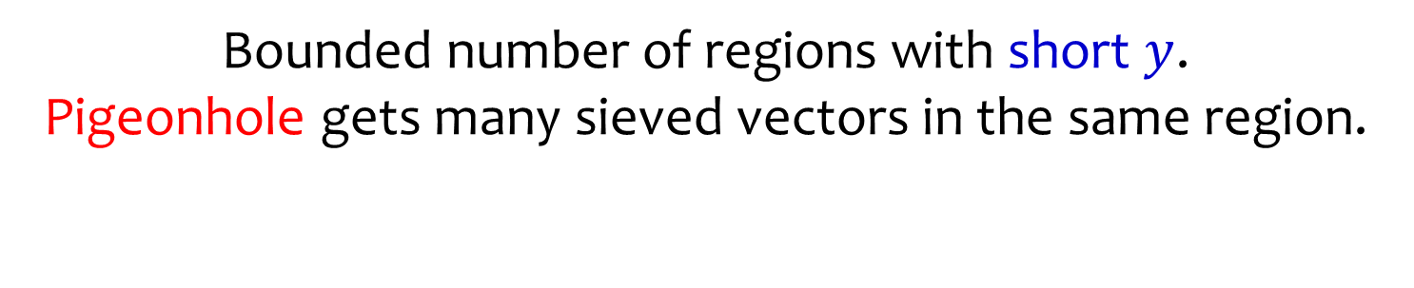


Randomized Sieve [Ajtai-Kumar-Sivakumar `00]
Why add noise to lattice points? (Noise ~ uniform(K))
$y,v ε L$, ${\left\|y\right\|}_{K}=O(1)$, $v$ shortest non-zero vector
$$x_{3}$$
$$K$$
$$x_{2}$$
$$y\text{+}v$$
$$y$$
$$v$$
$$K$$
$$x_{1}$$
$$0$$
Uncertainty region
Bounded number of regions with short $y$.
Pigeonhole gets many sieved vectors in the same region.

Slide 34

Randomized Sieve [Ajtai-Kumar-Sivakumar `00]
Why add noise to lattice points? (Noise ~ uniform(K))
$y,v ε L$, ${\left\|y\right\|}_{K}=O(1)$, $v$ shortest non-zero vector
$$x_{3}$$
$$K$$
$$x_{2}$$
$$y\text{+}v$$
$$y$$
$$v$$
$$K$$
$$x_{1}$$
$$0$$
Uncertainty region
Uncertainty guarantees set of differences
contains $v$ with overwhelming probability.

Slide 35

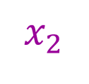

Randomized Sieve [Ajtai-Kumar-Sivakumar `00]
Why add noise to lattice points? (Noise ~ uniform(K))
$y,v ε L$, ${\left\|y\right\|}_{K}=O(1)$, $v$ shortest non-zero vector
$$K$$
$$x_{2}$$
$$x_{3}$$
$$y\text{+}v$$
$$y$$
$$x_{1}$$
$$v$$
$$K$$
$$0$$
Uncertainty region
Uncertainty guarantees set of differences
contains $v$ with overwhelming probability.

Slide 36
Randomized Sieve [Ajtai-Kumar-Sivakumar `00]
Why add noise to lattice points? (Noise ~ uniform(K))
$y,v ε L$, ${\left\|y\right\|}_{K}=O(1)$, $v$ shortest non-zero vector
$$K$$
$$x_{2}$$
$$x_{3}$$
$$y\text{+}v$$
$$y$$
$$x_{1}$$
$$v$$
$$K$$
$$0$$
Uncertainty region
What about CVP? Same with homogenization trick.
Can only guarantee many sieved vectors
land in “union” of uncertainty regions.
(hence only get approximate solution)

Slide 37
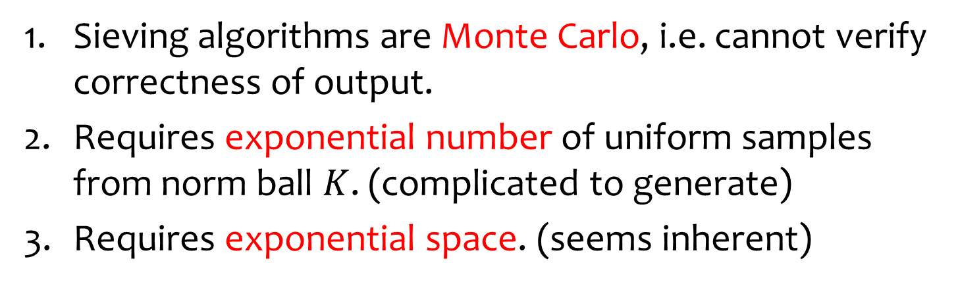
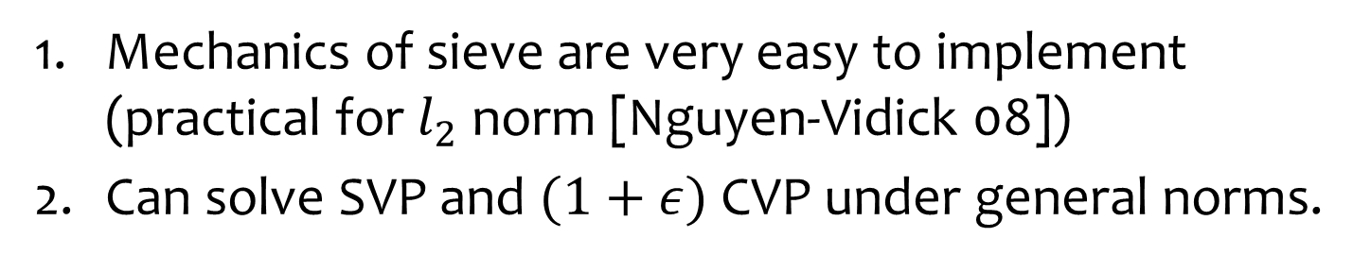
Randomized Sieve [Ajtai-Kumar-Sivakumar `00]
Pros
Mechanics of sieve are very easy to implement
(practical for $l_{2}$ norm [Nguyen-Vidick 08])
Can solve SVP and $(1+ε)$ CVP under general norms.
Cons
Sieving algorithms are Monte Carlo, i.e. cannot verify correctness of output.
Requires exponential number of uniform samples from norm ball $K$. (complicated to generate)
Requires exponential space. (seems inherent)

Slide 38
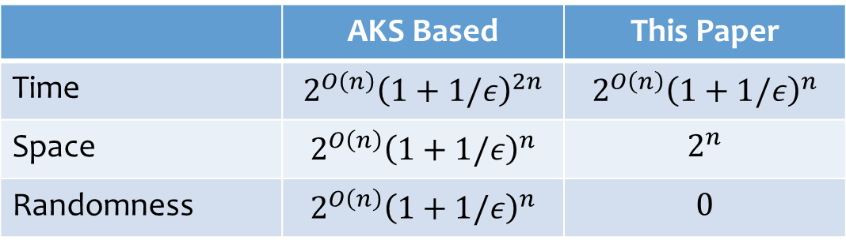
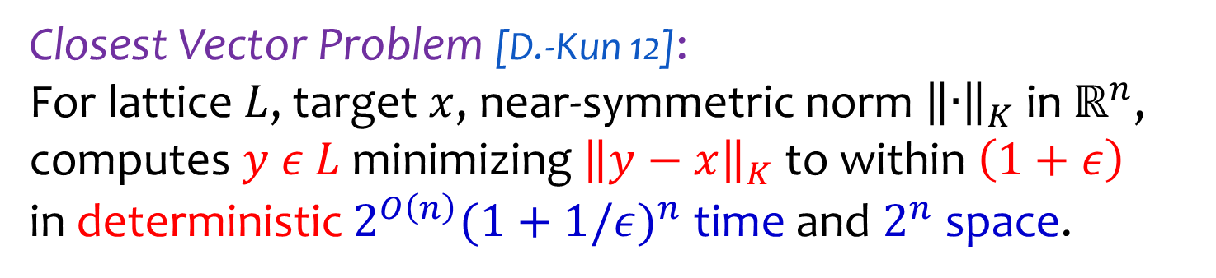
Main Result
Closest Vector Problem [D.-Kun 12]:
For lattice $L$, target $x$, near-symmetric norm ${\left\|∙\right\|}_{K}$ in $ℝ^{n}$,
computes $y ε L$ minimizing ${\left\|y−x\right\|}_{K}$ to within $\left(1+ε\right)$
in deterministic $2^{O\left(n\right)}{(1+1/ε)}^{n}$ time and $2^{n}$ space.
 | AKS Based | This Paper
Time | $$2^{O\left(n\right)}{\left(1+1/ε\right)}^{2n}$$ | $$2^{O\left(n\right)}{\left(1+1/ε\right)}^{n}$$
Space | $$2^{O\left(n\right)}{\left(1+1/ε\right)}^{n}$$ | $$2^{n}$$
Randomness | $$2^{O\left(n\right)}{\left(1+1/ε\right)}^{n}$$ | $$0$$

Slide 39
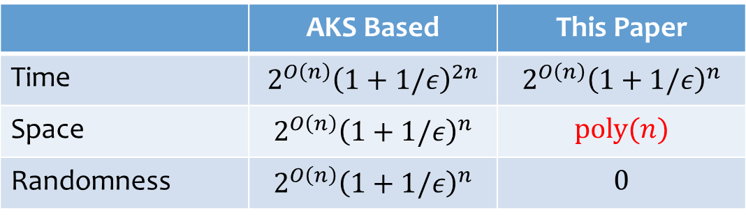
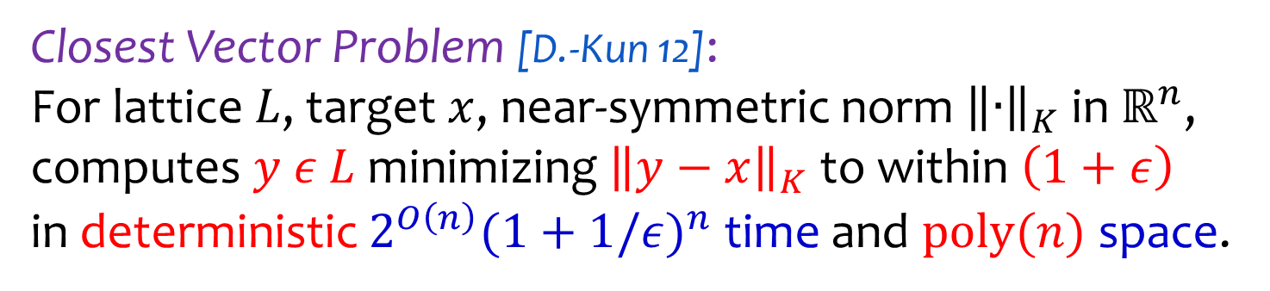
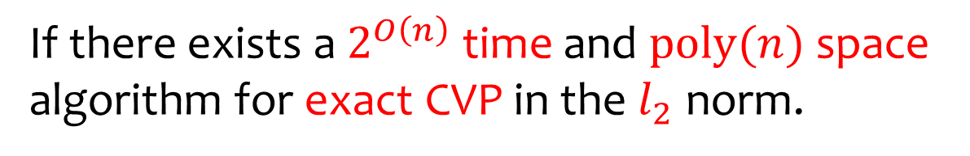
Main Result
Closest Vector Problem [D.-Kun 12]:
For lattice $L$, target $x$, near-symmetric norm ${\left\|∙\right\|}_{K}$ in $ℝ^{n}$,
computes $y ε L$ minimizing ${\left\|y−x\right\|}_{K}$ to within $\left(1+ε\right)$
in deterministic $2^{O\left(n\right)}{(1+1/ε)}^{n}$ time and $\text{poly}(n)$ space.
 | AKS Based | This Paper
Time | $$2^{O\left(n\right)}{\left(1+1/ε\right)}^{2n}$$ | $$2^{O\left(n\right)}{\left(1+1/ε\right)}^{n}$$
Space | $$2^{O\left(n\right)}{\left(1+1/ε\right)}^{n}$$ | $$\text{poly}(n)$$
Randomness | $$2^{O\left(n\right)}{\left(1+1/ε\right)}^{n}$$ | $$0$$
If there exists a $2^{O\left(n\right)}$ time and $\text{poly}(n)$ space
algorithm for exact CVP in the $l_{2}$ norm.

Slide 40
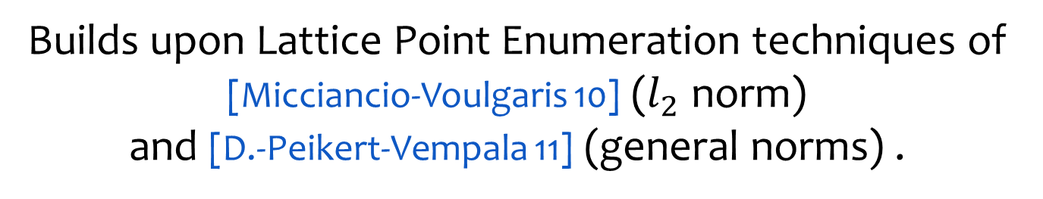
Main Result
Closest Vector Problem [D.-Kun 12]:
For lattice $L$, target $x$, near-symmetric norm ${\left\|∙\right\|}_{K}$ in $ℝ^{n}$,
computes $y ε L$ minimizing ${\left\|y−x\right\|}_{K}$ to within $\left(1+ε\right)$
in deterministic $2^{O\left(n\right)}{(1+1/ε)}^{n}$ time and $2^{n}$ space.
Builds upon Lattice Point Enumeration techniques of
[Micciancio-Voulgaris 10] ($l_{2}$ norm)
and [D.-Peikert-Vempala 11] (general norms) .

Slide 41

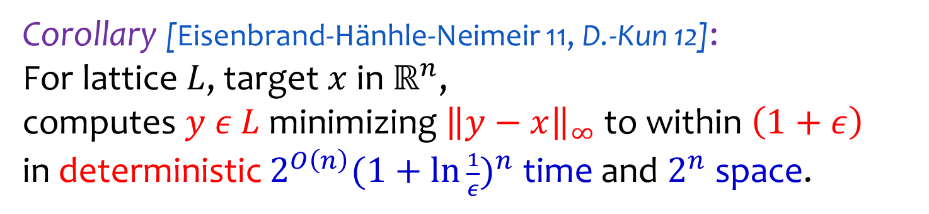
CVP under $l_{∞}$
Corollary [Eisenbrand-Hänhle-Neimeir 11, D.-Kun 12]:
For lattice $L$, target $x$ in $ℝ^{n}$,
computes $y ε L$ minimizing ${\left\|y−x\right\|}_{∞}$ to within $\left(1+ε\right)$
in deterministic $2^{O\left(n\right)}{(1+\ln{\frac{1}{ε}})}^{n}$ time and $2^{n}$ space.
Direct application of boosting technique
of [Eisenbrand-Hänhle-Neimeir 11].
Removes randomization due to AKS sieve.

Slide 42


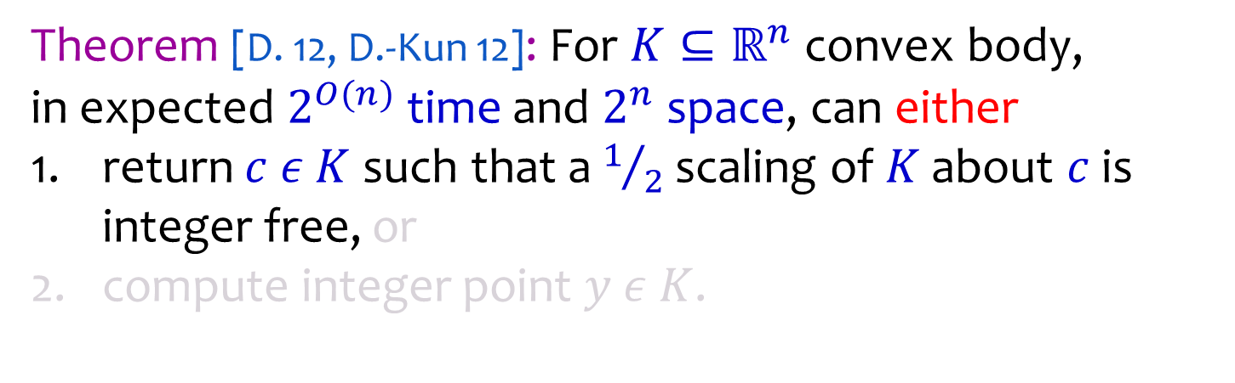

Application to IP
Theorem [D. 12, D.-Kun 12]: For $K⊆ℝ^{n}$ convex body,
in expected $2^{O(n)}$ time and $2^{n}$ space, can either
return $c ε K$ such that a $1/2$ scaling of $K$ about $c$ is integer free, or
compute integer point $y ε K$.
$$K$$
$$ℤ^{n}$$
$$c$$
$$\frac{1}{2}K$$

Slide 43
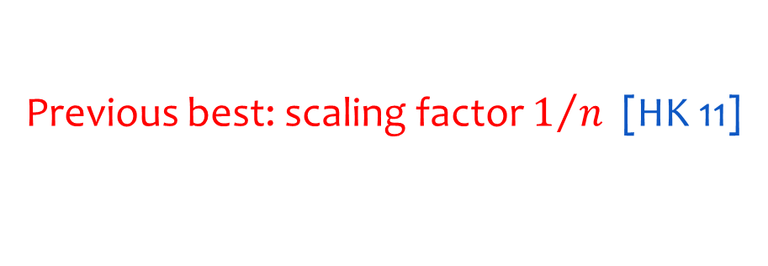
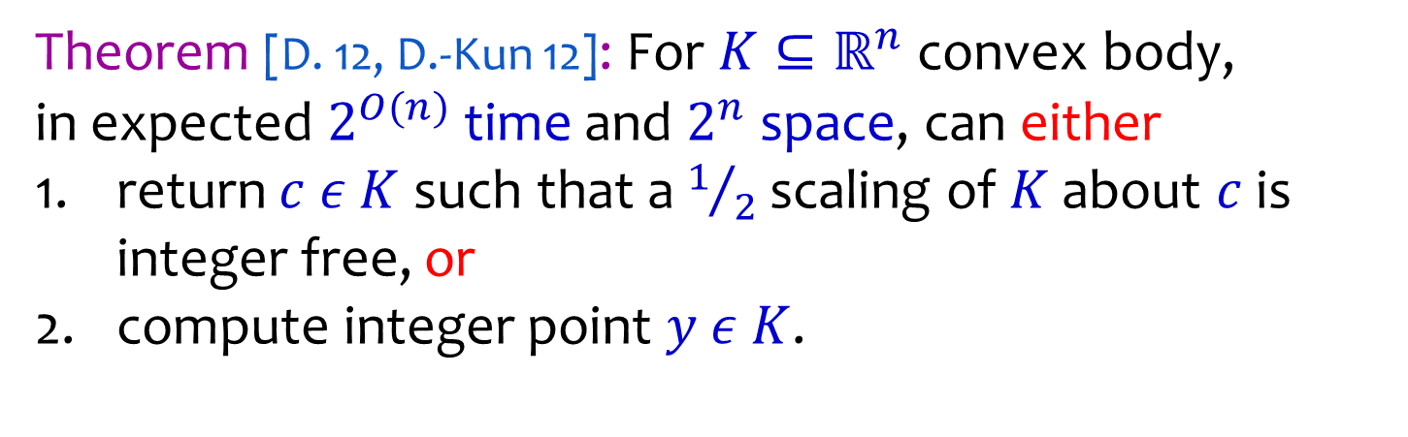

Application to IP
Theorem [D. 12, D.-Kun 12]: For $K⊆ℝ^{n}$ convex body,
in expected $2^{O(n)}$ time and $2^{n}$ space, can either
return $c ε K$ such that a $1/2$ scaling of $K$ about $c$ is integer free, or
compute integer point $y ε K$.
$$K$$
$$ℤ^{n}$$
$$c$$
$$y$$
Previous best: scaling factor $1/n$ [HK 11]
Used to improve complexity of
Integer Programming [D. 12]

Slide 44
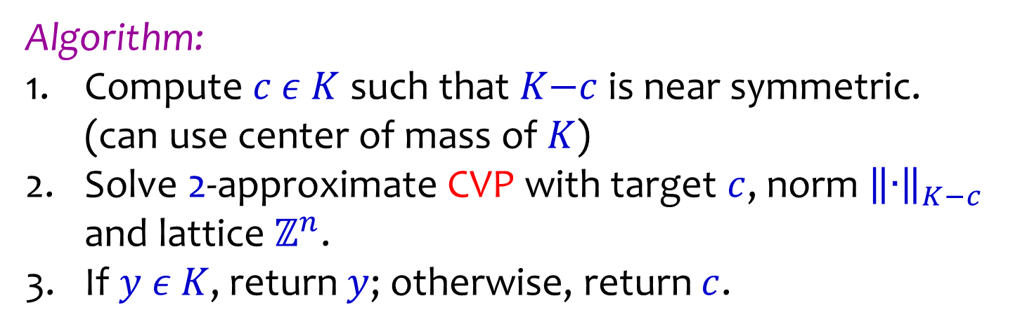
Application to IP
Algorithm:
Compute $c ε K$ such that $K\text{−}c$ is near symmetric.
(can use center of mass of $K$)
Solve 2-approximate CVP with target $c$, norm ${\left\|∙\right\|}_{K−c}$ and lattice $ℤ^{n}$.
If $y ε K$, return $y$; otherwise, return $c$.
$$K$$
$$ℤ^{n}$$
$$c$$
$$y$$

Slide 45
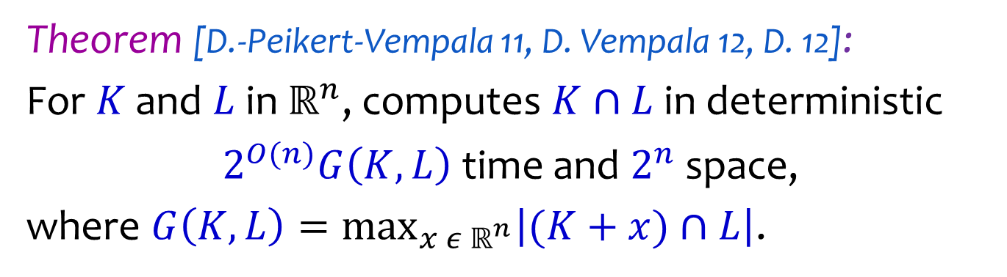
Lattice Point Enumerator
Theorem [D.-Peikert-Vempala 11, D. Vempala 12, D. 12]:
For $K$ and $L$ in $ℝ^{n}$, computes $K∩L$ in deterministic
$2^{O(n)}G\left(K,L\right)$ time and $2^{n}$ space,
where $G\left(K,L\right)=\max_{x{ ε ℝ}^{n}}\left|(K+x)∩L\right|$.
Main workhorse for solving lattice problems.

Slide 46


Lattice Point Enumerator
Theorem [D.-Peikert-Vempala 11, D. Vempala 12, D. 12]:
For $K$ and $L$ in $ℝ^{n}$, computes $K∩L$ in deterministic
$2^{O(n)}G\left(K,L\right)$ time and $2^{n}$ space,
where $G\left(K,L\right)=\max_{x{ ε ℝ}^{n}}\left|(K+x)∩L\right|$.
$$K$$
$$L$$

Slide 47




Lattice Point Enumerator
Theorem [D.-Peikert-Vempala 11, D. Vempala 12, D. 12]:
For $K$ and $L$ in $ℝ^{n}$, computes $K∩L$ in deterministic
$2^{O(n)}G\left(K,L\right)$ time and $2^{n}$ space,
where $G\left(K,L\right)=\max_{x{ ε ℝ}^{n}}\left|(K+x)∩L\right|$.
$$K$$
$$K$$
$$K$$
$$K$$
$$L$$

Slide 48

Lattice Point Enumerator
Theorem [D.-Peikert-Vempala 11, D. Vempala 12, D. 12]:
For $K$ and $L$ in $ℝ^{n}$, computes $K∩L$ in deterministic
$2^{O(n)}G\left(K,L\right)$ time and $\text{poly}(n)$ space,
where $G\left(K,L\right)=\max_{x{ ε ℝ}^{n}}\left|(K+x)∩L\right|$.
If there exists $2^{O\left(n\right)}$ time and $\text{poly}\left(n\right)$ space $l_{2}$ CVP solver.

Slide 49

Lattice Point Enumerator
Theorem [D.-Peikert-Vempala 11, D. Vempala 12, D. 12]:
For $K$ and $L$ in $ℝ^{n}$, computes $K∩L$ in deterministic
$2^{O(n)}G\left(K,L\right)$ time and $2^{n}$ space,
where $G\left(K,L\right)=\max_{x{ ε ℝ}^{n}}\left|(K+x)∩L\right|$.
Builds upon enumeration techniques of
[Micciancio-Voulgaris 10] for Ellipsoids +
Ellipsoid covering technique using M-ellipsoids [Milman 86].

Slide 50



Ellipsoid Enumeration
[Micciancio Voulgaris `10]
Goal: Compute $(E+x)∩L$.
$$x$$
$E$+$x$
$$L$$

Slide 51

Ellipsoid Enumeration
[Micciancio Voulgaris `10]
Alg: Find closest vector $y$ to $x$ under ${\left\|∙\right\|}_{E}$ .
$$y$$
$$x$$
$E$+$x$
$$L$$

Slide 52







Ellipsoid Enumeration
[Micciancio Voulgaris `10]
Alg: Compute “Voronoi relevant” vectors of $L$
with respect to ${\left\|∙\right\|}_{E}$ .
$$v_{6}$$
$$v_{1}$$
$$v_{4}$$
$$v_{3}$$
$$y$$
$$v_{2}$$
$$v_{5}$$
$$x$$
$E$+$x$
$$L$$

Slide 53


Ellipsoid Enumeration
[Micciancio Voulgaris `10]
Alg: For$z ε(E+x)∩L$, let $p\left(z\right)=z\text{+}v_{i}$ for
minimal index $i$ s.t. $p(z)$ closer to $x$.
$$v_{6}$$
$$v_{1}$$
$$z$$
$$v_{4}$$
$$p(z)$$
$$v_{3}$$
$$y$$
$$v_{2}$$
$$v_{5}$$
$$x$$
Note $p\left(y\right)=∅$
$E$+$x$
$$L$$

Slide 54
Ellipsoid Enumeration
[Micciancio Voulgaris `10]
Alg: Traverse implicit tree, starting from
root $y$, to enumerate $\left(E+x\right)∩L$.
$$v_{6}$$
$$v_{1}$$
$$v_{4}$$
$$v_{3}$$
$$y$$
$$v_{2}$$
$$v_{5}$$
$$x$$
$E$+$x$
$$L$$

Slide 55


General Enumeration
[D-Peikert-Vempala `10]
Goal: Compute $K∩L$.
$$L$$
$$K$$

Slide 56


General Enumeration
[D-Peikert-Vempala `10]
Alg: Compute “good covering” ellipsoid $E$ for $K$ (M-Ellipsoid).
$$E$$
$$L$$
$$K$$

Slide 57

General Enumeration
[D-Peikert-Vempala `10]
M-Ellipsoid: $2^{O(n)}$ translates of $E$ suffice to cover $K$
[Milman 86] $2^{O(n)}$ translates of $K$ suffice to cover $E$
$$E$$
$$L$$
$$K$$

Slide 58








General Enumeration
[D-Peikert-Vempala `10]
Alg: Compute a covering of $K$ by
$2^{O(n)}$ translates of $E$.
$E$+$t_{i}$
$$E$$
$$L$$
$$t_{3}$$
$$t_{6}$$
$$t_{2}$$
$$K$$
$$t_{5}$$
$$t_{1}$$
$$t_{4}$$

Slide 59
General Enumeration
[D-Peikert-Vempala `10]
Alg: Compute $\left(E+t_{i}\right)∩L ∀i$.
$E$+$t_{i}$
$$L$$
$$t_{3}$$
$$t_{6}$$
$$t_{2}$$
$$K$$
$$t_{5}$$
$$t_{1}$$
$$t_{4}$$

Slide 60
General Enumeration
[D-Peikert-Vempala `10]
Alg: Compute $\left(E+t_{i}\right)∩L ∀i$.
$$L$$
$$K$$

Slide 61

General Enumeration
[D-Peikert-Vempala `10]
Alg: Keep only the points in $K$.
$$L$$
$$K$$

Slide 62
General Enumeration
[D-Peikert-Vempala `10]
By covering properties enumerate at most
|cover of $K$ by $E$| x (max # points in $E$)
$$L$$
$$K$$

Slide 63

General Enumeration
[D-Peikert-Vempala `10]
By covering properties enumerate at most
|cover of $K$ by $E$| x |cover E by $K$| x (max # points in $K$)
$$L$$
$$K$$

Slide 64

General Enumeration
[D-Peikert-Vempala `10]
By covering properties enumerate at most
$$2^{O\left(n\right)}×G(K,L)$$
$$L$$
$$K$$

Slide 65

Lattice Point Enumerator
Theorem [D.-Peikert-Vempala 11, D. Vempala 12, D. 12]:
For $K$ and $L$ in $ℝ^{n}$, computes $K∩L$ in deterministic
$2^{O(n)}G\left(K,L\right)$ time and $2^{n}$ space,
where $G\left(K,L\right)=\max_{x{ ε ℝ}^{n}}\left|(K+x)∩L\right|$.
Questions: How to use enumerator for SVP / CVP? solve SVP / CVP?
In which situations is $G\left(K,L\right)$ reasonable?

Slide 66


Simple bound on $G(tK,L)$
Let $K$ be a symmetric convex body ($K=−K)$.
Let $λ_{1}\left(K,L\right)$ denote the length of the shortest
non-zero vector in $L$ under ${\left\|∙\right\|}_{K}$.
Lemma: For $t=αλ_{1}\left(K,L\right)$, $G\left(tK,L\right)≤{\left(2α+1\right)}^{n}$.
Will use a standard packing argument.
Similar bound holds for near symmetric bodies, i.e.
where $vol\left(K\right)≤2^{O(n)}vol\left(K∩−K\right)$.

Slide 67




Simple bound on $G(tK,L)$
Assume $λ_{1}\left(K,L\right)=1$.
$$tK\text{+}x$$
Pack copies of $\frac{1}{2}K$
around lat pts.
$$L$$

Slide 68



Simple bound on $G(tK,L)$
Assume $λ_{1}\left(K,L\right)=1$.
$$tK\text{+}x$$
$\frac{1}{2}K$
$$L$$
$$(\frac{1}{2}\text{+}t)K\text{+}x$$
Comparing Volumes:
$\left|\left(tK\text{+}x\right)∩L\right|≤{\text{vol}\left(\left(\frac{1}{2}\text{+}t\right)K\right)}/{\text{vol}(\frac{1}{2}K)}≤$ ${\left(2t\text{+}1\right)}^{n}$

Slide 69





SVP Algorithm
Goal: Find $y ε L∖\{0\}$ minimizing ${\left\|y\right\|}_{K}$ .
$$y$$
$$K$$
$$0$$
-$y$

Slide 70

SVP Algorithm
Alg: Scale $K$such that $K∩L=\{0\}$.
$$K$$
$$0$$

Slide 71



SVP Algorithm
Alg: Compute $2^{i}K∩L$ for $i=1,2,…$ until $2^{i}K∩L≠\{0\}$.
Return all shortest lattice vectors.
$$y$$
$$4K$$
$$2K$$
$$K$$
$$0$$
-$y$

Slide 72

SVP Algorithm
Runtime Analysis:
Suffices to bound the time to compute $2^{i}K∩L$ for the
last step $i$.
Since $i$ is last step, we have $2^{i−1}K∩L=\{0\}$.
This implies $λ_{1}\left(K,L\right)≥2^{i−1}$.
By our lemma, $G\left(2^{i}K,L\right)≤{\left(2×2+1\right)}^{n}=5^{n}$.
Hence enumeration time is proportion to $5^{n}$ as needed.

Slide 73





Approximate CVP
Goal: Find $y ε L$ minimizing $\left\|y−x\right\|$ to within $1+ε$.
$$(\text{1+}\text{ϵ})dK$$
$$dK$$
$$K$$
$$x$$
$$L$$

Slide 74


Approximate CVP
Question: What’s wrong with previous approach?
(successive doubling for exact CVP)
$$4K$$
$$2K$$
$$K$$
$$x$$
$$L$$

Slide 75

Approximate CVP
Problem: $d$ maybe much larger than $λ_{1}(K,L)$.
($d$ is distance of $x$ from $L$)
Shortest Vector
$$dK$$
$$K$$
$$x$$
$$L$$

Slide 76


Approximate CVP
Problem: No control on $G(dK,L)$.
($d$ is distance of $x$ from $L$)
$$dK$$
$$dK$$
$$K$$
$$x$$
$$L$$

Slide 77

Approximate CVP
Idea: Make the lattice “sparser” without changing distance of $x$ to $L$by much.
$$dK$$
$$K$$
$$x$$
$$L$$

Slide 78

Approximate CVP
Lattice Sparsifier: Build sublattice $L^{′}⊆L$ satisfying
$λ_{1}\left(K,L^{′}\right)=Ω(εd)$.
distance of $x$ to $L′$ is less than $\left(1+ε\right)d$.
$$dK$$
$$K$$
$$x$$
$$L$$

Slide 79


Approximate CVP
Lattice Sparsifier: Build sublattice $L^{′}⊆L$ satisfying
$λ_{1}\left(K,L^{′}\right)=Ω(εd)$.
distance of $x$ to $L′$ is less than $\left(1+ε\right)d$.
Runtime on $L′$: $G\left(\left(1\text{+}ε\right)dK,L^{′}\right)=2^{O\left(n\right)}{\left(1+1/ε\right)}^{n}$
$$(\text{1+}\text{ϵ})dK$$
$$dK$$
$$K$$
$$x$$
$$L′$$

Slide 80

Lattice Sparsifier
Let $d_{K}\left(L,x\right)=\min_{y ε L}{{\left\|y−x\right\|}_{K}}$ (distance of $x$ to $L$)
Theorem [D.-Kun 12]: For any distance $s$ > 0,
a sublattice $L^{′}⊆L$ satisfying
$λ_{1}\left(K,L^{′}\right)≥s$.
$∀x ε ℝ^{n} d_{K}\left(L^{′},x\right)≤d_{K}\left(L,x\right)+O(s)$
can be computed in deterministic
$2^{O(n)}$ time and $2^{n}$space.

Slide 81





Lattice Sparsifier Existence
Assume $L=ℤ^{n}$. Symmetric convex body $K$, $s>0.$
Let $N=|ℤ^{n}∩sK|$.
Choose prime $p$ s.t. $2N<p<4N$.
Let $L^{′}=\{y ε{ ℤ}^{n}:\sum_{i}{y_{i}a_{i}≡0 \left(mod p\right) \}}$
for $a_{1},…,a_{n}$ chosen uniformly from $ℤ_{p}$.
$$0$$
$$L$$
$$sK$$
$$N$$

Slide 82


Lattice Sparsifier Existence
Assume $L=ℤ^{n}$. Symmetric convex body $K$, $s>0.$
Let $N=|ℤ^{n}∩sK|$.
Choose prime $p$ s.t. $2N<p<4N$.
Let $L^{′}=\{y ε{ ℤ}^{n}:\sum_{i}{y_{i}a_{i}≡0 \left(mod p\right) \}}$
for $a_{1},…,a_{n}$ chosen uniformly from $ℤ_{p}$.
Theorem [D.-Kun 12]: Random sublattice $L′$ works with constant probability.
$$0$$
$$L′$$
$$sK$$
$$N$$

Slide 83

Lattice Sparsifier Existence
$S=ℤ^{n}∩sK$, $N=\left|S\right|, 2N<p<4N$, $p$ prime
$L^{′}=\{y ε{ ℤ}^{n}:\sum_{i}{y_{i}a_{i}≡0 \left(mod p\right) \}}$
Lemma (Property 1): All non-zero vector of $L’$ have
length $≥s$ with probability at least $1/2$.
$E\left[\left|L^{′}∩(S∖\left\{0\right\})\right|\right]= Σ_{yεS∖\{0\}}\operatorname{Pr}\left[\left\langle y,a\right\rangle ≡0\left(mod p\right)\right]$
$=\frac{\left|S∖\left\{0\right\}\right|}{p}=\frac{N−1}{p}<\frac{1}{2}$
Lemma follows from Markov’s inequality.

Slide 84








Lattice Sparsifier Existence
$S=ℤ^{n}∩sK$, $N=\left|S\right|, 2N<p<4N$, $p$ prime
$L^{′}=\{y ε{ ℤ}^{n}:\sum_{i}{y_{i}a_{i}≡0 \left(mod p\right) \}}$
2. $∀x ε ℝ^{n} d_{K}\left(L^{′},x\right)≤d_{K}\left(ℤ^{n},x\right)+O(s)$
Claim: Suffices that all $y ε ℤ^{n}$ be at distance $O(s)$ from $L′$.
$y$ closest to $x$ in $ℤ^{n}$
$z$ closest to $y$ in $L′$
$$y$$
$$z$$
$$L′$$
$$O(s)$$
$$d$$
$$d\text{+}O(s)$$
$$x$$

Slide 85

Lattice Sparsifier Existence
$S=ℤ^{n}∩sK$, $N=\left|S\right|, 2N<p<4N$, $p$ prime
$L^{′}=\{y ε{ ℤ}^{n}:\sum_{i}{y_{i}a_{i}≡0 \left(mod p\right) \}}$
2. $∀x ε ℝ^{n} d_{K}\left(L^{′},x\right)≤d_{K}\left(ℤ^{n},x\right)+O(s)$
Lemma (Property 2): All $y ε ℤ^{n}$ at distance $O(s)$ from $L′$ with probability at least $1/2$.

Slide 86

Lattice Sparsifier Existence
$S=ℤ^{n}∩sK$, $N=\left|S\right|, 2N<p<4N$, $p$ prime
$L^{′}=\{y ε{ ℤ}^{n}:\sum_{i}{y_{i}a_{i}≡0 \left(mod p\right) \}}$
Claim: Let $A =\{\left\langle y,a\right\rangle \left(mod p\right):$ $y ε S \}$,
then $\left|A\right|≥\frac{p}{20}+1$ with probability at least $1/2$.
# Collisions:
$E[\sum_{x,yεS}{I[}\left\langle x,a\right\rangle ≡\left\langle y,a\right\rangle (mod p)]]$ = |S$|+\frac{ |S|\left(\left|S\right|−1\right)}{p}$
Let $S^{i}=\{x ε S:\left\langle x,a\right\rangle ≡i\left(mod p\right)\}$
${\left|S\right|}^{2}={\left(\sum_{iεA}{|S^{i}|}\right)}^{2}≤|A|(\sum_{iεA}{{\left|S^{i}\right|}^{2})}=\left|A\right|$ (#Collisions)

Slide 87

Lattice Sparsifier Existence
$S=ℤ^{n}∩sK$, $N=\left|S\right|, 2N<p<4N$, $p$ prime
$L^{′}=\{y ε{ ℤ}^{n}:\sum_{i}{y_{i}a_{i}≡0 \left(mod p\right) \}}$
Claim: Let $A =\{\left\langle y,a\right\rangle \left(mod p\right):$ $y ε S \}$,
then $\left|A\right|≥\frac{p}{20}+1$ with probability at least $1/2$.
# Collisions:
$E[\sum_{x,yεS}{I[}\left\langle x,a\right\rangle ≡\left\langle y,a\right\rangle (mod p)]]$ = |S$|+\frac{ |S|\left(\left|S\right|−1\right)}{p}$
$\left|A\right|≥\frac{{\left|S\right|}^{2}}{\text{\# }\text{Collisions}}≥\frac{{\left|S\right|}^{2}}{2\left|S\right|\left(1+\frac{\left|S\right|}{p}\right)}>\frac{\left|S\right|/p}{2\left(1+\left|S\right|/p\right)}p>\frac{p}{10}$
by Markov since $\left|S\right|/p>1/4$

Slide 88

Lattice Sparsifier Existence
$S=ℤ^{n}∩sK$, $N=\left|S\right|, 2N<p<4N$, $p$ prime
$L^{′}=\{y ε{ ℤ}^{n}:\sum_{i}{y_{i}a_{i}≡0 \left(mod p\right) \}}$
Will need the following:
Theorem (Cauchy-Davenport): $A_{1},…,A_{k}⊆ℤ_{p}$
$$\left|A_{1}+…+A_{k}\right|≥\min{\{\left|A_{1}\right|+…+\left|A_{k}\right| \text{−}k\text{+}1,p\} }$$

Slide 89


Lattice Sparsifier Existence
$S=ℤ^{n}∩sK$, $N=\left|S\right|, 2N<p<4N$, $p$ prime
$L^{′}=\{y ε{ ℤ}^{n}:\sum_{i}{y_{i}a_{i}≡0 \left(mod p\right) \}}$
$A =\{\left\langle y,a\right\rangle \left(mod p\right):$ $y ε S \}$. Assume $\left|A\right|≥\frac{p}{20}+1$.
Lemma: All $y ε ℤ^{n}$ at distance $≤$ $20s$ from $L′$.
Let $A^{k}= A+…+A$. By Cauchy-Davenport,
$\left|A^{20}\right|≥\min\left\{p, 20\left(\frac{p}{20}+1\right)−19\right\}≥p$.
Therefore $A^{20}=ℤ_{p}$.
$k$ times

Slide 90

Lattice Sparsifier Existence
$S=ℤ^{n}∩sK$, $N=\left|S\right|, 2N<p<4N$, $p$ prime
$L^{′}=\{y ε{ ℤ}^{n}:\sum_{i}{y_{i}a_{i}≡0 \left(mod p\right) \}}$
$A=\{\left\langle y,a\right\rangle \left(mod p\right):$ $y ε S \}$. $A$ satisfies $A^{20}=ℤ_{p}$.
Take $y ε ℤ^{n}$. By above, can choose $y_{1},…,y_{20}ε S$ such that
$$\left\langle y,a\right\rangle ≡\left\langle y_{1},a\right\rangle +…+\left\langle y_{20},a\right\rangle (mod p)$$
By definition $y−\left(y_{1}+…+y_{20}\right) ε L′$.
$d_{K}\left(L^{′},y\right)≤ {\left\|y_{1}+…+y_{20}\right\|}_{K}≤20s$ (triangle inequality)

Slide 91

Random Lattices
Khot 03+04: NP-hard to distinguish lattices with many
short vectors vs few short vectors. Use random
sublattices to establish hardness of GapSVP.
Goldstein-Mayer 02: as $p→∞$, random sublattices “equidistributed” in space of lattices (after renormalization). Fill out space proportional to volume. Used to construct “extremal” lattices.

Slide 92

Derandomizing Construction
$S=ℤ^{n}∩sK$, $N=\left|S\right|, 2N<p<4N$, $p$ prime
$L^{′}=\{y ε{ ℤ}^{n}:\sum_{i}{y_{i}a_{i}≡0 \left(mod p\right) \}}$
$λ=λ_{1}\left(K,ℤ^{n}\right)$
Issue 1: $N$ can be huge.
Idea: Build sparsifier iteratively. Let ${20}^{k−1}λ≤ s≤{20}^{k} λ$.
Construct sequence $L_{k}^{′}⊆…⊆L_{1}^{′}⊆L_{0}^{′}=ℤ^{n}$
$L_{i}^{′}$ sparsifies $L_{i−1}^{′}$ at distance $20^{i}λ$.
$N_{i}=\left|L_{i}^{′}∩{20}^{i+1}λK\right|=2^{O(n)}$ since $λ_{1}\left(K,L_{i}^{′}\right)≥{20}^{i}λ$.

Slide 93

Derandomizing Construction
$S=ℤ^{n}∩sK$, $N=\left|S\right|, 2N<p<4N$, $p$ prime
$L^{′}=\{y ε{ ℤ}^{n}:\sum_{i}{y_{i}a_{i}≡0 \left(mod p\right) \}}$
May assume $p=2^{O(n)}$.
Issue 2: How to choose $a ε ℤ_{p}^{n}$ deterministically?
Idea: Existence depends only on $N,p$ (not $n$).
Find $n\text{−}1$ dim. projection $P$, $\left|PS (mod p)\right|=|S|$.
Once $n≤2$, use exhaustive search ($2^{O(n)}$ time).

Slide 94

$$Summary$$
Gave first deterministic single exponential time
algorithm for $\left(1+ε\right)$ CVP under general norms.
Introduced Lattice Sparsifier concept and showed its
utility for $\left(1+ε\right)$ CVP.
$$Future Directions$$
Fast $l_{2}$ CVP using polynomial (subexponential) space?
Faster algorithm for Integer Programming?
Further applications of Lattice Sparsifiers?

Slide 95

$$THANK YOU!$$

Slide 96



Norms and Convex Bodies
Convex body $K⊆ℝ^{n}$ containing origin in its interior.
Gauge Function: ${\left\|x\right\|}_{K}≝\inf{ \{s≥0:x ε sK\}}$
$$K$$
$$K∩−K$$
$$K=\{x ε ℝ^{n}: {\left\|x\right\|}_{K}≤1\}$$
$K$ is unit ball of ${\left\|∙\right\|}_{K}$
$$0$$
1. ${\left\|x+y\right\|}_{K}≤{\left\|x\right\|}_{K}+{\left\|y\right\|}_{K}$ (triangle inequality)
2.${\left\|tx\right\|}_{K}=t{\left\|x\right\|}_{K}, t≥0$ (homogeneity)
3. $\text{vol}\left(K\right)≤2^{O\left(n\right)}vol(K∩\text{−}K)$ (near-symmetry)

Slide 97


Why General Norms?
Integer Programming: General norm SVP & CVP
Polytope $P⊆ℝ^{n}$, decide if $P∩ℤ^{n}≠∅$. [Len 83, Kan 87]
Frobenius Problem: “CVP” under simplicial norm
$a_{1},…,a_{n} ε ℕ$, gcd 1, find largest $y ε ℕ$ that is not a non-negative integer combination of the $a_{i}$s. [Kan 89]
Rule of thumb: If $2^{O(n)}$ approximation suffices $⇒$
use $l_{2}$ techniques (lose additional $\sqrt{n}$ to $n^{3/2}$).
In these cases one usually has control on the choice
of lattice.

Slide 98
Why General Norms?
Integer Programming: General norm SVP & CVP
Polytope $P⊆ℝ^{n}$, decide if $P∩ℤ^{n}≠∅$. [Len 83, Kan 87]
Frobenius Problem: “CVP” under simplicial norm
$a_{1},…,a_{n} ε ℕ$, gcd 1, find largest $y ε ℕ$ that is not a non-negative integer combination of the $a_{i}$s. [Kan 89]
Need tailored methods when coarse approximations substantially degrade performance or
yield unusable results.

Slide 99
Why General Norms?
Integer Programming: General norm SVP & CVP
Polytope $P⊆ℝ^{n}$, decide if $P∩ℤ^{n}≠∅$. [Len 83, Kan 87]
Frobenius Problem: “CVP” under simplicial norm
$a_{1},…,a_{n} ε ℕ$, gcd 1, find largest $y ε ℕ$ that is not a non-negative integer combination of the $a_{i}$s. [Kan 89]
GOAL: Develop more efficient methods to
solve lattice problems under arbitrary norms
to near optimality.

Slide 100

Why General Norms?
Polynomial Approximation:
Intended for software libraries. Worthwhile to spend time for compute near-exact solutions. [BMT 06]
Integer Programming:
Can reduce from examining $O\left(n^{2}\right)$ [HK 10] subproblems per dimension to $O(n)$ [D 12] using general norm methods.
Frobenius Problem:
Need $\left(1+\frac{1}{n}\right)$ approximation for simplicial CVP to retrieve anything meaningful. [Kan 89]

Slide 101







Simple bound on $G(tK,L)$
$K$ symmetric convex body with $λ_{1}\left(K,L\right)=1$.
Claim: $\left(\frac{1}{2}K\text{+}x\right)∩\left(\frac{1}{2}K\text{+}y\right)=∅$,
for distinct $x,y ε L$.
Assume not then
$y−x ε L$, non-zero, and
${\left\|y−x\right\|}_{K}≤{\left\|y−c\right\|}_{K}+{\left\|c−x\right\|}_{K}$ (triangle ineq.)
$={\left\|y−c\right\|}_{K}+{\left\|x−c\right\|}_{K}$ (symmetry)
$<\frac{1}{2}+\frac{1}{2}<1$. Contradicts $λ_{1}\left(K,L\right)=1$.
$$c$$
$$y$$
$$x$$
$$\frac{1}{2}K$$
$$\frac{1}{2}K$$
$$x,y ε L$$

