Slide 1

Solving CVP in $2^{n}$ time via Discrete Gaussian Sampling
Divesh Aggarwal
École Polytechnique Fédérale de Lausanne (EPFL)
Daniel Dadush
Centrum Wiskunde en Informatica (CWI)
Noah Stephens-Davidowitz
New York University (NYU)

Slide 2

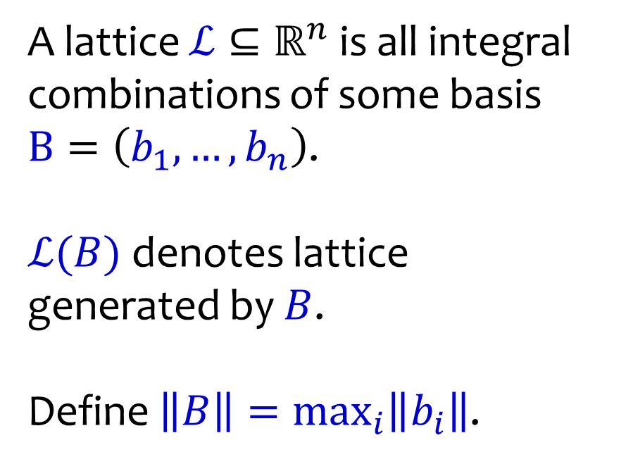


Lattices
A lattice $ℒ⊆ℝ^{n}$ is all integral combinations of some basis
$B=\left(b_{1},…,b_{n}\right)$.
$ℒ(B)$ denotes lattice
generated by $B$.
Define $\left\|B\right\|=\max_{i}\left\|b_{i}\right\|$.
$$b_{2}$$
$$b_{1}$$
$$ℒ$$

Slide 3
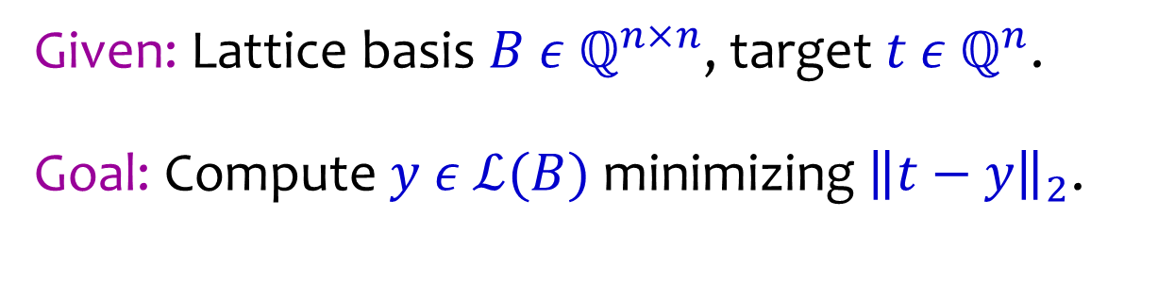



Closest Vector Problem (CVP)
Given: Lattice basis $B ε ℚ^{n×n}$, target $t ε ℚ^{n}$.
Goal: Compute $y ε$ $ℒ(B)$ minimizing ${\left\|t−y\right\|}_{2}$.
$$y$$
$$t$$
$$ℒ$$

Slide 4
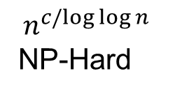

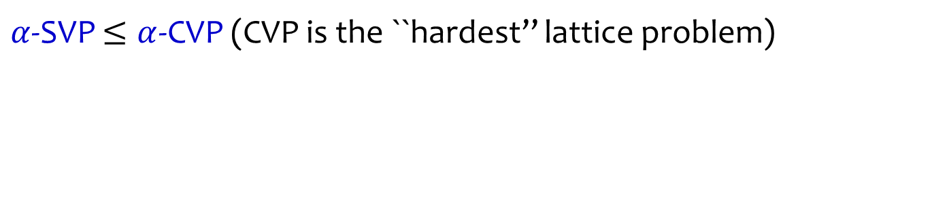
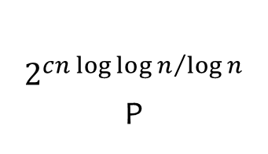
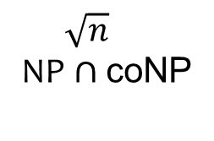
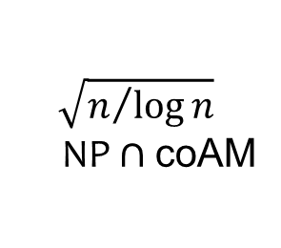
Applications of SVP & CVP
Optimization: Integer and Linear Programming
Number Theory: Factoring Polynomials, Number Field Sieve
Communication Theory: Decoding Gaussian Channels
Database Search: Approximate Nearest Neighbor Search
Cryptanalysis: RSA with Small Exponent, Knapsack Crypto Systems
Cryptography: Lattice based Crypto (hardness of LWE / SIS)
Hardness of CVP
$α$-SVP $≤α$-CVP (CVP is the ``hardest’’ lattice problem)
$$1$$
$$n^{c/log⁡log⁡n }$$
NP-Hard
$$\sqrt{n/{\log{n}}}$$
NP $∩$coAM
$\sqrt{n}$
NP $∩$coNP
$2^{cn {\log{\log{n}}}/{\log{n}}}$ P

Slide 5
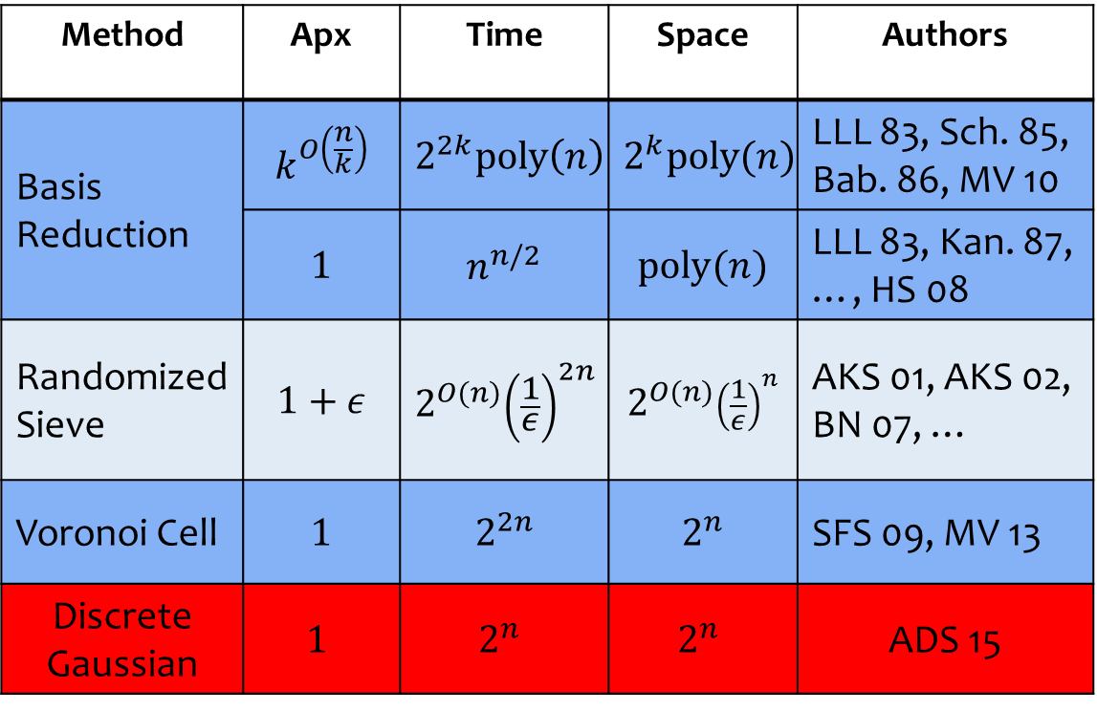
Main Result
Method | Apx | Time | Space | Authors
Basis Reduction | $$k^{O\left(\frac{n}{k}\right)}$$ | $$2^{2k}poly\left(n\right)$$ | $$2^{k}\text{p}\text{oly}(n)$$ | LLL 83, Sch. 85, Bab. 86, MV 10
 | $$1$$ | $$n^{n/2}$$ | $$\text{p}\text{oly}(n)$$ | LLL 83, Kan. 87, …, HS 08
Randomized Sieve | $$1+ε$$ | $$2^{O(n)}{\left(\frac{1}{ε}\right)}^{2n}$$ | $$2^{O(n)}{\left(\frac{1}{ε}\right)}^{n}$$ | AKS 01, AKS 02, BN 07, …
Voronoi Cell | $$1$$ | $$2^{2n}$$ | $$2^{n}$$ | SFS 09, MV 13
Discrete Gaussian | $$1$$ | $$2^{n}$$ | $$2^{n}$$ | ADS 15

Slide 6
Outline
Approximate CVP via (shifted) DGS sampling.
Relation between parameter and approx. factor.
A shifted DGS sampler.
Number of samples we can generate at desired parameters.
Sample clustering & recursion for exact CVP.
Learning the coordinates of a closest vector.

Slide 7
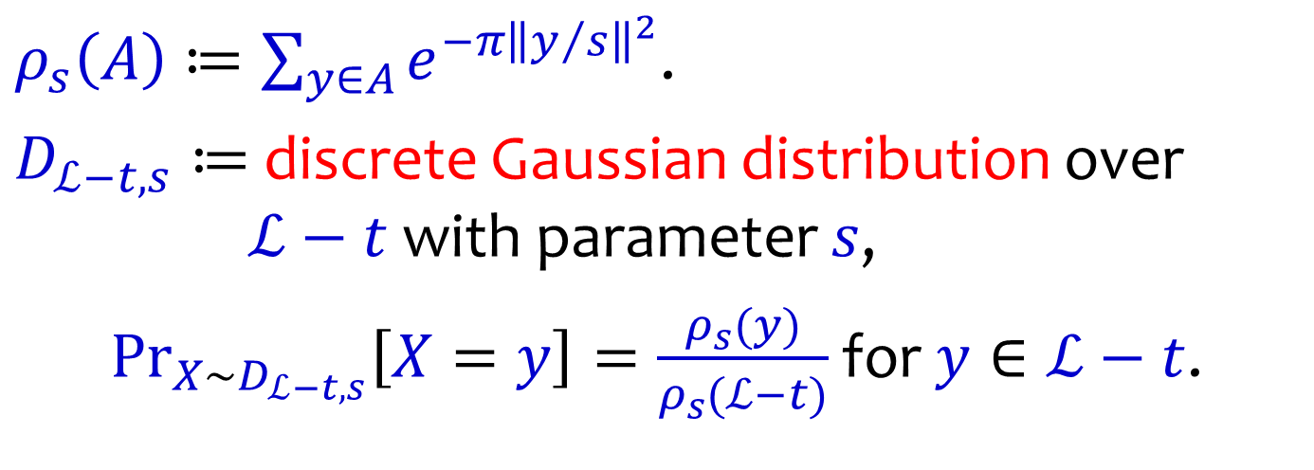
Shifted Discrete Gaussian
$ρ_{s}\left(A\right)≔\sum_{y∈A}{e^{−π{\left\|y/s\right\|}^{2}}}$.
$D_{ℒ−t, s}≔$ discrete Gaussian distribution over
$ℒ−t$ with parameter $s$,
$\underset{X∼D_{ℒ−t,s}}{Pr}\left[X=y\right]=\frac{ρ_{s}(y)}{ρ_{s}(ℒ−t)}$for $y∈ℒ−t$.

Slide 8


Shifted Discrete Gaussian
The discrete Gaussian
is more concentrated
as the parameter decreases.
$$s=10$$
$$s=4$$

Slide 9
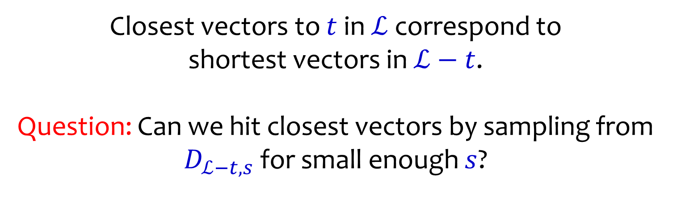
Discrete Gaussian and CVP
Closest vectors to $t$ in $ℒ$ correspond to
shortest vectors in $ℒ−t$.
Question: Can we hit closest vectors by sampling from $D_{ℒ−t,s}$ for small enough $s$?

Slide 10




Discrete Gaussian and CVP
Problem: Can have arbitrarily many approximate
closest vectors!
Let $d\left(ℒ,t\right)=\min_{y∈ℒ}\left\|y−t\right\|$ denote distance of $ℒ$ to $t$.
$(1$+$ε)d$
$$d$$
$$t$$
$$ℒ$$

Slide 11
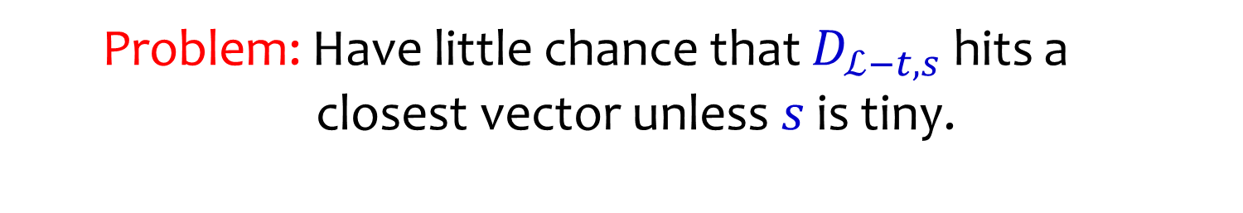
Discrete Gaussian and CVP
Problem: Have little chance that $D_{ℒ−t,s}$ hits a
closest vector unless $s$ is tiny.
$(1$+$ε)d$
$$d$$
$$t$$
$$ℒ$$

Slide 12

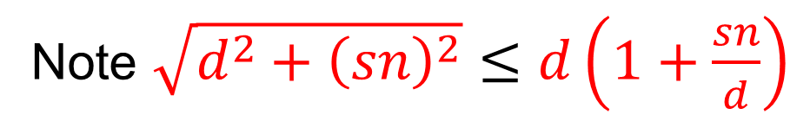
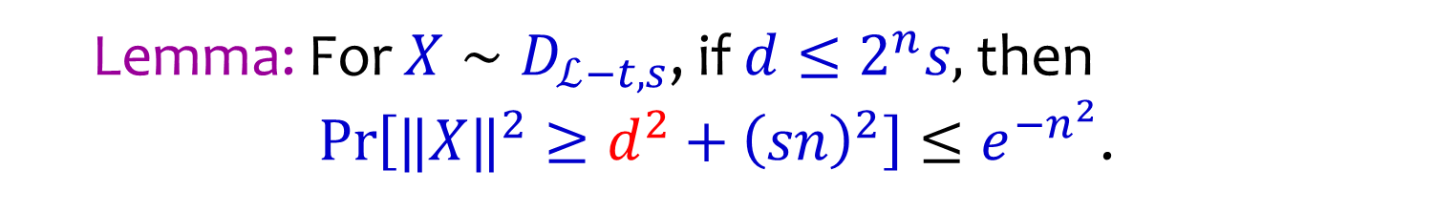
Approximate CVP via DGS
Lemma: For $X∼D_{ℒ−t,s}$, if $d≤2^{n}s,$ then
$\operatorname{Pr}\left[‖X‖^{2}≥d^{2}+{\left(sn\right)}^{2}\right]≤e^{−n^{2}}$.
Note $\sqrt{d^{2}+{\left(sn\right)}^{2}}≤d\left(1+\frac{sn}{d}\right)$
$$d$$
$\sqrt{d^{2}+{\left(sn\right)}^{2}}$
$$t$$
$$ℒ$$

Slide 13
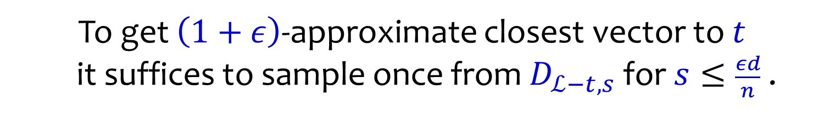
Approximate CVP via DGS
To get $\left(1+ε\right)$-approximate closest vector to $t$
it suffices to sample once from $D_{ℒ−t,s}$ for$s≤\frac{εd}{n}$ .
$$d$$
$\sqrt{d^{2}+{\left(sn\right)}^{2}}$
$$t$$
$$ℒ$$

Slide 14
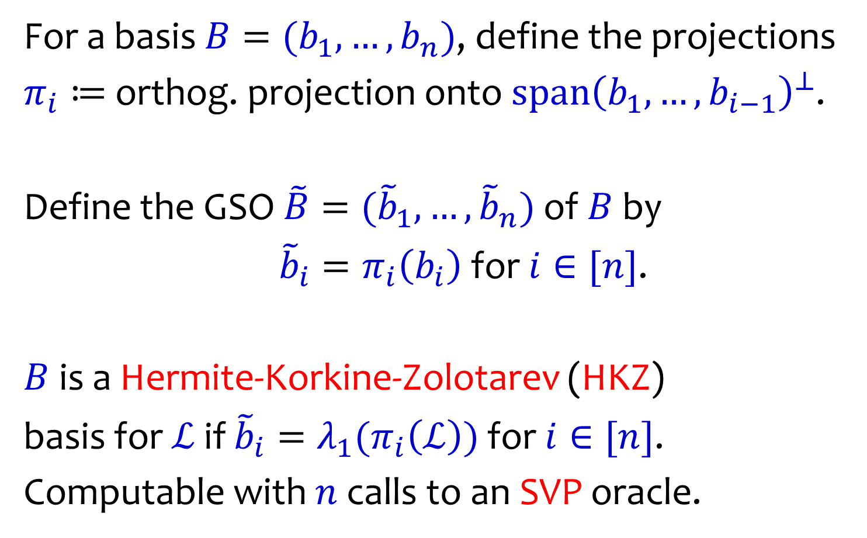
Hermite-Korkine-Zolotarev Basis
For a basis $B=(b_{1},…,b_{n})$, define the projections
$π_{i}≔$orthog. projection onto $span{\left(b_{1},…,b_{i−1}\right)}^{⊥}$.
Define the GSO $\tilde{B}=({\tilde{b}}_{1},…,{\tilde{b}}_{n})$ of $B$ by
${\tilde{b}}_{i}=π_{i}\left(b_{i}\right)$ for $i∈[n]$.
$B$ is a Hermite-Korkine-Zolotarev (HKZ)
basis for $ℒ$ if ${\tilde{b}}_{i}=λ_{1}(π_{i}\left(ℒ\right))$ for $i∈[n]$.
Computable with $n$ calls to an SVP oracle.

Slide 15
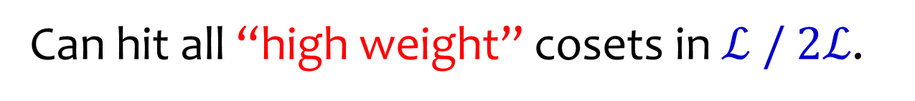
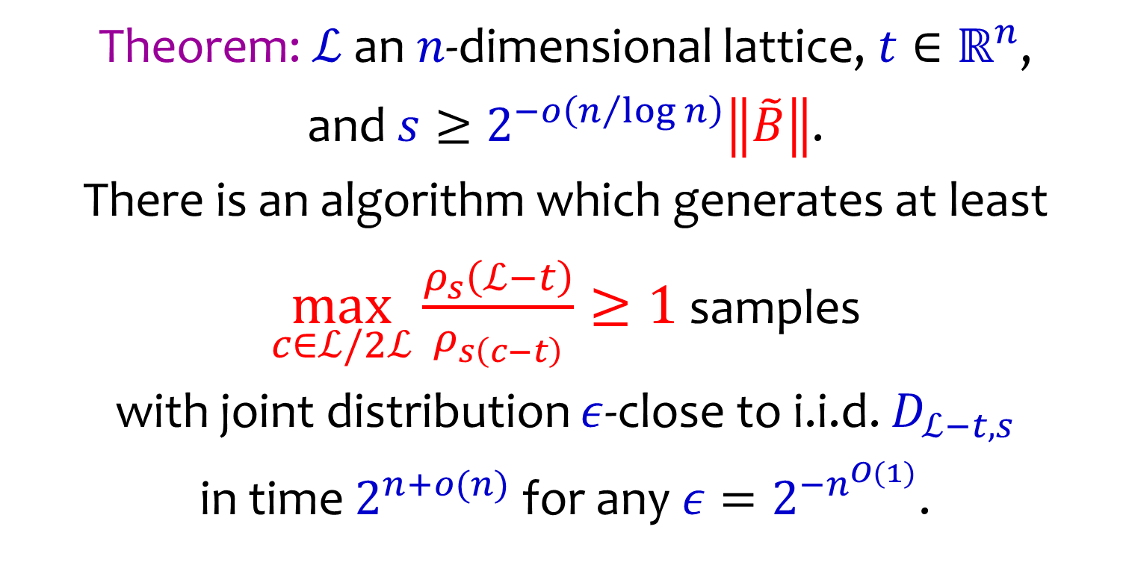
Shifted DGS Sampler
Theorem: $ℒ$ an $n$-dimensional lattice, $t∈ℝ^{n}$,
and $s≥2^{−o\left(n/{\log{n}}\right)}\left\|\tilde{B}\right\|$.
There is an algorithm which generates at least
$\max_{c∈ℒ/2ℒ}\frac{ρ_{s}\left(ℒ−t\right)}{ρ_{s\left(c−t\right)}}≥1$ samples
with joint distribution $ε$-close to i.i.d. $D_{ℒ−t,s}$
in time $2^{n+o(n)}$for any $ε=2^{−n^{O(1)}}$.
Can hit all “high weight” cosets in $ℒ / 2ℒ$.

Slide 16

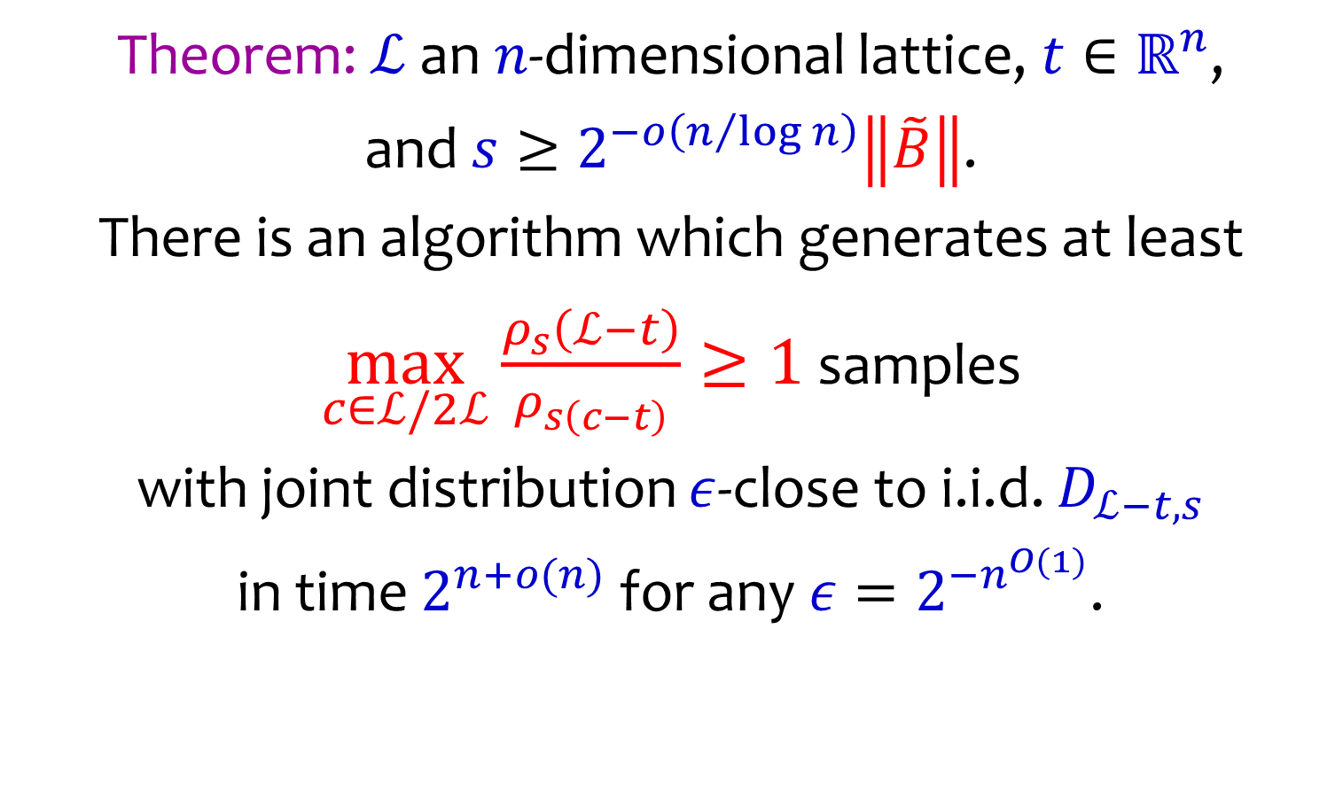
Shifted DGS Sampler
Theorem: $ℒ$ an $n$-dimensional lattice, $t∈ℝ^{n}$,
and $s≥2^{−o\left(n/{\log{n}}\right)}\left\|\tilde{B}\right\|$.
There is an algorithm which generates at least
$\max_{c∈ℒ/2ℒ}\frac{ρ_{s}\left(ℒ−t\right)}{ρ_{s\left(c−t\right)}}≥1$ samples
with joint distribution $ε$-close to i.i.d. $D_{ℒ−t,s}$
in time $2^{n+o(n)}$for any $ε=2^{−n^{O(1)}}$.
If $d\left(ℒ,t\right)≥\frac{\left\|\tilde{B}\right\|}{poly(n)}$ gives $(1+2^{−o\left(n/{\log{n}}\right)})$-approx!

Slide 17
Shifted DGS Sampler
Theorem: $ℒ$ an $n$-dimensional lattice, $t∈ℝ^{n}$,
and $s≥2^{−o\left(n/{\log{n}}\right)}\left\|\tilde{B}\right\|$.
There is an algorithm which generates at least
$\max_{c∈ℒ/2ℒ}\frac{ρ_{s}\left(ℒ−t\right)}{ρ_{s\left(c−t\right)}}≥1$ samples
with joint distribution $ε$-close to i.i.d. $D_{ℒ−t,s}$
in time $2^{n+o(n)}$for any $ε=2^{−n^{O(1)}}$.
More importantly, will suffice to solve exact CVP.

Slide 18

Averaging Discrete Gaussians
Let $t_{1},t_{2}∈ℝ^{n}$, $t^{+}={\left(t_{1}+t_{2}\right)}/2$, $t^{−}={\left(t_{1}−t_{2}\right)}/2$.
Then for $X_{1}∼D_{ℒ+t_{1},s}$, $X_{2}∼D_{ℒ+t_{2},s}$ and $y∈ℒ+t^{+}$,
$\operatorname{Pr}\left[\frac{X_{1}+X_{2}}{2}=y\right]= \frac{ρ_{s/{\sqrt{2}}}\left(y\right)ρ_{s/{\sqrt{2}}}(ℒ+t^{−})}{ρ_{s}\left(ℒ+t_{1}\right)ρ_{s}(ℒ+t_{2})}$ .
Hence ${\left(X_{1}+X_{2}\right)}/2$ conditioned on landing in
$ℒ+t^{+}$ is distributed as $D_{ℒ+t^{+},s/{\sqrt{2}} }$.

Slide 19

Averaging Discrete Gaussians
Let $t_{1},t_{2}∈ℝ^{n}$, $t^{+}={\left(t_{1}+t_{2}\right)}/2$, $t^{−}={\left(t_{1}−t_{2}\right)}/2$.
Then for $X_{1}∼D_{ℒ+t_{1},s}$, $X_{2}∼D_{ℒ+t_{2},s}$
$\operatorname{Pr}\left[\frac{X_{1}+X_{2}}{2}∈ℒ+t^{+}\right]= \frac{ρ_{s/{\sqrt{2}}}\left(ℒ+t^{+}\right)ρ_{s/{\sqrt{2}}}(ℒ+t^{−})}{ρ_{s}\left(ℒ+t_{1}\right)ρ_{s}(ℒ+t_{2})}$
$=\sum_{c∈ℒ/2ℒ}{\frac{ρ_{s}\left(c+t_{1}\right)ρ_{s}\left(c+t_{2}\right)}{ρ_{s}\left(ℒ+t_{1}\right)ρ_{s}(ℒ+t_{2})}}$ .
With above identity can show amazing inequalities.

Slide 20

Shifted DGS Combiner
Input: $X_{1},…,X_{M}$ i.i.d. samples from $D_{ℒ−t,s}$.
Output: $X_{1},…,X_{LM}$ i.i.d. samples from $D_{ℒ−t,s/\sqrt{2}}$.
Initialization:
Apply SVP solver to compute HKZ basis $B$ for $ℒ$.
Use [GPV08,BLPRS13] sampler on $B$ to produce
$D_{ℒ−t,s}$ samples at $s=\tilde{O}\left(\left\|\tilde{B}\right\|\right)$ in polytime.

Slide 21

Shifted DGS Combiner
Input: $X_{1},…,X_{M}$ i.i.d. samples from $D_{ℒ−t,s}$.
Output: $X_{1},…,X_{LM}$ i.i.d. samples from $D_{ℒ−t,s/\sqrt{2}}$.
Meta Procedure: Repeat $LM$ times
Sample $c∈ℒ/2ℒ$ with probability $\frac{ρ_{s}{\left(c−t\right)}^{2}}{\sum_{z∈ℒ/2ℒ}{ρ_{s}{\left(z−t\right)}^{2}}}$.
Pick unused $X_{i},X_{j}∈c−t$, return $(X_{i}+X_{j})/2$.

Slide 22

Shifted DGS Combiner
Input: $X_{1},…,X_{M}$ i.i.d. samples from $D_{ℒ−t,s}$.
Output: $X_{1},…,X_{LM}$ i.i.d. samples from $D_{ℒ−t,s/\sqrt{2}}$.
Question: How big can $L$ be?
Should at least not exhaust supply on expectation.
$\frac{2ρ_{s}{\left(c−t\right)}^{2}}{\sum_{z∈ℒ/2ℒ}{ρ_{s}{\left(z−t\right)}^{2}}} LM≤\frac{ρ_{s}\left(c−t\right)}{ρ_{s}\left(ℒ−t\right)}M ∀ c∈ℒ/2ℒ$

Slide 23

Shifted DGS Combiner
Input: $X_{1},…,X_{M}$ i.i.d. samples from $D_{ℒ−t,s}$.
Output: $X_{1},…,X_{LM}$ i.i.d. samples from $D_{ℒ−t,s/\sqrt{2}}$.
Question: How big can $L$ be?
Worst case for $c^{∗}∈ℒ/2ℒ$ maximizing $ρ_{s}\left(c^{∗}−t\right)$.
$\frac{2ρ_{s}{\left(c−t\right)}^{2}}{\sum_{z∈ℒ/2ℒ}{ρ_{s}{\left(z−t\right)}^{2}}} LM≤\frac{ρ_{s}\left(c−t\right)}{ρ_{s}\left(ℒ−t\right)}M ∀ c∈ℒ/2ℒ$

Slide 24

Shifted DGS Combiner
Input: $X_{1},…,X_{M}$ i.i.d. samples from $D_{ℒ−t,s}$.
Output: $X_{1},…,X_{LM}$ i.i.d. samples from $D_{ℒ−t,s/\sqrt{2}}$.
Question: How big can $L$ be?
Worst case for $c^{∗}∈ℒ/2ℒ$ maximizing $ρ_{s}\left(c^{∗}−t\right)$.
$L≤\frac{\sum_{z∈ℒ/{2ℒ}}{ρ_{s}{\left(z−t\right)}^{2}}}{2{ρ_{s}\left(c^{∗}−t\right)ρ}_{s}\left(ℒ−t\right)}=\frac{ρ_{s/{\sqrt{2}}}\left(ℒ\right)ρ_{s/{\sqrt{2}}}(ℒ−t)}{2ρ_{s}\left(c^{∗}−t\right)ρ_{s}\left(ℒ−t\right)}$

Slide 25

Shifted DGS Combiner
Let $s_{k}=s/{{\sqrt{2}}^{k}}$, $c_{k}^{∗}∈ℒ/2ℒ$ maximizes $ρ_{s_{k}}\left(c_{k}^{∗}−t\right)$.
Theorem: The loss after $k$ steps
$\prod_{i∈[k]}{\frac{ρ_{s_{k}}\left(ℒ\right)ρ_{s_{k}}(ℒ−t)}{2ρ_{s_{k−1}}\left(c_{k−1}^{∗}−t\right)ρ_{s_{k−1}}\left(ℒ−t\right)}}≥2^{−\left(n+k\right)}\frac{ρ_{s_{k}}\left(ℒ−t\right)}{ρ_{s_{k}}\left(c_{k}^{∗}−t\right)}$
Need at least $2^{\left(n+k\right)}$ initial samples to go $k$ steps.

Slide 26

Key Inequality
Let $s_{k}=s/{{\sqrt{2}}^{k}}$, $c_{k}^{∗}∈ℒ/2ℒ$ maximize $ρ_{s_{k}}\left(c_{k}^{∗}−t\right)$.
Lemma:
$ρ_{s_{k}}{\left(c_{k}^{∗}−t\right)}^{2}≤ρ_{s_{k+1}}\left(c_{k+1}^{∗}−t\right)ρ_{s_{k+1}}\left(ℒ\right)$.
Proof:
Take $t_{1}∈c_{k}^{∗}−t$ and $t_{2}=0$. Then
$ρ_{s_{k}}{\left(c_{k}^{∗}−t\right)}^{2} =ρ_{s_{k}}{\left(2ℒ+t_{1}\right)}^{2}=ρ_{s_{k+2}}{\left(ℒ+t_{1}/2\right)}^{2}$
$=\sum_{c∈ℒ/2ℒ}{ρ_{s_{k+1}}\left(c+t_{1}\right)}ρ_{s_{k+1}}(c)$
$≤$ $ρ_{s_{k+1}}\left(c_{k+1}^{∗}−t\right)$ $\sum_{c∈ℒ/{2ℒ}}{ρ_{s_{k+1}}\left(c\right)}$

Slide 27

Key Inequality
Let $s_{k}=s/{{\sqrt{2}}^{k}}$, $c_{k}^{∗}∈ℒ/2ℒ$ maximize $ρ_{s_{k}}\left(c_{k}^{∗}−t\right)$.
Lemma:
$ρ_{s_{k}}{\left(c_{k}^{∗}−t\right)}^{2}≤ρ_{s_{k+1}}\left(c_{k+1}^{∗}−t\right)ρ_{s_{k+1}}\left(ℒ\right)$.
Proof:
Take $t_{1}∈c_{k}^{∗}−t$ and $t_{2}=0$. Then
$ρ_{s_{k}}{\left(c_{k}^{∗}−t\right)}^{2} =ρ_{s_{k}}{\left(2ℒ+t_{1}\right)}^{2}=ρ_{s_{k+2}}{\left(ℒ+t_{1}/2\right)}^{2}$
$=\sum_{c∈ℒ/2ℒ}{ρ_{s_{k+1}}\left(c+t_{1}\right)}ρ_{s_{k+1}}(c)$
$≤$ $ρ_{s_{k+1}}\left(c_{k+1}^{∗}−t\right) ρ_{s_{k+1}}(ℒ)$

Slide 28

Hope for Exact CVP
From approximate CVP solutions can try to learn
subspaces that must contain the closest vector.
$2$ lattice subspaces
$$t$$
$$ℒ$$

Slide 29
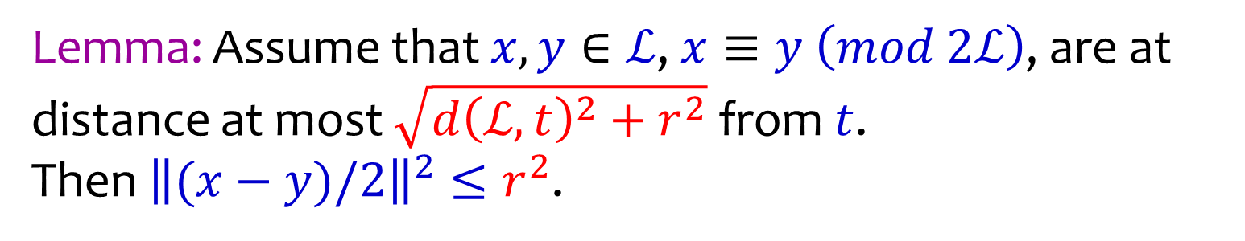






Clustering approx. closest vectors
Lemma: Assume that $x,y∈ℒ$, $x≡y \left(mod 2ℒ\right)$, are at distance at most $\sqrt{d{\left(ℒ,t\right)}^{2}+r^{2}}$ from $t$.
Then ${\left\|(x−y)/2\right\|}^{2}≤r^{2}$.
$$x$$
$$\frac{x+y}{2}$$
$$y$$
$$t$$
$$d(ℒ,t)$$
$$ℒ$$
$$r$$

Slide 30
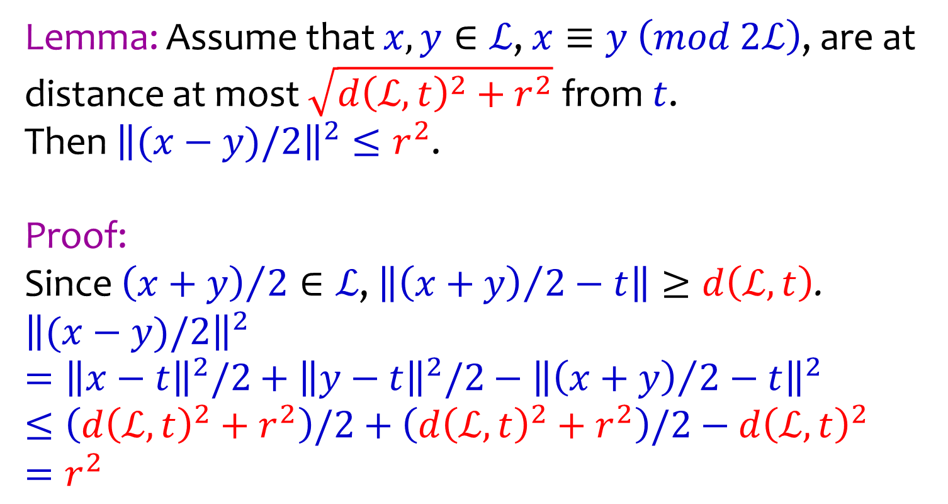
Clustering approx. closest vectors
Lemma: Assume that $x,y∈ℒ$, $x≡y \left(mod 2ℒ\right)$, are at distance at most $\sqrt{d{\left(ℒ,t\right)}^{2}+r^{2}}$ from $t$.
Then ${\left\|(x−y)/2\right\|}^{2}≤r^{2}$.
Proof:
Since ${\left(x+y\right)}/2∈ℒ$, $\left\|{\left(x+y\right)}/2−t\right\|≥d\left(ℒ,t\right)$.
$${\left\|(x−y)/2\right\|}^{2}$$
$$={\left\|x−t\right\|}^{2}/2+{\left\|y−t\right\|}^{2}/2−{\left\|{\left(x+y\right)}/2−t\right\|}^{2}$$
$$≤\left(d{\left(ℒ,t\right)}^{2}+r^{2}\right)/2+\left(d{\left(ℒ,t\right)}^{2}+r^{2}\right)/2−d{\left(ℒ,t\right)}^{2}$$
$$=r^{2}$$

Slide 31
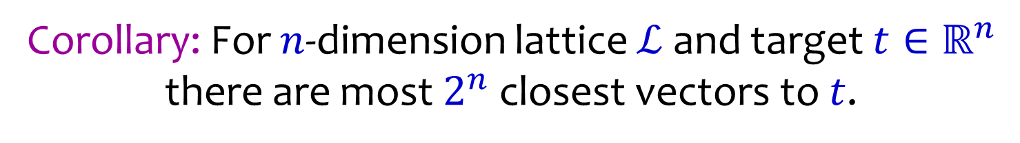





How many closest vectors?
Corollary: For $n$-dimension lattice $ℒ$ and target $t∈ℝ^{n}$
there are most $2^{n}$ closest vectors to $t$.
$$(0,1)$$
$$(1,1)$$
Bound is trivially tight.
$$(1/2,1/2)$$
$$(0,0)$$
$$(1,0)$$

Slide 32
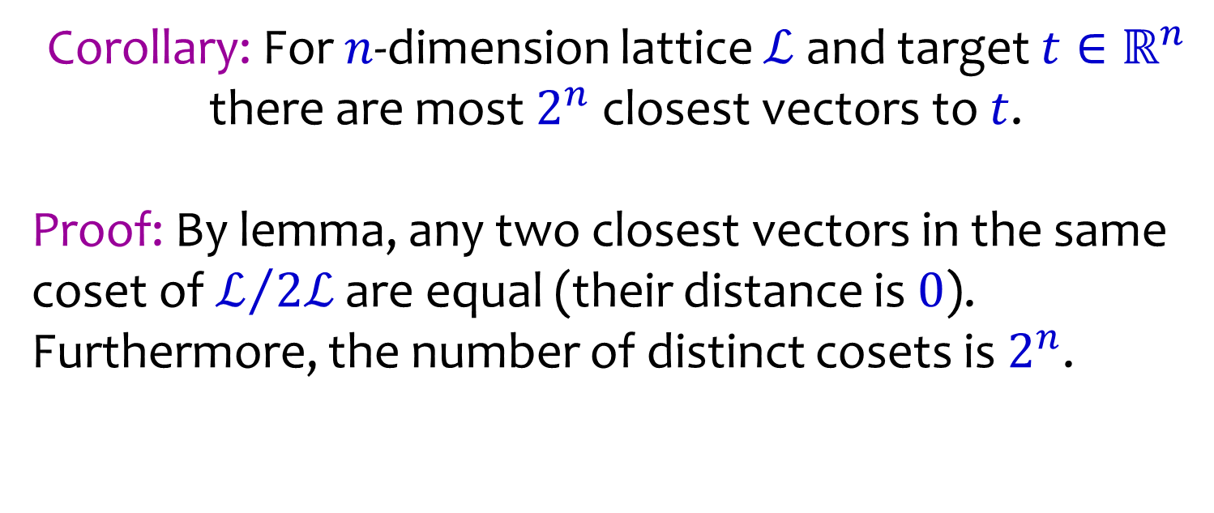
How many closest vectors?
Corollary: For $n$-dimension lattice $ℒ$ and target $t∈ℝ^{n}$
there are most $2^{n}$ closest vectors to $t$.
Proof: By lemma, any two closest vectors in the same coset of $ℒ/{2ℒ}$ are equal (their distance is $0$).
Furthermore, the number of distinct cosets is $2^{n}$.

Slide 33
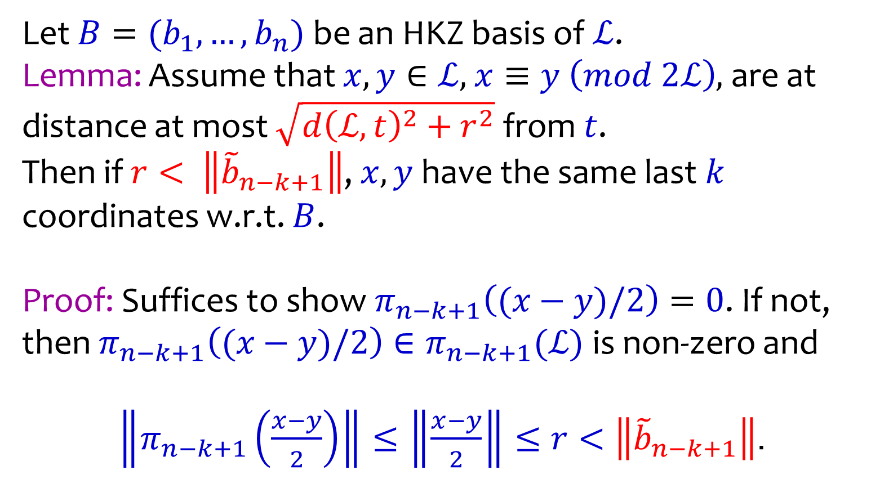
Dimension Reduction via Clustering
Let $B=(b_{1},…,b_{n})$ be an HKZ basis of $ℒ$.
Lemma: Assume that $x,y∈ℒ$, $x≡y \left(mod 2ℒ\right)$, are at distance at most $\sqrt{d{\left(ℒ,t\right)}^{2}+r^{2}}$ from $t$.
Then if $r< \left\|{\tilde{b}}_{n−k+1}\right\|$, $x,y$have the same last $k$ coordinates w.r.t. $B$.
Proof: Suffices to show $π_{n−k+1}\left((x−y)/2\right)=0$. If not,
then $π_{n−k+1}\left((x−y)/2\right)∈π_{n−k+1}(ℒ)$ is non-zero and
$\left\|π_{n−k+1}\left(\frac{x−y}{2}\right)\right\|≤\left\|\frac{x−y}{2}\right\|≤r<\left\|{\tilde{b}}_{n−k+1}\right\|$.

Slide 34
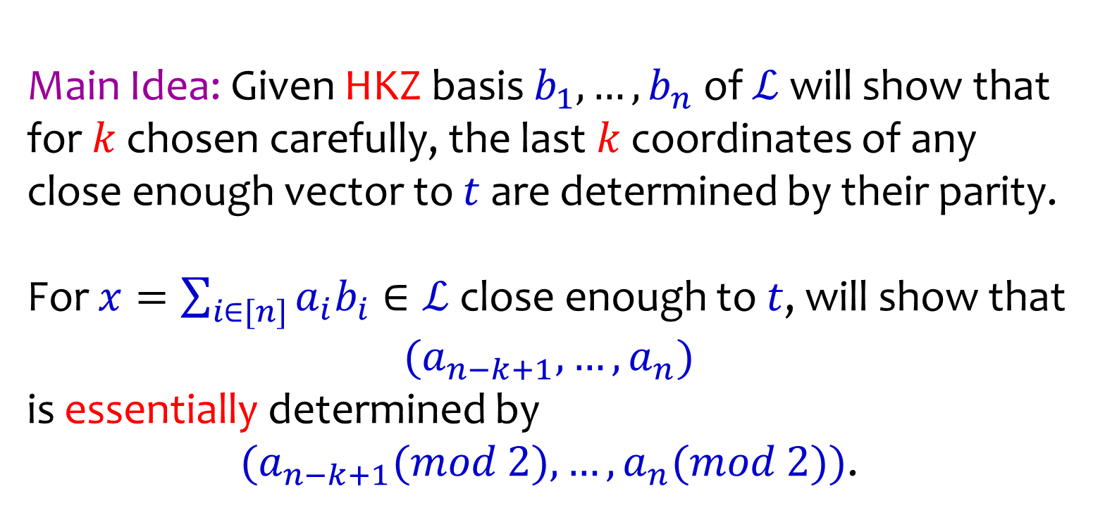
Exact CVP
Main Idea: Given HKZ basis $b_{1},…,b_{n}$ of $ℒ$ will show that for $k$ chosen carefully, the last $k$ coordinates of any close enough vector to $t$ are determined by their parity.
For $x=\sum_{i∈[n]}{a_{i}b_{i}}∈ℒ$ close enough to $t$, will show that
$(a_{n−k+1}, …, a_{n})$
is essentially determined by
$(a_{n−k+1}(mod 2), …, a_{n}(mod 2))$.

Slide 35


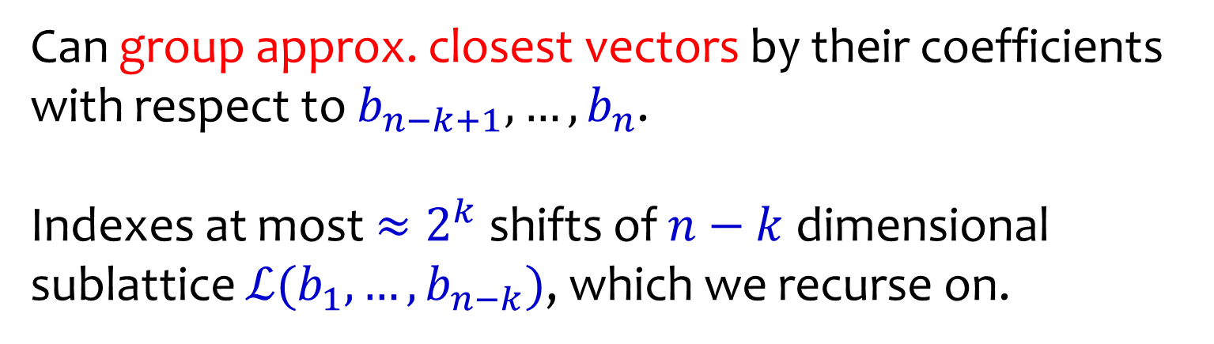


Exact CVP
Can group approx. closest vectors by their coefficients
with respect to $b_{n−k+1},…,b_{n}$.
Indexes at most $≈2^{k}$ shifts of $n−k$ dimensional sublattice $ℒ(b_{1},…,b_{n−k})$, which we recurse on.
$$b_{1}$$
$$a_{2}=0$$
$2$ lattice subspaces
$$t$$
$$ℒ$$
$$b_{2}$$
$$a_{2}=1$$

Slide 36
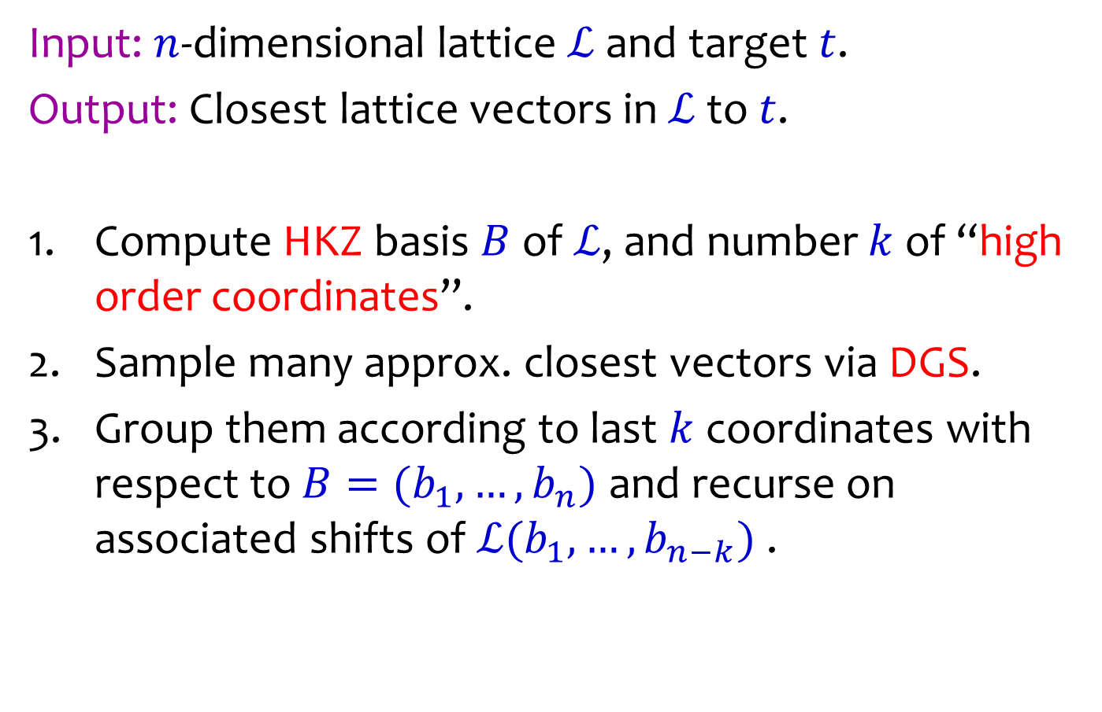
High Level Algorithm
Input: $n$-dimensional lattice $ℒ$ and target $t$.
Output: Closest lattice vectors in $ℒ$ to $t$.
Compute HKZ basis $B$ of $ℒ$, and number $k$ of “high order coordinates”.
Sample many approx. closest vectors via DGS.
Group them according to last $k$ coordinates with respect to $B=(b_{1},…,b_{n})$ and recurse on
associated shifts of $ℒ(b_{1},…,b_{n−k})$ .

Slide 37
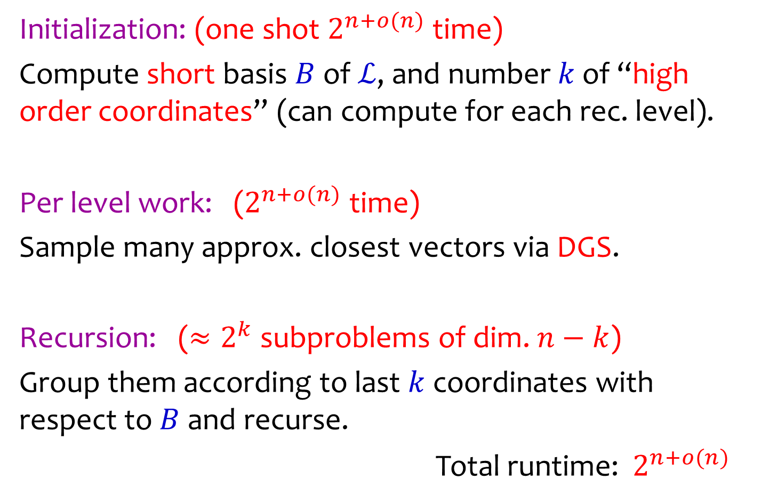
Complexity Sketch
Initialization: (one shot $2^{n+o(n)}$ time)
Compute short basis $B$ of $ℒ$, and number $k$ of “high order coordinates” (can compute for each rec. level).
Per level work: ($2^{n+o(n)}$ time)
Sample many approx. closest vectors via DGS.
Recursion: ($≈2^{k}$ subproblems of dim. $n−k$)
Group them according to last $k$ coordinates with respect to $B$ and recurse.
Total runtime: $2^{n+o(n)}$

Slide 38
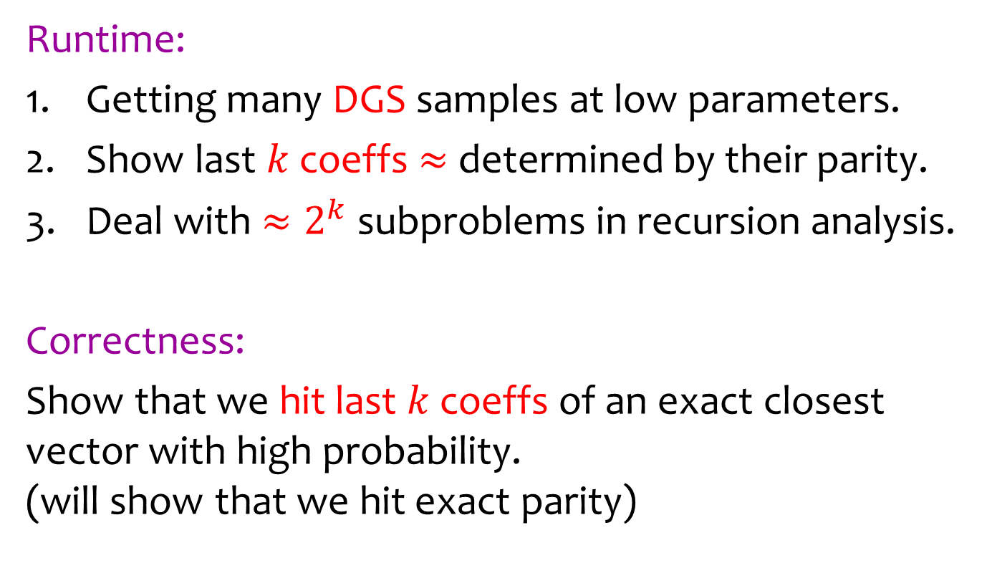
Key Challenges
Runtime:
Getting many DGS samples at low parameters.
Show last $k$ coeffs $≈$ determined by their parity.
Deal with $≈2^{k}$ subproblems in recursion analysis.
Correctness:
Show that we hit last $k$ coeffs of an exact closest vector with high probability.
(will show that we hit exact parity)

Slide 39
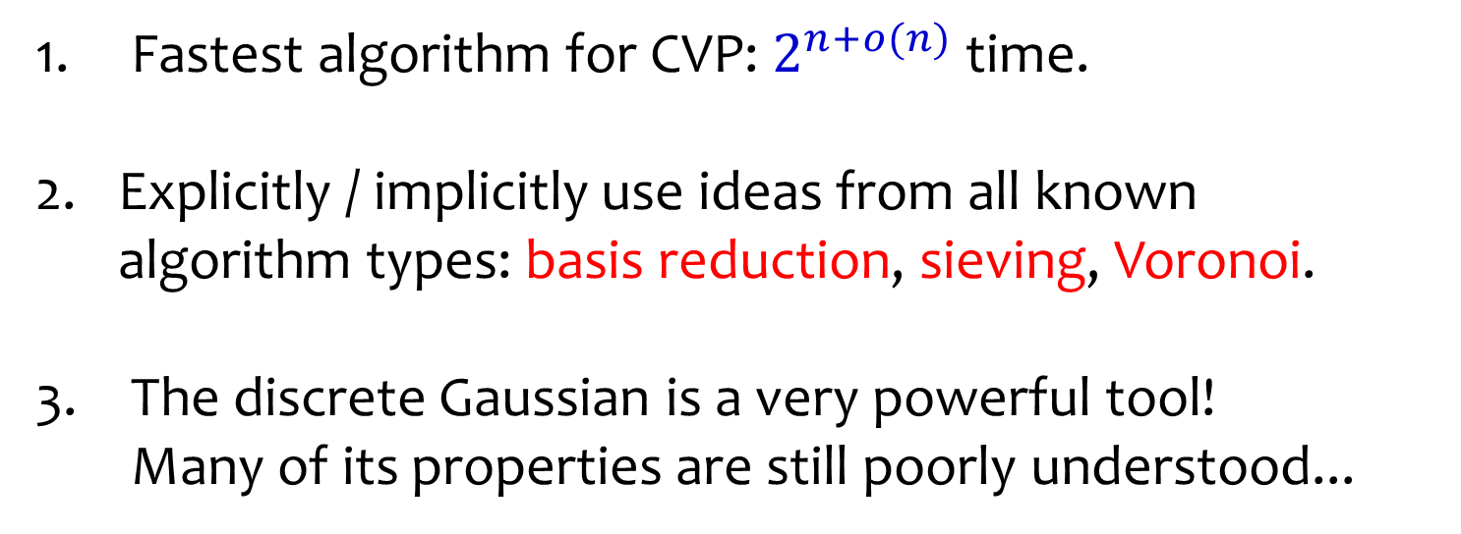
Conclusions
Fastest algorithm for CVP: $2^{n+o(n)}$ time.
Explicitly / implicitly use ideas from all known algorithm types: basis reduction, sieving, Voronoi.
The discrete Gaussian is a very powerful tool!
Many of its properties are still poorly understood...

Slide 40









Open Problems
Is $2^{n}$ optimal under SETH? (matches # closest vectors)
Is there a deterministic / Las Vegas algorithm?
($2^{n}$ time once the Voronoi cell is computed [BD 15])
Find a simpler & cleaner algorithm…
$$v_{2}$$
$$v_{1}$$
$$v_{3}$$
$$v_{6}$$
$$0$$
$$v_{4}$$
$$v_{5}$$
$$ℒ$$

Slide 41
THANK YOU!

