Slide 1
Solving SVP in $2^{n}$ Time Using Discrete Gaussian Sampling
Divesh Aggarwal
École Polytechnique Fédérale de Lausanne (EPFL)
Daniel Dadush
Centrum Wiskunde en Informatica (CWI)
Oded Regev
Noah Stephens-Davidowitz
New York University (NYU)

Slide 2
Lattices
A lattice $ℒ⊆ℝ^{n}$ is all integral combinations of some basis
$B=\left(b_{1},…,b_{n}\right)$.
$ℒ(B)$ denotes lattice
generated by $B$.
$$b_{2}$$
$$b_{1}$$
$$ℒ$$

Slide 3
Shortest Vector Problem (SVP)
Given: Lattice basis $B ε ℚ^{n×n}$.
Goal: Compute shortest non-zero vector in $ℒ(B)$.
$$0$$
$$y$$
$$ℒ$$

Slide 4
Shortest Vector Problem (SVP)
$λ_{1}\left(ℒ\right)=$ length of shortest non-zero vector
$$λ_{1}\left(ℒ\right)$$
$$0$$
$$y$$
$$ℒ$$

Slide 5
Status of (provable) $γ$-SVP
$2^{n}$ time
[ADRS15]
$2^{n/2}$ time
[ADRS15]
(Decisional)
$2^{0.8n}$ time
[LWXZ11]
$$≈2^{0.8n {\log{n}}/{(\log{γ}+\log{n})}}$$
$2^{0.4n}$ time
[Sch87, NV08, LWXZ11]
Hard
[Kh05, HR12]
NP $∩$ coNP
[AR 05]
Lots of crypto!
[…]
P
[Sch 87 , MV10]
$$γ$$
$$1$$
$$2$$
$$O(1)$$
$$n^{1/{\log{\log{n}}}}$$
$$\sqrt{n}$$
$n$
$$2^{n{\log{\log{n}}}/{\log{n}}}$$
Notes:
Khot, Popat, Vishnoi
\eps depends on the constant in the asymptotic

Slide 6
Progress on SVP
 | Time | Space
[Kan86] (Enumeration)
[AKS01] (Sieving)
[NV08, PS09, MV10a, …]
[MV10b] (Voronoi cell, deterministic, CVP)
This work (Discrete Gaussian sampling)
Notes:
Khot, Popat, Vishnoi
\eps depends on the constant in the asymptotic

Slide 7
Our Algorithm
Notes:
6:30-8:30
Aharonov and Regev use the periodic Gaussian function. You can see how oracle access to this can be helpful.

Slide 8
Gaussian Distribution
Notes:
6:30-8:30
Aharonov and Regev use the periodic Gaussian function. You can see how oracle access to this can be helpful.

Slide 9
Gaussian Distribution
Notes:
6:30-8:30
Aharonov and Regev use the periodic Gaussian function. You can see how oracle access to this can be helpful.

Slide 10
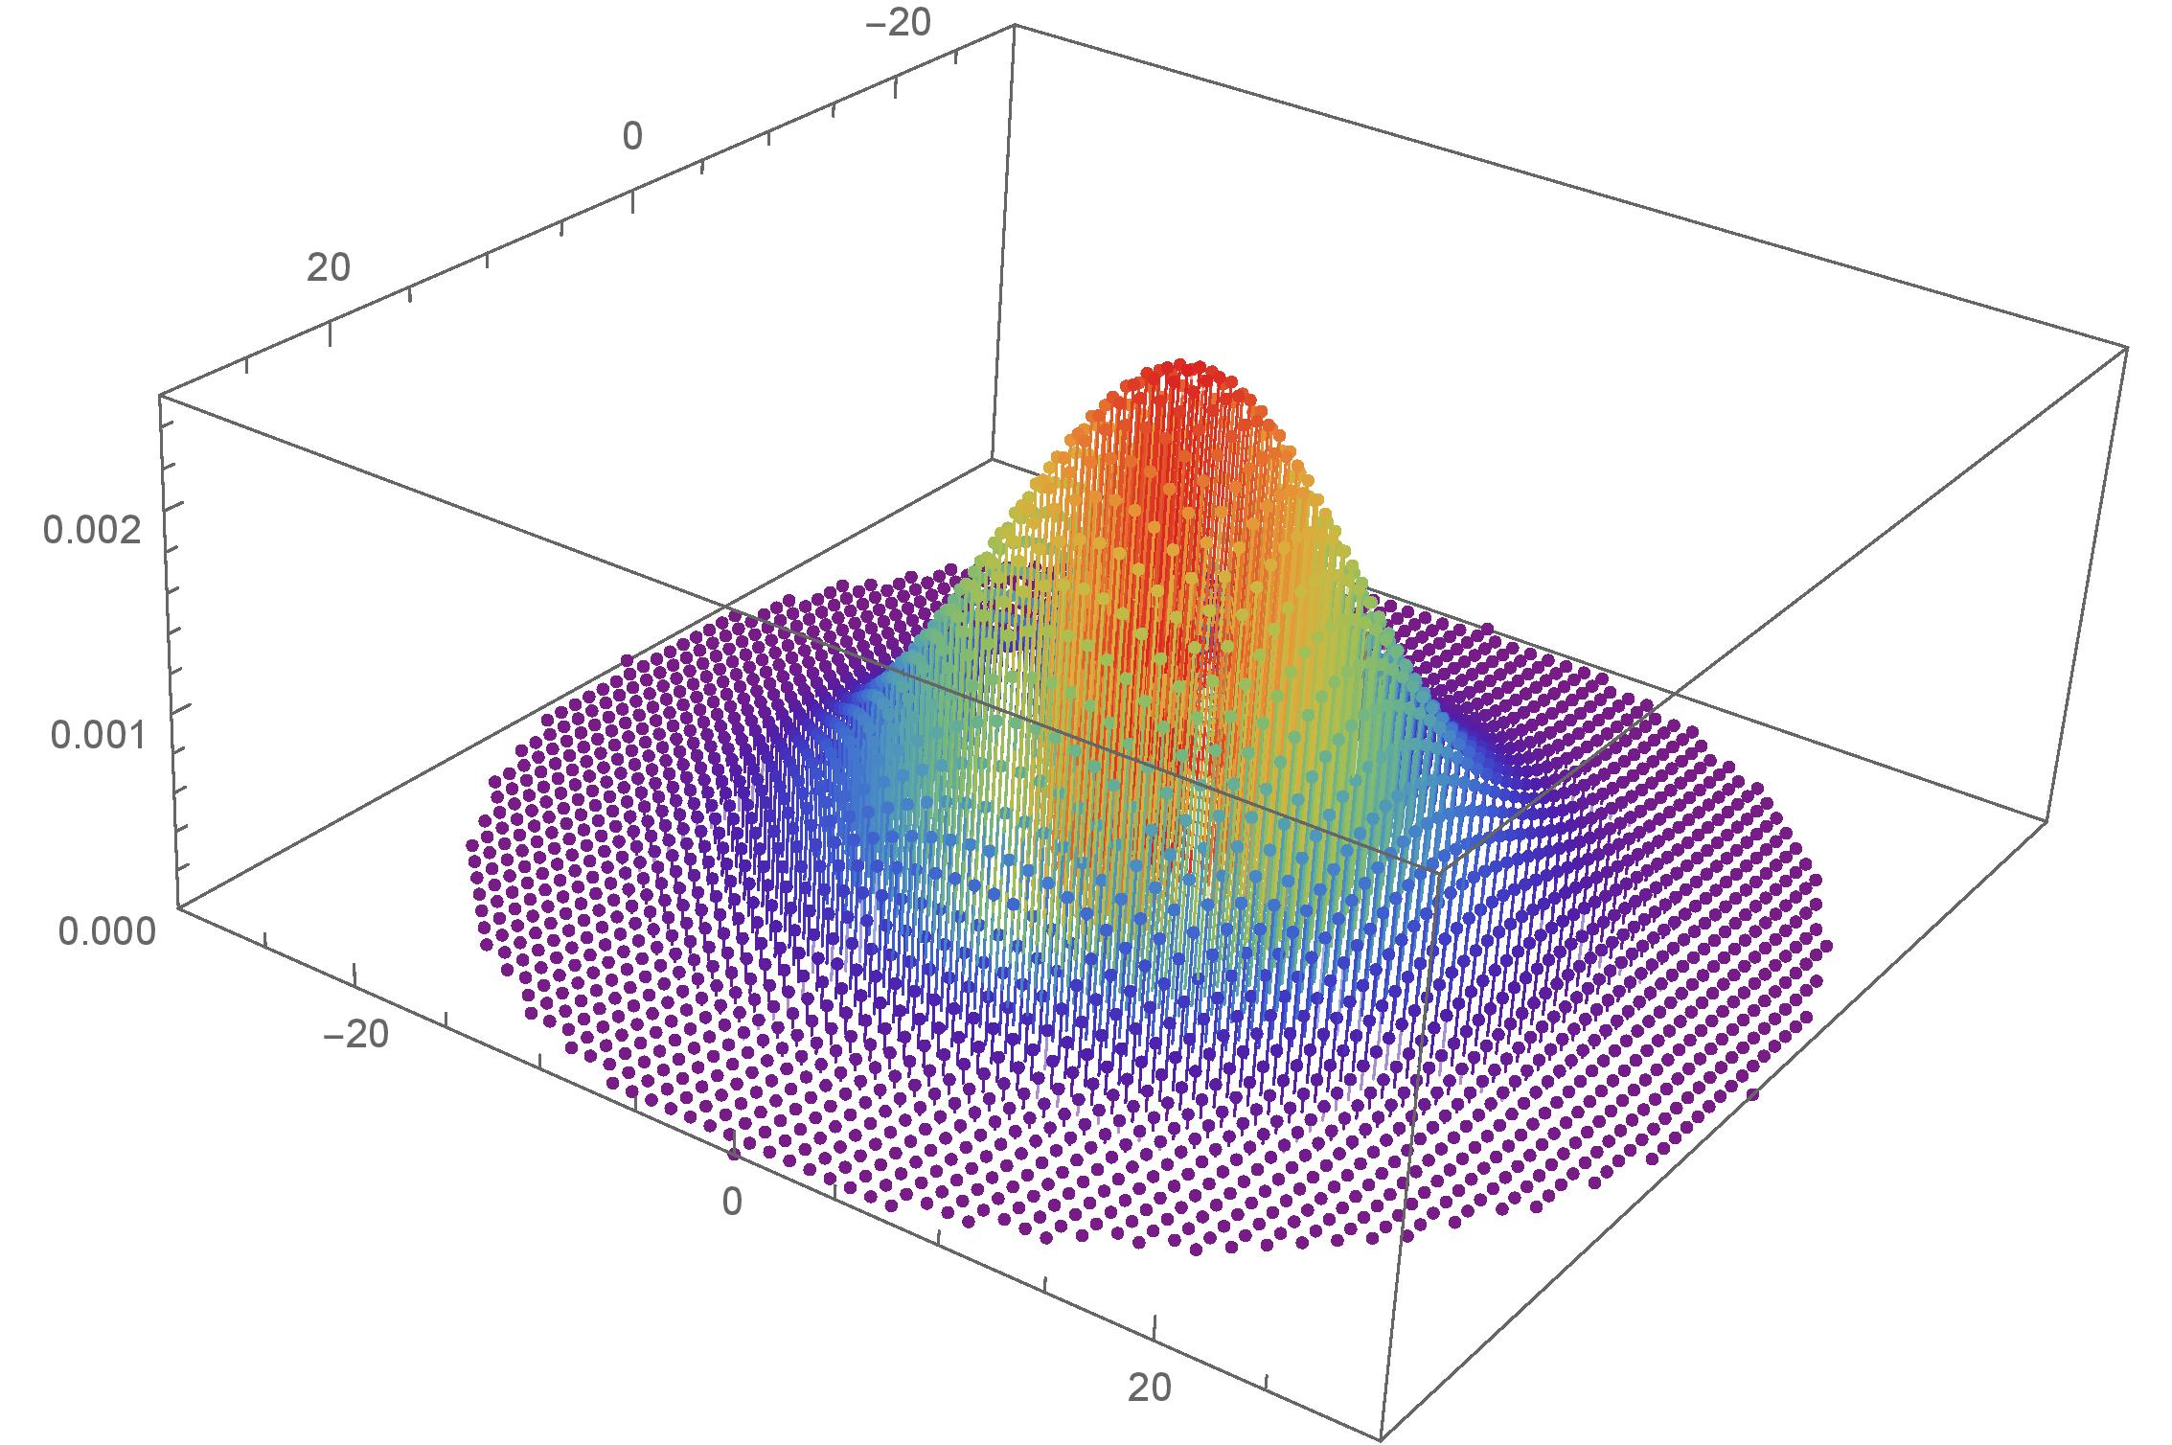
Discrete Gaussian Distribution
Notes:
6:30-8:30
Aharonov and Regev use the periodic Gaussian function. You can see how oracle access to this can be helpful.

Slide 11
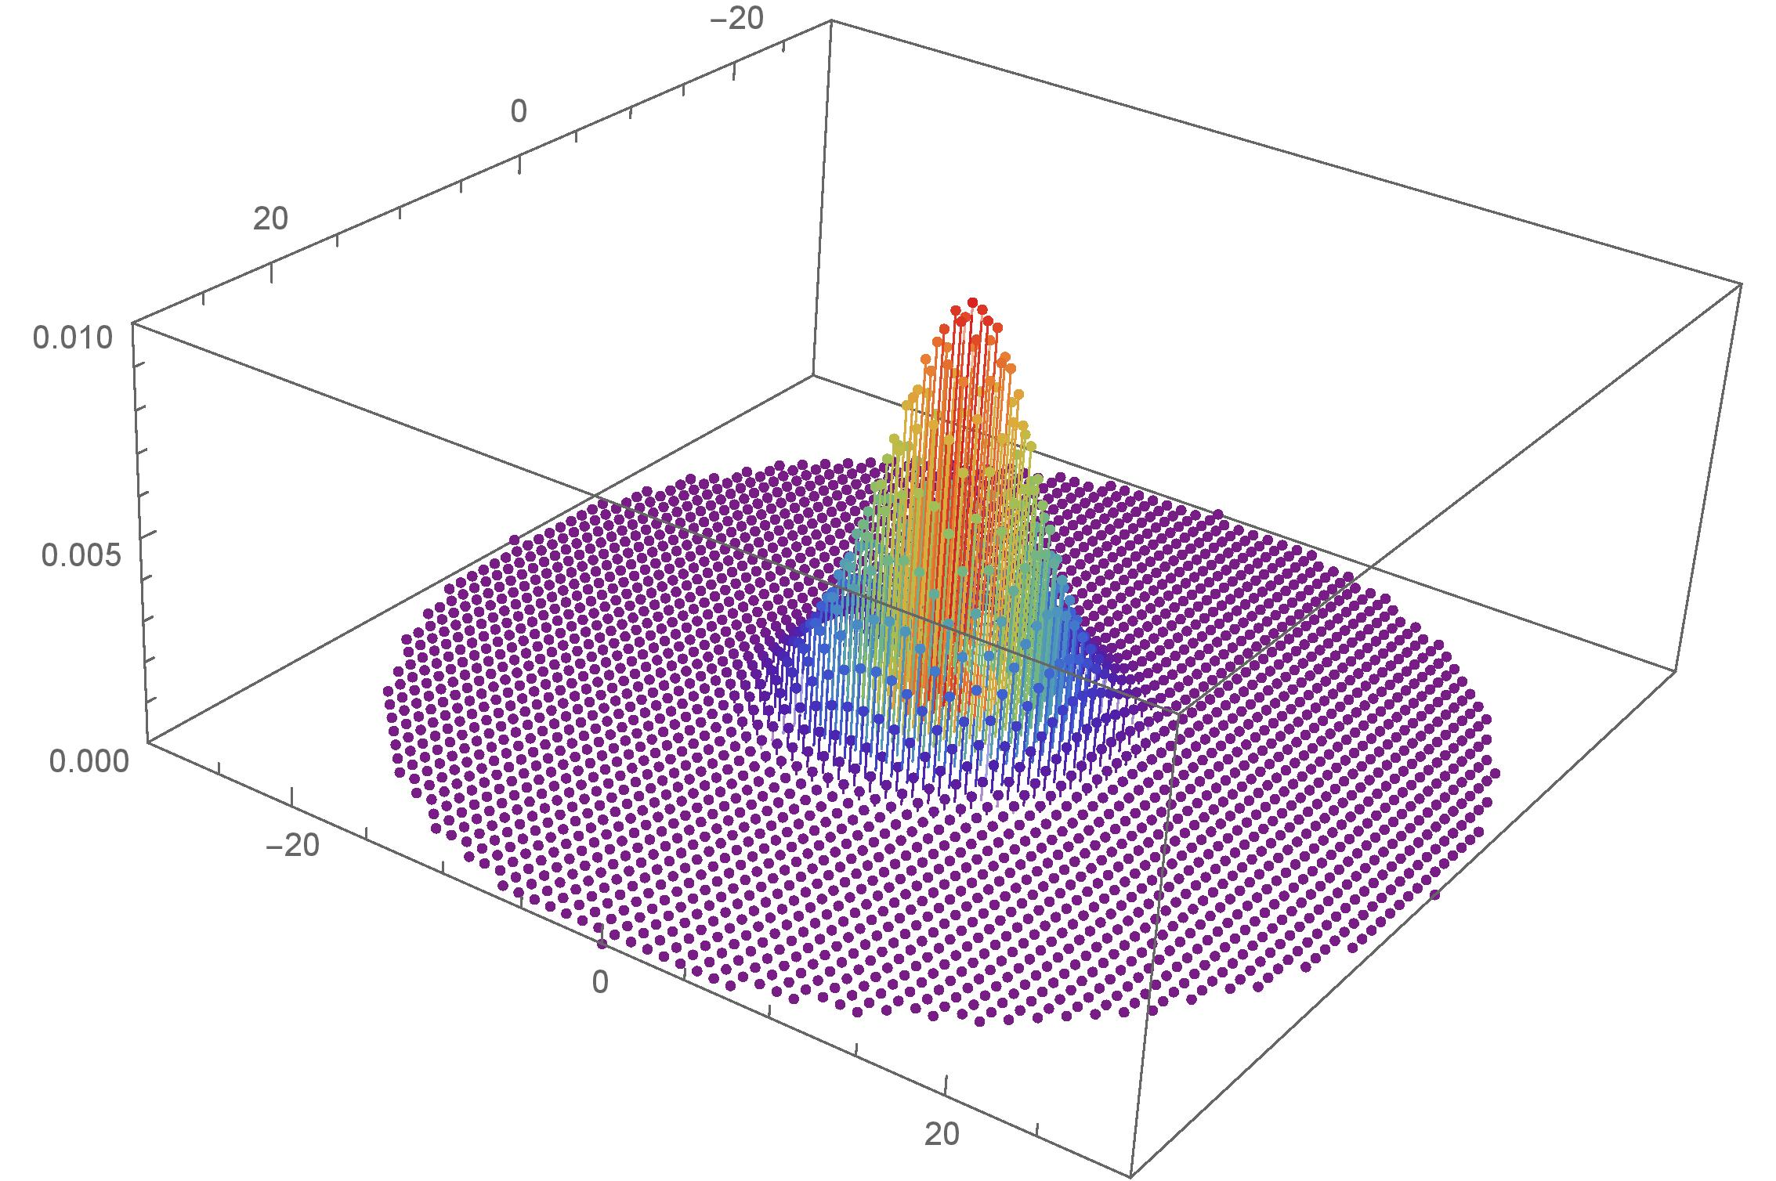
Discrete Gaussian Distribution
Notes:
6:30-8:30
Aharonov and Regev use the periodic Gaussian function. You can see how oracle access to this can be helpful.

Slide 12
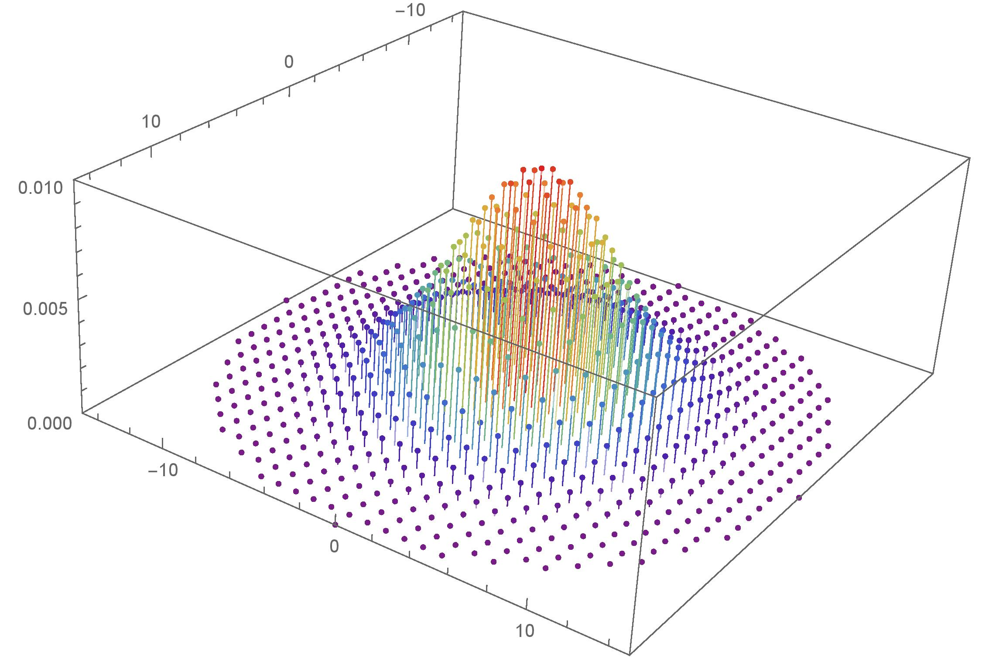
Discrete Gaussian Distribution
Notes:
6:30-8:30
Aharonov and Regev use the periodic Gaussian function. You can see how oracle access to this can be helpful.

Slide 13
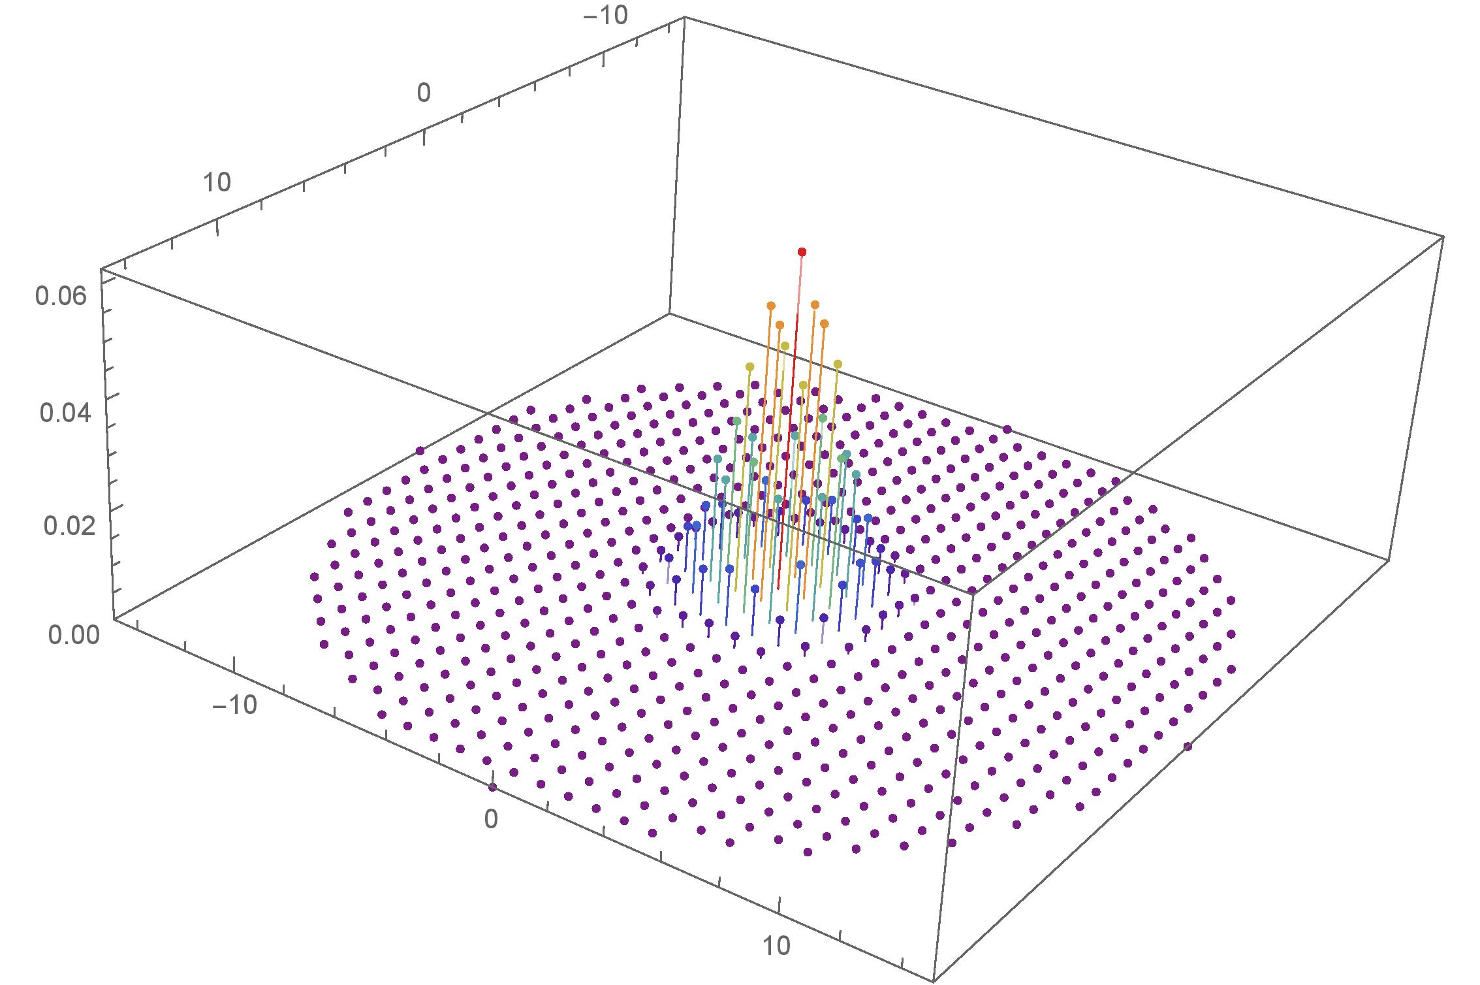
Discrete Gaussian Distribution
Notes:
6:30-8:30
Aharonov and Regev use the periodic Gaussian function. You can see how oracle access to this can be helpful.

Slide 14
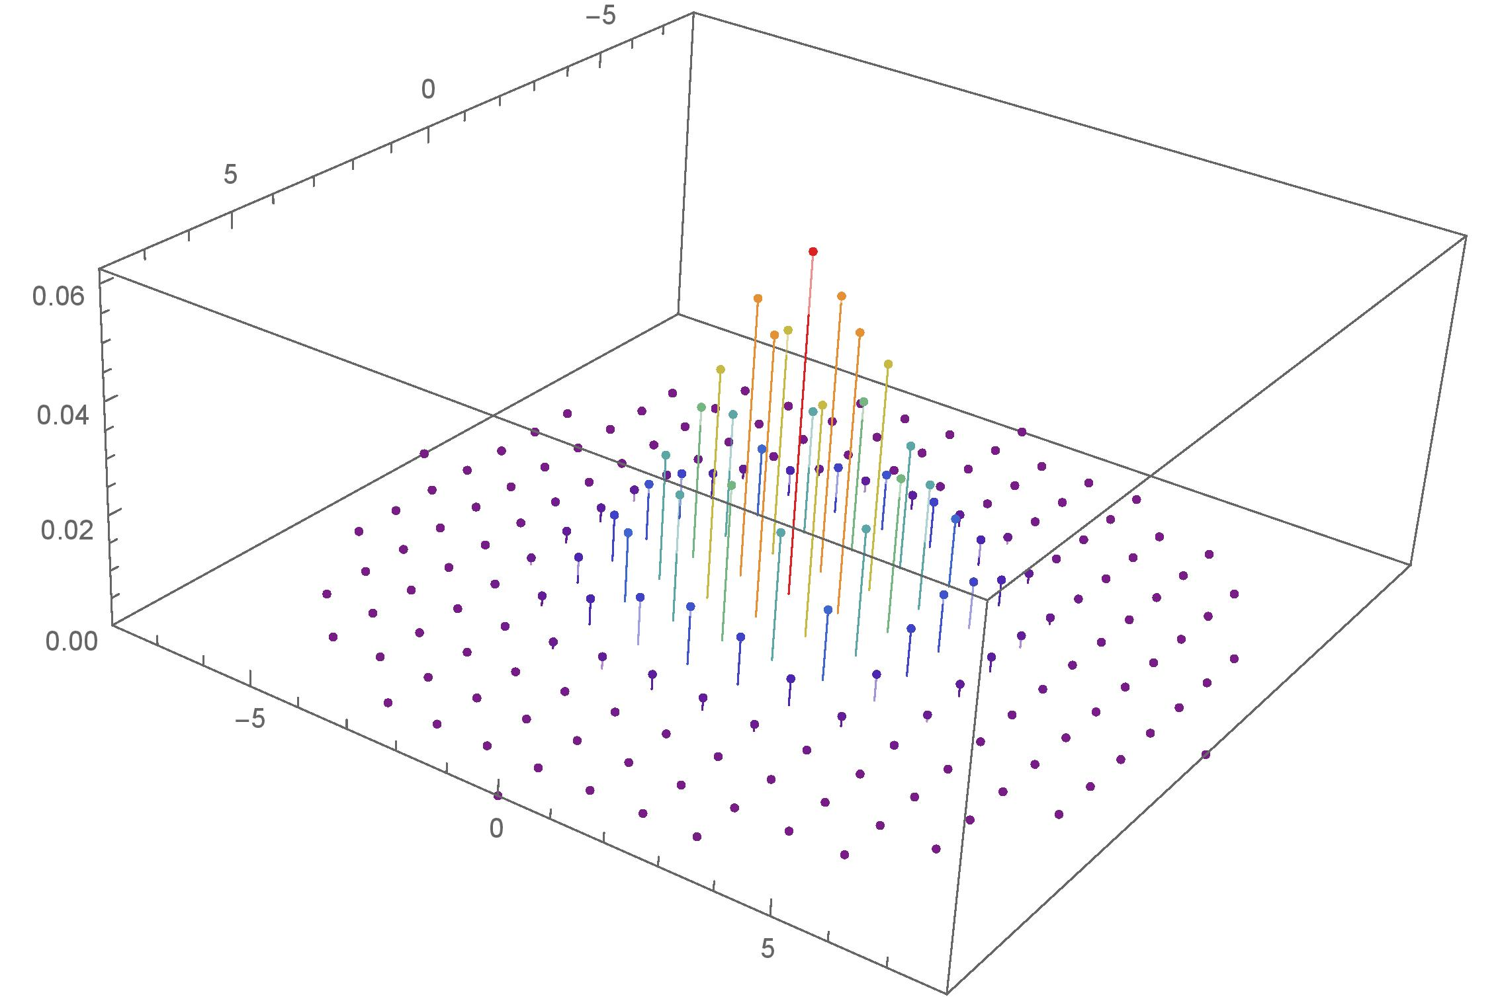
Discrete Gaussian Distribution
Notes:
6:30-8:30
Aharonov and Regev use the periodic Gaussian function. You can see how oracle access to this can be helpful.

Slide 15
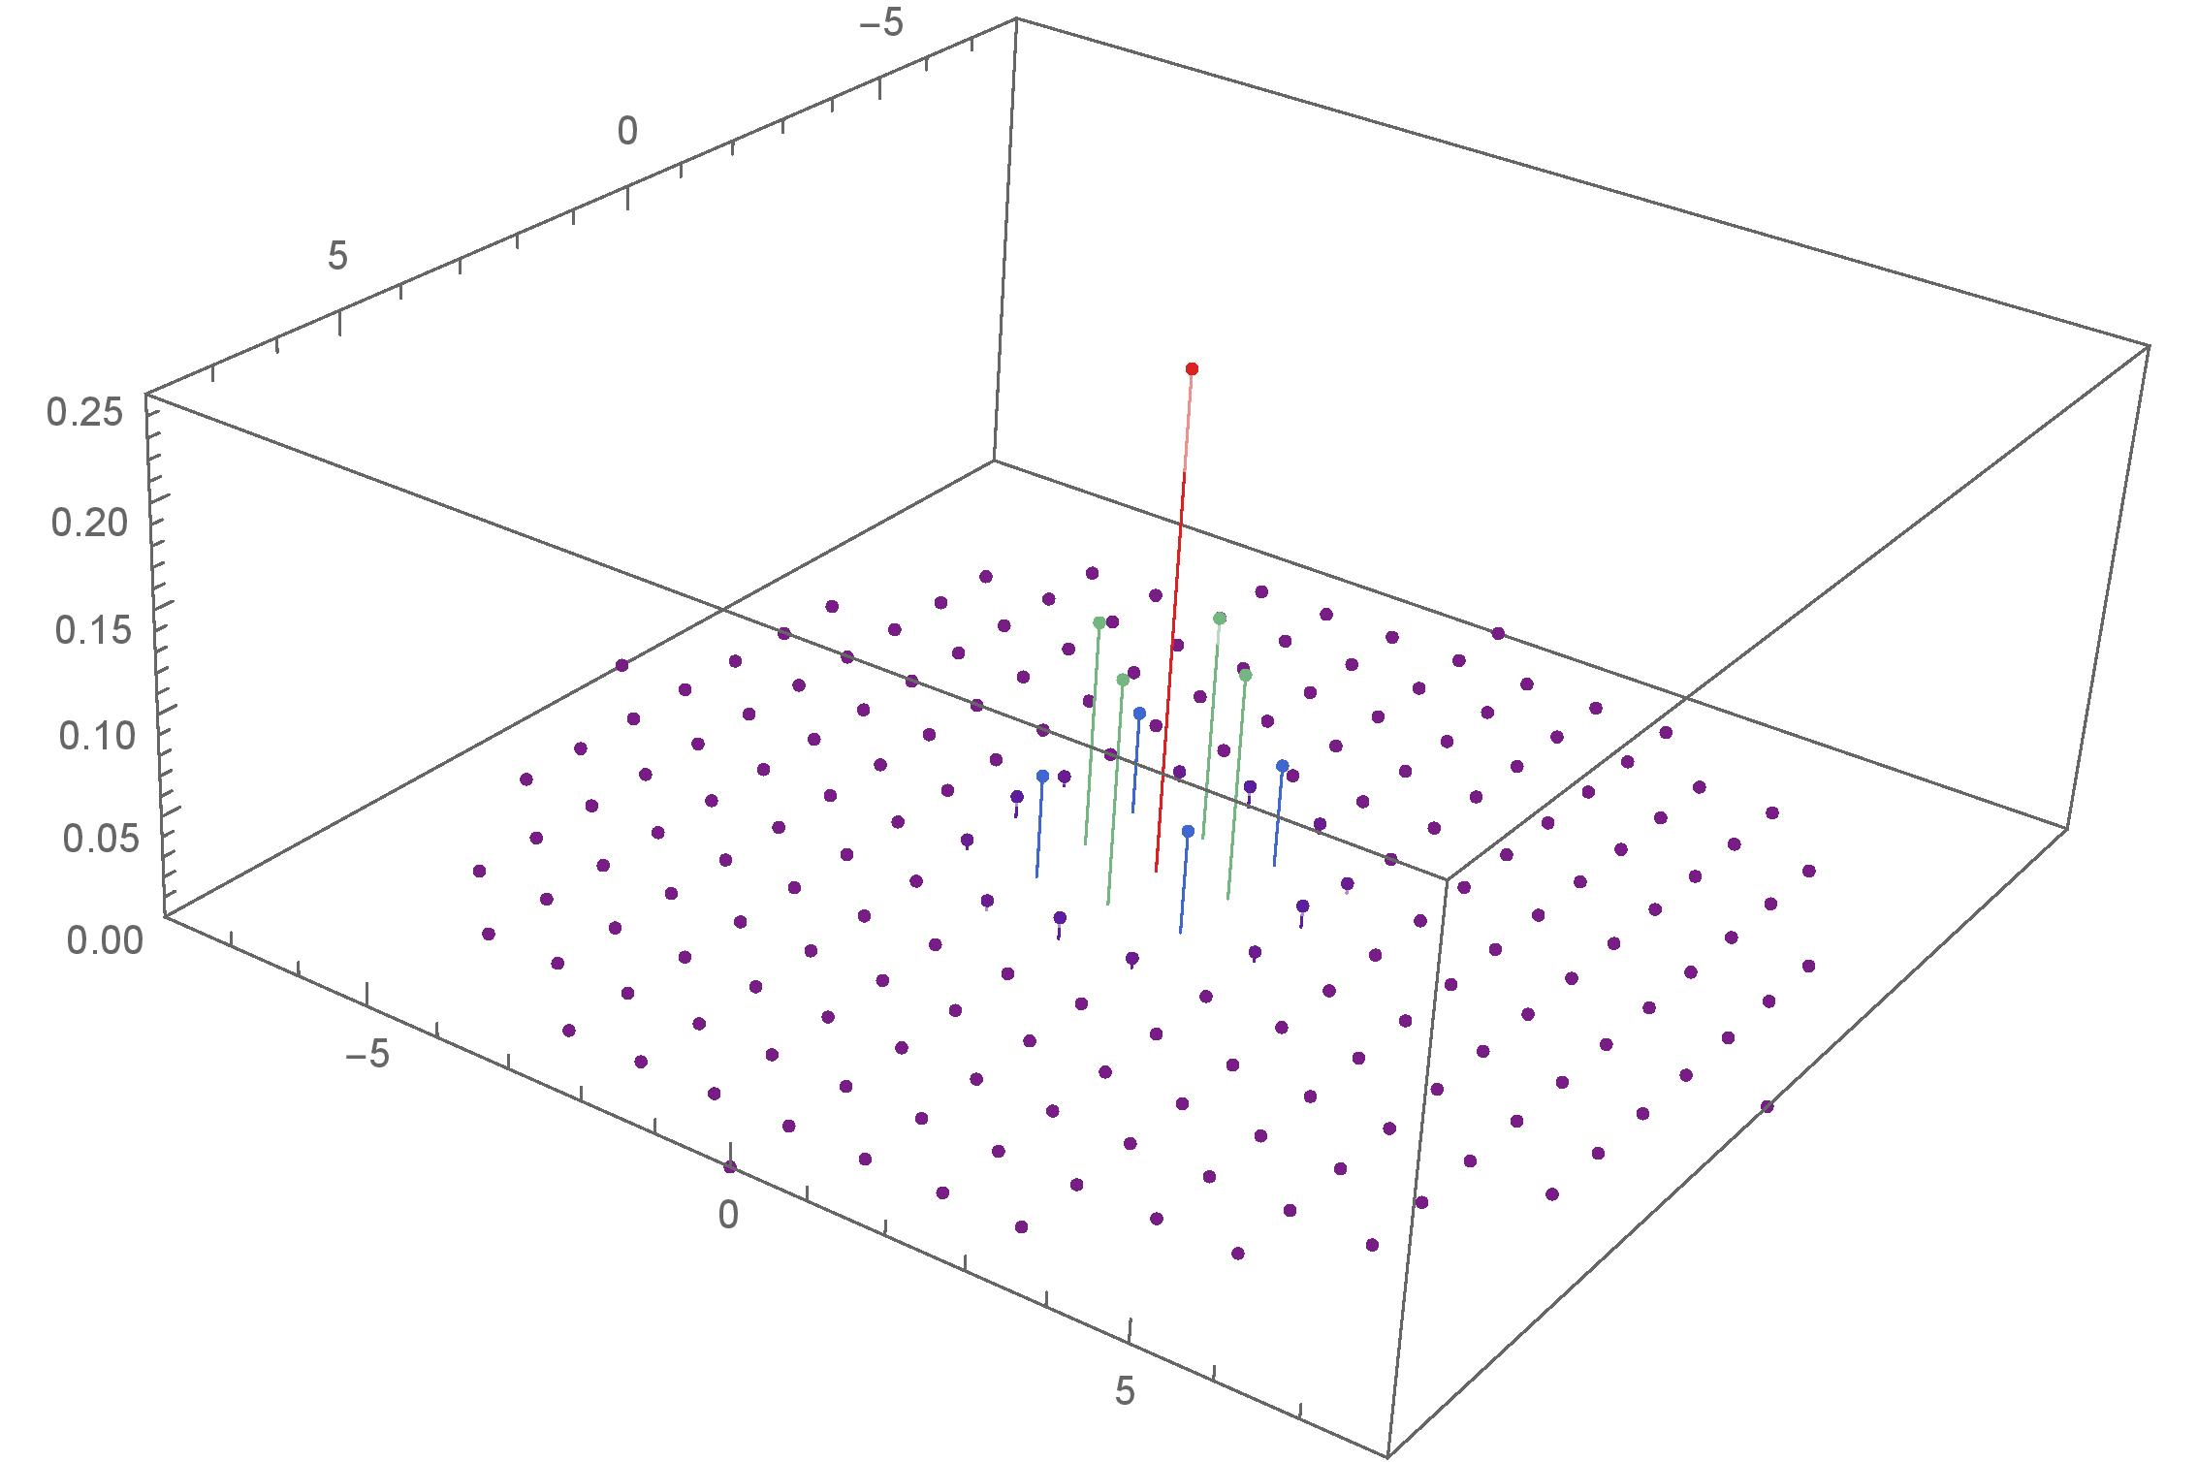
Discrete Gaussian Distribution
Notes:
6:30-8:30
Aharonov and Regev use the periodic Gaussian function. You can see how oracle access to this can be helpful.

Slide 16
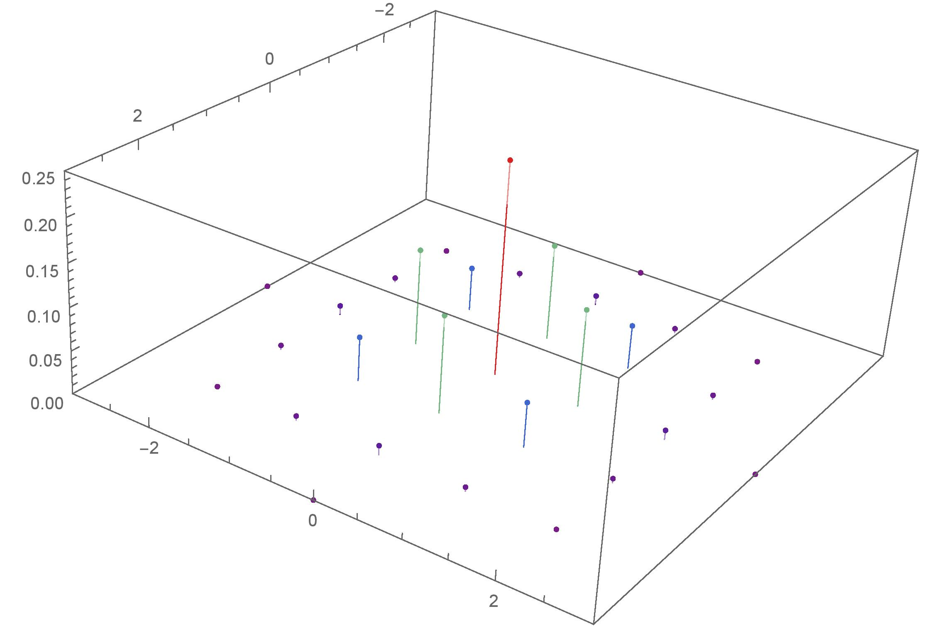
Discrete Gaussian Distribution
Notes:
6:30-8:30
Aharonov and Regev use the periodic Gaussian function. You can see how oracle access to this can be helpful.

Slide 17
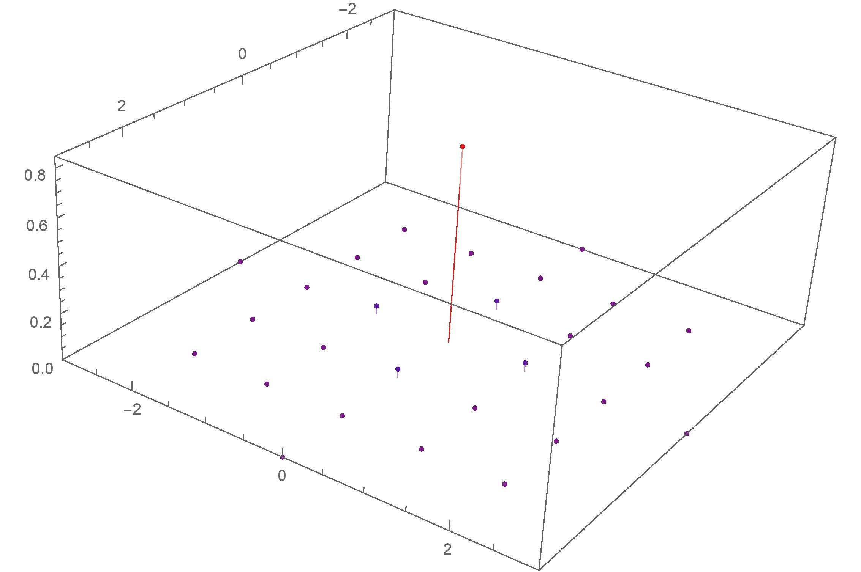
Discrete Gaussian Distribution
Notes:
6:30-8:30
Aharonov and Regev use the periodic Gaussian function. You can see how oracle access to this can be helpful.

Slide 18
Discrete Gaussian Distribution
shortest vector!
If we can obtain “enough” samples from the discrete Gaussian with the “right” (small) parameter, then we can solve SVP.
Notes:
6:30-8:30
Aharonov and Regev use the periodic Gaussian function. You can see how oracle access to this can be helpful.

Slide 19
Discrete Gaussian Distribution
We need at most ${1.38}^{n}$ vectors with $s≈λ_{1}\left(ℒ\right)/\sqrt{n}$ [KL78].
$D_{ℒ,s}$ is very well-studied for very high parameters, $s≿λ_{n}(ℒ)$, i.e. above the “smoothing parameter” of the lattice.
[Kle00, GPV08] show how to sample in this regime in polynomial time.
(Previously could not do much better, even in exponential time.)

Slide 20
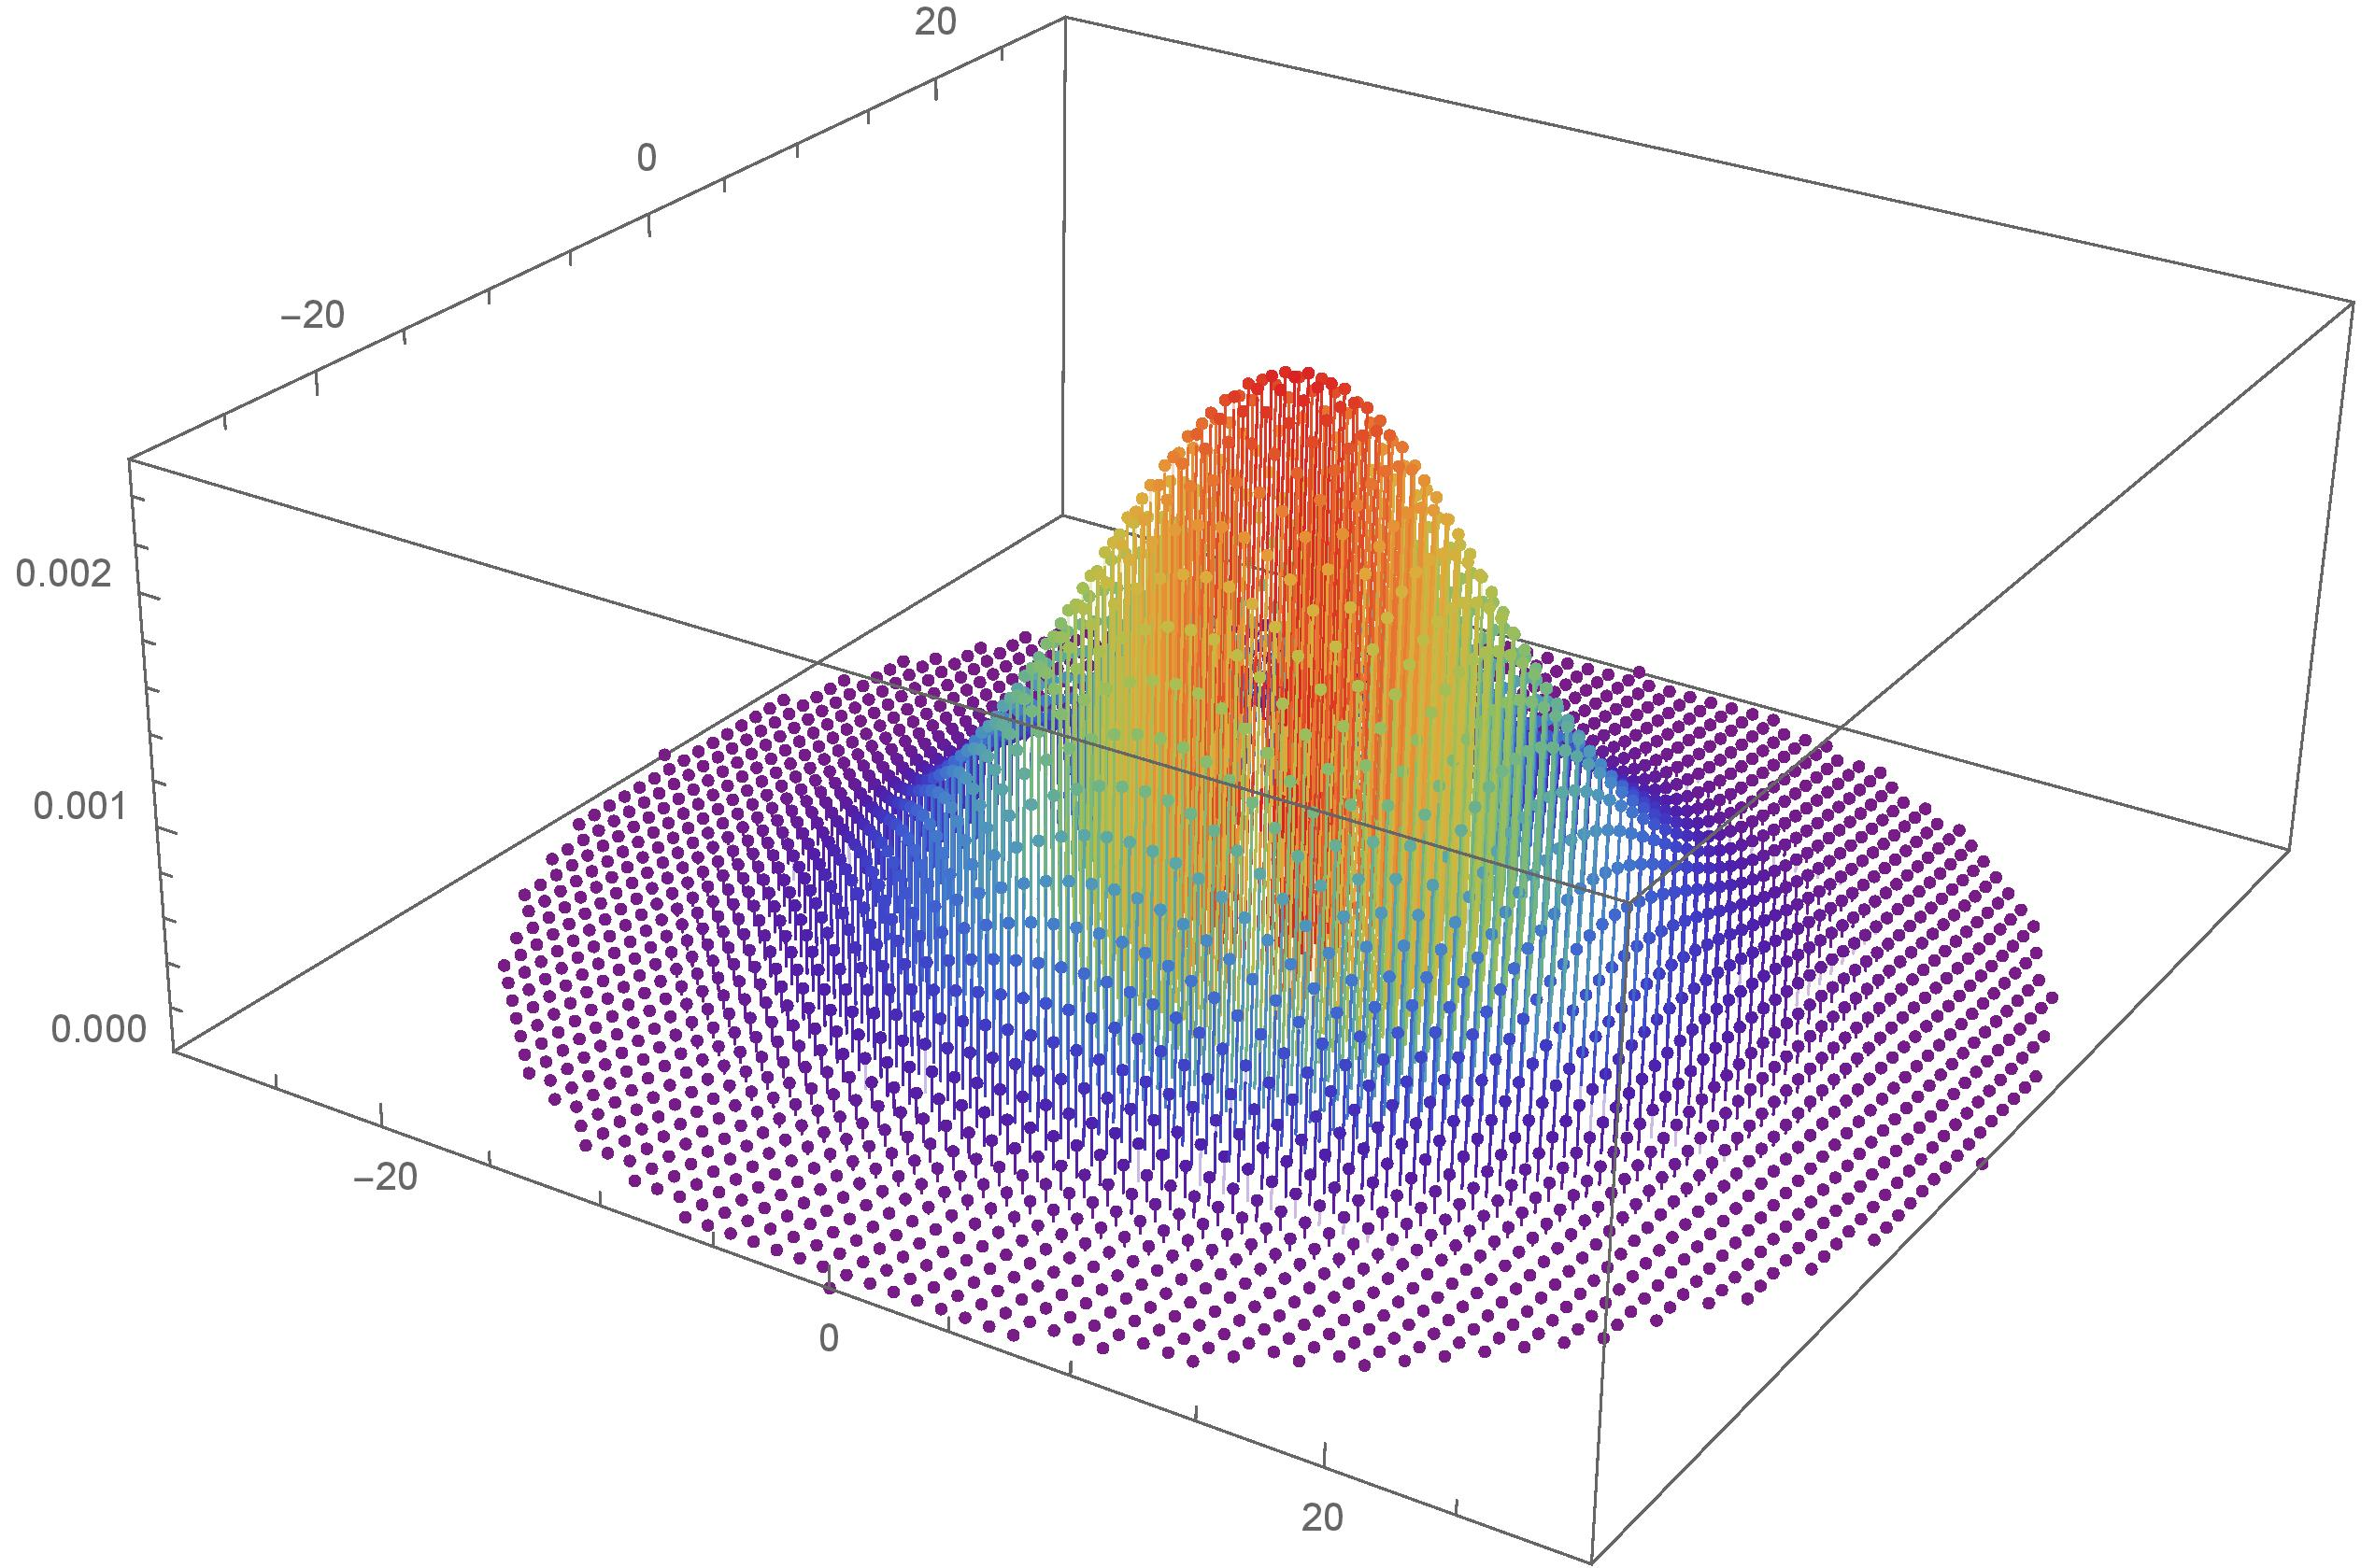
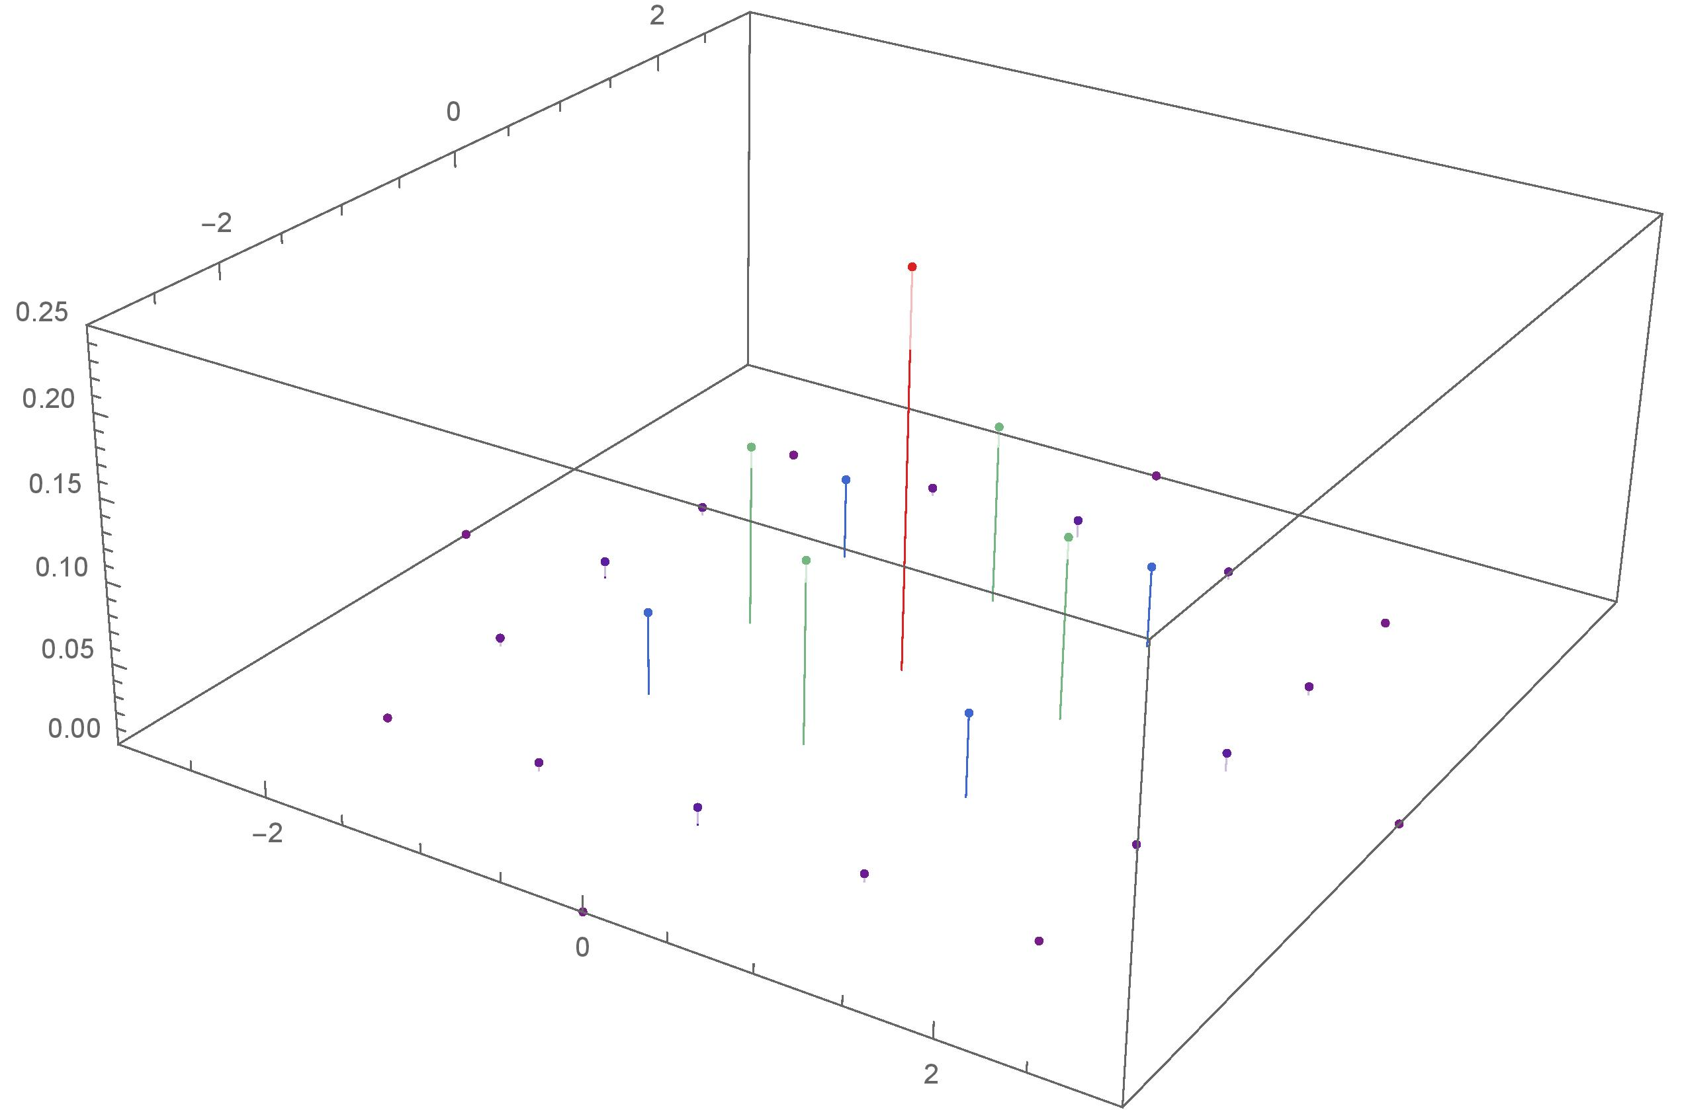
Discrete Gaussian Distribution
Easy
Hard
[Kle00, GPV08]
Our goal
Can we use samples from the LHS to get samples from the RHS?
Notes:
6:30-8:30
Aharonov and Regev use the periodic Gaussian function. You can see how oracle access to this can be helpful.

Slide 21
Discrete Gaussian Distribution
=
2
Notes:
6:30-8:30
Aharonov and Regev use the periodic Gaussian function. You can see how oracle access to this can be helpful.

Slide 22
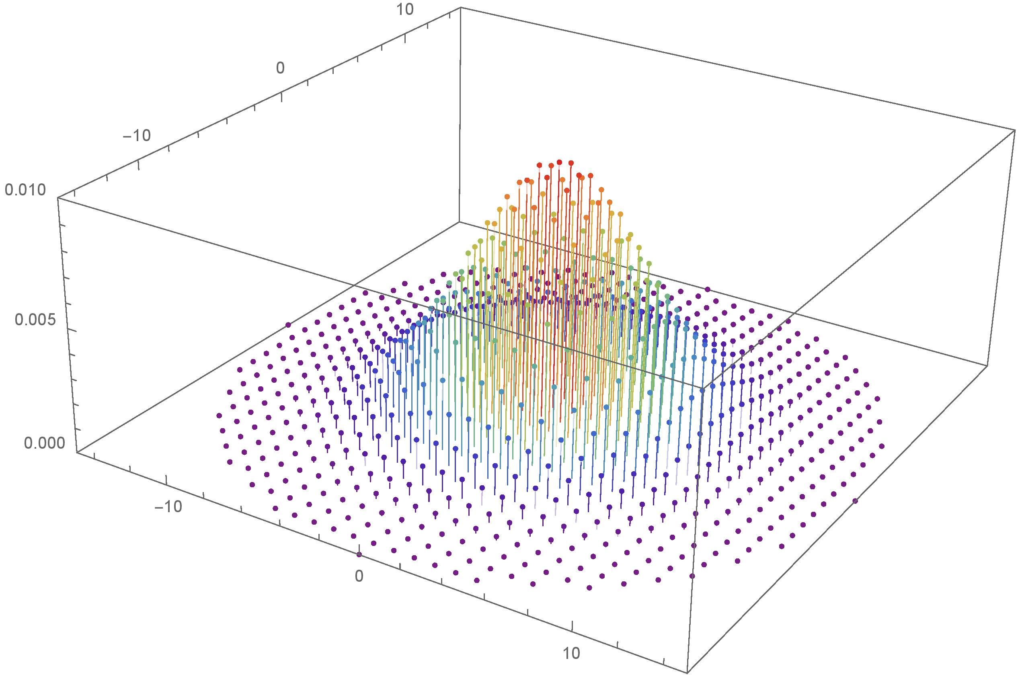
Discrete Gaussian Distribution
?
=
2
Notes:
6:30-8:30
Aharonov and Regev use the periodic Gaussian function. You can see how oracle access to this can be helpful.

Slide 23
Discrete Gaussian Distribution
0
Notes:
6:30-8:30
Aharonov and Regev use the periodic Gaussian function. You can see how oracle access to this can be helpful.

Slide 24
Converting Gaussian Vectors
What if we condition on the result being in the lattice?
Progress!
Unfortunately, this requires us to throw out a lot of vectors.
We only keep one from every $≈2^{n}$ vectors each time we do this,
leading to a very slow algorithm!
Notes:
6:30-8:30
Aharonov and Regev use the periodic Gaussian function. You can see how oracle access to this can be helpful.

Slide 25
Converting Gaussian Vectors
+
=
2
Notes:
6:30-8:30
Aharonov and Regev use the periodic Gaussian function. You can see how oracle access to this can be helpful.

Slide 26
Converting Gaussian Vectors
?
+
=
2
Notes:
6:30-8:30
Aharonov and Regev use the periodic Gaussian function. You can see how oracle access to this can be helpful.

Slide 27
Converting Gaussian Vectors
0
Notes:
6:30-8:30
Aharonov and Regev use the periodic Gaussian function. You can see how oracle access to this can be helpful.

Slide 28
Converting Gaussian Vectors
What about the average of two discrete Gaussian vectors conditioned on the result being in the lattice?
Notes:
6:30-8:30
Aharonov and Regev use the periodic Gaussian function. You can see how oracle access to this can be helpful.

Slide 29
Converting Gaussian Vectors
When do we have ?
We have $\frac{y_{1}+y_{2}}{2}∈ℒ$ if and only if
$y_{1},y_{2}$ are in the same coset of $2ℒ$ .
(Note that there are $2^{n}$ cosets)
Notes:
6:30-8:30
Aharonov and Regev use the periodic Gaussian function. You can see how oracle access to this can be helpful.

Slide 30
Converting Gaussian Vectors
What about the average of two discrete Gaussian vectors conditioned on the result being in the lattice?
Notes:
6:30-8:30
Aharonov and Regev use the periodic Gaussian function. You can see how oracle access to this can be helpful.

Slide 31
Converting Gaussian Vectors
$$ℒ^{†}=\{\left(y_{1},y_{2}\right) :y_{1}≡y_{2} \left(mod 2ℒ\right)\}$$
$$ℒ×ℒ$$
What about the average of two discrete Gaussian vectors conditioned on the result being in the lattice?
Notes:
6:30-8:30
Aharonov and Regev use the periodic Gaussian function. You can see how oracle access to this can be helpful.

Slide 32
Converting Gaussian Vectors
$$avg\left(y_{1},y_{2}\right)=(\frac{y_{1}+y_{2}}{2}, \frac{y_{1}−y_{2}}{2})$$
What about the average of two discrete Gaussian vectors conditioned on the result being in the lattice?
Notes:
6:30-8:30
Aharonov and Regev use the periodic Gaussian function. You can see how oracle access to this can be helpful.

Slide 33
Converting Gaussian Vectors
$$avg\left(ℒ^{†}\right)$$
$$= ℒ×ℒ$$
What about the average of two discrete Gaussian vectors conditioned on the result being in the lattice?
Notes:
6:30-8:30
Aharonov and Regev use the periodic Gaussian function. You can see how oracle access to this can be helpful.

Slide 34
Converting Gaussian Vectors
$$avg\left(ℒ^{†}\right)=ℒ×ℒ$$
If we sample $y_{1},y_{2}\sim D_{ℒ,s}$,
then their average will be distributed as $D_{ℒ,s/{\sqrt{2}}}$,
if we condition on the result being in the lattice.
$$\left\|avg\left(y_{1},y_{2}\right)\right\|=\left\|\frac{y_{1}+y_{2}}{2}, \frac{y_{1}−y_{2}}{2}\right\|={\left\|{(y}_{1},y_{2})\right\|}/{\sqrt{2}}$$
$$\left(y_{1},y_{2}\right)∼D_{ℒ^{†}}⇒avg\left(y_{1},y_{2}\right)∼D_{ℒ×ℒ, s/{\sqrt{2}}}$$
Progress!
Notes:
6:30-8:30
Aharonov and Regev use the periodic Gaussian function. You can see how oracle access to this can be helpful.

Slide 35
Stitching a Discrete Gaussian Together
$$\underset{y_{1},y_{2}\sim D_{ℒ,s}}{Pr}\left[\frac{y_{1}+y_{2}}{2}=y | \frac{y_{1}+y_{2}}{2}∈ℒ\right]$$
$$∝\sum_{c∈ℒ(mod 2ℒ)}{ }$$
$$\operatorname{Pr}{{\left[D_{ℒ,s}∈c\right]}^{2}}\underset{y_{1},y_{2}\sim D_{2ℒ+c,s}}{Pr}\left[\frac{y_{1}+y_{2}}{2}=y \right]$$
Generating a single $D_{𝓛,s/{\sqrt{2}}}$ sample:
Sample $c∈ℒ (mod 2ℒ)$ with probability $∝Pr{\left[D_{ℒ,s}∈c\right]}^{2}$.
Output $(Y_{1}+Y_{2})/2$ where $Y_{1},Y_{2}∼$ $D_{2ℒ+c,s}$.

Slide 36
Discrete Gaussian Combiner
Input: $Y_{1},…,Y_{M}$ iid $D_{ℒ,s}$ samples ($M≈2^{n})$
“Bucket” samples according to their coset $(mod 2ℒ)$.
Repeat many times:
Sample coset $c$ with probability $∝Pr{\left[D_{ℒ,s}∈c\right]}^{2}$.
Output $(Y_{i}+Y_{j})/2$, for $Y_{i},Y_{j}∈c$.
Remove $Y_{i},Y_{j}$ from list.
Don’t have access to
this distribution!

Slide 37
Rejection Sampling
Achieving $∝Pr{\left[D_{𝓛,s}∈c\right]}^{2}$:
First Pass:
Sample $c∼D_{ℒ,s} (mod 2ℒ)$.
Accept $c$ with probability $Pr⁡[D_{ℒ,s}∈c]$ o/w reject.
Implementation:
Sample $Y_{1}∼D_{ℒ,s}$ and let $c$ be $Y_{1} (mod 2ℒ)$.
Sample $Y_{2}∼D_{ℒ,s}$.
Output $c$if $Y_{1}≡Y_{2} (mod 2ℒ)$.
Same as trivial strategy!

Slide 38
Rejection Sampling
Achieving $∝Pr{\left[D_{𝓛,s}∈c\right]}^{2}$:
Second Try:
Sample $c∼D_{ℒ,s} (mod 2ℒ)$.
Accept $c$ with probability $\frac{\operatorname{Pr}\left[D_{ℒ,s}∈c\right]}{p_{max}}$ o/w reject,
where
$$p_{max}=\max_{b∈ℒ(mod 2ℒ)}{\operatorname{Pr}{[D_{ℒ,s}∈b]}}$$
Implementation: ???

Slide 39
Discrete Gaussian Combiner
Input: $Y_{1},…,Y_{M}$ iid $D_{ℒ,s}$ samples ($M≈2^{n})$
Use first $M/6$ samples to estimate $p_{max}$.
$$1$$ | $$…$$ | $$Mp_{max}/3$$
$$ℒ(mod 2ℒ)$$
$2^{n}$ buckets
# samples in each bucket
First $1/{p_{max}}$ samples
$$⋯$$
Last $1/{p_{max}}$ samples

Slide 40
Discrete Gaussian Combiner
Input: $Y_{1},…,Y_{M}$ iid $D_{ℒ,s}$ samples ($M≈2^{n})$
Compute $p_{max}$ and bucket counts (previous slide).
For $i$ ranging over last $M/6$ samples:
Let $c=Y_{i} (mod 2ℒ)$.
Find first unused bucket count $k_{c}$ for coset $c$.
With probability $\min{ \{1, {k_{c}}/{1000}\}}$,
output $(Y_{i}+Y_{j})/2$ where $Y_{j}$ is any sample contributing to $k_{c}$.

Slide 41
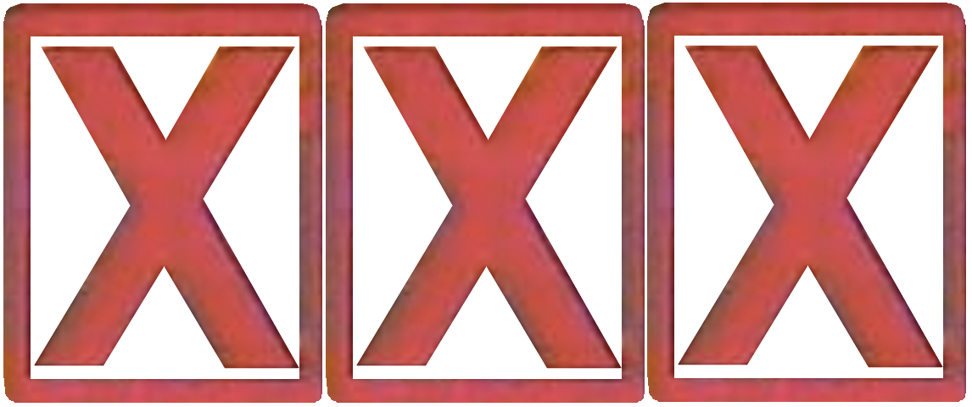
How Many Vectors Do We Get?
$M ≔\#$ input vectors
$\#$ output vectors $≈M⋅ \frac{\sum_{c}{\operatorname{Pr}{{\left[D_{ℒ,s}∈c\right]}^{2}}}}{\max_{b}{\operatorname{Pr}{[D_{ℒ,s}∈b]}}}$
Worst case bound: probability is at least $1/{\sqrt{|support|}}$.
May drop to $M/{2^{n/2}}$ after a single step!
Notes:
6:30-8:30
Aharonov and Regev use the periodic Gaussian function. You can see how oracle access to this can be helpful.

Slide 42
How Many Vectors Do We Get?
$ρ_{s}\left(ℒ\right) ≔ \sum_{y∈ℒ}{e^{−{\left\|y/s\right\|}^{2}}}$
Notes:
6:30-8:30
Aharonov and Regev use the periodic Gaussian function. You can see how oracle access to this can be helpful.

Slide 43
How Many Vectors Do We Get?
$ρ_{s}\left(ℒ\right) ≔ \sum_{y∈ℒ}{e^{−{\left\|y/s\right\|}^{2}}}$
Notes:
6:30-8:30
Aharonov and Regev use the periodic Gaussian function. You can see how oracle access to this can be helpful.

Slide 44
How Many Vectors Do We Get?
Recall that we only need ${1.38}^{n}$ samples to solve SVP!
Setting $M≈2^{n}$ gives
Notes:
6:30-8:30
Aharonov and Regev use the periodic Gaussian function. You can see how oracle access to this can be helpful.

Slide 45
Final Algorithm
SVPSolver($ℒ)$
Use GPV to get $≈2^{n}$ samples from $D_{ℒ,s}$ with $s ≫λ_{1}(ℒ)$.
Run the (“squaring”) discrete Gaussian combiner on the result repeatedly.
Output $≈2^{n}$ samples from $D_{ℒ,s}$ with $s≈{λ_{1}(ℒ)}/{\sqrt{n}}$. .
We can then simply output a shortest non-zero vector from our samples.
Notes:
6:30-8:30
Aharonov and Regev use the periodic Gaussian function. You can see how oracle access to this can be helpful.

Slide 46
Summary of Results
Discussed in this talk
$2^{n+o(n)}$ algorithm for SVP.
(sample $2^{n/2}$ vectors from $D_{ℒ,s}$ for any $s$ in time $2^{n+o(n)}$ time)
Additional results from this work
$2^{n/{2+o(n)}}$ -time algorithm for sampling $2^{n/2}$ vectors above smoothing.
$1.93$-GapSVP.
$.422$-BDD.
Recent addition
$2^{n+o(n)}$ time algorithm for CVP. [ADS15]
Sampling from DGS reduces to SVP. [Ste16]
(not equivalence because the reduction in the other direction requires ${1.38}^{n}$ $D_{ℒ,s}$ samples.)

Slide 47
Open Questions/Future Work
Other uses for discrete Gaussian sampling at arbitrary parameters?
Faster discrete Gaussian sampling?
Is centered discrete Gaussian sampling NP-hard?
Strong lower bounds for CVP/SVP assuming SETH (or something similar)?
Notes:
6:30-8:30
Aharonov and Regev use the periodic Gaussian function. You can see how oracle access to this can be helpful.

Slide 48
Thanks!
Notes:
6:30-8:30
Aharonov and Regev use the periodic Gaussian function. You can see how oracle access to this can be helpful.

