Slide 1
Elementary Closures in Nonlinear Integer Programming
Daniel Dadush – CWI
Santanu Dey – Georgia Tech
Juan Pablo Vielma – MIT

Slide 2
Cutting Planes for Integer Linear Programs
$\min{ctx}$
$\text{s}\text{.}\text{t}\text{. }Ax ≤b$
$$x ε ℤn$$
$(c,A,b rational)$
Cutting plane: valid inequality for integer hull.
Use to get tighter relaxations – important component in practical solvers.
Very well developed theory within ILP..
$$K$$

Slide 3
Mixed and Non Linear Models?
$\text{m}\text{in}{f\left(x,y\right)}$
$\text{s}\text{.}\text{t}\text{. }gi(x,y) ≤ 0 ∀ i$
$$x ε ℤn, y ε ℝl$$
Many other important Integer Programming models.
Substantial Progress in recent years:
Solvers, Complexity, Heuristics, etc.
Cutting planes poorly understood, even when objective and constraints are convex.
$$K$$

Slide 4
Convex Integer Programming
$\text{m}\text{in}{f\left(x\right)}$
$\text{s}\text{.}\text{t}\text{. }gi\left(x\right)≤ 0 ∀ i$
$$x ε ℤn$$
$(f, g_{i}^{′}s convex)$
Goal: understand basic behavior for fundamental classes of cutting planes.
Issue: most current theory depends heavily on rational linear structure.
Plan: Develop stronger / more robust Analytical Tools.
$$K$$

Slide 5
Chvátal-Gomory (CG) Cuts
$K⊆ℝn$ compact convex
Support function of $K$:
$$σK\left(v\right)={\text{max}}_{x ε K}\left\langle v,x\right\rangle$$
For $v ε ℤn, \text{CG}$ cut:
$\text{CG}\left(K,v\right)=\{x:\left\langle v,x\right\rangle ≤ \left\lfloor σK\left(v\right)\right\rfloor \}$
$$v$$
$$x1+x2≤4.8$$
$$v$$
$$x1+x2≤4$$
$$K$$
$$v$$
$$x1+x2≤0$$

Slide 6
Chvátal-Gomory Closure
$K⊆ℝn$ compact convex
$\text{CG}$ closure of $K$:
$$\text{CG}\left(K\right)= \bigcap_{v ε ℤn}{\text{CG}(K,v)}$$
$$v1$$
$$v6$$
$$K$$
$$v2$$
$$v3$$
$$v5$$
$$v4$$

Slide 7
Chvátal-Gomory Closure
$K⊆ℝn$ compact convex
$\text{CG}$ closure of $K$:
$$\text{CG}\left(K\right)= \bigcap_{v ε ℤn}{\text{CG}(K,v)}$$
$$v1$$
$$v6$$
$$K$$
$$v2$$
$$v3$$
$$v5$$
$$v4$$

Slide 8
Chvátal-Gomory Closure
$K⊆ℝn$ compact convex
$\text{CG}$ closure of $K$:
$$\text{CG}\left(K\right)= \bigcap_{v ε ℤn}{\text{CG}(K,v)}$$
Chvátal `73: Converge to integer hull
after finitely many iterations.
$$v1$$
$$v6$$
$$\text{CG}(K)$$
$$v2$$
$$v3$$
$$v5$$
$$v4$$

Slide 9
Split Cuts
$K⊆ℝn$ compact convex
Elementary disjunction:
$v x≤π or v x≥π+1$
$v ε ℤ^{n}, π ε ℤ$
$$x1+x2≥4$$
$$K$$
$$x1+x2≤3$$

Slide 10
Split Cuts
$K⊆ℝn$ compact convex
Elementary disjunction:
$v x≤π or v x≥π+1$
$v ε ℤ^{n}, π ε ℤ$
Split Cut:
$SC\left(K,v,π\right)=conv(K∩\left\{v x≤π\right\}∪K∩\left\{v x≥π+1\right\})$
$$x1+x2≥4$$
$$K$$
$$x1+x2≤3$$

Slide 11
Split Closure
$K⊆ℝn$ compact convex
Split Closure:
$$SC\left(K\right)=\bigcap_{vεℤ^{n}, πεℤ }{SC}(K,v,π)$$
$$K$$

Slide 12
Split Closure
$K⊆ℝn$ compact convex
Split Closure:
$$SC\left(K\right)=\bigcap_{vεℤ^{n}, πεℤ }{SC}(K,v,π)$$
$$CG(K)$$
$$x1+x2≥2$$
$$x1+x2≤1$$

Slide 13
Split Closure
$K⊆ℝn$ compact convex
Split Closure:
$$SC\left(K\right)=\bigcap_{vεℤ^{n}, πεℤ }{SC}(K,v,π)$$
$$SC(K)$$

Slide 14
Generating the CG Closure
Schrijver 1980
Theorem: If $K=\{x ϵ ℝ^{n}:Ax≤b\}$ is a rational polyhedron, then $\text{C}\text{G}(K)$ is finitely generated.
$$\text{C}\text{G}\left(K\right)= \bigcap_{v ε ℤn}{\text{C}\text{G}(K,v)}$$
$$v1$$
$$v4$$
$$K$$
$$v2$$
$$v3$$

Slide 15
Generating the CG Closure
Schrijver 1980
Theorem: If $K=\{x ϵ ℝ^{n}:Ax≤b\}$ is a rational polyhedron, then $\text{C}\text{G}(K)$ is finitely generated.
$$\text{C}\text{G}\left(K\right)= \bigcap_{v ε ℤn}{\text{C}\text{G}(K,v)}$$
$$v1$$
$$v4$$
$$\text{CG}(K)$$
$$v2$$
$$v3$$

Slide 16
Generating the CG Closure
Schrijver 1980
Theorem: If $K=\{x ϵ ℝ^{n}:Ax≤b\}$ is a rational polyhedron, then $\text{C}\text{G}(K)$ is finitely generated.
Question:
Is this true in general?
$$v1$$
$$v4$$
$$\text{CG}(K)$$
$$v2$$
$$v3$$

Slide 17
Generating the CG Closure
Schrijver 1980
Theorem: If $K=\{x ϵ ℝ^{n}:Ax≤b\}$ is a rational polyhedron, then $\text{C}\text{G}(K)$ is finitely generated.
Question:
Is this true in general?
Not always.
$$\sqrt{2}x1 − x2 ≥ .1$$
$$x2 ≥0$$

Slide 18
Generating the Split Closure
Cook, Kannan, Schrijver 1990
Theorem: If $K=\{x ϵ ℝ^{n}:Ax≤b\}$ is a rational polyhedron, then $\text{SC}(K)$ is finitely generated.
$$\text{SC}\left(K\right)= \bigcap_{vεℤ^{n}, πεℤ}{\text{SC}(K,v,π)}$$
$$v1$$
$$v4$$
$$K$$
$$v2$$
$$v3$$

Slide 19
Generating the Split Closure
Cook, Kannan, Schrijver 1990
Theorem: If $K=\{x ϵ ℝ^{n}:Ax≤b\}$ is a rational polyhedron, then $\text{SC}(K)$ is finitely generated.
$$\text{SC}\left(K\right)= \bigcap_{vεℤ^{n}, πεℤ}{\text{SC}(K,v,π)}$$
$$v1$$
$$v4$$
$$\text{SC}(K)$$
$$v2$$
$$v3$$

Slide 20
Generating the Split Closure
Cook, Kannan, Schrijver 1990
Theorem: If $K=\{x ϵ ℝ^{n}:Ax≤b\}$ is a rational polyhedron, then $\text{SC}(K)$ is finitely generated.
Question:
Is the Split Closure always
polyhedral?
No.
$$v1$$
$$v4$$
$\text{SC}(K)$
$$v2$$
$$v3$$

Slide 21
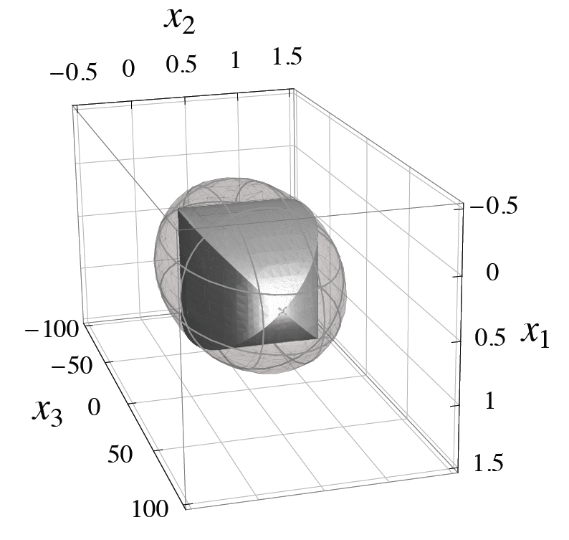
Non Polyhedral Split Closure
D., Dey, Vielma 11
Theorem:
The split closure
of an ellipsoid can
be non polyhedral.

Slide 22
Generating the CG Closure
D., Dey, Vielma 11
Theorem: If $K⊆ℝn$ is compact convex, then $\text{C}\text{G}(K)$ is proper and finitely generated.
$$\text{CG}\left(K\right)= \bigcap_{v ε ℤn}{\text{CG}(K,v)}$$
$$v1$$
$$v4$$
$$K$$
$$v2$$
$$v3$$

Slide 23
Generating the Split Closure
D., Dey, Vielma 11
Theorem: If $K⊆ℝn$ is compact strictly convex, then $\text{S}\text{C}(K)$ is proper and finitely generated.
$$\text{SC}\left(K\right)= \bigcap_{vεℤ^{n}, πεℤ}{\text{SC}(K,v,π)}$$
$K$ is strictly convex if $∂K$ does not
contain lines.
$$v1$$
$$v4$$
$$K$$
$$v2$$
$$v3$$

Slide 24
Generating the CG Closure
D., Dey, Vielma 13
Theorem: If $K⊆ℝn$ is a thin, totally closed convex set with rational polyhedral $rec(K)$, then $\text{C}\text{G}\left(K\right)$ is proper and finitely generated.
$$\text{CG}\left(K\right)= \bigcap_{v ε ℤn}{\text{CG}(K,v)}$$
If $K$ is closed convex with
$\text{CG}\left(K\right)$ proper, non-empty &
rational polyhedral then:
$K$ is thin.
$rec(K)$ is rational polyhedral.
$$v1$$
$$v4$$
$$K$$
$$v3$$

Slide 25
Thin Convex Sets
Definition: Closed convex set $K$ is thin if
$K ⊆ rec\left(K\right)+rB_{2}^{n}$
for some finite radius $r≥0$.
Thin
Not Thin

Slide 26
Thin Convex Sets
Definition: Closed convex set $K$ is thin if
$K ⊆ rec\left(K\right)+rB_{2}^{n}$
for some finite radius $r≥0$.
Lemma: If $rec(K)$ is polyhedral, then $K$ is thin $⇔$
for generators cone$\left(v_{1},…,v_{m}\right)=$ $rec{\left(K\right)}^{∗},$
$\max_{i∈[m]} \max_{x∈K} \left\langle v,x\right\rangle ≤M$
for some constant $M≥0$.

Slide 27
Totally Closed Sets
Definition: A convex set $K⊆ℝ^{n}$ is totally closed if
${Proj}_{W}(K)$ is closed
for any subspace $W$ of $ℝ^{n}$.
Not Totally
Closed
Totally
Closed

Slide 28
Totally Closed Sets
Definition: A convex set $K⊆ℝ^{n}$ is totally closed if
${Proj}_{W}(K)$ is closed
for any subspace $W$ of $ℝ^{n}$.
Thin &
Totally Closed

Slide 29
Totally Closed Sets
Definition: A convex set $K⊆ℝ^{n}$ is totally closed if
${Proj}_{W}(K)$ is closed
for any subspace $W$ of $ℝ^{n}$.
Lemma: If $rec(K)$ is polyhedral, then $K$ is totally closed $⇔$
for every face $F$ of $rec{\left(K\right)}^{∗}$, the projection of
$K$ onto span(F) is closed.

Slide 30
Building the CG Closure
$S⊆ℤ^{n}$ denotes the partial closure.
Achieve Containment: $\text{CG}\left(K,S\right)⊆K$
$$K$$
Most difficult step (trivial for rational polytopes). Need tools from Convex Analysis and Geometry of Numbers.

Slide 31
Building the CG Closure
$S⊆ℤ^{n}$ denotes the partial closure.
Achieve Containment: $\text{CG}\left(K,S\right)⊆K$
Complete the Boundary: $\text{CG}\left(K,S\right)∩∂K⊆CG\left(K\right)∩∂K$
$$CG\left(K,S\right)∩∂K$$
$$K$$
Only a finite number of faces of $K$ need fixing. Use induction on each face.

Slide 32
Building the CG Closure
$S⊆ℤ^{n}$ denotes the partial closure.
Achieve Containment: $\text{CG}\left(K,S\right)⊆K$
Complete the Boundary: $\text{CG}\left(K,S\right)∩∂K⊆CG\left(K\right)∩∂K$
Complete the Closure: Add all cuts separating a vertex of $\text{CG}(K,S)$.
$$δ$$
$$δ$$
$$K$$
$$δ$$
$$δ$$
$$δ$$
All remaining cuts have bounded norm.

Slide 33
Lifting CG cuts
D., Dey, Vielma 11
Theorem: Let $F$ be an exposed face of $K$.
Then $\text{CG}\left(F\right)=\text{CG}\left(K\right)∩F.$
Goal: Lift $\text{CG}(F,v)$ to $K$.
Find $v’$: $\text{CG}(F,v)=\text{CG}(K,v’)$
on “rational” part of $F$.
Remove “irrational” parts
of $F$ using additional $\text{CG}$ cuts.
$$v′$$
$$v′$$
$$v$$
$$v$$
$$F$$
$$v$$
$$v$$
$$K$$

Slide 34
Removing Irrational Parts
Since $F$ is an irrational line segment, a rational polytope contained in $K$ can only intersect $F$ at $0$.
Need CG cuts that remove irrational parts of $F$.
$$(\frac{\sqrt{3}}{2}, \frac{\sqrt{2}}{3})$$
Rational Polytope
$$K$$
$$0$$
$$F$$
$$ℤ^{n}$$

Slide 35
Removing Irrational Parts
Kronecker’s Approximation Theorem
Fractional part is dense.
$$(\frac{\sqrt{3}}{2}, \frac{\sqrt{2}}{3})$$
$$K$$
$$0$$
$$F$$
$$ℤ^{n}$$

Slide 36
Removing Irrational Parts
Integers close to $(\frac{\sqrt{3}}{2}, \frac{\sqrt{2}}{3})$ line give “nearly” same inequality for K.
$$(\frac{\sqrt{3}}{2}, \frac{\sqrt{2}}{3})$$
$$K$$
$$0$$
$$F$$
$$ℤ^{n}$$

Slide 37
Removing Irrational Parts
Use density to find “close” cuts biased towards opposite sides of $F$.
Cuts remove irrational parts of $F$.
$$(\frac{\sqrt{3}}{2}, \frac{\sqrt{2}}{3})$$
$$K$$
$$0$$
$$F$$
$$ℤ^{n}$$

Slide 38
Extending to General Convex Sets
Main Technical Issues:
Can only build CG cuts in integer directions where the objective value is finite.
(need thinness and rational polyhedral recession cone)
To lift CG cuts from faces must show fine continuity properties of the objective function.
(need total closedness)

Slide 39
$$Open Question$$
Is the split closure of a compact convex set finitely generated?

Slide 40
Thank You!

