Slide 1
Faster Deterministic
Volume Estimation in the Oracle Model via Thin Lattice Coverings
Daniel Dadush
Centrum Wiskunde & Informatica

Slide 2

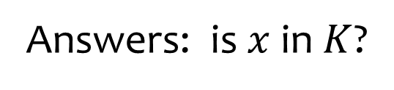
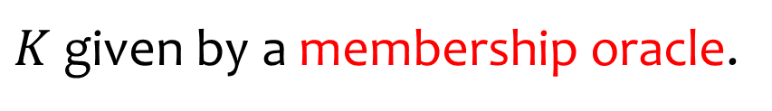

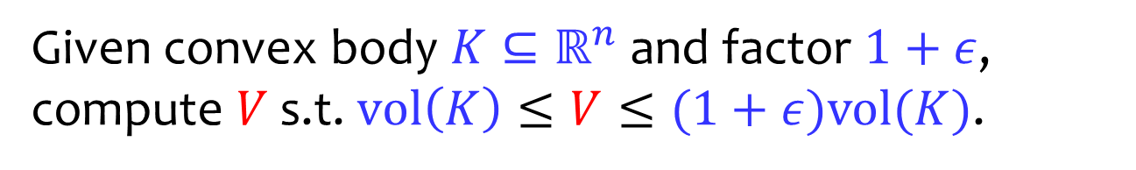
Volume Estimation Problem
Given convex body $K⊆ℝ^{n}$ and factor $1+ε$,
compute $V$ s.t. $vol\left(K\right)≤V≤(1+ε)vol(K)$.
$$K$$
$$x$$
Answers: is $x$ in $K$?
$K$ given by a membership oracle.

Slide 3


Volume Estimation Problem
Given convex body $K⊆ℝ^{n}$ and factor $1+ε$,
compute $V$ s.t. $vol\left(K\right)≤V≤(1+ε)vol(K)$.
$$K$$
$$r$$
$$R$$
Assume appropriate sandwiching guarantees.

Slide 4
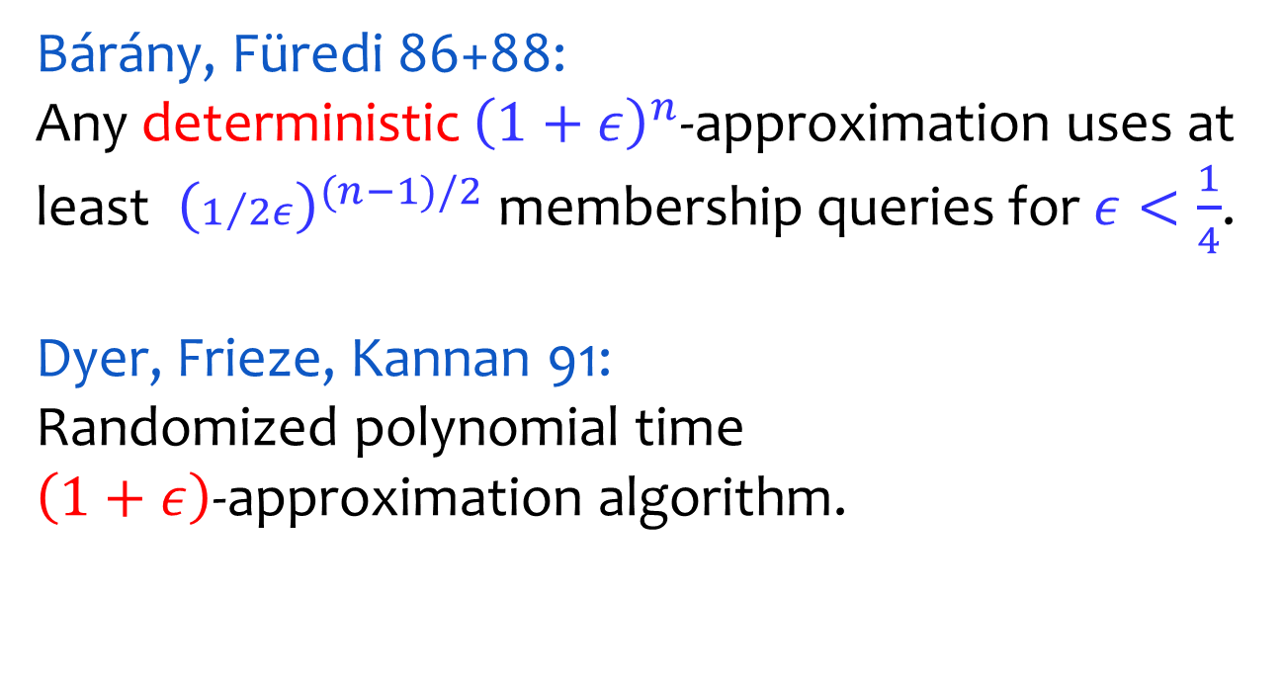

Volume Estimation: Known Bounds
Bárány, Füredi 86+88:
Any deterministic ${\left(1+ε\right)}^{n}$-approximation uses at least ${ \left(1/{2ε}\right)}^{(n−1)/2}$ membership queries for $ε<\frac{1}{4}$.
Dyer, Frieze, Kannan 91:
Randomized polynomial time
$\left(1+ε\right)$-approximation algorithm.
$$K$$

Slide 5
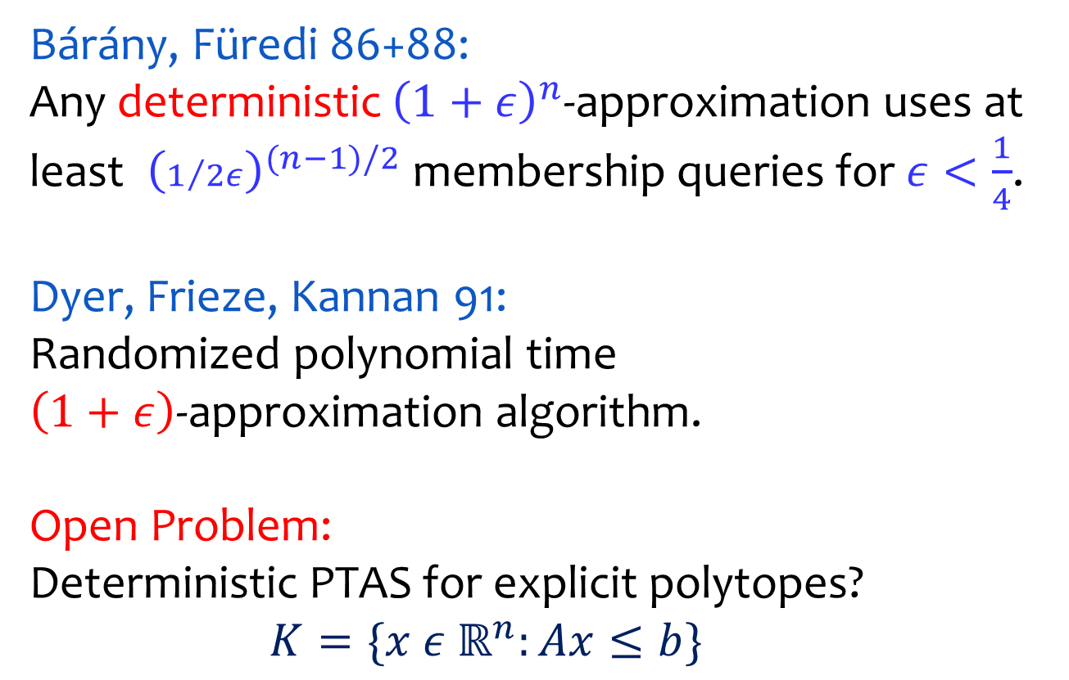
Volume Estimation: Known Bounds
Bárány, Füredi 86+88:
Any deterministic ${\left(1+ε\right)}^{n}$-approximation uses at least ${ \left(1/{2ε}\right)}^{(n−1)/2}$ membership queries for $ε<\frac{1}{4}$.
Dyer, Frieze, Kannan 91:
Randomized polynomial time
$\left(1+ε\right)$-approximation algorithm.
Open Problem:
Deterministic PTAS for explicit polytopes?
$K=\{x ε{ ℝ}^{n}:Ax≤b\}$

Slide 6
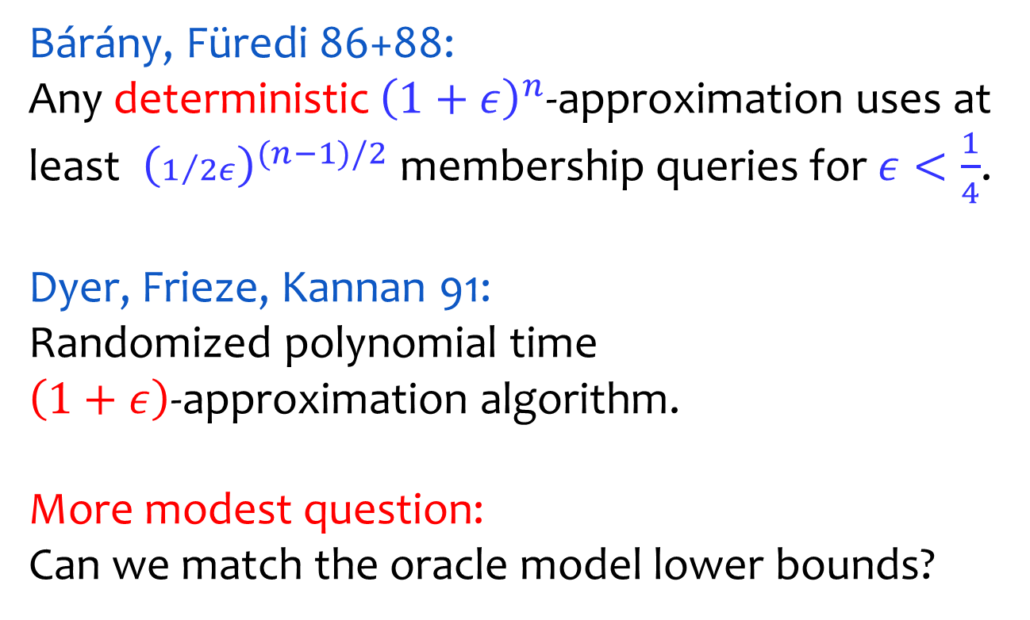
Volume Estimation: Known Bounds
Bárány, Füredi 86+88:
Any deterministic ${\left(1+ε\right)}^{n}$-approximation uses at least ${ \left(1/{2ε}\right)}^{(n−1)/2}$ membership queries for $ε<\frac{1}{4}$.
Dyer, Frieze, Kannan 91:
Randomized polynomial time
$\left(1+ε\right)$-approximation algorithm.
More modest question:
Can we match the oracle model lower bounds?

Slide 7
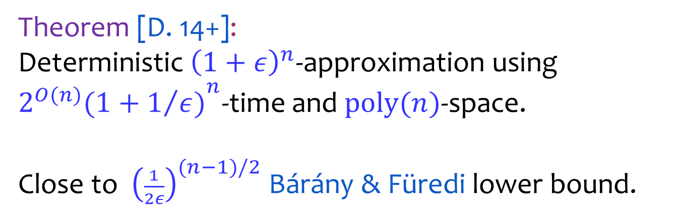
Main Result
Theorem [D. 14+]:
Deterministic ${\left(1+ε\right)}^{n}$-approximation using ${2^{O(n)}(1+1/{ε)}}^{n}$-time and $\text{poly}(n)$-space.
Close to ${ \left(\frac{1}{2ε}\right)}^{(n−1)/2}$ Bárány & Füredi lower bound.

Slide 8

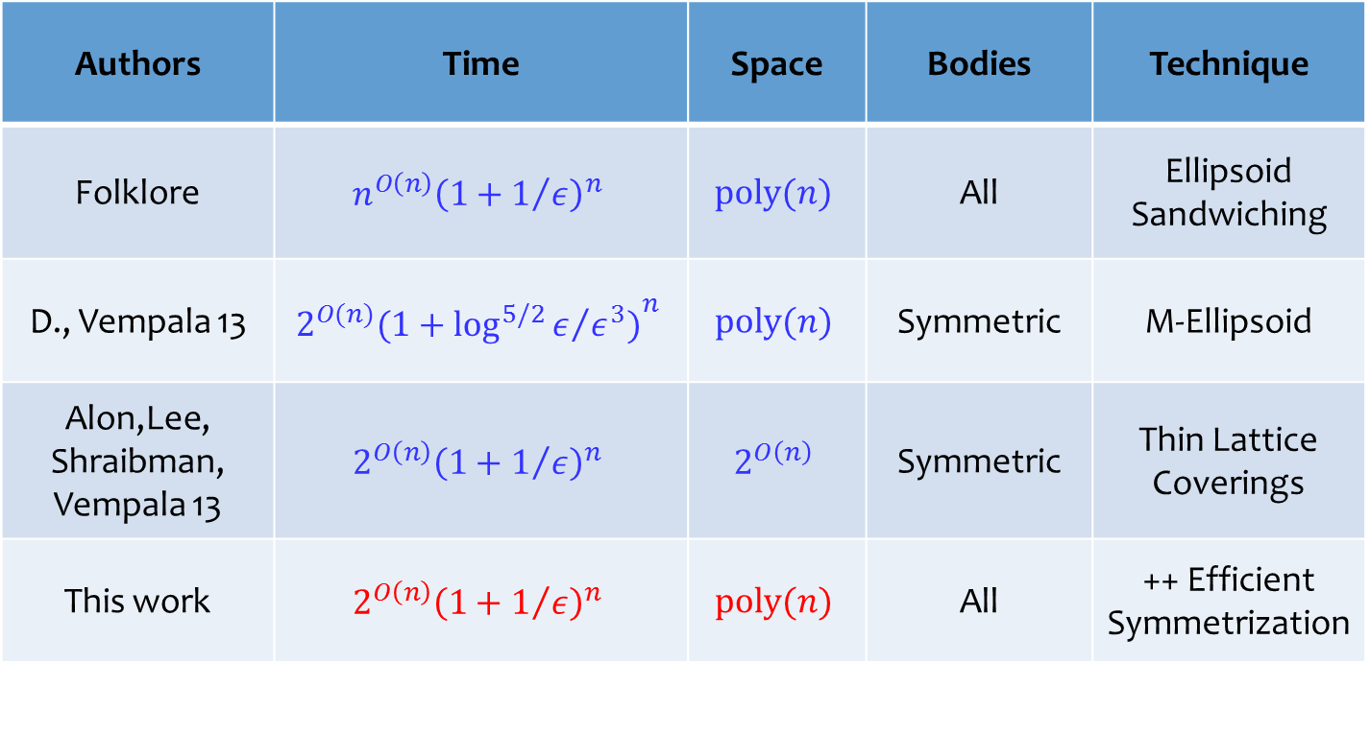
Deterministic ${\left(1+ε\right)}^{n}$-approximations
Authors | Time | Space | Bodies | Technique
Folklore | $$n^{O\left(n\right)}{\left(1+1/ε\right)}^{n}$$ | $$poly(n)$$ | All | Ellipsoid Sandwiching
D., Vempala 13 | $${2^{O(n)}(1+{\log^{5/2}{ε}}/{ε^{3})}}^{n}$$ | $$poly(n)$$ | Symmetric | M-Ellipsoid
Alon,Lee, Shraibman, Vempala 13 | $$2^{O\left(n\right)}{\left(1+1/ε\right)}^{n}$$ | $$2^{O\left(n\right)}$$ | Symmetric | Thin Lattice Coverings
This work | $$2^{O\left(n\right)}{\left(1+1/ε\right)}^{n}$$ | $$poly(n)$$ | All | ++ Efficient Symmetrization
asymmetric
symmetric

Slide 9


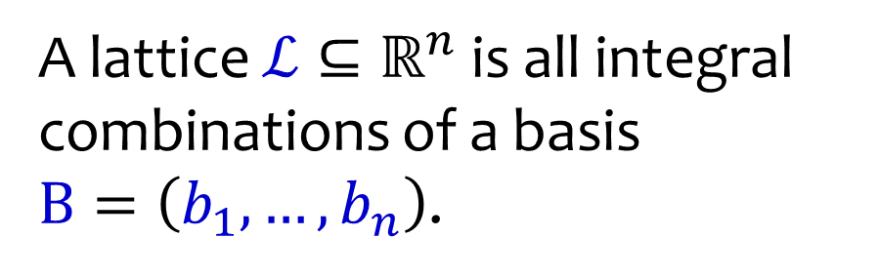

Lattices
A lattice $ℒ⊆ℝ^{n}$ is all integral combinations of a basis
$B=\left(b_{1},…,b_{n}\right)$.
$$b_{1}$$
$$b_{2}$$
$$ℒ$$

Slide 10
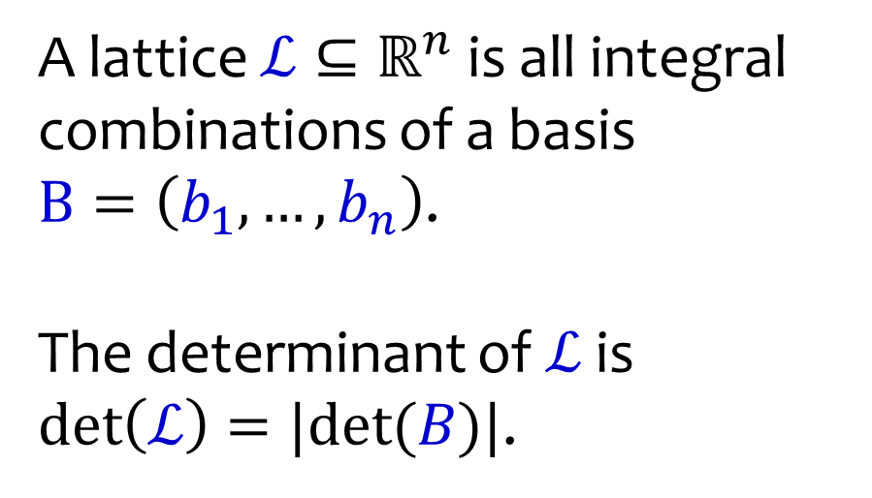
Lattices
A lattice $ℒ⊆ℝ^{n}$ is all integral combinations of a basis
$B=\left(b_{1},…,b_{n}\right)$.
The determinant of $ℒ$ is
$\text{det}\left(ℒ\right)=|det⁡(B)|$.
$$b_{1}$$
$$b_{2}$$
$$ℒ$$

Slide 11
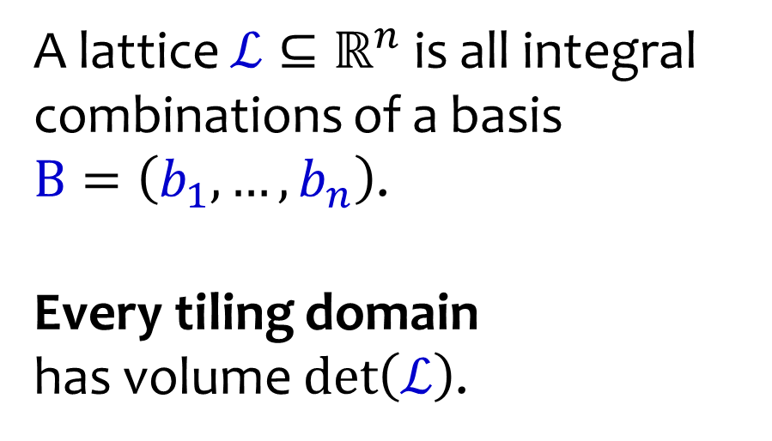
Lattices
A lattice $ℒ⊆ℝ^{n}$ is all integral combinations of a basis
$B=\left(b_{1},…,b_{n}\right)$.
Every tiling domain
has volume $\text{det}\left(ℒ\right)$.
$$ℒ$$

Slide 12
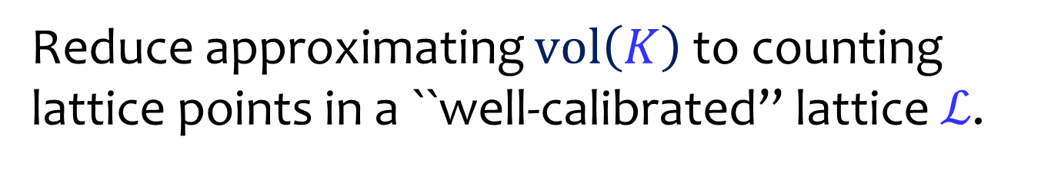

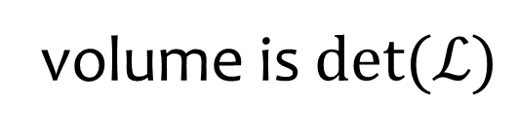

High Level Idea
Reduce approximating $vol\left(K\right)$ to counting lattice points in a ``well-calibrated’’ lattice $ℒ$.
$$K$$
$$ℒ$$
volume is $det(ℒ)$

Slide 13

High Level Algorithm
Input: convex body $K$, approx factor ${\left(1+ε\right)}^{n}$.
$$K$$

Slide 14
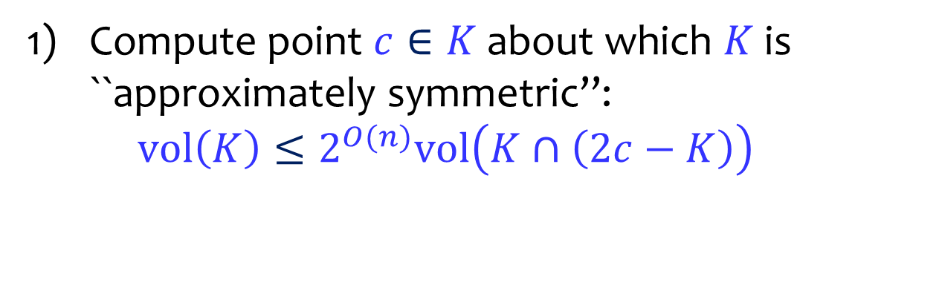



High Level Algorithm
Compute point $c∈K$ about which $K$ is ``approximately symmetric’’:
$vol\left(K\right)≤2^{O(n)}vol\left(K∩\left(2c−K\right)\right)$
Treat above as optimization problem.
$$K∩\text{2}\text{c}\text{−}K$$
$$K$$
$$c$$
$$\text{2}\text{c}\text{−}K$$

Slide 15
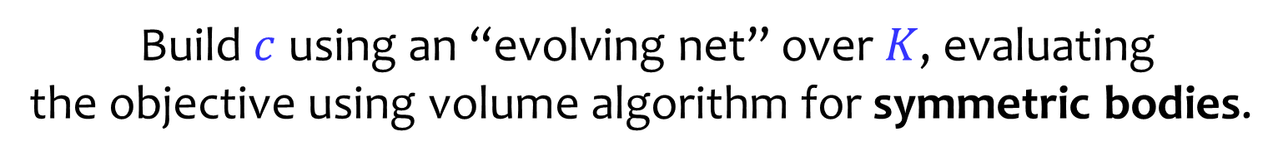
High Level Algorithm
Compute point $c∈K$ about which $K$ is ``approximately symmetric’’:
$vol\left(K\right)≤2^{O(n)}vol\left(K∩\left(2c−K\right)\right)$
Build $c$ using an “evolving net” over $K$, evaluating
the objective using volume algorithm for symmetric bodies.
$$K∩\text{2}\text{c}\text{−}K$$
$$K$$
$$c$$
$$\text{2}\text{c}\text{−}K$$

Slide 16
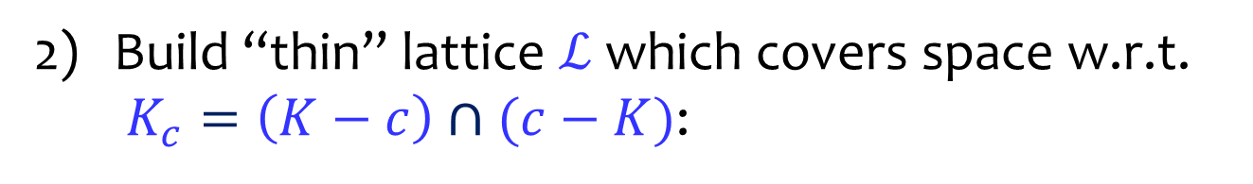
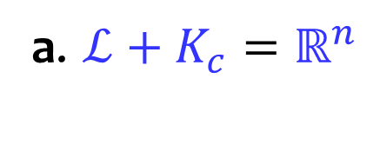

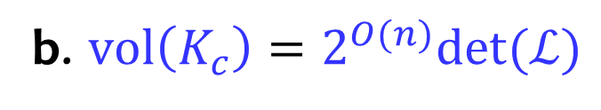

High Level Algorithm
Build “thin” lattice $ℒ$ which covers space w.r.t. $K_{c}=\left(K−c\right)∩(c−K)$:
a. $ℒ+K_{c}=ℝ^{n}$
b. $vol\left(K_{c}\right)=2^{O(n)}det⁡(ℒ)$
$$K_{c}$$
$$ℒ$$

Slide 17
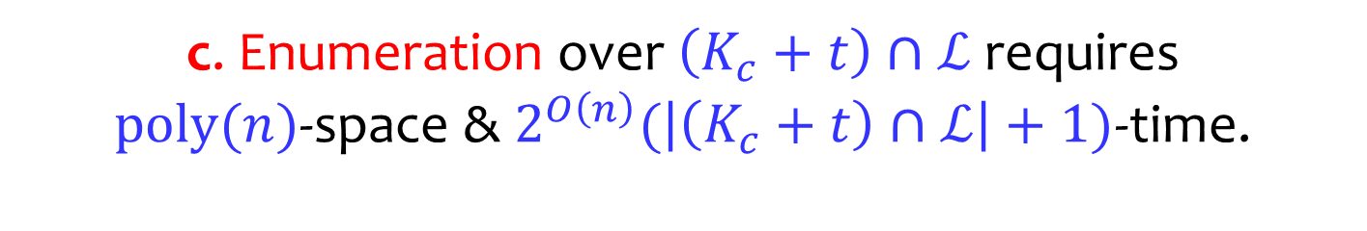
High Level Algorithm
Build “thin” lattice $ℒ$ which covers space w.r.t. $K_{c}=\left(K−c\right)∩(c−K)$:
c. Enumeration over $\left(K_{c}+t\right)∩ℒ$ requires
$poly(n)$-space & $2^{O\left(n\right)}(\left|\left(K_{c}+t\right)∩ℒ\right|+1)$-time.
$$K_{c}$$
$$ℒ$$

Slide 18

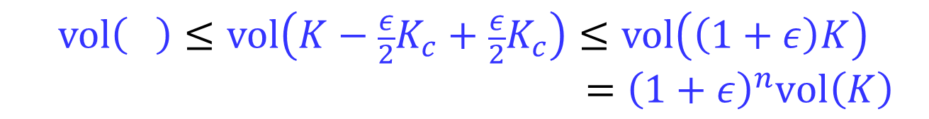


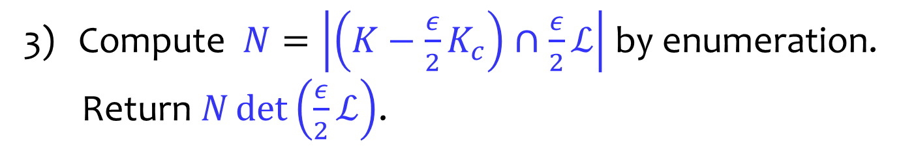
High Level Algorithm
Compute $N=\left|\left(K−{\frac{ε}{2}K}_{c}\right)∩\frac{ε}{2}ℒ\right|$ by enumeration.
Return $N\det\left(\frac{ε}{2}ℒ\right)$.
$$vol\left( \right)≤vol\left(K−{\frac{ε}{2}K}_{c}+{\frac{ε}{2}K}_{c}\right)≤vol\left(\left(1+ε\right)K\right)$$
$={\left(1+ε\right)}^{n}vol\left(K\right)$
$$K$$
$${\frac{ε}{2}K}_{c}$$
$$\frac{ε}{2}ℒ$$

Slide 19
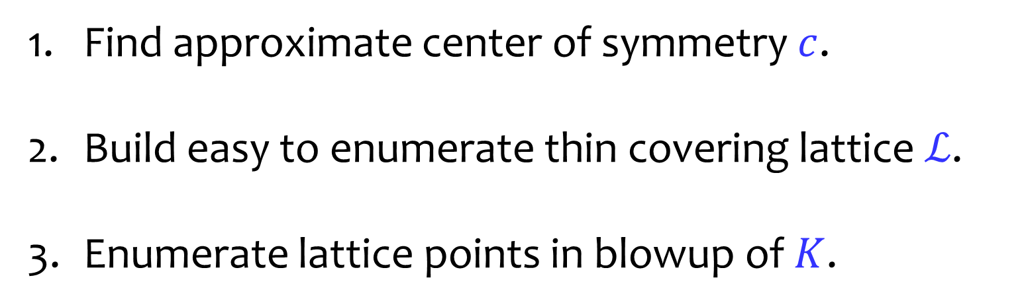
Algorithm Recap
Find approximate center of symmetry $c$.
Build easy to enumerate thin covering lattice $ℒ$.
Enumerate lattice points in blowup of $K$.
$$K$$
$${\frac{ε}{2}K}_{c}$$
$$\frac{ε}{2}ℒ$$

Slide 20

Algorithm Recap
Find approximate center of symmetry $c$.
Build easy to enumerate thin covering lattice $ℒ$.
Enumerate lattice points in blowup of $K$.
$$K$$

Slide 21
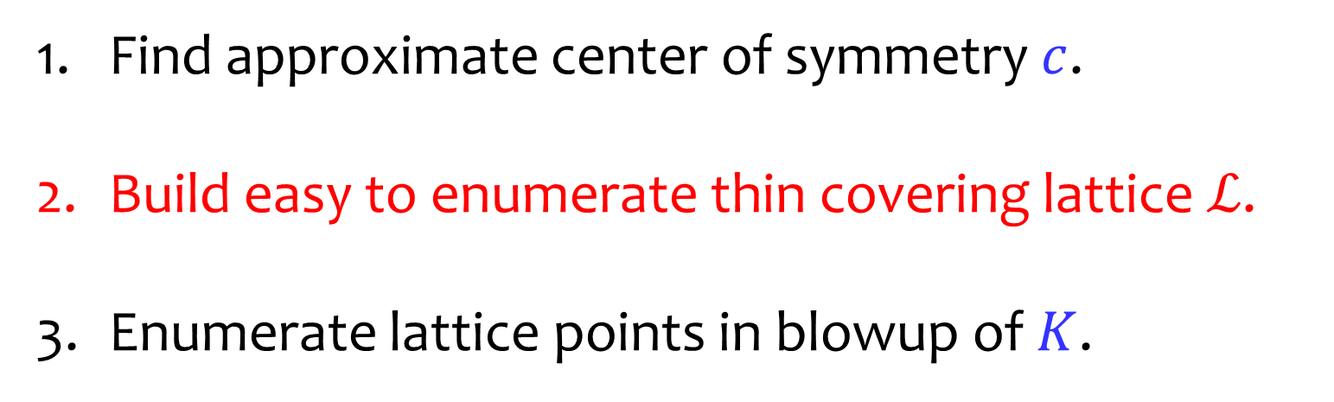
Algorithm Recap
Find approximate center of symmetry $c$.
Build easy to enumerate thin covering lattice $ℒ$.
Enumerate lattice points in blowup of $K$.
$$K$$

Slide 22


How to build $ℒ$
Want easy to enumerate thin covering lattice $ℒ$.
$$K$$

Slide 23



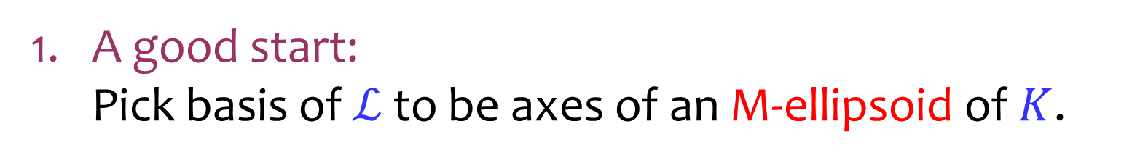
How to build $ℒ$
A good start:
Pick basis of $ℒ$ to be axes of an M-ellipsoid of $K$.
$$b_{1}$$
$$K$$
$$E$$
$$b_{2}$$

Slide 24


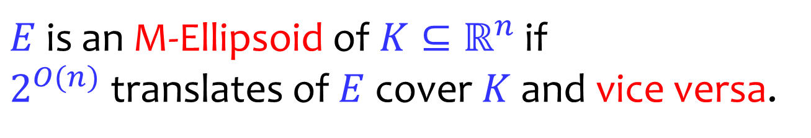
Milman’s Ellipsoid
$$K$$
$$E$$
$E$ is an M-Ellipsoid of $K⊆ℝ^{n}$ if
$2^{O(n)}$ translates of $E$ cover $K$ and vice versa.

Slide 25




Milman’s Ellipsoid
$$E_{2}$$
$$E_{1}$$
$$K$$
$$E_{4}$$
$$E_{3}$$
$2^{O(n)}$ translates of $E$ suffice to cover $K$.

Slide 26





Milman’s Ellipsoid
$$K_{3}$$
$$E$$
$$K_{1}$$
$$K_{4}$$
$$K_{2}$$
$2^{O(n)}$ translates of $K$ suffice to cover $E$.

Slide 27
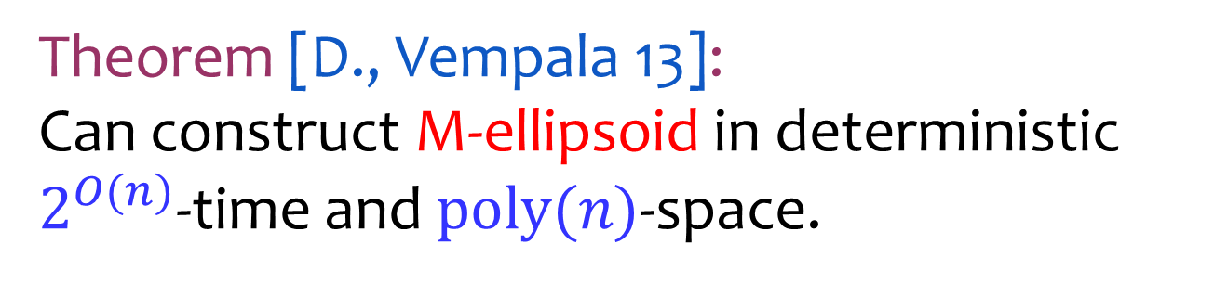
Milman’s Ellipsoid
$$K$$
$$E$$
Theorem [D., Vempala 13]:
Can construct M-ellipsoid in deterministic
$2^{O(n)}$-time and $poly(n)$-space.

Slide 28

How to build $ℒ$
A good start:
Pick basis of $ℒ$ to be axes of an M-ellipsoid of $K$.
Get: $vol\left(K\right)≤2^{O(n)}det⁡(ℒ)$ &
“easy to enumerate” $ℒ$ .
$$b_{1}$$
$$K$$
$$E$$
$$b_{2}$$

Slide 29
How to build $ℒ$
A good start:
Pick basis of $ℒ$ to be axes of an M-ellipsoid of $K$.
Don’t get: covering property $ℒ+K=ℝ^{n}$.
$$b_{1}$$
$$K$$
$$E$$
$$b_{2}$$

Slide 30
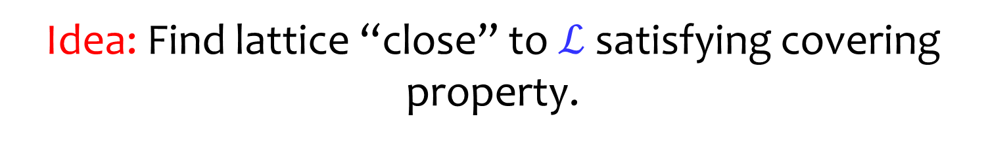
How to build $ℒ$
A good start:
Pick basis of $ℒ$ to be axes of an M-ellipsoid of $K$.
Idea: Find lattice “close” to $ℒ$ satisfying covering property.
$$b_{1}$$
$$K$$
$$E$$
$$b_{2}$$

Slide 31




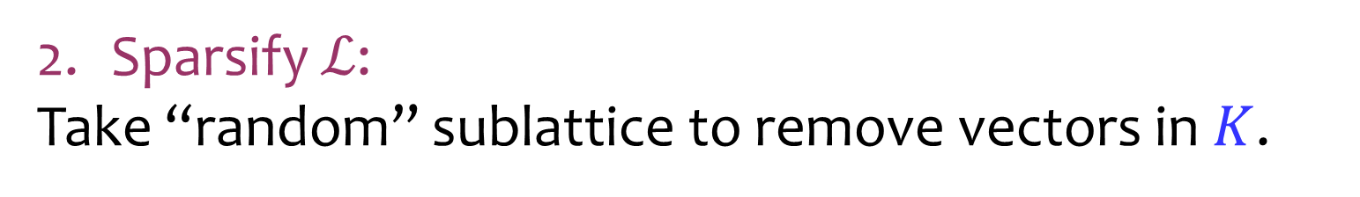

How to build $ℒ$
Sparsify $ℒ$:
Take “random” sublattice to remove vectors in $K$.
$$b_{1}$$
$$K$$
$$b_{2}$$
$$0$$
$$ℒ$$

Slide 32
How to build $ℒ$
Sparsify $ℒ$:
Take “random” sublattice to remove vectors in $K$.
$$K$$
$$0$$
$$ℒ$$

Slide 33
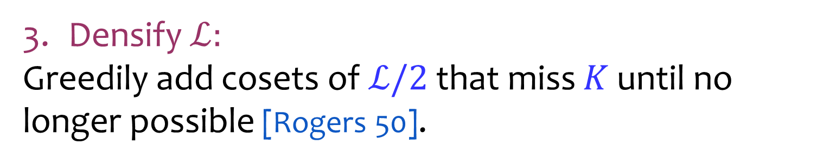
How to build $ℒ$
Densify $ℒ:$
Greedily add cosets of $ℒ/2$ that miss $K$ until no longer possible [Rogers 50].
$$K$$
$$0$$
$$ℒ$$

Slide 34
How to build $ℒ$
Densify $ℒ:$
Greedily add cosets of $ℒ/2$ that miss $K$ until no longer possible [Rogers 50].
$$K$$
$$0$$
$$ℒ$$

Slide 35
How to build $ℒ$
Densify $ℒ:$
Greedily add cosets of $ℒ/2$ that miss $K$ until no longer possible [Rogers 50].
$$K$$
$$0$$
$$ℒ$$

Slide 36
How to build $ℒ$
Return $ℒ/2$ as final lattice.
$$K$$
$$0$$
$$ℒ$$

Slide 37
Summary
Nearly optimal deterministic algorithm for volume estimation in the oracle model.
New construction of “easy to enumerate” thin-covering lattices.
Open Questions
Ignoring efficiency, can we match query lower bound?
Other applications of thin-covering lattices?

Slide 38
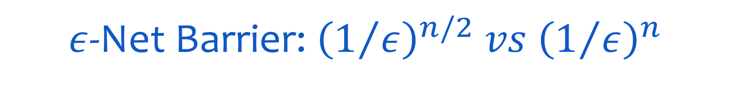
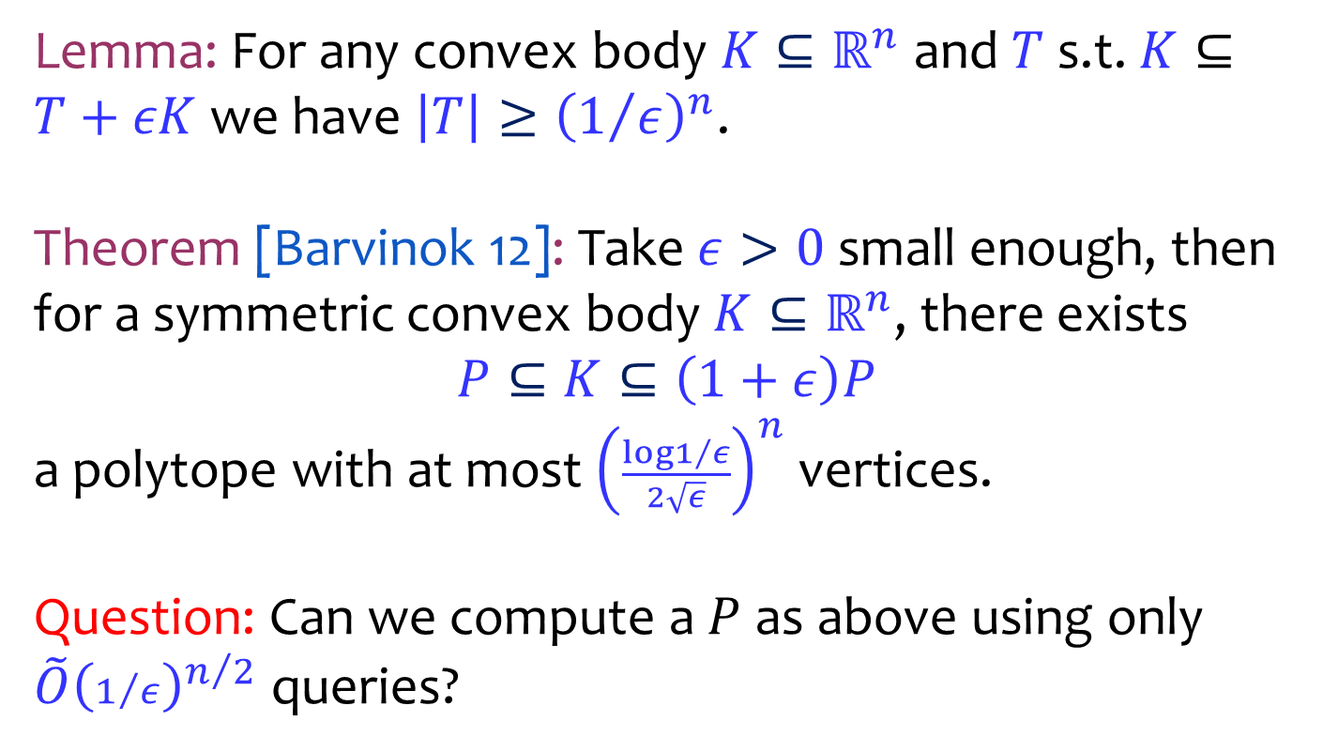
$ε$-Net Barrier: ${\left(1/ε\right)}^{n/2} vs {\left(1/ε\right)}^{n}$
Lemma: For any convex body $K⊆ℝ^{n}$ and $T$ s.t. $K⊆T+εK$ we have $\left|T\right|≥{\left(1/ε\right)}^{n}$.
Theorem [Barvinok 12]: Take $ε>0$ small enough, then for a symmetric convex body $K⊆ℝ^{n}$, there exists
$$P⊆K⊆\left(1+ε\right)P$$
a polytope with at most ${\left(\frac{\log{1/ε}}{2\sqrt{ε}}\right)}^{n}$ vertices.
Question: Can we compute a $P$ as above using only ${\tilde{O}\left(1/ε\right)}^{n/2}$ queries?

