Slide 1
New Conjectures in the Geometry of Numbers
Daniel Dadush
Centrum Wiskunde & Informatica (CWI)
Oded Regev
New York University

Slide 2
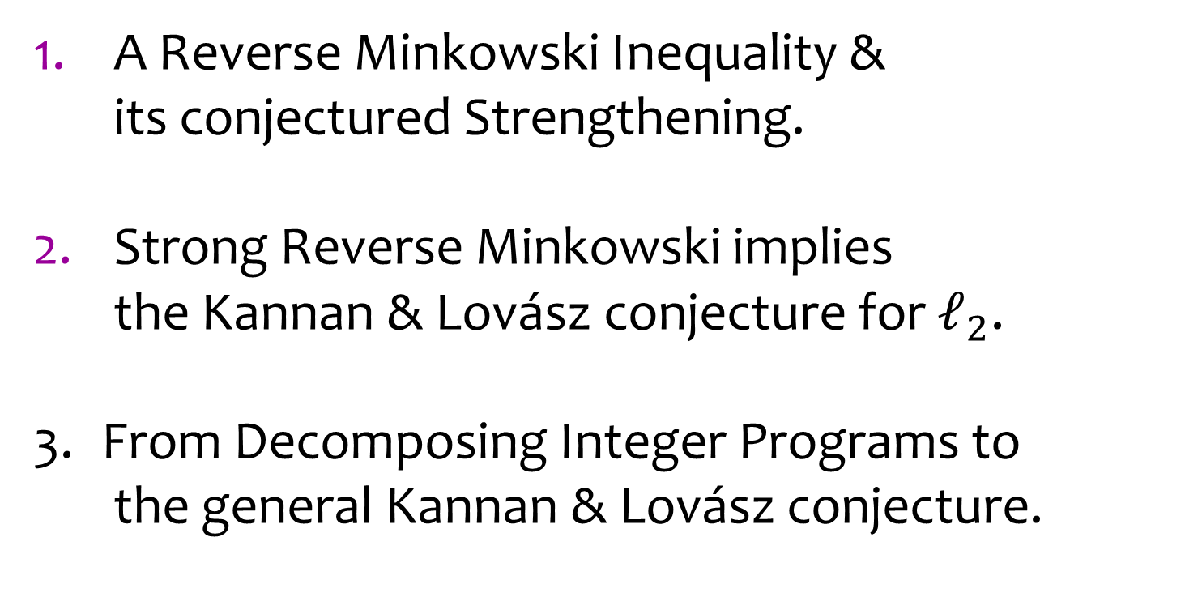
Talk Outline
A Reverse Minkowski Inequality & its conjectured Strengthening.
Strong Reverse Minkowski implies the Kannan & Lovász conjecture for $ℓ_{2}$.
From Decomposing Integer Programs to the general Kannan & Lovász conjecture.

Slide 3




Lattices
The standard integer lattice $ℤ^{n}$.
$$e_{2}$$
$$e_{1}$$
$$ℤ^{n}$$

Slide 4



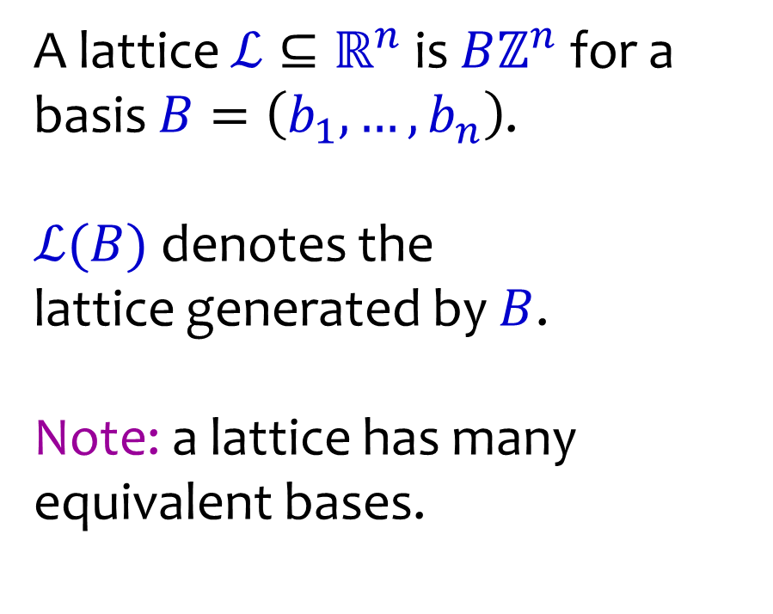



Lattices
A lattice $ℒ⊆ℝ^{n}$ is $Bℤ^{n}$ for a basis $B=\left(b_{1},…,b_{n}\right)$.
$ℒ(B)$ denotes the
lattice generated by $B$.
Note: a lattice has many equivalent bases.
$$b_{2}$$
$$b_{1}$$
$$b_{1}$$
$$b_{2}$$
$$b_{2}$$
$$ℒ$$

Slide 5
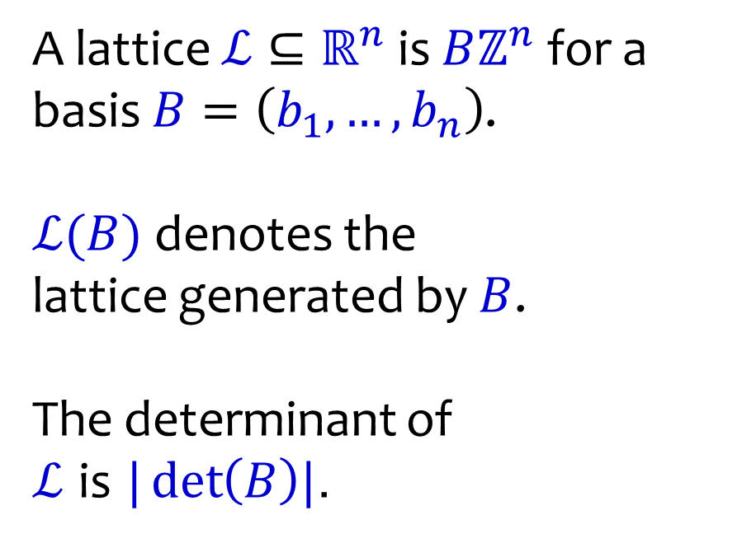
Lattices
A lattice $ℒ⊆ℝ^{n}$ is $Bℤ^{n}$ for a basis $B=\left(b_{1},…,b_{n}\right)$.
$ℒ(B)$ denotes the
lattice generated by $B$.
The determinant of
$ℒ$ is $|\det\left(B\right)|$.
$$b_{1}$$
$$b_{2}$$
$$ℒ$$

Slide 6

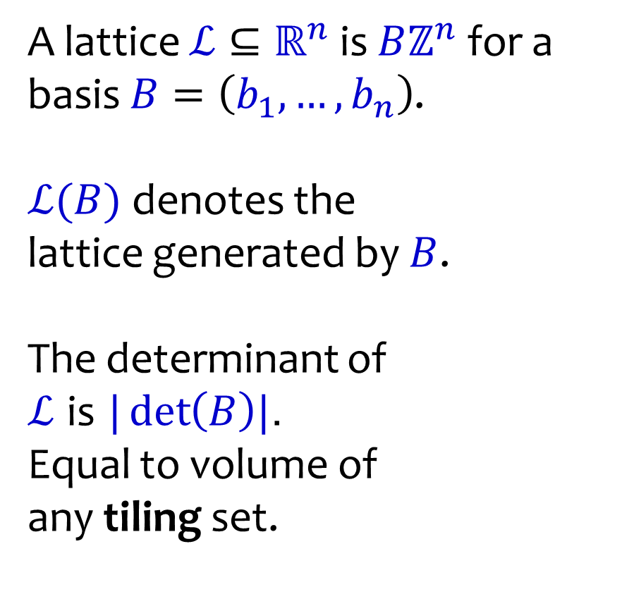
Lattices
A lattice $ℒ⊆ℝ^{n}$ is $Bℤ^{n}$ for a basis $B=\left(b_{1},…,b_{n}\right)$.
$ℒ(B)$ denotes the lattice generated by $B$.
The determinant of
$ℒ$ is $|\det\left(B\right)|$.
Equal to volume of
any tiling set.
$$b_{1}$$
$$b_{2}$$
$$ℒ$$

Slide 7
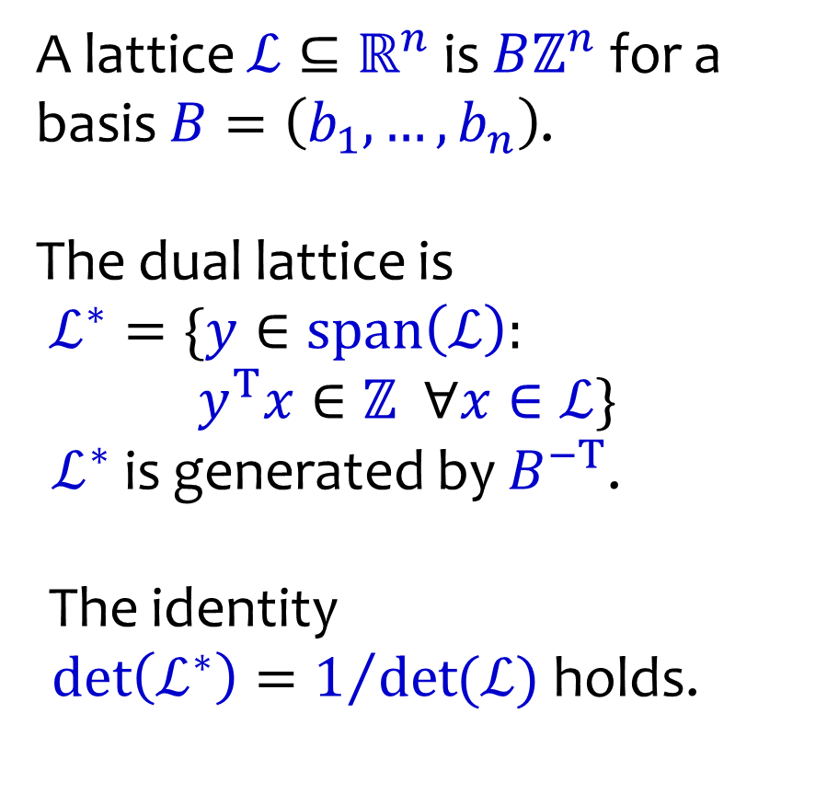
Lattices
A lattice $ℒ⊆ℝ^{n}$ is $Bℤ^{n}$ for a basis $B=\left(b_{1},…,b_{n}\right)$.
The dual lattice is
$ℒ^{∗}=\{y∈span\left(ℒ\right):$ $y^{T}x∈ℤ ∀x∈ℒ\}$
$ℒ^{∗}$ is generated by $B^{−T}$.
The identity
$\det\left(ℒ^{∗}\right)=1/{\det{(ℒ)}}$ holds.
$$ℒ$$

Slide 8

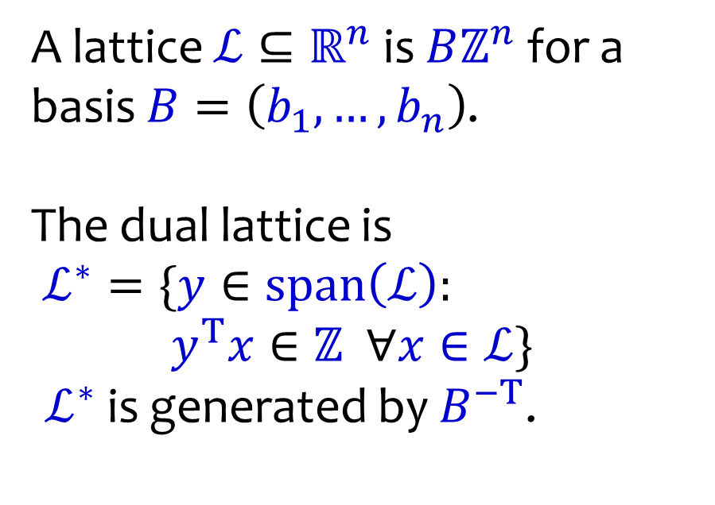




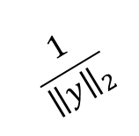

Lattices
A lattice $ℒ⊆ℝ^{n}$ is $Bℤ^{n}$ for a basis $B=\left(b_{1},…,b_{n}\right)$.
The dual lattice is
$ℒ^{∗}=\{y∈span\left(ℒ\right):$ $y^{T}x∈ℤ ∀x∈ℒ\}$
$ℒ^{∗}$ is generated by $B^{−T}$.
$$\frac{1}{{\left\|y\right\|}_{2}}$$
$$y∈ℒ^{∗}$$
$$ℒ$$
$$y^{T}x=0$$
$$y^{T}x=1$$
$$y^{T}x=2$$
$$y^{T}x=3$$
$$y^{T}x=4$$

Slide 9
Reversing Minkowski’s Convex Body Theorem

Slide 10

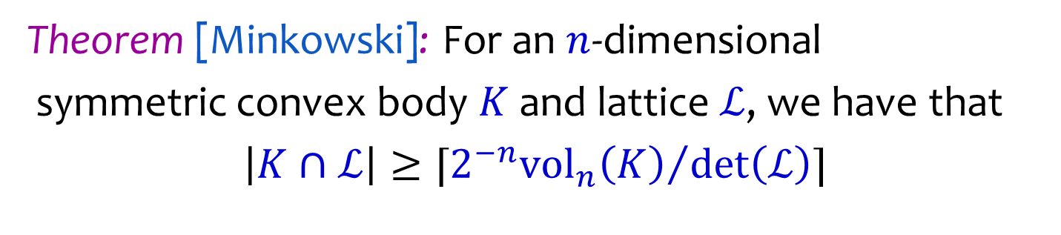


Minkowski’s Convex Body Theorem
Theorem [Minkowski]: For an $n$-dimensional
symmetric convex body $K$ and lattice $ℒ$, we have that
$\left|K∩ℒ\right|≥⌈{{2^{−n}vol}_{n}\left(K\right)}/{\det\left(ℒ\right)}⌉$
$$K$$
$$0$$
$$ℒ$$

Slide 11
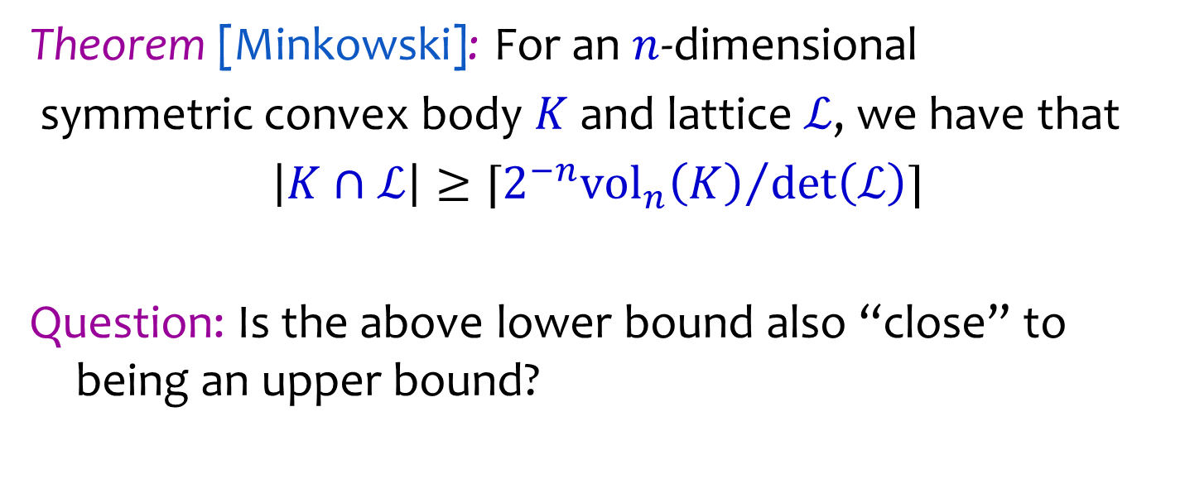
Minkowski’s Convex Body Theorem
Theorem [Minkowski]: For an $n$-dimensional
symmetric convex body $K$ and lattice $ℒ$, we have that
$\left|K∩ℒ\right|≥⌈{{2^{−n}vol}_{n}\left(K\right)}/{\det\left(ℒ\right)}⌉$
Question: Is the above lower bound also “close” to being an upper bound?

Slide 12


Minkowski’s Convex Body Theorem
Theorem [Minkowski]: For an $n$-dimensional
symmetric convex body $K$ and lattice $ℒ$, we have that
$\left|K∩ℒ\right|≥⌈{{2^{−n}vol}_{n}\left(K\right)}/{\det\left(ℒ\right)}⌉$
Clearly NO!
$$K$$
$$0$$
$$ℒ$$

Slide 13
Minkowski’s Convex Body Theorem
Theorem [Minkowski]: For an $n$-dimensional
symmetric convex body $K$ and lattice $ℒ$, we have that
$\left|K∩ℒ\right|≥⌈{{2^{−n}vol}_{n}\left(K\right)}/{\det\left(ℒ\right)}⌉$
Can we strengthen the lower bound?
$$K$$
$$0$$
$$ℒ$$
Points all lie in a lattice subspace.

Slide 14
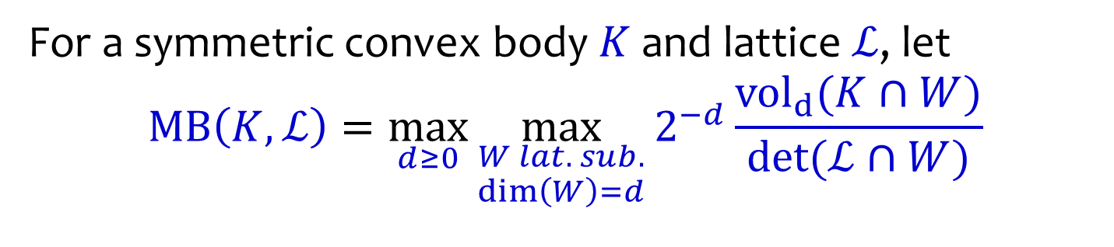

Reverse Minkowski Inequality
For a symmetric convex body $K$ and lattice $ℒ$, let
$$MB\left(K,ℒ\right)=\max_{d≥0}{\max_{\begin{aligned}W lat. sub. \\ \dim\left(W\right)=d\end{aligned}}{2^{−d}}\frac{vol_{d}(K∩W)}{\det{(ℒ∩W)}}}$$
$$K$$
$$0$$
$$W$$
$$ℒ$$
$W$ is a lattice subspace of $ℒ$ if $\dim\left(W∩ℒ\right)=\dim{(W)}$.

Slide 15
Reverse Minkowski Inequality
For a symmetric convex body $K$ and lattice $ℒ$, let
$$MB\left(K,ℒ\right)=\max_{d≥0}{\max_{\begin{aligned}W lat. sub. \\ \dim\left(W\right)=d\end{aligned}}{2^{−d}}\frac{vol_{d}(K∩W)}{\det{(ℒ∩W)}}}$$
$$K$$
$$0$$
$$W$$
$$ℒ$$
Is this bound any better?

Slide 16
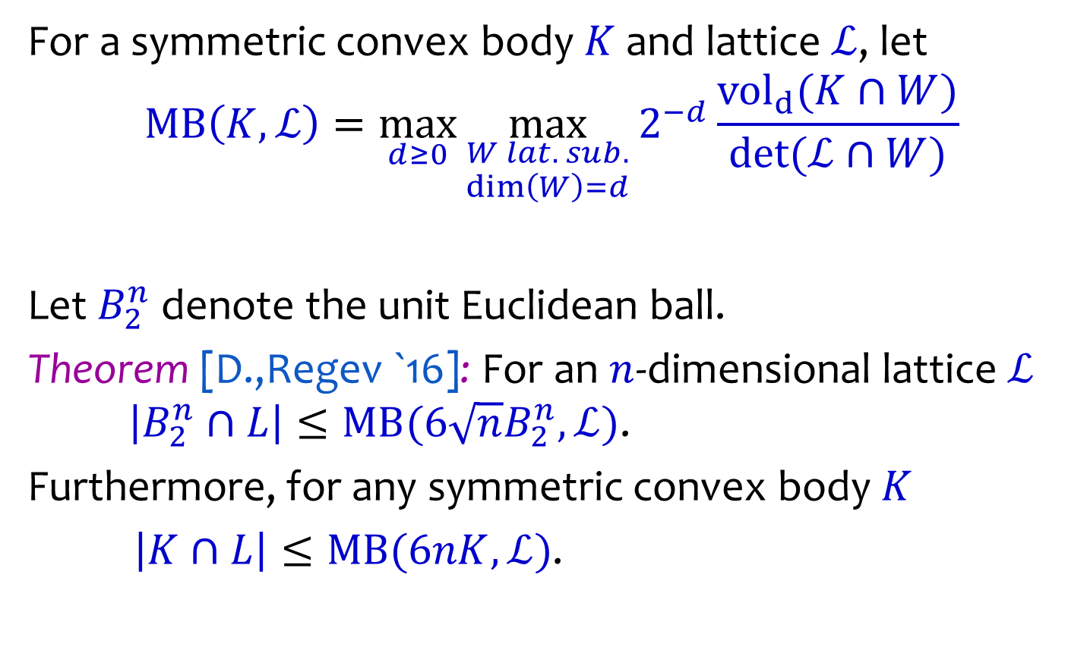
Weak Reverse Minkowski
For a symmetric convex body $K$ and lattice $ℒ$, let
$$MB\left(K,ℒ\right)=\max_{d≥0}{\max_{\begin{aligned}W lat. sub. \\ \dim\left(W\right)=d\end{aligned}}{2^{−d}}\frac{vol_{d}(K∩W)}{\det{(ℒ∩W)}}}$$
Let $B_{2}^{n}$ denote the unit Euclidean ball.
Theorem [D.,Regev `16]: For an $n$-dimensional lattice $ℒ$ $\left|B_{2}^{n}∩L\right|≤MB(6\sqrt{n}B_{2}^{n},ℒ)$.
Furthermore, for any symmetric convex body $K$
$\left|K∩L\right|≤MB(6nK,ℒ)$.

Slide 17
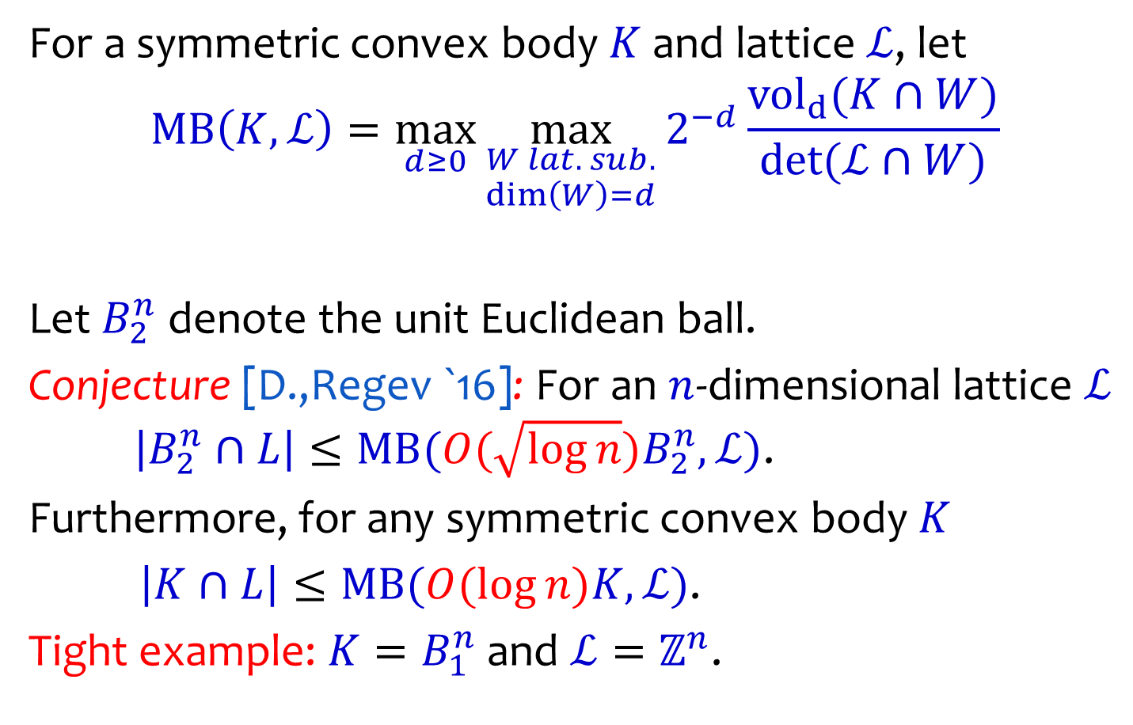
Strong Reverse Minkowski
For a symmetric convex body $K$ and lattice $ℒ$, let
$$MB\left(K,ℒ\right)=\max_{d≥0}{\max_{\begin{aligned}W lat. sub. \\ \dim\left(W\right)=d\end{aligned}}{2^{−d}}\frac{vol_{d}(K∩W)}{\det{(ℒ∩W)}}}$$
Let $B_{2}^{n}$ denote the unit Euclidean ball.
Conjecture [D.,Regev `16]: For an $n$-dimensional lattice $ℒ$ $\left|B_{2}^{n}∩L\right|≤MB(O(\sqrt{\log{n}})B_{2}^{n},ℒ)$.
Furthermore, for any symmetric convex body $K$
$\left|K∩L\right|≤MB(O(\log{n})K,ℒ)$.
Tight example: $K=B_{1}^{n}$ and $ℒ=ℤ^{n}$.

Slide 18
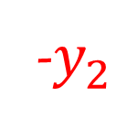
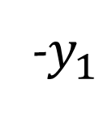



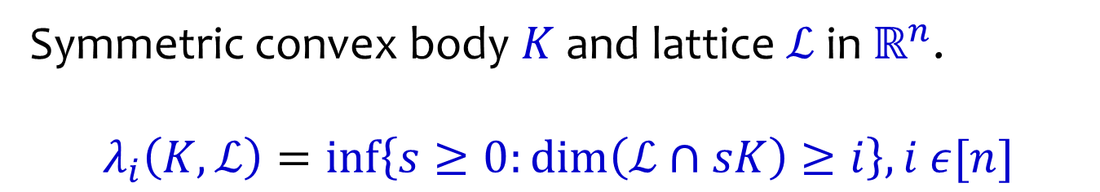


Successive Minima
Symmetric convex body $K$and lattice $ℒ$ in $ℝ^{n}$.
$$λ_{i}\left(K,ℒ\right)=\inf\left\{s≥0:\dim\left(ℒ∩sK\right)≥i\right\},i ε[n]$$
$$y_{2}$$
$$λ_{1}K$$
$$λ_{2}K$$
-$y_{1}$
$$0$$
$$y_{1}$$
-$y_{2}$

Slide 19
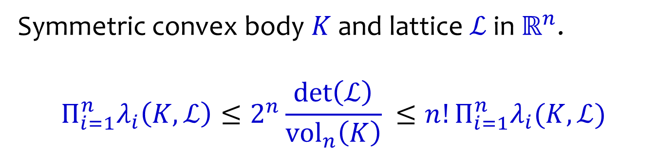
Minkowski’s Second Theorem
Symmetric convex body $K$and lattice $ℒ$ in $ℝ^{n}$.
$$Π_{i=1}^{n}λ_{i}\left(K,ℒ\right)≤2^{n}\frac{\det\left(ℒ\right)}{{\text{vol}}_{n}\left(K\right)} ≤n!Π_{i=1}^{n}λ_{i}(K,ℒ)$$
$$y_{2}$$
$$λ_{1}K$$
$$λ_{2}K$$
-$y_{1}$
$$0$$
$$y_{1}$$
-$y_{2}$

Slide 20
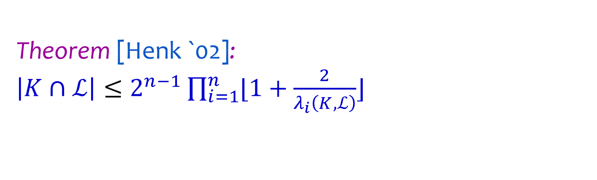
Lattice points bounds via Minima
Theorem [Henk `02]:
$\left|K∩ℒ\right|≤2^{n−1}\prod_{i=1}^{n}{⌊1+\frac{2}{λ_{i}\left(K,ℒ\right)}⌋}$
$$K$$
$$0$$
$$ℒ$$

Slide 21
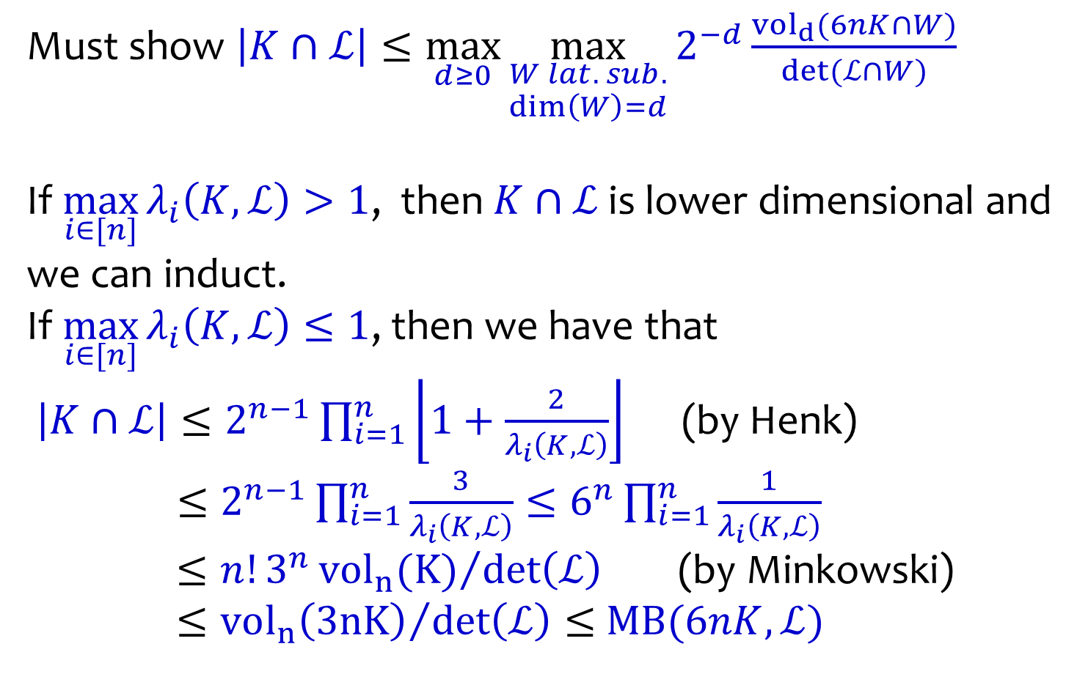
Proof of Weak Minkowski
Must show $\left|K∩ℒ\right|≤\max_{d≥0}{\max_{\begin{aligned}W lat. sub. \\ \dim\left(W\right)=d\end{aligned}}{2^{−d}}\frac{vol_{d}(6nK∩W)}{\det{(ℒ∩W)}}}$
If $\max_{i∈[n]}{λ_{i}\left(K,ℒ\right)>1}$, then $K∩ℒ$ is lower dimensional and we can induct.
If $\max_{i∈[n]}{λ_{i}\left(K,ℒ\right)≤1}$, then we have that
$\left|K∩ℒ\right|≤2^{n−1}\prod_{i=1}^{n}{\left\lfloor 1+\frac{2}{λ_{i}\left(K,ℒ\right)}\right\rfloor }$ (by Henk)
$≤2^{n−1}\prod_{i=1}^{n}{\frac{3}{λ_{i}\left(K,ℒ\right)}}≤6^{n}\prod_{i=1}^{n}{\frac{1}{λ_{i}\left(K,ℒ\right)}}$
$≤n!3^{n}{vol_{n}(K)}/{\det\left(ℒ\right)}$ (by Minkowski)
$≤{vol_{n}\left(3nK\right)}/{\det\left(ℒ\right)}≤$ $MB(6nK,ℒ)$

Slide 22

The Kannan & Lovász conjecture for $ℓ_{2}$

Slide 23



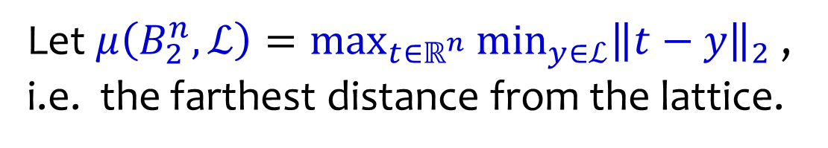
$ℓ_{2}$ covering radius
Let $μ\left(B_{2}^{n},ℒ\right)=\max_{t∈ℝ^{n}}{\min_{y∈ℒ}{{\left\|t−y\right\|}_{2} }}$, i.e. the farthest distance from the lattice.
$$μ$$
$$ℒ$$
Main question: How to get good lower bounds on the covering radius?

Slide 24








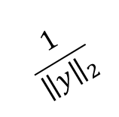
Lower bounds for covering radius
Lemma: $μ\left(B_{2}^{n},ℒ\right)≥\frac{1}{2λ_{1}(B_{2}^{n},ℒ^{∗})}$
$$t$$
$$\frac{1}{{\left\|y\right\|}_{2}}$$
$$y∈ℒ^{∗}$$
$$ℒ$$
$$y^{T}x=1$$
$$y^{T}x=2$$
$$y^{T}x=3$$
$$y^{T}x=4$$

Slide 25

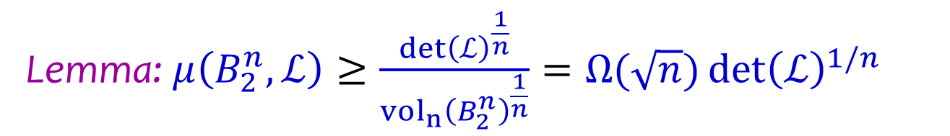

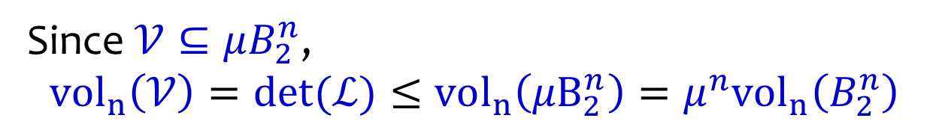

Lower bounds for covering radius
Lemma: $μ\left(B_{2}^{n},ℒ\right)≥\frac{\det{{\left(ℒ\right)}^{\frac{1}{n}}}}{vol_{n}{\left(B_{2}^{n}\right)}^{\frac{1}{n}}}=Ω(\sqrt{n})\det{{\left(ℒ\right)}^{1/n}}$
$$μ$$
$$𝒱$$
$$ℒ$$
Since $𝒱⊆μB_{2}^{n}$, $$vol_{n}\left(𝒱\right)=\det{(ℒ)}≤vol_{n}\left({μB}_{2}^{n}\right)=μ^{n}vol_{n}\left(B_{2}^{n}\right)$$

Slide 26
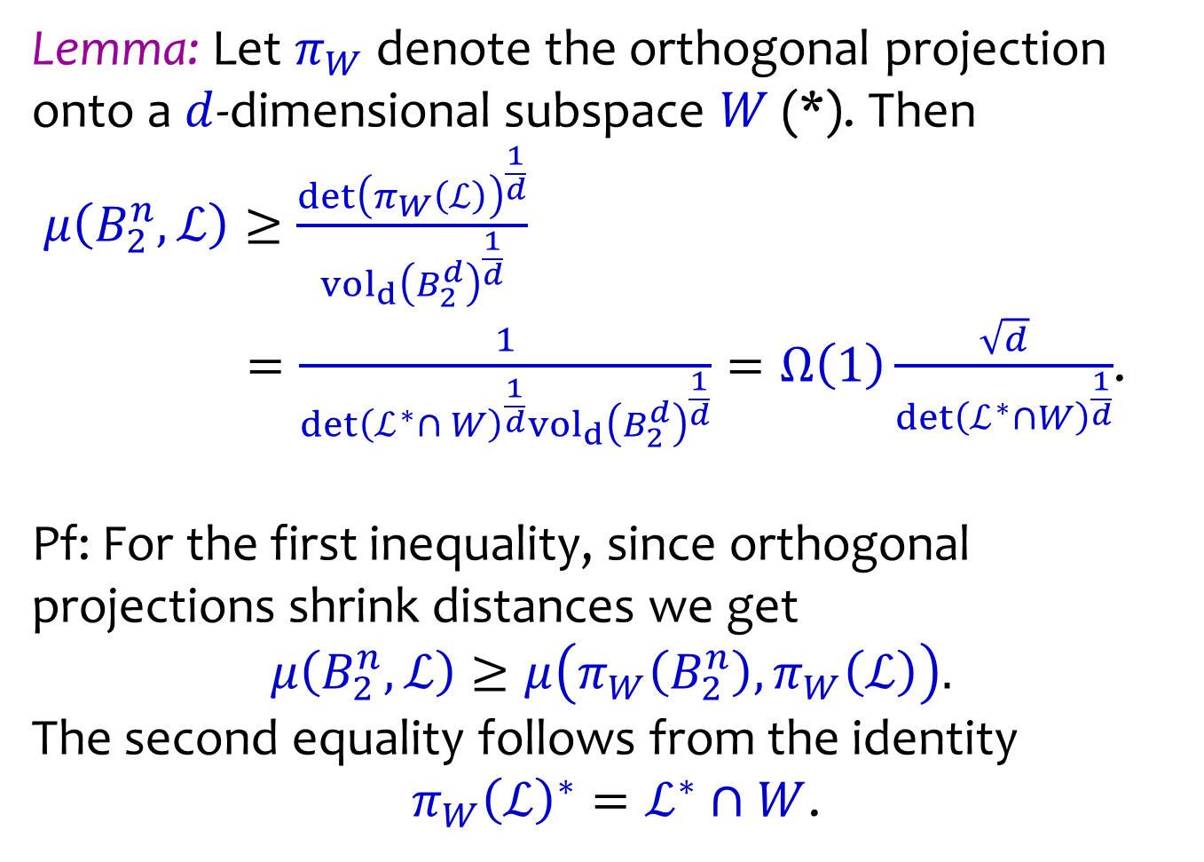
Lower bounds for covering radius
Lemma: Let $π_{W}$ denote the orthogonal projection onto a $d$-dimensional subspace $W$ (*). Then
$μ\left(B_{2}^{n},ℒ\right)≥\frac{\det{{\left(π_{W}\left(ℒ\right)\right)}^{\frac{1}{d}}}}{vol_{d}{\left(B_{2}^{d}\right)}^{\frac{1}{d}}}$
$=\frac{1}{\det{{\left(ℒ^{∗}∩ W\right)}^{\frac{1}{d}}}vol_{d}{\left(B_{2}^{d}\right)}^{\frac{1}{d}}}=Ω\left(1\right)\frac{\sqrt{d}}{\det{{\left(ℒ^{∗}∩W\right)}^{\frac{1}{d}}}}$.
Pf: For the first inequality, since orthogonal projections shrink distances we get
$$μ\left(B_{2}^{n},ℒ\right)≥μ\left(π_{W}\left(B_{2}^{n}\right),π_{W}\left(ℒ\right)\right).$$
The second equality follows from the identity
$π_{W}{\left(ℒ\right)}^{∗}=ℒ^{∗}∩W$.

Slide 27


Kannan & Lovász for $ℓ_{2}$
Theorem [Kannan-Lovasz `88]:
$Ω(1)≤μ\left(B_{2}^{n},ℒ\right)\min_{\begin{aligned}lat. subspace W \\ 1≤dim\left(W\right)=d≤n\end{aligned}}{\frac{{\det\left(ℒ^{∗}∩W\right)}^{\frac{1}{d}}}{\sqrt{d}}}≤O(\sqrt{n})$

Slide 28
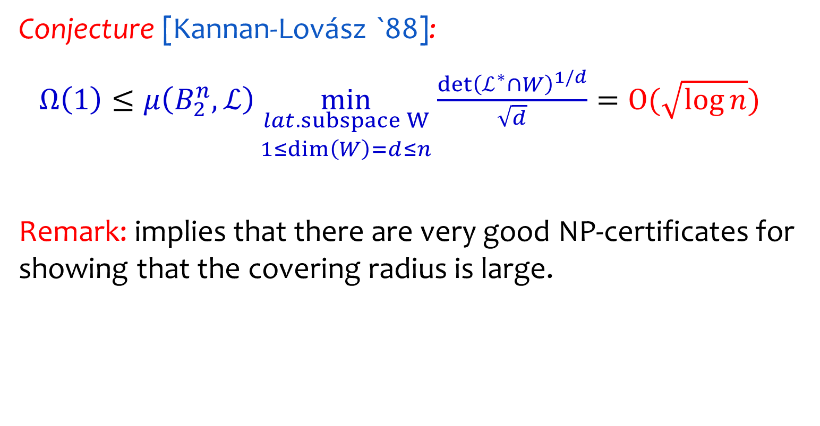
Kannan & Lovász for $ℓ_{2}$
Conjecture [Kannan-Lovász `88]:
$Ω\left(1\right)≤μ\left(B_{2}^{n},ℒ\right)\min_{\begin{aligned}lat. subspace W \\ 1≤dim\left(W\right)=d≤n\end{aligned}}{\frac{{\det\left(ℒ^{∗}∩W\right)}^{1/d}}{\sqrt{d}}}=O(\sqrt{\log{n}}{)}$
Remark: implies that there are very good NP-certificates for showing that the covering radius is large.

Slide 29
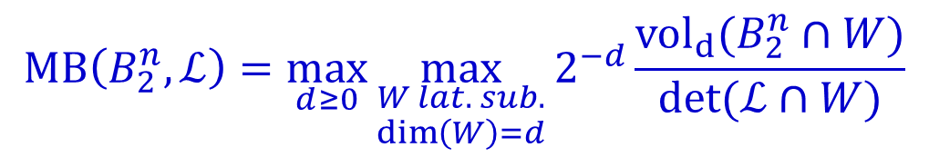
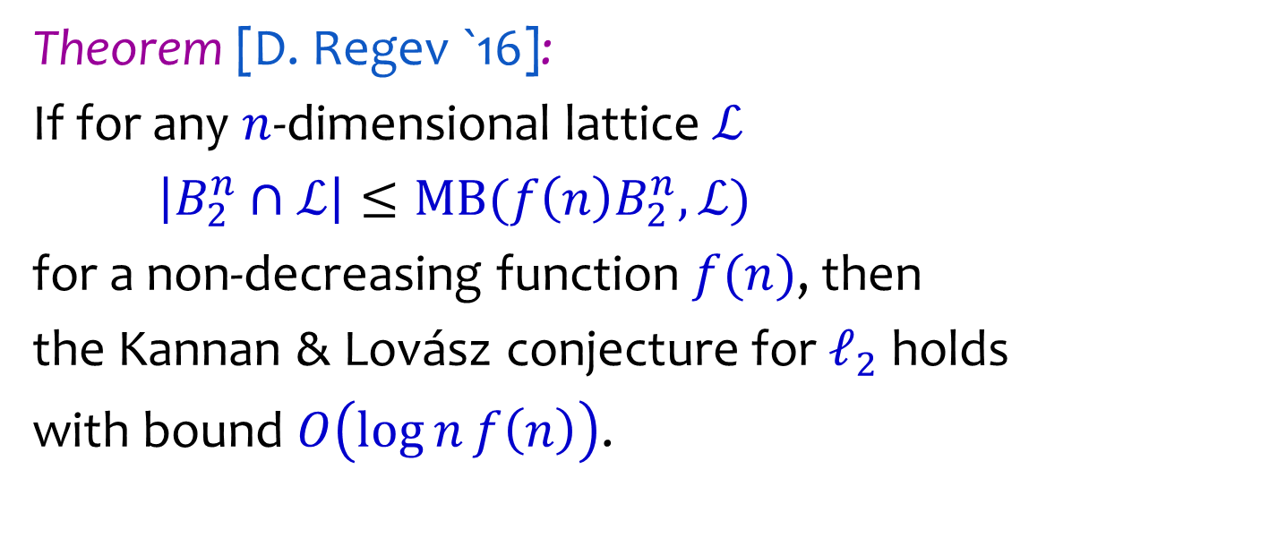
Reverse Minkowski vs Kannan & Lovász
$$MB\left(B_{2}^{n},ℒ\right)=\max_{d≥0}{\max_{\begin{aligned}W lat. sub. \\ \dim\left(W\right)=d\end{aligned}}{2^{−d}}\frac{vol_{d}(B_{2}^{n}∩W)}{\det{(ℒ∩W)}}}$$
Theorem [D. Regev `16]:
If for any $n$-dimensional lattice $ℒ$
$\left|B_{2}^{n}∩ℒ\right|≤MB(f\left(n\right)B_{2}^{n},ℒ)$
for a non-decreasing function $f(n)$, then
the Kannan & Lovász conjecture for $ℓ_{2}$ holds
with bound $O\left(\log{n}f\left(n\right)\right)$.

Slide 30
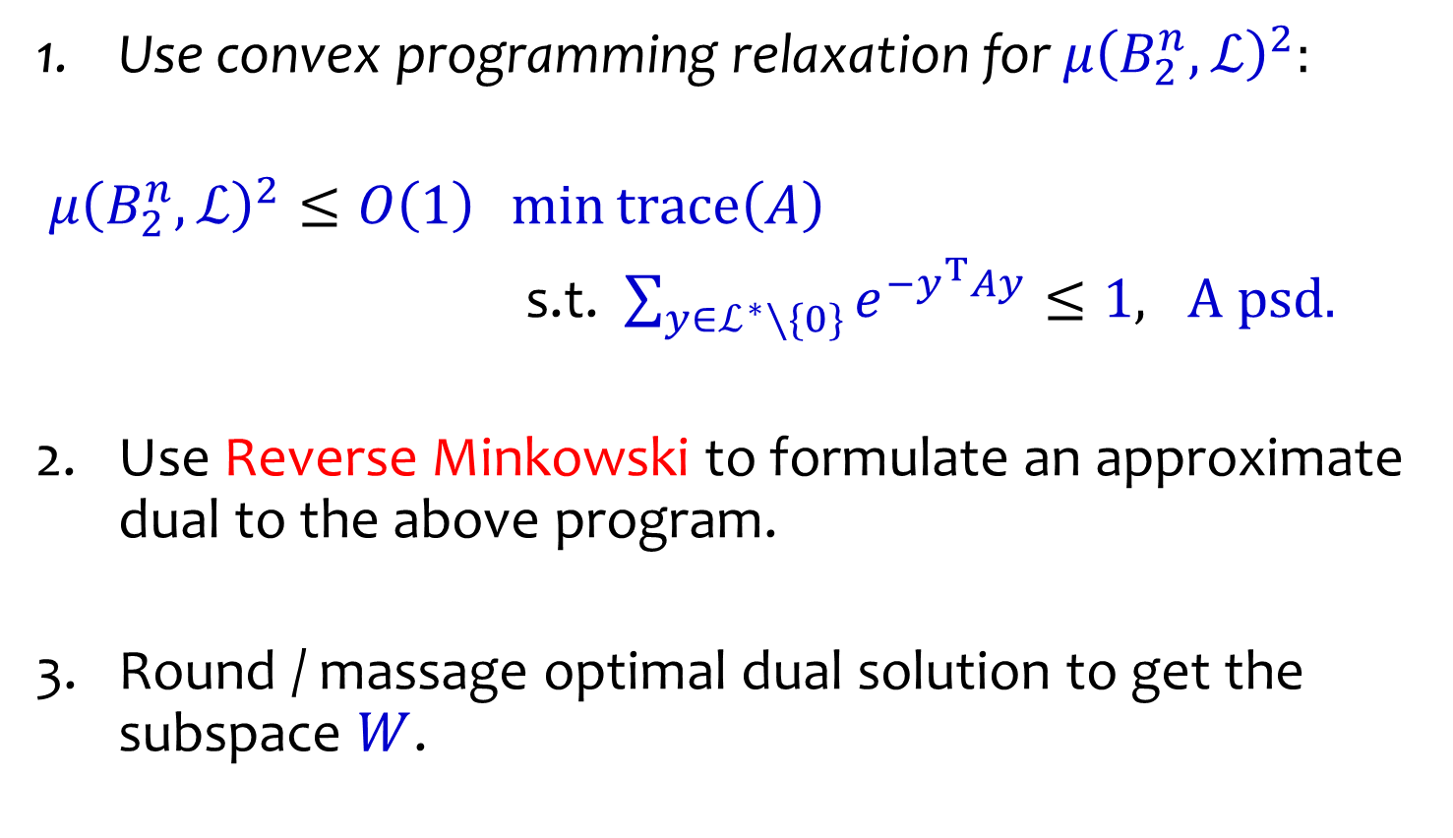
Main Approach
Use convex programming relaxation for $μ{\left(B_{2}^{n},ℒ\right)}^{2}:$
$μ{\left(B_{2}^{n},ℒ\right)}^{2}≤O\left(1\right) \min{trace\left(A\right)}$
s.t. $\sum_{y∈ℒ^{∗}∖\{0\}}{e^{−y^{T}Ay}}≤1, A psd.$
Use Reverse Minkowski to formulate an approximate dual to the above program.
Round / massage optimal dual solution to get the subspace $W$.

Slide 31
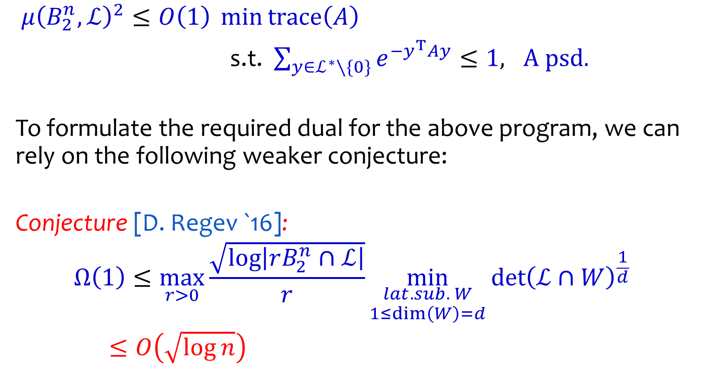
A Sufficient Conjecture
$μ{\left(B_{2}^{n},ℒ\right)}^{2}≤O\left(1\right) \min{trace\left(A\right)}$
s.t. $\sum_{y∈ℒ^{∗}∖\{0\}}{e^{−y^{T}Ay}}≤1, A psd.$
To formulate the required dual for the above program, we can rely on the following weaker conjecture:
Conjecture [D. Regev `16]:
$$Ω\left(1\right)≤\max_{r>0}{\frac{\sqrt{\log\left|rB_{2}^{n}∩ℒ\right|}}{r}}\min_{\begin{aligned}lat. sub. W \\ 1≤dim\left(W\right)=d\end{aligned}}{{\det\left(ℒ∩W\right)}^{\frac{1}{d}}}$$
$≤O\left(\sqrt{\log{n}}\right)$

Slide 32
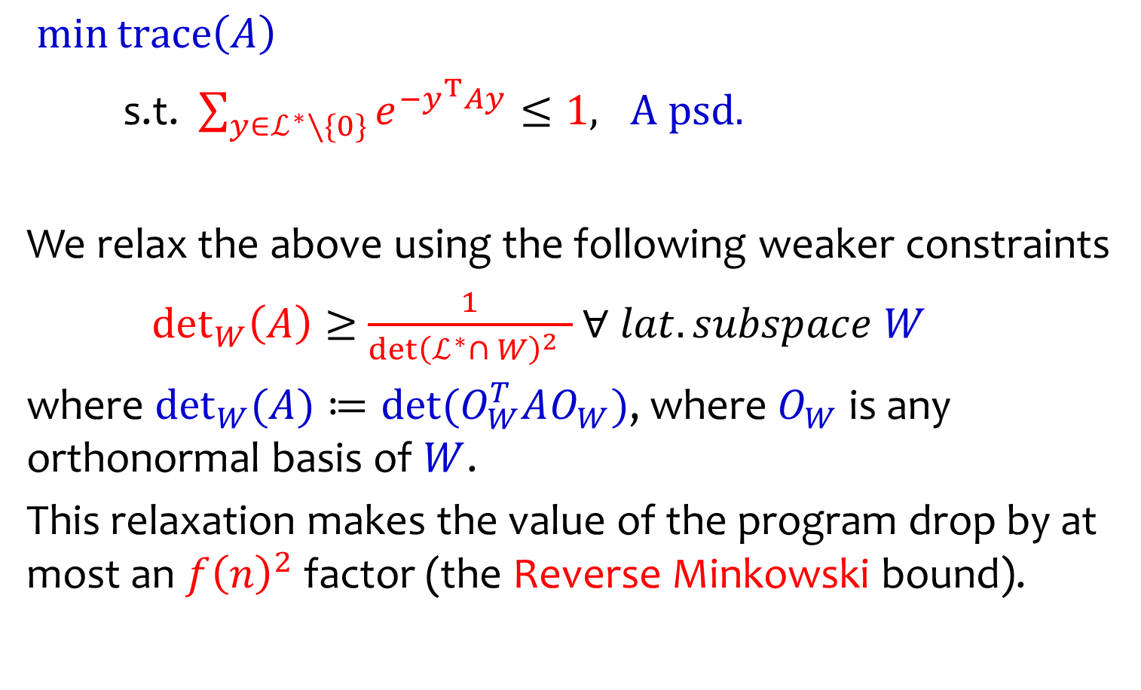
The Relaxed Program
$\min{trace\left(A\right)}$
s.t. $\sum_{y∈ℒ^{∗}∖\{0\}}{e^{−y^{T}Ay}}≤1, A psd.$
We relax the above using the following weaker constraints
$det_{W}\left(A\right)≥$ $\frac{1}{\det{{\left(ℒ^{∗}∩ W\right)}^{2}} }$ $∀ lat. subspace W$
where $det_{W}{(A)}≔\det{(O_{W}^{T}AO_{W})}$, where $O_{W}$ is any orthonormal basis of $W$.
This relaxation makes the value of the program drop by at most an $f{\left(n\right)}^{2}$ factor (the Reverse Minkowski bound).

Slide 33
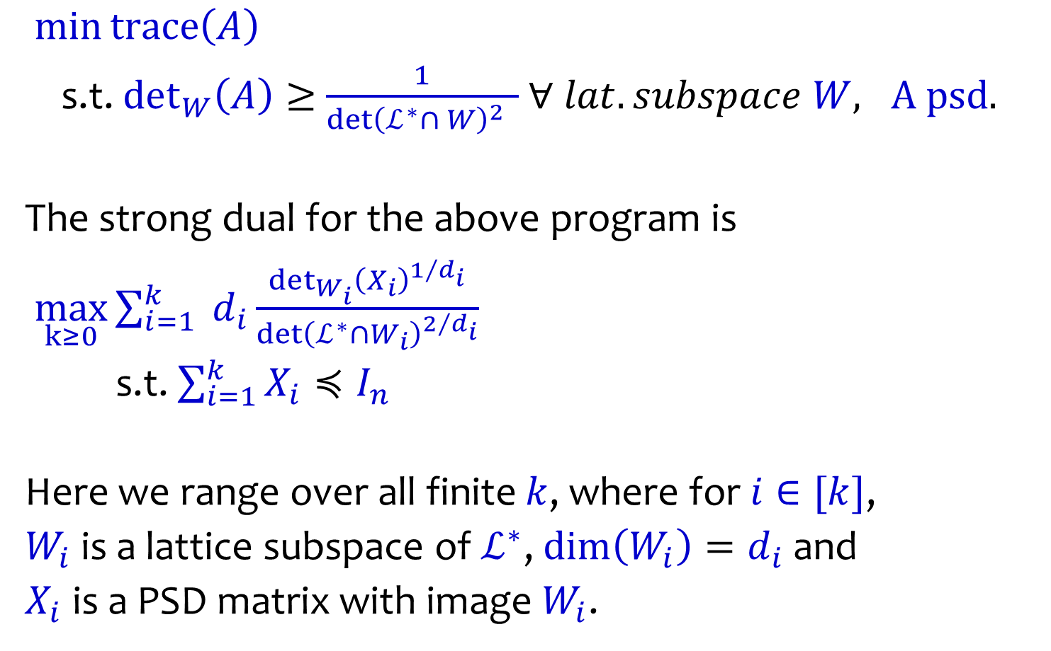
The Dual Program
$\min{trace\left(A\right)}$
s.t. $det_{W}\left(A\right)≥$ $\frac{1}{\det{{\left(ℒ^{∗}∩ W\right)}^{2}} }$ $∀ lat. subspace W, A$ psd.
The strong dual for the above program is
$\max_{k≥0}{\sum_{i=1}^{k}{ d_{i}\frac{det_{W_{i}}{{\left(X_{i}\right)}^{1/{d_{i}}}}}{\det{{\left(ℒ^{∗}∩W_{i}\right)}^{2/{d_{i}}}}}}}$
s.t. $\sum_{i=1}^{k}{X_{i}}≼I_{n}$
Here we range over all finite $k$, where for $i∈[k]$,
$W_{i}$ is a lattice subspace of $ℒ^{∗}$, $\dim\left(W_{i}\right)=d_{i}$ and
$X_{i}$ is a PSD matrix with image $W_{i}$.

Slide 34
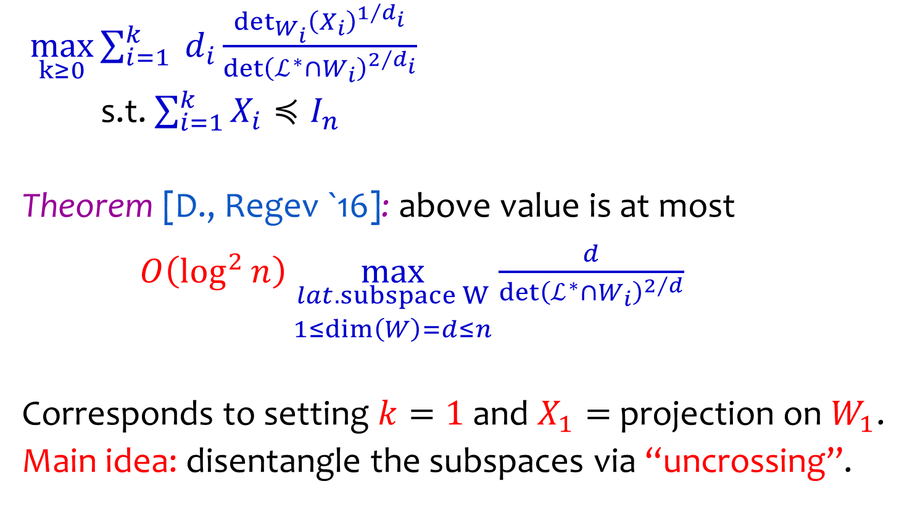
The Dual Program
$\max_{k≥0}{\sum_{i=1}^{k}{ d_{i}\frac{det_{W_{i}}{{\left(X_{i}\right)}^{1/{d_{i}}}}}{\det{{\left(ℒ^{∗}∩W_{i}\right)}^{2/{d_{i}}}}}}}$
s.t. $\sum_{i=1}^{k}{X_{i}}≼I_{n}$
Theorem [D., Regev `16]: above value is at most
$O\left(\log^{2}{n}\right)\max_{\begin{aligned}lat. subspace W \\ 1≤dim\left(W\right)=d≤n\end{aligned}}{\frac{d}{\det{{\left(ℒ^{∗}∩W_{i}\right)}^{2/d}}}}$
Corresponds to setting $k=1$ and $X_{1}=$ projection on $W_{1}$.
Main idea: disentangle the subspaces via “uncrossing”.

Slide 35
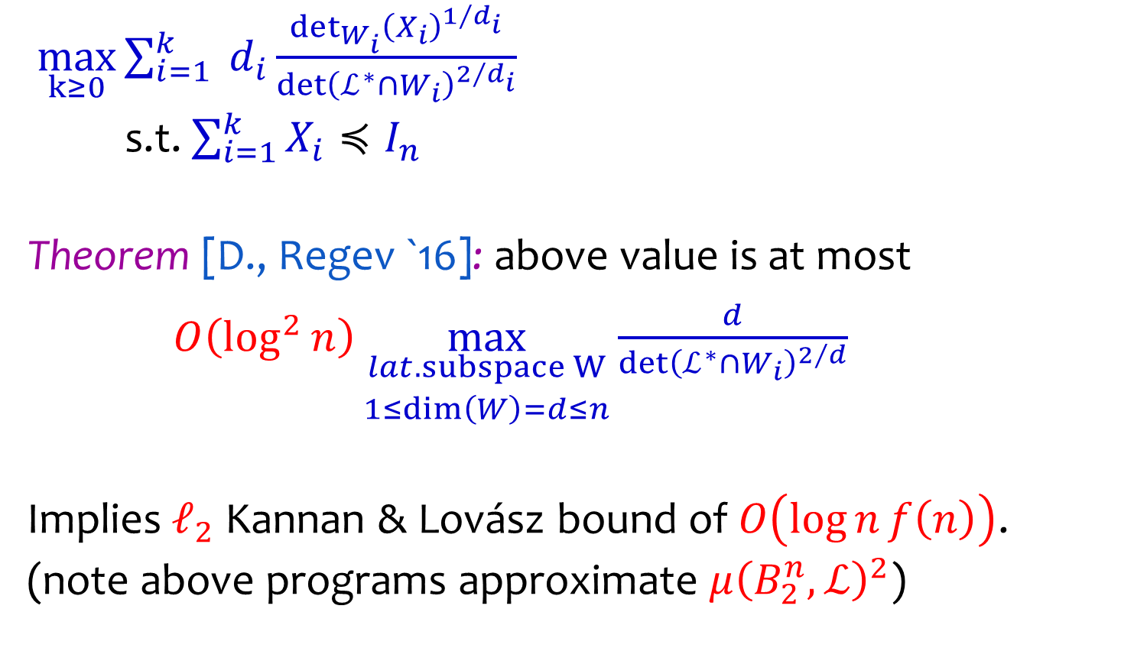
The Dual Program
$\max_{k≥0}{\sum_{i=1}^{k}{ d_{i}\frac{det_{W_{i}}{{\left(X_{i}\right)}^{1/{d_{i}}}}}{\det{{\left(ℒ^{∗}∩W_{i}\right)}^{2/{d_{i}}}}}}}$
s.t. $\sum_{i=1}^{k}{X_{i}}≼I_{n}$
Theorem [D., Regev `16]: above value is at most
$O\left(\log^{2}{n}\right)\max_{\begin{aligned}lat. subspace W \\ 1≤dim\left(W\right)=d≤n\end{aligned}}{\frac{d}{\det{{\left(ℒ^{∗}∩W_{i}\right)}^{2/d}}}}$
Implies $ℓ_{2}$ Kannan & Lovász bound of $O\left(\log{n}f\left(n\right)\right)$.
(note above programs approximate $μ{\left(B_{2}^{n},ℒ\right)}^{2}$)

Slide 36
Integer Programming and the general Kannan & Lovász conjecture

Slide 37



Anatomy of an IP Algorithm
$$K$$
$$ℤ^{n}$$
Problem: Find point in $K∩ℤ^{n}$ or
decide that $K$ is integer free.

Slide 38

Anatomy of an IP Algorithm
$$y$$
$$K$$
$$ℤ^{n}$$
Problem: Find point in $K∩ℤ^{n}$ or
decide that $K$ is integer free.

Slide 39


Anatomy of an IP Algorithm
$$y$$
$$K$$
$$c$$
$$ℤ^{n}$$
Main dichotomy:
Either $K$ contains a “deep” integer point:
find $y$ by “rounding” from center $c$ of $K$.

Slide 40
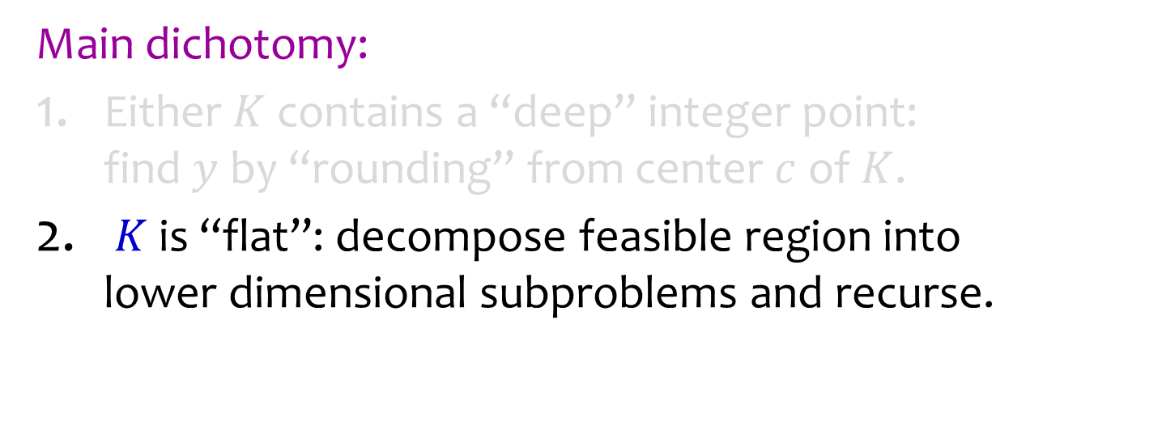



Anatomy of an IP Algorithm
$$x_{2}\text{=}2$$
subproblems
$$K$$
$$x_{2}\text{=}1$$
$$ℤ^{n}$$
Main dichotomy:
Either $K$ contains a “deep” integer point: find $y$ by “rounding” from center $c$ of $K$.
$K$ is “flat”: decompose feasible region into lower dimensional subproblems and recurse.

Slide 41
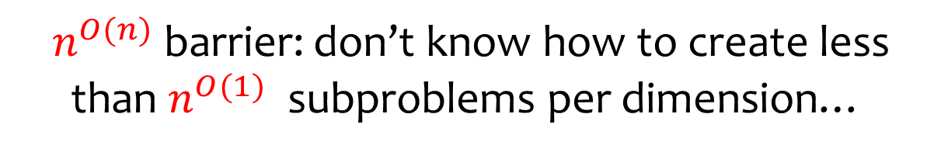
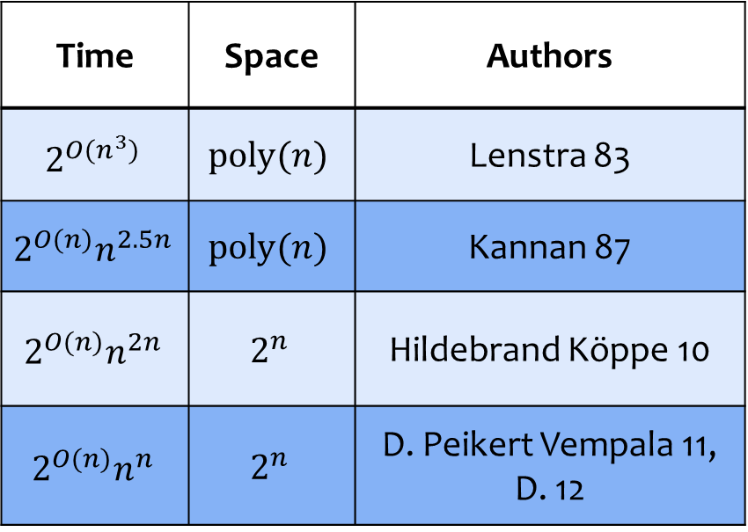
IP Algorithms
Time | Space | Authors
$$2^{O(n^{3})}$$ | $$\text{poly}(n)$$ | Lenstra 83
$$2^{O(n)}n^{2.5n}$$ | $$\text{poly}(n)$$ | Kannan 87
$$2^{O(n)}n^{2n}$$ | $$2^{n}$$ | Hildebrand Köppe 10
$$2^{O(n)}n^{n}$$ | $$2^{n}$$ | D. Peikert Vempala 11, D. 12
$n^{O(n)}$ barrier: don’t know how to create less than $n^{O(1)}$ subproblems per dimension…

Slide 42
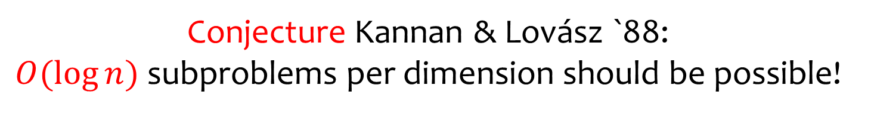
IP Algorithms
Time | Space | Authors
$$2^{O(n^{3})}$$ | $$\text{poly}(n)$$ | Lenstra 83
$$2^{O(n)}n^{2.5n}$$ | $$\text{poly}(n)$$ | Kannan 87
$$2^{O(n)}n^{2n}$$ | $$2^{n}$$ | Hildebrand Köppe 10
$$2^{O(n)}n^{n}$$ | $$2^{n}$$ | D. Peikert Vempala 11, D. 12
Conjecture Kannan & Lovász `88:
$O(\log{n})$ subproblems per dimension should be possible!

Slide 43



General Covering Radius & Deep Points
The covering radius of $K$ with respect to $ℤ^{n}$ is
$μ\left(K,ℤ^{n}\right)=\min{ \{s≥0: {∀t∈ℝ}^{n}, (sK+t)∩ℤ^{n}≠∅\}}$
or, smallest scaling $s$ such that every shift $sK+t$ contains an integer point.
$$K$$
$$ℤ^{2}$$

Slide 44


General Covering Radius & Deep Points
The covering radius of $K$ with respect to $ℤ^{n}$ is
$μ\left(K,ℤ^{n}\right)=\min{ \{s≥0: {∀t∈ℝ}^{n}, (sK+t)∩ℤ^{n}≠∅\}}$
or, smallest scaling $s$ such that every shift $sK+t$ contains an integer point.
$$μ\left(K,ℤ^{2}\right)>1$$
$K$+ $t$
$$ℤ^{2}$$

Slide 45



General Covering Radius & Deep Points
The covering radius of $K$ with respect to $ℤ^{n}$ is
$μ\left(K,ℤ^{n}\right)=\min{ \{s≥0: {∀t∈ℝ}^{n}, (sK+t)∩ℤ^{n}≠∅\}}$
$$μ\left(K,ℤ^{2}\right)=2$$
$$2K$$
$$ℤ^{2}$$

Slide 46



General Covering Radius & Deep Points
Integral shifts of $2K$ “cover” $ℝ^{2}$, i.e. $2K+ℤ^{2}=ℝ^{2}$.
$$2K$$
$$ℤ^{2}$$

Slide 47



General Covering Radius & Deep Points
If covering radius $μ\left(K,ℤ^{n}\right)≤1/2$,
then any shift of $K$ contains a “deep” integer point.
$$c$$
$$K+t_{1}$$
$$ℤ^{2}$$

Slide 48
General Covering Radius & Deep Points
If covering radius $μ\left(K,ℤ^{n}\right)≤1/2$,
then any shift of $K$ contains a “deep” integer point.
$$c$$
$$K+t_{1}$$
$$ℤ^{2}$$

Slide 49


General Covering Radius & Deep Points
If covering radius $μ\left(K,ℤ^{n}\right)≤1/2$,
then any shift of $K$ contains a “deep” integer point.
$$c$$
$$K+t_{2}$$
$$ℤ^{2}$$

Slide 50


General Covering Radius & Deep Points
If covering radius $μ\left(K,ℤ^{n}\right)≤1/2$,
then any shift of $K$ contains a “deep” integer point.
$$c$$
$$K+t_{3}$$
$$ℤ^{2}$$

Slide 51


General Covering Radius & Deep Points
Thus, if $μ\left(K,ℤ^{n}\right)≤1/2$ finding an
integer point in $K$ is “easy”.
$$c$$
$$K$$
$$ℤ^{2}$$

Slide 52


General Covering Radius & Deep Points
Thus, if $μ\left(K,ℤ^{n}\right)≤1/2$ finding an
integer point in $K$ is “easy”.
If not, we should decompose $K$ into lower dimensional pieces…
$$K$$
$$ℤ^{2}$$

Slide 53


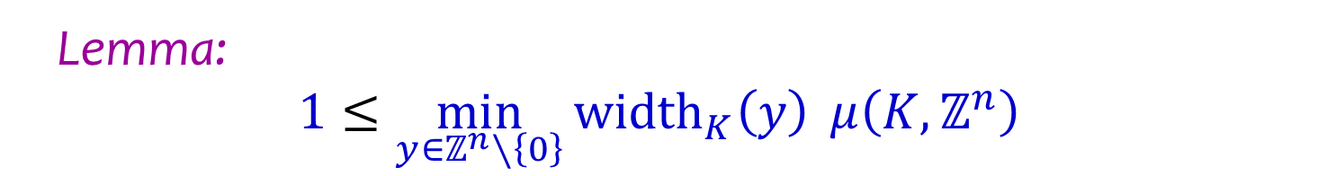




Lower Bounds on the Covering Radius
Lemma:
$$1≤\min_{y∈ℤ^{n}∖\left\{0\right\}}{{width}_{K}\left(y\right)} μ\left(K,ℤ^{n}\right)$$
$$y^{T}x=.9$$
$$.8$$
$$K$$
$$y$$
$$y^{T}x=.1$$
To cover space, $K$ must have width at least $1$.

Slide 54

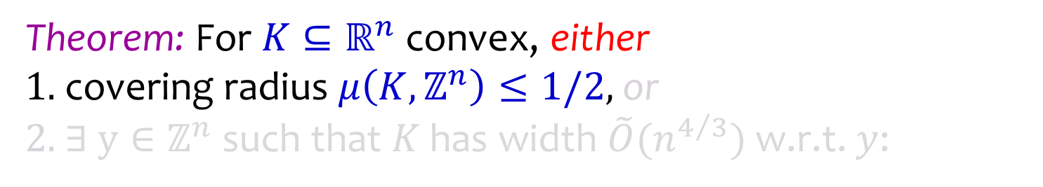

Khinchine’s Flatness Theorem
Theorem: For $K⊆ℝ^{n}$ convex, either 1. covering radius $μ\left(K,ℤ^{n}\right)≤1/2$, or 2. $∃ y∈ℤ^{n}$ such that $K$ has width $\tilde{O}(n^{4/3})$ w.r.t. $y$:
$$K$$
$$K$$
$$K$$
$$ℤ^{2}$$

Slide 55

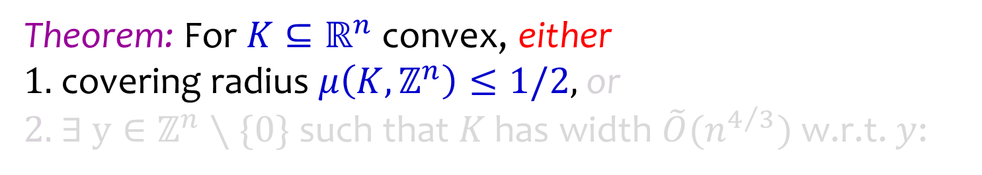
Khinchine’s Flatness Theorem
Theorem: For $K⊆ℝ^{n}$ convex, either 1. covering radius $μ\left(K,ℤ^{n}\right)≤1/2$, or 2. $∃ y∈ℤ^{n}∖\{0\}$ such that $K$ has width $\tilde{O}(n^{4/3})$ w.r.t. $y$:
$$K$$
$$K$$
$$ℤ^{2}$$

Slide 56


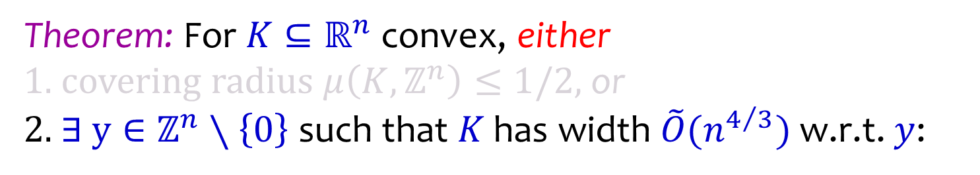


Khinchine’s Flatness Theorem
Theorem: For $K⊆ℝ^{n}$ convex, either 1. covering radius $μ\left(K,ℤ^{n}\right)≤1/2$, or 2. $∃ y∈ℤ^{n}∖\left\{0\right\}$ such that $K$ has width $\tilde{O}(n^{4/3})$ w.r.t. $y$:
$$y^{T}x=2.3$$
$$1.5$$
$$y$$
$$K$$
$$y^{T}x=.8$$
$$ℤ^{2}$$

Slide 57





Khinchine’s Flatness Theorem
Theorem: For $K⊆ℝ^{n}$ convex, either 1. covering radius $μ\left(K,ℤ^{n}\right)≤1/2$, or 2. $∃ y∈ℤ^{n}∖\left\{0\right\}$ such that $K$ has width $\tilde{O}(n^{4/3})$ w.r.t. $y$.
$$y^{T}x=3$$
$$y^{T}x=2$$
$$K$$
$$y$$
$$y^{T}x=1$$
$$ℤ^{2}$$
$$y^{T}x=0$$

Slide 58
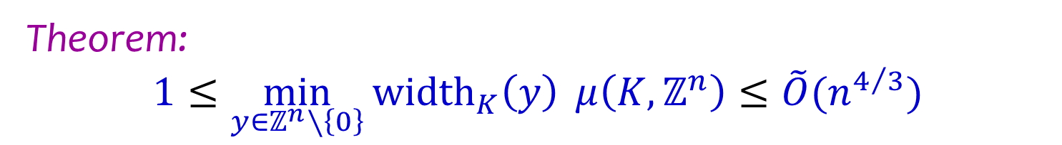

Khinchine’s Flatness Theorem
Theorem:
$$1≤\min_{y∈ℤ^{n}∖\left\{0\right\}}{{width}_{K}\left(y\right)} μ\left(K,ℤ^{n}\right)≤\tilde{O}(n^{4/3})$$
To cover space, suffices to scale $K$ to have width
somewhere between $1$ and $\tilde{O}(n^{4/3})$.

Slide 59

Khinchine’s Flatness Theorem
Bounds improvements for general bodies:
Khinchine `48: $(n+1)!$
Babai `86: $2^{O(n)}$
Lenstra-Lagarias-Schnorr `87: ${ n}^{5/2}$ Kannan-Lovasz `88: ${ n}^{2}$
Banaszczyk et al `99: ${ n}^{3/2}$
Rudelson `00: ${ n}^{4/3}\log^{c}{n}$
[Khinchine `48, Babai `86, Hastad `86, Lenstra-Lagarias-Schnorr `87, Kannan-Lovasz `88, Banaszczyk `93-96, Banaszczyk-Litvak-Pajor-Szarek `99, Rudelson `00]

Slide 60




Khinchine’s Flatness Theorem
Best known bounds:
Ellipsoids: $Θ(n)$ [Banaszczyk `93]
Centrally Symmetric: $O(n\log{n})$ [Banaszczyk `96]
General: $\tilde{O}(n^{4/3})$ [Banaszczyk `96,
Rudelson `00]
Bound conjectured to be $O(n)$ (best possible).
$$ℤ^{n}$$
$K=\{x:\sum_{i}{x_{i}}≤n, x≥0\}$
$$K$$

Slide 61








How can we improve decompositions?
Recursion only uses integrality of
“one variable” at a time. Why?
$$y^{T}x=3$$
$$2.3$$
$$y^{T}x=2$$
$$y$$
$$K$$
$$y^{T}x=1$$
$$.8$$
$$ℤ^{2}$$
$$y^{T}x=0$$
Reason: It’s very efficient to enumerate
integer points in an interval.

Slide 62


How can we improve decompositions?
When else is it efficient to enumerate integer points?
Theorem [D. Peikert Vempala `11, D. `12]:
For $K⊆ℝ^{d}$ convex, can enumerate $K∩ℤ^{d}$ in time
$2^{O(d)}\max_{t∈ℝ^{d}}{|K+t|}$ .
$$K$$

Slide 63

How can we improve decompositions?
When else is it efficient to enumerate integer points?
Theorem [D. Peikert Vempala `11, D. `12]:
For $K⊆ℝ^{d}$ convex, can enumerate $K∩ℤ^{d}$ in time
$2^{O(d)}\max_{t∈ℝ^{d}}{|K+t|}$ .
$K$+$t$

Slide 64



How can we improve decompositions?
Generalized Decomposition Strategy for $K$:
Choose $d≥1, P∈ℤ^{d×n}$ rank $d$ such that
$\max_{t∈ℝ^{d}}{{\left|P\left(K\right)+t\right|}^{1/d}}$ is “small”
$$P(K)$$

Slide 65
How can we improve decompositions?
Generalized Decomposition Strategy for $K$:
Choose $d≥1, P∈ℤ^{d×n}$ rank $d$ such that
$\max_{t∈ℝ^{d}}{{\left|P\left(K\right)+t\right|}^{1/d}}$ is “small”
Enumerate $P\left(K\right)∩ℤ^{d}$ and recurse on subproblems.
$$P(K)$$
subproblems

Slide 66


How can we improve decompositions?
How should we choose $d≥1,P∈ℤ^{d×n}?$
Hardest bodies to decompose satisfy $μ\left(K,ℤ^{n}\right)=1/2$,
i.e. as “fat” as possible without containing deep points.
$$K$$

Slide 67


How can we improve decompositions?
How should we choose $d≥1,P∈ℤ^{d×n}?$
If $μ\left(K,ℤ^{n}\right)=1/2$ then also $μ\left(P\left(K\right),ℤ^{d}\right)≤1/2$,
so integer projections of $K$ are only “fatter”.
$$K$$
$$P(K)$$

Slide 68


How can we improve decompositions?
How should we choose $d≥1,P∈ℤ^{d×n}?$
If $μ\left(P\left(K\right),ℤ^{d}\right)≤1/2$, then
$\max_{t∈ℝ^{d}}{{\left|P\left(K\right)+t\right|}^{1/d}}=O\left(1\right)vol_{d}{\left(P\left(K\right)\right)}^{1/d}$.
Good choice of $d≥1,P∈ℤ^{d×n}$ should approximately minimize
$\min_{d≥1}{\min_{\begin{aligned}P∈ℤ^{d×n} \\ rank d\end{aligned}}{vol_{d}{\left(P\left(K\right)\right)}^{1/d}}}$.

Slide 69


Volumetric bounds on the Covering Radius
Lemma: If $K+ℤ^{n}=ℝ^{n}$, then ${vol}_{n}\left(K\right)≥1$.
$$K$$
$$ℤ^{2}$$

Slide 70



Volumetric bounds on the Covering Radius
Lemma: If $K+ℤ^{n}=ℝ^{n}$, then ${vol}_{n}\left(K\right)≥1$.
Pf: Let $C={\left[0,1\right)}^{n}$ be the cube.
${vol}_{n}\left(K\right)=\sum_{y∈ℤ^{n}}{{vol}_{n}\left(K∩\left(C+y\right)\right)=\sum_{y∈ℤ^{n}}{{vol}_{n}(\left(K−y\right)∩C)}}$
$≥{vol}_{n}\left(\left(K+ℤ^{n}\right)∩C\right)=vol\left(C\right)=1$.
$$C$$
$$K$$
$$ℤ^{2}$$

Slide 71

Volumetric bounds on the Covering Radius
Lemma: If $K+ℤ^{n}=ℝ^{n}$, then ${vol}_{n}\left(K\right)≥1$.
Lemma: Let $P∈ℤ^{k×n}$ have rank $k$.
If $K+ℤ^{n}=ℝ^{n}$, then $vol_{k}\left(PK\right)≥1$.
Pf: $ℝ^{k}=P\left(K+ℤ^{n}\right)=P\left(K\right)+P\left(ℤ^{n}\right)⊆P\left(K\right)+ℤ^{k}$.

Slide 72

Volumetric bounds on the Covering Radius
Lemma: Let $P∈ℤ^{d×n}$ have rank $d$.
If $K+ℤ^{n}=ℝ^{n}$, then $vol_{d}\left(PK\right)≥1$.
Lemma: For a convex body $K⊆ℝ^{n}$
$μ\left(K,ℤ^{n}\right)≥\max_{d∈[n]}{\max_{\begin{aligned}P∈ℤ^{d×n} \\ rank d\end{aligned}}{\frac{1}{{vol}_{d}{\left(PK\right)}^{1/d} }}}$
Pf: Must scale $K$ to have volume at least $1$ in
each integer projection.

Slide 73

Kannan Lovász Conjecture
Theorem [Kannan-Lovász `88]: For $K⊆ℝ^{n}$ convex, either 1. Covering radius $μ\left(K,ℤ^{n}\right)≤1/2$, or 2. $∃ d≥1, P∈ℤ^{d×n}$ rank $d$ such that $vol_{d}\left(PK\right)≤{\left(2n\right)}^{d}$.
In particular,
$$1≤μ\left(K,ℤ^{n}\right)\min_{d∈\left[n\right]}{\min_{\begin{aligned}P∈ℤ^{d×n} \\ rank d\end{aligned}}{{vol}_{d}{\left(PK\right)}^{\frac{1}{d}}}}≤2n$$
Proof is constructive.
Enables a $2^{O(n)}n^{n}$ time IP algorithm [D. `12].

Slide 74


Kannan Lovász Conjecture
Theorem [Kannan-Lovász `88]: For $K⊆ℝ^{n}$ convex, either 1. Covering radius $μ\left(K,ℤ^{n}\right)≤1/2$, or 2. $∃ d≥1, P∈ℤ^{d×n}$ rank $d$ such that $vol_{d}\left(PK\right)≤{\left(2n\right)}^{d}$.
$ex$: $d=2, P=\left(\begin{matrix}1 & 0 \\ 0 & 1\end{matrix}\right)$
$$K$$
$$ℤ^{2}$$

Slide 75
Kannan Lovász Conjecture
Theorem [Kannan-Lovász `88]: For $K⊆ℝ^{n}$ convex, either 1. Covering radius $μ\left(K,ℤ^{n}\right)≤1/2$, or 2. $∃ d≥1, P∈ℤ^{d×n}$ rank $d$ such that $vol_{d}\left(PK\right)≤{\left(2n\right)}^{d}$.
$ex$: $d=2, P=\left(\begin{matrix}1 & 0 \\ 0 & 1\end{matrix}\right)$
subproblems
$$K$$
$$ℤ^{2}$$

Slide 76

Kannan Lovász Conjecture
Theorem [Kannan-Lovász `88]: For $K⊆ℝ^{n}$ convex, either 1. Covering radius $μ\left(K,ℤ^{n}\right)≤1/2$, or 2. $∃ d≥1, P∈ℤ^{d×n}$ rank $d$ such that $vol_{d}\left(PK\right)≤{\left(2n\right)}^{d}$.
$ex$: $d=1, P=\left(0 1\right)$
subproblems
Same as standard flatness.
$$K$$
$$ℤ^{2}$$

Slide 77

Kannan Lovász Conjecture
Conjecture [Kannan-Lovász `88]: For $K⊆ℝ^{n}$ convex, either 1. Covering radius $μ\left(K,ℤ^{n}\right)≤1/2$, or 2. $∃ d≥1, P∈ℤ^{d×n}$ rank $d$ such that
$vol_{d}\left(PK\right)≤{O\left(\log{n}\right)}^{d}$.
In particular,
$$1≤μ\left(K,ℤ^{n}\right)\min_{d∈\left[n\right]}{\min_{\begin{aligned}P∈ℤ^{d×n} \\ rank d\end{aligned}}{{vol}_{d}{\left(PK\right)}^{\frac{1}{d}}}}≤O(\log{n})$$
An efficient enough construction would imply
a $2^{O\left(n\right)}{\left(\log{n}\right)}^{O(n)}$ time IP algorithm!

Slide 78
Conclusions
New natural conjectured converse for Minkowski’s convex body theorem.
Showed that it implies an important special case of a conjecture of Kannan & Lovász.
Open Problems
Prove or disprove any of the conjectures!
Find new applications.

Slide 79
THANK YOU!

