Slide 1
Near Optimal Deterministic Algorithms for Volume Computation via M-ellipsoids
Daniel Dadush (CWI)
Joint with Santosh Vempala

Slide 2

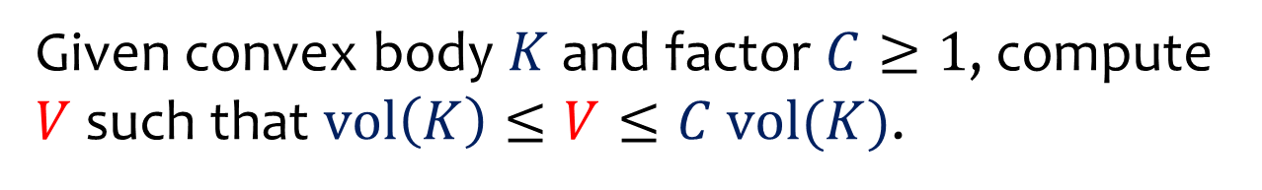
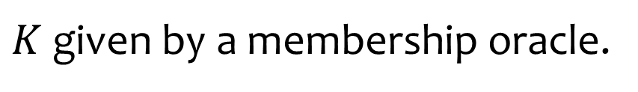


Volume Estimation
Given convex body $K$ and factor $C≥1$, compute $V$ such that $vol\left(K\right)≤V≤C vol(K)$.
$$K$$
$$r$$
$$R$$
$K$ given by a membership oracle.

Slide 3
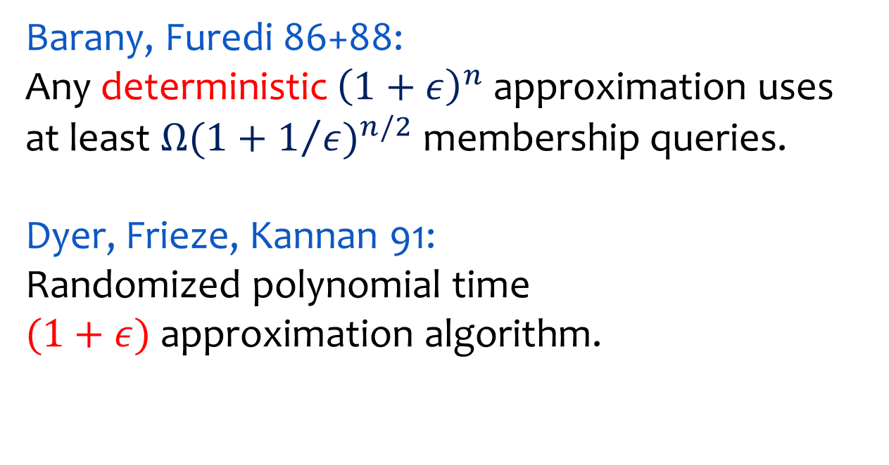

Volume Estimation
Barany, Furedi 86+88:
Any deterministic ${\left(1+ε\right)}^{n}$ approximation uses at least ${Ω(1+1/ε)}^{n/2}$ membership queries.
Dyer, Frieze, Kannan 91:
Randomized polynomial time
$(1+ε)$ approximation algorithm.
$$K$$

Slide 4
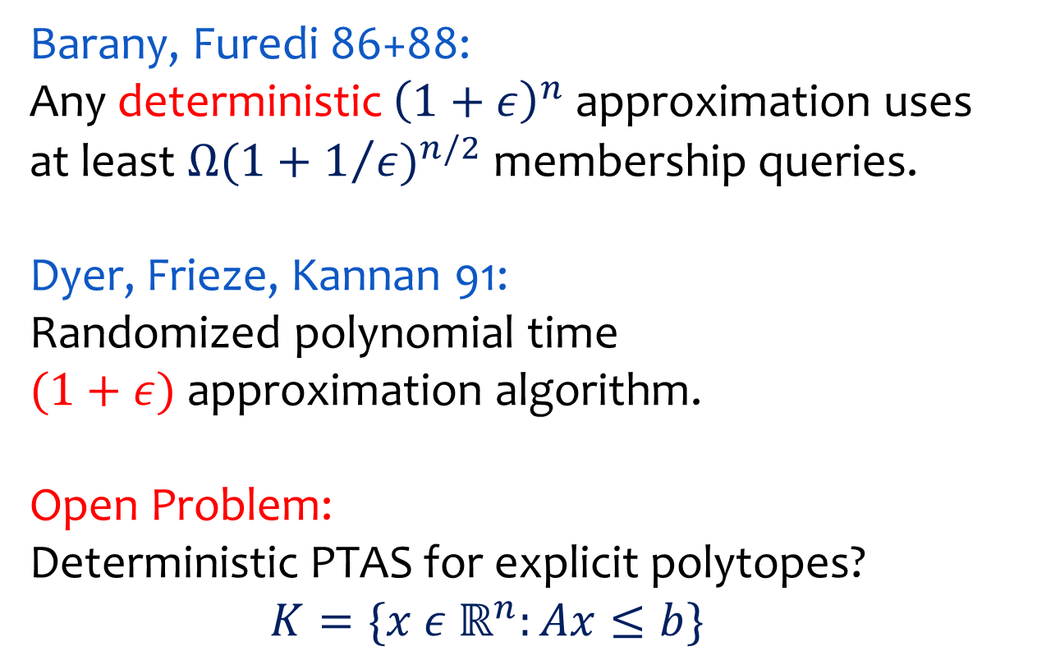
Volume Estimation
Barany, Furedi 86+88:
Any deterministic ${\left(1+ε\right)}^{n}$ approximation uses at least ${Ω(1+1/ε)}^{n/2}$ membership queries.
Dyer, Frieze, Kannan 91:
Randomized polynomial time
$(1+ε)$ approximation algorithm.
Open Problem:
Deterministic PTAS for explicit polytopes?
$K=\{x ε{ ℝ}^{n}:Ax≤b\}$

Slide 5
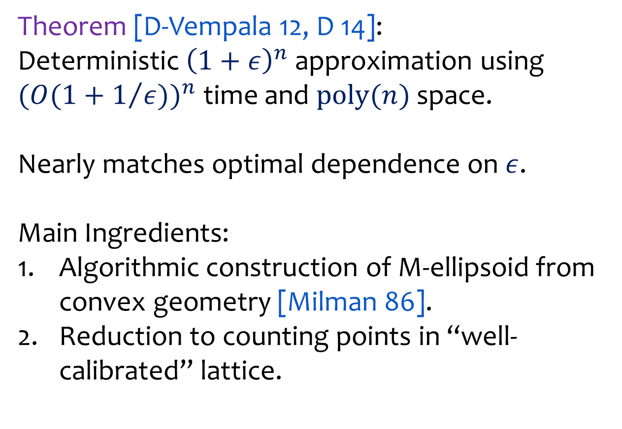
Volume Estimation
Theorem [D-Vempala 12, D 14]:
Deterministic ${\left(1+ε\right)}^{n}$ approximation using ${(O(1+1/{ε)})}^{n}$ time and $\text{poly}(n)$ space.
Nearly matches optimal dependence on $ε$.
Main Ingredients:
Algorithmic construction of M-ellipsoid from convex geometry [Milman 86].
Reduction to counting points in “well-calibrated” lattice.

Slide 6


Volume Estimation
Assumption: $K$ is symmetric about the origin
$$K$$
$$K$$
asymmetric
symmetric

Slide 7
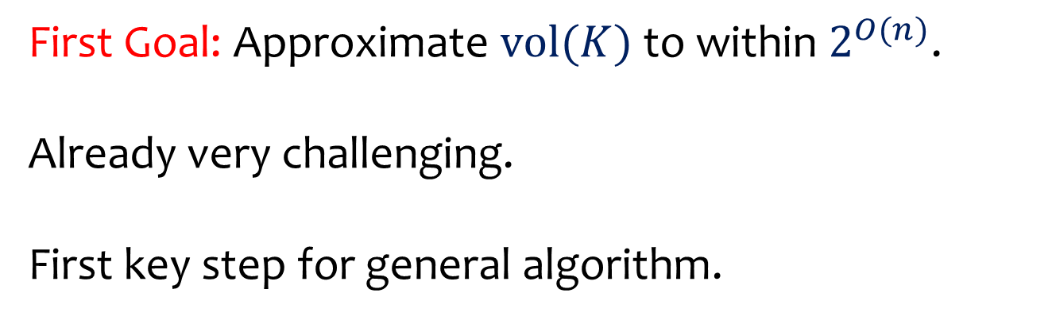
Volume Estimation
First Goal: Approximate $vol(K)$ to within $2^{O(n)}$.
Already very challenging.
First key step for general algorithm.

Slide 8

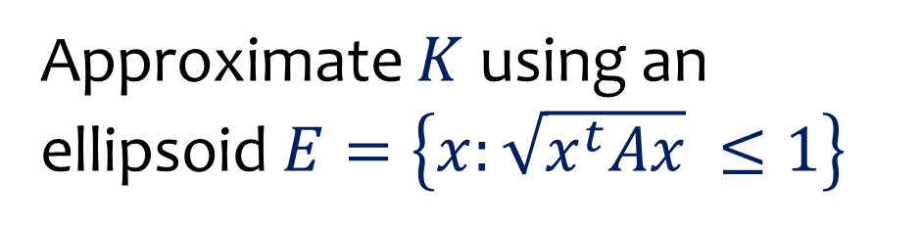

Ellipsoidal Approximation
$$K$$
$$E$$
Approximate $K$ using an
ellipsoid $E=\left\{x:\sqrt{x^{t}Ax} ≤1\right\}$

Slide 9



Ellipsoidal Approximation
How well can we approximate volume
using sandwiching ellipsoids?
$$E_{2}$$
$$E_{1}$$
$$K$$
$$E_{1}⊆K⊆E_{2}$$

Slide 10

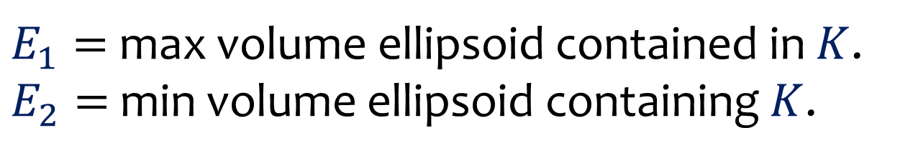



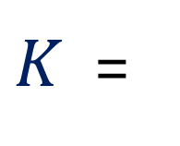

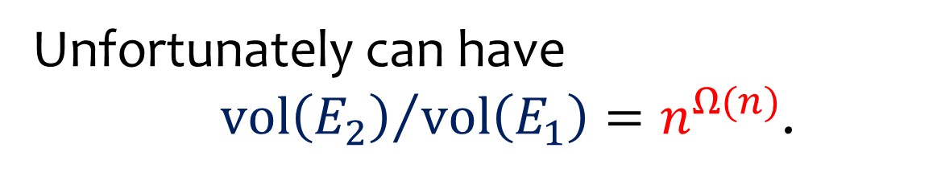

Ellipsoidal Approximation
Unfortunately can have
${\text{vol}\left(E_{2}\right)}/{\text{vol}\left(E_{1}\right)}=n^{Ω(n)}$.
$$n/2$$
$$n/2$$
$K$ =
$$×$$
$$E_{1}⊆K⊆E_{2}$$
$${\left\|x\right\|}_{∞}≤1$$
$${\left\|x\right\|}_{1}≤1$$
$E_{1}=$ max volume ellipsoid contained in $K$.
$E_{2}=$ min volume ellipsoid containing $K$.

Slide 11
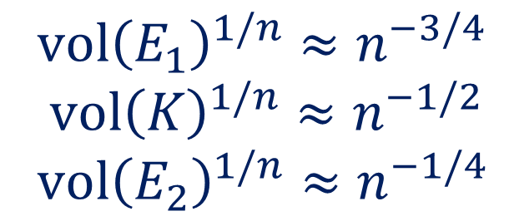
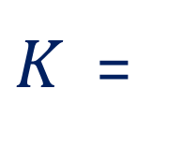
Ellipsoidal Approximation
Unfortunately can have
${\text{vol}\left(E_{2}\right)}/{\text{vol}\left(E_{1}\right)}=n^{Ω(n)}$.
$$n/2$$
$$n/2$$
$K$ =
$$×$$
$$E_{1}⊆K⊆E_{2}$$
$${\left\|x\right\|}_{∞}≤1$$
$${\left\|x\right\|}_{1}≤1$$
$vol{\left(E_{1}\right)}^{1/n}≈n^{−3/4}$
$vol{\left(K\right)}^{1/n}≈n^{−1/2}$
$vol{\left(E_{2}\right)}^{1/n}≈n^{−1/4}$

Slide 12

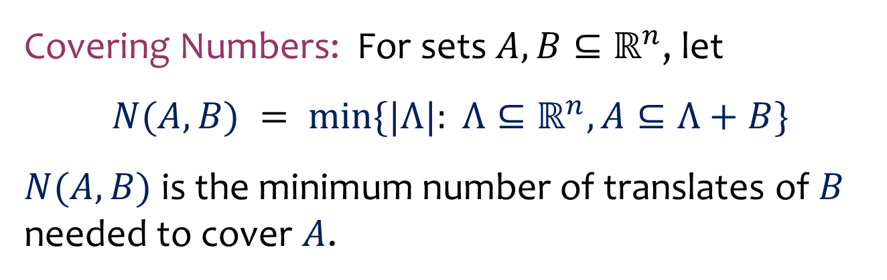

Milman’s Ellipsoid
$$E$$
$$K$$
Covering Numbers: For sets $A,B⊆ℝ^{n}$, let
$$N(A,B) = min⁡\{|Λ|: Λ⊆ℝ^{n}, A⊆Λ+B\}$$
$N(A,B)$ is the minimum number of translates of $B$ needed to cover $A$.

Slide 13
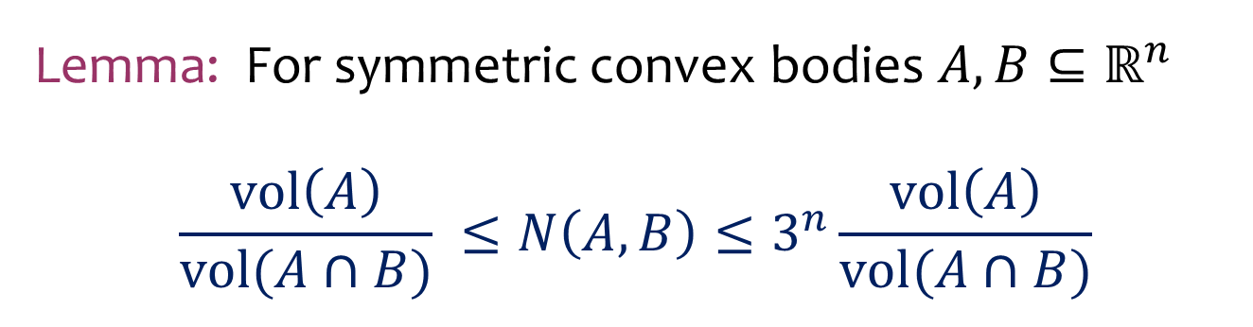
Milman’s Ellipsoid
$$E$$
$$K$$
Lemma: For symmetric convex bodies $A,B⊆ℝ^{n}$
$$\frac{vol\left(A\right)}{vol(A∩B)} ≤N\left(A,B\right)≤3^{n}\frac{vol\left(A\right)}{vol(A∩B)}$$

Slide 14


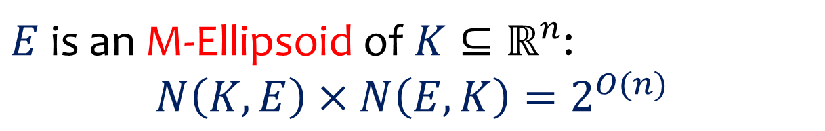
Milman’s Ellipsoid
$$K$$
$$E$$
$E$ is an M-Ellipsoid of $K⊆ℝ^{n}$:
$$N\left(K,E\right)×N\left(E,K\right)=2^{O(n)}$$

Slide 15





Milman’s Ellipsoid
$$E_{2}$$
$$E_{1}$$
$$K$$
$$E_{4}$$
$$E_{3}$$
$E$ is an M-ellipsoid of $K⊆ℝ^{n}$:
$$N\left(K,E\right)×N\left(E,K\right)=2^{O(n)}$$

Slide 16





Milman’s Ellipsoid
$$K_{3}$$
$$E$$
$$K_{1}$$
$$K_{4}$$
$$K_{2}$$
$E$ is an M-Ellipsoid of $K⊆ℝ^{n}$:
$$N\left(K,E\right)×N\left(E,K\right)=2^{O(n)}$$

Slide 17

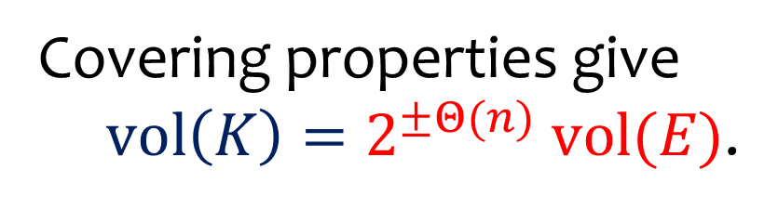

Milman’s Ellipsoid
$$K$$
$$K$$
$$E$$
$$E$$
Covering properties give
$\text{vol}\left(K\right)=2^{±Θ(n)} \text{vol}(E)$.
$E$ is an M-Ellipsoid of $K⊆ℝ^{n}$:
$$N\left(K,E\right)×N\left(E,K\right)=2^{O(n)}$$

Slide 18
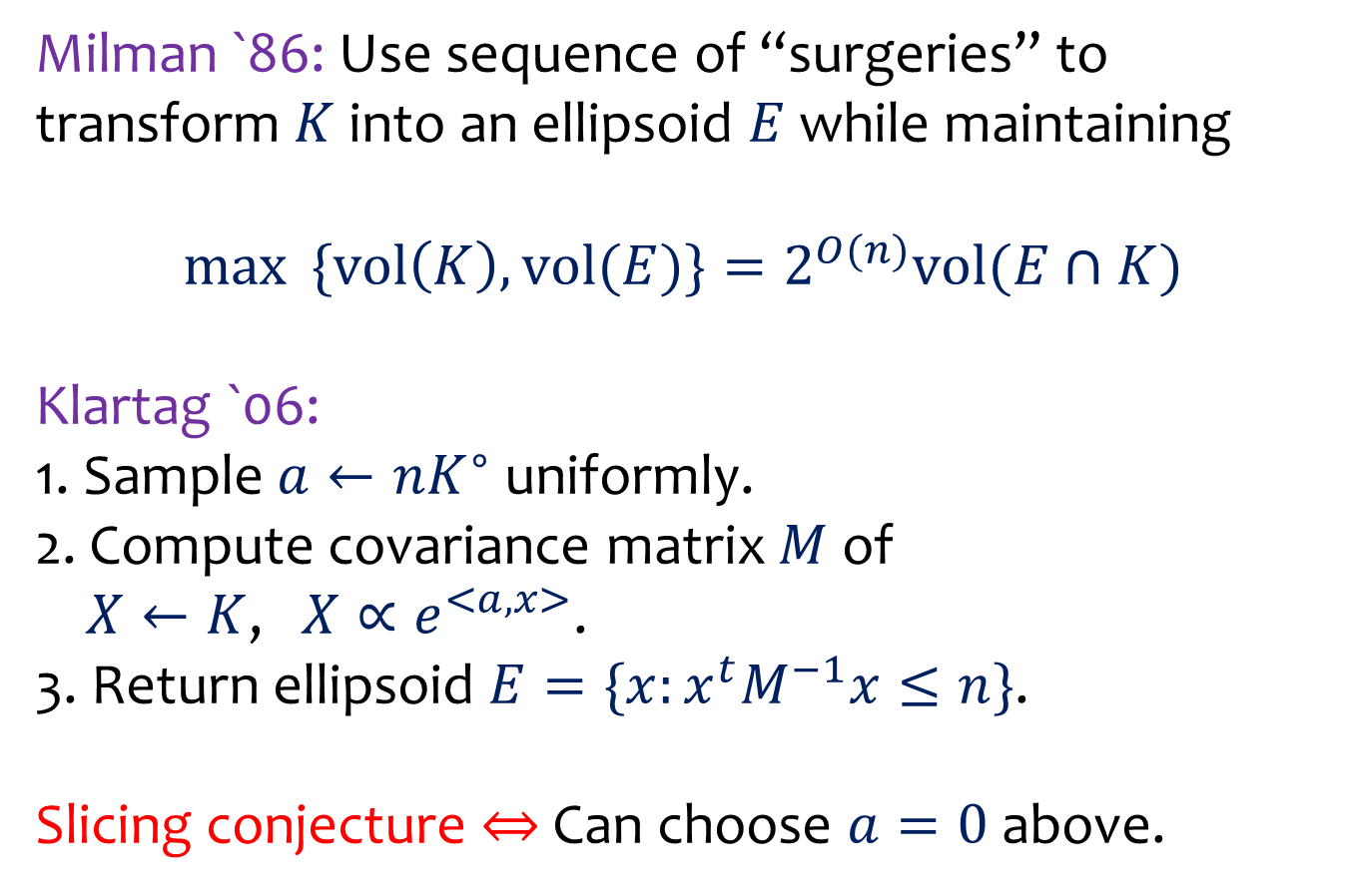
M-ellipsoid Constructions
Milman `86: Use sequence of “surgeries” to transform $K$ into an ellipsoid $E$ while maintaining
$\max{ \{vol\left(K\right), vol(E)\}}=2^{O(n)}vol(E∩K)$
Klartag `06:
1. Sample $a←nK^{∘}$ uniformly.
2. Compute covariance matrix $M$ of
$X←K$, $X∝e^{<a,x>}$.
3. Return ellipsoid $E=\{x:x^{t}M^{−1}x≤n\}$.
Slicing conjecture $⇔$ Can choose $a=0$ above.

Slide 19
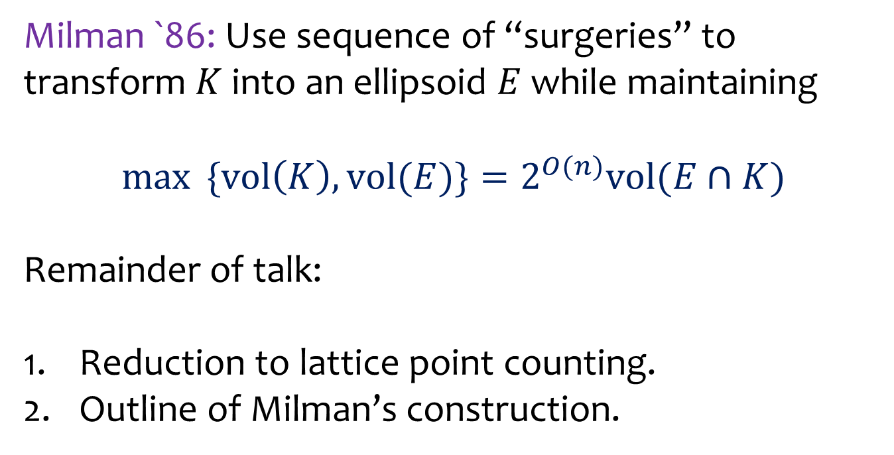
M-ellipsoid Constructions
Milman `86: Use sequence of “surgeries” to transform $K$ into an ellipsoid $E$ while maintaining
$\max{ \{vol\left(K\right), vol(E)\}}=2^{O(n)}vol(E∩K)$
Remainder of talk:
Reduction to lattice point counting.
Outline of Milman’s construction.

Slide 20
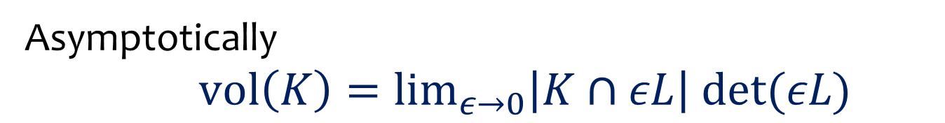

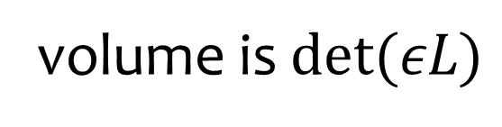

Volume via Counting
Asymptotically
$\text{vol}\left(K\right)=\lim_{ε→0}\left|K∩εL\right| det⁡(εL)$
$$K$$
$$εL$$
volume is $det(εL)$

Slide 21
Volume via Counting
For which $ε$ does this yield a good approximation?
$$K$$
$$εL$$
volume is $det(εL)$

Slide 22
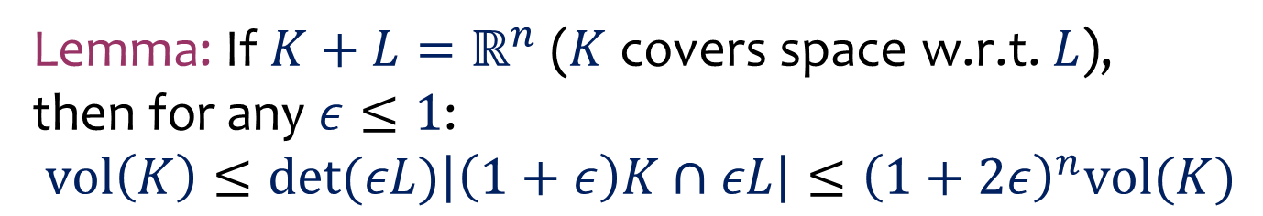
Volume via Counting
Lemma: If $K+L=ℝ^{n}$ ($K$ covers space w.r.t. $L$),
then for any $ε≤1$:
$$vol\left(K\right)≤det⁡(εL)\left|\left(1+ε\right)K∩εL\right|≤{\left(1+2ε\right)}^{n}vol(K)$$
$$K$$
$$εL$$
volume is $det(εL)$

Slide 23

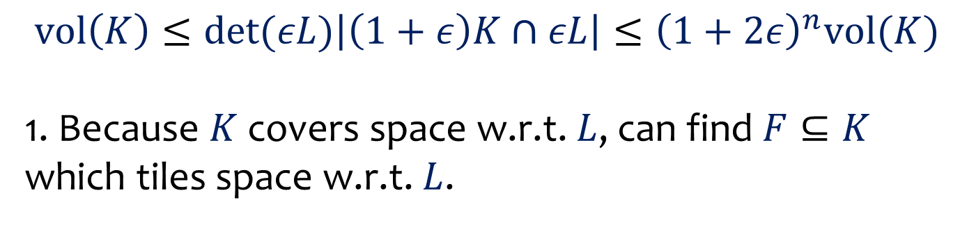


Volume via Counting
$$vol\left(K\right)≤det⁡(εL)\left|\left(1+ε\right)K∩εL\right|≤{\left(1+2ε\right)}^{n}vol(K)$$
1. Because $K$ covers space w.r.t. $L$, can find $F⊆K$ which tiles space w.r.t. $L$.
$$K$$
$$F$$
$$L$$

Slide 24

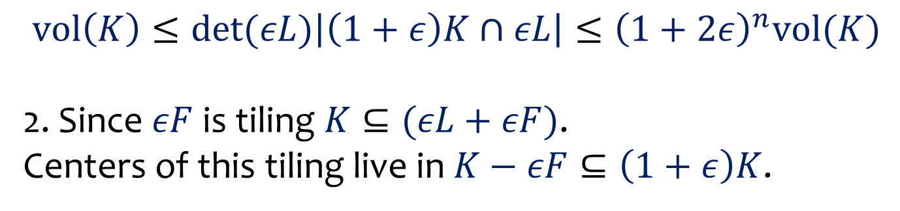


Volume via Counting
$$vol\left(K\right)≤det⁡(εL)\left|\left(1+ε\right)K∩εL\right|≤{\left(1+2ε\right)}^{n}vol(K)$$
2. Since $εF$ is tiling $K⊆(εL+εF)$.
Centers of this tiling live in $K−εF⊆\left(1+ε\right)K$.
$$εF$$
$$K$$
$$εL$$

Slide 25
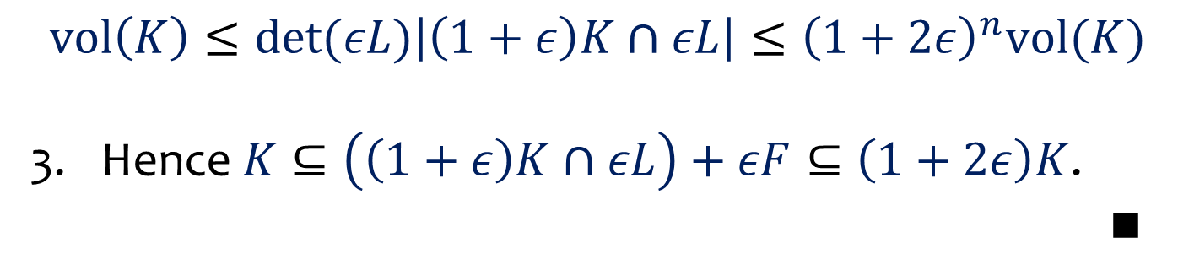
Volume via Counting
$$vol\left(K\right)≤det⁡(εL)\left|\left(1+ε\right)K∩εL\right|≤{\left(1+2ε\right)}^{n}vol(K)$$
Hence $K⊆\left(\left(1+ε\right)K∩εL\right)+εF⊆\left(1+2ε\right)K$.
$∎$
$$εF$$
$$K$$
$$εL$$

Slide 26
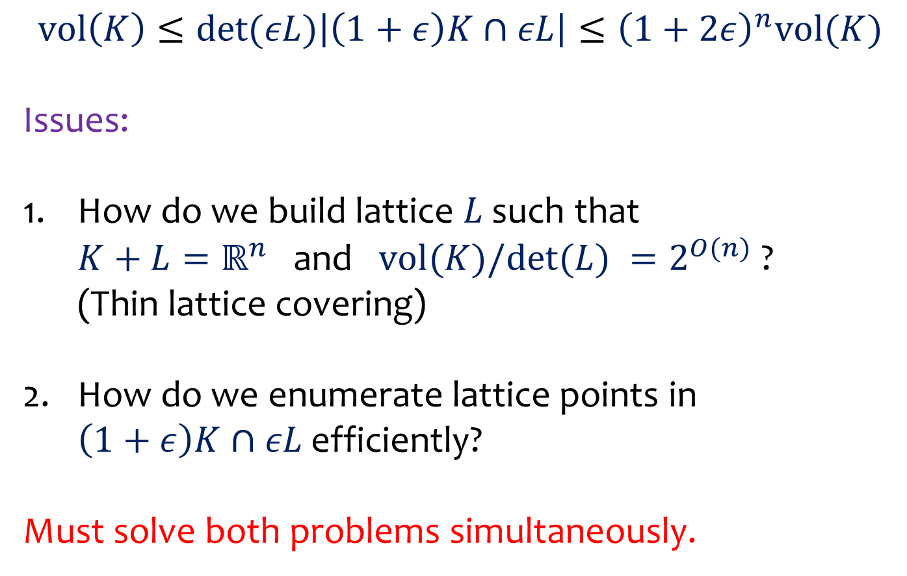
Volume via Counting
$$vol\left(K\right)≤det⁡(εL)\left|\left(1+ε\right)K∩εL\right|≤{\left(1+2ε\right)}^{n}vol(K)$$
Issues:
How do we build lattice $L$ such that
$K+L=ℝ^{n}$ and $vol(K)/det⁡(L) =2^{O(n)}$ ?
(Thin lattice covering)
How do we enumerate lattice points in
$\left(1+ε\right)K∩εL$ efficiently?
Must solve both problems simultaneously.

Slide 27

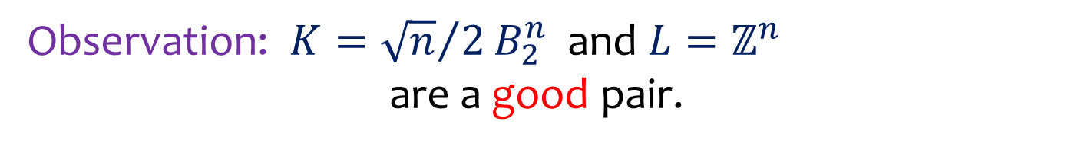



Volume via Counting
Observation: $K={\sqrt{n}}/2B_{2}^{n}$ and $L=ℤ^{n}$
are a good pair.
$$e_{2}$$
$$K$$
$$F$$
$$e_{1}$$

Slide 28
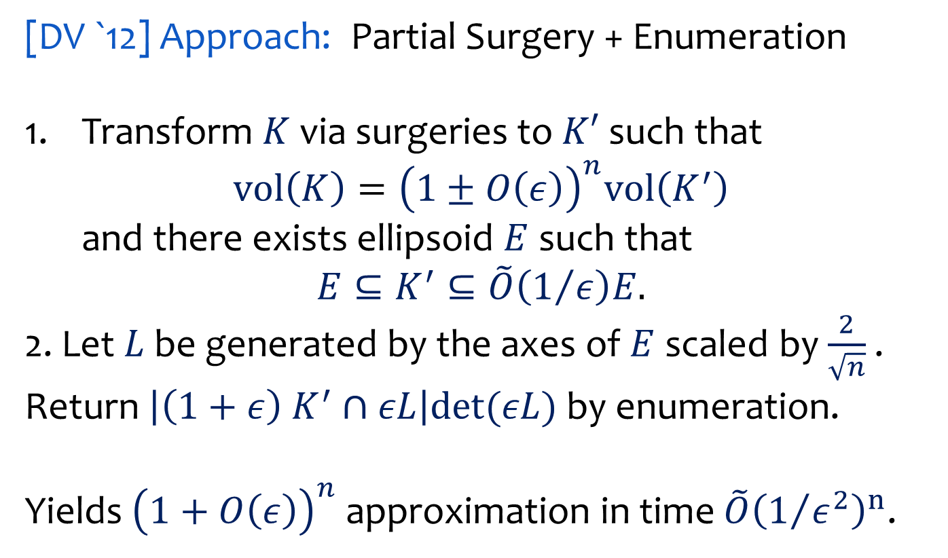
Volume via Counting
[DV `12] Approach: Partial Surgery + Enumeration
Transform $K$ via surgeries to $K′$ such that
$vol\left(K\right)={\left(1±O\left(ε\right)\right)}^{n}vol\left(K^{′}\right)$
and there exists ellipsoid $E$ such that
$$E⊆K^{′}⊆\tilde{O}\left(1/ε\right)E.$$
2. Let $L$ be generated by the axes of $E$ scaled by $\frac{2}{\sqrt{n}}$ .
Return $\left|\left(1+ε\right) K^{′}∩εL\right|det⁡(εL)$ by enumeration.
Yields ${\left(1+O\left(ε\right)\right)}^{n}$ approximation in time $\tilde{O}{\left(1/{ε^{2}}\right)}^{n}$.

Slide 29
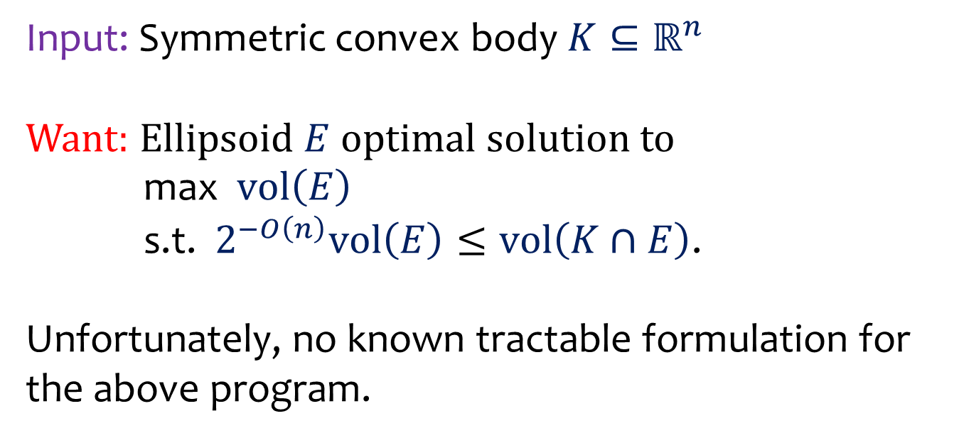
Building a good ellipsoid
Input: Symmetric convex body $K⊆ℝ^{n}$
Want: Ellipsoid $E$ optimal solution to
max $\text{vol}\left(E\right)$
s.t. $2^{−O\left(n\right)}\text{vol}\left(E\right)≤\text{vol}\left(K∩E\right)$.
Unfortunately, no known tractable formulation for the above program.

Slide 30
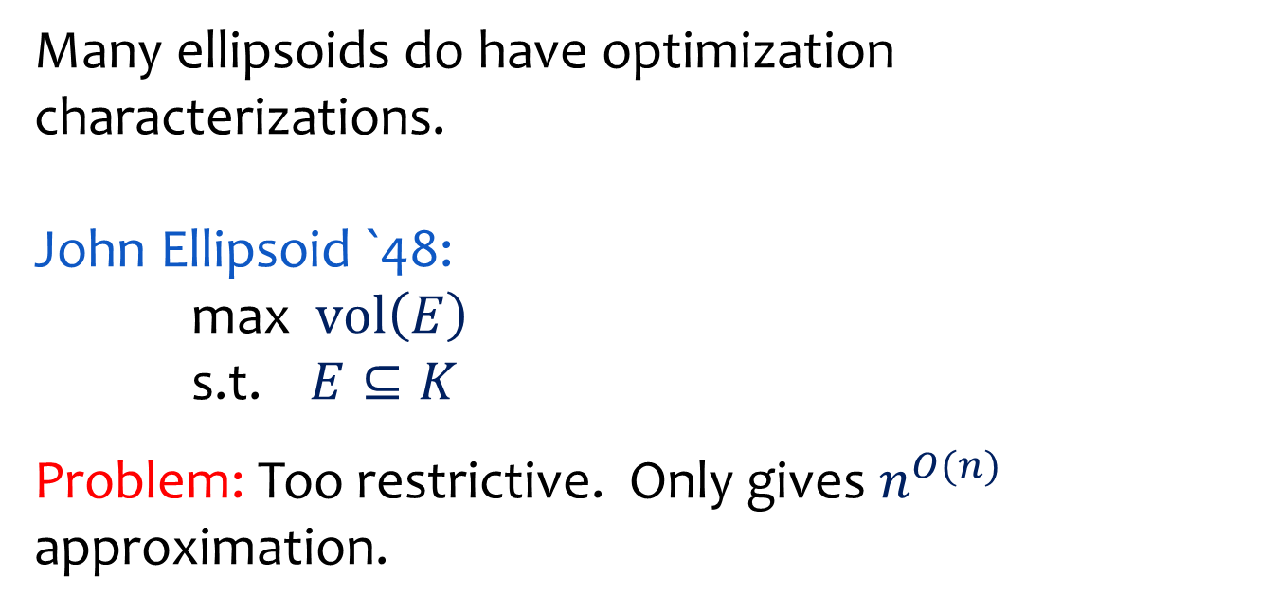
Building a good ellipsoid
Many ellipsoids do have optimization characterizations.
John Ellipsoid `48:
max $\text{vol}\left(E\right)$
s.t. $E⊆K$
Problem: Too restrictive. Only gives $n^{O(n)}$ approximation.

Slide 31
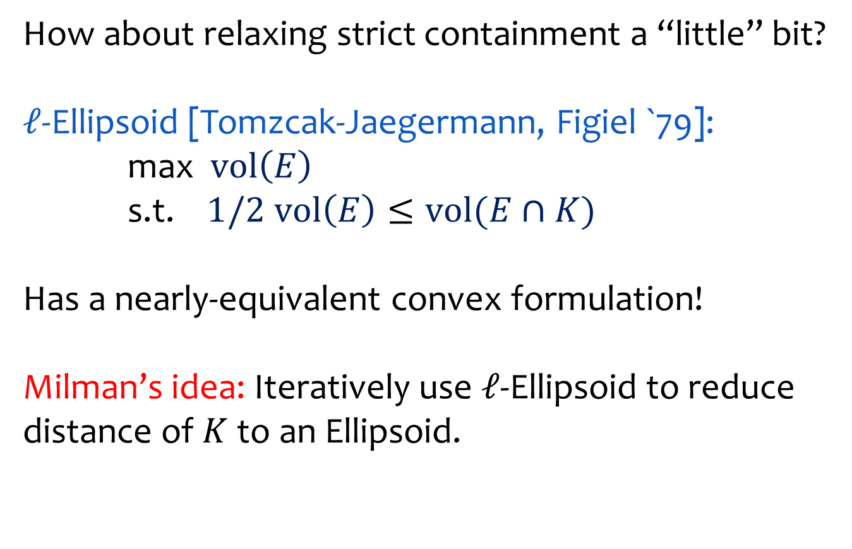
Building a good ellipsoid
How about relaxing strict containment a “little” bit?
$ℓ$-Ellipsoid [Tomzcak-Jaegermann, Figiel `79]:
max $\text{vol}\left(E\right)$
s.t. $1/2 vol\left(E\right)≤vol(E∩K)$
Has a nearly-equivalent convex formulation!
Milman’s idea: Iteratively use $ℓ$-Ellipsoid to reduce distance of $K$to an Ellipsoid.

Slide 32
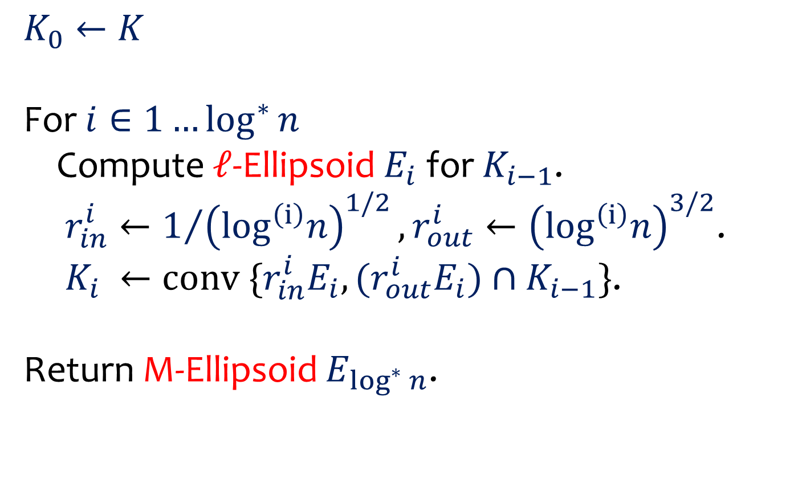
Milman’s Iteration
$$K_{0}←K$$
For $i∈1…\log^{∗}{n}$
Compute $ℓ$-Ellipsoid $E_{i}$ for $K_{i−1}$.
$r_{in}^{i}←1/{{\left(\log^{\left(i\right)}n\right)}^{1/2}}, r_{out}^{i}←{\left(\log^{\left(i\right)}n\right)}^{3/2}$.
$K_{i} ←\text{conv} \{r_{in}^{i}E_{i}, (r_{out}^{i}E_{i})∩K_{i−1}\}$.
Return M-Ellipsoid $E_{\log^{∗}{n}}$.

Slide 33

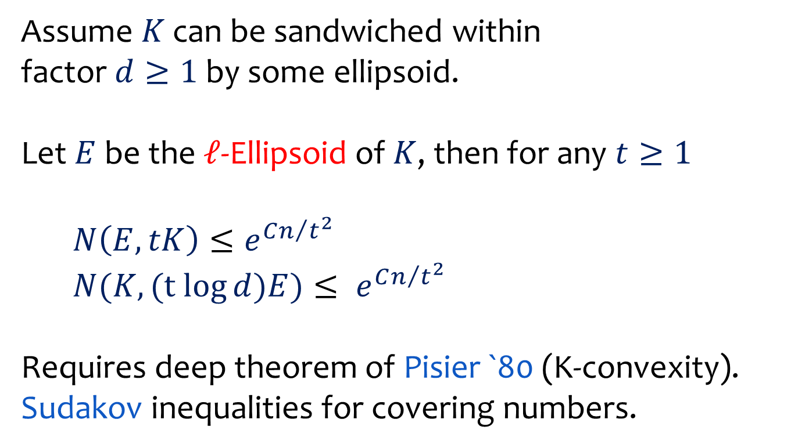
$ℓ$-Ellipsoid: Covering Estimates
Assume $K$ can be sandwiched within
factor $d≥1$ by some ellipsoid.
Let $E$ be the $ℓ$-Ellipsoid of $K$, then for any $t≥1$
$N\left(E,tK\right)≤e^{Cn/{t^{2}}}$
$N(K,(t log{d})E)≤ e^{Cn/{t^{2}}}$
Requires deep theorem of Pisier `80 (K-convexity).
Sudakov inequalities for covering numbers.

Slide 34
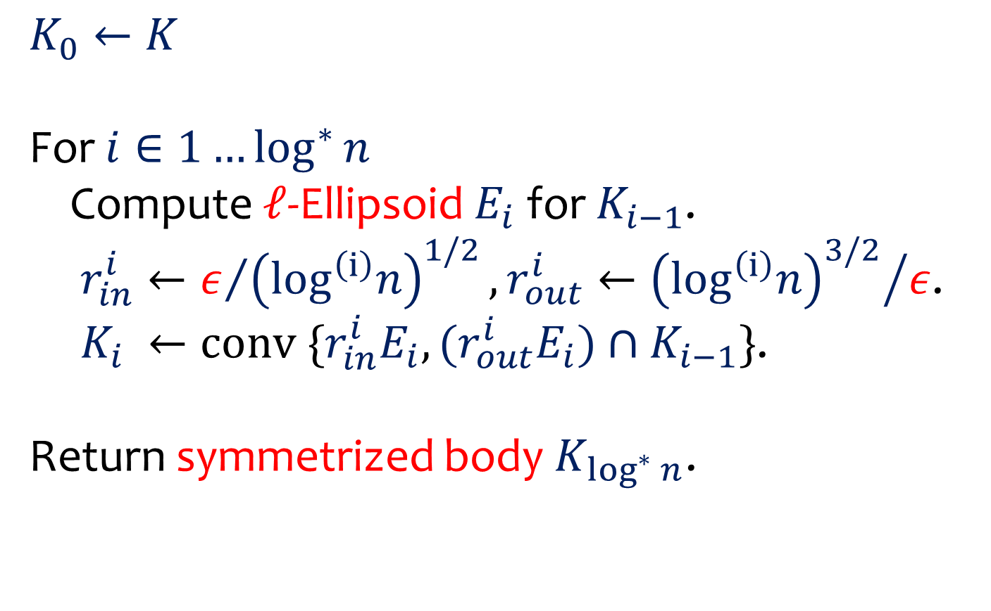
“Slowed down” Milman’s Iteration
$$K_{0}←K$$
For $i∈1…\log^{∗}{n}$
Compute $ℓ$-Ellipsoid $E_{i}$ for $K_{i−1}$.
$r_{in}^{i}←ε/{{\left(\log^{\left(i\right)}n\right)}^{1/2}}, r_{out}^{i}←{{\left(\log^{\left(i\right)}n\right)}^{3/2}}/ε$.
$K_{i} ←\text{conv} \{r_{in}^{i}E_{i}, (r_{out}^{i}E_{i})∩K_{i−1}\}$.
Return symmetrized body $K_{\log^{∗}{n}}$.

Slide 35




$ℓ$-Ellipsoid
$K$-norm: ${\left\|x\right\|}_{K}=\inf{ \{s≥0:x ε sK\}}$
$$x$$
$$sK$$
$$K$$

Slide 36
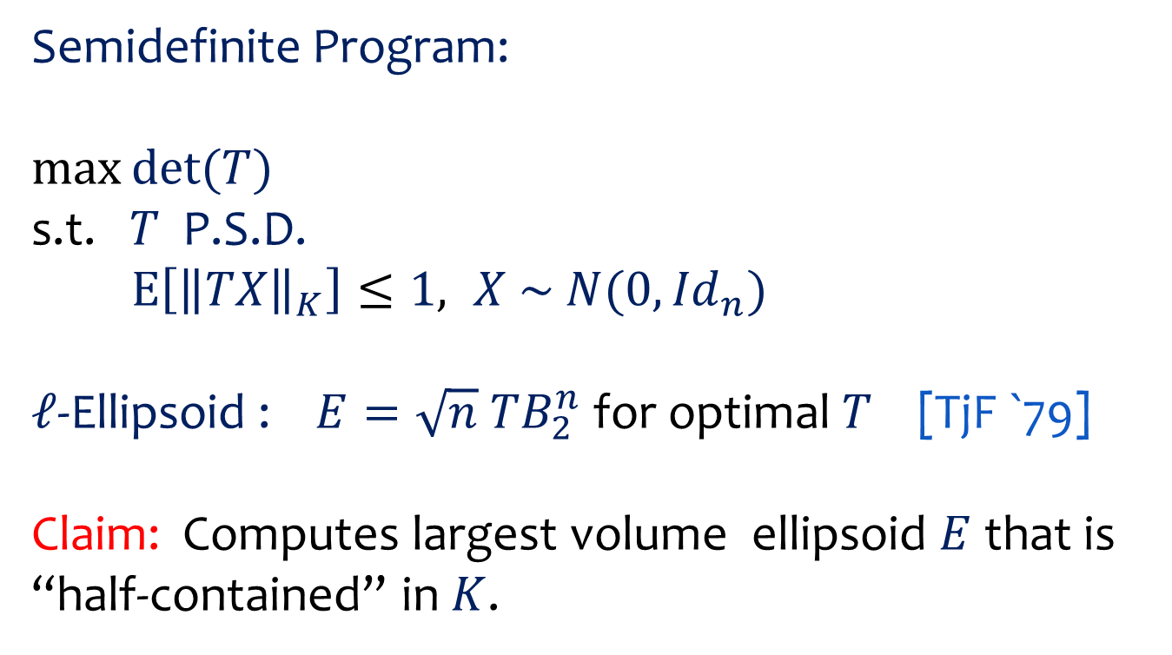
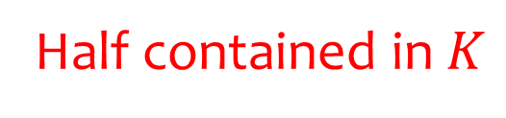

$ℓ$-Ellipsoid
Semidefinite Program:
$$\max{det⁡(T)}$$
s.t. $T$ P.S.D.
$\text{E}\left[{\left\|TX\right\|}_{K}\right]≤1, X \sim N(0,{Id}_{n})$
$ℓ$-Ellipsoid : $E=\sqrt{n} TB_{2}^{n}$ for optimal $T$ [TjF `79]
Claim: Computes largest volume ellipsoid $E$ that is “half-contained” in $K$.
Largest volume
Half contained in $K$

Slide 37

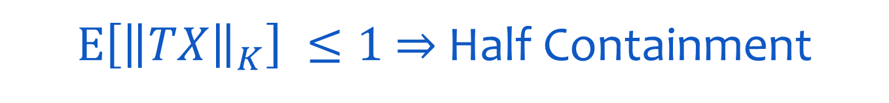

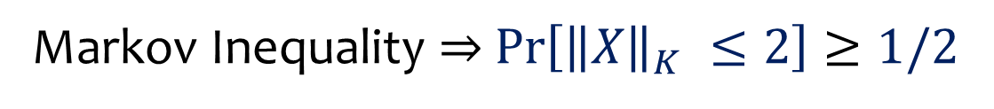

$\text{E}\left[{\left\|TX\right\|}_{K}\right] ≤1$ $⇒$ Half Containment
Assume $T={\text{Id}}_{n}$ (wlog). $X$ is standard gaussian in $ℝ^{n}$.
$$2K$$
$$E$$
$$\sqrt{n}$$
Markov Inequality $⇒$ $\operatorname{Pr}\left[{\left\|X\right\|}_{K} ≤2\right]≥1/2$

Slide 38
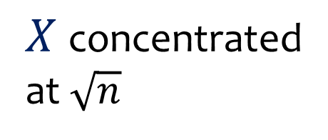
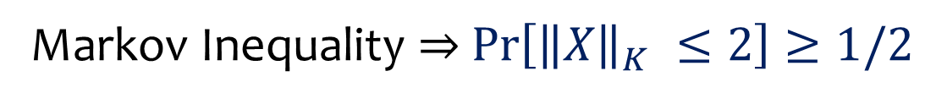
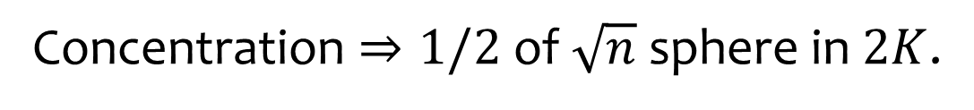
$\text{E}\left[{\left\|TX\right\|}_{K}\right] ≤1$ $⇒$ Half Containment
Assume $T={\text{Id}}_{n}$ (wlog). $X$ is standard gaussian in $ℝ^{n}$.
$X$ concentrated
at $\sqrt{n}$
$$2K$$
$$E$$
$$\sqrt{n}$$
Concentration $⇒1/2$ of $\sqrt{n}$ sphere in $2K$.
Markov Inequality $⇒$ $\operatorname{Pr}\left[{\left\|X\right\|}_{K} ≤2\right]≥1/2$

Slide 39
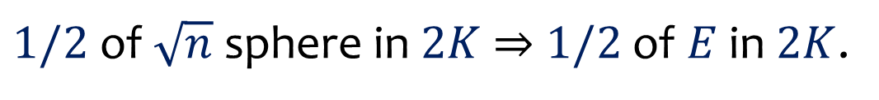
$\text{E}\left[{\left\|TX\right\|}_{K}\right] ≤1$ $⇒$ Half Containment
Assume $T={\text{Id}}_{n}$ (wlog). $X$ is standard gaussian in $ℝ^{n}$.
$$2K$$
$$E$$
$$\sqrt{n}$$
$1/2$ of $\sqrt{n}$ sphere in $2K$ $⇒$ $1/2$ of $E$ in $2K$.

Slide 40
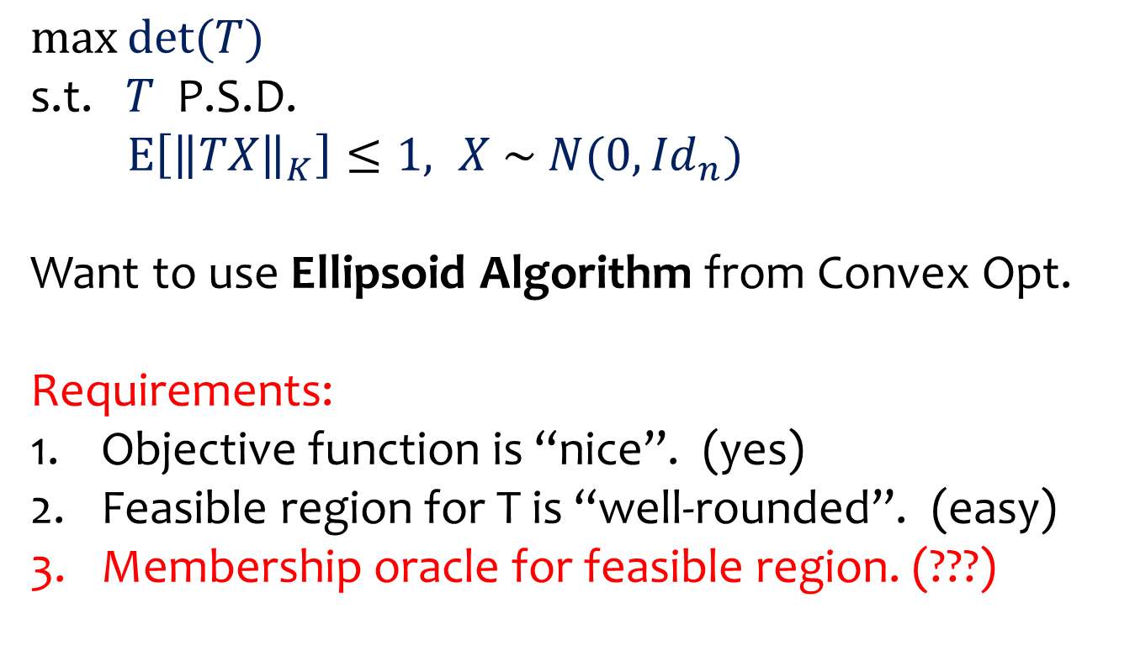
$$Solving the Convex Program$$
$$\max{det⁡(T)}$$
s.t. $T$ P.S.D.
$\text{E}\left[{\left\|TX\right\|}_{K}\right]≤1, X \sim N(0,{Id}_{n})$
Want to use Ellipsoid Algorithm from Convex Opt.
Requirements:
Objective function is “nice”. (yes)
Feasible region for T is “well-rounded”. (easy)
Membership oracle for feasible region. (???)

Slide 41
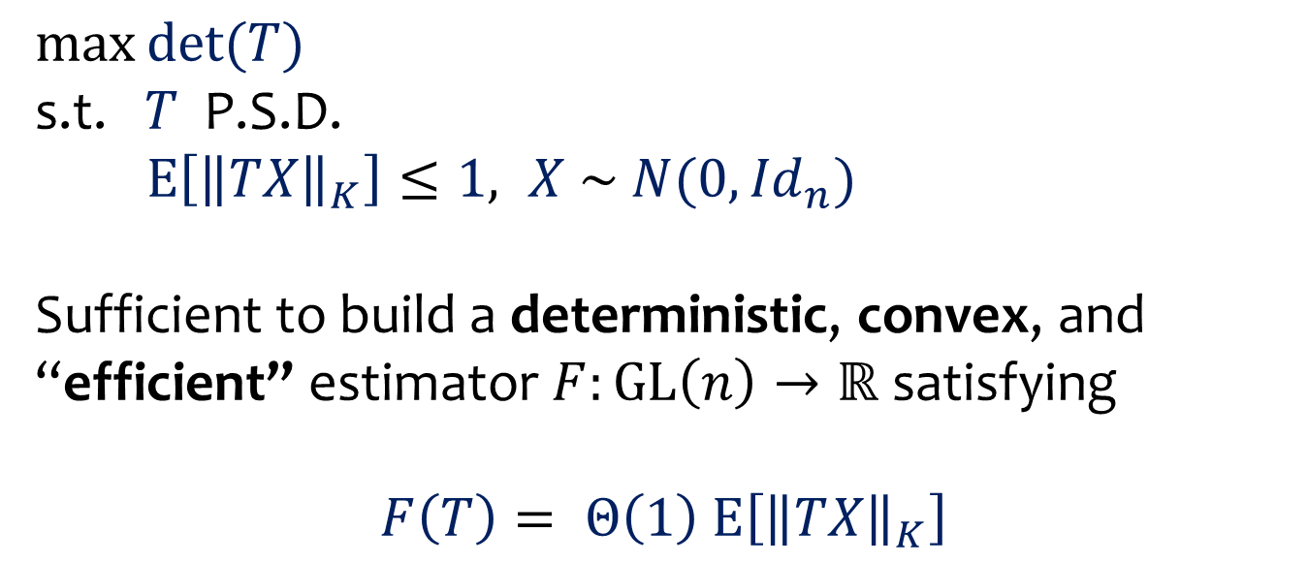
$$Constructing a Membership Oracle$$
$$\max{det⁡(T)}$$
s.t. $T$ P.S.D.
$\text{E}\left[{\left\|TX\right\|}_{K}\right]≤1, X \sim N(0,{Id}_{n})$
Sufficient to build a deterministic, convex, and “efficient” estimator $F:\text{GL}\left(n\right)→ℝ$ satisfying
$$F\left(T\right)= Θ\left(1\right) \text{E}\left[{\left\|TX\right\|}_{K}\right]$$

Slide 42




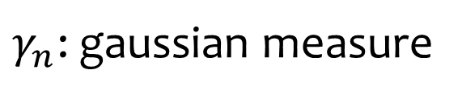
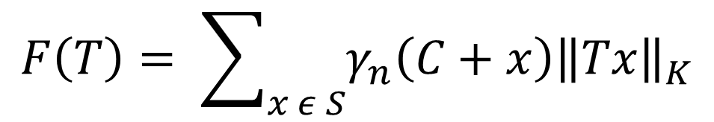
$$Simple Estimator for \text{E}\left[{\left\|TX\right\|}_{K}\right]$$
$$S$$
$$2\sqrt{n}$$
$$εℤ^{n}$$
$$C$$
$γ_{n}$: gaussian measure
$$F\left(T\right)= \sum_{x ε S}{γ_{n}\left(C+x\right){\left\|Tx\right\|}_{K}}$$

Slide 43
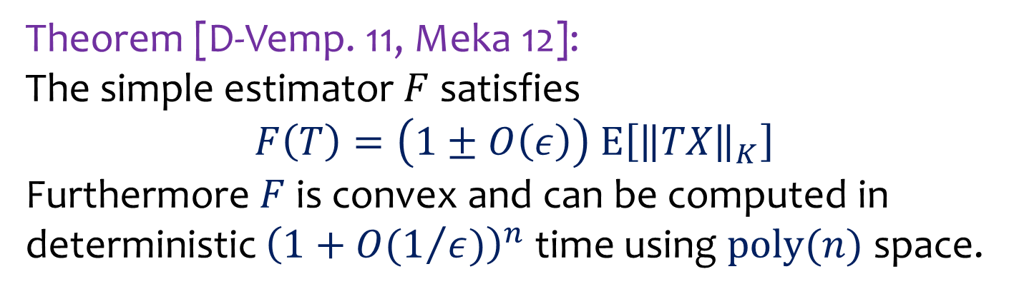
$$Simple Estimator for \text{E}\left[{\left\|TX\right\|}_{K}\right]$$
Theorem [D-Vemp. 11, Meka 12]:
The simple estimator $F$ satisfies
$$F\left(T\right)=\left(1±O\left(ε\right)\right) \text{E}\left[{\left\|TX\right\|}_{K}\right]$$
Furthermore $F$ is convex and can be computed in deterministic ${\left(1+{O(1}/{ε)}\right)}^{n}$ time using $poly(n)$ space.

Slide 44
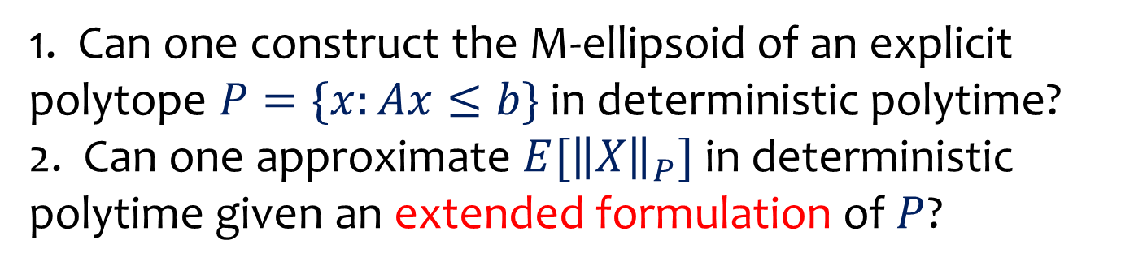
Conclusions
1. Nearly optimal deterministic algorithm for estimating the volume of a convex body.
2. Algorithmic construction of the M-ellipsoid.
Open Problems
1. Can one construct the M-ellipsoid of an explicit polytope $P=\{x:Ax≤b\}$ in deterministic polytime?
2. Can one approximate $E[{\left\|X\right\|}_{P}]$ in deterministic polytime given an extended formulation of $P$?

Slide 45

$$THANK YOU!$$

Slide 46

Lattice Problems
Shortest Vector Problem (SVP): For lattice $L⊆ℝ^{n}$ and norm $\left\|∙\right\|$, find shortest non-zero vector in $L$.
[D, Peikert, Vempala 11]: Given an ellipsoid $E⊆ℝ^{n}$ as advice, the SVP for $L$ and $\left\|∙\right\|$ can be solved in time $2^{O(n)}×N\left(K,E\right)×N\left(E,K\right)$,
where $K=\{x: \left\|x\right\|≤1\} ($unit ball of $\left\|∙\right\|$).
Useful for other lattice problems as well (CVP, IP, …).

Slide 47




Lattice Enumeration: M-Ellipsoid
Idea: Cover $K$ with translates of an ellipsoid$E$.
Enumerate in these and retain points in $K$.
[D, Peikert, Vempala 11]
$$L$$
$$E$$
$$K$$

Slide 48


Lattice Enumeration: M-Ellipsoid
A lattice $L⊆ℝ^{n}$ is the integer span of a basis $b_{1},…,b_{n}$.
Task: Compute $K∩L$.
$$L$$
$$K$$

Slide 49
Lattice Enumeration: M-Ellipsoid
Idea: Cover $K$ with translates of an ellipsoid$E$.
Enumerate in these and retain points in $K$.
[D, Peikert, Vempala 11]
$$L$$
$$E$$
$$K$$

Slide 50

Lattice Enumeration: M-Ellipsoid
Want:
Not too many translates of $E$ needed to cover $K$.
$E$ is not too much bigger than $K$.
$$L$$
$$E$$
$$K$$

