Slide 1



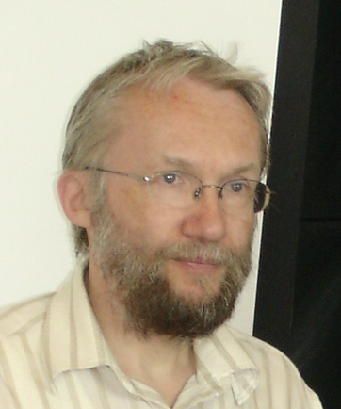

Quantum Homomorphic Encryption for Polynomial-Size Circuits
Christian Schaffner
Joint work with
Yfke Dulek and Florian Speelman
http://arxiv.org/abs/1603.09717
Institute for Logic, Language and Computation (ILLC)
University of Amsterdam
Research Center for Quantum Software
Centrum
Wiskunde & Informatica
Symposium on the Work of Ivan Damgård
Friday, 1 April 2016

Slide 2
Roadmap
(Classical) Homomorphic Encryption
Quantum Homomorphic Encryption
Computation by teleportation
Our scheme

Slide 3
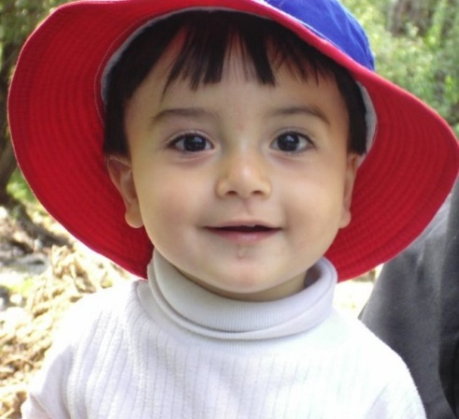
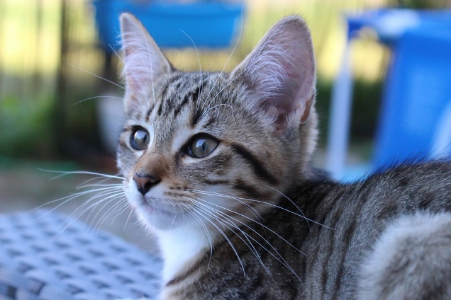
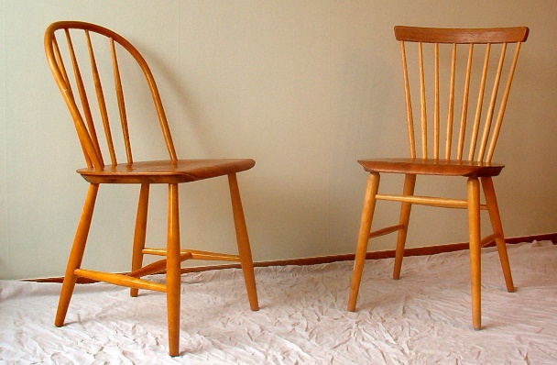

Homomorphic encryption
Classical case
Encrypt data so that another party can perform calculations on the encrypted data
Many
applications
CHILD
CAT
CHAIR
Tagging

Slide 4

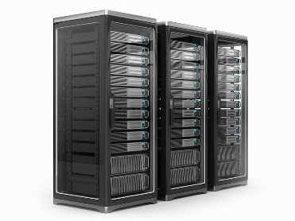

CHILD
CAT
CHAIR

Slide 5


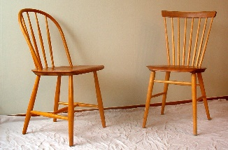


CHILD
CAT
CHAIR
CHILD
CAT
CHAIR

Slide 6
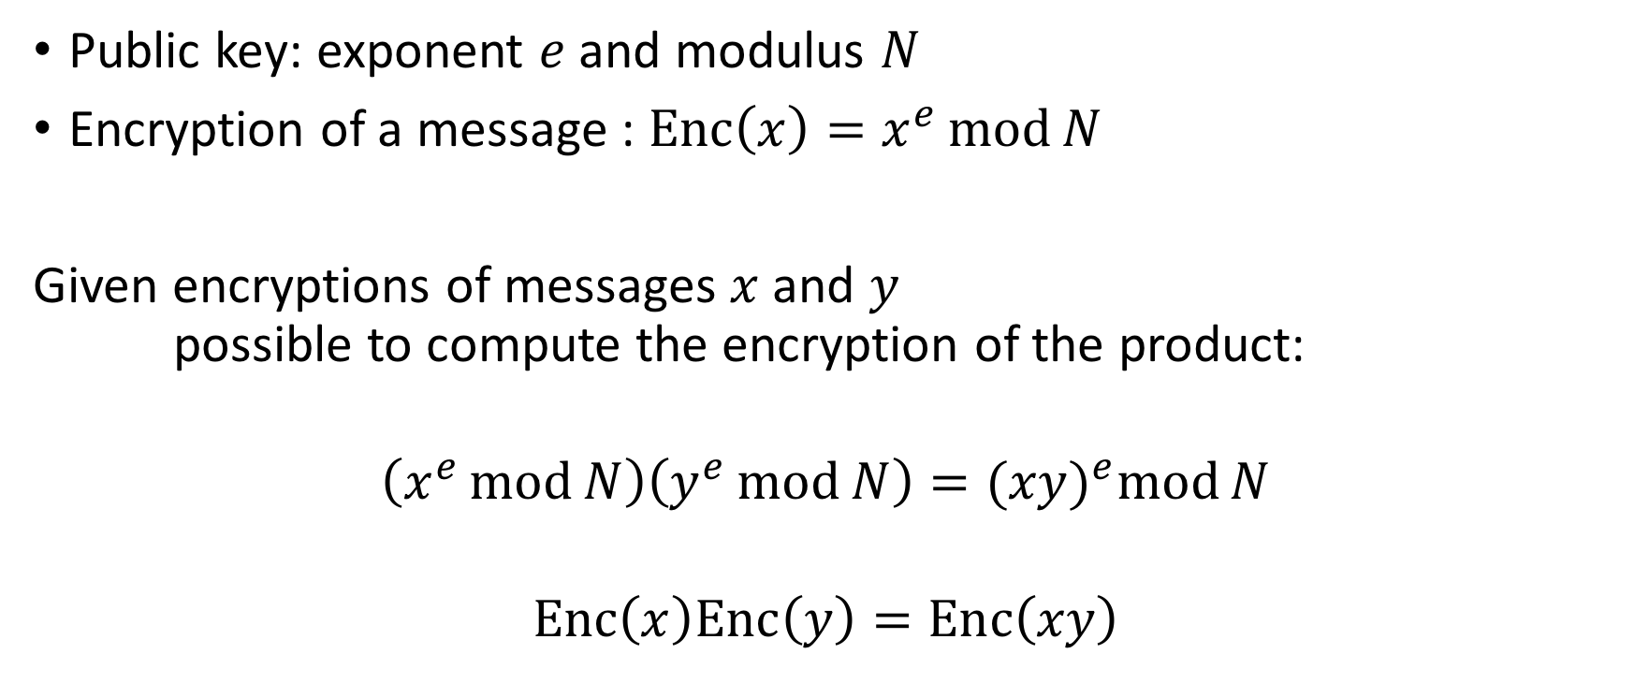
RSA
Multiplicative homomorphic
Public key: exponent $e$ and modulus $N$
Encryption of a message : $Enc\left(x\right)=x^{e}\operatorname{mod}{N}$
Given encryptions of messages $x$ and $y$
possible to compute the encryption of the product:
$$\left(x^{e}\operatorname{mod}{N}\right)\left(y^{e}\operatorname{mod}{N}\right)={(xy)}^{e}\operatorname{mod}{N}$$
$$Enc\left(x\right)Enc\left(y\right)=Enc\left(xy\right)$$

Slide 7
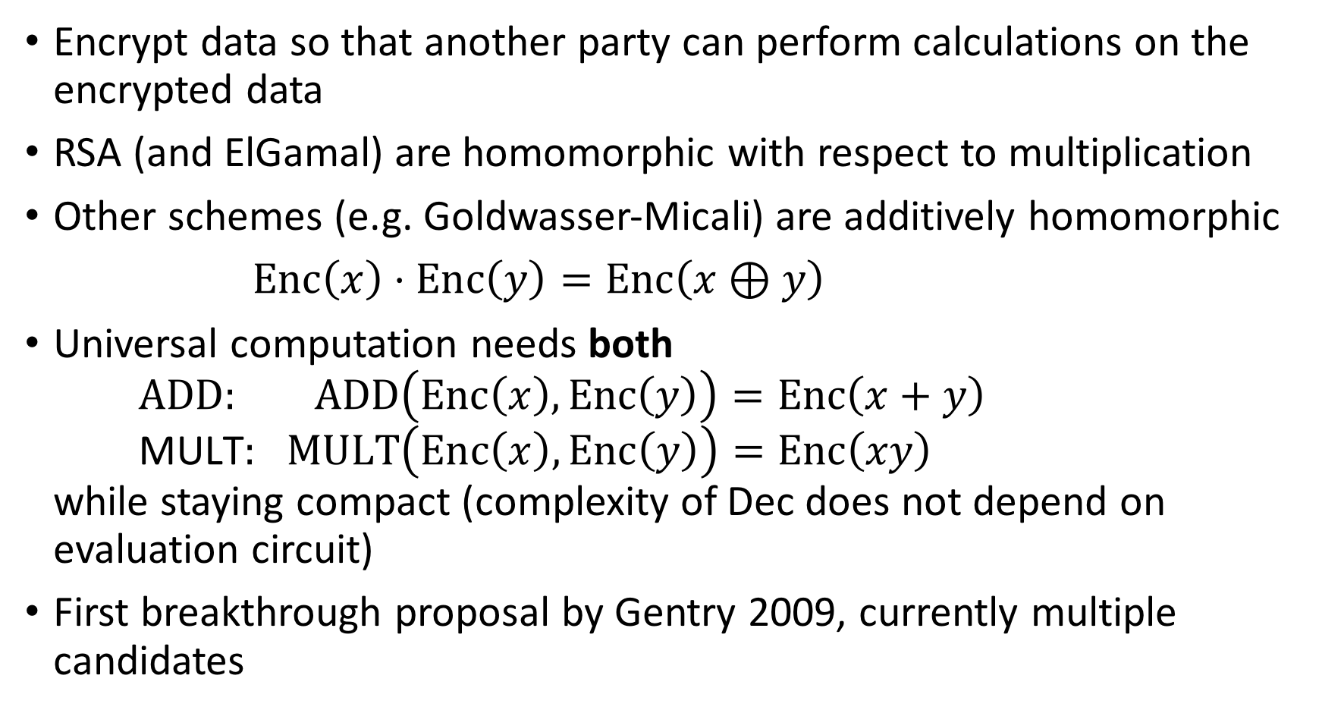
Fully Homomorphic Encryption
Encrypt data so that another party can perform calculations on the encrypted data
RSA (and ElGamal) are homomorphic with respect to multiplication
Other schemes (e.g. Goldwasser-Micali) are additively homomorphic
$Enc\left(x\right)⋅Enc\left(y\right)=Enc\left(x⊕y\right)$
Universal computation needs both
$\text{ADD}\text{: }\text{ADD}\left(Enc\left(x\right),Enc\left(y\right)\right)=Enc\left(x+y\right)$
$\text{MULT}\text{: }\text{MULT}\left(Enc\left(x\right),Enc\left(y\right)\right)=Enc\left(xy\right)$
while staying compact (complexity of Dec does not depend on evaluation circuit)
First breakthrough proposal by Gentry 2009, currently multiple candidates
still slow: seconds per bit operation, but some of you know better than I do…

Slide 8
Roadmap
(Classical) Homomorphic Encryption
Quantum Homomorphic Encryption
New ingredients – computation by teleportation
Our scheme

Slide 9
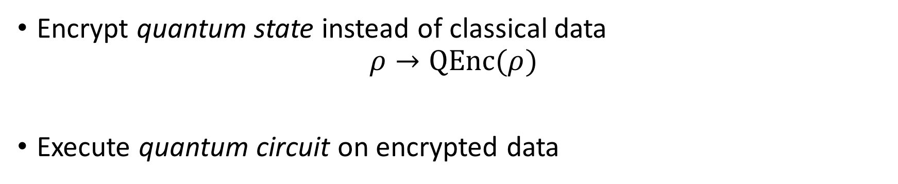
Quantum Homomorphic Encryption
Encrypt quantum state instead of classical data
$$ρ→\text{QEnc}\text{(}ρ)$$
Execute quantum circuit on encrypted data
CNOT
P
CNOT
P
CNOT
CNOT
T
CNOT
H
H

Slide 10
Classical Homomorphic Encryption
Quantum
One-Time Pad
Quantum Homomorphic Encryption
for Clifford circuits

Slide 11
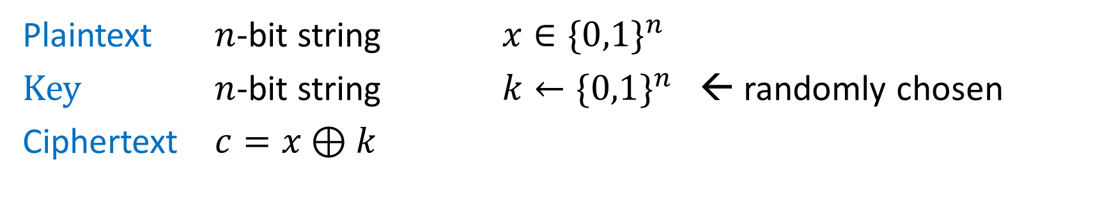
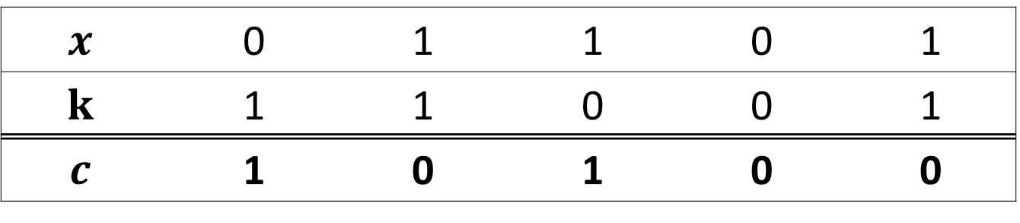
One-time pad
Plaintext $n$-bit string $x∈{\{0,1\}}^{n}$
Key $n$-bit string $k←{\{0,1\}}^{n}$ ← randomly chosen
Ciphertext $c=x⊕k$
$$x$$ | 0 | 1 | 1 | 0 | 1
$$k$$ | 1 | 1 | 0 | 0 | 1
$$c$$ | 1 | 0 | 1 | 0 | 0
Properties:
Perfectly secure
Key same size as message – each key can be used only once
Notes:
TODO:
Show why it is secure
either say: each bit is uniformly random, no matter the key
or: given a ciphertext, there is a possible key for each plaintext

Slide 12
One-time pad table (U.S. National Security Agency)

Slide 13
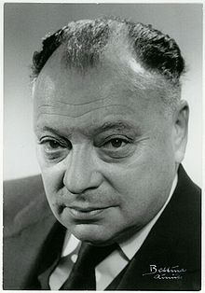
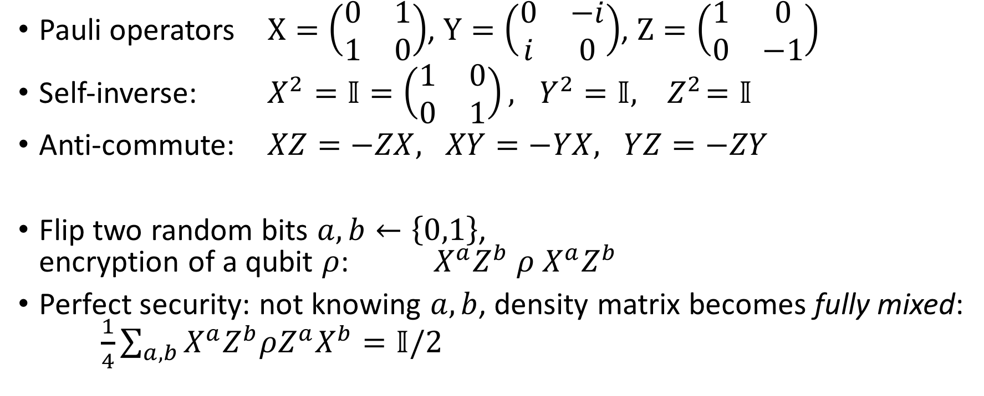
Quantum One-time Pad
Pauli operators $X=\left(\begin{matrix}0 & 1 \\ 1 & 0\end{matrix}\right)$, $Y=\left(\begin{matrix}0 & −i \\ i & 0\end{matrix}\right)$, $Z=\left(\begin{matrix}1 & 0 \\ 0 & −1\end{matrix}\right)$
Self-inverse: $X^{2}=𝕀=\left(\begin{matrix}1 & 0 \\ 0 & 1\end{matrix}\right), { Y^{2}=𝕀, Z}^{2}=𝕀$
Anti-commute: $XZ=−ZX, XY=−YX, YZ=−ZY$
Flip two random bits $a,b←\left\{0,1\right\}$,
encryption of a qubit $ρ$: $X^{a}Z^{b} ρ X^{a}Z^{b}$
Perfect security: not knowing $a,b$, density matrix becomes fully mixed:
$\frac{1}{4}\sum_{a,b}{X^{a}Z^{b}ρZ^{a}X^{b}}=𝕀/2$
[AMTW00] A. Ambainis, M. Mosca, A. Tapp, and R. De Wolf. Private quantum channels. FOCS‘00
Notes:
Wolfgang Ernst Pauli 1900-1958

Slide 14

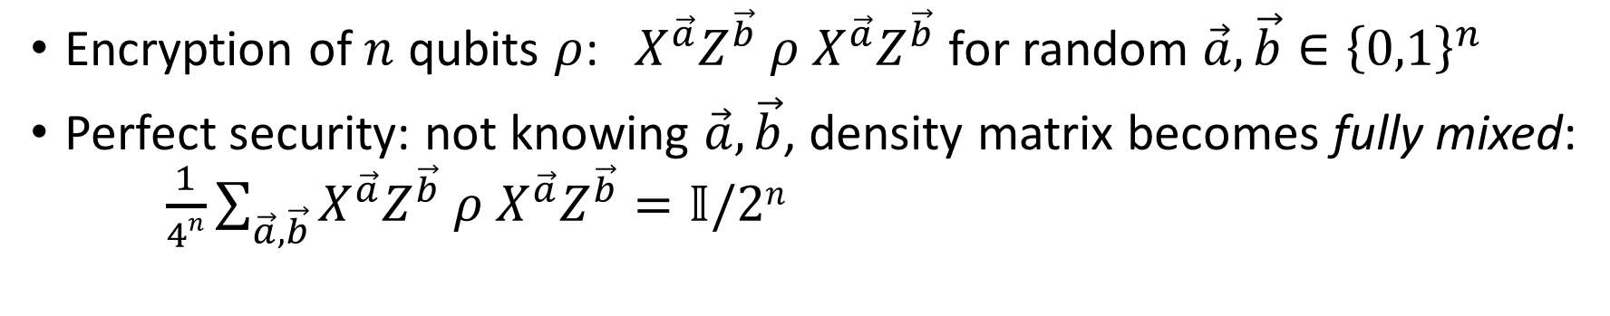

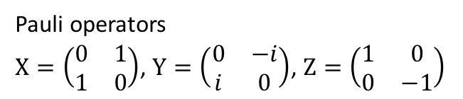
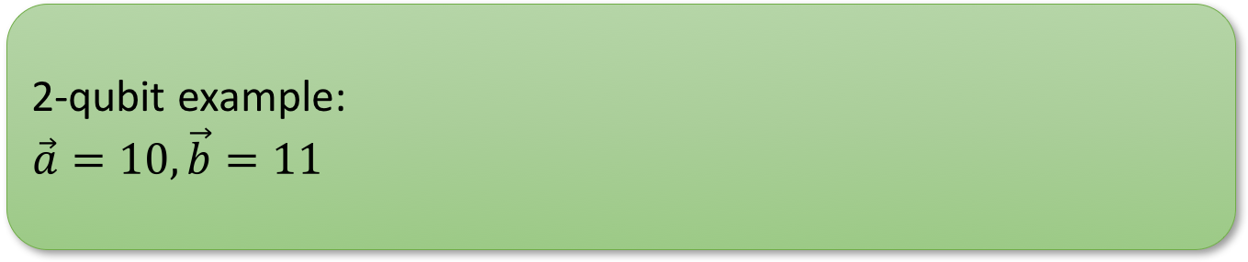


Pauli Group on $n$ Qubits
Pauli operators
$X=\left(\begin{matrix}0 & 1 \\ 1 & 0\end{matrix}\right)$, $Y=\left(\begin{matrix}0 & −i \\ i & 0\end{matrix}\right)$, $Z=\left(\begin{matrix}1 & 0 \\ 0 & −1\end{matrix}\right)$
Pauli group $P_{n}≔\{φX^{\vec{a}}Z^{\vec{b}} :\vec{a},\vec{b}∈{\left\{0,1\right\}}^{n}, φ∈\left\{±i, ±1\right\}\}$
2-qubit example:
$$\vec{a}=10, \vec{b}=11$$
$$Z$$
$$X$$
$$X^{\vec{a}}Z^{\vec{b}}=$$
$$Z$$
Encryption of $n$ qubits $ρ$: $X^{\vec{a}}Z^{\vec{b}}{ ρ X}^{\vec{a}}Z^{\vec{b}}$ for random $\vec{a},\vec{b}∈{\left\{0,1\right\}}^{n}$
Perfect security: not knowing $\vec{a},\vec{b}$, density matrix becomes fully mixed:
$\frac{1}{4n}\sum_{\vec{a},\vec{b}}{X^{\vec{a}}Z^{\vec{b}}{ ρ X}^{\vec{a}}Z^{\vec{b}}}=𝕀/2n$
[AMTW00] A. Ambainis, M. Mosca, A. Tapp, and R. De Wolf. Private quantum channels. FOCS’00
(based on Stacey Jeffery’s slides)
Notes:
Wolfgang Ernst Pauli 1900-1958

Slide 15
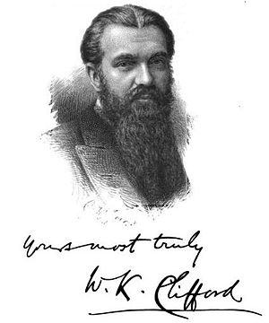
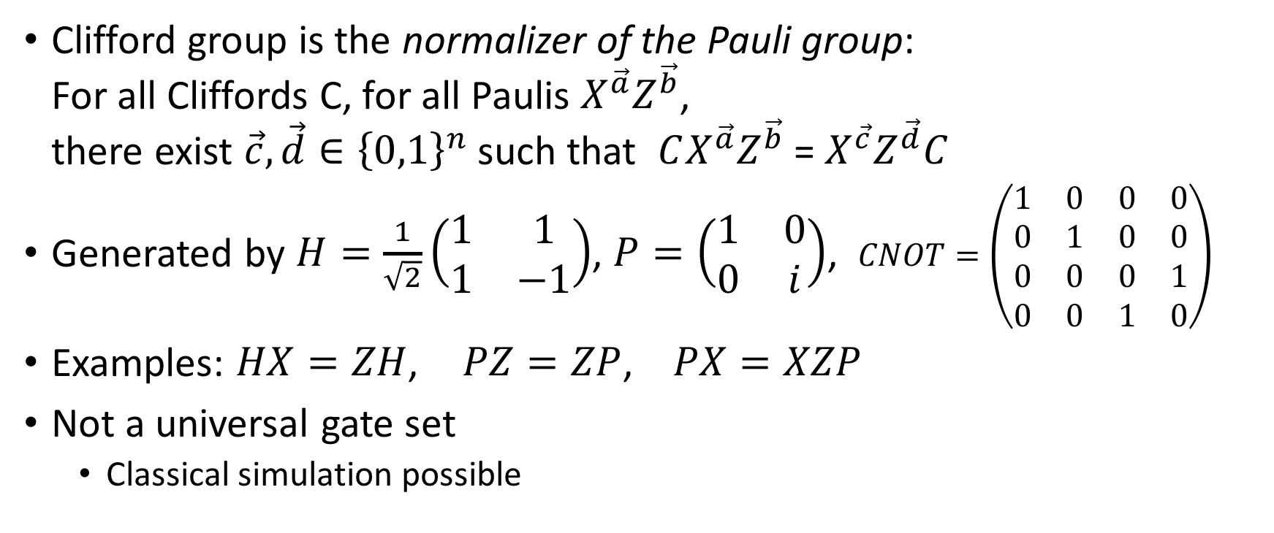
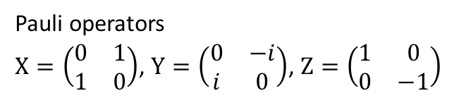
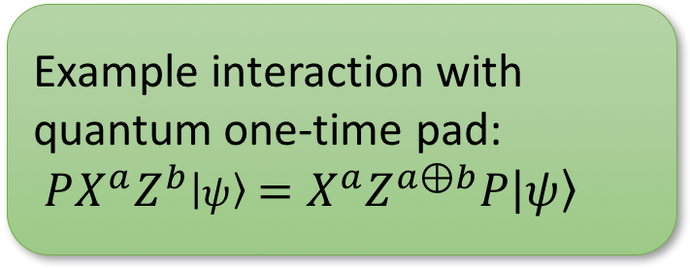
The Clifford group
Pauli operators
$X=\left(\begin{matrix}0 & 1 \\ 1 & 0\end{matrix}\right)$, $Y=\left(\begin{matrix}0 & −i \\ i & 0\end{matrix}\right)$, $Z=\left(\begin{matrix}1 & 0 \\ 0 & −1\end{matrix}\right)$
Clifford group is the normalizer of the Pauli group:
For all Cliffords C, for all Paulis $X^{\vec{a}}Z^{\vec{b}}$,
there exist $\vec{c}, \vec{d}∈{\left\{0,1\right\}}^{n}$such that $CX^{\vec{a}}Z^{\vec{b}}$ = $X^{\vec{c}}Z^{\vec{d}}C$
Generated by $H=\frac{1}{\sqrt{2}}\left(\begin{matrix}1 & 1 \\ 1 & −1\end{matrix}\right)$, $P=\left(\begin{matrix}1 & 0 \\ 0 & i\end{matrix}\right)$, $CNOT=\left(\begin{matrix}1 & 0 & 0 & 0 \\ 0 & 1 & 0 & 0 \\ 0 & 0 & 0 & 1 \\ 0 & 0 & 1 & 0\end{matrix}\right)$
Examples: $HX=ZH$, $PZ=ZP$, $PX=XZP$
Not a universal gate set
  Classical simulation possible
Example interaction with
quantum one-time pad:
$PX^{a}Z^{b}\left|ψ\right\rangle =X^{a}Z^{a⊕b}P\left|ψ\right\rangle$
Notes:
William Kingdon Clifford 1845 - 1879

Slide 16
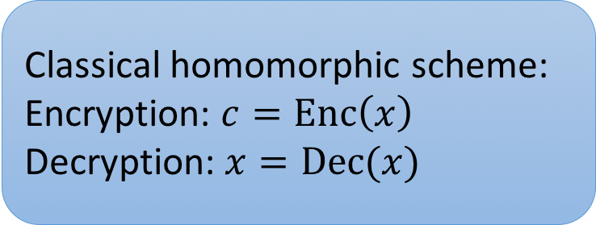
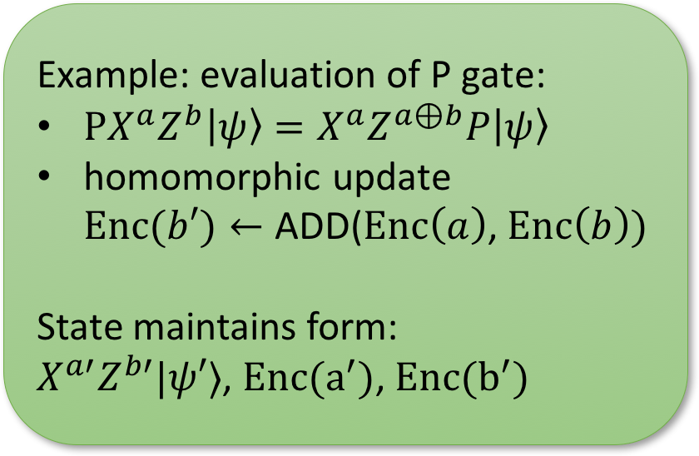
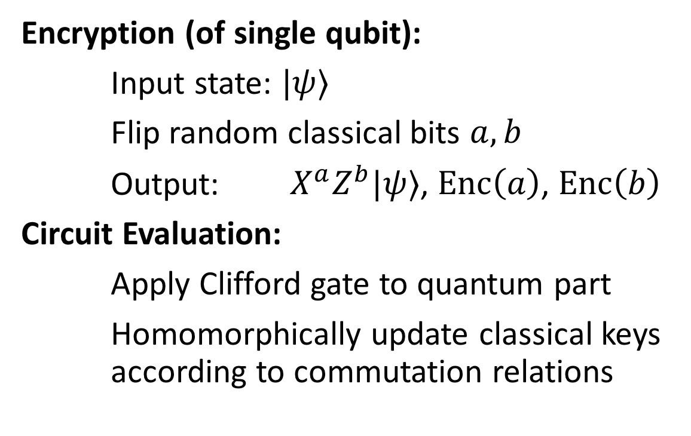
Quantum Homomorphic Encryption
For Clifford circuits
Classical homomorphic scheme:
Encryption: $c=Enc\left(x\right)$
Decryption: $x=Dec(x)$
Encryption (of single qubit):
Input state: $|ψ⟩$
Flip random classical bits $a,b$
Output: $X^{a}Z^{b}|ψ⟩$, $Enc\left(a\right)$, $Enc\left(b\right)$
Circuit Evaluation:
Apply Clifford gate to quantum part
Homomorphically update classical keys according to commutation relations
Example: evaluation of P gate:
$PX^{a}Z^{b}\left|ψ\right\rangle =X^{a}Z^{a⊕b}P\left|ψ\right\rangle$
homomorphic update
$Enc(b′)←\text{ADD}\text{(}Enc\left(a\right)\text{, }Enc\left(b\right))$
State maintains form:
$X^{a′}Z^{b′}|ψ′⟩$, $Enc(a^{′})$, $Enc(b^{′})$
Folklore, last formalized by [BJ15] A. Broadbent, S. Jeffery. Quantum Homomorphic Encryption for Circuits of Low T-gate Complexity. CRYPTO 2015

Slide 17
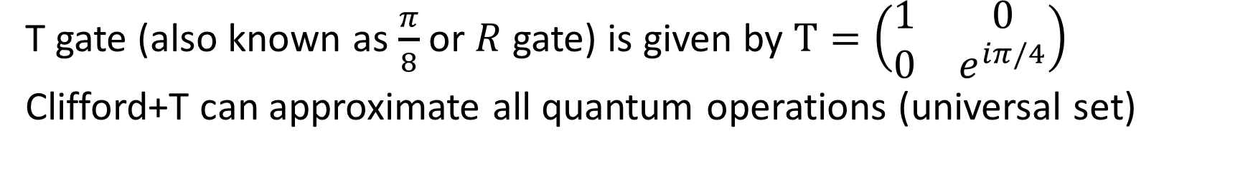
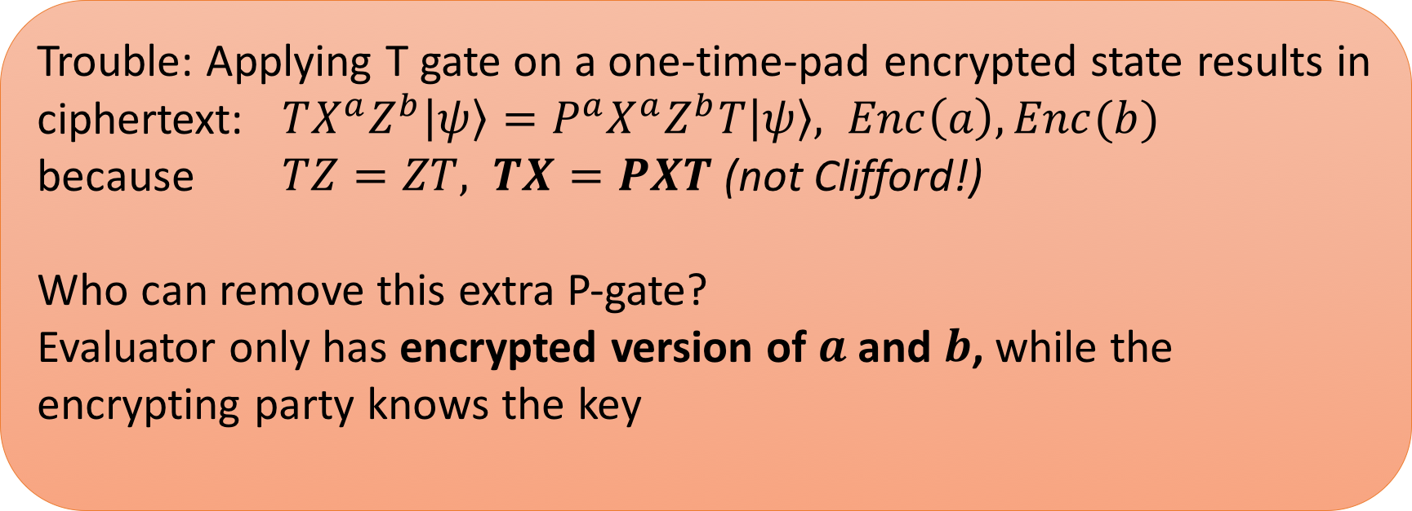
Extending the gate set: T gate
T gate (also known as $\frac{π}{8}$ or $R$ gate) is given by $T=\left(\begin{matrix}1 & 0 \\ 0 & e^{iπ/4}\end{matrix}\right)$
Clifford+T can approximate all quantum operations (universal set)
Trouble: Applying T gate on a one-time-pad encrypted state results in
ciphertext: $TX^{a}Z^{b}\left|ψ\right\rangle =P^{a}X^{a}Z^{b}T\left|ψ\right\rangle , Enc\left(a\right), Enc(b)$
because $TZ=ZT, TX=PXT$(not Clifford!)
Who can remove this extra P-gate?
Evaluator only has encrypted version of $a$ and $b$, while the encrypting party knows the key

Slide 18
Previous Work: Overview
 | homomorphic for | compactness | security
Not encrypting | Quantum circuits | yes | no
append evaluation description | Quantum circuits | Complexity of Dec prop to (# gates) | yes
Quantum OTP | no | yes | inf theoretic
Clifford Scheme | Clifford circuits | yes | computational
[BJ15]: AUX | Q circuits with constant T-depth | yes | computational
[BJ15]: EPR | Quantum circuits | Complexity of Dec prop to (#T-gates)^2 | computational
Our result | Quantum circuits of polynomial size (levelled fully homorphic) | yes | computational
[BJ15] A. Broadbent, S. Jeffery. Quantum Homomorphic Encryption for Circuits of Low T-gate Complexity. CRYPTO 2015
(comparison based on Stacey Jeffery’s slides)

Slide 19
Related Work
Secure delegated quantum computing
  Childs 2005; Broadbent, Fitzsimons, Kashefi 2009;
  Aharonov, Ben-Or, Eban 2010; Broadbent 2015
Secure 2-party quantum computation
  Dupuis, Nielsen, Salvail 2010; Dupuis, Nielsen, Salvail 2010
Perfectly secure quantum FHE not possible with information-theoretic security
  Yu, Perez-Delgado, Fitzsimons 2014
Quantum homomorphic encryption with information leakage (not IND secure)
  Tan, Kettlewell, Ouyang, Chen, Fitzsimons 2014
require interaction between encryptor and evaluator
(based on Stacey Jeffery’s slides)

Slide 20
Roadmap
(Classical) Homomorphic Encryption
Quantum Homomorphic Encryption
Computation by Teleportation
Our scheme

Slide 21
Classical Homomorphic Encryption
Quantum
One-Time Pad
Computation by teleportation
Quantum homomorphic encryption
for polynomial-sized circuits
[GC99] Daniel Gottesman and Isaac L. Chuang. Quantum Teleportation is a Universal Computational Primitive. Nature ’99

Slide 22
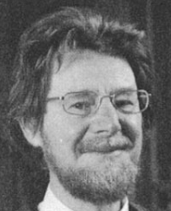
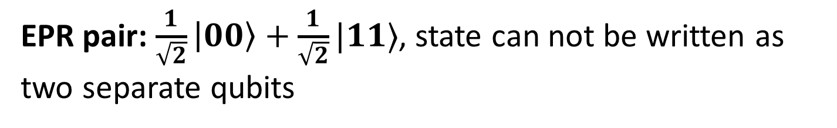

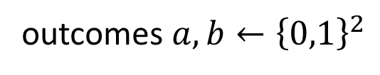

Entanglement and Quantum Teleportation
Entanglement
EPR pair: $\frac{1}{\sqrt{2}}\left|00\right\rangle +\frac{1}{\sqrt{2}}|11⟩$, state can not be written as two separate qubits
Teleportation transfers a quantum bit using an EPR pair and two classical bits
outcomes $a,b←{\left\{0,1\right\}}^{2}$
$$|ψ〉$$
Bell measurement
$$X^{a}Z^{b}|ψ〉$$
Notes:
John Stewart Bell 1928-1990

Slide 23


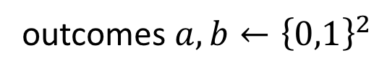

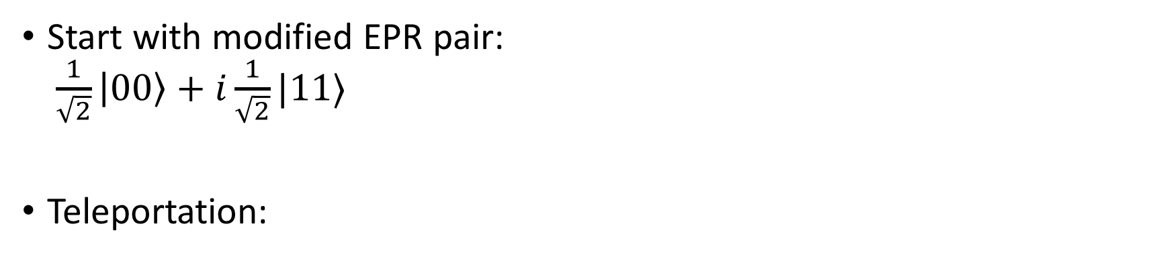
Teleportation of Clifford gates
$$P=\left(\begin{matrix}1 & 0 \\ 0 & i\end{matrix}\right)$$
Start with modified EPR pair:
$\frac{1}{\sqrt{2}}\left|00\right\rangle +i\frac{1}{\sqrt{2}}|11⟩$
Teleportation:
P
outcomes $a,b←{\left\{0,1\right\}}^{2}$
$$|ψ〉$$
Bell measurement
$$X^{a}Z^{b}P|ψ〉$$
P
[GC99] Daniel Gottesman and Isaac L. Chuang. Quantum Teleportation is a Universal Computational Primitive. Nature ’99

Slide 24






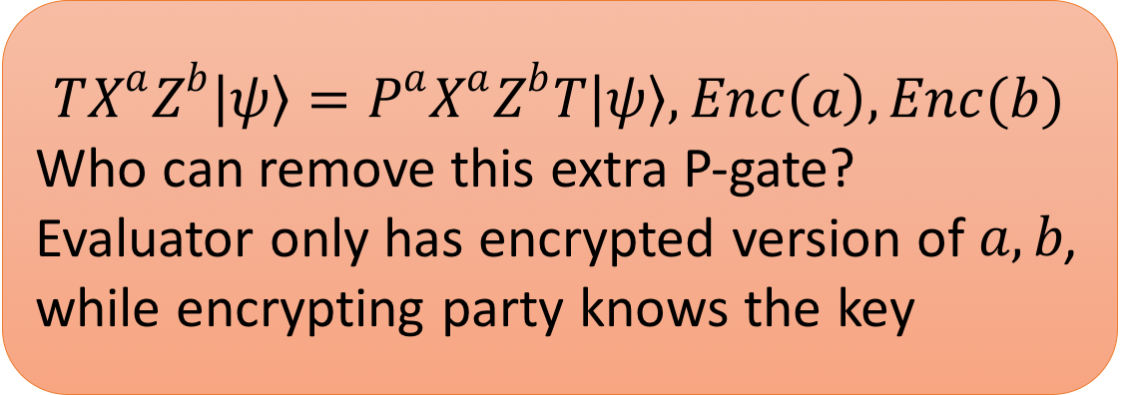
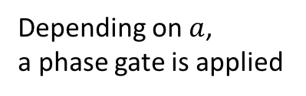
Creating a T-gate gadget
$$TX^{a}Z^{b}\left|ψ\right\rangle =P^{a}X^{a}Z^{b}T\left|ψ\right\rangle , Enc\left(a\right), Enc(b)$$
Who can remove this extra P-gate?
Evaluator only has encrypted version of $a,b$, while encrypting party knows the key
$$P^{a}|ψ〉$$
$$X^{c}Z^{d}|ψ〉$$
$$,\text{Enc}\text{(}c),\text{Enc}\text{(}d)$$
$$,\text{Enc}\text{(}a)$$
Depending on $a$,
a phase gate is applied

Slide 25




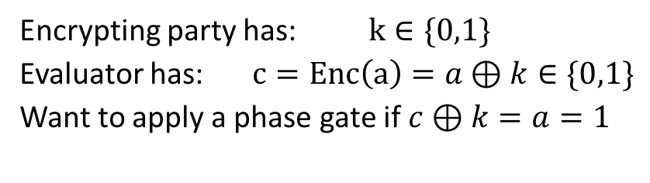
Toy example of gadget
Evaluator uses gadget:
$$c=1$$
$$c=0$$
Encrypting party has: $k∈\{0,1\}$
Evaluator has: $c=Enc\left(a\right)=a⊕k∈\{0,1\}$
Want to apply a phase gate if $c⊕k=a=1$
P
$$k=0$$
Encryptor prepares gadget:
$$k=1$$
P

Slide 26





Toy example of gadget
$$c=0$$
Evaluator uses gadget:
$$c=1$$
Encrypting party has: $k∈\{0,1\}$
Evaluator has: $c=Enc\left(a\right)=a⊕k∈\{0,1\}$
Want to apply a phase gate if $c⊕k=a=1$
P
P
P
$$X^{c}Z^{d}P$$
Using a fixed Bell state is insecure, but choice of Bell state can be randomized
$$k=0$$
$$X^{c}Z^{d}$$
Encryptor prepares gadget:
$$X^{c}Z^{d}$$
$$k=1$$
P
P
P
$$X^{c}Z^{d}P$$

Slide 27
Construction of T-gate gadget
Using Barrington’s theorem, we can construct gadgets for decryption functions computable in poly-sized log-depth circuits.
Using techniques from the garden-hose model, we can create gadgets for any decryption function computable in log-space.
Fortunately for us: all known classical homomorphic encryption schemes have a decryption function computable in log-space
[BFSS13] Harry Buhrman, Serge Fehr, Christian Schaffner, and Florian Speelman. The garden-hose model. ITCS ‘13

Slide 28
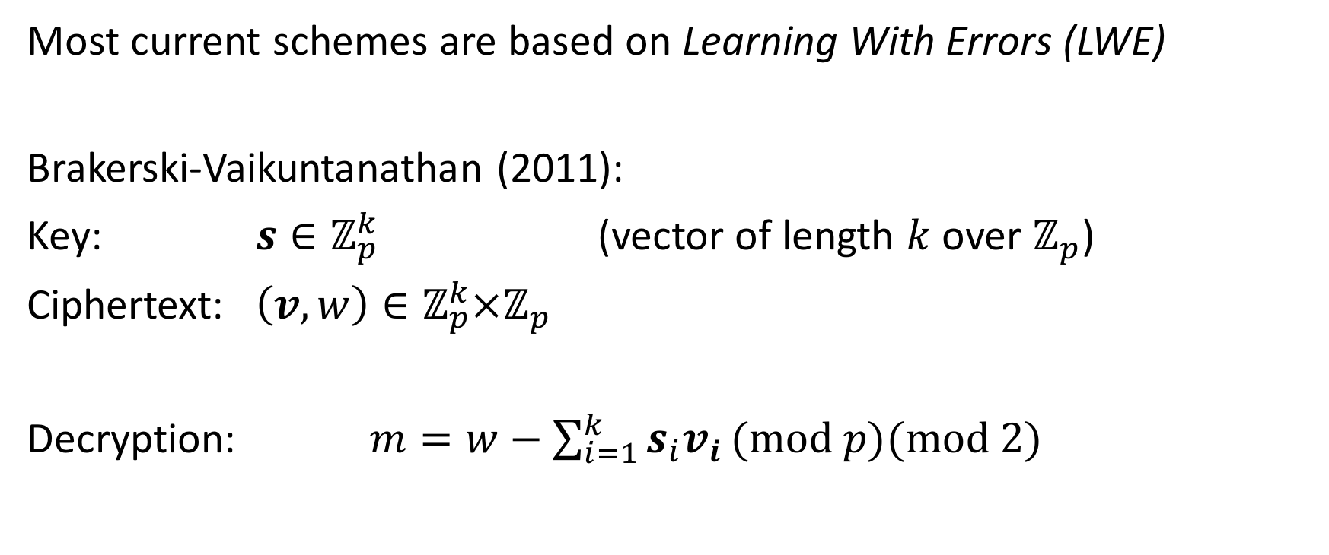
Homomorphic decryption
Most current schemes are based on Learning With Errors (LWE)
Brakerski-Vaikuntanathan (2011):
Key: $s∈ℤ_{p}^{k}$ (vector of length $k$ over $ℤ_{p}$)
Ciphertext: $\left(v,w\right)∈ℤ_{p}^{k}×ℤ_{p}$
Decryption: $m=w−\sum_{i=1}^{k}{s_{i}v_{i}}(\text{mod} p\text{)}(\text{mod}\text{ 2)}$

Slide 29
Putting the scheme together
Encryption:
  Encrypt qubits using Quantum One-Time Pad
  Use classical HE to encrypt the key to the one-time pad
  Create extra helper-gadgets from private key:
Evaluation:
  Clifford gates: execute and update keys
  T gates: execute and use gadget to correct the state
  measurement choices are given by
  classical encrypted information
P
P

Slide 30
Summary
Scheme for quantum homomorphic encryption
  Single quantum gadget for every T gate
  Polynomial-size for all current classical homomorphic schemes
  We require the computational assumptions of classical scheme
Main ingredients:
  Classical homomorphic encryption
  Quantum one-time pad
  EPR gadgets (depending on secret key) to conditionally remove errors

Slide 31

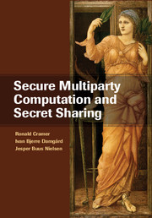
Open questions / Future work
Quantum Fully Homomorphic Encryption
  Currently: helper gadgets required for evaluation of each T gate
Other cryptographic primitives
  (round-efficient) delegated quantum computation
  Quantum Multi-Party Computation
  Quantum circuit obfuscation
  …?

Slide 32
Thank you for your attention!
Questions

Slide 33






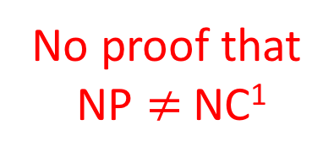

Barrington’s Theorem
[1989]
NC¹
Width-5 PBP
Boolean circuits with
Fan-in 2 gates
Polynomial size
Depth is log(n)
Branching Programs
Polynomial size
Permutations from S₅
=
$$f(x)$$
contains many non-trivial functions:
Majority, Parity, Equality
Decryption of common FHE schemes
NP
not
or
P
and
L
No proof that
NP $≠$ NC¹
$$x_{1}$$
$$x_{2}$$
$$x_{n}$$
NC¹

Slide 34


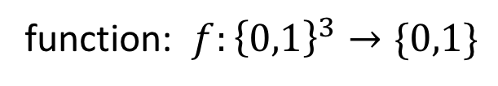
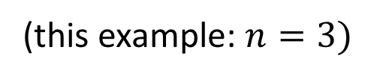
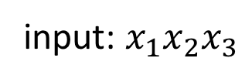
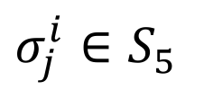
Width-5 Permutation Branching Programs
function: $f:{\left\{0,1\right\}}^{3}→\{0,1\}$
input: $x_{1}x_{2}x_{3}$
(this example: $n=3)$
instructions:
$$\left(σ_{1}^{0},σ_{1}^{1}\right), \left(σ_{2}^{0},σ_{2}^{1}\right),\left(σ_{3}^{0},σ_{3}^{1}\right),\left(σ_{4}^{0},σ_{4}^{1}\right),…,\left(σ_{k}^{0},σ_{k}^{1}\right)$$
$$σ_{j}^{i}∈S_{5}$$
$$x_{1}=0$$
$$x_{1}=1$$

Slide 35




Width-5 Permutation Branching Programs
function: $f:{\left\{0,1\right\}}^{3}→\{0,1\}$
input: $x_{1}x_{2}x_{3}$
(this example: $n=3)$
instructions:
$$\left(σ_{1}^{0},σ_{1}^{1}\right), \left(σ_{2}^{0},σ_{2}^{1}\right),\left(σ_{3}^{0},σ_{3}^{1}\right),\left(σ_{4}^{0},σ_{4}^{1}\right),…,\left(σ_{k}^{0},σ_{k}^{1}\right)$$
$$x_{1}=0$$
$$x_{2}=0$$
$$x_{3}=0$$
$$x_{1}=0$$
…
$$x_{1}=1$$
$$x_{2}=1$$
$$x_{3}=1$$
$$x_{1}=1$$
…
$$σ_{1}^{x_{1}}⋅σ_{2}^{x_{2}}⋅σ_{3}^{x_{3}}⋅σ_{4}^{x_{1}}⋯σ_{k}^{x_{k mod 3}}= \left\{\begin{aligned}id \text{if} f\left(x_{1}x_{2}x_{3}\right)=1 \\ π \text{if} f\left(x_{1}x_{2}x_{3}\right)=0\end{aligned}\right.$$

Slide 36
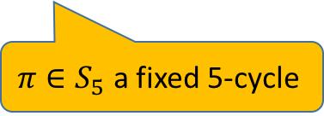
Width-5 Permutation Branching Programs
function: $f:{\left\{0,1\right\}}^{3}→\{0,1\}$
input: $x_{1}x_{2}x_{3}$
(this example: $n=3)$
instructions:
$$\left(σ_{1}^{0},σ_{1}^{1}\right), \left(σ_{2}^{0},σ_{2}^{1}\right),\left(σ_{3}^{0},σ_{3}^{1}\right),\left(σ_{4}^{0},σ_{4}^{1}\right),…,\left(σ_{k}^{0},σ_{k}^{1}\right)$$
$$x_{1}=0$$
$$x_{2}=0$$
$$x_{3}=0$$
$$x_{1}=0$$
…
$$x_{1}=1$$
$$x_{2}=1$$
$$x_{3}=1$$
$$x_{1}=1$$
…
$$σ_{1}^{x_{1}}⋅σ_{2}^{x_{2}}⋅σ_{3}^{x_{3}}⋅σ_{4}^{x_{1}}⋯σ_{k}^{x_{k mod 3}}= \left\{\begin{aligned}id \text{if} f\left(x_{1}x_{2}x_{3}\right)=1 \\ π \text{if} f\left(x_{1}x_{2}x_{3}\right)=0\end{aligned}\right.$$
$π∈S_{5}$ a fixed 5-cycle

Slide 37
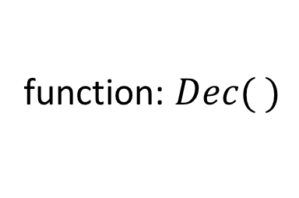
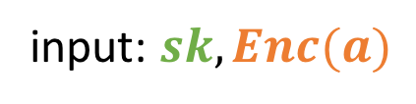
From Perm Branching Programs to Quantum Gadgets
function: $Dec( )$
input: $sk, Enc(a)$
instructions:
$$\left(σ_{1}^{0},σ_{1}^{1}\right), \left(σ_{2}^{0},σ_{2}^{1}\right),\left(σ_{3}^{0},σ_{3}^{1}\right),\left(σ_{4}^{0},σ_{4}^{1}\right),……………,\left(σ_{k}^{0},σ_{k}^{1}\right)$$
encryptor
evaluator
…
…
$$σ_{1}^{x_{1}}⋅σ_{2}^{x_{2}}⋅σ_{3}^{x_{3}}⋅σ_{4}^{x_{1}}⋯⋯⋯σ_{k}^{x_{⋅}}= \left\{\begin{aligned}id \text{if} Dec(sk,Enc\left(a\right))=1 \\ π \text{if} Dec(sk,Enc\left(a\right))=0\end{aligned}\right.$$

Slide 38
From Perm Branching Programs to Quantum Gadgets
function: $Dec( )$
input: $sk, Enc(a)$
instructions:
$$\left(σ_{1}^{0},σ_{1}^{1}\right), \left(σ_{2}^{0},σ_{2}^{1}\right),\left(σ_{3}^{0},σ_{3}^{1}\right),\left(σ_{4}^{0},σ_{4}^{1}\right),……………,\left(σ_{k}^{0},σ_{k}^{1}\right)$$
encryptor
evaluator
P
…
$$σ_{1}^{x_{1}}⋅σ_{2}^{x_{2}}⋅σ_{3}^{x_{3}}⋅σ_{4}^{x_{1}}⋯⋯⋯σ_{k}^{x_{⋅}}= \left\{\begin{aligned}id \text{if} Dec(sk,Enc\left(a\right))=1 \\ π \text{if} Dec(sk,Enc\left(a\right))=0\end{aligned}\right.$$
Finally, run all instructions in reverse to get the qubit to a known location

