Slide 1
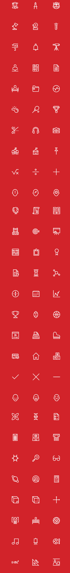

Quantum Cryptography
Christian Schaffner
Research Center for Quantum Software
Institute for Logic, Language and Computation (ILLC)
University of Amsterdam
Centrum Wiskunde & Informatica
Notes:
In het licht van recente experimentele successen en grote investeringen door o.a. Alphabet (voorheen Google), Microsoft, IBM en Intel is het realistisch dat er binnen 10-30 jaar een praktische quantumcomputer op de markt komt. Quantumcomputers kunnen exponentieel sneller algoritmes uitvoeren die aan de basis liggen van de meest gebruikte data-encryptiemethodes, zoals RSA.
Moeten we ons zorgen maken over een ‘cryptocalips’ wanneer de quantumcomputer er is? En hoe zit het met encryptiemethoden die tegen een quantumaanval bestand zijn, zoals post-quantum crypto en quantum key distribution? Zijn deze al op de markt en hoe moet uw organisatie hier mee aan de slag om optimaal voorbereid te zijn op de quantumtoekomst?

Slide 2
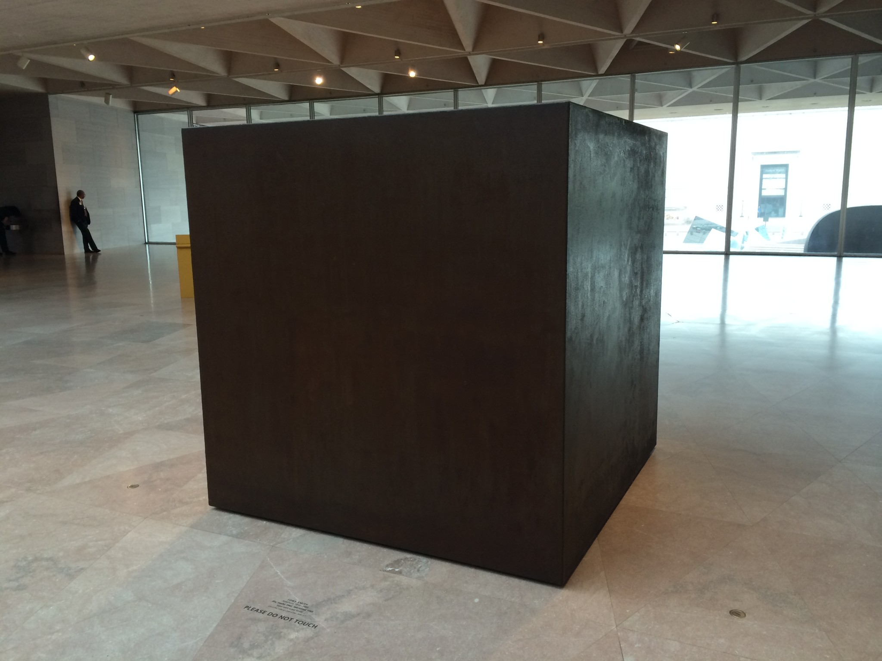
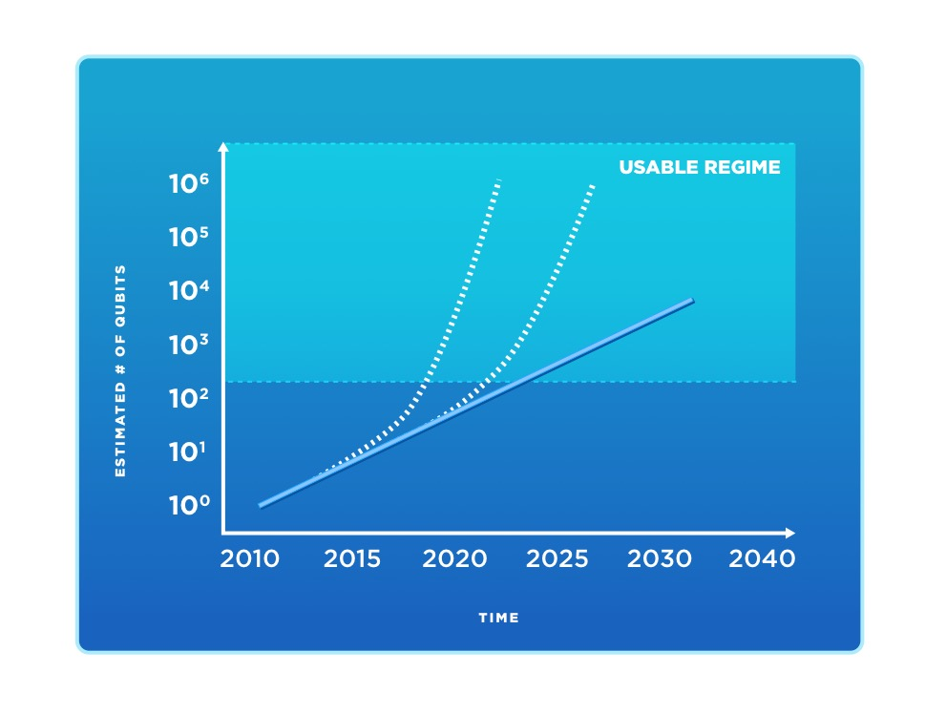
Quantum Computer
Quantum Computer
What are you going to do with it?
10-20 quantum bits now
50-100 qubits in the next 5 years!

Slide 3


Quantum Software is Fundamentally Different
Qubit: superposition of 0 and 1
Massive parallel computation:
  Each extra qubit doubles number of parameters
  300 qubits bigger than number of atoms in universe
  Exponentially large state space
How to get the answer out??
  Measuring destroys computation!!
Quantum Program
  Use interference to cancel unwanted computations
  Counterintuitive, fundamentally different from classical programming
Does not work for every computational problem!
  most problems no speed-up!

Slide 4



Quantum Software
Focus mostly on quantum hardware
Time is now to put more effort into quantum software. It is essential for a successful quantum future.
Launch research center for quantum software:

Slide 5
“Enabling the power of quantum computers”

Slide 6
“Enabling the power of quantum computers”
This talk:
What are the effects on cryptography?

Slide 7

Talk Outline
Classical Cryptography
Impact of Quantum Computers on Cryptography
When do we need to worry?
Solutions
Quantum Future

Slide 8
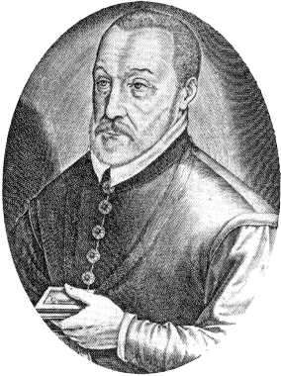
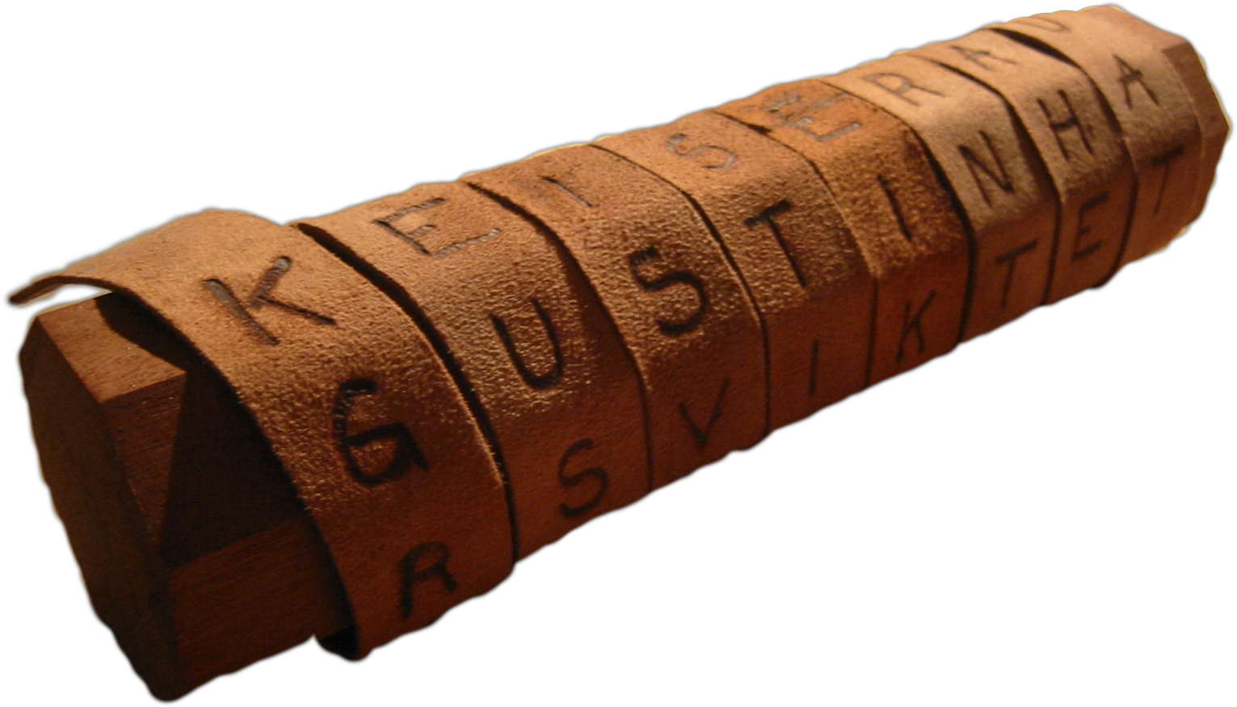
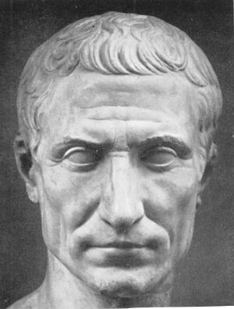

Ancient Cryptography
Blaise de Vigenère
Scytale
50 BC
1000 AD
2015 AD
500 BC
500 AD
1500 AD
Caesar Cipher (ROT4)

Slide 9
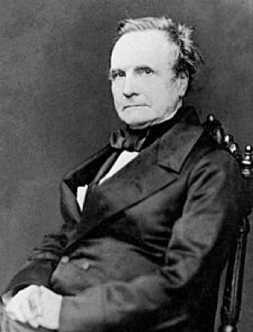
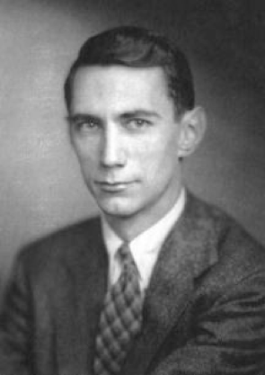
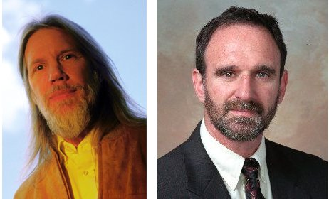
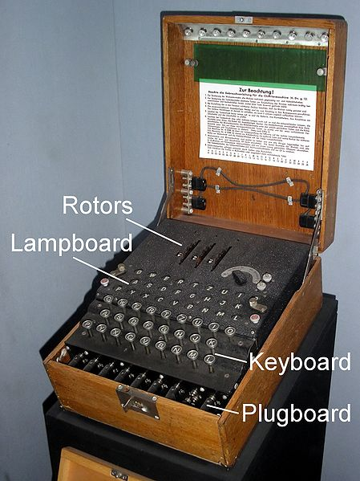
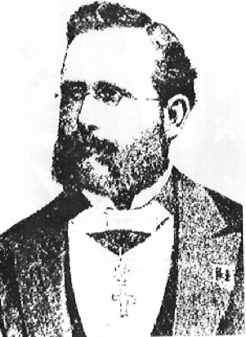
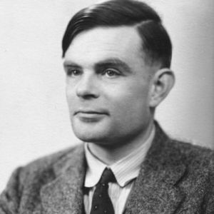

Ancient Cryptography
Charles Babbage
Claude Shannon
Diffie / Hellman
1850
1950
2015
1800
1900
1976
“een systeem van versleuteling moet even veilig zijn, zelfs als alles behalve de sleutel over het systeem publiek bekend is”
Enigma
Alan Turing
Auguste Kerckhoffs

Slide 10
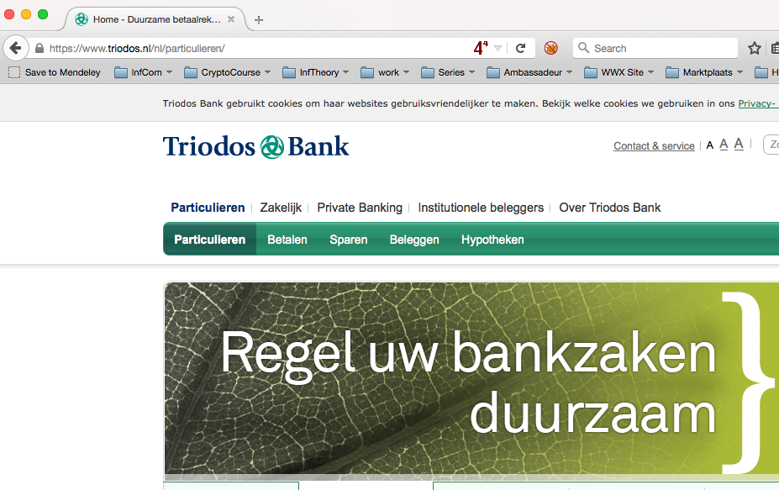
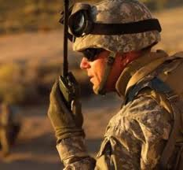
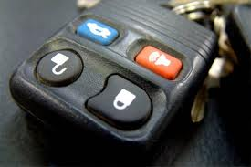
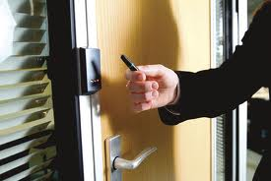
Modern Cryptography
is everywhere!
is concerned with all settings where people do not trust each other

Slide 11
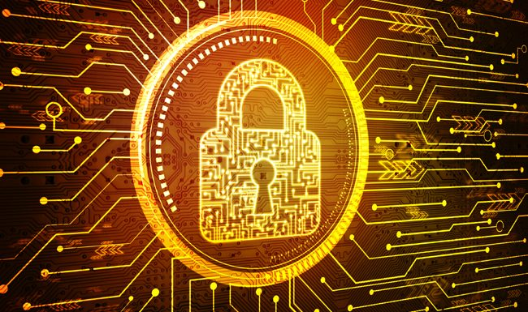
Cyber Security
“Cyber Security in the Netherlands is an important focal area that provides security, safety and privacy solutions that are vital for our economy including but not limited to critical infrastructures, smart cities, cloud computing, online services and e-government.”
Cloud computing
Internet of Things (IoT)
Payment systems
eHealth
Auto-updates – Digital Signatures
Secure Browsing - TLS/SSL
VPN – IPSec
Secure email – s/MIME, PGP
RSA, DSA, DH, ECDH, …
AES, 3-DES, SHA, …
Based on slides by Michele Mosca

Slide 12
Quantum Effects
Classical bit: 0 or 1
Quantum bit: can be in
superposition of 0 and 1
Yields a more powerful computational model:
  Shor’s algorithm allows to factor numbers
  Grover’s algorithm allows to search faster

Slide 13
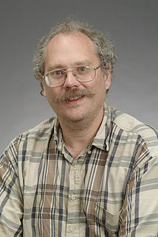
Quantum Algorithms: Factoring
[Shor ’94] Polynomial-time quantum algorithm for factoring integer numbers
15 = 3 * 5
27 = 3 * 3 * 3
31 = 1 * 31
57 = 3 * 19
91 = 7 * 13
173 = 1 * 173
RSA-100 = 1522605027922533360535618378132637429718068114961380688657908494580122963258952897654000350692006139 = 37975227936943673922808872755445627854565536638199 × 40094690950920881030683735292761468389214899724061
Notes:
15 = 3 * 5
51 = 3 * 17
123 * 456 = 56088

Slide 14
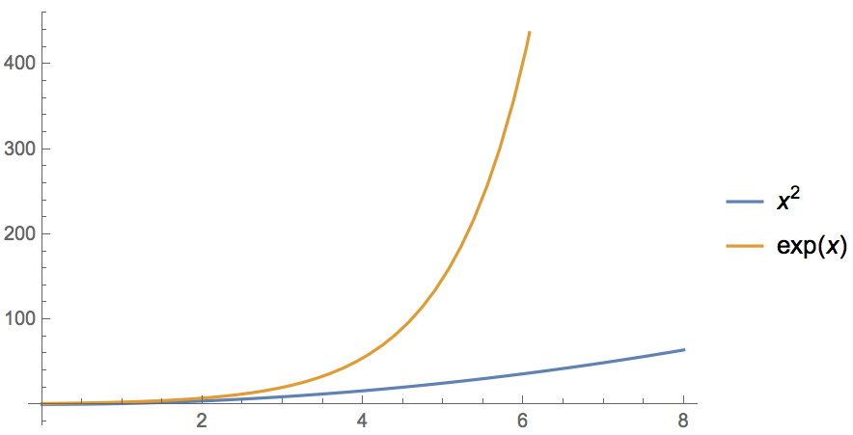
Quantum Algorithms: Factoring
[Shor ’94] Polynomial-time quantum algorithm for factoring integer numbers
Classical Computer : Exponential time
Quantum Computer : Poly-time: n²
For a 600-digit number (RSA-2048)
    Classical: age of universe
    Quantum: few minutes
Notes:
15 = 3 * 5
51 = 3 * 17
123 * 456 = 56088

Slide 15
Current Cryptography under Quantum Attacks
Security level systems | Conventional attacks | Quantum attacks
Symmetric-key encryption (AES-256) | 256 bits of security | 128 bits
Hash functions (SHA3-256) | 128 bits | 85 bits
Public-key crypto (key exchange, digital signatures, encryption) (RSA-2048, ECC-256) | 112 bits | ~ 0 bits
Products, services, businesses relying on security either stop functioning or do not provide expected levels of security (like last week’s ransomware events)
Notes:
Ask who knows the difference between private and public key! Explain the advantage of public-key crypto

Slide 16
When do we need to worry?
Depends on:
How long do you need to keep your secrets secure? (x years)
How much time will it take to re-tool the existing infrastructure? (y years)
How long will it take for a large-scale quantum computer to be built? (z years)
Theorem (Mosca): If x + y > z, then worry.
y
x
z
secrets revealed
time
2017
2027 ?
Corollary: If x > z or y > z, you are in big trouble!
Slide by Michele Mosca

Slide 17
Talk Outline
Classical Cryptography
Impact of Quantum Computers on Crypto
When do we need to worry?
Solutions
Quantum Future

Slide 18
Solution:
Quantum-Safe Cryptography
Classical quantum-safe cryptography
(post-quantum crypto)
Quantum Cryptography
Slide by Michele Mosca

Slide 19
Quantum Crypto Landscape
Security level systems | Conventional attacks | Quantum attacks
Symmetric-key encryption (AES-256) | 256 bits | 128 bits
Hash functions (SHA3-256) | 128 bits | 85 bits
Public-key crypto (key exchange, digital signatures, encryption) (RSA-2048) | 112 bits | ~ 0 bits
Hash-based signatures | probably | probably
McEliece | probably | probably
Lattice-based | probably | probably
Quantum Key Distribution (QKD) | provable | provable
technical difficulty (€)
Qantum-safe Crypto

Slide 20
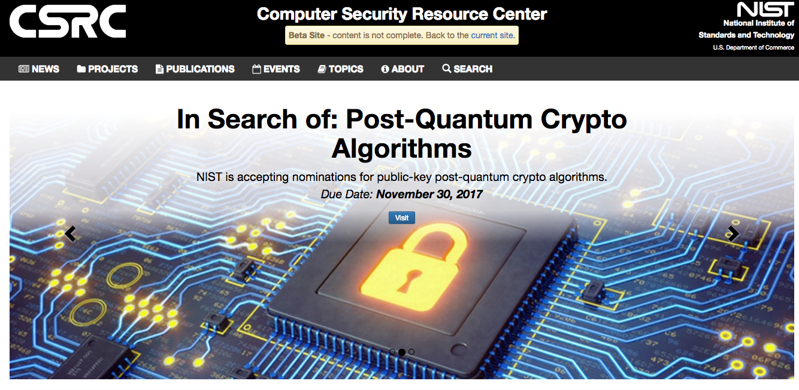


Conventional Quantum-Safe Crypto
Wanted: new assumptions to replace factoring and discrete logarithms in order to build conventional public-key cryptography

Slide 21
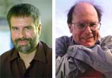


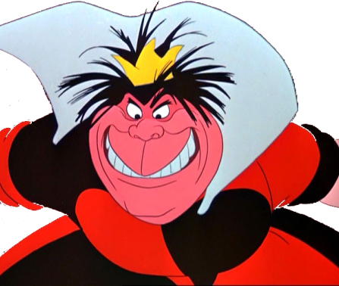
Quantum Key Distribution (QKD)
[Bennett Brassard 84]
Alice
Bob
k = ?
k = 0101 1011
k = 0101 1011
Eve
Offers an quantum solution to the key-exchange problem which does not rely on computational assumptions

Slide 22

Quantum Key Distribution (QKD)
[Bennett Brassard 84]
Alice
Bob
Eve
technically feasible: no quantum computer required,
only quantum communication

Slide 23
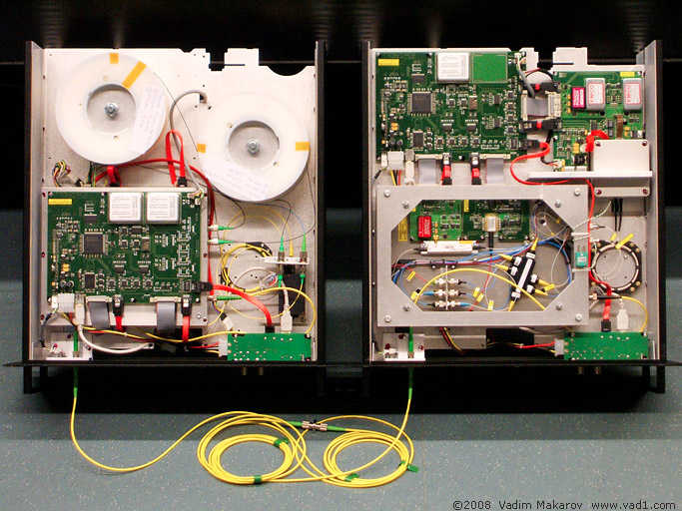
Quantum Key Distribution (QKD)
[Bennett Brassard 84]
Alice
Bob
Eve
technically feasible: no quantum computer required,
only quantum communication

Slide 24
Solution:
Quantum-Safe Cryptography
Conventional quantum-safe cryptography
(post-quantum crypto)
Can be deployed without quantum technologies
Believed to be secure against quantum attacks of the future
Quantum Cryptography
Requires some quantum technology (but no large-scale quantum computer)
Typically no computational assumptions
Slide by Michele Mosca

Slide 25
Talk Outline
Classical Cryptography
Impact of Quantum Computers on Crypto
When do we need to worry?
Solutions
Quantum Future

Slide 26
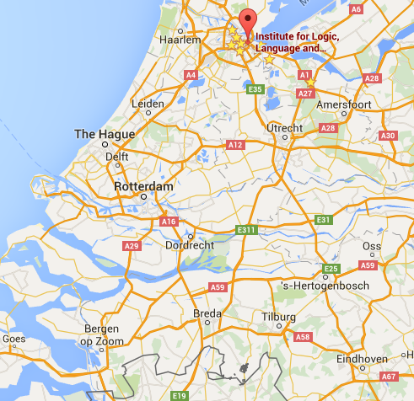





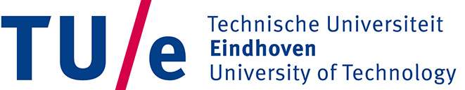
Quantum Research in NL
QuTech: 135 mln € , 50 mln $ Intel
May 2017: NWO Zwaartekracht: 18.8 mln € for 10 years

Slide 27
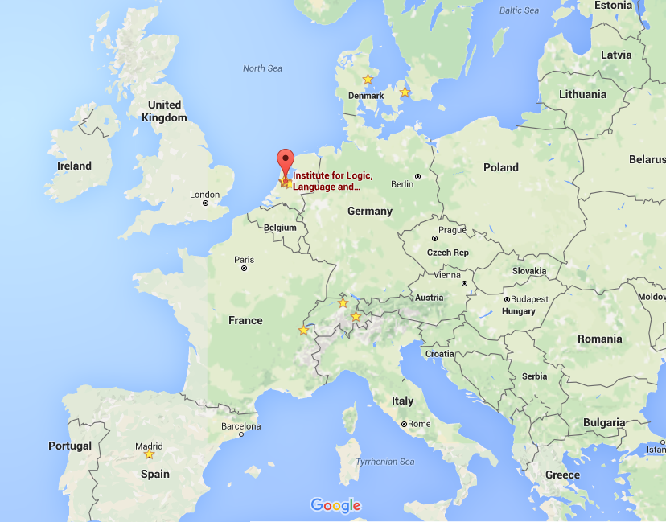


Quantum Research in EU
17 May 2016: 1 mld € flagship program on Q technologies

Slide 28
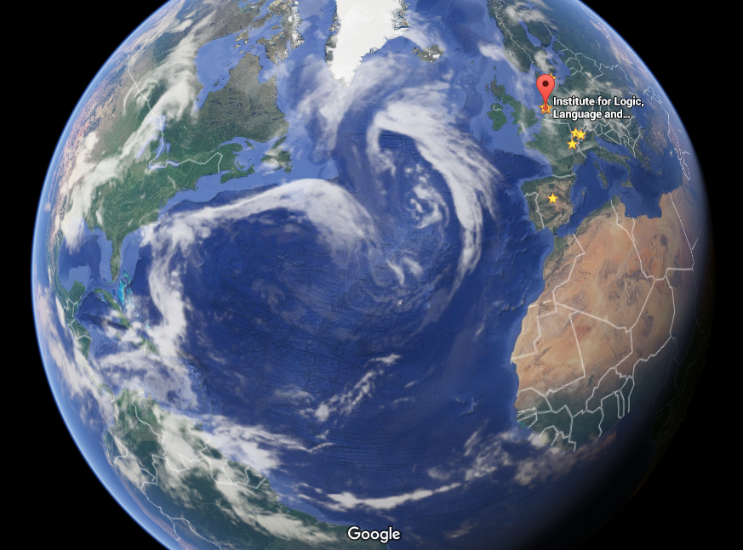


Quantum Research Worldwide
Waterloo, Singapore, Santa Barbara, China, …

Slide 29
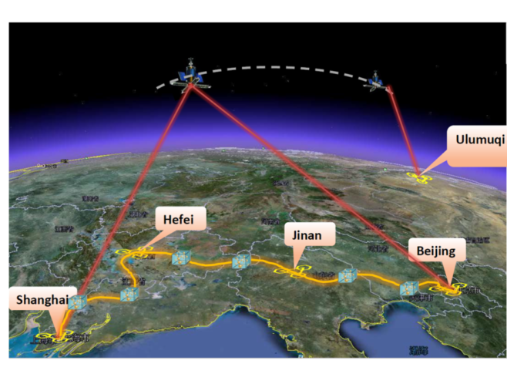
Quantum Networks
2000km QKD backbone network between Beijing and Shanghai
first QKD satellite launched
in 2016 from China
Quantum entanglement allows to generate secure keys (like QKD)

Slide 30
Secure Computing in Quantum Cloud
Distributed quantum computing
Recent result: quantum homomorphic encryption allows for secure delegated quantum computation
Y. Dulek, C. Schaffner, and F. Speelman, arXiv:1603.09717
Quantum homomorphic encryption for polynomial-sized circuits, in CRYPTO 2016, QIP 2017

Slide 31
Summary
Cloud computing
Internet of Things (IoT)
Payment systems, eHealth
Cyber Security
Impact of Quantum Computing on crypto
Auto-updates – Digital Signatures
Secure Browsing - TLS/SSL
VPN – IPSec
Secure email – s/MIME, PGP
RSA, DSA, DH, ECDH, …
AES, 3-DES, SHA, …
Security level systems | Conventional attacks | Quantum attacks
Symmetric-key crypto | 128 bits | reduced
Public-key crypto | 112 bits | broken!
Thm: If x + y > z, then worry

Slide 32
Summary
Quantum-safe crypto:
Quantum Key Distribution, Quantum Cloud
Conventional quantum-safe cryptography
(post-quantum crypto)
Quantum Cryptography

Slide 33
Thank you for your attention!
Questions
Get in touch: schaffner@qusoft.org

