Slide 1
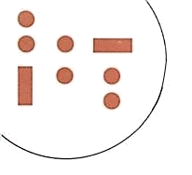


Welcome to the
Workshop on Cryptography from Storage Imperfections
Organizers:
John Preskill
Stephanie Wehner
Christian Schaffner
Institute for Quantum Information, Caltech, USA
20-22 March 2010

Slide 2

Cryptographic Primitives and the
Noisy-Storage Model
Christian Schaffner
CWI Amsterdam, Netherlands
Workshop on Cryptography from Storage Imperfections
Institute for Quantum Information, Caltech, USA
Saturday, 20 March 2010

Slide 3
Outline
Cryptographic Primitives
  Motivation
  Basic Two-Party Primitives
The Noisy-Storage Model
  Definition
  Relation to Previous Results
Protocols and Techniques (Stephanie)

Slide 4


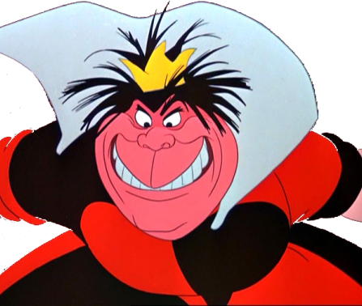
Cryptography
employed whenever parties do not trust each other:
  secure communication
  authentication
Bob
Alice
Eve
Three-Party Scenario

Slide 5
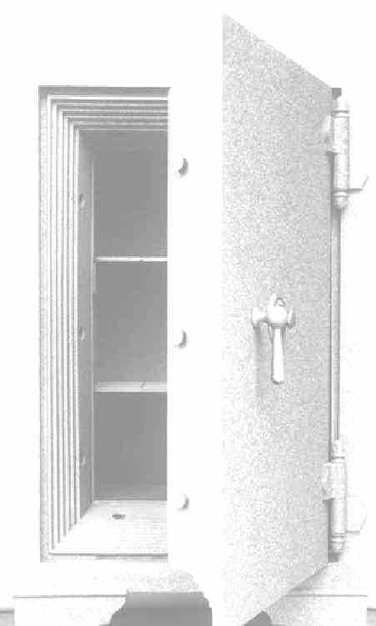


Modern-Day Cryptography
I’m Alice,
my PIN is 4049
I want $25
Alright Alice, here you go.
(stolen from Louis Salvail)

Slide 6

Modern-Day Cryptography
Alice:
4049
I’m Alice
my PIN is 4049
I want $25
Sorry, I’m out of order

Slide 7
Modern-Day Cryptography
Alice:
4049
I’m Alice,
my PIN is 4049
I want $250000
Alright Alice, here you go.

Slide 8
Where It Went Wrong
I’m Alice
my PIN is 4049
I want $25

Slide 9
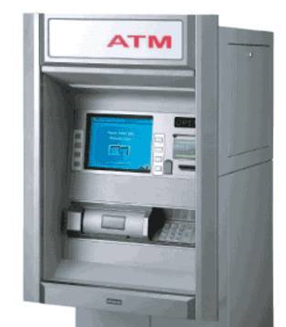
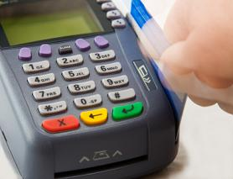
Secure Evaluation of the Equality
a
=
b
?
?
?
a = b
a = b
PIN-based identification scheme should be a
secure evaluation of the equality function
dishonest player can exclude only one possible password

Slide 10
Secure Function Evaluation
we want: ideal functionality
IDEAL
x
f
y
f(x,y)
f(x,y)
we have: protocol
REAL
security: if REAL looks like IDEAL to the outside world

Slide 11
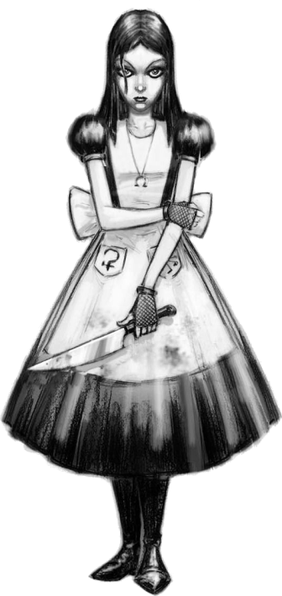
Dishonest Alice
we want: ideal functionality
IDEAL
x
f
y
f(x,y)
f(x,y)
we have: protocol
REAL
security: if REAL looks like IDEAL to the outside world

Slide 12
Dishonest Bob
we want: ideal functionality
IDEAL
x
f
y
f(x,y)
f(x,y)
we have: protocol
REAL
security: if REAL looks like IDEAL to the outside world

Slide 13

Modern Cryptography
two-party scenarios:
  password-based identification (=)
  millionaire‘s problem (<)
  dating problem (AND)
multi-party scenarios:
  sealed-bid auctions
  e-voting
  …

Slide 14
Outline
Cryptographic Primitives
  Motivation
  Basic Two-Party Primitives
The Noisy-Storage Model
  Definition
  Relation to Previous Results
Protocols and Techniques (Stephanie)

Slide 15
1-out-of-2 Oblivious Transfer
s₀ , s₁
1-2 OT
c 2 {0,1}
s_{c}
dishonest Alice does not learn anything about c
dishonest Bob learns only one of the two strings s₀ , s₁
    „given c and s_{c} , his knowledge about s_{1-c} is negligible“

Slide 16
1-out-of-2 Oblivious Transfer
s₀ , s₁
1-2 OT
c
s_{c}
universal for two-party secure cryptography
example:
„proof of principle“ of power of a cryptographic model
x
f
y 2 {0,1}
f(x,y)
f(x,0), f(x,1)
1-2 OT
y
f(x,y)

Slide 17
Bit Commitment
b=?
commit:
b
open:
b
hiding/concealing: dishonest verifier does not learn b
binding: dishonest committer cannot change b

Slide 18
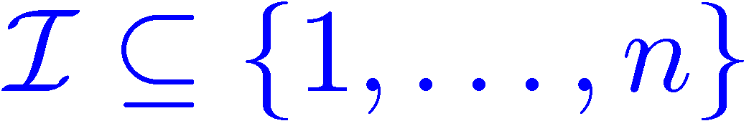
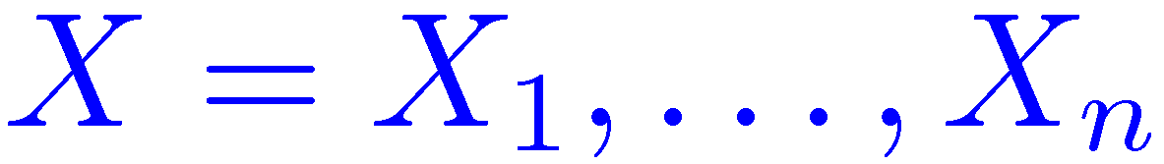
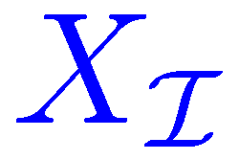
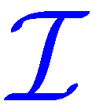
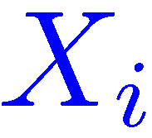
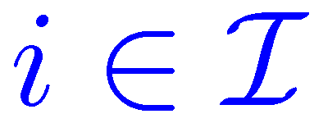
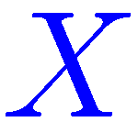
Weak String Erasure (WSE)
weak string erasure
dishonest Alice does not learn anything about
dishonest Bob learns only the
with
    „Bob has only limited knowledge about “
Weak String Erasure implies BC and OT

Slide 19



Overview of Two-Party Primitives
x
f
y
Secure Function Evaluation (SFE):
Oblivious Transfer (OT):
Bit Commitment (BC):
Coin Toss:
f(x,y)
f(x,y)
s₀ , s₁
1-2 OT
c
s_{c}
quantum only
b
b
r
r

Slide 20
Can we implement these primitives?
In the plain model (no restrictions on adversary,
using quantum communication):
  Bit Commitment is impossible (Lo&Chau/Mayers ‘96)
  Secure function evaluation is impossible (Lo ‘97)
Restrict the adversary:
  Computational assumptions (e.g. factoring or discrete logarithms are hard)
  Classical storage is bounded (Maurer ’90)
unproven
hard to enforce

Slide 21
Quantum Storage Imperfections
Storing quantum information is difficult!
  Bounded-Quantum-Storage Model :
  bound the number of qubits an adversary can store
  (Damgaard, Fehr, Salvail, S ‘05)
  Noisy-(Quantum-)Storage Model:
  more general and realistic model
  (Wehner, S, Terhal ’07; König, Wehner, Wullschleger ‘09)
Conversion can fail
Error in storage
Readout can fail

Slide 22
Outline
Cryptographic Primitives
  Motivation
  Basic Two-Party Primitives
The Noisy-Storage Model
  Definition
  Relation to Previous Results
Protocols and Techniques (Stephanie)

Slide 23
The Noisy-Storage Model
(Wehner, S, Terhal ’07)

Slide 24
The Noisy-Storage Model
(Wehner, S, Terhal ’07)
waiting time: ¢t
what an (active) adversary can do:
  change messages
  computationally all-powerful
  unlimited classical storage
  actions are ‘instantaneous’
restriction:
  noisy quantum storage

Slide 25
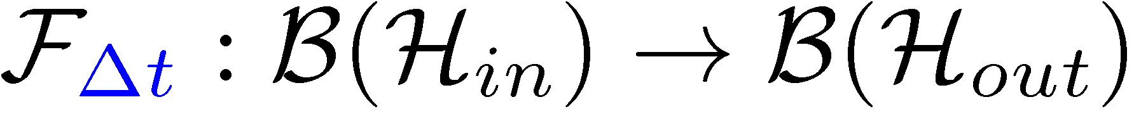
The Noisy-Storage Model
(Wehner, S, Terhal ’07)
change messages
computationally all-powerful
unlimited classical storage
actions are ‘instantaneous’
waiting time: ¢t
Adversary’s state
Arbitrary
encoding
attack
Unlimited classical storage
Noisy quantum storage
models:
decoherence in memory
transfer into storage (photonic states onto different carrier)

Slide 26
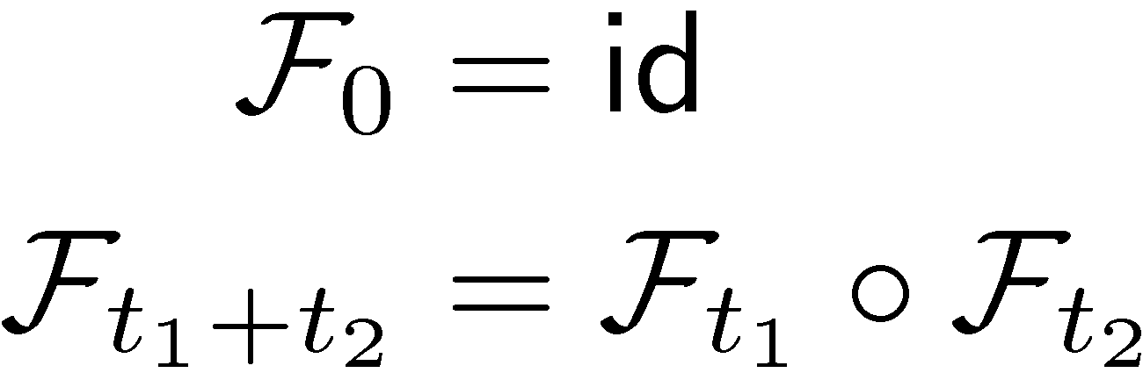
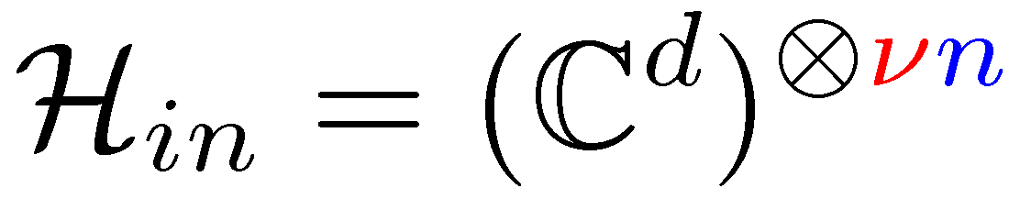
The Noisy-Storage Model
during waiting time: ¢t
Adversary’s state
Arbitrary
encoding
attack
Unlimited classical storage
Noisy quantum storage
waiting does not help:
input space:
storage rate
# of transmitted qubits

Slide 27

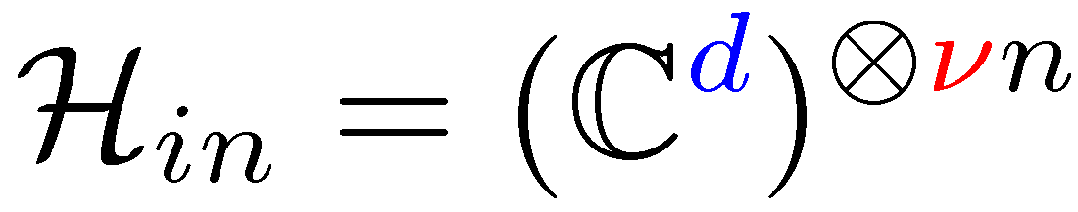
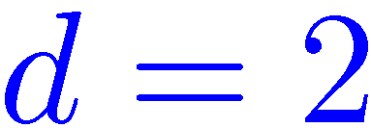
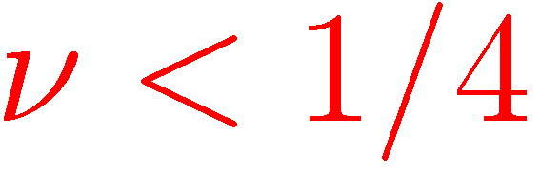
Relation to Previous Work
Noisy quantum storage
waiting time: ¢t
Bounded-storage model (Damgaard Fehr Salvail S ’05)
  Storing qubits:
  No noise:
  Low storage rate:
easy to work with in theory
unrealistic model

Slide 28

Relation to Previous Work
Noisy quantum storage
waiting time: ¢t
Noisy-storage with individual-storage attacks
(Wehner S Terhal ’08)
  Storing qubits:
  Any single qubit noise (e.g. depolarizing noise)
  High storage rate:
more realistic model
pulses are treated individually

Slide 29
Noisy-Storage Model
Noisy quantum storage
waiting time: ¢t
General case (König Wehner Wullschleger ‘09)
  Storage channels with “strong converse” property
  Trade-offs between storage noise and storage rate º
yields Weak String Erasure, then BC and OT
  entropic uncertainty relations
  interactive hashing
  min-entropy sampling
  privacy amplification

Slide 30
Summary
Cryptographic Primitives
  Motivation
  Basic Two-Party Primitives
The Noisy-Storage Model
  Definition
  Relation to Previous Results
Protocols and Techniques
(by Stephanie)
=
1-2 OT
Noisy quantum storage

