Slide 1

Simple Protocols for OT and Secure Identification in the Noisy-Storage Model
(arxiv: 1002.1495)
Christian Schaffner
Amsterdam, Netherlands
Workshop on Cryptography from Storage Imperfections
Institute for Quantum Information, Caltech, USA
22 March 2010

Slide 2


Goal: 1-out-of-2 Oblivious Transfer
c
s₀ , s₁
1-2 OT
s_{c}

Slide 3
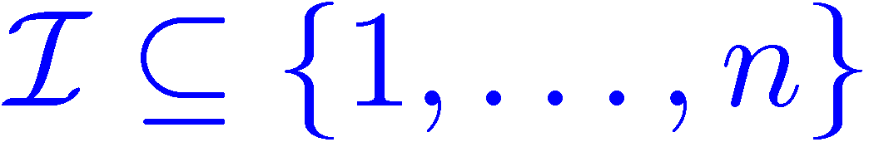
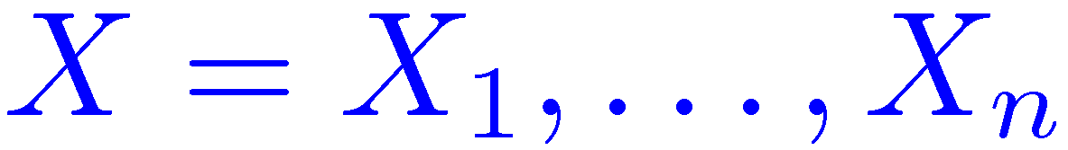
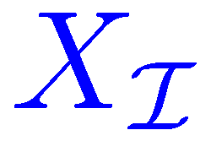
Previous Approach (KWW ‘09)
weak string erasure
Inter-active Hashing
Min-entropy sampling
Privacy Amplifi-cation
1-2 OT
standard protocol (NOVY 98) requires many communication rounds
works well only on blocks of bits
results in complicated post-processing and
poor error parameters
so far: no secure identification
Notes:
Naor Ostrovsky Venkatesan Yung

Slide 4
Alternative Approach
weak string erasure
Inter-active Hashing
Min-entropy sampling
Privacy Amplifi-cation
Min-Entropy Splitting
1-2 OT
easier analysis and better security error
canonical protocols
allows for secure identification
requires noisier storage, i.e. secure for smaller class of adversaries

Slide 5
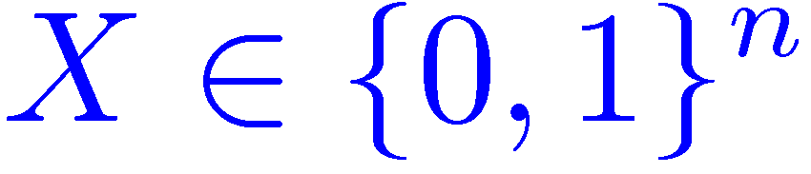
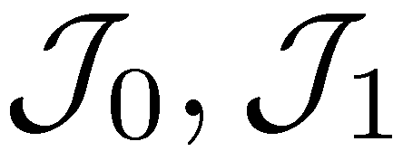
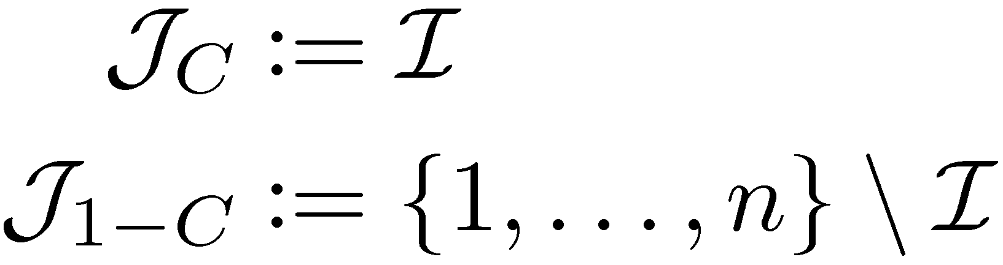
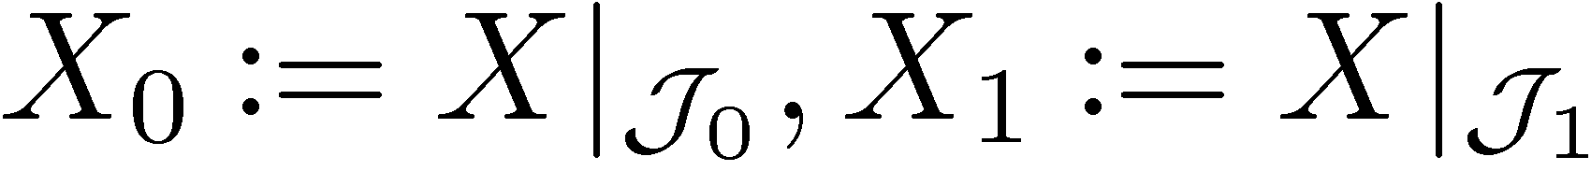

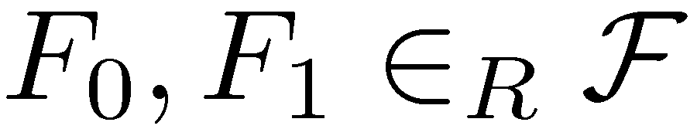
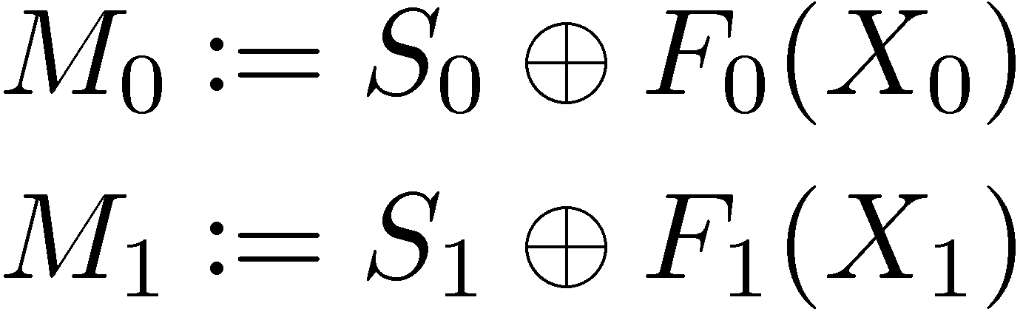
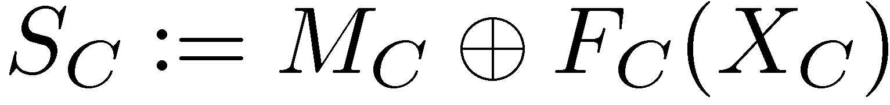
Standard Protocol for 1-2 OT
[Wiesner ~70, Bennett Brassard Crepeau Skubiszewska 92]
C
S₀ , S₁
1-2 OT
S_{C}
weak string erasure
secure identification: protocol (as presented by Serge) works

Slide 6

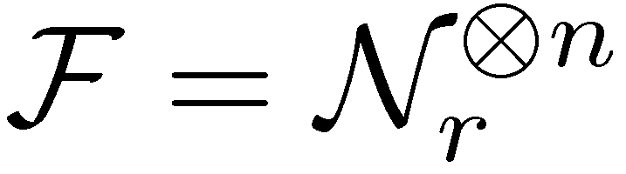
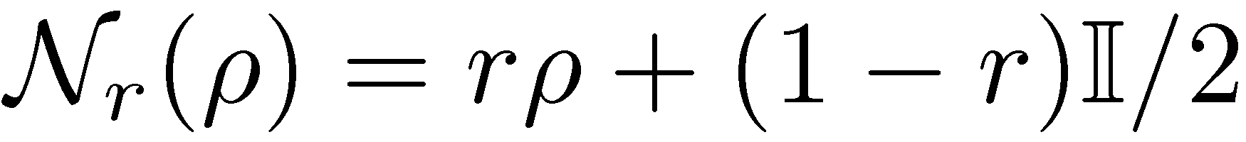
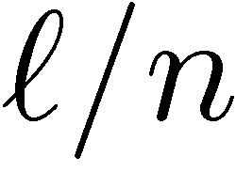

Rate Comparison
goal: 1-2 OT of - bit strings
scenario: n=10¹⁰ (ca. 30 sec), security error < 10⁻⁸
storage noise: where
Simple Protocol
Interactive Hashing, Min-Entropy Sampling [KWW 09]

Slide 7
Rate Comparison
goal: 1-2 OT of - bit strings
scenario: n=10¹⁵ (ca. 30 days), security error < 10⁻⁸
storage noise: where
Simple Protocol
Interactive Hashing, Min-Entropy Sampling [KWW 09]

Slide 8
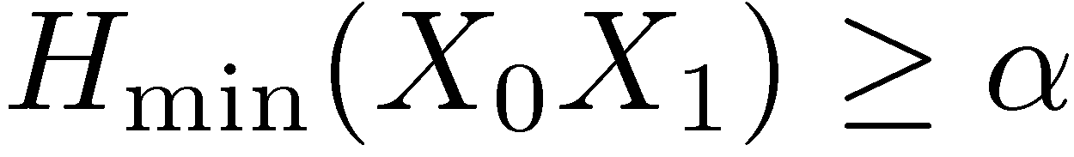
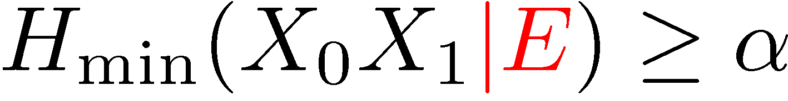
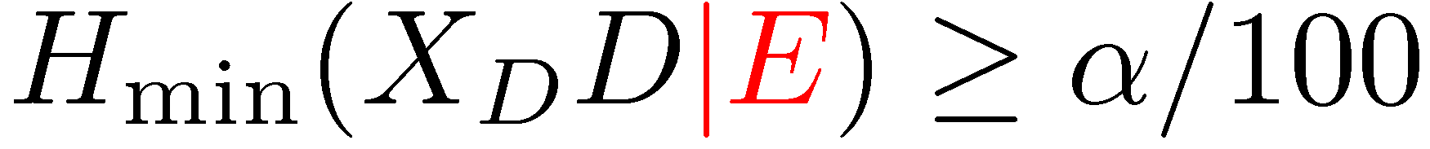
Min-Entropy Splitting
classical version:
(Wullschleger, Damgaard Fehr Renner Salvail S)
proof for Shannon entropy:
(proof for min-entropy: 3 lines)
with quantum side information?
wrong in general, but weaker version?
Min-Entropy Splitting
Privacy Amplification
1-2 OT

Slide 9
Summary
take-home messages for experimentalists:
  interactive hashing is not strictly necessary
  original simple protocols remain secure in the noisy-storage model
take-home messages for theorists:
  min-entropy splitting is an alternative way of proving security in the noisy-storage model
  does it hold with quantum side information?
http://arxiv.org/abs/1002.1495

Slide 10
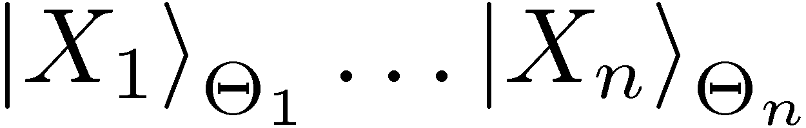
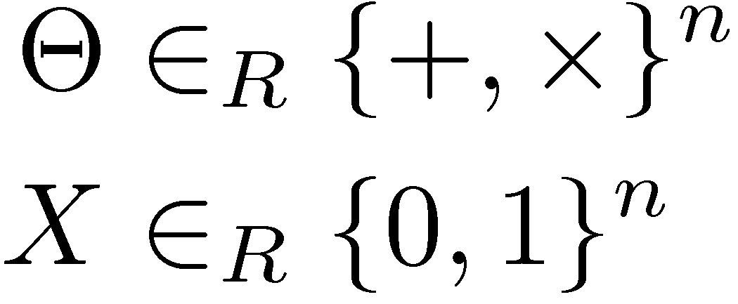
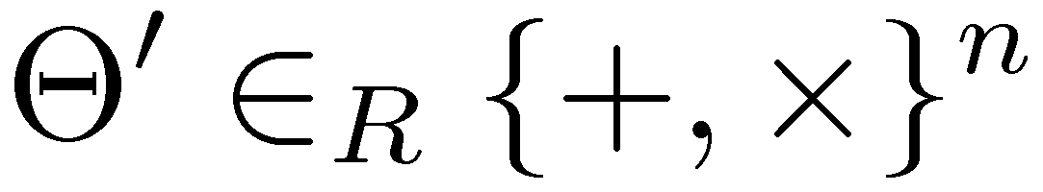
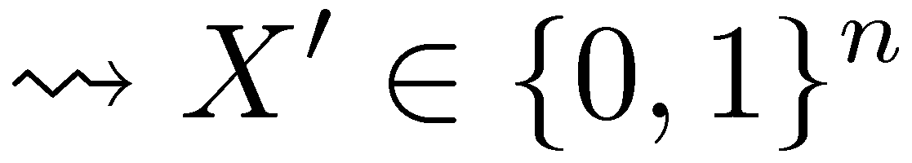

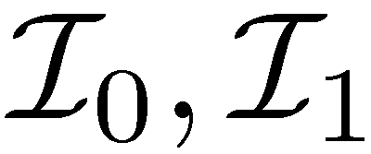
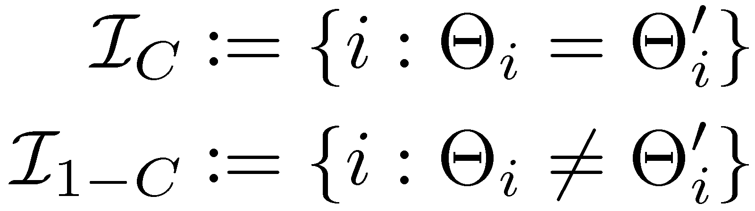
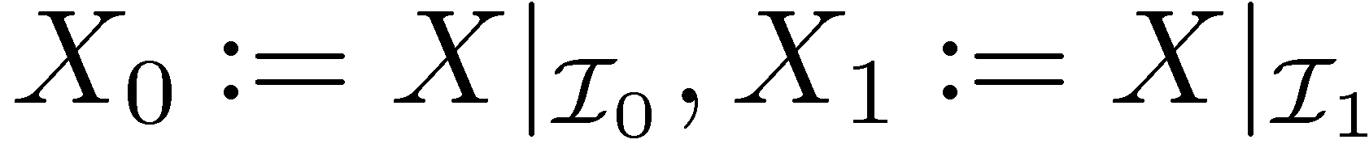
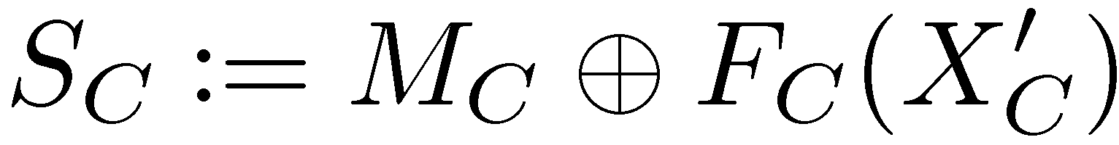
Goal: 1-out-of-2 Oblivious Transfer
c
s₀ , s₁
1-2 OT
s_{c}
waiting time: ¢t
[Wiesner ~70, Bennett Brassard Crepeau Skubiszewska 92]

Slide 11

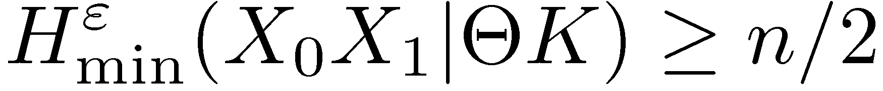
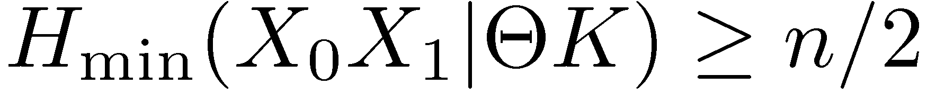
Proof Strategy Against Dishonest Bob
Weak string erasure
uncertainty relation:
KWW09-Lemma:
min-entropy splitting lemma:
(Wullschleger, Damgaard Fehr Renner Salvail S) :
Privacy ampli-fication
OT

