Slide 1

Limited-Quantum-Storage Cryptography
From Theory to Practice
Christian Schaffner
Centrum Wiskunde & Informatica, Amsterdam, Netherlands
Workshop in Dagstuhl, July 2009
TexPoint fonts used in EMF.
Read the TexPoint manual before you delete this box.: A

Slide 2

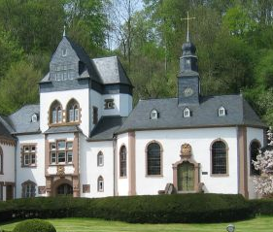
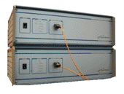
Contributors and Outline
(in order of appearance)
Ivan Damgaard
Louis Salvail
Serge Fehr
Renato Renner
Stephanie Wehner
Barbara Terhal
Jürg Wullschleger
Carolin Lunemann
Robert König
Hoi-Kwong Lo
Marcos Curty
2004
Bounded Quantum Storage
The Protocol
Noisy Quantum Storage
Secure Identification
Composability
Practical Problems
2009
201?

Slide 3
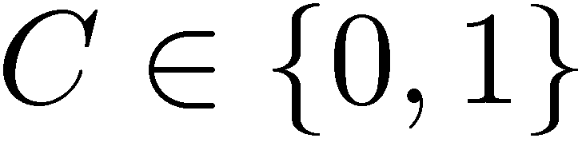
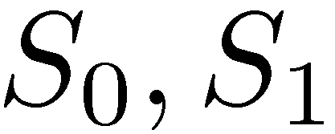

Inspiration: Classical Bounded-Storage
[Maurer 90]
…010011100011010010101…
1001101001011100101011
100110
100110
Alice
Bob
goal:
honest player‘s memory: n
dishonest player‘s memory: · O(n²)
information-theoretic security, no time-restrictions
tight bound [Dziembowski Maurer 04],
relies on the difficulty of storing classical information
1-2 OT

Slide 4
Bounded-Quantum-Storage Model
[Damgaard Fehr Salvail Schaffner 05, dito with Renner 07]
01110
goal:
information-theoretic security, no running time-restrictions
honest player‘s quantum memory: 0
security as long as
dishonest player‘s quantum memory: · n/4
relies on technical difficulty of storing quantum information
1-2 OT

Slide 5
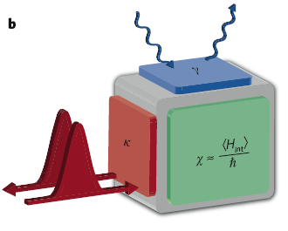
Storing Photonic Quantum Information
major research field in quantum physics
light - ‘flying media’
matter - ‘stationary media’
goal: light–matter interaction
early stage: only special purpose experiments
despite the efforts:
  storage times of only microseconds
  low success probabilities
storing quantum information is difficult, i.e.
limited quantum-storage is realistic assumption
“The Quantum Internet” [Kimble 08]

Slide 6
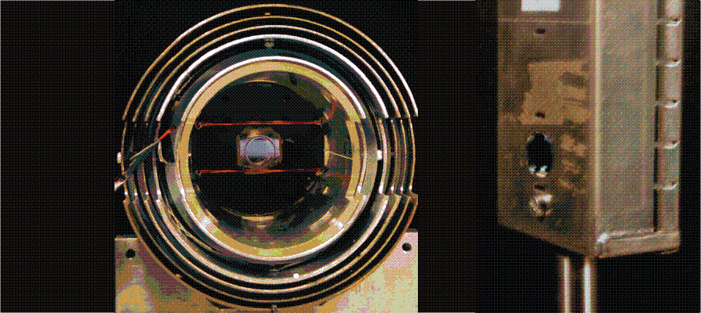
Storing Photonic Quantum Information
[physics group of Eugene Polzik, Copenhagen (DK)]
70% fidelity, few milliseconds, …

Slide 7
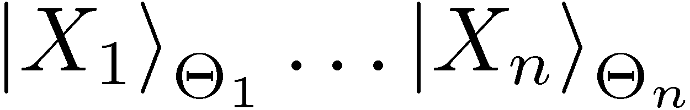
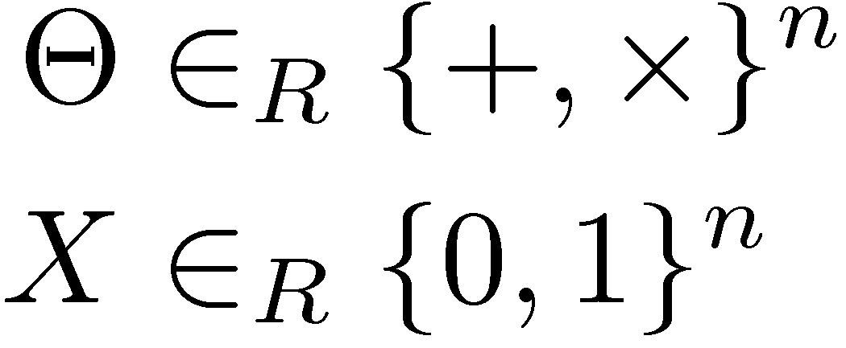
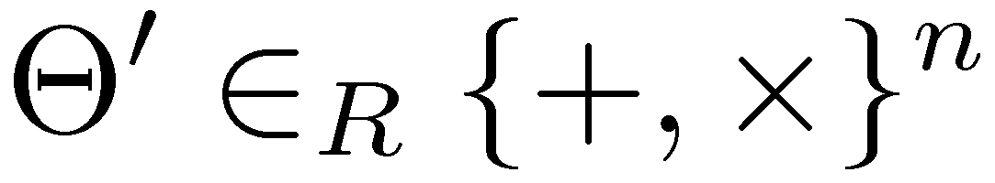
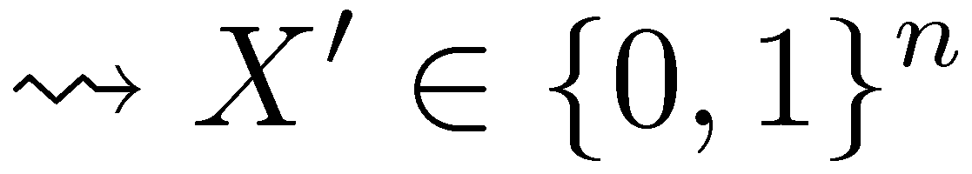

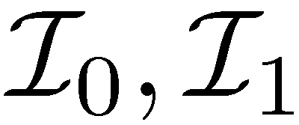
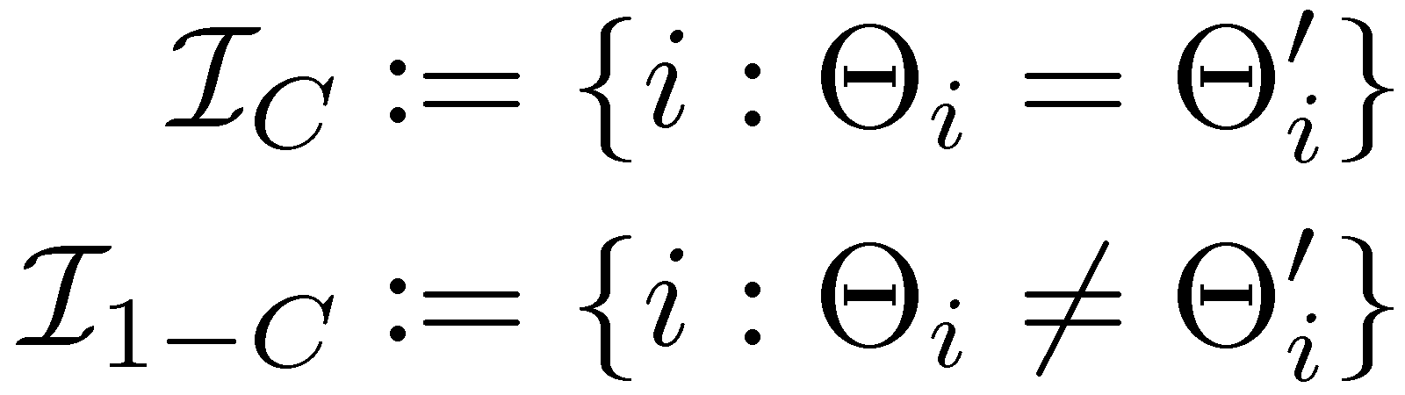
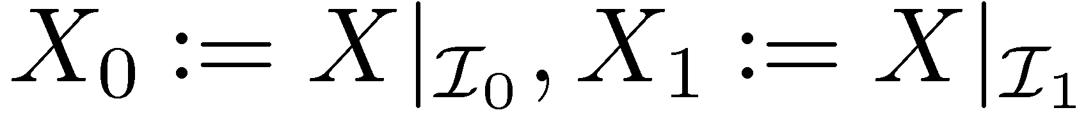

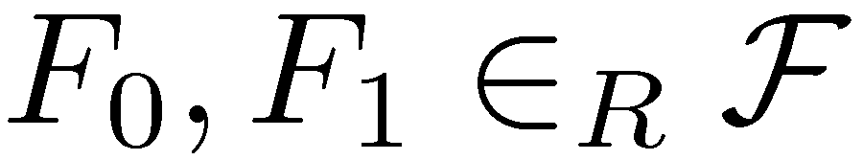
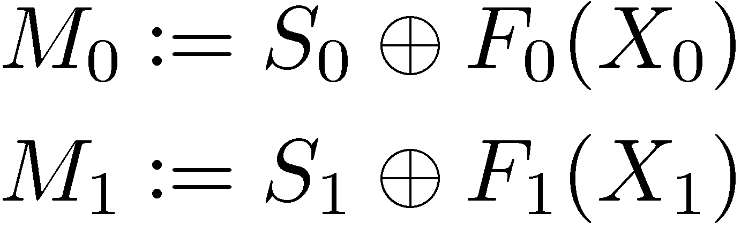
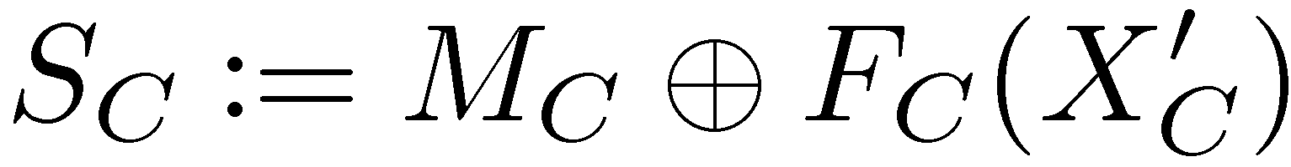
The Protocol
[Wiesner ~70, Bennett Brassard Crepeau Skubiszewska 92]
goal:
correct
secure against cheating Alice
1-2 OT

Slide 8
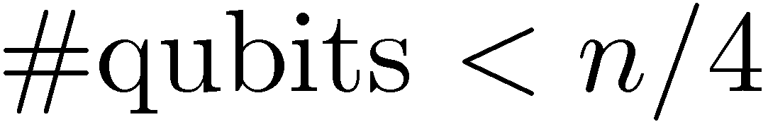
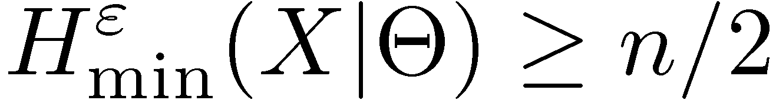
Dishonest Bob with Bounded Q Storage
[Damgaard Fehr Renner Salvail Schaffner 07]
purification argument (as in QKD)
entropic uncertainty relation:
privacy amplification against quantum adversaries
[Renner Koenig 07]

Slide 9
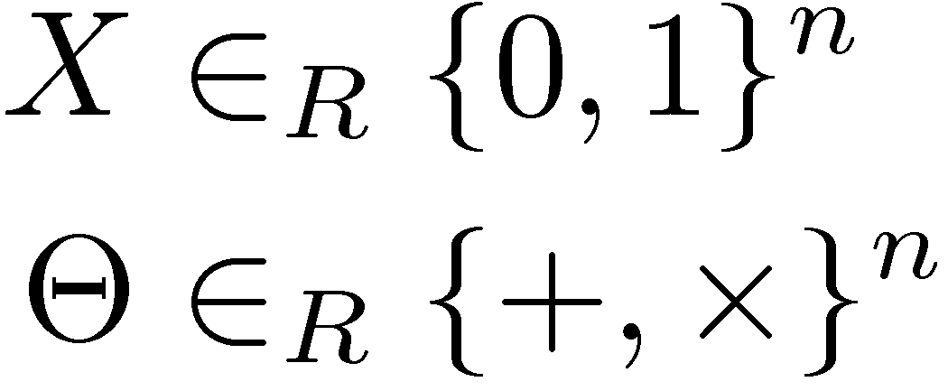

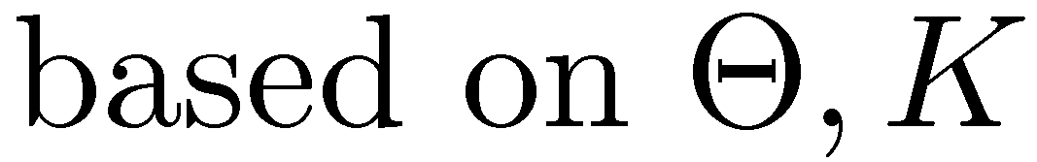
Noisy-Quantum-Storage Model
[Wehner Schaffner Terhal 08, König Wehner Wullschleger 09]
Encoding Attack
Noisy Storage
?
?
more realistic limitation on quantum storage capabilities
first step: individual-storage attacks
recent result: general attacks
related to classical capacities of quantum channels

Slide 10

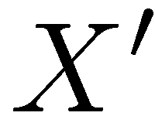
Combining Security Assumptions
[Damgaard Fehr Lunemann Salvail Schaffner 09]
two-party cryptography in the plain quantum model is impossible [Lo 96]
security can be based on
  difficulty of storing quantum information
  computational assumptions
can be combined!
idea from [BBCS92]: commit to bases and outcomes
forces adversary to have almost no quantum memory

Slide 11
Outline
Bounded Quantum Storage
The Protocol
Noisy Quantum Storage
Secure Identification
Composability
Practical Problems
Future

Slide 12
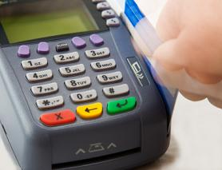
Secure Identification
[Damgaard Fehr Salvail Schaffner 07]
goal:
3 classical messages,
much more efficient than relying on reduction to 1-2 OT
secure against adversaries with quant memory < const n
can be made secure against man-in-the middle attacks
a
=
b
?
?
?
a = b
a = b

Slide 13


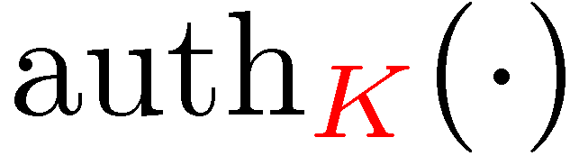

Man-In-The-Middle Security and QKD
[Damgaard Fehr Salvail Schaffner 07]
PIN
PIN
non-trivial extension is also secure against man-in-the middle attacks (while preserving original security)
QKD: key can be reused, even if scheme is disrupted, i.e.
q-memory bounded Eve cannot make honest players run out of auth key.

Slide 14
Composable Security Definitions
[Wehner Wullschleger 08, Fehr Schaffner 09, Unruh 09]
goal:
want to use primitive in an classical outer protocol
  or compose it with other quantum protocols
subtle in the quantum domain, quantum information
cannot be copied and carried through to the end
need the right security definitions!
general frameworks: [Ben-Or Mayers 02], [Unruh 04]
simulation-based definitions allow for sequential composition
1-2 OT

Slide 15
Practical Problems
[Wehner Curty Lo Schaffner 09]
imperfections similar to QKD:
  approximation to single-photon sources (weak coherent pulses or parametric-down-conversion)
  erasures in the channel
  bit errors in the channel
  dark counts
  ...
solutions: adapted security analyses, error-correction
computational efficiency of classical post-processing
physical size of devices
̶̶ no trusted peer
+ shorter distances

Slide 16

Similarities to QKD
[BB84]
commercial
1984
2009
QKD know-how is now available
similar technology can be used for limited-quantum-storage applications!
but with different parameter ranges (e.g. shorter distances)
big potential:
Practical Quantum Crypto
other difficulties
in doing quantum comp
Limited-Q-Storage Crypto:
identification
comparison
QKD

Slide 17
Near and Far Future
Technology:
Theory:
harvest QKD knowledge
conduct experiments
check assumptions
miniaturize devices
find more direct protocols
continuous variables
more realistic models for the difficulty of storing quantum information
exploit other difficulties in doing quantum computation
win-win situation:
either large-scale quantum computing is possible or
the reason why not can be exploited for cryptography

Slide 18
Summary
Limited-Quantum-Storage Crypto: From Theory to Practice:
  Inspiration
  Basic Protocol for 1-2 OT
  Secure Identification
  Composability
  Practical Problems
  Similarities to QKD
  Outlook

Slide 19
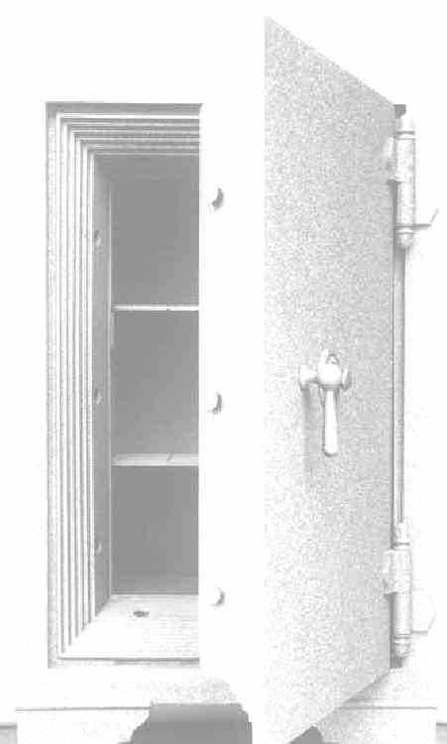

Modern-Day Cryptography
I’m Alice,
my PIN is 4049
I want $25
Alright Alice, here you go.

Slide 20
Modern-Day Cryptography
Alice:
4049
I’m Alice
my PIN is 4049
I want $25
Sorry, I’m out of order

Slide 21
Modern-Day Cryptography
Alice:
4049
I’m Alice,
my PIN is 4049
I want $250000
Alright Alice, here you go.

Slide 22
Secure Evaluation of the Equality
a
=
b
?
?
?
a = b
a = b
PIN-based identification scheme should be a
secure evaluation of the equality function
dishonest player can exclude only one possible password
two-party cryptography vs three-party settings

Slide 23
Modern Cryptography
employed whenever parties do not trust each other:
  secure communication
  authentication
  password-based identification
  millionaire‘s problem
  dating problem
  sealed-bid auctions
  ...

