Slide 1


Quantum Cryptography
Christian Schaffner
Research Center for Quantum Software
Institute for Logic, Language and Computation (ILLC)
University of Amsterdam
Centrum Wiskunde & Informatica
ICT OPEN 2017
Tuesday, 21 March 2017

Slide 2

Keynote: Quantum Computer
Barbara Terhal
Where we stand with building
This talk:
What are the effects on cryptography?

Slide 3

Talk Outline
Classical Cryptography
Impact of Quantum Computers on Crypto
When do we need to worry?
Solutions
Quantum Future

Slide 4
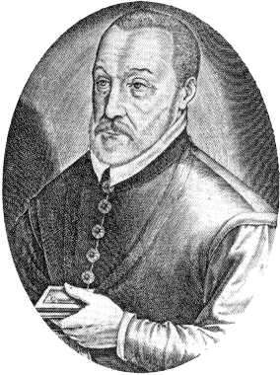
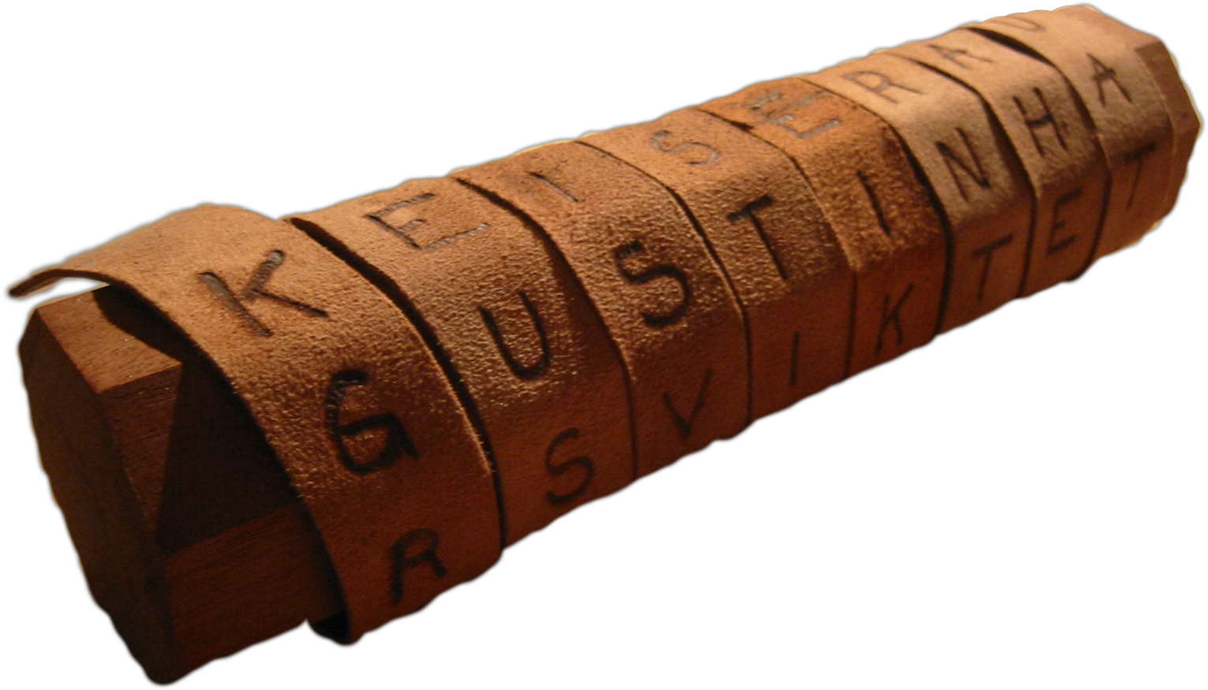
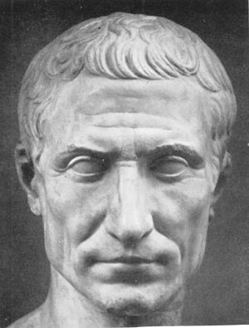

Ancient Cryptography
Blaise de Vigenère
Scytale
50 BC
1000 AD
2015 AD
500 BC
500 AD
1500 AD
Caesar Cipher (ROT4)

Slide 5
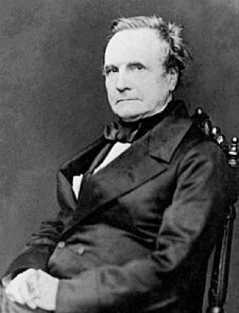
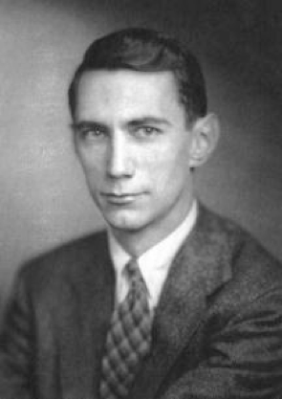
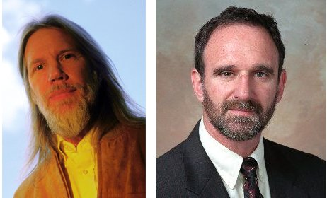
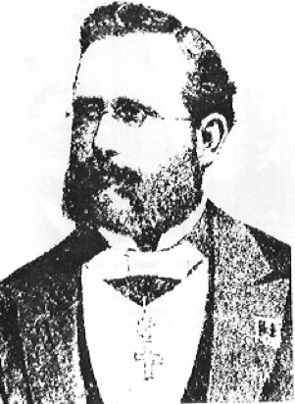
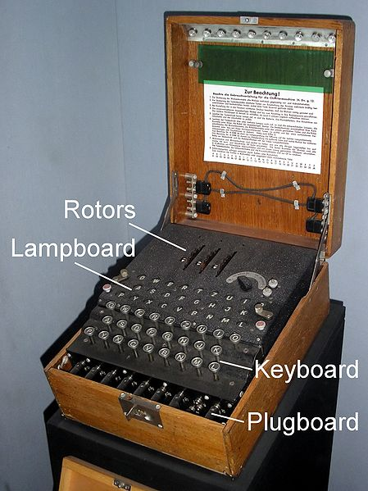
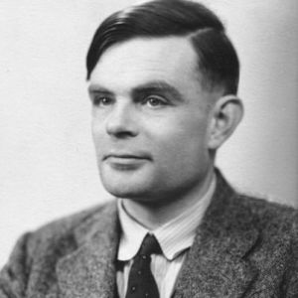

Ancient Cryptography
Charles Babbage
Claude Shannon
Diffie / Hellman
1850
1950
2015
1800
1900
1976
“A cryptosystem should be secure even if everything about the system, except the key, is public knowledge”
Auguste Kerckhoffs
Enigma
Alan Turing

Slide 6
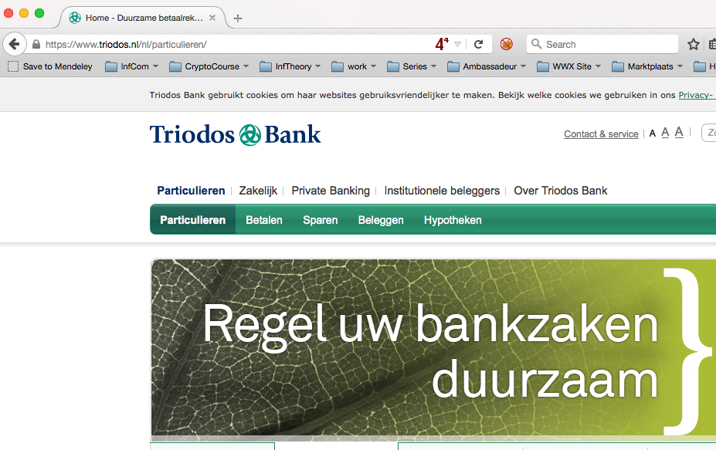

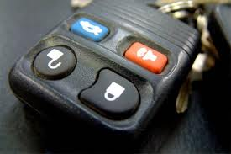

Modern Cryptography
is everywhere!
is concerned with all settings where people do not trust each other

Slide 7
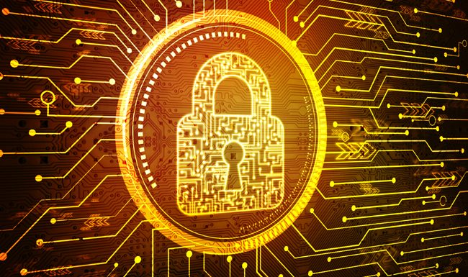
Cyber Security
“Cyber Security in the Netherlands is an important focal area that provides security, safety and privacy solutions that are vital for our economy including but not limited to critical infrastructures, smart cities, cloud computing, online services and e-government.”
Cloud computing
Internet of Things (IoT)
Payment systems
eHealth
Auto-updates – Digital Signatures
Secure Browsing - TLS/SSL
VPN – IPSec
Secure email – s/MIME, PGP
RSA, DSA, DH, ECDH, …
AES, 3-DES, SHA, …
Based on slides by Michele Mosca

Slide 8


Quantum Effects
Classical bit: 0 or 1
Quantum bit: can be in
superposition of 0 and 1
Yields a more powerful computational model:
  1. Shor’s algorithm allows to efficiently factor integers
  2. Grover’s algorithm allows to search faster
Notes:
You are all familiar with classical bits who can be 0 or 1. In quantum mechanics, we like to think of them as orthogonal directions: say horizontal for 0, and vertical for 1.
Now, a quantum bit can be both 0 and 1 at the same time, it can be in a “superposition” of them, you can think of them as these two 45-degree directions.
This ability to be in superposition yields a more powerful computational model, the most famous example being Shor’s algorithm which allows to factor large integer number efficiently on a quantum computer.
Another peculiarity of quantum mechanics is the “no-cloning theorem” which says that if we have an unknown quantum state, say one of our four states here, and we want to make a perfect clone of this state (like with Dolly the sheep). That is not allowed by quantum mechanics. You see, the inability of copying information already smells like cryptography, and indeed.

Slide 9
Current Crypto under Quantum Attacks
9
Security level systems | Conventional attacks | Quantum attacks
Symmetric-key encryption (AES-256) | 256 bits | 128 bits
Hash functions (SHA3-256) | 128 bits | 85 bits
Public-key crypto (key exchange, digital signatures, encryption) (RSA-2048) | 112 bits | ~ 0 bits
Public-key crypto (ECC-256) | 128 bits | ~ 0 bits
Products, services, businesses relying on security either stop functioning or do not provide expected levels of security
Notes:
Fastest algorithms for ECC need O(sqrt(n)) steps

Slide 10
When do we need to worry?
Depends on:
How long do you need to keep your secrets secure? (x years)
How much time will it take to re-tool the existing infrastructure? (y years)
How long will it take for a large-scale quantum computer to be built? (z years)
Theorem (Mosca): If x + y > z, then worry.
y
x
z
secrets revealed
time
2017
2027
Corollary: If x > z or y > z, you are in big trouble!
Slide by Michele Mosca
Notes:
The majority of the current work in quantum cryptography is spent on securing communication between Alice and Bob who want to communicate over an insecure line overheard by Eve.
For this problem, quantum cryptography offers a solution called “Quantum Key Distribution” which exploits the no-cloning theorem.
On the other hand, the standard classical solution for securely communicating on the internet is the RSA public-key scheme, whose security is based on the difficulty of factoring large integers. If a quantum computer is built, Shor’s factoring algorithm would render basically all of the internet communication insecure.

Slide 11
Talk Outline
Classical Cryptography
Impact of Quantum Computers on Crypto
When do we need to worry?
Solutions
Quantum Future

Slide 12
Solution: Quantum-Safe Cryptography
Conventional quantum-safe cryptography
(post-quantum crypto)
Can be deployed without quantum technologies
Believed to be secure against quantum attacks of the future
Quantum Cryptography
Requires some quantum technology (but no large-scale quantum computer)
Typically no computational assumptions
Slide by Michele Mosca
Notes:
The majority of the current work in quantum cryptography is spent on securing communication between Alice and Bob who want to communicate over an insecure line overheard by Eve.
For this problem, quantum cryptography offers a solution called “Quantum Key Distribution” which exploits the no-cloning theorem.
On the other hand, the standard classical solution for securely communicating on the internet is the RSA public-key scheme, whose security is based on the difficulty of factoring large integers. If a quantum computer is built, Shor’s factoring algorithm would render basically all of the internet communication insecure.

Slide 13
Quantum Cryptography Landscape
13
Security level systems | Conventional attacks | Quantum attacks
Symmetric-key encryption (AES-256) | 256 bits | 128 bits
Hash functions (SHA3-256) | 128 bits | 85 bits
Public-key crypto (key exchange, digital signatures, encryption) (RSA-2048) | 112 bits | ~ 0 bits
Hash-based signatures | probably | probably
McEliece | probably | probably
Lattice-based | probably | probably
Quantum Key Distribution (QKD) | provable | provable
technical difficulty (€)
Qantum-safe Crypto
Notes:
add link to BB84

Slide 14
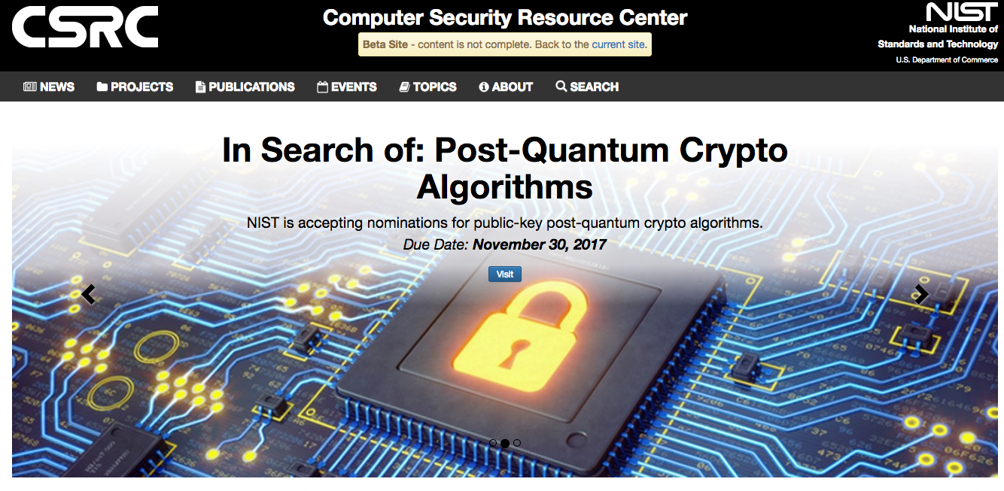

Conventional Quantum-Safe Crypto
Wanted: new assumptions to replace factoring and discrete logarithms in order to build conventional public-key cryptography

Slide 15
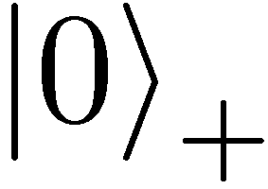
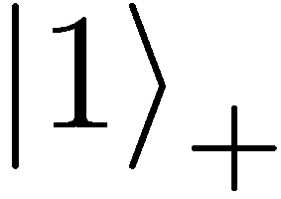
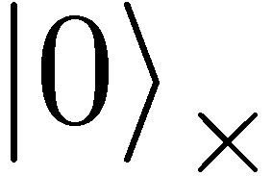
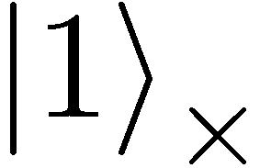
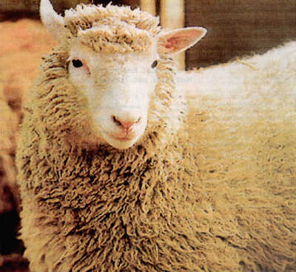
No-Cloning Theorem
U
Quantum operations:
?
?
?
Proof: copying is a non-linear operation
Notes:
information vs disturbance trade-off

Slide 16




Quantum Key Distribution (QKD)
16
[Bennett Brassard 84]
Alice
Bob
k = ?
k = 0101 1011
Eve
k = 0101 1011
Offers an quantum solution to the key-exchange problem which does not rely on computational assumptions (such as factoring, discrete logarithms, security of AES, SHA-3 etc.)
Puts the players into the starting position to use symmetric-key cryptography (encryption, authentication etc.).
Notes:
add link to BB84

Slide 17
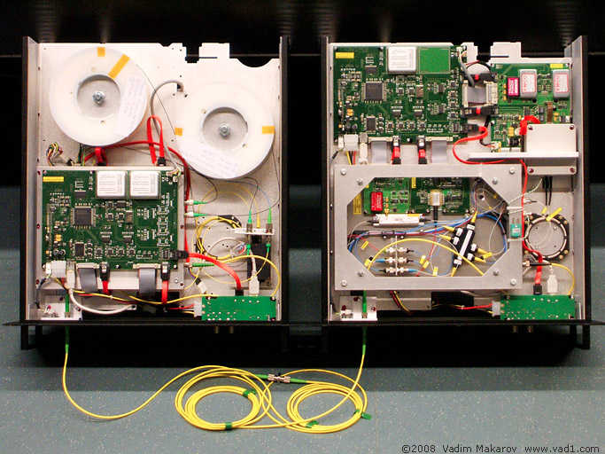

Quantum Key Distribution (QKD)
17
[Bennett Brassard 84]
Alice
Bob
Eve
technically feasible: no quantum computer required,
only quantum communication

Slide 18
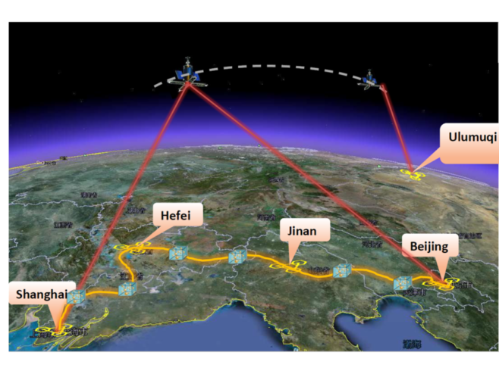
Quantum Networks
2000km QKD backbone network between Beijing and Shanghai
first QKD satellite launched
in 2016 from China
Applied for funding to build the first quantum network in NL
Quantum entanglement allows to generate secure keys (like QKD)

Slide 19
Secure Computing in Quantum Cloud
Distributed quantum computing
Recent result: quantum homomorphic encryption allows for secure delegated quantum computation
Y. Dulek, C. Schaffner, and F. Speelman, arXiv:1603.09717
Quantum homomorphic encryption for polynomial-sized circuits, in CRYPTO 2016, QIP 2017

Slide 20
Summary
Cloud computing
Internet of Things (IoT)
Payment systems, eHealth
Cyber Security
Impact of Quantum Computing on crypto
Auto-updates – Digital Signatures
Secure Browsing - TLS/SSL
VPN – IPSec
Secure email – s/MIME, PGP
RSA, DSA, DH, ECDH, …
AES, 3-DES, SHA, …
Security level systems | Conventional attacks | Quantum attacks
Symmetric-key crypto | 128 bits | reduced
Public-key crypto | 112 bits | broken!
Thm: If x + y > z, then worry

Slide 21
Summary
Quantum-safe crypto:
Quantum Key Distribution, Quantum Cloud
Conventional quantum-safe cryptography
(post-quantum crypto)
Quantum Cryptography

Slide 22
Thank you for your attention!
Questions
check http://arxiv.org/abs/1510.06120 for a recent survey on quantum cryptography beyond key distribution

