Slide 1

Position-Based
Quantum Cryptography
Christian Schaffner
ILLC, University of Amsterdam
Centrum Wiskunde & Informatica
Logic Tea, ILLC
Tuesday, 14/02/2012

Slide 2
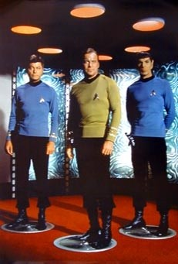
What will you Learn from this Talk?
Quantum Computing & Teleportation
Position-Based Cryptography
No-Go Theorem
Garden-Hose Model

Slide 3
Quantum Bit: Polarization of a Photon

Slide 4
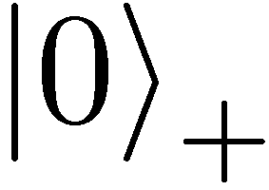
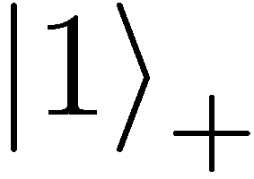
Qubit: Rectilinear/Computational Basis

Slide 5


Detecting a Qubit
no photons: 0
Alice
Bob

Slide 6
Measuring a Qubit
no photons: 0
photons: 1
Alice
Bob
measurement:
with prob. 1 yields 1
0/1

Slide 7
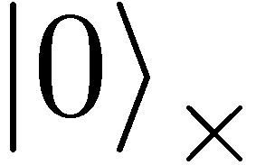
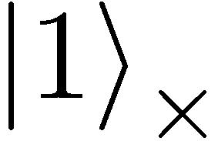
Diagonal/Hadamard Basis
Measurement:
with prob. ½ yields 0
with prob. ½ yields 1
0/1

Slide 8
Quantum Mechanics
+ basis
£ basis
Measurements:
with prob. 1 yields 1
0/1
with prob. ½ yields 0
0/1
with prob. ½ yields 1

Slide 9
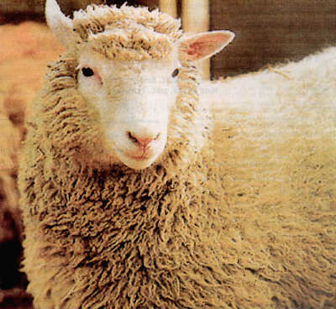
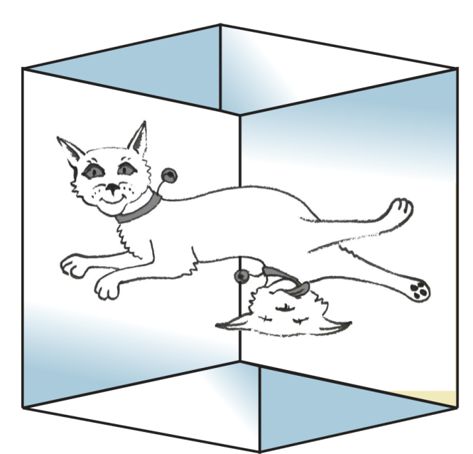
Quantum Information Processing (QIP)

Slide 10
No-Cloning Theorem
U
quantum operations:
?
?
?
Proof: copying is a non-linear operation

Slide 11
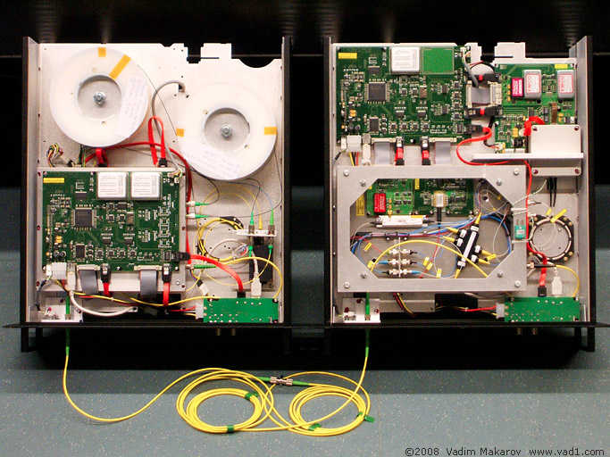

Early results of QIP
Efficient quantum algorithm for factoring [Shor’94]
  breaks public-key cryptography (RSA)
Fast quantum search algorithm [Grover’96]
  quadratic speedup, widely applicable
Quantum communication complexity
  exponential savings in communication
Quantum Cryptography [Bennett-Brassard’84,Ekert’91]
  Quantum key distribution

Slide 12
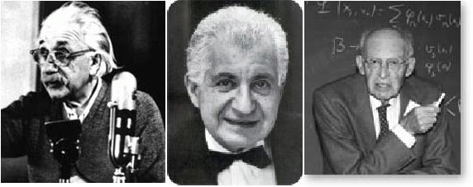
EPR Pairs
[Einstein Podolsky Rosen 1935]
prob. ½ : 0
prob. ½ : 1
EPR magic!
prob. 1 : 0
“spukhafte Fernwirkung” (spooky action at a distance)
EPR pairs do not allow to communicate
(no contradiction to relativity theory)
can provide a shared random bit
(or other non-signalling correlations)

Slide 13
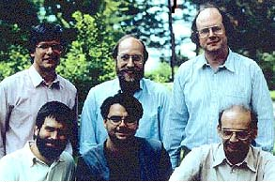
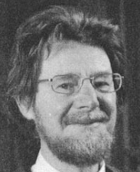




Quantum Teleportation
[Bennett Brassard Crépeau Jozsa Peres Wootters 1993]
?
[Bell]
?
?
does not contradict relativity theory
teleported state can only be recovered
once the classical information ¾ arrives

Slide 14
What to Learn from this Talk?
Quantum Computing & Teleportation
Position-Based Cryptography
No-Go Theorem
Garden-Hose Model

Slide 15
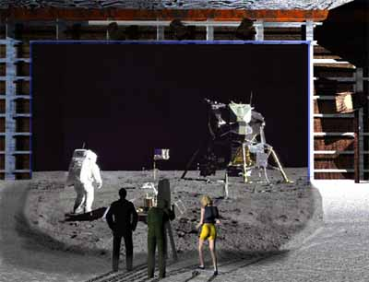
How to Convince Someone of Your Presence at a Location
The Great Moon Landing Hoax
http://www.unmuseum.org/moonhoax.htm

Slide 16
Basic Task: Position Verification
Prove you are at a certain location:
  launching-missile command comes from within the Pentagon
  talking to South-Korea and not North-Korea
  pizza delivery problem
  …
building block for advanced cryptographic tasks:
  authentication, position-based key-exchange
  can only decipher message at specific location
Can the geographical location of a player be used as cryptographic credential ?

Slide 17





Basic task: Position Verification
Verifier1
Prover
Verifier2
Prover wants to convince verifiers that she is at a particular position
assumptions:  communication at speed of light
            instantaneous computation
            verifiers can coordinate
no coalition of (fake) provers, i.e. not at the claimed position, can convince verifiers

Slide 18




Position Verification: First Try
Verifier1
Prover
Verifier2
time
distance bounding [Brands Chaum ‘93]

Slide 19
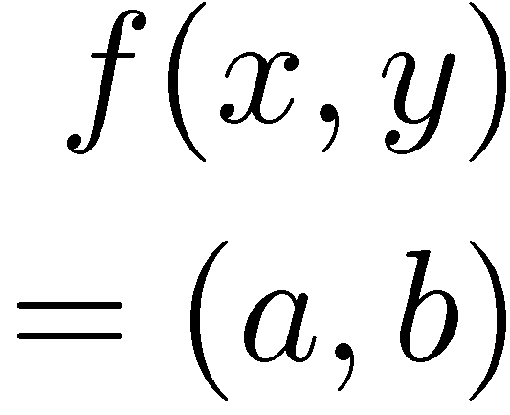


Position Verification: Second Try
Verifier1
Prover
Verifier2
position verification is classically impossible !
[Chandran Goyal Moriarty Ostrovsky: CRYPTO ’09]

Slide 20




Equivalent Attacking Game
independent messages m_{x} and m_{y}
copying classical information
this is impossible quantumly

Slide 21

Position Verification: Quantum Try
[Kent Munro Spiller 03/10]
?
?
?
Let us study the attacking game

Slide 22




Attacking Game
?
?
?
?
?
impossible
but possible with entanglement!!

Slide 23


Entanglement attack
?
?
[Bell]
done if b=1
?
Notes:
appears INSTANTANEOUSLY on the other side

Slide 24

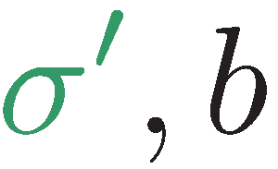
Entanglement attack
?
?
?
[Bell]
[Bell]
the correct person can reconstruct the qubit in time!
the scheme is completely broken

Slide 25
more complicated schemes?
Different schemes proposed by
  Chandran, Fehr, Gelles, Goyal, Ostrovsky [2010]
  Malaney [2010]
  Kent, Munro, Spiller [2010]
  Lau, Lo [2010]
Unfortunately they can all be broken!
  general no-go theorem [Buhrman, Chandran, Fehr, Gelles, Goyal, Ostrovsky, S 2010]

Slide 26
Most General Single-Round Scheme
U
Let us study the attacking game

Slide 27
Distributed Q Computation in 1 Round
U
tricky back-and-forth teleportation [Vaidman 03]
using a double exponential amount of EPR pairs, players succeed with probability arbitrarily close to 1
improved to exponential in [Beigi,König ‘11]

Slide 28
No-Go Theorem
Any position-verification protocol can be broken
  using a double-exponential number of EPR-pairs
  reduced to single-exponential [Beigi,König‘11]
Question: is this optimal?
Does there exist a protocol such that:
  any attack requires many EPR-pairs
  honest prover and verifiers efficient

Slide 29

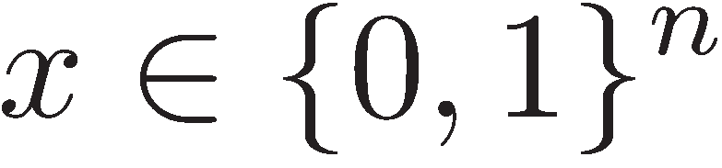
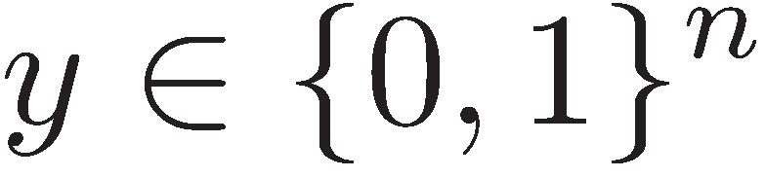
Single-Qubit Protocol: SQP_{f}
[Kent Munro Spiller 03/10]
?
?
?
if f(x,y)=0
if f(x,y)=1
efficiently computable

Slide 30
Attacking Game for SQP_{f}
x
y
?
?
?
if f(x,y)=0
if f(x,y)=1
Define E(SQP_{f}) := minimum number of EPR pairs required for attacking SQP_{f}

Slide 31

What to Learn from this Talk?
Quantum Computing & Teleportation
Position-Based Cryptography
No-Go Theorem
Garden-Hose Model
arXiv:1109.2563
The Garden-Hose Game: A New Model of Computation
and Application to Position-Based Quantum Cryptography
Buhrman, Fehr, S, Speelman

Slide 32




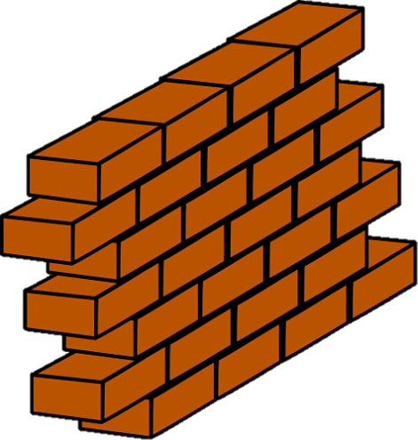

The Garden-Hose Model
share s pipes

Slide 33




The Garden-Hose Model
water exits @ Alice
water exits @ Bob
players connect pipes with pieces of hose
Alice also connects a water tap

Slide 34
The Garden-Hose Model
water exits @ Alice
water exits @ Bob
Garden-Hose complexity of f:
GH(f) := minimum number of pipes needed to compute f

Slide 35












Inequality on Two Bits

Slide 36

n-bit Inequality Puzzle
current world record: 2n + 1 pipes
  the first person to tell me the protocol wins:
More challenging:
Can you do better? Or prove optimality?

Slide 37
The Garden-Hose Model
water exits @ Alice
water exits @ Bob
Garden-Hose complexity of f:
GH(f) := minimum # of pipes needed to compute f

Slide 38
Relationship between
E(SQP_{f}) and GH(f)

Slide 39




GH(f)¸E(SQP_{f})
Garden-Hose
Attacking Game
?
teleport
teleport
teleport
teleport

Slide 40
GH(f)¸E(SQP_{f})
Garden-Hose
Attacking Game
?
teleport
teleport
teleport
teleport
using x & y, can follow the water/qubit
correct water/qubit using all measurement outcomes
x, Alice’s
telep. keys
y, Bob’s
telep. keys

Slide 41
Relation with SQP_{f}
GH(f) ¸ E(SQP_{f})
The two models are not equivalent:
  exists f such that GH(f) = n , but E(SQP_{f}) · log(n)
Quantum garden-hose model:
  give Alice & Bob also entanglement
  research question: are the models now equivalent?

Slide 42
Garden-Hose complexity
every f has GH(f) · exponential
if f in logspace, then GH(f) · polynomial
  efficient f & no efficient attack ) P≠ L
exist f with GH(f) exponential (counting argument)
for g 2 {equality, IP, majority}: GH(g) ¸ n log(n)
  techniques from communication complexity
Many open problems!

Slide 43
What Have You Learned from this Talk?
Quantum Computing & Teleportation
Position-Based Cryptography

Slide 44
What Have You Learned from this Talk?
No-Go Theorem
  Impossible unconditionally, but attack requires unrealistic amounts of resources
Garden-Hose Model
  Restricted class of single-qubit schemes: SQP_{f}
  Easily implementable
  Garden-hose model to study attacks
  Connections to complexity theory

Slide 45
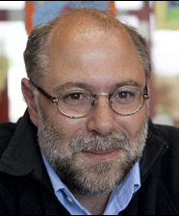
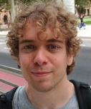
n-bit Inequality Puzzle
current world record: 2n + 1 pipes
  the first person to tell me (cschaffner@uva.nl) the protocol wins:
Can you do better? Or prove optimality?
Come talk to us!

Slide 46
Open Problems
Is Quantum-GH(f) equivalent to E(SQP_{f})?
Find good lower bounds on E(SQP_{f})
Does P≠L/poly imply f in P with GH(f) > poly ?
Are there other position-verification schemes?
Parallel repetition, link with Semi-Definite Programming (SDP) and non-locality.
Implementation: handle noise & limited precision
Can we achieve other position-based primitives?

Slide 47

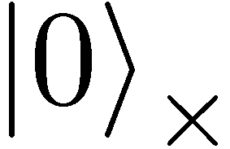
Quantum Operations
are linear isometries
can be described by a unitary matrix:
examples:
  identity
  bitflip (Pauli X): mirroring at axis
X
X
X
X

Slide 48

Quantum Operations
are linear isometries
can be described by a unitary matrix:
examples:
  identity
  bitflip (Pauli X): mirroring at axis
  phase-flip (Pauli Z): mirroring at axis
  both (Pauli XZ)
Z

Slide 49
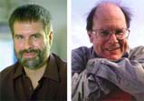
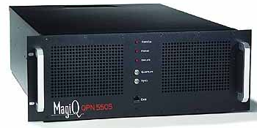

Quantum Key Distribution (QKD)
[Bennett Brassard 84]
Alice
Bob
Eve
inf-theoretic security against unrestricted eavesdroppers:
  quantum states are unknown to Eve, she cannot copy them
  honest players can check whether Eve interfered
technically feasible: no quantum computation required,
only quantum communication

