Slide 1


Quantum Cryptography
Christian Schaffner
Research Center for Quantum Software
Institute for Logic, Language and Computation (ILLC)
University of Amsterdam
Centrum Wiskunde & Informatica
Winter’17 QuantumDay@Portland
Friday, 13 January 2017

Slide 2
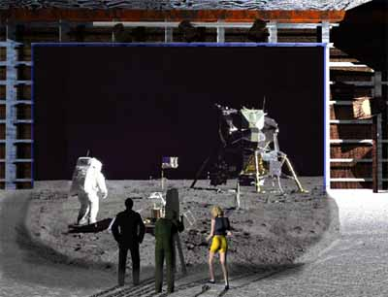
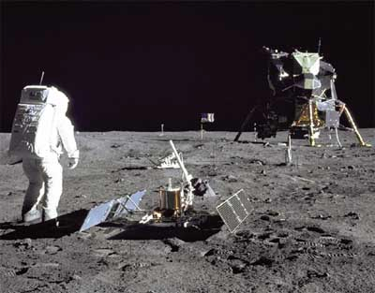
1969: Man on the Moon
The Great Moon-Landing Hoax?
NASA
http://www.unmuseum.org/moonhoax.htm
How can you prove that you are at a specific location?
Notes:
In 1969, man has first set foot on the moon, as you can see here on this picture sent around the world by NASA...
Or not? Maybe it was all just a “great moon-landing hoax”, as speculated on various conspiracy-theory websites on the internet?
One fascinating cryptographic question I want to study in my project is: “How can you prove that you are at a specific location?”
More about it later…

Slide 3
What will you learn from this Talk?
Classical Cryptography
Introduction to Quantum Mechanics
Quantum Key Distribution
Position-Based Cryptography
Notes:
only scattered relations to logic, I’m afraid

Slide 4
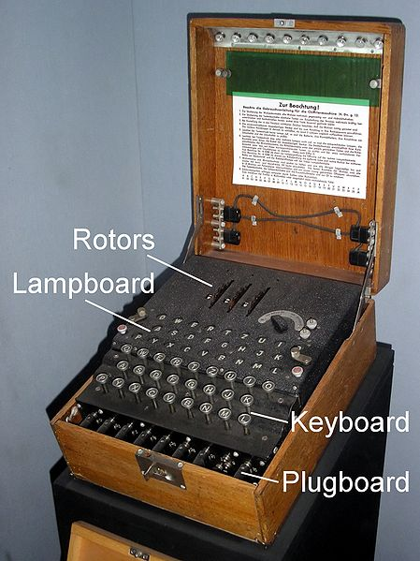
Ancient Cryptography
3000 years of fascinating history
until 1970: private communication was the only goal

Slide 5
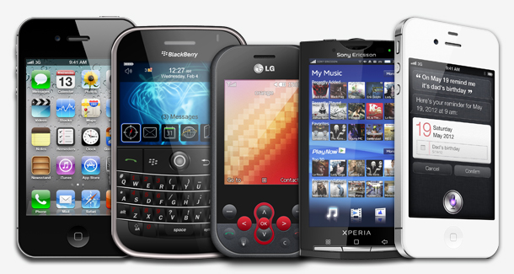
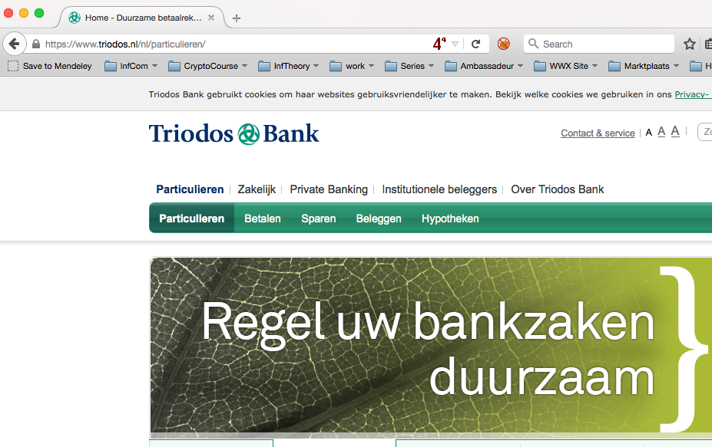
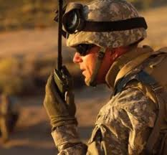
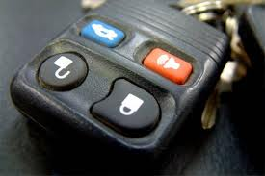
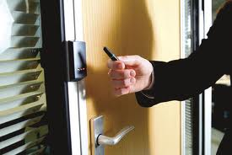
Modern Cryptography
is everywhere!
is concerned with all settings where people do not trust each other

Slide 6



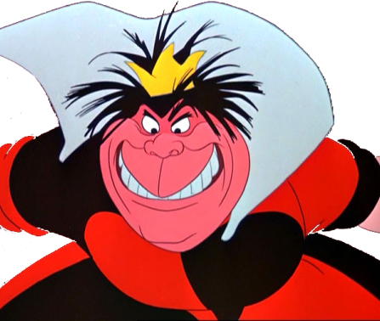
Secure Encryption
m = “I love you”
m = 0000 1111
Alice
Bob
k = ?
Eve
k = 0101 1011
k = 0101 1011
Goal: Eve does not learn the message
Setting: Alice and Bob share a secret key k

Slide 7
eXclusive OR (XOR) Function
7
x | y | x © y
0 | 0 | 0
1 | 0 | 1
0 | 1 | 1
1 | 1 | 0
Some properties:
  8 x : x © 0 = x
  8 x : x © x = 0
  ) 8 x,y : x © y © y = x
Notes:
quick check: please raise your hand if you have NOT seen this function before.
Please raise your hand if you HAVE seen this function before.
Now raise your hand if you have not raised your hand yet. For the people raising their hand now: you should seriously double-check the logic “axiom of the excluded middle”, asserting that either you HAVE seen this function before, or that you have NOT.

Slide 8
One-Time Pad Encryption
8
m = 0000 1111
c = m © k = 0101 0100
m = c © k = 0000 1111
Alice
Bob
k = ?
Eve
k = 0101 1011
k = 0101 1011
Goal: Eve does not learn the message
Setting: Alice and Bob share a key k
Recipe:
Is it secure?
x | y | x © y
0 | 0 | 0
0 | 1 | 1
1 | 0 | 1
1 | 1 | 0
m = 0000 1111
c = 0101 0100
k = 0101 1011
k = 0101 1011
c = m © k = 0101 0100
c © k = 0000 1111
c © k = m © k © k = m © 0 = m

Slide 9
Perfect Security
9
m = ?
c = m © k = 0101 0100
m = c © k = ?
Alice
Bob
k = ?
Eve
k = ?
k = ?
Given that c = 0101 0100,
  is it possible that m = 0000 0000 ?
    Yes, if k = 0101 0100.
  is it possible that m = 1111 1111 ?
    Yes, if k = 1010 1011.
  it is possible that m = 0101 0101 ?
    Yes, if k = 0000 0001
In fact, every m is possible.
Hence, the one-time pad is perfectly secure!
x | y | x © y
0 | 0 | 0
0 | 1 | 1
1 | 0 | 1
1 | 1 | 0

Slide 10
Problems With One-Time Pad
10
m = 0000 1111
c = m © k = 0101 0100
m = c © k = 0000 1111
Alice
Bob
k = ?
Eve
k = 0101 1011
k = 0101 1011
The key has to be as long as the message (Shannon’s theorem)
The key can only be used once.
In practice, other encryption schemes (such as AES) are used which allow to encrypt long messages with short keys.
One-time pad does not provide authentication:
Eve can easily flip bits in the message
Notes:
for encrypting internet traffic

Slide 11
Symmetric-Key Cryptography
11
Alice
Bob
Eve
Encryption insures secrecy:
Eve does not learn the message, e.g. one-time pad
Authentication insures integrity:
Eve cannot alter the message
General problem: players have to exchange a key to start with

Slide 12
What will you Learn from this Talk?
Classical Cryptography
Introduction to Quantum Mechanics
Quantum Key Distribution
Position-Based Cryptography

Slide 13
Quantum Bit: Polarization of a Photon
q
u
b
i
t
a
s
u
n
i
t
v
e
c
t
o
r
i
n
C
2

Slide 14
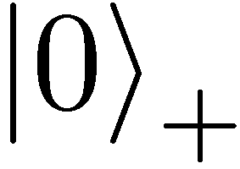
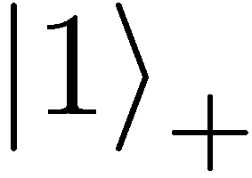
Qubit: Rectilinear/Computational Basis

Slide 15
Detecting a Qubit
No photons: 0
Alice
Bob

Slide 16
Measuring a Qubit
No photons: 0
Photons: 1
Alice
Bob
Measurement:
with prob. 1 yields 1
0/1

Slide 17
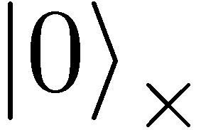
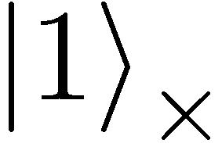

Diagonal/Hadamard Basis
Measurement:
with prob. ½ yields 0
=
with prob. ½ yields 1
0/1

Slide 18
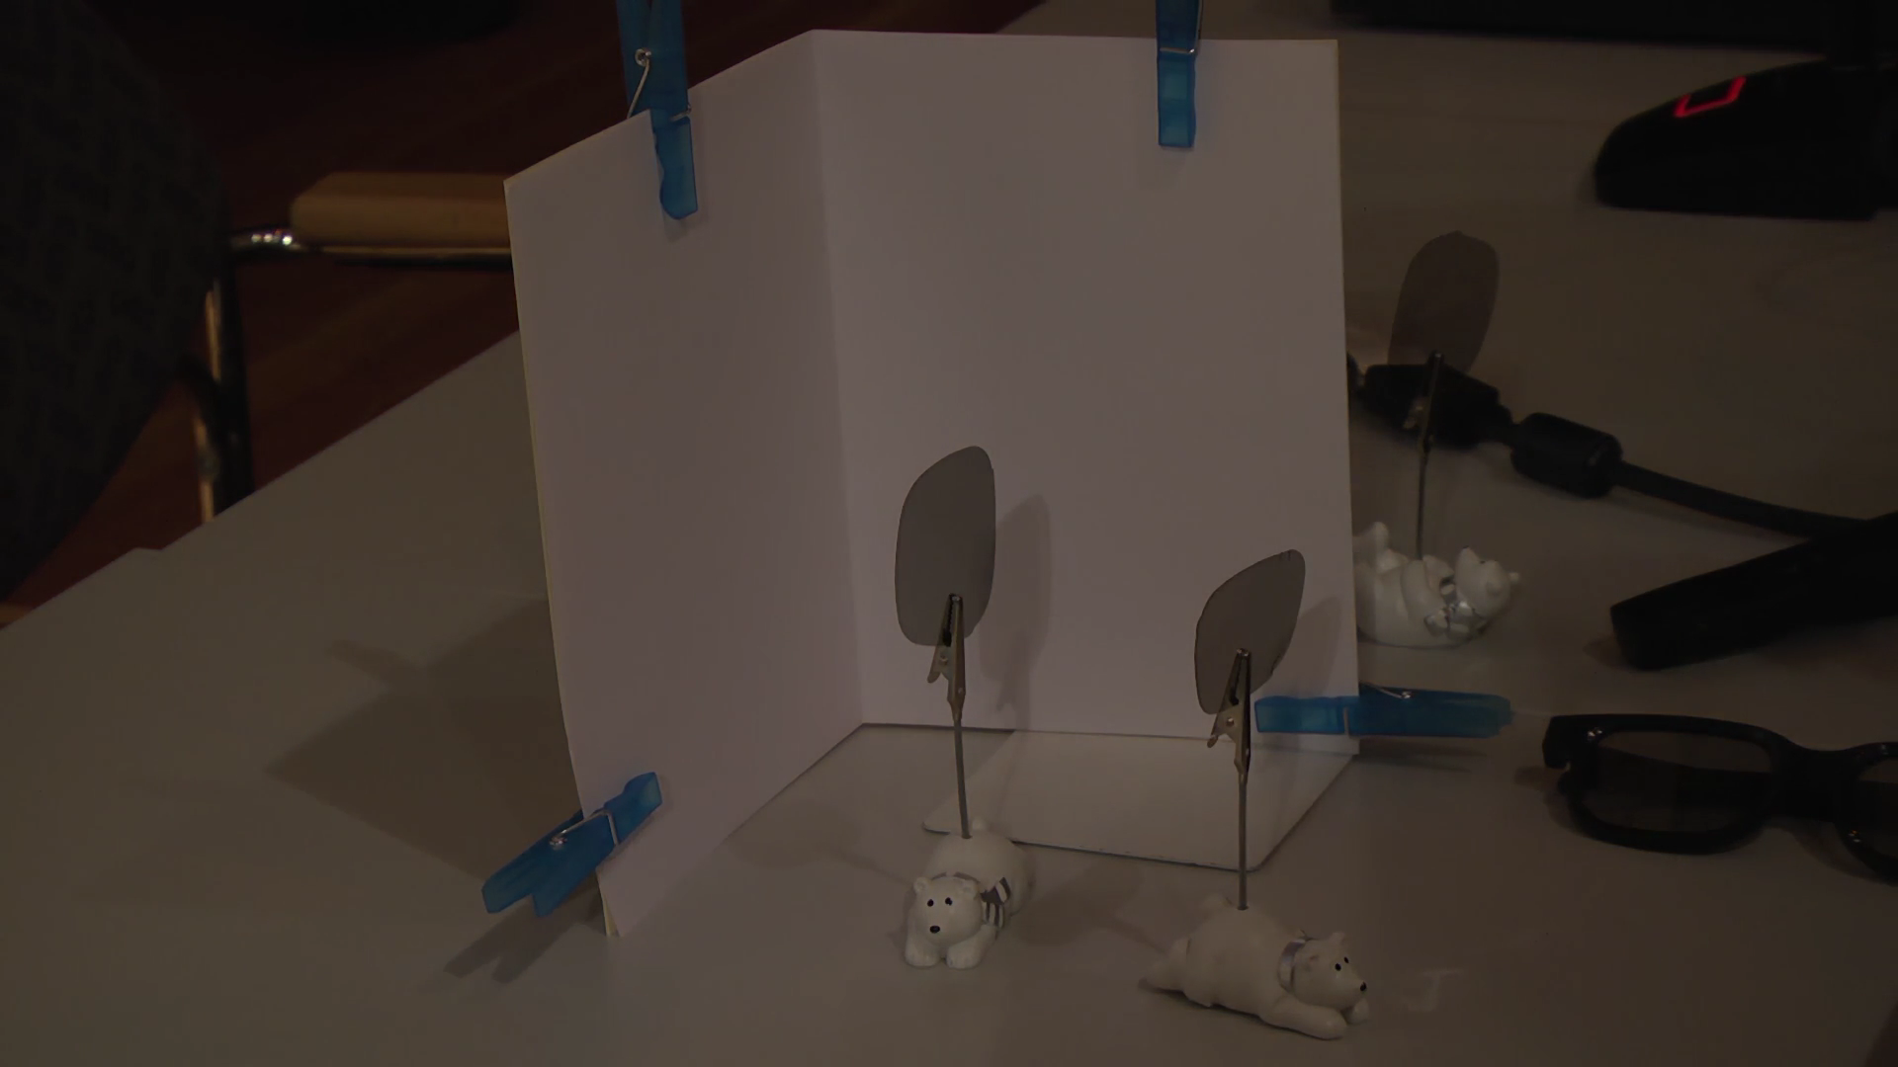
Video

Slide 19
Measuring Collapses the State
Measurement:
with prob. ½ yields 0
=
with prob. ½ yields 1
0/1

Slide 20
Measuring Collapses the State
=
=

Slide 21
Quantum Mechanics
+ basis
£ basis
Measurements:
with prob. 1 yields 1
0/1
with prob. ½ yields 0
0/1
with prob. ½ yields 1

Slide 22
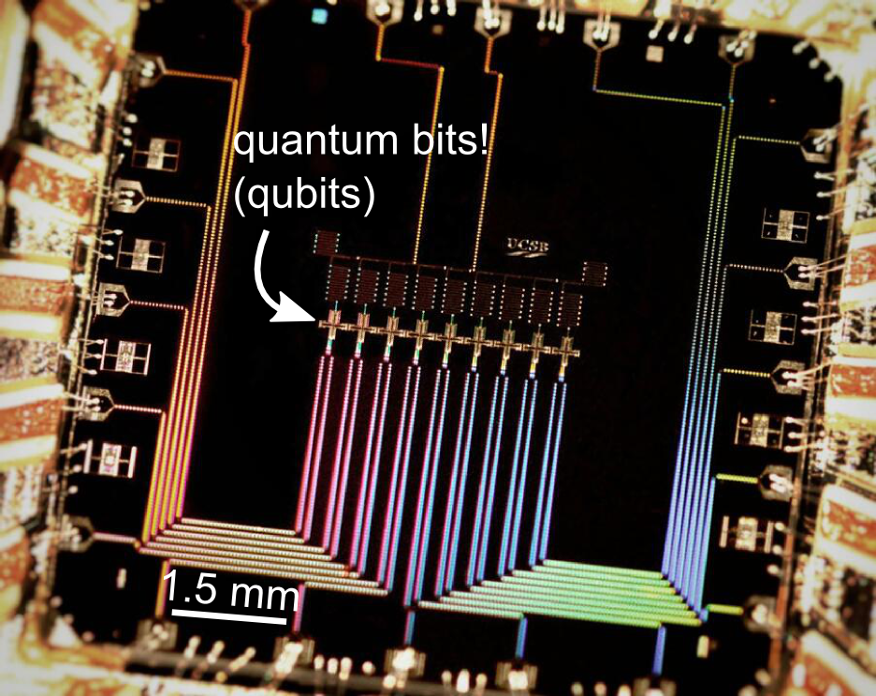
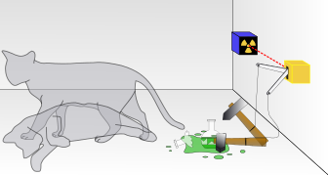

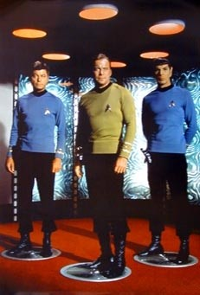
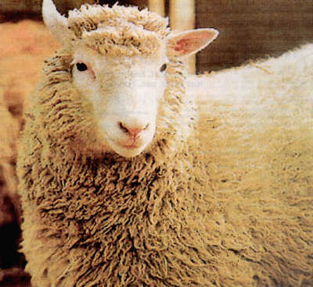
Wonderland of Quantum Mechanics
Notes:
better picture of Schroedinger’s cat

Slide 23
Demonstration of Quantum Technology
generation of random numbers
50%
50%
(diagram from idQuantique white paper)
no quantum computation, only
quantum communication required

Slide 24
What will you Learn from this Talk?
Classical Cryptography
Introduction to Quantum Mechanics
Quantum Key Distribution
Position-Based Cryptography

Slide 25
No-Cloning Theorem
U
Quantum operations:
?
?
?
Proof: copying is a non-linear operation
Notes:
information vs disturbance trade-off

Slide 26
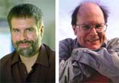
Quantum Key Distribution (QKD)
26
[Bennett Brassard 84]
Alice
Bob
k = ?
k = 0101 1011
Eve
k = 0101 1011
Offers an quantum solution to the key-exchange problem which does not rely on computational assumptions (such as factoring, discrete logarithms, security of AES, SHA-3 etc.)
Puts the players into the starting position to use symmetric-key cryptography (encryption, authentication etc.).
Notes:
add link to BB84

Slide 27
Quantum Cryptography Landscape
27
attackers systems | efficient classical attacks | efficient quantum attacks | everlasting security (store and break later)
AES | confident | longer keys | brute force
SHA | confident | longer outputs | brute force
RSA, DiscLogs | confident | Shor | brute force
Hash-Based Sign | probably | probably | brute force
McEliece | probably | probably | brute force
Lattice-based | probably | probably | brute force
QKD
physical security
technical difficulty (€)
Post Quantum
Crypto
Notes:
add link to BB84

Slide 28
Quantum Key Distribution (QKD)
28
[Bennett Brassard 84]
0 1 1 1 0
0 0 1 1 0
k = 110
k = 110

Slide 29
Quantum Key Distribution (QKD)
29
[Bennett Brassard 84]
?
?
?
?
?
0 1 1 1 0
0 0 1 1 0
k = ?
k = 10
k = 10
Quantum states are unknown to Eve, she cannot copy them.
Honest players can test whether Eve interfered.

Slide 30

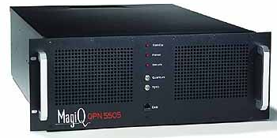
Quantum Key Distribution (QKD)
30
[Bennett Brassard 84]
Alice
Bob
Eve
technically feasible: no quantum computer required,
only quantum communication

Slide 31
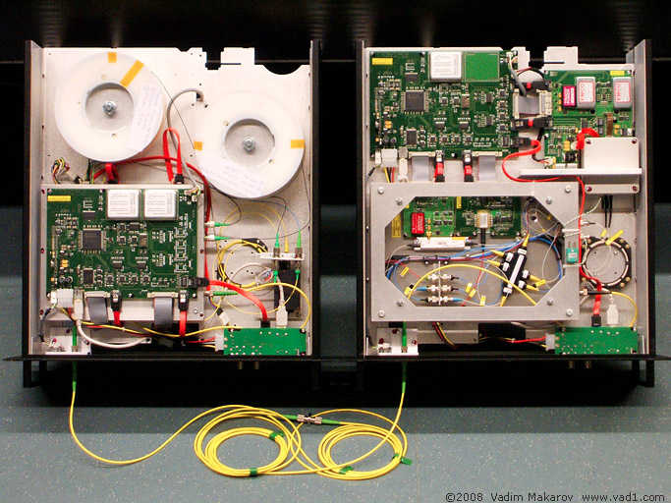
Quantum Key Distribution (QKD)
31
[Bennett Brassard 84]
Alice
Bob
Eve
technically feasible: no quantum computer required,
only quantum communication

Slide 32

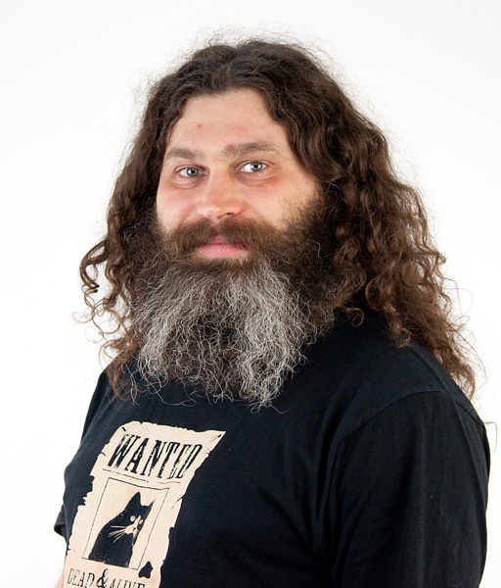
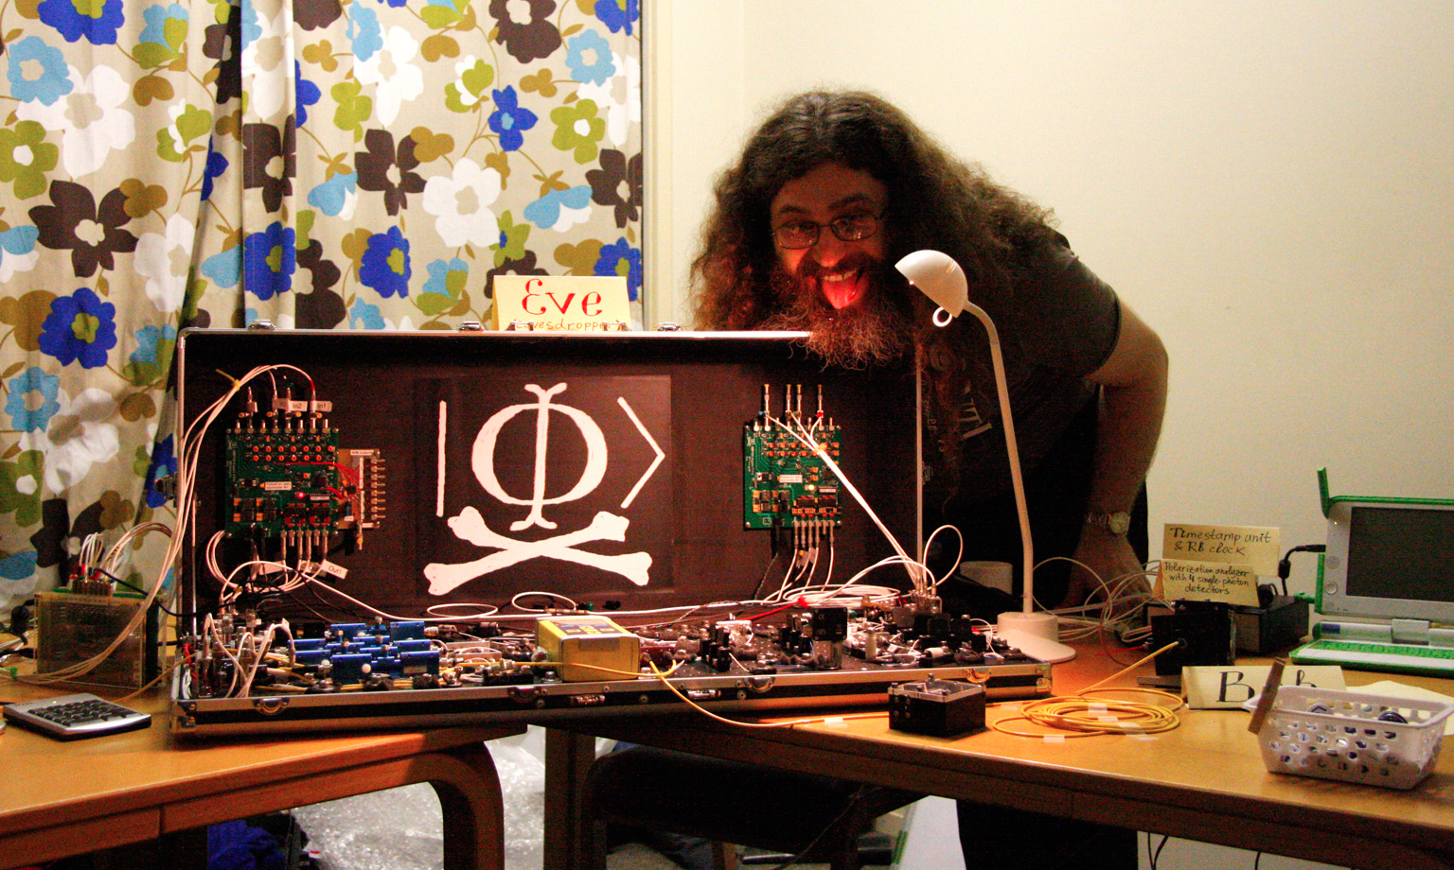
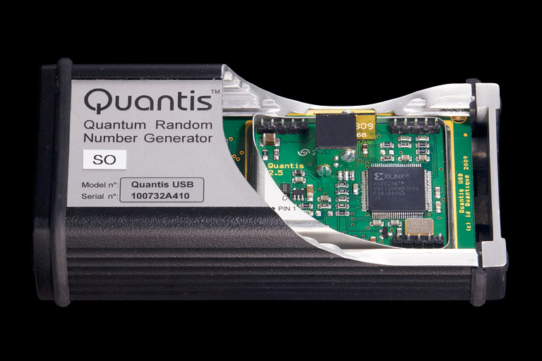
Quantum Hacking
e.g. by the group of Vadim Makarov (University of Waterloo, Canada)

Slide 33
What will you Learn from this Talk?
Classical Cryptography
Introduction to Quantum Mechanics
Quantum Key Distribution
Position-Based Cryptography

Slide 34
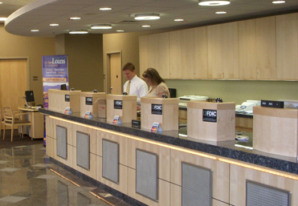
Position-Based Cryptography
Typically, cryptographic players use credentials such as
  secret information (e.g. password or secret key)
  authenticated information
  biometric features
Can the geographical location of a player be used
as cryptographic credential ?

Slide 35
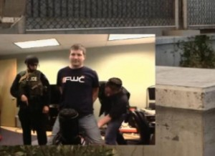
Position-Based Cryptography
Can the geographical location of a player be used as sole cryptographic credential ?
Possible Applications:
  Launching-missile command comes
  from within your military headquarters
  Talking to the correct assembly
  Pizza-delivery problem /
  avoid fake calls to emergency services
  …

Slide 36
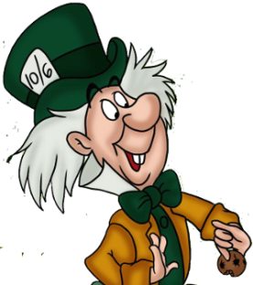


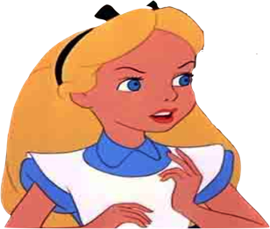

Basic task: Position Verification
Verifier1
Prover
Verifier2
Prover wants to convince verifiers that she is at a particular position
no coalition of (fake) provers, i.e. not at the claimed position, can convince verifiers
(over)simplifying assumptions:
    communication at speed of light
    instantaneous computation
    verifiers can coordinate

Slide 37




Position Verification: First Try
Verifier1
Prover
Verifier2
time
distance bounding [Brands Chaum ‘93]

Slide 38
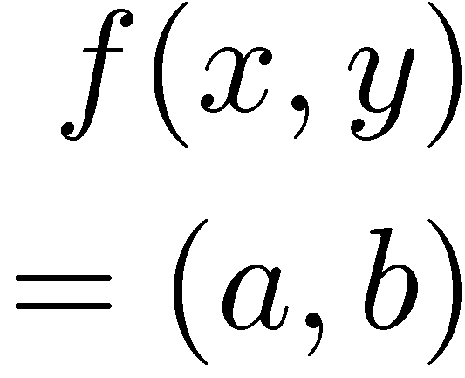


Position Verification: Second Try
Verifier1
Prover
Verifier2
position verification is classically impossible ! [Chandran Goyal Moriarty Ostrovsky 09]
Notes:
classical impossibility proof by [Chandran Goyal Moriarty Ostrovsky: CRYPTO ’09]

Slide 39


The Attack
copying classical information
this is impossible quantumly

Slide 40


Position Verification: Quantum Try
[Kent Munro Spiller 03/10]
?
?
?
Can we brake the scheme now?

Slide 41




Attacking Game
?
?
?
?
?
Impossible to cheat due to
no-cloning theorem
Or not?

Slide 42
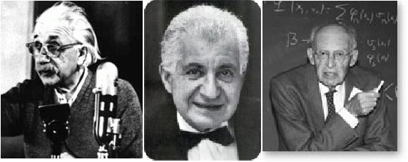
EPR Pairs
[Einstein Podolsky Rosen 1935]
prob. ½ : 0
prob. ½ : 1
EPR magic!
prob. 1 : 0
“spukhafte Fernwirkung” (spooky action at a distance)
EPR pairs do not allow to communicate
(no contradiction to relativity theory)
can provide a shared random bit

Slide 43
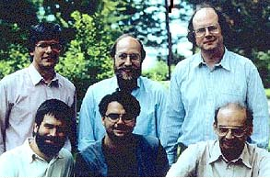
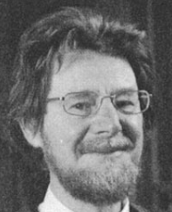




Quantum Teleportation
[Bennett Brassard Crépeau Jozsa Peres Wootters 1993]
?
[Bell]
?
?
does not contradict relativity theory
Bob can only recover the teleported qubit
after receiving the classical information ¾

Slide 44
Teleportation Attack
?
?
?
[Bell]
[Bell]
?
?
It is possible to cheat with entanglement !!
Quantum teleportation allows to
break the protocol perfectly.

Slide 45
No-Go Theorem
[Buhrman, Chandran, Fehr, Gelles, Goyal, Ostrovsky, Schaffner 2010] [Beigi Koenig 2011]
Any position-verification protocol can be broken using an exponential number of entangled qubits.
Question: Are so many quantum resources really necessary?
Does there exist a protocol such that:
  honest prover and verifiers are efficient, but
  any attack requires lots of entanglement
see http://homepages.cwi.nl/~schaffne/positionbasedqcrypto.php for recent developments

Slide 46
What Have You Learned from this Talk?
Classical Cryptography
Quantum Computing & Teleportation

Slide 47
What Have You Learned from this Talk?
Quantum Key Distribution (QKD)
Position-Based Cryptography

Slide 48
Thank you for your attention!
Questions
check http://arxiv.org/abs/1510.06120 for a survey about quantum cryptography beyond key distribution

