Slide 1



Quantum Cryptography beyond
Key Distribution
Christian Schaffner
CWI Amsterdam, Netherlands
Workshop on Post-Quantum Security Models
Paris, France
Tuesday , 12 October 2010

Slide 2
Outline
Cryptographic Primitives
Noisy-Storage Model
Position-Based Quantum Cryptography
Conclusion

Slide 3

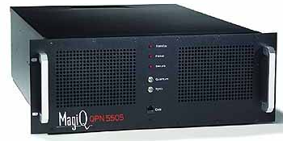



Cryptography
settings where parties do not trust each other:
  secure communication
  authentication
Bob
Alice
use the same quantum hardware for
applications in two- and multi-party scenarios
Eve
= ?
three-party scenario

Slide 4
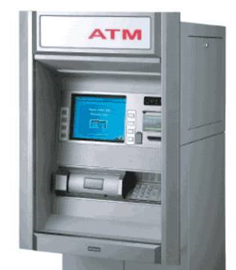
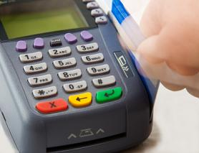
Example: ATM
a
=
b
?
?
?
a = b
a = b
PIN-based identification scheme should be a
secure evaluation of the equality function
dishonest player can exclude only one possible password

Slide 5

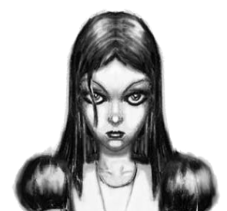
Modern Cryptography
use QKD hardware for
applications in two- and multi-party scenarios
two-party scenarios:
  password-based identification (=)
  millionaire‘s problem (<)
  dating problem (AND)
multi-party scenarios:
  sealed-bid auctions
  e-voting
  …

Slide 6
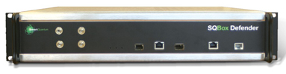
Can we implement these primitives?
In the plain model (no restrictions on adversaries,
using quantum communication, as in QKD):
  Secure function evaluation is impossible (Lo ‘97)
Restrict the adversary:
  Computational assumptions (e.g. factoring or discrete logarithms are hard)
unproven

Slide 7
Exploit Quantum-Storage Imperfections
use the technical difficulties in building a quantum computer to our advantage
storing quantum information is a technical challenge
  Bounded-Quantum-Storage Model :
  bound the number of qubits an adversary can store
  (Damgaard, Fehr, Salvail, S ‘05)
  Noisy-(Quantum-)Storage Model:
  more general and realistic model
  (Wehner, S, Terhal ’07; König, Wehner, Wullschleger ‘09)
Conversion can fail
Error in storage
Readout can fail

Slide 8
Outline
Cryptographic Primitives
Noisy-Storage Model
Position-Based Quantum Cryptography
Conclusion

Slide 9
The Noisy-Storage Model
(Wehner, S, Terhal ’07)

Slide 10
The Noisy-Storage Model
(Wehner, S, Terhal ’07)
waiting time: ¢t
what an (active) adversary can do:
  change messages
  computationally all-powerful
  actions are ‘instantaneous’
  unlimited classical storage
restriction:
  noisy quantum storage

Slide 11
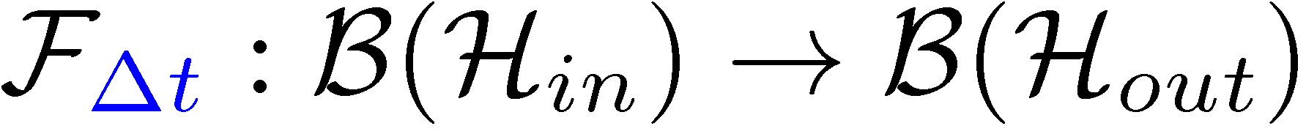
The Noisy-Storage Model
(Wehner, S, Terhal ’07)
change messages
computationally all-powerful
unlimited classical storage
actions are ‘instantaneous’
waiting time: ¢t
Adversary’s state
Arbitrary
encoding
attack
Unlimited classical storage
Noisy quantum storage
models:
transfer into storage (photonic states onto different carrier)
decoherence in memory

Slide 12

Protocol Structure
quantum part as in BB84
waiting time: ¢t
Noisy quantum storage
classical post-processing
weak string erasure
bit commitment
oblivious transfer
secure identification
General case [König Wehner Wullschleger 09]:
  Storage channels with “strong converse” property,
  e.g. depolarizing channel
Some simplifications [S 10]

Slide 13
Summary
defined the noisy-storage model
exactly specified capabilities of adversary
protocol structure
  quantum: BB84
  classical post-processing resulting in
security proofs:
  entropic uncertainty relations
  quantum channel properties
  quantum information theory
change messages
computationally all-powerful
unlimited classical storage
actions are ‘instantaneous’
=
<
AND

Slide 14
Outline
Cryptographic Primitives
Noisy-Storage Model
Position-Based Quantum Cryptography
Conclusion

Slide 15


Example: Position Verification
Verifier1
Prover
Verifier2
Prover wants to convince verifiers that she is at a particular position
assumptions:  communication at speed of light
            instantaneous computation
            verifiers can coordinate
no coalition of (fake) provers, i.e. not at the claimed position, can convince verifiers

Slide 16




Position Verification: First Try
Verifier1
Prover
Verifier2
time

Slide 17
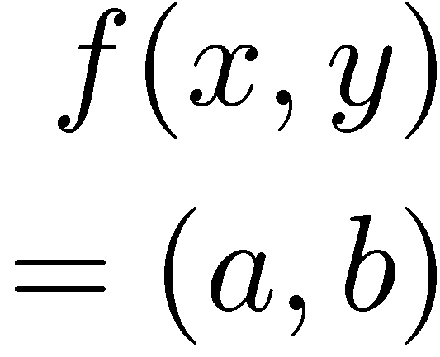


Position Verification: Second Try
[Chandran Goyal Moriarty Ostrovsky: CRYPTO ‘09]
Verifier1
Prover
Verifier2
position verification is classically impossible ! even using computational assumptions

Slide 18



Position-Based Quantum Cryptography
[Kent Munro Spiller 03/10, Chandran Fehr Gelles Goyal Ostrovsky, Malaney 10]
Verifier1
Prover
Verifier2
intuitively: security follows from no cloning
formally, usage of recently established [Renes Boileau 09]
strong complementary information trade-off

Slide 19
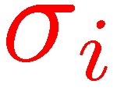

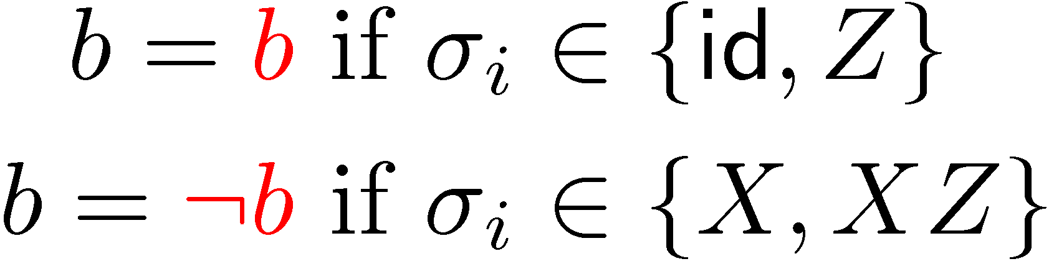
Position-Based QC: Teleportation Attack
[Kent Munro Spiller 03/10, Lau Lo 10]

Slide 20
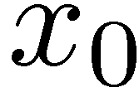
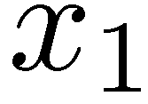
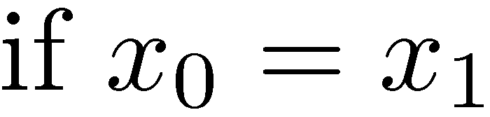
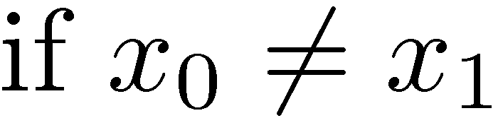
Position Verification: Fourth Try
[Kent Munro Spiller 03/10, Malaney 10, Lau Lo 10]
exercise: insecure if adversaries share 2 EPR pairs!

Slide 21
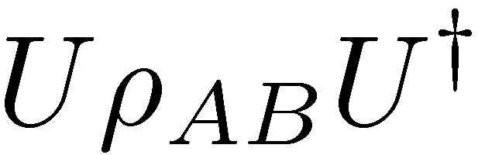
Impossibility of Position-Based Q Crypto
[Buhrman Chandran Fehr Gelles Goyal Ostrovsky S 10]
general attack
clever way of back-and-forth teleportation, based on ideas by [Vaidman 03] for “instantaneous measurement of nonlocal variables”

Slide 22
Position-Based Quantum Cryptography
[Buhrman Chandran Fehr Gelles Goyal Ostrovsky S 10]
Verifier1
Prover
Verifier2
can be generalized to more dimensions
plain model: classically and quantumly impossible
basic scheme for secure positioning if adversaries have no pre-shared entanglement
more advanced schemes allow message authentication and key distribution

Slide 23
Open Questions
[Buhrman Chandran Fehr Gelles Goyal Ostrovsky S 10]
Verifier1
Prover
Verifier2
no-go theorem vs. secure schemes
how much entanglement is required to break the scheme?
security in the bounded-entanglement model?
interesting connections to entropic uncertainty relations and non-local games

Slide 24

Conclusion
cryptographic primitives
noisy-storage model:
  well-defined adversary model
position-based q cryptography
  general no-go theorem
  security if no entanglement
=
QKD hardware and know-how is useful in applications beyond key distribution

