Slide 1


Computational Security of Quantum Encryption
http://arxiv.org/abs/1602.01441
Gorjan Alagic, Copenhagen
Anne Broadbent, Ottawa
Bill Fefferman, Maryland
Tommaso Gagliardoni, Darmstadt
Michael St Jules, Ottawa
Christian Schaffner, Amsterdam
QCrypt 2016. Friday, September 16, 2016. Washington DC, USA

Slide 2








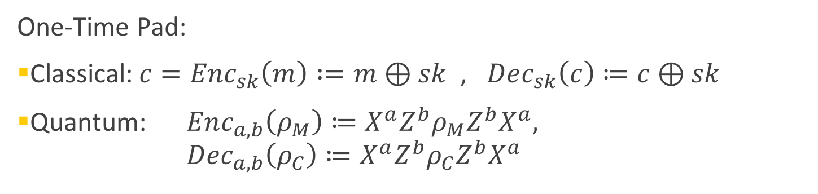



Secure Encryption
plaintext message $m$
ciphertext $c=Enc_{sk}(m)$
$$m=Dec_{sk} (c)$$
Alice
Bob
$sk$ = ?
Secret key $sk$
Eve
Secret key $sk$
One-Time Pad:
Classical: $c=Enc_{sk}\left(m\right) :=m⊕sk$ , $Dec_{sk}\left(c\right)≔c⊕sk$
Quantum: $Enc_{a,b}\left(ρ_{M}\right)≔X^{a}Z^{b}ρ_{M}{Z^{b}X}^{a},$
$Dec_{a,b}\left(ρ_{C}\right)≔X^{a}Z^{b}ρ_{C}{Z^{b}X}^{a}$
Secure
QOTP

Slide 3
End of Talk
Thank you for your attention!

Slide 4
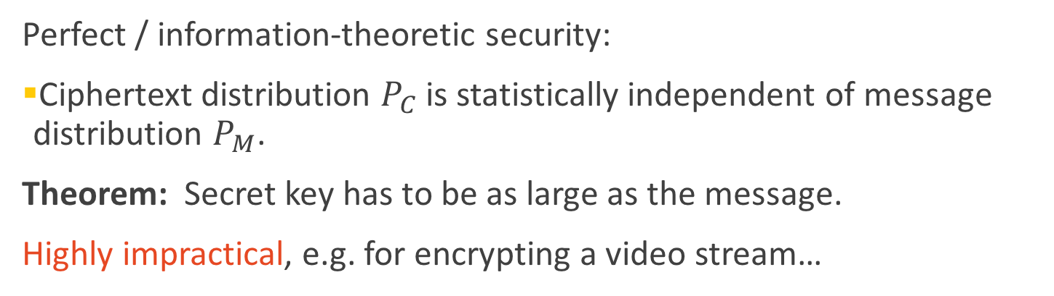
Information-Theoretic Security
plaintext message $m$
ciphertext $c=Enc_{sk}(m)$
$$m=Dec_{sk} (c)$$
Alice
Bob
$sk$ = ?
Secret key $sk$
Eve
Secret key $sk$
Secure
QOTP
Perfect / information-theoretic security:
Ciphertext distribution $P_{C}$ is statistically independent of message distribution $P_{M}$.
Theorem: Secret key has to be as large as the message.
Highly impractical, e.g. for encrypting a video stream…
[Shannon 48, Dodis 12, Boykin Roychowdhury 03]

Slide 5
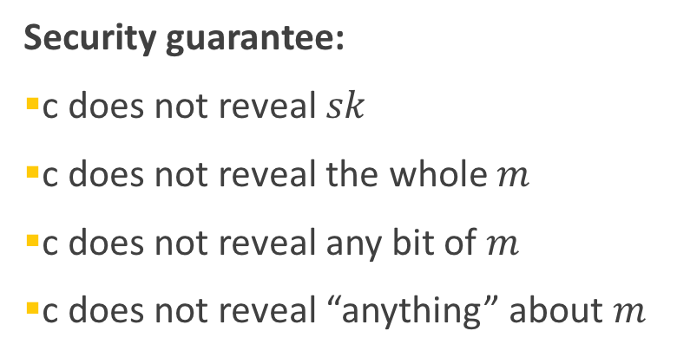
Computational Security
plaintext message $m$
ciphertext $c=Enc_{sk}(m)$
$$m=Dec_{sk} (c)$$
Alice
Bob
$sk$ = ?
Secret key $sk$
Eve
Secret key $sk$
Threat model:
Eve sees ciphertexts (eavesdropper)
Eve knows plaintext/ciphertext pairs
Eve chooses plaintexts to be encrypted
Eve can decrypt ciphertexts
Security guarantee:
c does not reveal $sk$
c does not reveal the whole $m$
c does not reveal any bit of $m$
c does not reveal “anything” about $m$

Slide 6
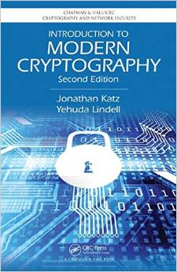
Semantic Security
plaintext message $m$
ciphertext $c=Enc_{sk}(m)$
$$m=Dec_{sk} (c)$$
Alice
Bob
$sk$ = ?
Secret key $sk$
Eve
Secret key $sk$
[Goldwasser Micali 84]

Slide 7

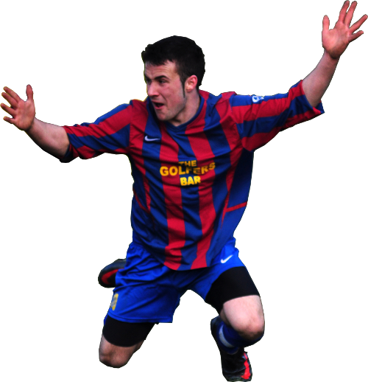

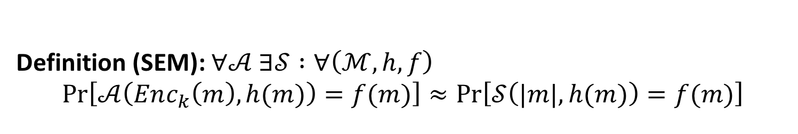







Classical Semantic Security
$$Enc$$
REAL world
$$ℳ$$
$$m$$
Adversary $𝒜$
auxiliary
$$h(m)$$
$$f(m)$$
target
$|m|$
IDEAL world
Simulator $𝒮$
Definition (SEM): $∀𝒜 ∃𝒮 :∀\left(ℳ, h,f\right)$
$$Pr\left[𝒜\left(Enc_{k}\left(m\right),h(m)\right)=f(m)\right]≈Pr\left[𝒮\left(|m|,h(m)\right)=f(m)\right]$$
[Goldwasser Micali 84]

Slide 8

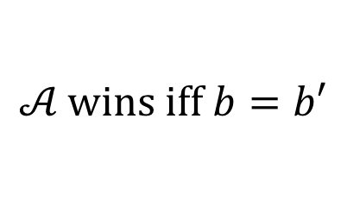
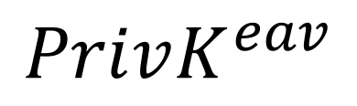
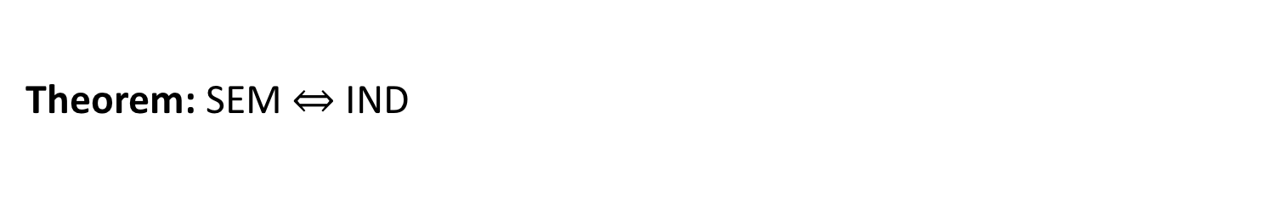



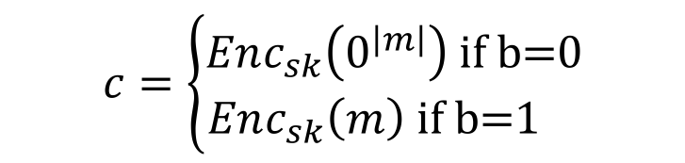


Classical Indistinguishability
$$PrivK^{eav}$$
Challenger
$$m$$
$$𝒜$$
$$b←\{0,1\}$$
$$c=\left\{\begin{aligned}Enc_{sk}\left(0^{\left|m\right|}\right) \text{if} \text{b}\text{=0} \\ Enc_{sk}\left(m\right) \text{if} \text{b}\text{=1 }\end{aligned}\right.$$
$$c$$
$$b′$$
$$𝒜 \text{wins} \text{iff} b=b′$$
Definition (IND): $∀𝒜: \operatorname{Pr}\left[𝒜 \text{wins} PrivK^{eav}\right]≤\frac{1}{2}+ negl(n)$
Theorem: SEM $⇔$IND
[Goldwasser Micali 84]

Slide 9
Our Contributions
Formal definition of Quantum Semantic Security
Equivalence to Quantum Indistinguishability
Extension to CPA and CCA1 scenarios
Construction of IND-CCA1 Quantum Secret-Key Encryption from Post-Quantum One-Way Functions
Construction of Quantum Public-Key Encryption from Post-Quantum One-Way Trapdoor Permutations

Slide 10



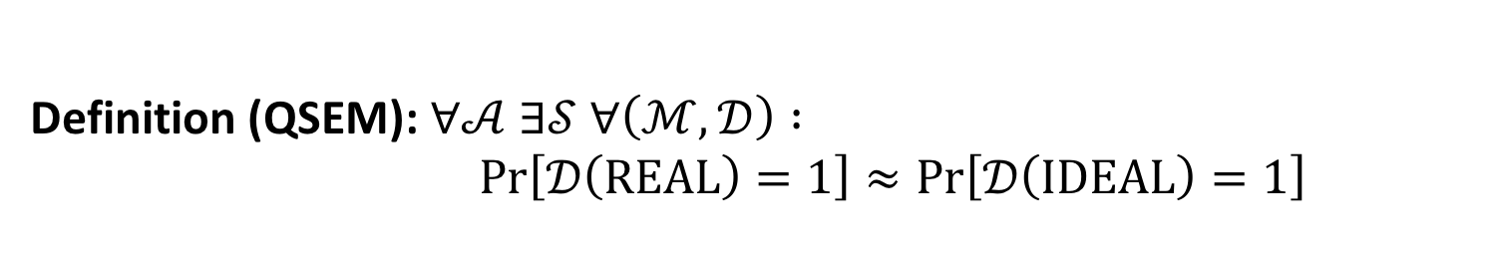


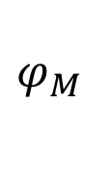



Quantum Semantic Security
$$Enc$$
REAL world
$$ℳ$$
$$φ_{M }$$
Adversary $𝒜$
$$φ_{aux}$$
$$0/1$$
$$φ_{tgt}$$
Distinguisher $𝒟$
IDEAL world
Simulator $𝒮$
Definition (QSEM): $∀𝒜 ∃𝒮 ∀\left(ℳ, 𝒟\right) :$
$Pr\left[𝒟\left(\text{REAL}\right)=1\right]≈Pr\left[𝒟\left(\text{IDEAL}\right)=1\right]$

Slide 11
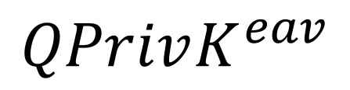


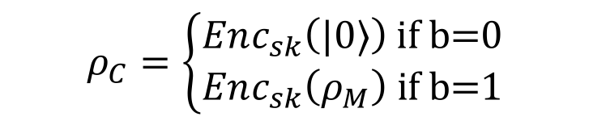

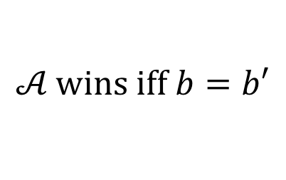
Quantum Indistinguishability
$$QPrivK^{eav}$$
Challenger
$$ρ_{M}$$
$$𝒜$$
$$b←\{0,1\}$$
$$ρ_{C}=\left\{\begin{aligned}Enc_{sk}\left(|0〉\right) \text{if} \text{b}\text{=0} \\ Enc_{sk}\left(ρ_{M}\right) \text{if} \text{b}\text{=1}\end{aligned}\right.$$
$$ρ_{C}$$
$$b′$$
$$𝒜 \text{wins} \text{iff} b=b′$$
Definition (QIND): $∀𝒜: \operatorname{Pr}\left[𝒜 \text{wins} QPrivK^{eav}\right]≤\frac{1}{2}+negl(n)$
Theorem: QSEM $⇔$ QIND
QIND: [Broadbent Jeffery 15, Gagliardoni Huelsing Schaffner 16]

Slide 12
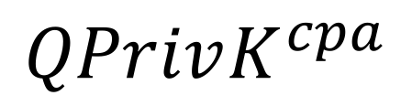



Chosen-Plaintext Attacks (CPA)
$$QPrivK^{cpa}$$
$$ρ_{M}$$
Challenger
$$Enc_{sk}(ρ_{M})$$
$$𝒜$$
$$b←\{0,1\}$$
$$ρ_{M}$$
$$ρ_{C}=\left\{\begin{aligned}Enc_{sk}\left(|0〉\right) \text{if} \text{b}\text{=0} \\ Enc_{sk}\left(ρ_{M}\right) \text{if} \text{b}\text{=1}\end{aligned}\right.$$
$$ρ_{C}$$
$$b′$$
$$𝒜 \text{wins} \text{iff} b=b′$$
Definition (QIND-CPA): $∀𝒜: \operatorname{Pr}\left[𝒜 \text{wins} QPrivK^{cpa}\right]≤\frac{1}{2}+ negl(n)$
Theorem: QSEM-CPA $⇔$ QIND-CPA
Fact: CPA security requires randomized encryption

Slide 13
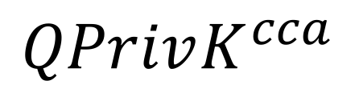





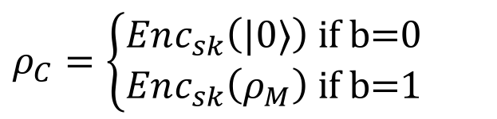
Chosen-Ciphertext Attacks (CCA1)
$$QPrivK^{cca}$$
$$ρ_{C}$$
Challenger
$$Dec_{sk}(ρ_{C})$$
$$𝒜$$
$$b←\{0,1\}$$
$$ρ_{M}$$
$$ρ_{C}=\left\{\begin{aligned}Enc_{sk}\left(|0〉\right) \text{if} \text{b}\text{=0} \\ Enc_{sk}\left(ρ_{M}\right) \text{if} \text{b}\text{=1}\end{aligned}\right.$$
$$ρ_{C}$$
$$ρ_{M}$$
$$Enc_{sk}(ρ_{M})$$
$$b′$$
$$𝒜 \text{wins} \text{iff} b=b′$$
Definition (QIND-CCA1): $∀𝒜: \operatorname{Pr}\left[𝒜 \text{wins} QPrivK^{cca}\right]≤\frac{1}{2}+ negl(n)$
Theorem: QSEM-CCA1 $⇔$ QIND-CCA1
Fact: QSEM-CCA1 $\underset{⇒}{≠}$ QIND-CPA $\underset{⇒}{≠}$ QIND

Slide 14
Our Contributions
Formal definition of Quantum Semantic Security
Equivalence to Quantum Indistinguishability
Extension to CPA and CCA1 scenarios
Construction of IND-CCA1 Quantum Secret-Key Encryption from Post-Quantum One-Way Functions
Construction of Quantum Public-Key Encryption from Post-Quantum One-Way Trapdoor Permutations

Slide 15


Quantum Secret-Key Encryption
Goal: build CCA1-secure quantum secret-key encryption
Ingredients:
quantum one-time pad (QOTP)
Long Key
QOTP
Plaintext
Ciphertext
Not even CPA secure, scheme is not randomized!

Slide 16
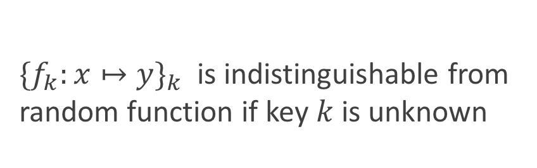


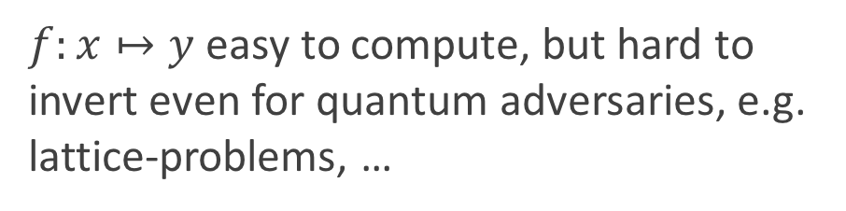


Quantum Secret-Key Encryption
Goal: build CCA1-secure quantum secret-key encryption
Ingredients:
quantum one-time pad (QOTP)
quantum-secure one-way function (OWF)
$$x$$
$f:x↦y$ easy to compute, but hard to invert even for quantum adversaries, e.g. lattice-problems, …
OWF
$$y$$
Theorem: One-Way Function $⟹$ Pseudo-Random Function
$$x$$
${{\{f}_{k}:x↦y\}}_{k}$ is indistinguishable from random function if key $k$ is unknown
PRF
$$y$$
[Hastad Impagliazzo Levin Luby 99]

Slide 17

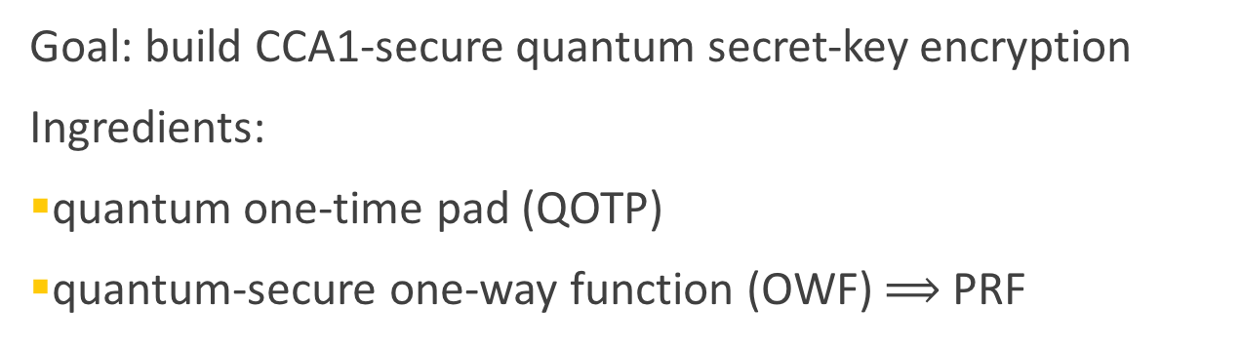
Quantum Secret-Key Encryption
Goal: build CCA1-secure quantum secret-key encryption
Ingredients:
quantum one-time pad (QOTP)
quantum-secure one-way function (OWF) $⟹$ PRF
Randomness
PRF
Long Key
QOTP
$$r$$
Plaintext
Ciphertext
Classical version: [Goldreich Goldwasser Micali 85]

Slide 18



Intuition of CCA1 security
Replace pseudo-random function with totally random function
Encryption queries result in polynomially many ciphertexts with different randomness:
With overwhelming probability the randomness of the challenge ciphertext will be different from previous r’s.
$$r_{1}$$
$$r_{q}$$
$$r^{∗}$$

Slide 19
Conclusion and Open Questions
Formal definition of Quantum Semantic Security
Equivalence to Quantum Indistinguishability
Extension to CPA and CCA1 scenarios
Construction of IND-CCA1 Quantum Secret-Key Encryption from Post-Quantum One-Way Functions
Construction of Quantum Public-Key Encryption from Post-Quantum One-Way Trapdoor Permutations
How to define quantum CCA2 security?

Slide 20
Thank you!
http://arxiv.org/abs/1602.01441
Questions

Slide 21
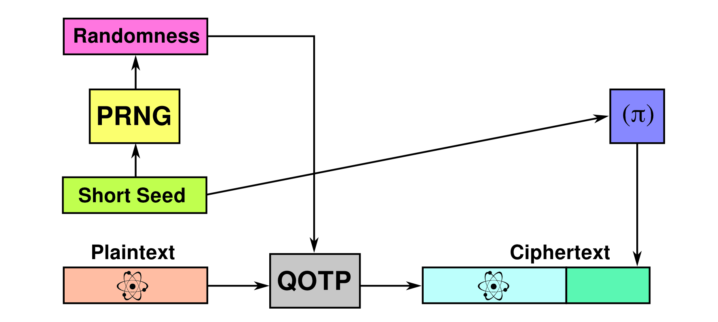
Quantum Public-Key Encryption

