Slide 1


Quantum Cryptography
Christian Schaffner
Institute for Logic, Language and Computation (ILLC)
University of Amsterdam
Centrum Wiskunde & Informatica
Research Center for
Quantum Software
BSc IW visit to ILLC
Tuesday, 31 October 2017

Slide 2
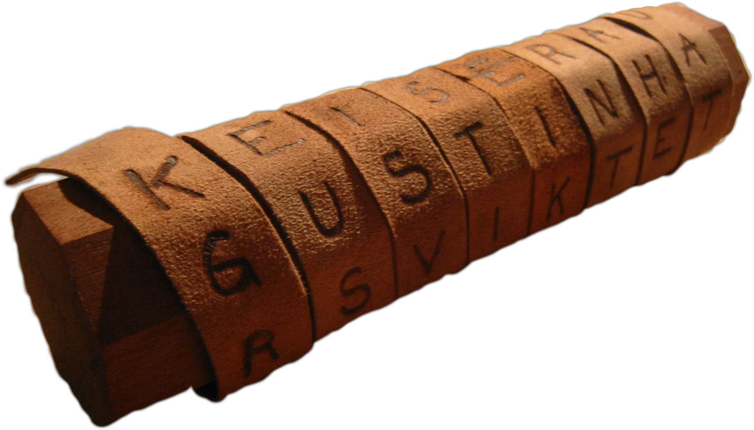
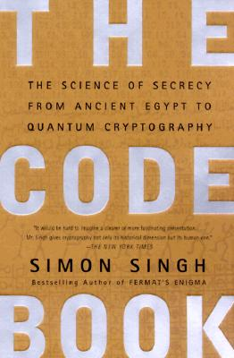
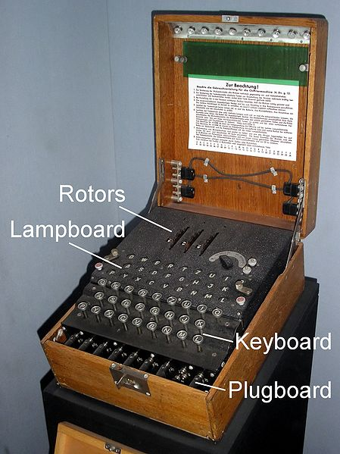
Classical Cryptography
3000 years of fascinating history
Until 1970: private communication was the only goal
Scytale
Enigma

Slide 3
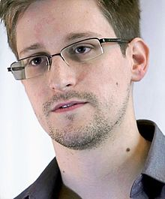
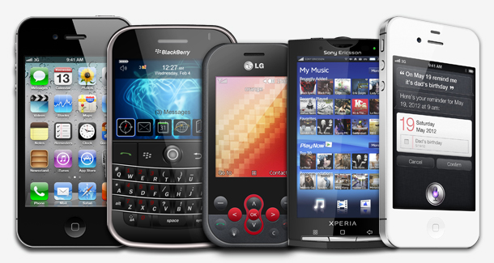
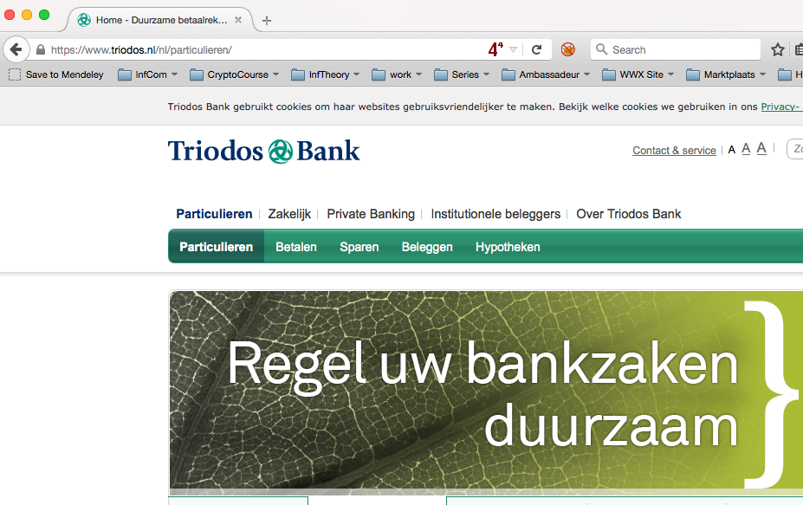
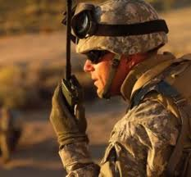
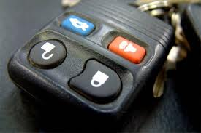
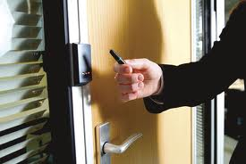
Modern Cryptography
Edward Snowden
is everywhere!
is concerned with all settings where people do not trust each other

Slide 4
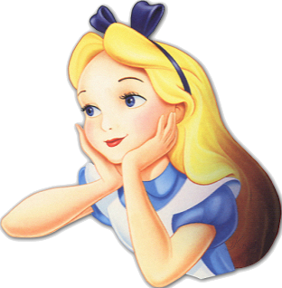

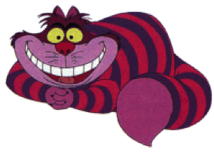
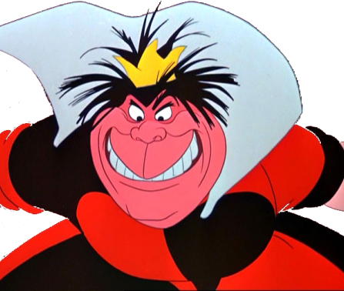
Secure Encryption
m = “I love you”
m = 0000 1111
Alice
Bob
k = ?
Eve
k = 0101 1011
k = 0101 1011
Goal: Eve does not learn the message
Setting: Alice and Bob share a secret key k

Slide 5
Perfectly Secure Encryption: One-Time Pad
5
m = 0000 1111
c = m © k = 0101 0100
m = c © k = 0000 1111
Alice
Bob
k = ?
Eve
k = 0101 1011
k = 0101 1011
Goal: Eve does not learn the message
Setting: Alice and Bob share a key k
Recipe:
It is perfectly secure!
x | y | x © y
0 | 0 | 0
0 | 1 | 1
1 | 0 | 1
1 | 1 | 0
m = 0000 1111
c = 0101 0100
k = 0101 1011
k = 0101 1011
c = m © k = 0101 0100
c © k = 0000 1111
c © k = m © k © k = m © 0 = m

Slide 6
Problems With One-Time Pad
6
m = 0000 1111
c = m © k = 0101 0100
m = c © k = 0000 1111
Alice
Bob
k = ?
Eve
k = 0101 1011
k = 0101 1011
BSc Informatica course:
Modern Cryptography
The key has to be as long as the message.
The key can only be used once.
In practice, other encryption schemes
(such as AES) are used which allow to encrypt long messages with short keys.
Master of Logic course:
Basic Probability
Master of Logic course:
Information Theory
Master of Logic course:
Computational Complexity
Notes:
for encrypting internet traffic

Slide 7
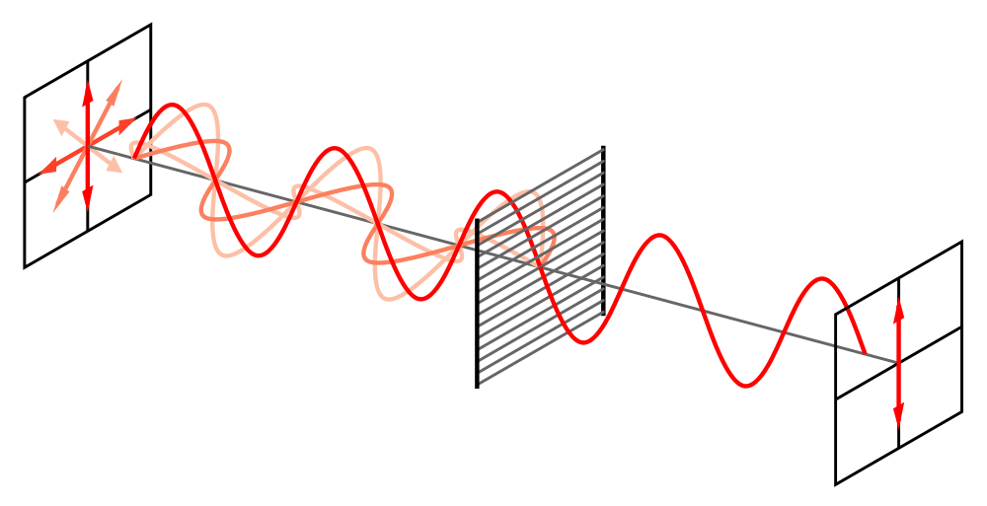
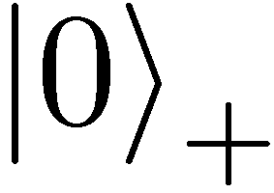
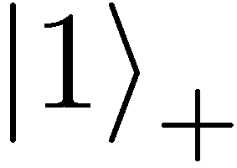
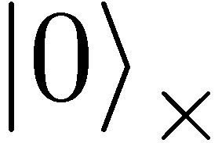
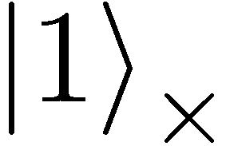
Quantum Mechanics
+ basis
£ basis
Measurements:
with prob. 1 yields 1
0/1
with prob. ½ yields 0
0/1
with prob. ½ yields 1

Slide 8
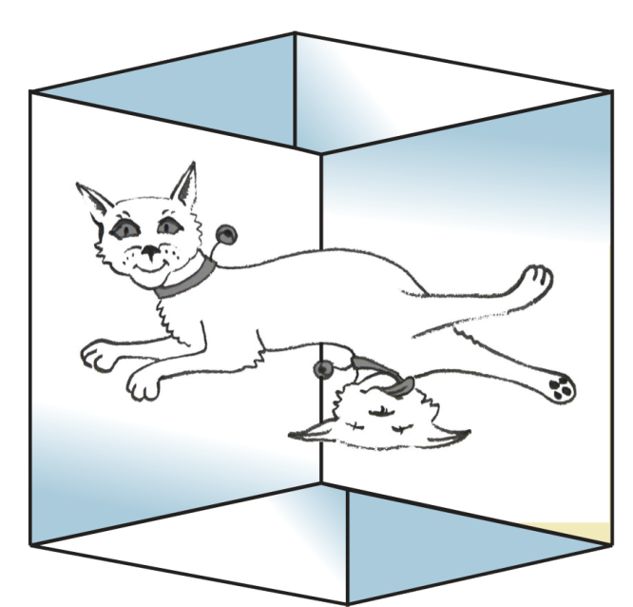
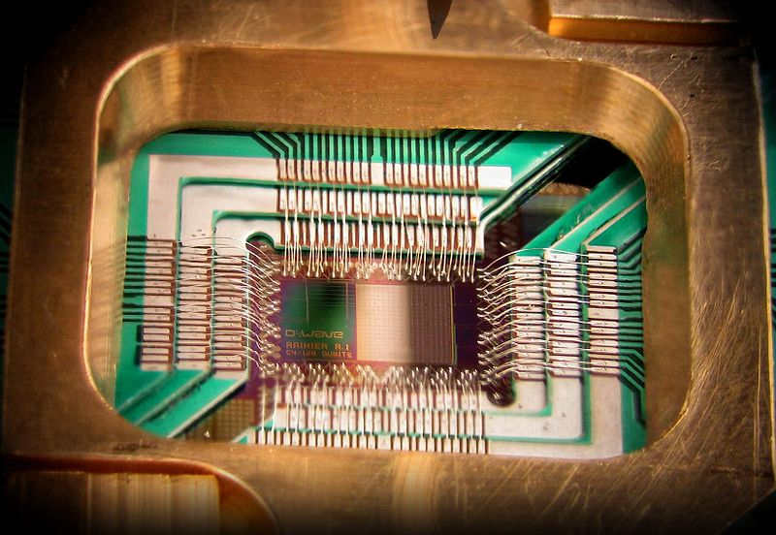

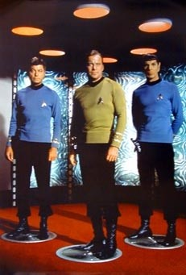
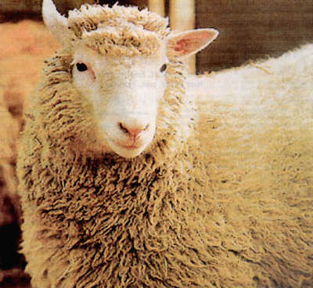
Wonderland of Quantum Mechanics

Slide 9
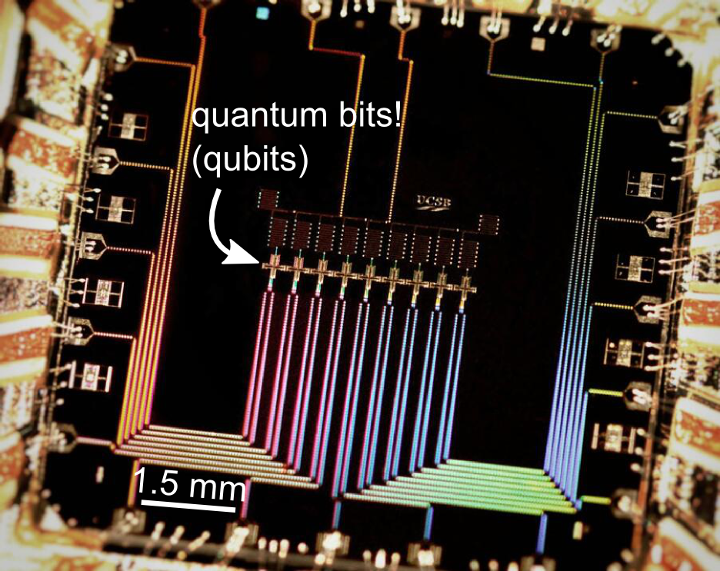
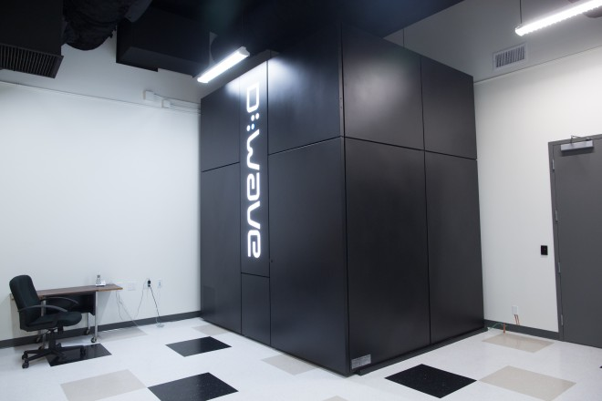
Can Quantum Computers Be Built?
Possible to build in theory, no fundamental theoretical obstacles have been found yet.
Canadian company “D-Wave” claims to have build a quantum computer with 2048 qubits. Did they?
2014/15: 135+50 Mio € investment in QuTech centre in Delft
2015: center in Amsterdam
2017+: 1 Bio € EU flagship on Quantum Technology
Martinis group (UCSB)
9 qubits
Master of Logic course:
Quantum Computing
Possibilities for
Research Projects at QuSoft

Slide 10
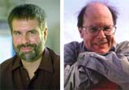
Quantum Key Distribution (QKD)
10
[Bennett Brassard 84]
Alice
Bob
k = ?
k = 0101 1011
Eve
k = 0101 1011
Offers a quantum solution to the key-exchange problem
Puts the players into the starting position to use symmetric-key cryptography (such as the one-time pad)

Slide 11

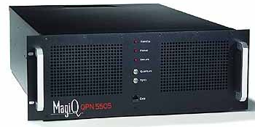
Quantum Key Distribution (QKD)
11
[Bennett Brassard 84]
Alice
Bob
Eve
technically feasible: no quantum computer required,
only quantum communication

Slide 12
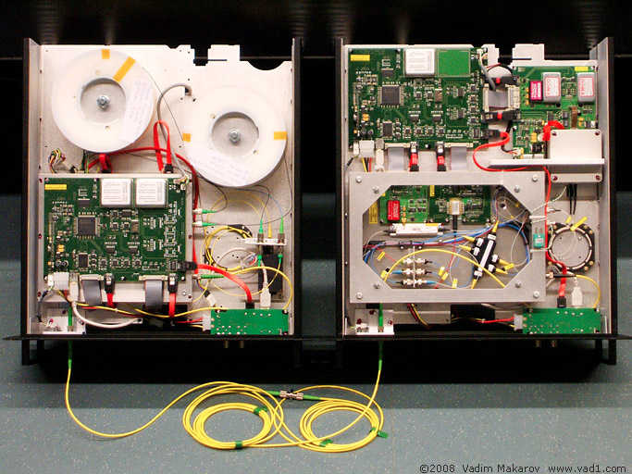
Quantum Key Distribution (QKD)
12
[Bennett Brassard 84]
Alice
Bob
Eve
technically feasible: no quantum computer required,
only quantum communication

Slide 13
Summary
One-Time Pad
Quantum Key Distribution
BSc Informatica course:
Modern Cryptography
Master of Logic course:
Computational Complexity
Master of Logic course:
Basic Probability
Master of Logic course:
Quantum Computing
Master of Logic course:
Information Theory
Possibilities for
Research Projects at QuSoft

Slide 14
Perfect Security
14
m = ?
c = m © k = 0101 0100
m = c © k = ?
Alice
Bob
k = ?
Eve
k = ?
k = ?
Given that c = 0101 0100,
  is it possible that m = 0000 0000 ?
    Yes, if k = 0101 0100.
  is it possible that m = 1111 1111 ?
    Yes, if k = 1010 1011.
  it is possible that m = 0101 0101 ?
    Yes, if k = 0000 0001
In fact, every m is possible.
Hence, the one-time pad is perfectly secure!
x | y | x © y
0 | 0 | 0
0 | 1 | 1
1 | 0 | 1
1 | 1 | 0

