Slide 1




Quantum Homomorphic ENCRYPTION for polynomial-sized circuits
Christian Schaffner
(joint work with Yfke Dulek and Florian Speelman)
http://arxiv.org/abs/1603.09717
QuICS seminar, Maryland, USA, Wednesday 8 March 2017

Slide 2

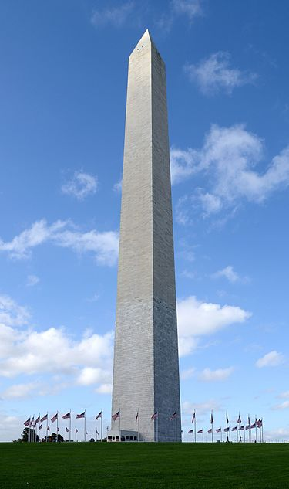





example: image tagging
Classical homomorphic encryption: Gentry [2009]
What about quantum?
CAPITOL
WASHINGTON
CAPITOL
WASHINGTON

Slide 3
1. HOMOMORPHIc ENCRYPTION
2. Previous results: Clifford scheme
3. New Scheme

Slide 4







Homomorphic encryption
Key Generation
public key
secret key
evaluation key
Encryption
+
x
↦
x
(secure)
Evaluation
+ +
↦
x
f(x)
CAPITOL
Decryption
↦
+
f(x)
f(x)
CAPITOL
CAPITOL
Classical homomorphic encryption: Gentry [2009]

Slide 5




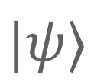
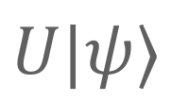
Homomorphic encryption
Key Generation
public key
secret key
evaluation key
quantum
Encryption
+
$$|ψ⟩$$
↦
$$|ψ⟩$$
(secure)
Evaluation
+ +
↦
$$|ψ⟩$$
$$U|ψ⟩$$
Decryption
↦
+
$$U|ψ⟩$$
$$U|ψ⟩$$

Slide 6

1. HOMOMORPHIc ENCRYPTION
2. Previous results: Clifford scheme
3. New SCHEME

Slide 7

Quantum Homomorphic enc
 | homomorphic for | compactness | security
Not encrypting | Quantum circuits | yes | no
Quantum OTP | no | yes | yes
append evaluation description | Quantum circuits | Complexity of Dec prop to (# gates) | yes
Clifford Scheme | Clifford circuits | yes | computational
Quantum one-time pad:
pick a,b ∈R {0,1}
|𝜓⟩ ↦ XªZ^{b} |𝜓⟩

Slide 8
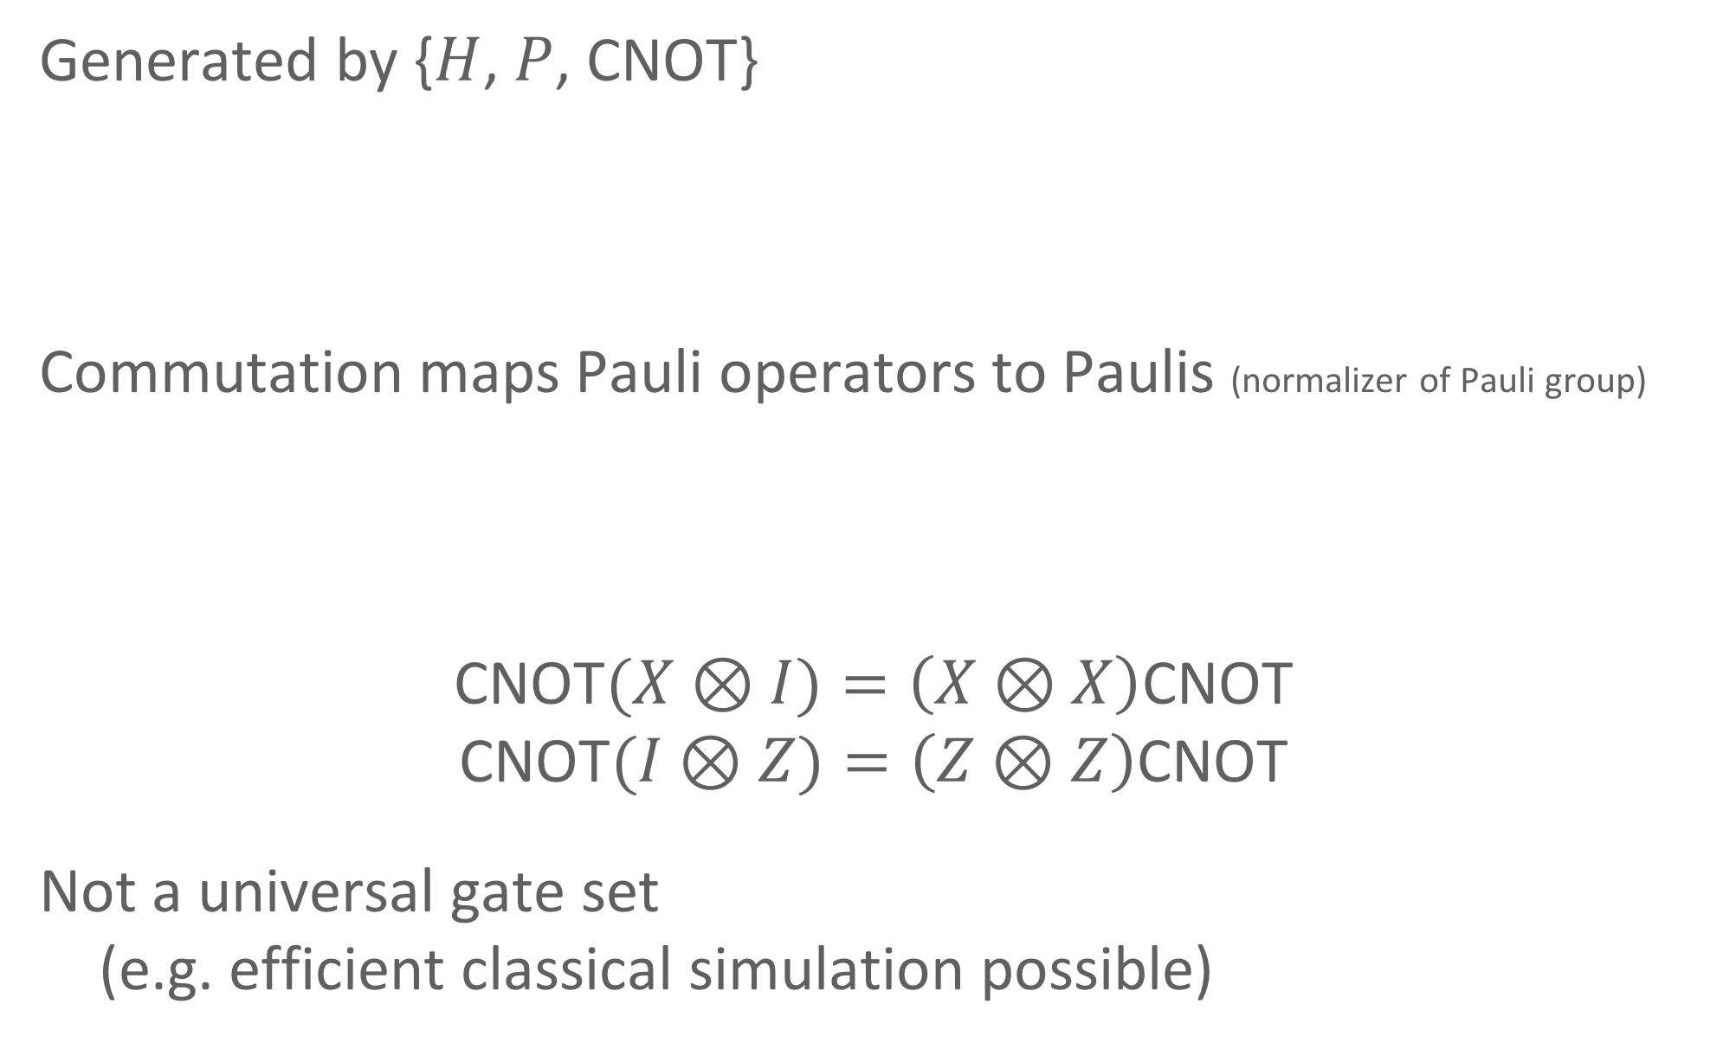

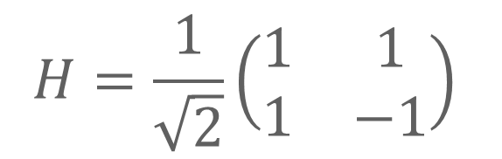

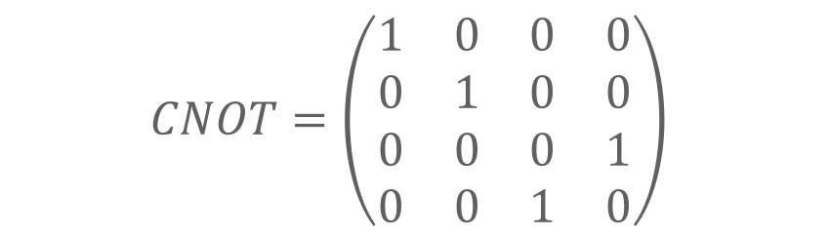
The Clifford Group
$$H=\frac{1}{\sqrt{2}}\left(\begin{matrix}1 & 1 \\ 1 & −1\end{matrix}\right)$$
$$P=\left(\begin{matrix}1 & 0 \\ 0 & i\end{matrix}\right)$$
Generated by {$H$, $P$, CNOT}
Commutation maps Pauli operators to Paulis (normalizer of Pauli group)
CNOT$(X⊗I)=\left(X⊗X\right)$CNOT
CNOT$(I⊗Z)=\left(Z⊗Z\right)$CNOT
Not a universal gate set
  (e.g. efficient classical simulation possible)
$$CNOT=\left(\begin{matrix}1 & 0 & 0 & 0 \\ 0 & 1 & 0 & 0 \\ 0 & 0 & 0 & 1 \\ 0 & 0 & 1 & 0\end{matrix}\right)$$
$$HX=ZH$$ | $$PZ=ZP$$
$$HZ=XH$$ | $$PX=XZP$$

Slide 9
Clifford Scheme
Ingredient 1: quantum one-time pad
pick a,b ∈R {0,1}
|𝜓⟩ ↦ XªZ^{b} |𝜓⟩
encryption:
a,b
=
|𝜓⟩
a,b
decryption:
XªZ^{b} |𝜓⟩ ↦ |𝜓⟩
Ingredient 2: classical homomorphic encryption (as black box)
[AMTW00] A. Ambainis, M. Mosca, A. Tapp, and R. De Wolf. Private quantum channels. FOCS’00
[Gentry 09] C. Gentry: Fully homomorphic encryption using ideal lattices. STOC’09

Slide 10






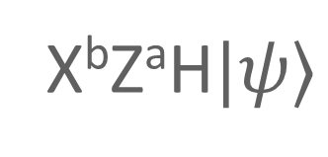
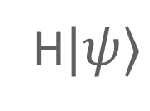
Clifford Scheme
H ( )
$$|ψ⟩$$
a,b
$$|ψ⟩$$
a,b
=
HXªZ^{b}|𝜓⟩
H
=
a,b
H|ψ⟩
b,a
X^{b}ZªH$|ψ⟩$
=
H$|ψ⟩$
b,a
Folklore, last formalized by [BJ15] A. Broadbent, S. Jeffery. Quantum Homomorphic Encryption for Circuits of Low T-gate Complexity. CRYPTO 2015

Slide 11
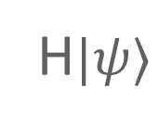
Clifford Scheme
Classical homomorphic encryption
Quantum one-time pad
$$|ψ⟩$$
a,b
update
function
H
a,b
b,a
H$|ψ⟩$
b,a
(x,y) ↦ (y,x)
Folklore, last formalized by [BJ15] A. Broadbent, S. Jeffery. Quantum Homomorphic Encryption for Circuits of Low T-gate Complexity. CRYPTO 2015

Slide 12

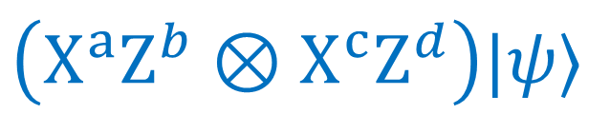





Clifford Scheme: CNOT
$$\left(X^{a}Z^{b}⊗X^{c}Z^{d}\right)|ψ⟩$$
a,b
c,d
2 qubit
$$|ψ⟩$$
a,b
CNOT
update
function
c,d
a,b$⊕$d
a$⊕$c,d
a,b$⊕$d
a$⊕$c,d
CNOT$|ψ⟩$
Folklore, last formalized by [BJ15] A. Broadbent, S. Jeffery. Quantum Homomorphic Encryption for Circuits of Low T-gate Complexity. CRYPTO 2015

Slide 13
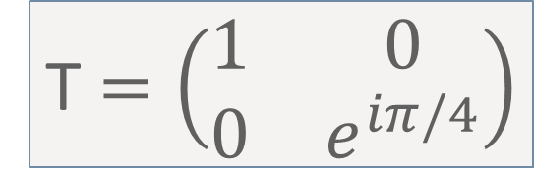
The challenge: T gate
T$=\left(\begin{matrix}1 & 0 \\ 0 & e^{iπ/4}\end{matrix}\right)$
TZ=ZT
TX=PXT
|ψ⟩
0,b
|ψ⟩
1,b
a,b
T
T
error!
P( )
T|ψ⟩
0,b
T|ψ⟩
1,b
how to apply correction P⁻¹ iff a = 1?

Slide 14
Previous results: overview
 | homomorphic for | compactness | security
Not encrypting | Quantum circuits | yes | no
Quantum OTP | No | yes | inf theoretic
append evaluation description | Quantum circuits | Complexity of Dec prop to (# gates) | yes
Clifford Scheme | Clifford circuits | yes | computational
[BJ15]: AUX | QCircuits with constant T-depth | yes | computational
[BJ15]: EPR | Quantum circuits | Comp of Dec is prop to (#T-gates)^2 | computational
[OTF15] | QCircuits with constant #T-gates | yes | inf theoretic
Our result | QCircuits of polynomial size (levelled FHE) | yes | computational
(comparison based on Stacey Jeffery’s slides)
[BJ15] A. Broadbent, S. Jeffery. Quantum Homomorphic Encryption for Circuits of Low T-gate Complexity. CRYPTO 2015
[OTF15] Y. Ouyang, S-H. Tan, J. Fitzsimons. Quantum homomorphic encryption from quantum codes. arxiv:1508.00938

Slide 15
1. HOMOMORPHIc ENCRYPTION
2. Previous results: Clifford Scheme
3. New SCHEME

Slide 16


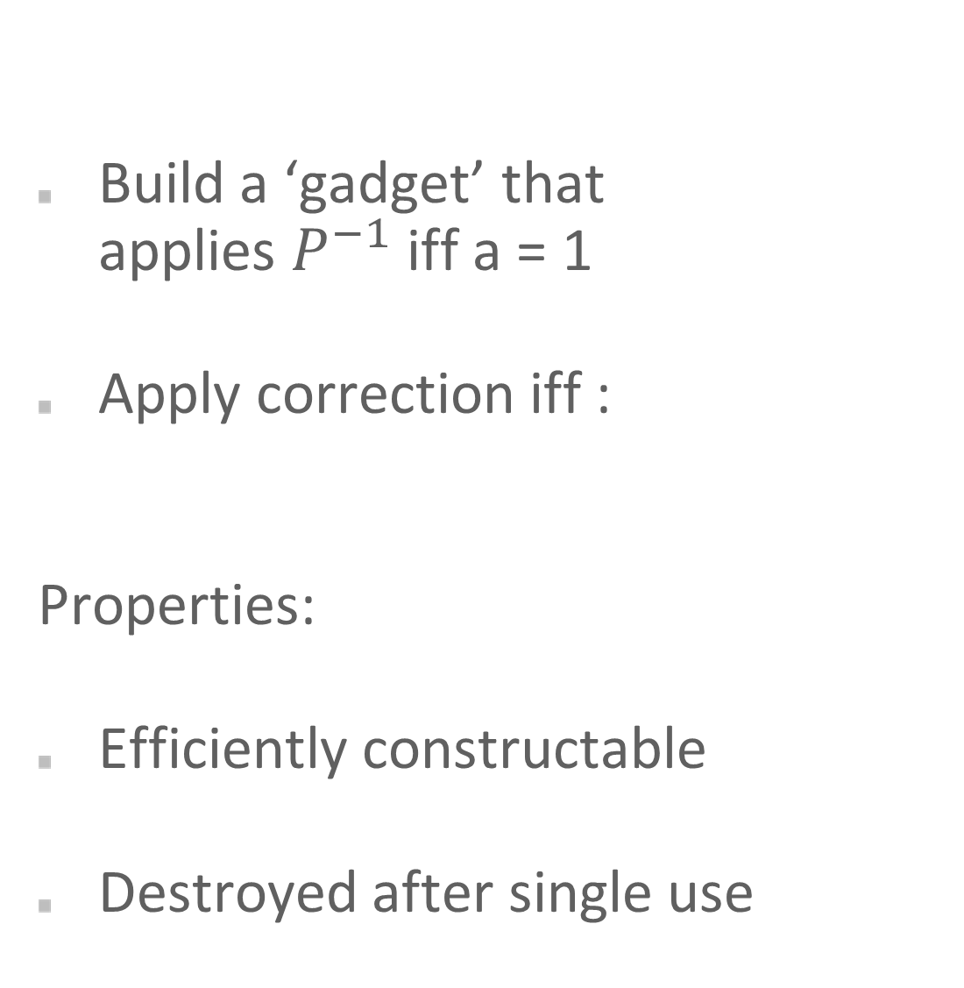
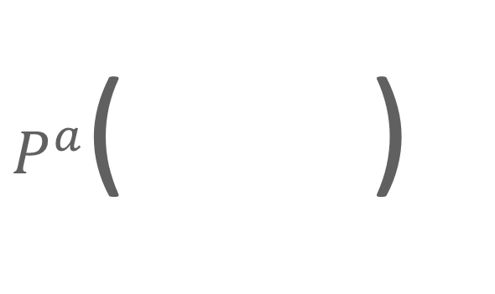
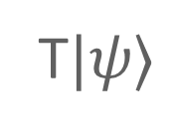
Error-correction ‘gadget’
$P^{a}$( )
Build a ‘gadget’ that
applies $P^{−1}$ iff a = 1
Apply correction iff :
Properties:
Efficiently constructable
Destroyed after single use
T$|ψ⟩$
a,b
a,b
a=decrypt( , ) = 1
c,d
T$|ψ⟩$
c,d
GADGET
a

Slide 17

Excursion
Theoretical Computer Science: Barrington’s Theorem

Slide 18
Permutation Branching Program
f : {0,1}^{n} x {0,1}^{n} → {0,1}
computes some Boolean function f(x,y)
list of instructions:
permutations of {1,2,3,4,5}
0: π
∈ S5
output: … ° σ’’ ° σ’ ° π
xi
1: σ
∈ S5
id
(fixed) cycle
⇒ f(x,y) = 0
0: π’
∈ S5
⇒ f(x,y) = 1
yj
1: σ’
∈ S5
0: π’’
∈ S5
length: # of instructions
xk
1: σ’’
∈ S5
…

Slide 19
EXAMPLE PBP OR(x,y)
x | y | OR(x,y)
0 | 0 | 0
0 | 1 | 1
1 | 0 | 1
1 | 1 | 1
length 4:
OR(0,0)
OR(0,1)
OR(1,0)
OR(1,1)
0: (12345)
x
1: id
0: (12453)
y
1: id
0: (54321)
x
1: id
0: (15243)
y
1: (14235)
output:
id
0
(14235)
1
(14235)
1
(14235)
1

Slide 20

Barrington’s theorem (1989)
Theorem (variation): if f : {0,1}^{n} x {0,1}^{n} → {0,1} is in NC¹,
then there exists a width-5 permutation branching program
for f with length polynomial in n.
NP
P
L
NC¹
Classical homomorphic decryption functions
happen to be in NC¹… [BV11]
[Barrington 89] Bounded-Width Polynomial-Size Branching Programs Recognize Exactly Those Languages in NC1, J. Comput. Syst. Sci. 38 (1): 150–164, 1989
[BV11] Z. Brakerski, V. Vaikuntanathan. Efficient fully homomorphic encryption from (standard) LWE. FOCS 2011
Notes:
NC1: Boolean circuits with, fan-in 2 gates, Polynomial size, Depth is log(n)

Slide 21

Error-correction gadget
$P^{a}$( )
Build a ‘gadget’ that
applies $P^{−1}$ iff a = 1
Apply correction iff
T$|ψ⟩$
a,b
a,b
GADGET
a = decrypt( , ) = 1
a
c,d
T$|ψ⟩$
c,d
has a poly-size PBP

Slide 22
error correction Gadget
$P^{a}$( )
T$|ψ⟩$
a,b
{
PBP for
a=decrypt( , )
a
{
P⁻¹ iff permutation ≠ id
P⁻¹
P⁻¹
P⁻¹
P⁻¹
{
GADGET
reverse PBP for
a=decrypt( , )
a

Slide 23
Error correction gadget
Branching program for decrypt( , )
a
0: π
EPR pairs
i
1: σ
0: π’
teleportation
measurements
a
j
1: σ’
0: π’’
EPR pairs
k
1: σ’’
0: π’’’
teleportation
measurements
a
l
1: σ’’’
…
…
…

Slide 24
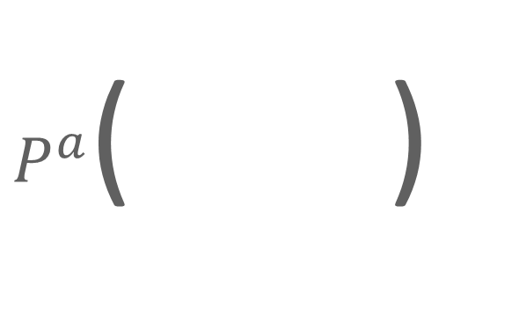
error correction Gadget
$P^{a}$( )
a,b
T$|ψ⟩$
a,b
Update key
depending on teleportation
outcomes
& gadget structure
gadget structure
{
PBP for
a=decrypt( , )
a
{
P⁻¹ iff permutation ≠ id
P⁻¹
P⁻¹
P⁻¹
P⁻¹
{
GADGET
reverse PBP for
a=decrypt( , )
a
c,d
T$|ψ⟩$
c,d

Slide 25
security
a,b
All quantum information: quantum one-time pad
(perfectly secure if classical info is hidden)
Gadget structure, each ‘connection’:
Random choice out of 4 Bell states
(perfectly secure if classical info is hidden)
All classical information: classical homomorphic scheme
Security of classical scheme is the only assumption

Slide 26


New scheme: overview
Key generation
classical keys
gadgets
ENCRYPTION
apply quantum one-time pad
classically encrypt pad keys
$$|ψ⟩$$
a,b
a,b
Evaluation
after / / : classically update keys
after : use
H
P
CNOT
T
Decryption
classically decrypt pad keys
remove quantum one-time pad
U$|ψ⟩$
c,d
c,d

Slide 27
Applications
Delegated quantum computation in two rounds
  No memory needed on Alice’s side
  ”Low-tech” generation of gadgets
Gadget generation on demand
Circuit privacy

Slide 28
FUTURE WORK
non-leveled QFHE?
verifiable delegated quantum computation
quantum obfuscation?
…

Slide 29
Thank you!

