Slide 1
Randomness Extraction via
±-Biased Masking in the
Presence of a Quantum Attacker
Serge Fehr & Christian Schaffner
CWI Amsterdam, The Netherlands
TCC 2008, 21/3/2008
New York, USA
TexPoint fonts used in EMF.
Read the TexPoint manual before you delete this box.: AAAAAAAAAA

Slide 2
Agenda
Motivation
Main Result
Applications
Related Work

Slide 3
Motivating Example
Key K
random source
Key K
X=01101001…
X=01101001…
Z =10011…

Slide 4

Left-Over Hash Lemma
Key K
Key K
H₁(X|KZ) ¸ m
F(X)=?
X=01101001…
X=01101001…
2-universal
F
F(X)=0011..
F(X)=0011..
m
Z =10011…
Key K
Key K can be reused!

Slide 5
Imperfect Source
imperfect random source
Key K
Key K
X=01101011…
X’=01111001…
Z =10011…

Slide 6
Information Reconciliation
Key K
Key K
H₁(X|KZ) ¸ m + |syn(X)|
X=01101011…
X’=01111001…
Y = X © C
C 2_{R} C
decode C’ = Y©X’
X=01101011…
F(X)=?
F(X)=0011..
F(X)=0011..
Z =10011…

Slide 7
Reusability Problem
Key K
Key K
H₁(X|KZ) ¸ m + |syn(X)|
X=01101011…
X’=01111001…
Y = X © C
C 2_{R} C
decode C’ = Y©X’
X=01101011…
F(X)=?
F(X)=0011..
F(X)=0011..
Z =10011…
Problem: K cannot be reused!

Slide 8
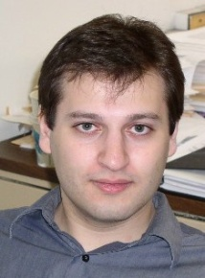

Solution
Key K
Key K
H₁(X|KZ) ¸ m + |syn(X)|
X=01101011…
X’=01111001…
Y = X © C
C 2_{R} C
decode C’ = Y©X’
X=01101011…
Y = ?
[Dodis, Smith 05]
Z =10011…
K can be safely reused!

Slide 9
The Quantum Case
imperfect random source
Key K
Key K
X=01101011…
X’=01111001…
ρ_{Z}
101…

Slide 10
Two-Universal Hashing
Key K
Key K
H₁(X|K ρ_{Z}) ¸ m + |syn(X)|
X=01101011…
X’=01111001…
Y = X © C
C 2_{R} C
decode C’ = Y©X’
X=01101011…
F(X)=?
F(X)=0011..
F(X)=0011..
ρ_{Z}
101…

Slide 11
Problem
Key K
Key K
H₁(X|K ρ_{Z}) ¸ m + |syn(X)|
X=01101011…
X’=01111001…
Y = X © C
C 2_{R} C
?
decode C’ = Y©X’
X=01101011…
Y = ?
[Dodis, Smith 05]
ρ_{Z}
101…
K can be safely reused!

Slide 12
Agenda
Motivation
Main Result
Applications
Related Work

Slide 13


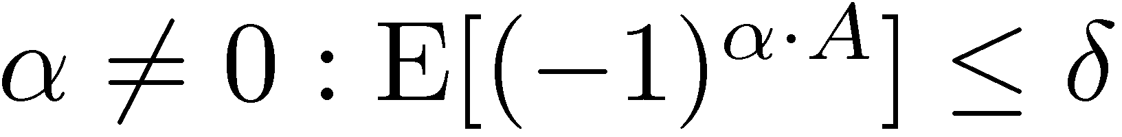
Classical Theorem
[Dodis, Smith 05]
random variable A in {0,1}^{n} is ±-biased
if for all
{A_{i}} ±-biased family over {0,1}^{n}
joint distribution P_{XZ} where X in {0,1}^{n}
and Z some side information
Then, for uniform I
{0,1}^{n}
A_{I} © X = ?
©
=
I,
Z

Slide 14
Main Theorem
random variable A in {0,1}^{n} is ±-biased
if for all
{A_{i}} ±-biased family over {0,1}^{n}
joint quantum-state ρ_{XZ} where
X in {0,1}^{n} and Z some quantum side information
Then, for uniform I
{0,1}^{n}
A_{I} © X = ?
©
=
I, ρ_{Z}

Slide 15
Proof Technique
random variable A in {0,1}^{n} is ±-biased
if for all
{A_{i}} ±-biased family over {0,1}^{n}
Joint quantum-state ρ_{XZ} where
X in {0,1}^{n} and Z some quantum side information
Then, for uniform I
{0,1}^{n}
A_{I} © X = ?
Proof:
  quantum-information theory
  Fourier-analysis of matrix-valued
  functions over {0,1}^{n}
I, ρ_{Z}

Slide 16
Application: Entropic Encryption
[Alon, Goldreich, Håstad, Peralta 90]
±-biased set K over {0,1}^{n} of size
|K|=O(n²/±²)
joint quantum-state ρ_{XZ} where
X n-bit message and Z some quantum side information
Then, for uniform I
if H₁( ρ_{XZ} |Z) ¸ t, then a key size of
log |K|= n - t +2 log(n)+2 log(1/²) + O(1)
suffices to encrypt X
K © X=?
ρ_{Z}

Slide 17
Weak Extractor
For any ε ¸ 0 and 0 · t · n,
there exists a (t,ε)-weak quantum extractor with
  n-bit output and
  seed length n - t +2 log(n)+2 log(1/ε) + O(1)
Then, for uniform I
if H₁( ρ_{XZ} |Z) ¸ t, then a key size of
log |K|= n - t +2 log(n)+2 log(1/²) + O(1)
suffices to encrypt X
K © X=?
ρ_{Z}

Slide 18
Application: Private Error Correction
[Dodis, Smith 05] for every 0 < λ < 1, there is a family of binary linear codes {C_{i}}
  of length n,
  correcting a linear fraction of errors, and
  {C_{i}} is δ < 2^{-λn/2} -biased
Joint quantum-state ρ_{XZ} where
X in {0,1}^{n} and Z some quantum side information with H₁(ρ_{XZ}|Z) ¸ t
Then, for uniform I
C_{I} © X =?
I, ρ_{Z}

Slide 19
Agenda
Motivation
Main Result
Applications
Related Work

Slide 20
Randomness Extraction against Q-Memory
[König, Renner, Maurer 03]
2-universal hashing
[König, Terhal 06]
1-bit-output extractors
[this work 06]
±-biased masking
[Smith 07]
Srinivasan-Zuckerman extractors
[König, Renner 07]
Sampling min-entropy relative to quantum knowledge
F
Ext
C_{I} © X = ?
|| ρ_{XZ} ||₂
H₁(X₁ X₂ … X_{n}|ρ_{Z}) = α
) H₁(X_{r1} X_{r2} … X_{rs}|ρ_{Z}) ¸ α s/n

Slide 21
Related work
[Gavinsky, Kempe, Kerenidis, Raz, de Wolf 06] counterexample:
strong extractor which is classically “secure”, but completely insecure against q-memory of similar size
[Ambainis, Smith 04]
encrypting quantum messages with ±-biased masking
[Desrosiers, Dupuis 07]
quantum entropic security
Quantum Schemes

Slide 22
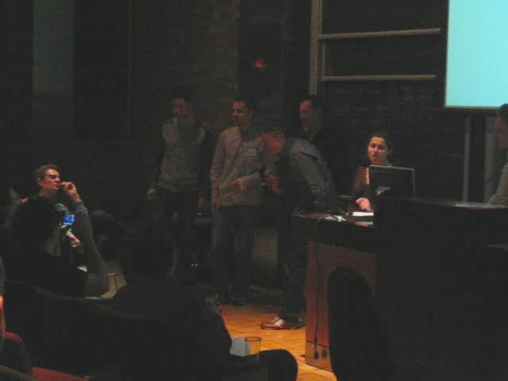





Conclusions
randomness extraction via ±-biased masking is secure in the presence of quantum attacker
entropic security
Error Correction without Leaking Partial Information
Applications in the Bounded-(Quantum-)Storage Model
Thanks to
you!

Slide 23
Strong Extractor
Let {C_{i}} be a δ-biased family of binary linear [n,k,d]₂ codes. {H_{i}} the parity-check matrix.
Then, Ext: (i,x)  H_{i} x is a (t, ε)-strong quantum extractor with
  with (n-k)-bit output,
  ε= δ 2^{(n-t)/2}
Seed length must be linear in n
Then,
C_{I} © X =?
I, ρ_{Z}

