Slide 1



Quantum Cryptography beyond
Key Distribution
Christian Schaffner
CWI Amsterdam, Netherlands
Tropical QKD
Waterloo, ON, Canada
Wednesday, 16 June 2010

Slide 2
Outline
Cryptographic Primitives
Noisy-Storage Model
Position-Based Quantum Cryptography
Conclusion

Slide 3

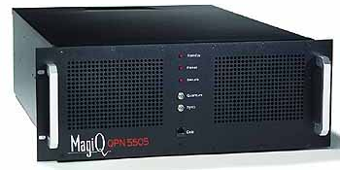


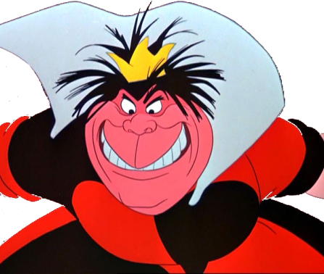
Cryptography
settings where parties do not trust each other:
  secure communication
  authentication
Bob
Alice
use the same quantum hardware for
applications in two- and multi-party scenarios
Eve
= ?
three-party scenario

Slide 4
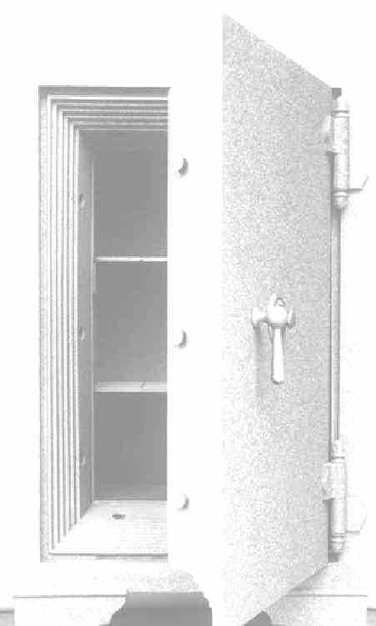


Modern-Day Cryptography
I’m Alice,
my PIN is 4049
I want $50
Alright Alice, here you go.
(example stolen from Louis Salvail)

Slide 5

Modern-Day Cryptography
Alice:
4049
I’m Alice
my PIN is 4049
I want $50
Sorry, I’m out of order

Slide 6
Modern-Day Cryptography
Alice:
4049
I’m Alice,
my PIN is 4049
I want $500.000
Alright Alice, here you go.

Slide 7
Where It Went Wrong
I’m Alice
my PIN is 4049
I want $50

Slide 8
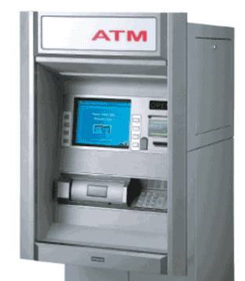
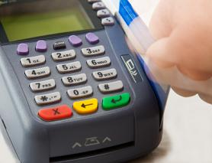
Secure Evaluation of the Equality
a
=
b
?
?
?
a = b
a = b
PIN-based identification scheme should be a
secure evaluation of the equality function
dishonest player can exclude only one possible password

Slide 9
Secure Function Evaluation: Definition
we want: ideal functionality
IDEAL
x
f
y
f(x,y)
f(x,y)
we have: protocol
REAL
security: if REAL looks like IDEAL to the outside world

Slide 10
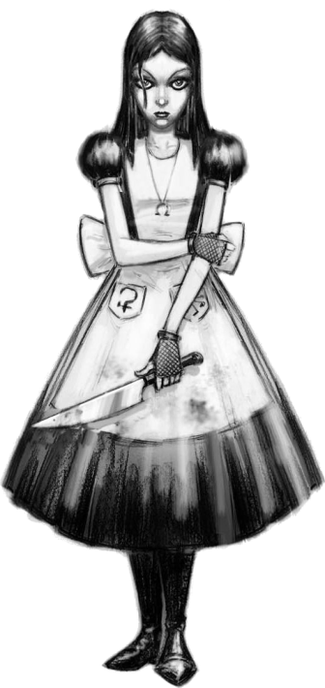
Secure Function Evaluation: Dishonest Alice
we want: ideal functionality
IDEAL
x
f
y
f(x,y)
f(x,y)
we have: protocol
REAL
security: if REAL looks like IDEAL to the outside world

Slide 11
Secure Function Evaluation: Dishonest Bob
we want: ideal functionality
IDEAL
x
f
y
f(x,y)
f(x,y)
we have: protocol
REAL
security: if REAL looks like IDEAL to the outside world

Slide 12

Modern Cryptography
use QKD hardware for
applications in two- and multi-party scenarios
two-party scenarios:
  password-based identification (=)
  millionaire‘s problem (<)
  dating problem (AND)
multi-party scenarios:
  sealed-bid auctions
  e-voting
  …

Slide 13
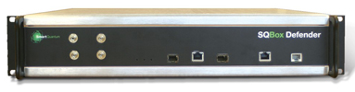
Can we implement these primitives?
In the plain model (no restrictions on adversaries,
using quantum communication, as in QKD):
  Secure function evaluation is impossible (Lo ‘97)
Restrict the adversary:
  Computational assumptions (e.g. factoring or discrete logarithms are hard)
unproven

Slide 14
Exploit Quantum-Storage Imperfections
use the technical difficulties in building a quantum computer to our advantage
storing quantum information is a technical challenge
  Bounded-Quantum-Storage Model :
  bound the number of qubits an adversary can store
  (Damgaard, Fehr, Salvail, S ‘05)
  Noisy-(Quantum-)Storage Model:
  more general and realistic model
  (Wehner, S, Terhal ’07; König, Wehner, Wullschleger ‘09)
Conversion can fail
Error in storage
Readout can fail

Slide 15
Outline
Cryptographic Primitives
Noisy-Storage Model
Position-Based Quantum Cryptography
Conclusion

Slide 16
The Noisy-Storage Model
(Wehner, S, Terhal ’07)

Slide 17
The Noisy-Storage Model
(Wehner, S, Terhal ’07)
waiting time: ¢t
what an (active) adversary can do:
  change messages
  computationally all-powerful
  unlimited classical storage
  actions are ‘instantaneous’
restriction:
  noisy quantum storage

Slide 18
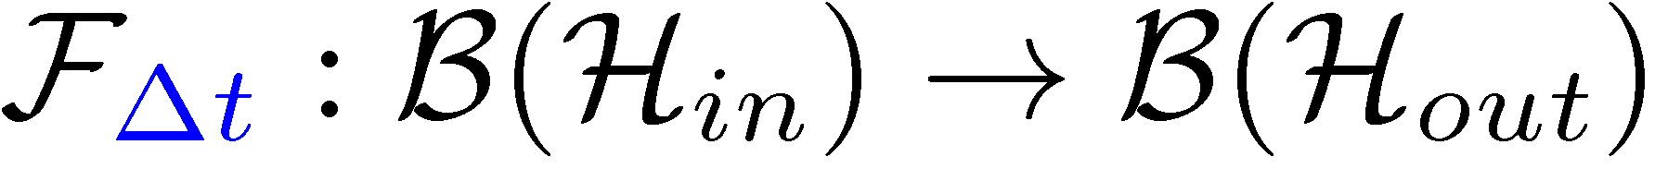
The Noisy-Storage Model
(Wehner, S, Terhal ’07)
change messages
computationally all-powerful
unlimited classical storage
actions are ‘instantaneous’
waiting time: ¢t
Adversary’s state
Arbitrary
encoding
attack
Unlimited classical storage
Noisy quantum storage
models:
decoherence in memory
transfer into storage (photonic states onto different carrier)

Slide 19
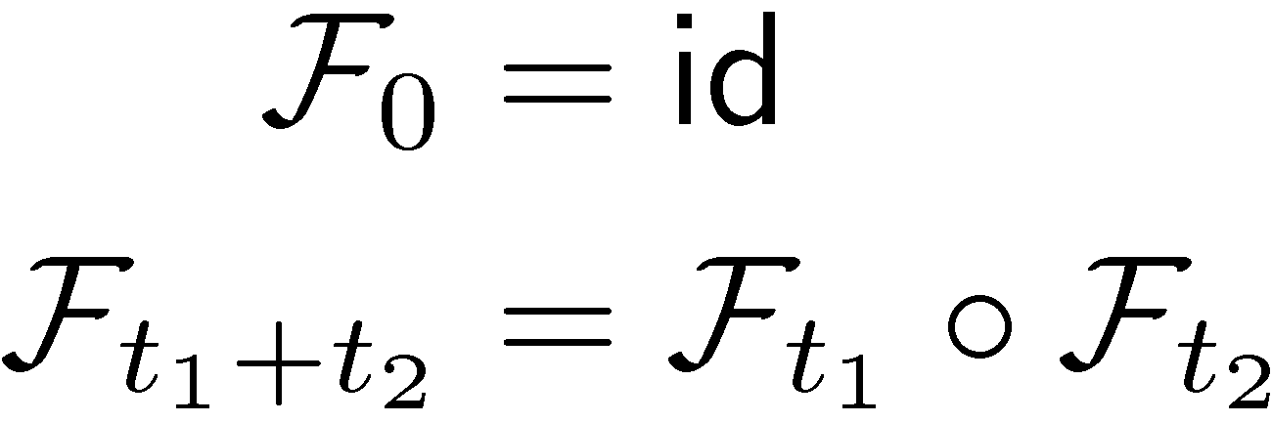
The Noisy-Storage Model
during waiting time: ¢t
Adversary’s state
Arbitrary
encoding
attack
Unlimited classical storage
Noisy quantum storage
natural conditions on the storage channel:
waiting does not help:

Slide 20

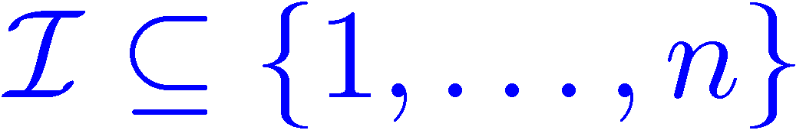
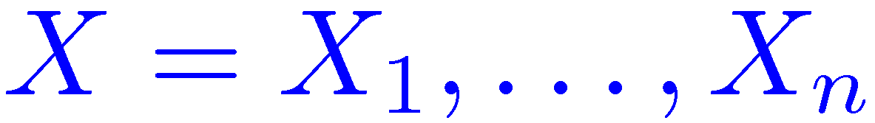
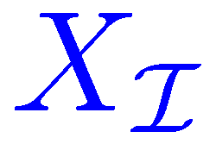
Protocol Structure
quantum part as in BB84
waiting time: ¢t
Noisy quantum storage
weak string erasure
General case [König Wehner Wullschleger arxiv:0906.1030]:
  Storage channels with “strong converse” property, e.g. depolarizing channel
Some simplifications [S arxiv:1002.1495]

Slide 21
Outline
Cryptographic Primitives
Noisy-Storage Model
Position-Based Quantum Cryptography
Conclusion

Slide 22


Position-Based Quantum Cryptography
[Malaney: 1004.4689, Chandran Fehr Gelles Goyal Ostrovsky: 1005.1750]
Verifier1
Prover
Verifier2
Prover wants to convince verifiers that she is at a particular position
assumptions:  communication at speed of light
            instantaneous computation
            verifiers can coordinate
no coalition of (fake) provers, i.e. not at the claimed position, can convince verifiers
classically impossible !
even using computational assumptions

Slide 23
Position-Based Quantum Cryptography
[Chandran Fehr Gelles Goyal Ostrovsky: 1005.1750]
Verifier1
Prover
Verifier2
intuitively: security follows from no cloning
formally, usage of recently established strong complementary information trade-off

Slide 24
Position-Based Quantum Cryptography
[Chandran Fehr Gelles Goyal Ostrovsky: 1005.1750]
Verifier1
Prover
Verifier2
can be generalized to more dimensions
basic scheme for secure positioning
more advanced schemes allow message authentication and key distribution
connections to entropic uncertainty relations and
non-local games
many open questions

Slide 25
Conclusion
cryptographic primitives
noisy-storage model:
  well-defined adversary model
  composable security definitions
position-based q cryptography
=
QKD hardware and know-how is useful in applications beyond key distribution

