Slide 1
Secure Identification
Using
Quantum Communication
Serge Fehr, Christian Schaffner (CWI Amsterdam, NL)
Ivan Damgård, Louis Salvail (University of Århus, DK)
Workshop: Practical Applications of New Research in Cryptography
Sabanci University, Turkey
Friday, April 18, 2008

Slide 2
Quantum Bit: Polarization of a Photon

Slide 3
Qubit: Rectilinear Basis
j
0
i
j
1
i
j
1
i
+
+
+
j
0
i
+

Slide 4
Detecting a Qubit
j
0
i
j
1
i
j
1
i
+
+
+
no photon: 0
j
j
i
0
i
0
+
+
Alice
Bob

Slide 5
Measuring a Qubit
j
0
i
j
1
i
j
1
i
+
+
+
no photon: 0
photon: 1
j
j
i
0
i
0
+
+
Alice
Bob
Measurement:
with prob. 1 yields 1
0/1

Slide 6
Diagonal Basis
j
0
i
j
1
i
j
1
i
+
+
+
j
i
j
i
j
i
0
1
1
j
i
£
£
£
0
£
j
0
i
+
Measurement:
with prob. ½ yields 0
with prob. ½ yields 1
0/1

Slide 7
Quantum Mechanics
+ basis
j
0
i
j
i
+
1
+
£ basis
j
0
i
j
1
i
£
£
Measurements:
with prob. 1 yields 1
0/1
with prob. ½ yields 0
0/1
with prob. ½ yields 1

Slide 8
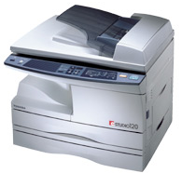
Non-Classical Properties
j
0
i
j
1
i
+
+
j
0
i
j
1
i
£
£
No Cloning Theorem:
?
?
?

Slide 9
Outline
Quantum Mechanics
Quantum Key Distribution
Two-Party Setting
Secure Identification
Conclusion

Slide 10
Quantum Key Distribution (QKD)
Bob
Alice
Eve
most-studied in quantum cryptography
3-party scenario
unconditional security against unrestricted eavesdroppers

Slide 11
QKD: Intuition
Bob
Alice
?
?
?
?
?
Eve
quantum states are unknown to Eve, cannot copy them
honest players can check whether Eve interfered
then amplify their advantage

Slide 12
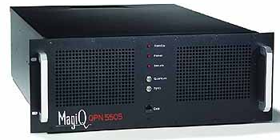
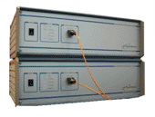
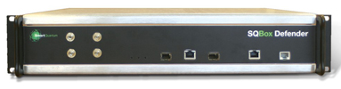
Commercial QKD-Products
MagicQ (USA)
idQuantique (Switzerland)
SmartQuantum (France/USA)
only quantum communication,
no quantum storage
nor quantum computation required

Slide 13
Outline
Quantum Mechanics
Quantum Key Distribution
Two-Party Setting
Secure Identification
Conclusion

Slide 14
Two-Party Setting?
Bob
Alice
Bit Commitment
*
Oblivious Transfer
1-2 OT
C 2 {0,1}
⇓
S₀ S₁
S_{C}
Equality Test
S_{A}
=
S_{B}
?
?
S_{A} = S_{B}

Slide 15
Impossibility Results
Bob
Alice
Bit Commitment
[Mayers,LoChau96]
*
[Lo98]
Oblivious Transfer
1-2 OT
C 2 {0,1}
⇓
S₀ S₁
S_{C}
Equality Test
S_{A}
=
S_{B}
?
?
S_{A} = S_{B}

Slide 16
Possible Assumptions
Bob
Alice
bounded time ) classical cryptography, assumption-based
noisy ressources
bounded memory
1-2 OT
=
?

Slide 17
Classical Bounded-Storage Model
[Maurer92]
010011001100
long random string in the sky which players try to store
a memory bound applies at a specified moment (string disappears)
protocol for Oblivious Transfer
[CCM98, DHRS04]:
memory size of honest players: k
memory of dishonest players: < k²
tight bound [DM04]
1-2 OT
=
?

Slide 18
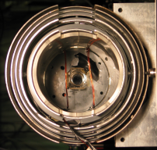
Bounded-Quantum-Storage Model
[Damgaard Fehr Salvail S 05]
quantum memory bound applies at a specified moment
besides that, players are unbounded
(in time and space)
honest players do not need quantum memory at all
honest players: 0 k
dishonest players: <n/4 <k²
unconditional security against quantum-memory bounded adversaries
1-2 OT
=
?

Slide 19
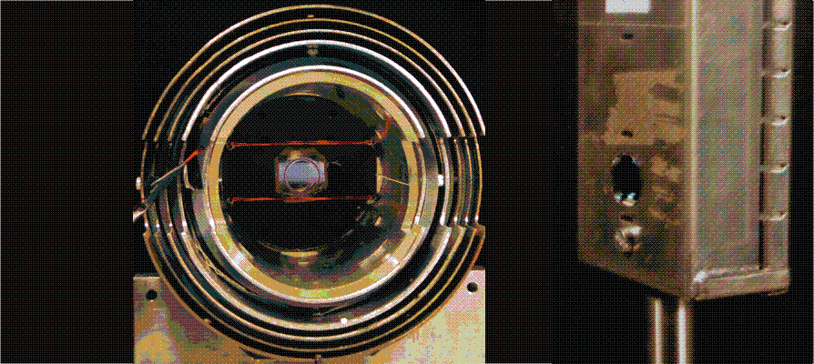
Quantum Memory
[physics group of Eugene Polzik, Copenhagen (DK)]
70% fidelity, few milliseconds, …
technically very challenging

Slide 20
A Bit of History
[Damgaard Fehr Salvail S 05]
Rabin-OT and Bit Commitment
[Damgaard Fehr Renner Salvail S 07]
1-2 Oblivious Transfer
[Damgaard Fehr Salvail S 07]
Secure Identification
1-2 OT
=
?

Slide 21
Outline
Quantum Mechanics
Quantum Key Distribution
Two-Party Setting
Secure Identification
Conclusion

Slide 22
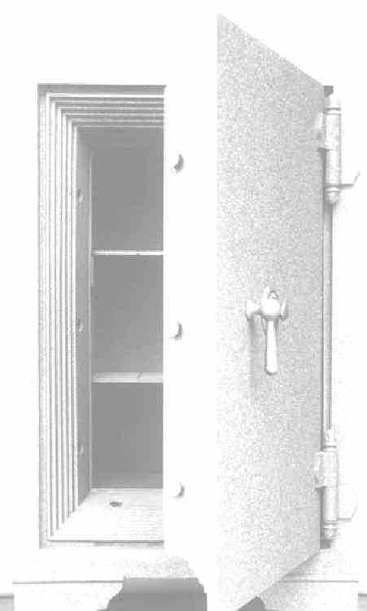

Why Secure Identification?
I’m Alice
my PIN is IMAB52
I want $25
Alright Alice, here you go.

Slide 23
Why Secure Identification?
Alice:
IMAB52
I’m Alice
my PIN is IMAB52
I want $25
Sorry, I’m out of order

Slide 24
Why Secure Identification?
Alice:
IMAB52
I’m Alice
my PIN is IMAB52
I want $25,000,000
Alright Alice, here you go.

Slide 25
Secure Evaluation of the Equality
W_{A}
=
W_{B}
?
?
W_{A} = W_{B}
PIN-based identification scheme should be a
secure evaluation of the equality function
A dishonest player can exclude only one possible password

Slide 26

Quantum Identification Protocol
W
W
X= 0 1 1 1 0
C(W)=
X’=
0 0 1 1 0
C(W)=
f
two-univ hash fct
f
classical binary
code C with large minimal distance
g
g
f(X) © g(W)
?
= f(X’) © g(W)
correct protocol

Slide 27
Dishonest Alice
W
X= 0 1 1 1 0
C(W)=
W=?
X’=
0 0 1 1 0
C(W‘)=
C(W‘‘)=
f
two-univ hash fct
f
…
g
g
f(X) © g(W’)
f(X) © g(W’’)
?
…
whp all different
= f(X’) © g(W)
secure against unbounded Alice

Slide 28
Unbounded Dishonest Bob
W=?
W
X= 0 1 1 1 0
X=
0 1 1 1 0
C(W)=
f
two-univ hash fct
f
g
g
f(X) © g(W)
= f(X) © g(W’)
= f(X) © g(W’’)
completely insecure!
…

Slide 29
Restricted Dishonest Bob
W=?
W
X= 0 1 1 1 0
C(W)=
two-univ hash fct
f
f
g
g
f(X) © g(W)
after a lot of work:
dishonest Bob can only learn one W’

Slide 30
Properties of the Basic Scheme
W
W
efficient: n qubits, 3 classical messages,
honest players do not require quantum memory
provably secure against:
  unbounded dishonest user Alice
  dishonest server Bob with quantum memory < n/11
  both have unbounded computing power and
  classical memory
can be extended to tolerate noise, therefore
implementable with current technology

Slide 31

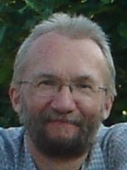
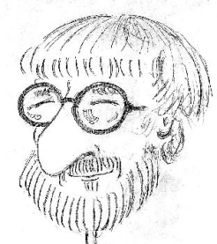
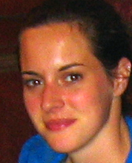
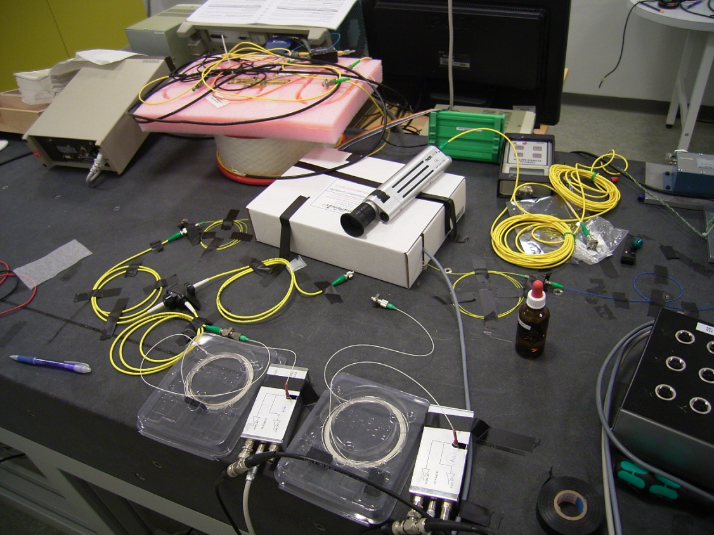
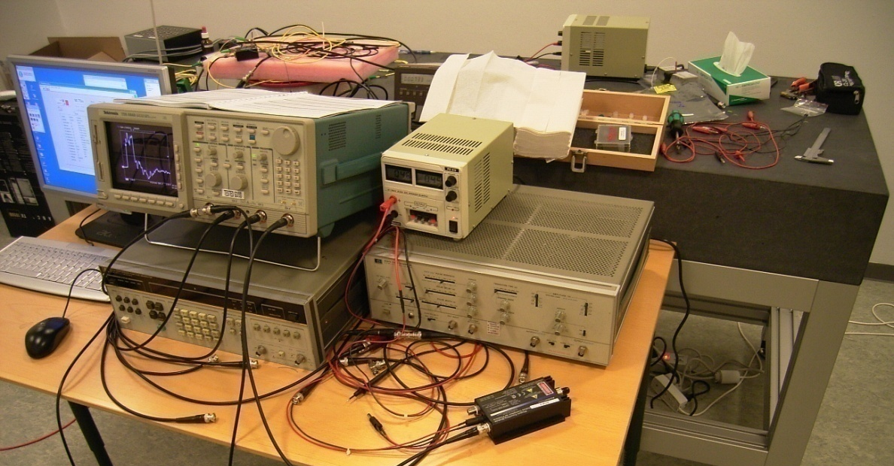
QUSEP Project:
[Sørensen Damgård Salvail
Lunemann Funder
University of Århus]
Bob
Alice
Notes:
QUantum protocols for SEcure computation in Practice

Slide 32
Conclusion
Intro to Quantum Mechanics
Quantum Key Distribution
Two-Party Quantum Cryptography
PIN-Based Identification secure against quantum-memory bounded Adversaries
1-2 OT
=
W
W

Slide 33






Conclusion
Quantum Cryptography is
practical !!
(at least more than you thought)
Thanks to
you!

Slide 34
Extension: Man-in-the-Middle Attack
P
i
W
P
i
n
W
n
K
e
y
K
K
e
y
K
nontrivial
Dishonest Alice or Bob can only exclude one possible PIN W
Eve learns nothing about W ?
✓


Slide 35
Extension: Man-in-the-Middle Attack
P
i
W
P
i
n
W
n
K
e
y
K
K
e
y
K
Dishonest Alice or Bob can only exclude one possible PIN W, even given key K
Eve learns nothing about W and
only negligible information about key K
✓
✓

Slide 36
Application: QKD
a
u
t
h
(
¢
)
K
K
e
y
K
K
e
y
K
=
(
K
0
S
K
)
=
(
K
0
S
K
)
;
;
a
u
t
h
(
¢
)
K
0

Slide 37
Problem: Eve interferes with communication
a
u
t
h
(
¢
)
K
K
e
y
K
K
e
y
K
=
(
K
0
S
K
)
=
(
K
0
S
K
)
;
;
t
h
(
)
honest players run out of authentication key
secure QKD no longer possible
a
u
K
0
¢

Slide 38
Solution: QKD based on Secure Identification
P
i
W
P
i
n
W
n
a
u
t
h
(
¢
)
K
K
e
y
K
K
e
y
K
=
?
=
?
K and W remain secure, can be re-used over and over again, even if scheme is disrupted
Losing key K does not compromise security
(if loss is noticed)
BUT: security holds only against a
quantum-memory bounded eavesdropper

