Slide 1


Quantum Cryptography
Christian Schaffner
Research Center for Quantum Software
Institute for Logic, Language and Computation (ILLC)
University of Amsterdam
Centrum Wiskunde & Informatica
Physics@FOM, Veldhoven
Wednesday, 20 January 2016

Slide 2
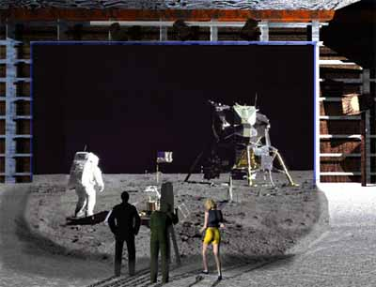
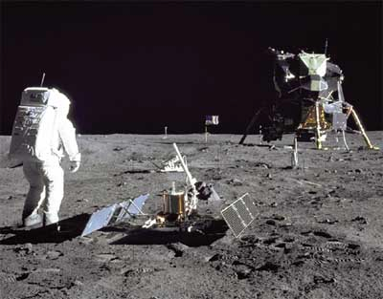
1969: Man on the Moon
The Great Moon-Landing Hoax?
NASA
http://www.unmuseum.org/moonhoax.htm
How can you prove that you are at a specific location?
Notes:
In 1969, man has first set foot on the moon, as you can see here on this picture sent around the world by NASA...
Or not? Maybe it was all just a “great moon-landing hoax”, as speculated on various conspiracy-theory websites on the internet?
One fascinating cryptographic question I want to study in my project is: “How can you prove that you are at a specific location?”
More about it later…

Slide 3
Talk Outline
Quantum Notation
Quantum Key Distribution
Position-Based Cryptography
Notes:
only scattered relations to logic, I’m afraid

Slide 4
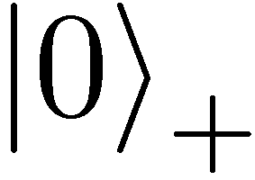
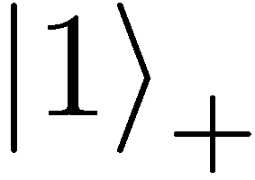
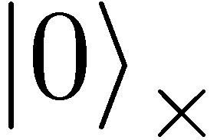
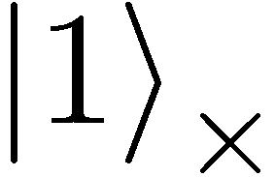
(Photonic) Quantum Mechanics
+ basis
£ basis
Measurements:
with prob. 1 yields 1
0/1
with prob. ½ yields 0
0/1
with prob. ½ yields 1

Slide 5
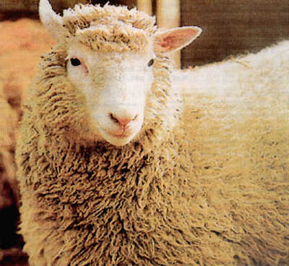
No-Cloning Theorem
U
Quantum operations:
?
?
?
Proof: copying is a non-linear operation
Notes:
information vs disturbance trade-off

Slide 6
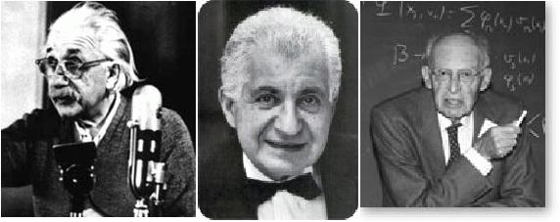



EPR Pairs
[Einstein Podolsky Rosen 1935]
prob. ½ : 0
prob. ½ : 1
EPR magic!
prob. 1 : 0
“spukhafte Fernwirkung” (spooky action at a distance)
EPR pairs do not allow to communicate
(no contradiction to relativity theory)
can provide a shared random bit

Slide 7
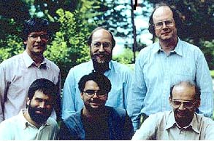

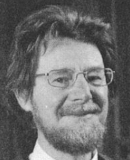




Quantum Teleportation
[Bennett Brassard Crépeau Jozsa Peres Wootters 1993]
?
[Bell]
?
?
quantum one-time pad encryption (applying a random Pauli operation)
does not contradict relativity theory
Bob can only recover the teleported qubit
after receiving the classical information ¾

Slide 8
Demonstration of Quantum Technology
generation of random numbers
50%
50%
(diagram from idQuantique white paper)
no quantum computation, only
quantum communication required

Slide 9
Talk Outline
Quantum Notation
Quantum Key Distribution
Position-Based Cryptography

Slide 10
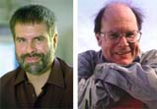

Quantum Key Distribution (QKD)
10
[Bennett Brassard 84]
Alice
Bob
k = ?
k = 0101 1011
Eve
k = 0101 1011
Offers an quantum solution to the key-exchange problem which does not rely on computational assumptions (such as factoring, discrete logarithms, etc.)
Puts the players into the starting position to use symmetric-key cryptography (encryption, authentication etc.).
Notes:
add link to BB84

Slide 11
Quantum Key Distribution (QKD)
11
[Bennett Brassard 84]
0 1 1 1 0
0 0 1 1 0
k = 110
k = 110

Slide 12
Quantum Key Distribution (QKD)
12
[Bennett Brassard 84]
?
?
?
?
?
0 1 1 1 0
0 0 1 1 0
k = ?
k = 10
k = 10
Quantum states are unknown to Eve, she cannot copy them.
Honest players can test whether Eve interfered.

Slide 13

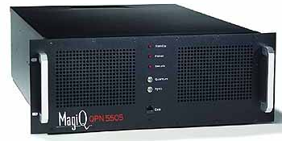
Quantum Key Distribution (QKD)
13
[Bennett Brassard 84]
Alice
Bob
Eve
technically feasible: no quantum computer required,
only quantum communication

Slide 14
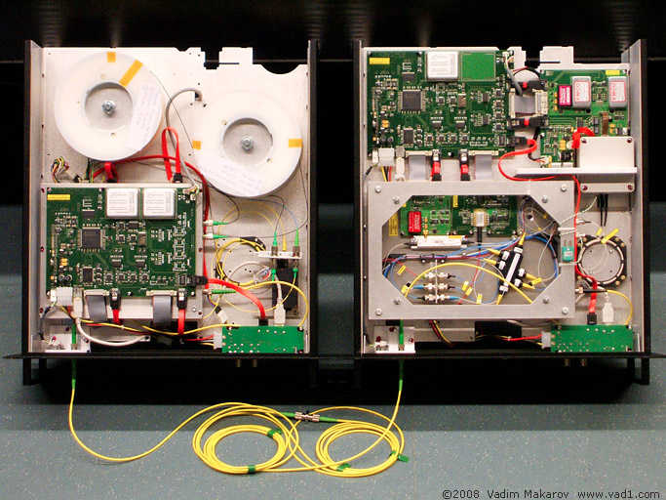
Quantum Key Distribution (QKD)
14
[Bennett Brassard 84]
Alice
Bob
Eve
technically feasible: no quantum computer required,
only quantum communication

Slide 15
What will you Learn from this Talk?
Introduction to Quantum Mechanics
Quantum Key Distribution
Position-Based Cryptography

Slide 16
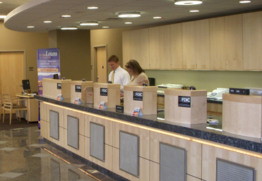
Position-Based Cryptography
Typically, cryptographic players use credentials such as
  secret information (e.g. password or secret key)
  authenticated information
  biometric features
Can the geographical location of a player be used
as cryptographic credential ?

Slide 17
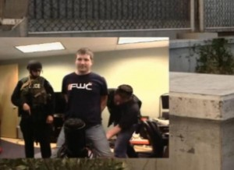
Position-Based Cryptography
Can the geographical location of a player be used as sole cryptographic credential ?
Possible Applications:
  Launching-missile command comes
  from within your military headquarters
  Talking to the correct assembly
  Pizza-delivery problem /
  avoid fake calls to emergency services
  …

Slide 18





Basic task: Position Verification
Verifier1
Prover
Verifier2
Prover wants to convince verifiers that she is at a particular position
no coalition of (fake) provers, i.e. not at the claimed position, can convince verifiers
(over)simplifying assumptions:
    communication at speed of light
    instantaneous computation
    verifiers can coordinate

Slide 19




Position Verification: First Try
Verifier1
Prover
Verifier2
time
distance bounding [Brands Chaum ‘93]

Slide 20
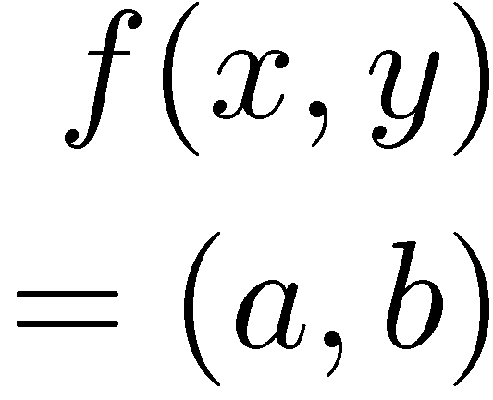


Position Verification: Second Try
Verifier1
Prover
Verifier2
position verification is classically impossible ! [Chandran Goyal Moriarty Ostrovsky 09]
Notes:
classical impossibility proof by [Chandran Goyal Moriarty Ostrovsky: CRYPTO ’09]

Slide 21


The Attack
copying classical information
this is impossible quantumly

Slide 22


Position Verification: Quantum Try
[Kent Munro Spiller 03/10]
?
?
?
Can we brake the scheme now?

Slide 23




Attacking Game
?
?
?
?
?
Impossible to cheat due to
no-cloning theorem
Or not?
It is possible to cheat with entanglement !!

Slide 24


Teleportation Attack
?
?
[Bell]
?
?
It is possible to cheat with entanglement !!
Quantum teleportation allows to
break the protocol perfectly.

Slide 25

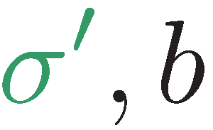
Teleportation Attack
?
?
[Bell]
[Bell]
?
?
It is possible to cheat with entanglement !!
Quantum teleportation allows to
break the protocol perfectly.

Slide 26
No-Go Theorem
[Buhrman, Chandran, Fehr, Gelles, Goyal, Ostrovsky, Schaffner 2010] [Beigi Koenig 2011]
Any position-verification protocol can be broken using an exponential number of entangled qubits.
Question: Are so many quantum resources really necessary?
Does there exist a protocol such that:
  honest prover and verifiers are efficient, but
  any attack requires lots of entanglement
see http://homepages.cwi.nl/~schaffne/positionbasedqcrypto.php for recent developments

Slide 27
Summary of Topics
Quantum Key Distribution (QKD)
Position-Based Cryptography

Slide 28
Thank you for your attention!
Questions

