Slide 1

Quantum Cryptography
Christian Schaffner
Institute for Logic, Language and Computation (ILLC)
University of Amsterdam
Centrum Wiskunde & Informatica
Bachelor vak cryptografie
Tuesday, 10 March 2015

Slide 2
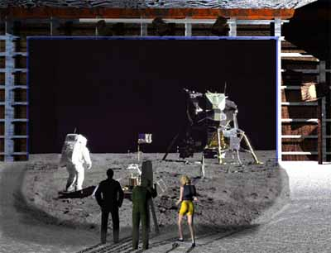
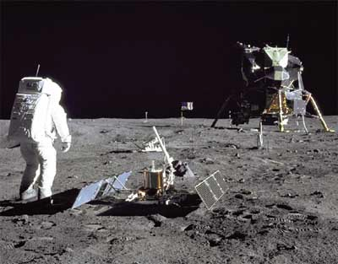
1969: Man on the Moon
The Great Moon-Landing Hoax?
NASA
http://www.unmuseum.org/moonhoax.htm
How can you prove that you are at a specific location?
Notes:
In 1969, man has first set foot on the moon, as you can see here on this picture sent around the world by NASA...
Or not? Maybe it was all just a “great moon-landing hoax”, as speculated on various conspiracy-theory websites on the internet?
One fascinating cryptographic question I want to study in my project is: “How can you prove that you are at a specific location?”
More about it later…

Slide 3
What will you learn from this Talk?
Recap of Classical Cryptography
Introduction to Quantum Mechanics
Post-Quantum Cryptography
Quantum Key Distribution
Position-Based Cryptography
Notes:
only scattered relations to logic, I’m afraid

Slide 4
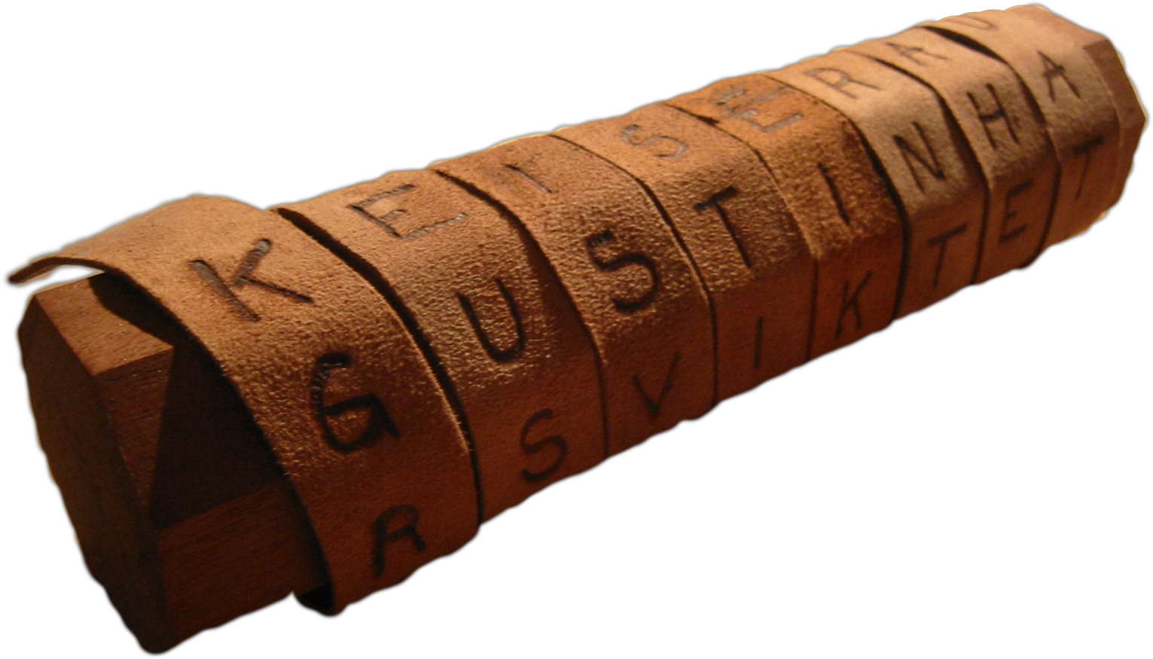
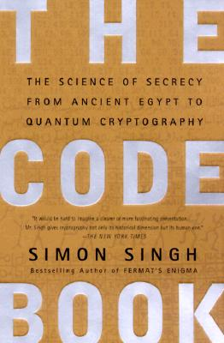
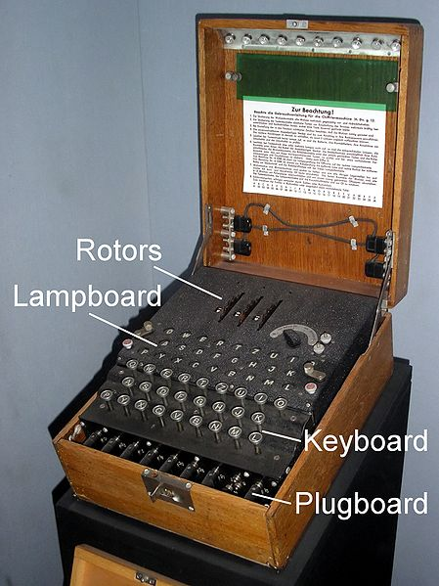
Classical Cryptography
3000 years of fascinating history
Until 1970: private communication was the only goal
Scytale
Enigma

Slide 5
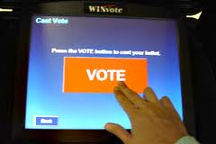
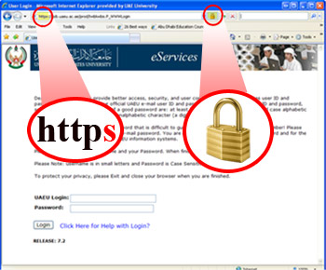
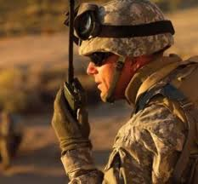
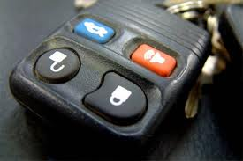
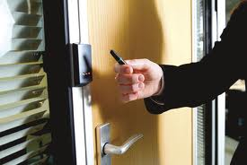
Modern Cryptography
is everywhere!
is concerned with all settings where people do not trust each other

Slide 6



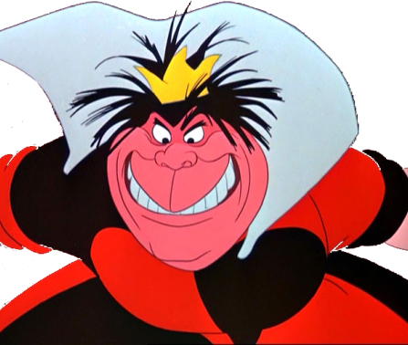
Secure Encryption
m = “I love you”
m = 0000 1111
Alice
Bob
k = ?
Eve
k = 0101 1011
k = 0101 1011
Goal: Eve does not learn the message
Setting: Alice and Bob share a secret key k

Slide 7
Quiz: eXclusive OR (XOR) Function
7
Which of the following are correct?
 | x | y | x © y
a.) | 10 | 01 | 10
b.) | 110 | 010 | 100
c.) | 0011 | 0100 | 0000
d.) | 1011 | 1101 | 0110
Notes:
quick check: please raise your hand if you have NOT seen this function before.
Please raise your hand if you HAVE seen this function before.
Now raise your hand if you have not raised your hand yet. For the people raising their hand now: you should seriously double-check the logic “axiom of the excluded middle”, asserting that either you HAVE seen this function before, or that you have NOT.

Slide 8
eXclusive OR (XOR) Function
8
x | y | x © y
0 | 0 | 0
1 | 0 | 1
0 | 1 | 1
1 | 1 | 0
Some properties:
  8 x : x © 0 = x
  8 x : x © x = 0
  ) 8 x,y : x © y © y = x
Notes:
quick check: please raise your hand if you have NOT seen this function before.
Please raise your hand if you HAVE seen this function before.
Now raise your hand if you have not raised your hand yet. For the people raising their hand now: you should seriously double-check the logic “axiom of the excluded middle”, asserting that either you HAVE seen this function before, or that you have NOT.

Slide 9
One-Time Pad Encryption
9
m = 0000 1111
c = m © k = 0101 0100
m = c © k = 0000 1111
Alice
Bob
k = ?
Eve
k = 0101 1011
k = 0101 1011
Goal: Eve does not learn the message
Setting: Alice and Bob share a key k
Recipe:
Is it secure?
x | y | x © y
0 | 0 | 0
0 | 1 | 1
1 | 0 | 1
1 | 1 | 0
m = 0000 1111
c = 0101 0100
k = 0101 1011
k = 0101 1011
c = m © k = 0101 0100
c © k = 0000 1111
c © k = m © k © k = m © 0 = m

Slide 10
Perfect Security
10
m = ?
c = m © k = 0101 0100
m = c © k = ?
Alice
Bob
k = ?
Eve
k = ?
k = ?
Given that c = 0101 0100,
  is it possible that m = 0000 0000 ?
    Yes, if k = 0101 0100.
  is it possible that m = 1111 1111 ?
    Yes, if k = 1010 1011.
  it is possible that m = 0101 0101 ?
    Yes, if k = 0000 0001
In fact, every m is possible.
Hence, the one-time pad is perfectly secure!
x | y | x © y
0 | 0 | 0
0 | 1 | 1
1 | 0 | 1
1 | 1 | 0

Slide 11
Problems With One-Time Pad
11
m = 0000 1111
c = m © k = 0101 0100
m = c © k = 0000 1111
Alice
Bob
k = ?
Eve
k = 0101 1011
k = 0101 1011
The key has to be as long as the message.
The key can only be used once.
In practice, other encryption schemes (such as AES) are used which allow to encrypt long messages with short keys.
One-time pad does not provide authentication:
Eve can easily flip bits in the message
Notes:
for encrypting internet traffic

Slide 12
Quiz: Encryption & Authentication
12
Which of the following are correct?
Secure encryption guarantees that an eavesdropper cannot learn a message.
Secure encryption guarantees that a message cannot be altered.
Authentication guarantees that an eavesdropper cannot learn a message.
Authentication detects altering of a message.

Slide 13
Symmetric-Key Cryptography
13
Alice
Bob
Eve
Encryption ensures secrecy:
Eve does not learn the message, e.g. one-time pad
Authentication ensures integrity:
Eve cannot alter the message
General problem: players have to exchange a key to start with

Slide 14
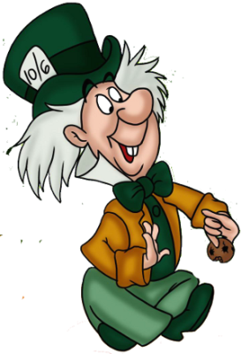
Public-Key Cryptography
14
Alice
Charlie
Bob
secret key
Eve
public key
Solves the key-exchange problem.
Everyone can encrypt using the public key.
Only the holder of the secret key can decrypt.
Digital signatures: Only secret-key holder can sign, but everyone can verify signatures using the public-key.

Slide 15
Quiz: RSA
15
Which of the following are correct?
RSA is a public-key encryption scheme.
The security of RSA encryption relies on the computational hardness of factoring large integer numbers.
The security of RSA encryption relies on the computational hardness of taking discrete logarithms in a finite field.
RSA encryption is secure against adversaries with unlimited computing power.

Slide 16
RSA Public-Key Encryption
16
Alice
Charlie
secret key
Eve
public key
Key generation: pick two large primes p and q, set N=p*q
public key: N, e 2 Z_{N}* , secret key: d = e⁻¹ mod Á(N)
Enc_{pk}(m) = m^{e} mod N
Dec_{sk}(c) = c^{d} mod N
security relies on the difficulty of factoring N, because Á(N)=(p-1)(q-1)

Slide 17
What will you Learn from this Talk?
Recap of Classical Cryptography
Introduction to Quantum Mechanics
Post-Quantum Cryptography
Quantum Key Distribution
Position-Based Cryptography

Slide 18
Quantum Bit: Polarization of a Photon
q
u
b
i
t
a
s
u
n
i
t
v
e
c
t
o
r
i
n
C
2

Slide 19
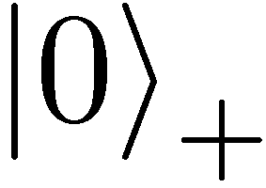
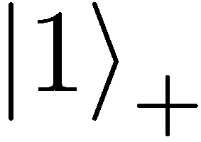
Qubit: Rectilinear/Computational Basis

Slide 20
Detecting a Qubit
No photons: 0
Alice
Bob

Slide 21
Measuring a Qubit
No photons: 0
Photons: 1
Alice
Bob
Measurement:
with prob. 1 yields 1
0/1

Slide 22
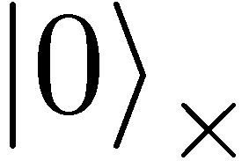
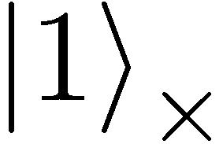

Diagonal/Hadamard Basis
Measurement:
with prob. ½ yields 0
=
with prob. ½ yields 1
0/1

Slide 23
Measuring Collapses the State
Measurement:
with prob. ½ yields 0
=
with prob. ½ yields 1
0/1

Slide 24
Measuring Collapses the State
=
=

Slide 25
Quantum Mechanics
+ basis
£ basis
Measurements:
with prob. 1 yields 1
0/1
with prob. ½ yields 0
0/1
with prob. ½ yields 1

Slide 26
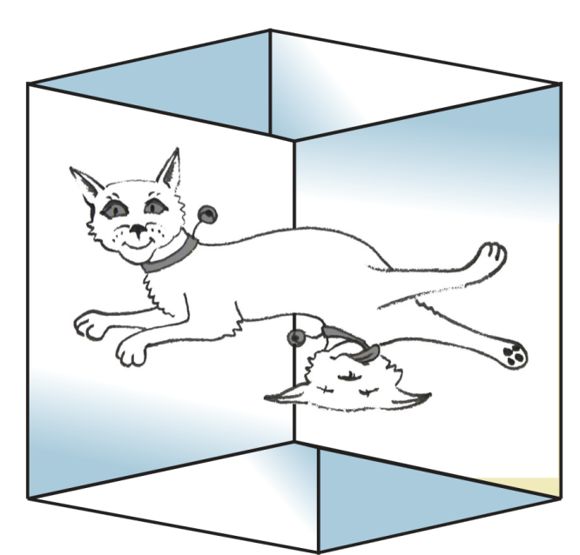
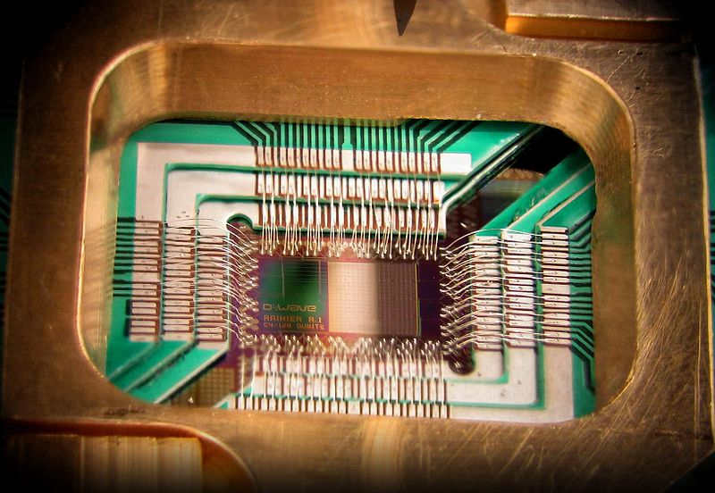

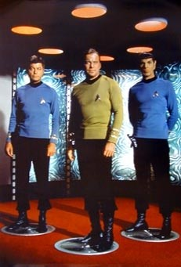
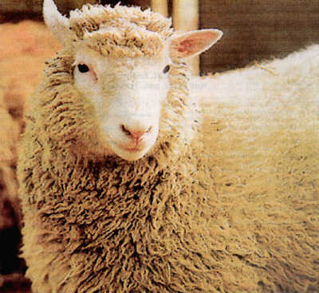
Wonderland of Quantum Mechanics

Slide 27
What will you Learn from this Talk?
Recap of Classical Cryptography
Introduction to Quantum Mechanics
Post-Quantum Cryptography
Quantum Key Distribution
Position-Based Cryptography

Slide 28


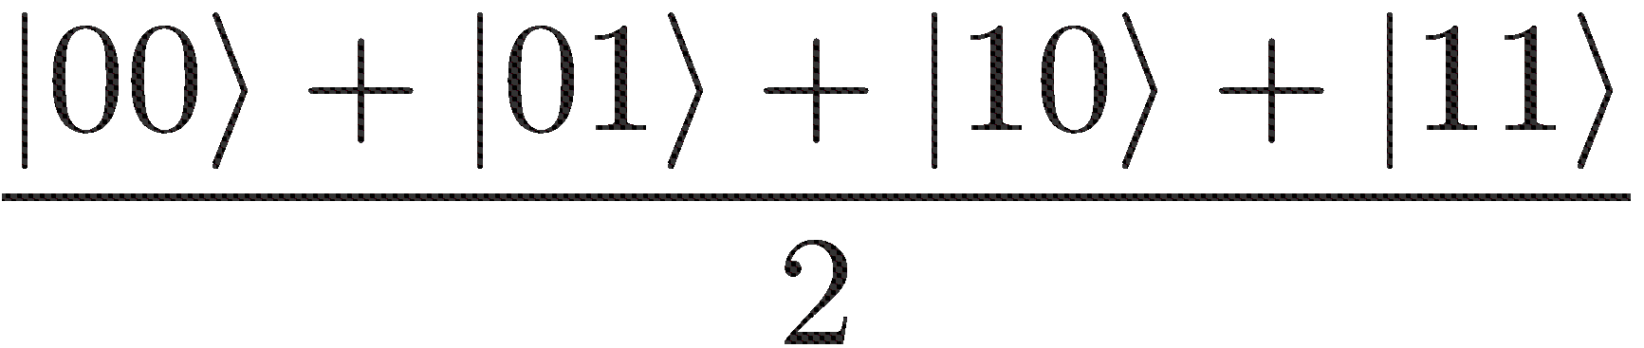

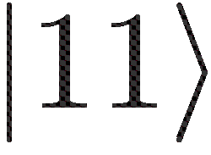
Many Qubits
=
1 qubit lives in a 2-dimensional space,
can be in a superposition of 2 states
2 qubits live in a 4-dimensional space,
can be in a superposition of 4 states
3 qubits can be in superposition of 8 states
n qubits can be in superposition of 2^{n} states
So, with 63 qubits, one can do
2⁶³ = 9223372036854775808 calculations simultaneously!
Problem: Measuring this huge superposition collapses everything and yields only one random outcome

Slide 29
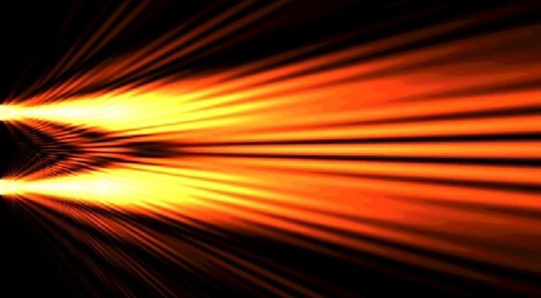
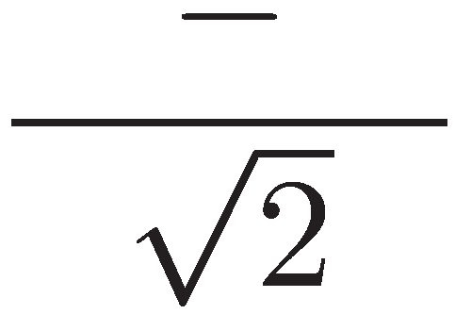
Quantum Computing
With n qubits, one can do 2^{n} calculations simultaneously
Problem: Measuring this huge superposition will collapse the state and only give one random outcome
Solution: Use quantum interference to measure the computation you are interested in!
=
seems to work for specific problems only

Slide 30
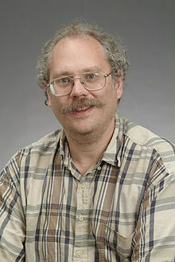
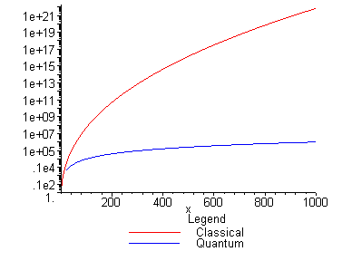
Quantum Algorithms: Factoring
[Shor ’94] Polynomial-time quantum algorithm for factoring integer numbers
Classical Computer : Exponential time
Quantum Computer : Poly-time: n²
For a 300 digit number:
    Classical: >100 years
    Quantum: 1 minute

Slide 31
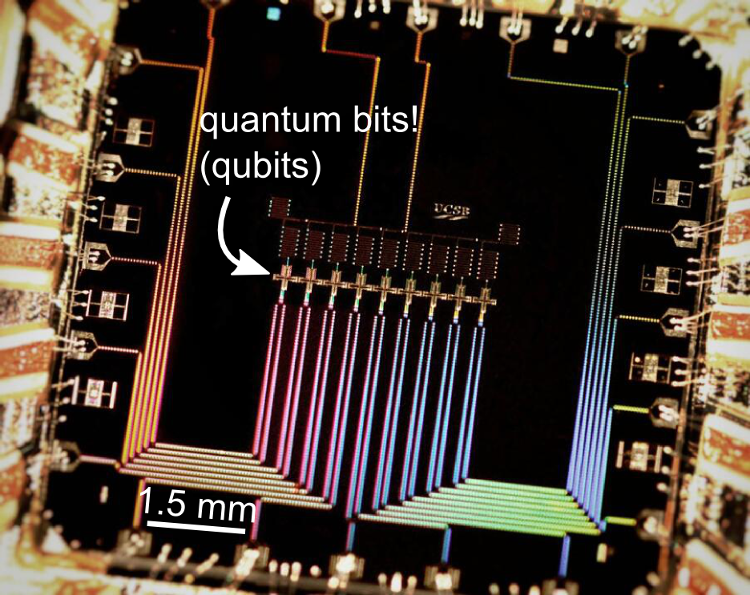
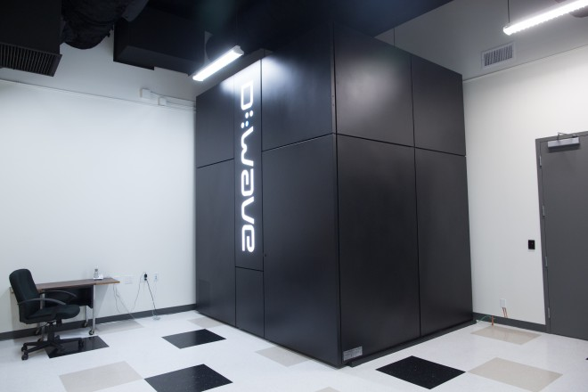

Can We Build Quantum Computers?
Possible to build in theory, no fundamental theoretical obstacles have been found yet.
Canadian company “D-Wave” claims to have build one. Did they?
2014: Martinis group recently “acquired” by Google
2014: QuTech centre in Delft
Martinis group (UCSB)
9 qubits

Slide 32
Post-Quantum Cryptography
[Shor ‘94] A large-scale quantum computer breaks most currently used public-key cryptography (everything based on factoring and discrete logarithms)
It is high time to think about alternative
computational problems which are hard
to solve also for quantum computers
Post-Quantum Cryptography studies
classical cryptographic schemes that remain
secure in the presence of quantum attackers.

Slide 33
Lattice-Based Cryptography
For any vectors v₁,…,v_{n} in R^{n},
the lattice spanned by v₁,…,v_{n}
is the set of points
L={a₁v₁+…+a_{n}v_{n}| a_{i} integers}
Shortest Vector Problem (SVP): given a lattice, find a shortest (nonzero) vector
2v₁
v₁+v₂
2v₂
v₁
v₂
2v₂-v₁
2v₂-2v₁
0

Slide 34
Lattice-Based Cryptography
v₂
v₁
3v₂-4v₁
0
Shortest Vector Problem (SVP): given a lattice, find a shortest (nonzero) vector
no efficient (classical or quantum) algorithms known
public-key encryption schemes can be built on the computational hardness of SVP

Slide 35
Quiz: Post-Quantum Crypto
35
Which of the following are correct?
Post-quantum cryptography uses quantum computers to do cryptography
Post-quantum cryptography studies which classical cryptoschemes remain secure against quantum attackers
Finding the shortest vector in a high-dimensional lattice is hard for a quantum computer
Quantum computers are commercially available
Large-scale quantum computers can never be built.

Slide 36
What will you Learn from this Talk?
Recap of Classical Cryptography
Introduction to Quantum Mechanics
Post-Quantum Cryptography
Quantum Key Distribution
Position-Based Cryptography

Slide 37
Demonstration of Quantum Technology
generation of random numbers
50%
50%
(diagram from idQuantique white paper)
no quantum computation, only
quantum communication required

Slide 38
No-Cloning Theorem
U
Quantum operations:
?
?
?
Proof: copying is a non-linear operation

Slide 39
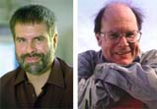
Quantum Key Distribution (QKD)
39
[Bennett Brassard 84]
Alice
Bob
k = ?
k = 0101 1011
Eve
k = 0101 1011
Offers an quantum solution to the key-exchange problem
Puts the players into the starting position to use symmetric-key cryptography (encryption, authentication etc.).

Slide 40
Quantum Key Distribution (QKD)
40
[Bennett Brassard 84]
0 1 1 1 0
0 0 1 1 0
k = 110
k = 110

Slide 41
Quantum Key Distribution (QKD)
41
[Bennett Brassard 84]
?
?
?
?
?
0 1 1 1 0
0 0 1 1 0
k = ?
k = 10
k = 10
Quantum states are unknown to Eve, she cannot copy them.
Honest players can test whether Eve interfered.

Slide 42
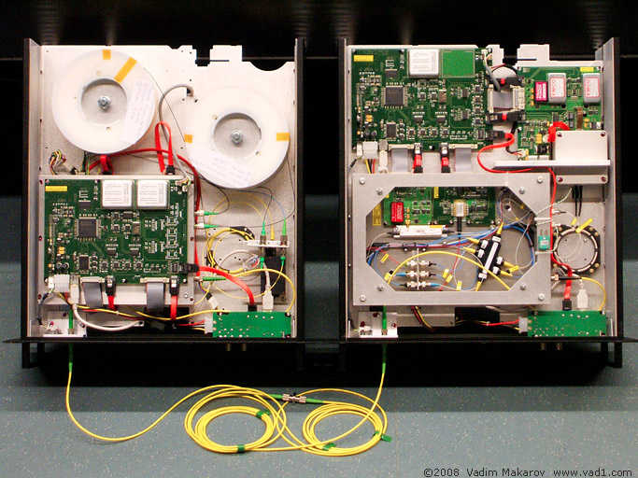

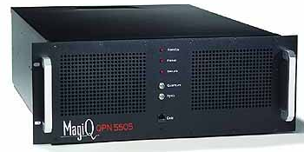
Quantum Key Distribution (QKD)
42
[Bennett Brassard 84]
Alice
Bob
Eve
technically feasible: no quantum computer required,
only quantum communication

Slide 43
Quiz: Quantum Key Distribution
43
Which of the following are correct?
The no-cloning theorem guarantees the security of quantum key distribution
A quantum computer is required to perform quantum key distribution
All public-key systems (e.g. RSA) can be broken by an eavesdropper with unlimited computing power. Hence, QKD is insecure against such eavesdroppers as well.
The output of QKD for honest players Alice and Bob is a shared classical key.
Notes:
quick check: please raise your hand if you have NOT seen this function before.
Please raise your hand if you HAVE seen this function before.
Now raise your hand if you have not raised your hand yet. For the people raising their hand now: you should seriously double-check the logic “axiom of the excluded middle”, asserting that either you HAVE seen this function before, or that you have NOT.

Slide 44
What will you Learn from this Talk?
Recap of Classical Cryptography
Introduction to Quantum Mechanics
Quantum Key Distribution
Post-Quantum Cryptography
Position-Based Cryptography

Slide 45
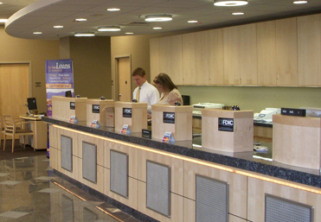
Position-Based Cryptography
Typically, cryptographic players use credentials such as
  secret information (e.g. password or secret key)
  authenticated information
  biometric features
Can the geographical location of a player be used
as cryptographic credential ?

Slide 46
Position-Based Cryptography
Can the geographical location of a player be used as sole cryptographic credential ?
Possible Applications:
  Launching-missile command comes
  from within the military headquarters
  Talking to the correct country
  Pizza-delivery problem /
  avoid fake calls to emergency services
  …

Slide 47
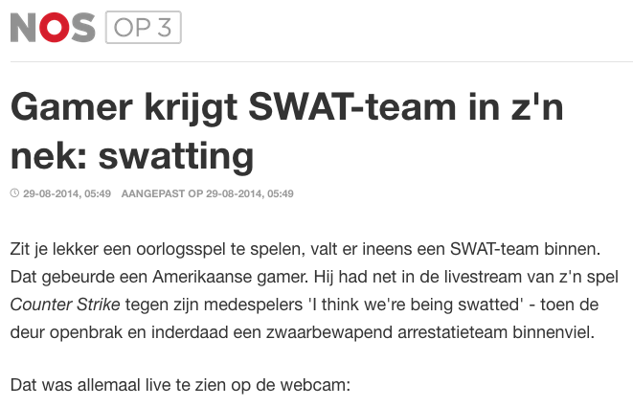
Position-Based Cryptography
http://nos.nl/op3/artikel/692138-gamer-krijgt-swatteam-in-zn-nek-swatting.html

Slide 48




Basic task: Position Verification
Verifier1
Prover
Verifier2
Prover wants to convince verifiers that she is at a particular position
no coalition of (fake) provers, i.e. not at the claimed position, can convince verifiers
assumptions:  communication at speed of light
            instantaneous computation
            verifiers can coordinate

Slide 49




Position Verification: First Try
Verifier1
Prover
Verifier2
time
distance bounding [Brands Chaum ‘93]

Slide 50
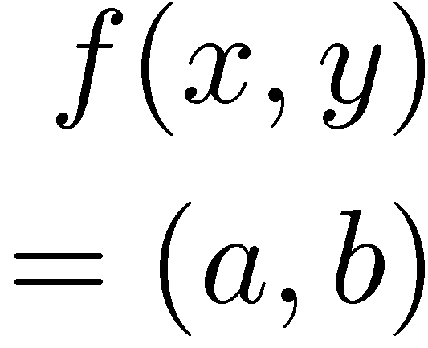


Position Verification: Second Try
Verifier1
Prover
Verifier2
position verification is classically impossible !
Notes:
classical impossibility proof by [Chandran Goyal Moriarty Ostrovsky: CRYPTO ’09]

Slide 51


The Attack
copying classical information
this is impossible quantumly

Slide 52


Position Verification: Quantum Try
[Kent Munro Spiller 03/10]
?
?
?
Can we brake the scheme now?

Slide 53




Attacking Game
?
?
?
?
?
Impossible to cheat due to non-cloning theorem
Or not?

Slide 54
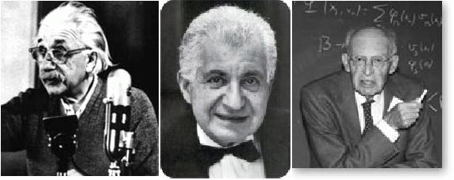
EPR Pairs
[Einstein Podolsky Rosen 1935]
prob. ½ : 0
prob. ½ : 1
EPR magic!
prob. 1 : 0
“spukhafte Fernwirkung” (spooky action at a distance)
EPR pairs do not allow to communicate
(no contradiction to relativity theory)
can provide a shared random bit

Slide 55
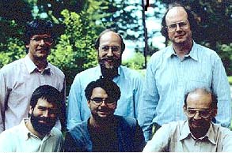
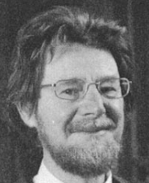




Quantum Teleportation
[Bennett Brassard Crépeau Jozsa Peres Wootters 1993]
?
[Bell]
?
?
does not contradict relativity theory
teleported state can only be recovered
once the classical information ¾ arrives

Slide 56
Teleportation Attack
?
?
?
[Bell]
[Bell]
?
?
It is possible to cheat with entanglement !!
Quantum teleportation allows to
break the protocol perfectly.

Slide 57
No-Go Theorem
[Buhrman, Chandran, Fehr, Gelles, Goyal, Ostrovsky, Schaffner 2010]
Any position-verification protocol can be broken using an exponential number of entangled qubits.
Question: Are so many quantum resources really necessary?
Does there exist a protocol such that:
  honest prover and verifiers are efficient, but
  any attack requires lots of entanglement

Slide 58
Quiz: Position-Based Q Crypto
58
Which of the following are correct?
Position verification using classical protocols is impossible against unbounded colluding attackers
Position verification using quantum protocols is impossible against unbounded colluding attackers
Quantum teleportation can send information faster than the speed of light
Entangled qubits are difficult to create in practice.
Entangled qubits are difficult to store for 1 second in practice.

Slide 59
What have you learned today?
Recap of Classical Cryptography
Introduction to Quantum Mechanics
Quantum Key Distribution
Post-Quantum Cryptography
Position-Based Cryptography

Slide 60
What Have You Learned from this Talk?
Recap of Classical Cryptography
  Long history
  One-time pad
  Public-key cryptography, e.g. RSA
m = 0000 1111
c = m © k = 0101 0100
Alice
Bob
k = ?
Eve
k = 0101 1011
k = 0101 1011

Slide 61
What Have You Learned from this Talk?
Quantum Mechanics
  Qubits
  No-cloning
  Entanglement
  Quantum Teleportation

Slide 62
What Have You Learned from this Talk?
Quantum Computing
Post-Quantum Cryptography
v₂
v₁
3v₂-4v₁
0

Slide 63
What Have You Learned from this Talk?
Quantum Key Distribution (QKD)
Position-Based Cryptography

Slide 64
Thank you for your attention!
Questions

Slide 65
Quiz: Quantum Crypto
65
Which of the following are correct?
Quantum Crypto studies the impact of quantum technology on the field of cryptography
As RSA encryption will be broken by quantum computers, we should switch to other systems already now (in order to secure information for more than 10 years)
Position-based cryptography exploits the fact that information cannot travel faster than the speed of light
Quantum Key Distribution is fundamentally more secure than classical public-key cryptography

Slide 66
Are There Secure Schemes?
Different quantum schemes proposed by
  Chandran, Fehr, Gelles, Goyal, Ostrovsky [2010]
  Malaney [2010]
  Kent, Munro, Spiller [2010]
  Lau, Lo [2010]
Unfortunately they can all be broken!
  General no-go theorem
  [Buhrman, Chandran, Fehr, Gelles, Goyal, Ostrovsky, Schaffner 2010]

Slide 67

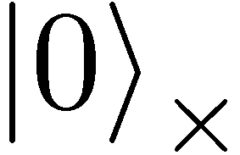
Quantum Operations
are linear isometries
can be described by a unitary matrix:
examples:
  identity
  bitflip (Pauli X): mirroring at axis
X
X
X
X

Slide 68

Quantum Operations
are linear isometries
can be described by a unitary matrix:
examples:
  identity
  bitflip (Pauli X): mirroring at axis
  phase-flip (Pauli Z): mirroring at axis
  both (Pauli XZ)
Z

Slide 69
Most General Single-Round Scheme
U
Let us study the attacking game

Slide 70
Distributed Q Computation in 1 Round
U
using some form of back-and-forth teleportation, players succeed with probability arbitrarily close to 1
requires an exponential amount of EPR pairs

Slide 71
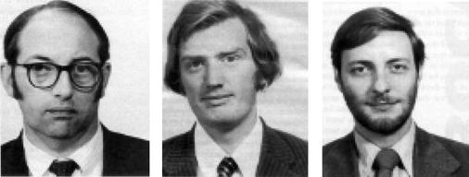


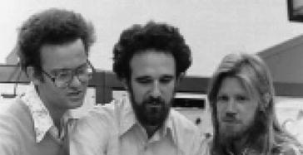
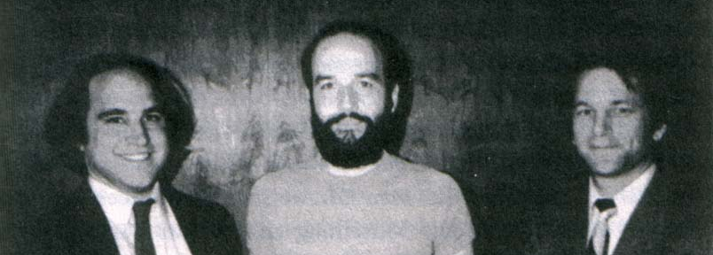
History of Public-Key Crypto
71
Early 1970s: invented in the „classified world“ at the
British Government Communications Head Quarters (GCHQ) by Ellis, Cocks, Williamson
Mid/late 1970s: invented in the „academic world“
by Merkle, Hellman, Diffie, and Rivest, Shamir, Adleman
Notes:
picture: http://link.springer.com/referenceworkentry/10.1007%2F978-1-4419-5906-5_210/fulltext.html#Fig2_210
James H. Ellis, Clifford C. Cocks, Malcolm J. Williamson (from left to right)
Ralph Merkle, Martin Hellman, Whitfield Diffie, (at Stanford)
and Ron Rivest, Adi Shamir, Leonard Adleman (at MIT)

