Slide 1
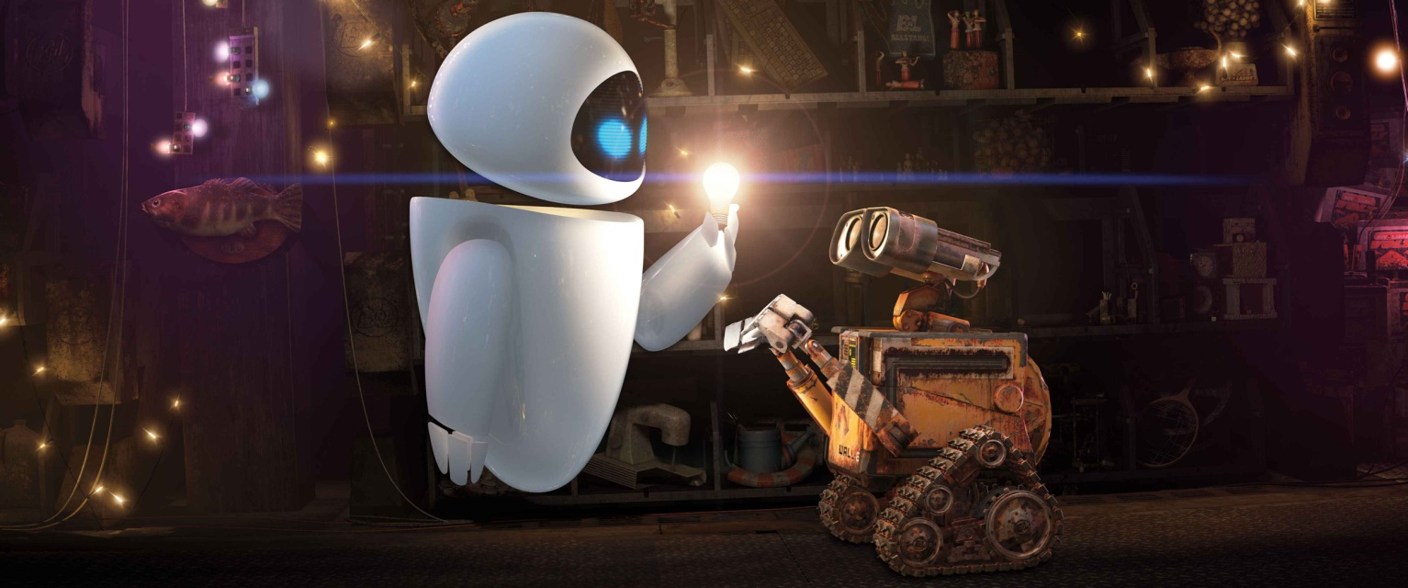
0
Zero
Knowledge Proofs(2)
Suzanne van Wijk & Maaike Zwart
MoL Research Project
Maaike Zwart, Suzanne van Wijk

Slide 2
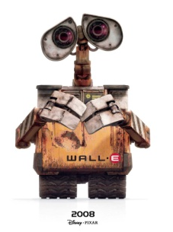

Last time
Interactive machines
?
!
Turing Machines
Interactive Proof Systems
Zero-Knowledge Proofs
MoL Research Project
Maaike Zwart, Suzanne van Wijk

Slide 3
Today
Perfect
Zero-Knowledge
Almost Perfect
Zero-Knowledge
Computational Zero-Knowledge
MoL Research Project
Maaike Zwart, Suzanne van Wijk

Slide 4
Come again?
Zero-Knowledge proofs: Proving a statement without revealing anything other than the validity of the claim.
‘I know where Waldo is’
‘I know the secret of the cave’
‘I know the 3-colouring of this graph’
‘These graphs are isomorphic’
MoL Research Project
Maaike Zwart, Suzanne van Wijk

Slide 5
Come again?
An interactive proof is zero-knowledge if the output can be simulated without interaction with the prover
Ali Baba’s brother pretending to know the secret
Simulator has to be polynomial time
MoL Research Project
Maaike Zwart, Suzanne van Wijk

Slide 6
Come again?
(Definition Perfect Zero-Knowledge)
MoL Research Project
Maaike Zwart, Suzanne van Wijk

Slide 7
Perfect Zero-Knowledge - Example
Graph Isomorphism
Input: graphs G and H
Claim: G and H are isomorphic (i.e., G = ψ(H))
Protocol:
Prover sends isomorphic copy F = φ(G) to the verifier
Verifier randomly selects G or H
Prover sends φ if verifier selected G and φ ◦ ψ otherwise
Verifier accepts when function received from prover is indeed an isomorphism between G (or H respectively) and F.
MoL Research Project
Maaike Zwart, Suzanne van Wijk

Slide 8
Perfect Zero-Knowledge - Example
Graph Isomorphism
Why is this an interactive proof system?
→ Homework!
Why is this a zero-knowledge proof?
MoL Research Project
Maaike Zwart, Suzanne van Wijk

Slide 9
Perfect Zero-Knowledge - Example
Why is this a zero-knowledge proof?
→ We need a simulator
For a verifier who follows the protocol
For a verifier who follows the protocol, but outputs the entire conversation.
MoL Research Project
Maaike Zwart, Suzanne van Wijk

Slide 10
Perfect Zero-Knowledge
Allows the simulator to sometimes not know.
Since the probability is ≤ ½, we can ask it to be negligable.
By enough repetitions
But the moment he does know, he’d better be very sure, since the two outputs have to be exactly the same.
MoL Research Project
Maaike Zwart, Suzanne van Wijk

Slide 11
Is perfection necessary?
Short answer: No.
Long answer: It is sufficient if they are similar enough.
How similar?
Why is this good enough?
MoL Research Project
Maaike Zwart, Suzanne van Wijk

Slide 12
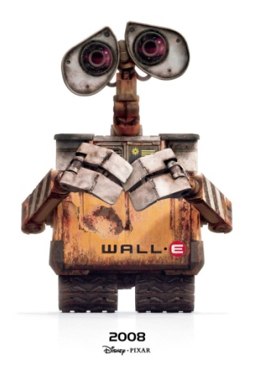
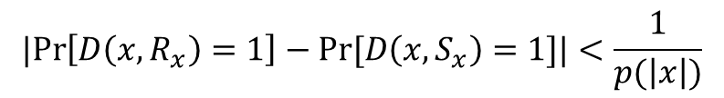
Computational indistinguishability
R?
S?
Two random variables are computationally indistinguishable if a polynomial-time algorithm cannot distinguish between them. So:
The output of the polynomial-time algorithm when working with R
The output of the polynomial-time algorithm when working with S
The difference in dealing with R and S…
…must be smaller than 1 devided by a polynomial
MoL Research Project
Maaike Zwart, Suzanne van Wijk

Slide 13
Computational Zero-Knowledge
(Note taking is advised!)
MoL Research Project
Maaike Zwart, Suzanne van Wijk

Slide 14
Computational Zero-Knowledge - Exercise
Show that allowing M to output a special symbol (like in Perfect ZK) with probability bounded above by ½ does not add to the power of this definition.
MoL Research Project
Maaike Zwart, Suzanne van Wijk

Slide 15
Compromise
We don’t actually need Perfect Zero-Knowledge…
…but we might want something more than Computational Zero-Knowledge
(because better is… well… better)
Almost-Perfect (Statistical) Zero-Knowledge
MoL Research Project
Maaike Zwart, Suzanne van Wijk

Slide 16
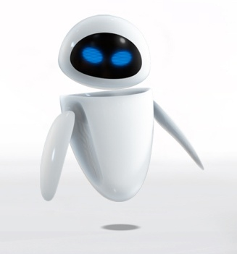

Statistically close functions
Ensembles are só close that even if one has infinite time, one couldn’t distinguish between them.
S?
R?
MoL Research Project
Maaike Zwart, Suzanne van Wijk

Slide 17
Almost-Perfect Zero-Knowledge
(Something more you might want to write down)
MoL Research Project
Maaike Zwart, Suzanne van Wijk

Slide 18
Perfect vs. Almost-Perfect vs. Computational
Exercise
Show that perfect zero-knowledge implies almost-perfect zero-knowledge, and that almost-perfect zero-knowledge implies computational zero-knowledge.
Perfect
Almost-Perfect
Computational
Homework!
MoL Research Project
Maaike Zwart, Suzanne van Wijk

Slide 19
Next Time
What can we use this for?!
Zero-knowledge proofs for ALL NP problems!
Last but not least: build your own zero-knowledge proof
MoL Research Project
Maaike Zwart, Suzanne van Wijk

