Slide 1
Enumerative Lattice Algorithms in any Norm via M-Ellipsoid Coverings
Daniel Dadush (CWI)
Joint with Chris Peikert and Santosh Vempala

Slide 2
Outline
Introduction: Classic Lattice Problems.
Results: Algorithms for SVP / CVP / IP.
Analysis of SVP algorithm.
How to build M-ellipsoid.
Conclusions / Open Problems.

Slide 3
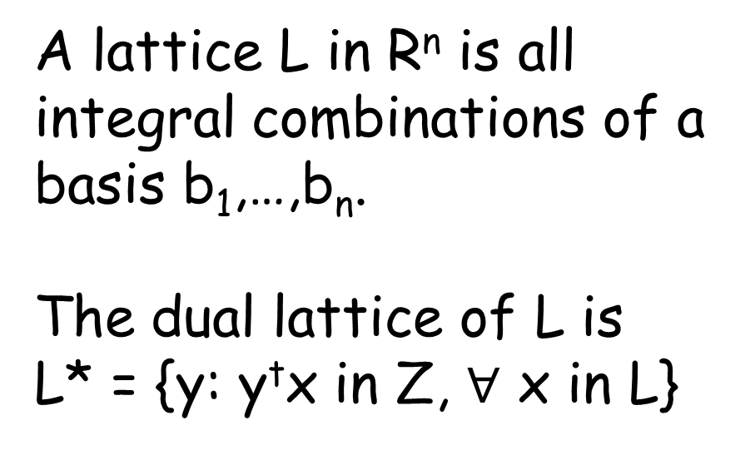
Lattices
A lattice L in R^{n} is all integral combinations of a basis b₁,…,b_{n}.
The dual lattice of L is
L* = {y: y^{t}x in Z, $∀$ x in L}
b₂
b₁
L

Slide 4
Shortest Vector Problem (SVP):
Given: lattice L, norm ||.|| in R^{n}.
Goal: Find y in L \ {0} minimizing ||y|| .
y
B
0
-y

Slide 5
Closest Vector Problem (CVP):
Given: lattice L, target x, norm ||.|| in R^{n}.
Goal: Find y in L minimizing ||y-x|| .
B
y
x

Slide 6
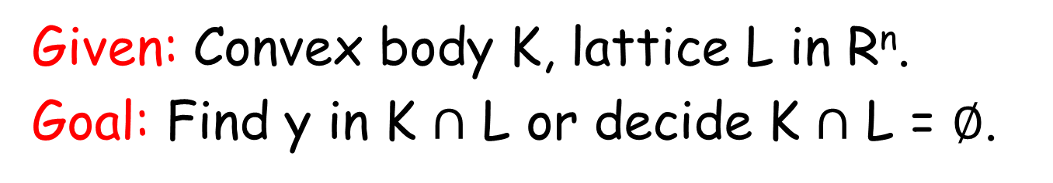
Integer Programming:
Given: Convex body K, lattice L in R^{n}.
Goal: Find y in K $∩$ L or decide K $∩$ L = $∅$.
K
y

Slide 7
Applications / Motivation
Algebra:
  Factoring polynomials, solving integer linear systems, diophantine approximation, etc.
Optimization:
  IP models many discrete optimization problems.
Cryptography:
  Many cryptographic primitives based on variants of SVP & CVP (LWE, SIS, etc.).
Geometry of Numbers:
  Rich interaction between lattices and convexity.

Slide 8
Hardness
  IP: NP-Hard.
  SVP: hard to approximate for all l_{p} norms within any constant factor [Ajt98, CN98, Mic98, Kho03,…].
  CVP: hard to approximated for all l_{p} norms within factor n^{c/loglogn} [ABSS93, DKRS98].
  Don’t expect to solve (or even closely approximate) any of these in polynomial time.

Slide 9
SVP / CVP Algorithms
Basis Reduction: 1980’s starts with LLL ‘83
Use Local Search on Bases + Exhaustive Search (iteratively) to to solve (approx-) SVP / CVP under l₂.
Randomized Sieve: 2000’s starts with AKS 01
Sample Exponentially many Lattice Points, Combine them to make shorter & shorter (closer & closer) lattice vectors.
Voronoi cell based: 2010 - Micciancio Voulgaris (MV)
Build Voronoi cell of Lattice and use it
to perform very efficient Lattice Point Search under l₂.

Slide 10
Algorithms: SVP
Norms | Approx | Time | Space | Random | Type | Authors
l₂ | 2^{O(n/logn)} | poly(n) | poly(n) | 0 | det. | LLL 83, Sch 87
l₂ | 1 | O(n)^{n/2e} | poly(n) | 0 | det. | Kan 87, Hel 86, Blo 00, HS 08
all | 1 | 2^{O(n)} | 2^{O(n)} | 2^{O(n)} | Monte Carlo | AKS 01, BN 07, AJ 09, D11
l₂ | 1 | 2^{O(n)} | 2^{O(n)} | 0 | det. | MV 10
all | 1 | 2^{O(n)} | 2^{O(n)} | poly(n) | Las Vegas | this paper
Basis Reduction Algorithms

Slide 11
Algorithms: SVP
Norms | Approx | Time | Space | Random | Type | Authors
l₂ | 2^{O(n/logn)} | poly(n) | poly(n) | 0 | det. | LLL 83, Sch 87
l₂ | 1 | O(n)^{n/2e} | poly(n) | 0 | det. | Kan 87, Hel 86, Blo 00, HS 08
all | 1 | 2^{O(n)} | 2^{O(n)} | 2^{O(n)} | Monte Carlo | AKS 01, BN 07, AJ 09, D11
l₂ | 1 | 2^{O(n)} | 2^{O(n)} | 0 | det. | MV 10
all | 1 | 2^{O(n)} | 2^{O(n)} | poly(n) | Las Vegas | this paper
Randomized Sieving Algorithms

Slide 12
Algorithms: SVP
Norms | Approx | Time | Space | Random | Type | Authors
l₂ | 2^{O(n/logn)} | poly(n) | poly(n) | 0 | det. | LLL 83, Sch 87
l₂ | 1 | O(n)^{n/2e} | poly(n) | 0 | det. | Kan 87, Hel 86, Blo 00, HS 08
all | 1 | 2^{O(n)} | 2^{O(n)} | 2^{O(n)} | Monte Carlo | AKS 01, BN 07, AJ 09, D11
l₂ | 1 | 2^{O(n)} | 2^{O(n)} | 0 | det. | MV 10
all | 1 | 2^{O(n)} | 2^{O(n)} | poly(n) | Las Vegas | this paper
Voronoi cell based

Slide 13
Algorithms: SVP
Norms | Approx | Time | Space | Random | Type | Authors
l₂ | 2^{O(n/logn)} | poly(n) | poly(n) | 0 | det. | LLL 83, Sch 87
l₂ | 1 | O(n)^{n/2e} | poly(n) | 0 | det. | Kan 87, Hel 86, Blo 00, HS 08
all | 1 | 2^{O(n)} | 2^{O(n)} | 2^{O(n)} | Monte Carlo | AKS 01, BN 07, AJ 09, D11
l₂ | 1 | 2^{O(n)} | 2^{O(n)} | 0 | det. | MV 10
all | 1 | 2^{O(n)} | 2^{O(n)} | poly(n) | Las Vegas | this paper
Remarks: Output is guaranteed (Las Vegas).
Randomness only used to preprocess norm.
Deterministic for l_{p} norms.

Slide 14
Algorithms: CVP
Norms | Approx | Time | Space | Random | Type | Authors
l₂ | 2^{O(n/logn)} | poly(n) | poly(n) | 0 | det. | LLL 83, Bab 86 Sch 87
l₂ | 1 | O(n)^{n/2} | poly(n) | 0 | det. | Kan 87, Hel 86, Blo 00, HS 08
all | 1+ | (1/)^{O(n)} | (1/)^{O(n)} | (1/)^{O(n)} | Monte Carlo | AKS 01-02, BN 07, AJ 09, D11
“ | 1 | * d^{O(n)} | d^{O(n)} | d^{O(n)} | “ | “
l₂ | 1 | 2^{O(n)} | 2^{O(n)} | 0 | det. | MV 10
all | 1 | * d^{O(n)} | 2^{O(n)} | poly(n) | Las Vegas | this paper
* assume distance to target ≤ d x (length of SVP)

Slide 15

Flatness Theorem and IP
Flatness Theorem: Either (K+t) $∩$ L $≠∅ ∀$t, or there exists y in L*\{0} such that
width_{K}(y) = max_{x  K} y^{t}x – min_{x  K} y^{t}x $≤$f(n)
L
y
K
y^{t}x=0
y^{t}x=1
y^{t}x=2

Slide 16
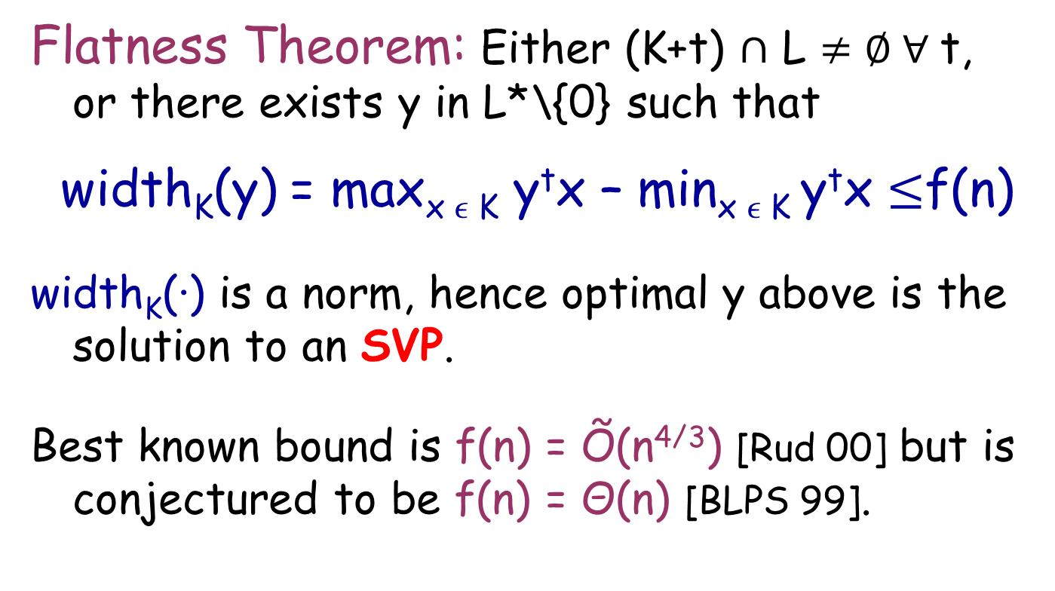
Flatness Theorem and IP
Flatness Theorem: Either (K+t) $∩$ L $≠∅ ∀$t, or there exists y in L*\{0} such that
width_{K}(y) = max_{x  K} y^{t}x – min_{x  K} y^{t}x $≤$f(n)
width_{K}(·) is a norm, hence optimal y above is the solution to an SVP.
Best known bound is f(n) = Õ(n^{4/3}) [Rud 00] but is conjectured to be f(n) = Θ(n) [BLPS 99].

Slide 17
Algorithms: IP
Feasible Region | Time | Space | Type | Authors
LP | 2^{O(n3)} | poly(n) | det. | Lenstra 83
LP | O(n)^{2.5n} | poly(n) | det. | Kannan 87
Quasiconvex Polynomials | O(n)^{2n} | 2^{O(n)} | det. | Hildebrand Köppe 10
Separation Oracle | Õ(n)^{4/3n} | 2^{O(n)} | Las Vegas | this paper

Slide 18
Algorithms: IP
Feasible Region | Time | Space | Type | Authors
LP | 2^{O(n3)} | poly(n) | det. | Lenstra 83
LP | O(n)^{2.5n} | poly(n) | det. | Kannan 87
Quasiconvex Polynomials | O(n)^{2n} | 2^{O(n)} | det. | Hildebrand Köppe 10
Separation Oracle | Õ(n)^{4/3n} | 2^{O(n)} | Las Vegas | this paper
Lenstra: Any n dimensional IP can be reduced to bounded number of n-1 dimensional IPs by computing a “flatness” direction of the feasible region.

Slide 19
Algorithms: IP
Feasible Region | Time | Space | Type | Authors
LP | 2^{O(n3)} | poly(n) | det. | Lenstra 83
LP | O(n)^{2.5n} | poly(n) | det. | Kannan 83
Quasiconvex Polynomials | O(n)^{2n} | 2^{O(n)} | det. | Hildebrand Köppe 10
Separation Oracle | Õ(n)^{4/3n} | 2^{O(n)} | Las Vegas | this paper
Lenstra: Computing a “flatness” direction corresponds to solving a general norm SVP on the dual lattice with respect to width norm of feasible region.

Slide 20
Algorithms: IP
Feasible Region | Time | Space | Type | Authors
LP | 2^{O(n3)} | poly(n) | det. | Lenstra 83
LP | O(n)^{2.5n} | poly(n) | det. | Kannan 83
Quasiconvex Polynomials | O(n)^{2n} | 2^{O(n)} | det. | Hildebrand Köppe 10
Separation Oracle | Õ(n)^{4/3n} | 2^{O(n)} | Las Vegas | this paper
Improvement: Make reduction more efficient by directly solving general norm SVP problem. Avoids loss due the ellipsoidal approximation of the feasible region used in previous works.

Slide 21
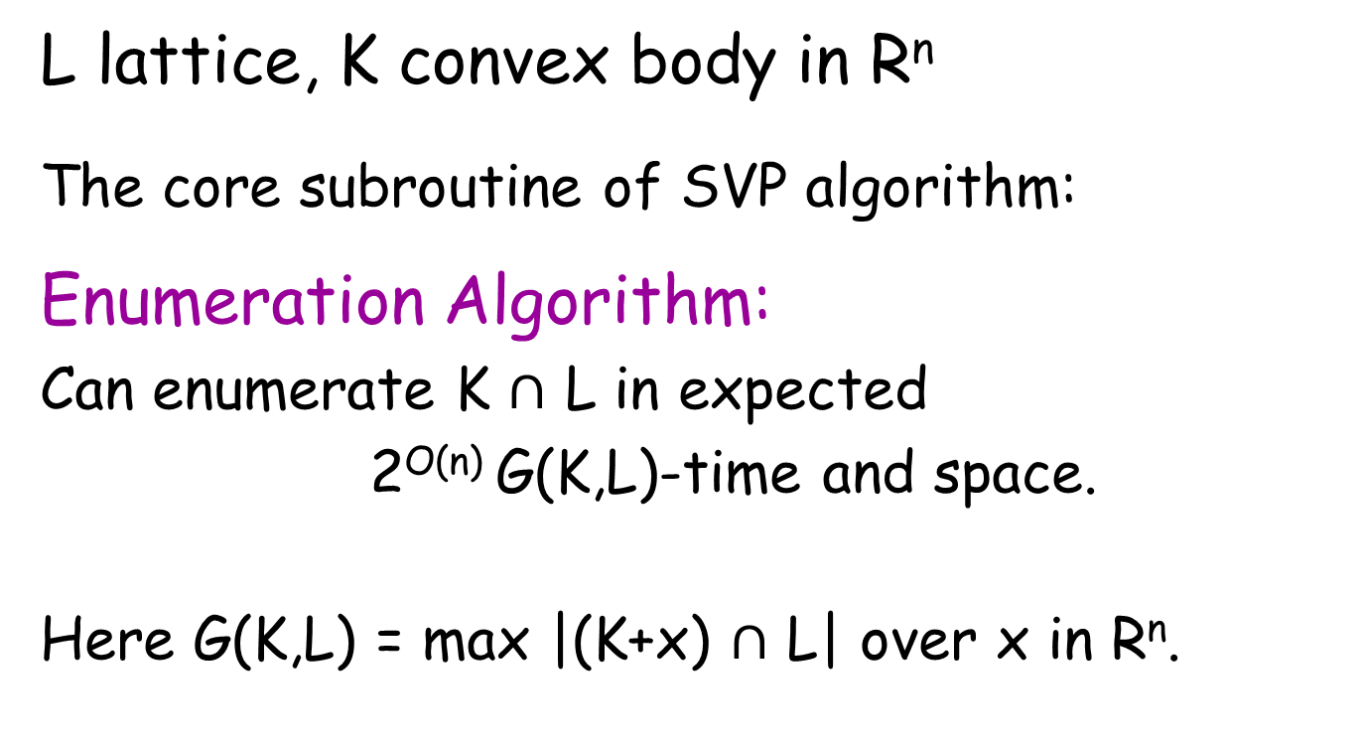
Core Algorithm
L lattice, K convex body in R^{n}
The core subroutine of SVP algorithm:
Enumeration Algorithm:
Can enumerate K $∩$ L in expected
2^{O(n)} G(K,L)-time and space.
Here G(K,L) = max |(K+x) $∩$ L| over x in R^{n}.

Slide 22
SVP Algorithm
Goal: Find y in L\{0} minimizing ||y||
y
B
0
-y

Slide 23
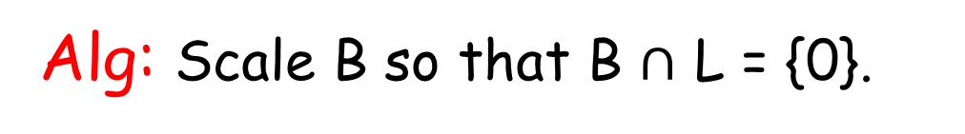
SVP Algorithm
Alg: Scale B so that B $∩$ L = {0}.
B
0

Slide 24
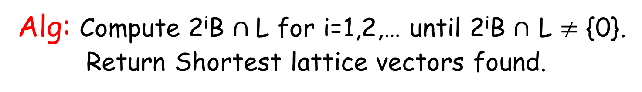
SVP Algorithm
Alg: Compute 2^{i}B $∩$L for i=1,2,… until 2^{i}B $∩$ L $≠$ {0}.
Return Shortest lattice vectors found.
y
4B
2B
B
0
-y

Slide 25
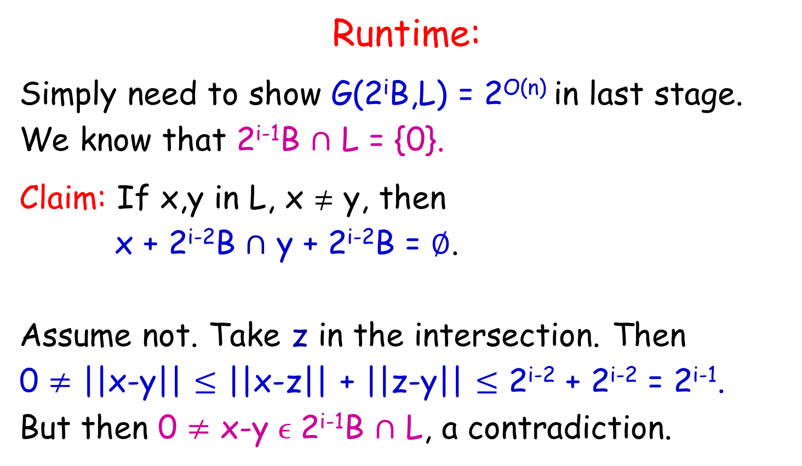
SVP Algorithm
Runtime:
Simply need to show G(2^{i}B,L) = 2^{O(n)} in last stage.
We know that 2^{i-1}B $∩$ L = {0}.
Claim: If x,y in L, x  y, then
x + 2^{i-2}B $∩$ y + 2^{i-2}B = $∅$.
Assume not. Take z in the intersection. Then
0 $≠$ ||x-y|| $≤$ ||x-z|| + ||z-y|| $≤$ 2^{i-2} + 2^{i-2} = 2^{i-1}.
But then 0 $≠$ x-y  2^{i-1}B $∩$ L, a contradiction.
2^{i-2}B
x
y

Slide 26
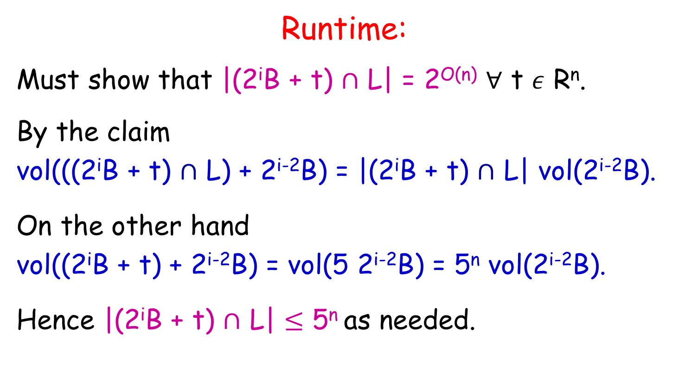
SVP Algorithm
Runtime:
Must show that |(2^{i}B + t) $∩$ L| = 2^{O(n)} $∀$ t $ε$ R^{n}.
By the claim
vol(((2^{i}B + t) $∩$ L) + 2^{i-2}B) = |(2^{i}B + t) $∩$ L| vol(2^{i-2}B).
On the other hand
vol((2^{i}B + t) + 2^{i-2}B) = vol(5 2^{i-2}B) = 5^{n} vol(2^{i-2}B).
Hence |(2^{i}B + t) $∩$ L| $≤$ 5^{n} as needed.

Slide 27
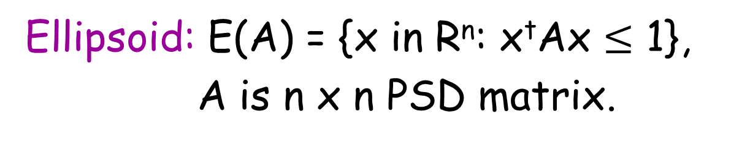
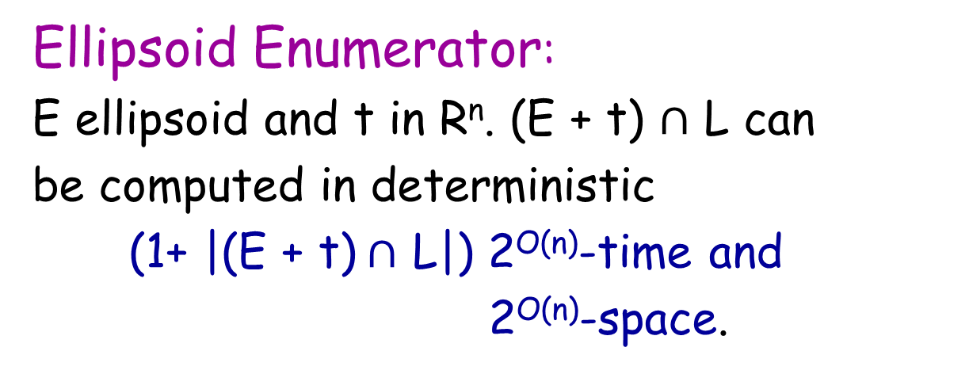
Enumeration Algorithm:
Ellipsoid: E(A) = {x in R^{n}: x^{t}Ax $≤$ 1},
A is n x n PSD matrix.
Ellipsoid Enumerator:
E ellipsoid and t in R^{n}. (E + t) $∩$ L can
be computed in deterministic
(1+ |(E + t)$∩$ L|) 2^{O(n)}-time and
2^{O(n)}-space.
This is a slight tweak of the Micciancio-Voulgaris algorithm for CVP.

Slide 28
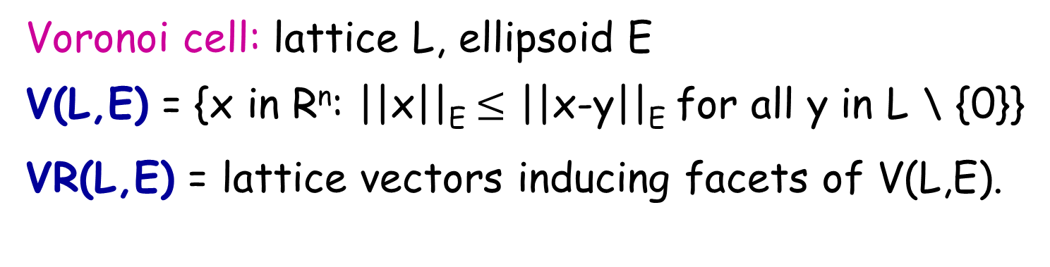
MV: Voronoi Cell
Voronoi cell: lattice L, ellipsoid E
V(L,E) = {x in R^{n}: ||x||_{E} $≤$ ||x-y||_{E} for all y in L \ {0}}
VR(L,E) = lattice vectors inducing facets of V(L,E).
e₂
V
VR(Z²,B₂) = {e_{1,} e₂}
0
e₁
-e₁
-e₂

Slide 29

MV: Enumeration in an Ellipsoid
Goal: Compute (E + t) $∩$ L
E+t
L
t

Slide 30
MV: Enumeration in an Ellipsoid
Alg: Solve CVP for L, t under norm of E.
E+t
L
t
x

Slide 31
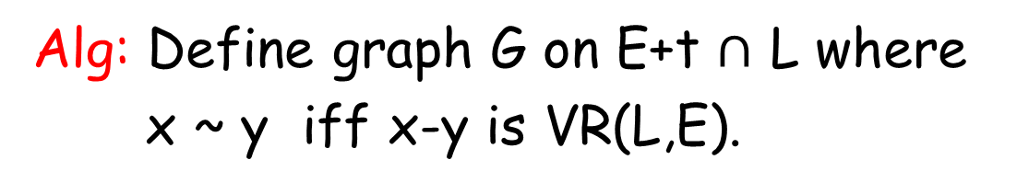
MV: Enumeration in an Ellipsoid
Alg: Define graph G on E+t $∩$ L where
x ~ y iff x-y is VR(L,E).
E+t
L
t
x

Slide 32

MV: Enumeration in an Ellipsoid
Alg: Perform a DFS on G $∩$ (E+t) starting from x to find remaining points.
E+t
L
t
x

Slide 33
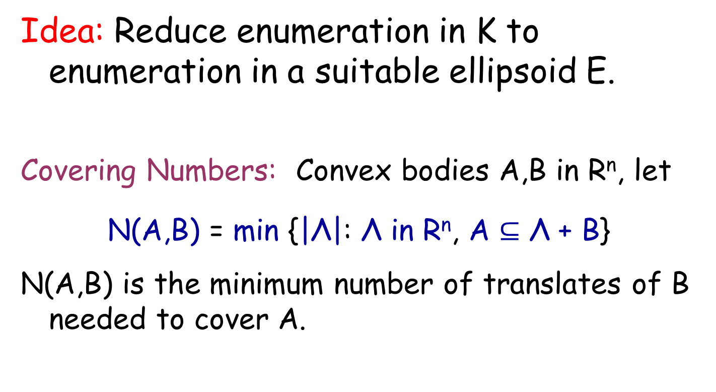
Enumeration Algorithm:
Idea: Reduce enumeration in K to enumeration in a suitable ellipsoid E.
Covering Numbers: Convex bodies A,B in R^{n}, let
N(A,B) = min {|Λ|: Λ in R^{n}, A $⊆$ Λ + B}
N(A,B) is the minimum number of translates of B needed to cover A.

Slide 34
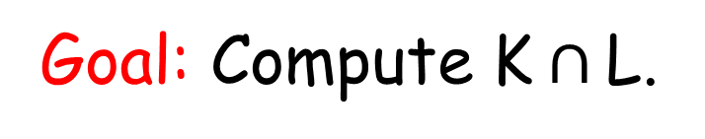
Enumeration Algorithm
Goal: Compute K$∩$L.
L
K

Slide 35
Enumeration Algorithm
Alg: Compute Covering of K by E
E+t_{i}
L
t3
t6
t2
K
t5
t1
t4

Slide 36

Enumeration Algorithm
Alg: Compute (E+t_{i}) $∩$ L $∀$i.
E+t_{i}
L
t3
t6
t2
K
t5
t1
t4

Slide 37
Enumeration Algorithm
Alg: Compute (E+t_{i}) $∩$ L $∀$i.
L
K

Slide 38
Enumeration Algorithm
Alg: Keep only the points in K.
L
K

Slide 39
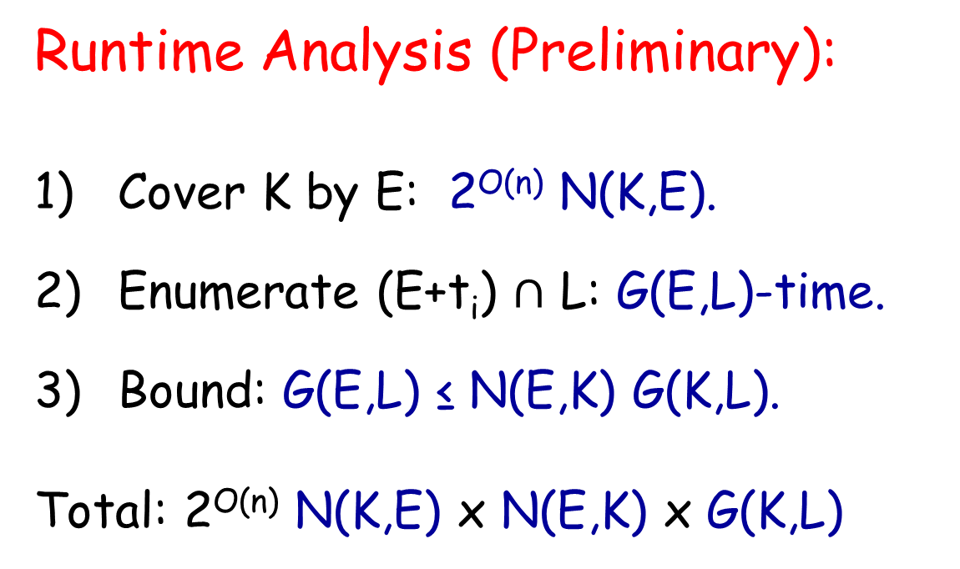
Enumeration Algorithm
Runtime Analysis (Preliminary):
Cover K by E: 2^{O(n)} N(K,E).
Enumerate (E+t_{i}) $∩$ L: G(E,L)-time.
Bound: G(E,L) ≤ N(E,K) G(K,L).
Total: 2^{O(n)} N(K,E) x N(E,K) x G(K,L)

Slide 40
The M-Ellipsoid
Need to bound N(K,E) x N(E,K).
What ellipsoid do we use for E?
An M-Ellipsoid of K is an ellipsoid E satisfying
N(K,E) = 2^{O(n)}.
N(E,K) = 2^{O(n)}.
Existence first proven by Milman ‘86.
How do we build it? Want Las Vegas algorithm.

Slide 41
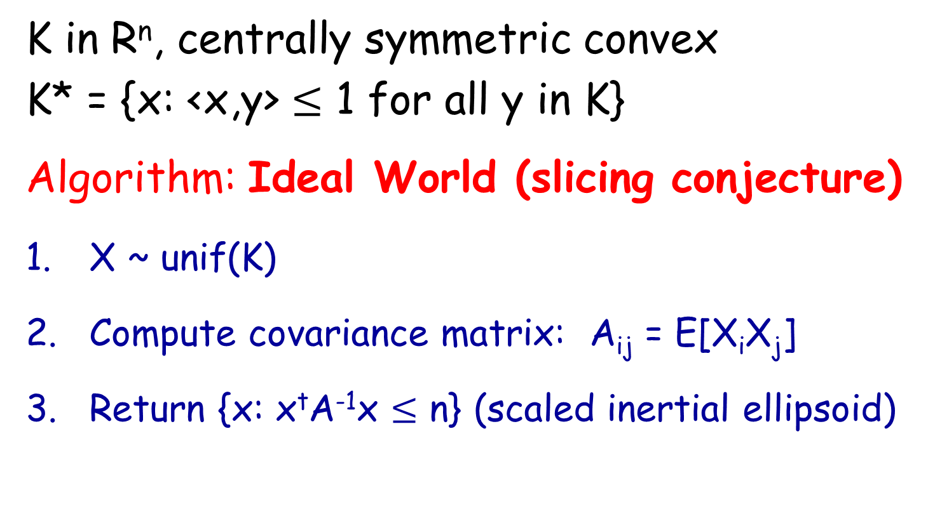
Klartag’s Procedure [K06]
K in R^{n}, centrally symmetric convex
K* = {x: <x,y> $≤$ 1 for all y in K}
Algorithm: Ideal World (slicing conjecture)
X ~ unif(K)
Compute covariance matrix: A_{ij} = E[X_{i}X_{j}]
Return {x: x^{t}A⁻¹x $≤$ n} (scaled inertial ellipsoid)

Slide 42
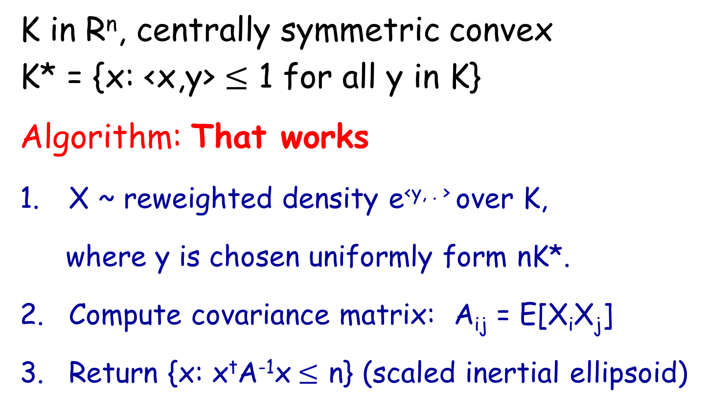
Klartag’s Procedure [K06]
K in R^{n}, centrally symmetric convex
K* = {x: <x,y> $≤$ 1 for all y in K}
Algorithm: That works
X ~ reweighted density e^{<y, . >} over K,
where y is chosen uniformly form nK*.
Compute covariance matrix: A_{ij} = E[X_{i}X_{j}]
Return {x: x^{t}A⁻¹x$≤$ n} (scaled inertial ellipsoid)

Slide 43
M-ellipsoid
M-Ellipsoid Generator:
Can generate an M-ellipsoid E for a convex body K in probabilistic polynomial time with high probability.
Given candidate M-ellipsoid E of K, we need to verify that it satisfies the desired covering properties.
M-Ellipsoid Verifier:
There is a deterministic 2^{O(n)}-time algorithm which verifies that E is an M-ellipsoid of K and outputs a covering of K by E.

Slide 44
Building an M-Ellipsoid covering
Idea: Replace E by C, the inscribed cuboid.
E
C

Slide 45
Building an M-Ellipsoid covering
Alg: Tile K by C using a DFS of tiling graph.
If the tiling grows too large abort.
C+t_{i}
t3
t6
t2
K
t5
t1
t4

Slide 46
Building an M-Ellipsoid covering
Alg: Replace C by E.
E+t_{i}
t3
t6
t2
K
t5
t1
t4

Slide 47
Building an M-Ellipsoid covering
Alg: Output the t_{i}’s
E+t_{i}
t3
t6
t2
K
t5
t1
t4

Slide 48
Building an M-Ellipsoid covering
How do we verify N(E,K) = 2^{O(n)}?
Don’t know how to do this directly.
Idea: use duality of entropy
N(E,K) ~= N((K-K)*,E*)
Apply previous algorithm to get an existential proof.

Slide 49
Conclusions
Give new lattice point enumeration procedure (should be useful elsewhere).
Apply it to give first Las Vegas 2^{O(n)}-time algorithm for SVP under general norms.
Improve complexity of IP.
Introduce use of the M-ellipsoid into design of lattice algorithms.

Slide 50
Open Problems
Time vs Space Tradeoff: What can we do with 2^{O(n)} –space, for 0 <  < 1? (even for l₂)
Las Vegas algorithm for (1+eps)-CVP?
Compute N(E,K) directly (avoid duality of entropy)?
Solve IP in O(n)^{(1-)n}-time, for any fixed  > 0. (more powerful Flatness Theorem?)

Slide 51
THANK YOU!

