Slide 1
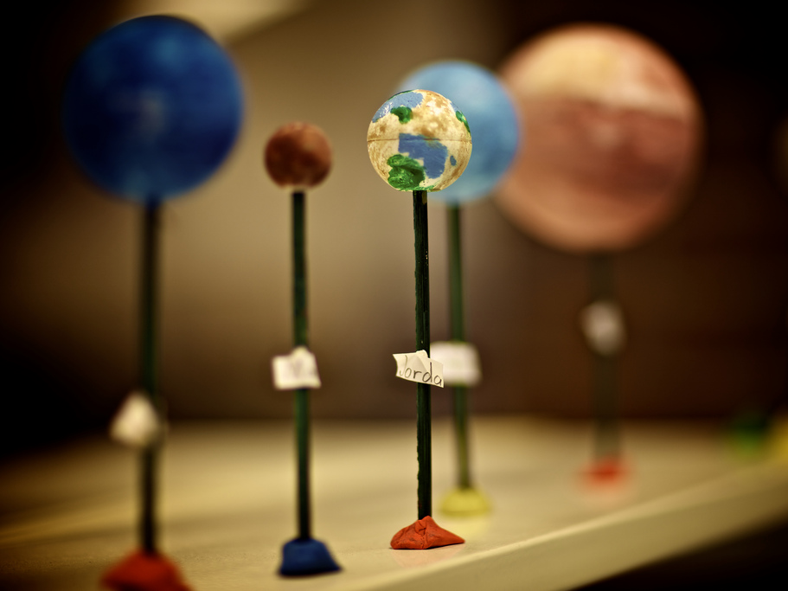
Using semantics to improve interactive information access
Lynda Hardman http://www.cwi.nl/~lynda
CWI, Interactive Information Access UvA, Institute for Informatics
http://www.flickr.com/photos/iboy/4528401870/
Notes:
Good morning ladies & gentlemen. It is my pleasure to be given this opportunity to address you this morning.
I have been working for many years on developing technology topics, with the motivation to support users who are not yet familiar with these technologies, but whom we believe we can support by their development.
One of my observations is that, because we each have to publish papers, researchers live in their own clearly defined worlds, with their own criteria for success.
In particular, for my research, there are
those who create algorithms that can extract meaningful information from media assets;
those who understand how to represent this knowledge;
those who understand what users want (even though sometimes users may not even know themselves).
I hope today’s talk will give a glimpse of a future where inhabitants live symbiotically in the same solar system!
We are here this week to discuss semantic computing and I believe semantics can help us – the technologists – to help real people access information for real needs, be they medical, social, or technological. My goal is not to convert all worlds to “semanticism” but to illustrate practical examples where the association of metadata with media can improve the ways users access information.
My examples today are drawn from fields where we have access to media and metadata that we can use in our experimentation. Many of these can be carried across to other topic areas.

Slide 2
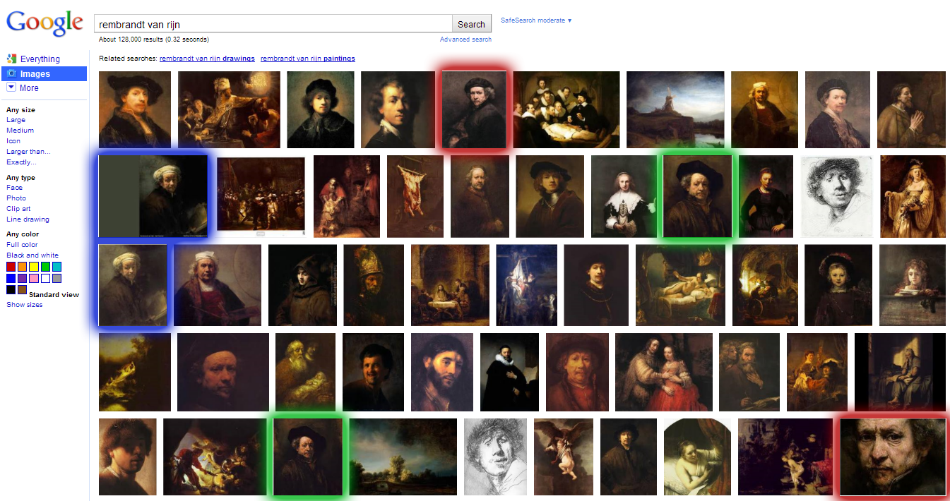
Google: Rembrandt van Rijn
Notes:
Let's take the presentation of results from Google as an example of what the problem is.
(This is not to complain about the search engine, I use it all the time…)
If we type in Rembrandt van Rijn, a Dutch painter from the 17th century then
Google does a great job of finding images that co-occur with elements of the string.
But there is no overview of what is available: painting created by Rembrandt? painting of Rembrandt?
There are also duplicates. Are these different images of the same painting, or is one an image of an excellent forgery?
If you aren’t even sure what you are looking for, then difficult to get an overview of what is available (“dimensions” of the “semantic space”)
While the “visual” space is relatively easy to establish, the ”semantic space” is not only difficult to see, but also very difficult to visualise effectively.
The solutions I am going to discuss this morning require insights from our different worlds:
understanding the limitations of extracting “meaning” from human-created media (images, video);
understanding the context in which users use media to communicate;
conveying to the user what media are available;
basically supporting the user moving back from a “query-centric” search to supporting interaction with the system.

Slide 3
Notes:
[[New LOD here!!!]]
What do we have?
Users have information tasks, and want access to images, or videos, for their task.
We can analyse the information content of media, and make this explicit in a computer-readable form. In parallel, the linked data cloud provides an information context with which parts of media assets can be associated.
http://esw.w3.org/SweoIG/TaskForces/CommunityProjects/LinkingOpenData
The data sets consist of over 38 billion RDF triples (dataset statistics), which are interlinked by around 389 million RDF links (linksset statistics) (August 2010).
linked data, media
applications using these, interaction with the end-user (3)
therefore, need to link metadata with media (2)
when you do that, need a workflow that takes that into account (1)

Slide 4
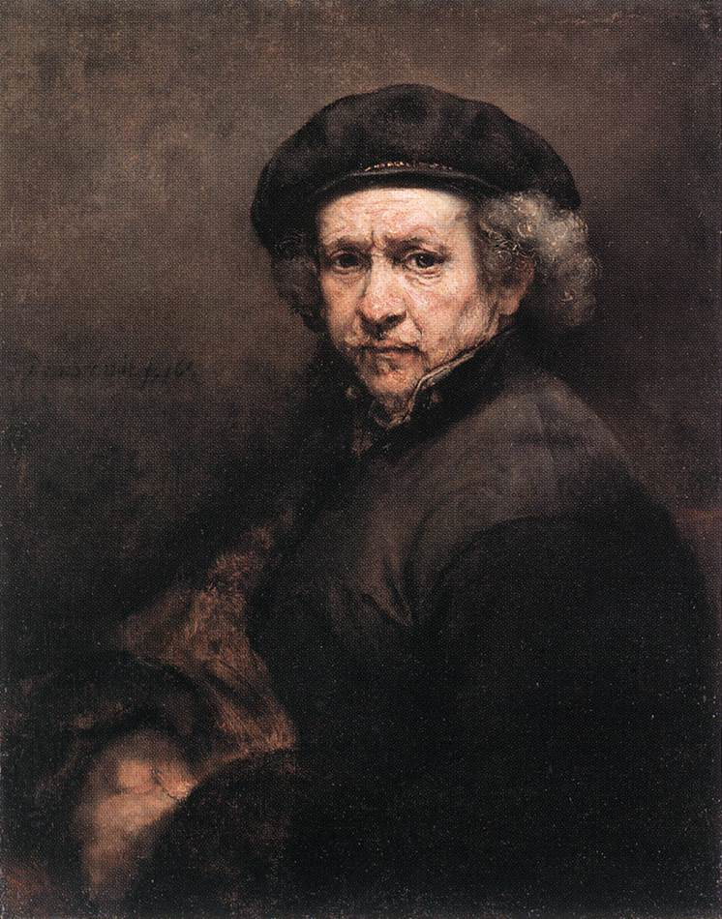
Interactive Information Access
Users need support for
the processing of information-bearing content
in one or more media types
for their specific task
We need to be aware that there is more than the information “expressed'' by the media asset itself, e.g.
the intended purpose of the creator
the context in which the media asset was created
Notes:
For example, for creating an exhibition about Rembrandt van Rijn.
If I want to use semantics for improving interactive information access, then what do I mean by Interactive information access?
While user task oriented, we need to remember that a picture is not WYSIWYG…
I just discussed the paintings of Rembrandt, and have now planted the idea that there may be a forgery of this painting. Next time you see a picture of this painting you will not just think of a Rembrandt painting, but will start wondering whether there was a forgery…

Slide 5
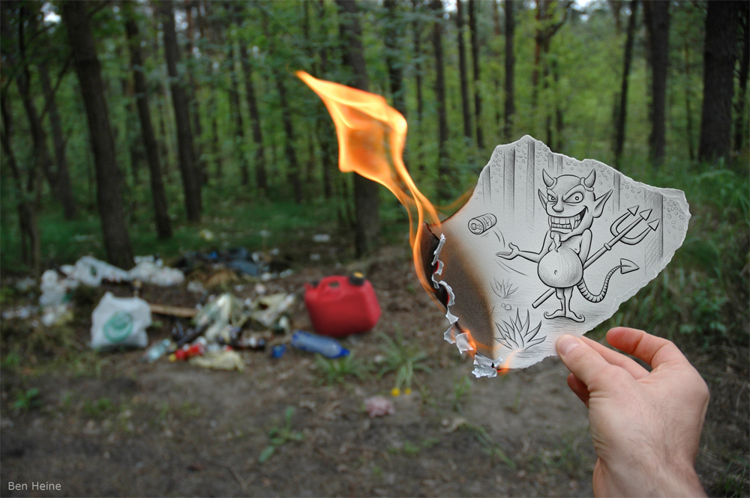
We don’t care about the media!
We need to enable
the processing of information-bearing content
of one or more media types
that can be interpreted by end users
End-users are primarily interested in
the meaning conveyed by a combination of media assets
interacting further with the media
as part of complex search task
passing it on to someone else in media “chain”
http://www.flickr.com/photos/benheine/4687572408/
Notes:
In some sense we don’t even care about the media.
We care about the story or the information conveyed by the media. (the narrative in a broad sense of the word)
E.g., in the context of a complex search task; or passing the media along to someone else in the “media chain”

Slide 6
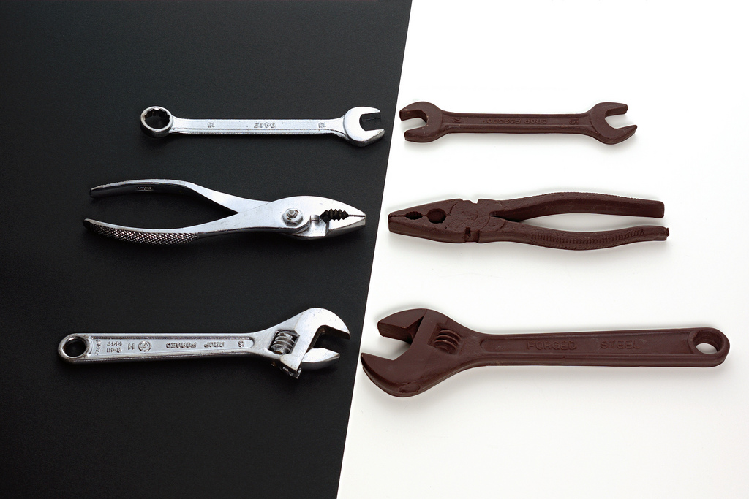
How can we get this to work?
We need mechanisms
for identifying (part of) an individual media asset
for associating metadata with an identified fragment
for agreeing on the meaning of metadata
that enable larger meaningful structures to be composed, identified and annotated
http://www.flickr.com/photos/jannem/3312115991
Notes:
Tools aren't enough - we need them to create houses - but
they don't tell us how to be architects.
Similarly, if we want to communicate using media, then we need to first
understand what it is we want to communicate and how we are able to communicate it.

Slide 7
Outline of talk
Explain information processes in which media and metadata play a role
“canonical processes of media production”
Example systems showing different types of user interaction enabled by media and metadata
Vox Populi
MultimediaN E-Culture project
Artwork annotation
Browsing artefacts
LISA

Slide 8
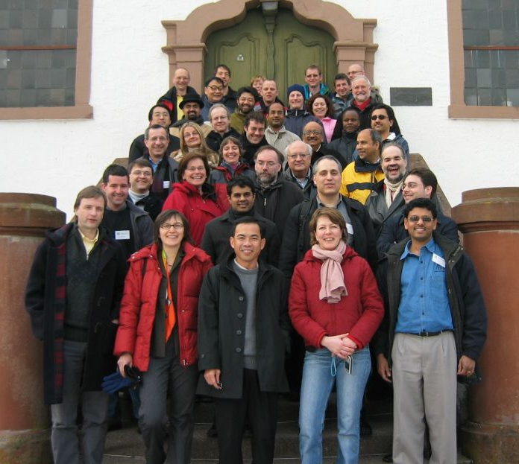
Understanding Multimedia Applications Workflow
Identify and define a number of canonical processes of media production
Community effort
2005: Dagstuhl seminar
2005: ACM MM Workshop on Multimedia for Human Communication
2008: Multimedia Systems Journal Special Issue (core model and companion system papers) editors: Frank Nack, Zeljko Obrenovic and Lynda Hardman
Notes:
Media is about enabling human communciation
The journal special issue was also an example of human communication – the model was formed after a number of interactions, in discussion with the authors who contributed the system paper descriptions.
The rule for contribution was: there needed to be an already-implemented system. This should then be described in terms of the canonical processes. The topics covered included:
feature extraction systems, professional news production systems, new media art, hyper-video production, photo book production, ambient multimedia systems with complex sensory networks.
See special issue for more details (link from my web page).
And remember this woman – she is Susanne Boll.

Slide 9
Canonical Reduced to the simplest and most significant form possible, without loss of generality

Slide 10
Overview of Canonical Processes
Notes:
Let me first introduce you to the 9 terms in the model.
I’m not going to explain them now, but will talk about them in an example.
Each process
short description
illustrated with use cases
input(s), actor(s) & output(s)
Formalization of processes in UML diagrams in paper

Slide 11
Example: CeWe Color PhotoBook
Application for authoring digital photo books
Automatic selection, sorting and ordering of photos
Context analysis methods: e.g., timestamp, annotation
Content analysis methods: e.g., color histograms, edge detection
Customized layout and background
http://www.cewe-photobook.com
Notes:
CeWe is the leading European photo finisher company.
Research work done together with Susanne Boll, University of Oldenburg, in Germany
(Remember the red circle…)

Slide 12
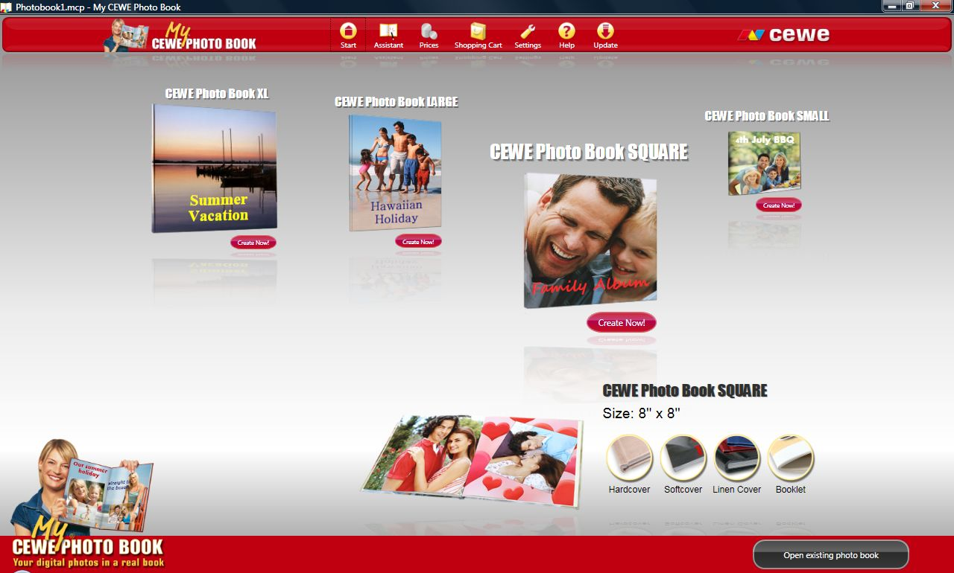
CeWe Color PhotoBook Processes
My winter ski holidays with my friends
Notes:
Premeditate is what you do before you start capturing any media (images, videos, audio).
Premeditate for a winter holiday requires taking your camera, and remembering to take it up the mountain with you.
A Hollywood movie is very different – a huge amount of premeditation has taken place: script has been written, actors chosen and camera moves pre-specified.
But even for a humble security camera, someone decided where to mount the camera.
In all these cases, metadata is already implicitly available: where is the camera situated; what is expected to be captured; who (will) own(s) the captured media.
Construct message: One of the types of metadata that can be captured is the intended message of the piece.
For a holiday – that you are having a great time.
For a Hollywood movie that it is good to
It would be very useful if a media system can store it and associate it with the media.

Slide 13
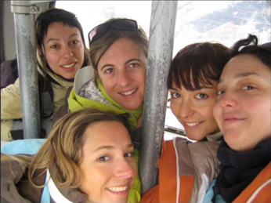
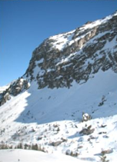
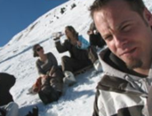
CeWe Color PhotoBook Processes
Media assets are captured, generated or transformed
Notes:
After a process of premeditation, however short or long, at some point a media asset is created.
Some device or another is used to collect images or sound for a period of time, be it photo or video camera, scanner, sound recorder, heart-rate monitor, MRI etc.
A media asset may already exist, and the creation process is the transformation of some exist asset to a new one (e.g. to make the sky look brighter).
Images can be created with image editing programs, or generated by transforming one or more existing images. We are not interested in the method of creation per se.
If the method is considered as significant, however, then this information should be recorded as part of the annotation.

Slide 14
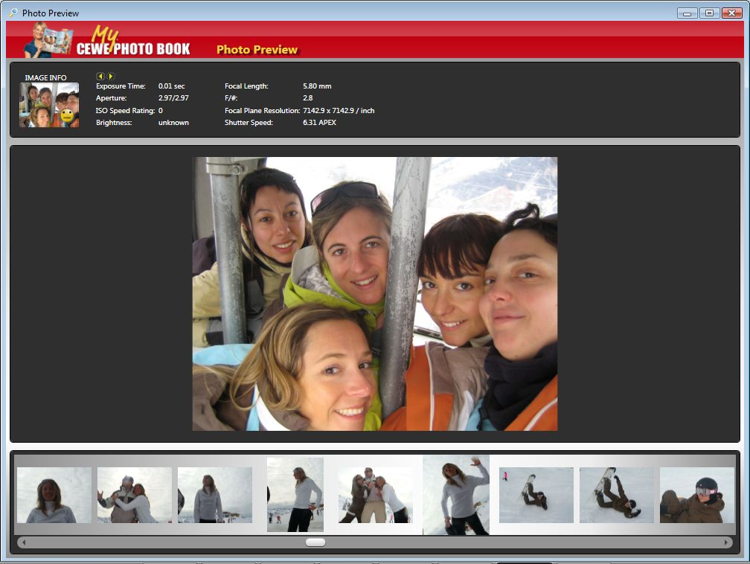
CeWe Color PhotoBook Processes
Notes:
Each photo has annotations associated with it. In the CeWe photobook they are taken from the image format.
For the canonical processes,
we use annotation to mean the broader process of adding partial (machine-processable) descriptions of the media asset.
The annotation process can never be complete, since different aspects of the media asset may be made explicit in different contexts.
The description can be viewed as providing ``potential for organisation’’.
We don’t care how the annotations are: they may be human-created or automatically generated, for example, from feature extraction processes.
The annotation may or may not have some associated meaning,
e.g. the colour histogram, a flickr tag,
or a term from a carefully crafted thesaurus or ontology (allowing other associations to be derived – but I’ll get back to this later).

Slide 15
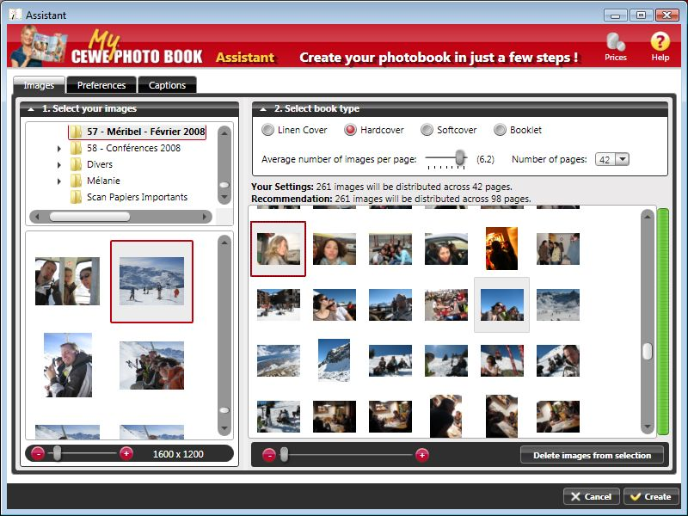
CeWe Color PhotoBook Processes
Notes:
At the end of the holiday we have a collection of great, and some not so great photos.
And now we get to create out photo book

Slide 16
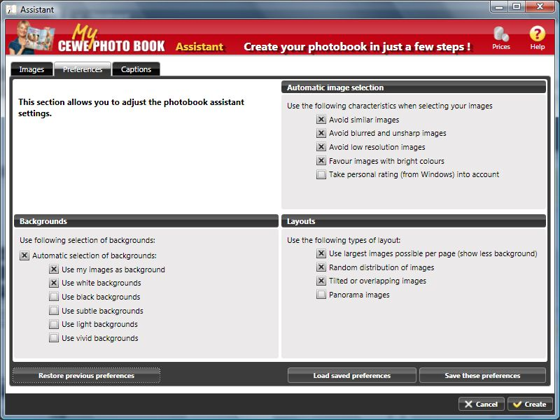
CeWe Color PhotoBook Processes
Notes:
Query: User retrieves a set of media assets based on a user-specified query.
Any interface that allows the artifacts to be searched, using query languages of choice or (generated) browsing interfaces that allow exploration of the content
Organise: These then need to be organised into an appealing photo book.
Remember I mentioned that annotations provide the potential for organisation.
The organisation in the photobook example is very visual, it also uses date and time to group the photos together.
Any annotations can be used for organisation, whether derived from the bits in the medium or from associated metadata, e.g. domain knowledge.

Slide 17
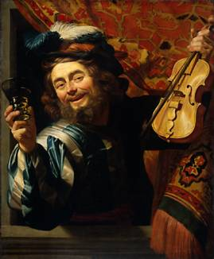
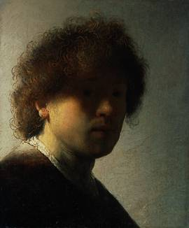
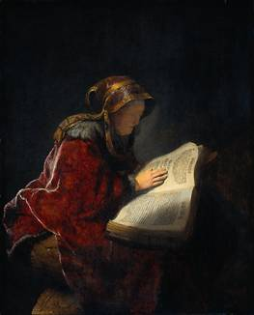
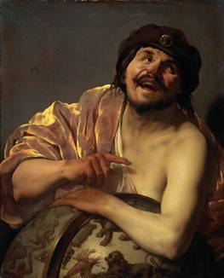
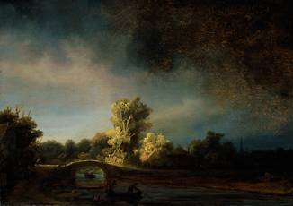
Organize using domain annotations
chiaroscuro
Caravaggists
1623
1628
1631
1628
1638
Rembrandt
Notes:
Organizing is very often the process of
Grouping and ordering assets for presentation to end-user.
When we have domain
This depends on the domain ontology, in this case, the technique clair-obscur was used by a number of painters including Rembrandt and the Caravaggists.
When designing the presentation it is useful to group the paintings by Rembrandt separately from those by the Caravaggists.
It is then a matter of deciding which group to present to the viewer first.
Similarly, when there are many paintings, some other attribute may be appropriate for deciding on the order of display.
For example, the date of creation.

Slide 18
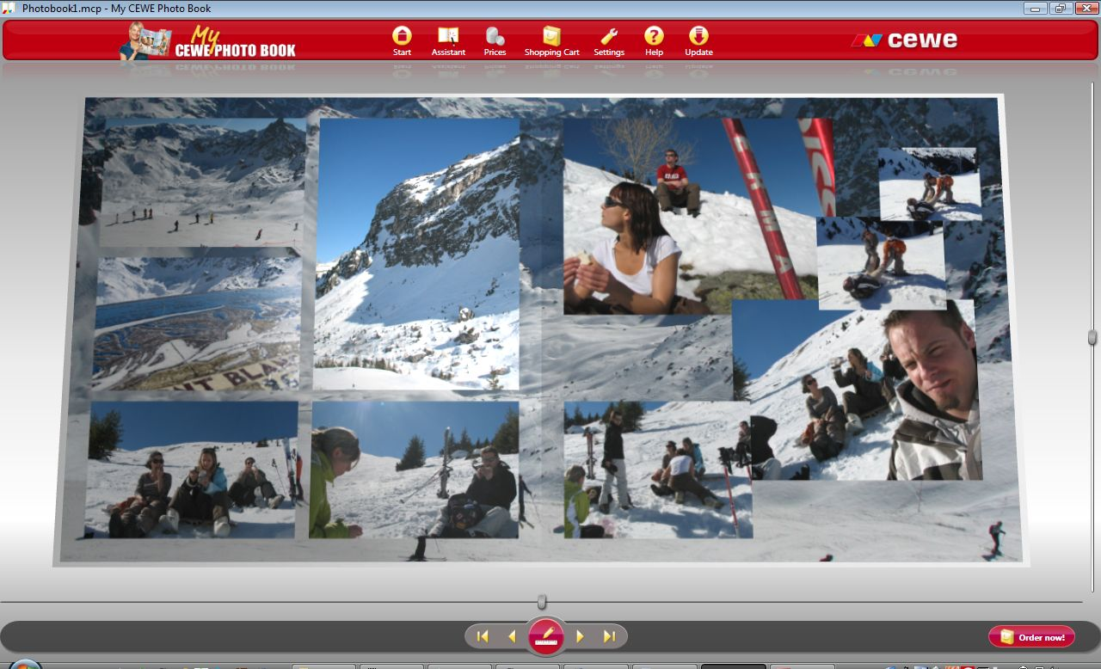
CeWe Color PhotoBook Processes
Notes:
and then we get to push the magic CeWe button and we get to see the automatically generated organisation of the photobook.
(It is clear that Raphael had a great holiday.)

Slide 19
CeWe Color PhotoBook Processes
Notes:
I haven’t been through all the processes in detail (you need to check out the special issue for that).
But you get an idea

Slide 20
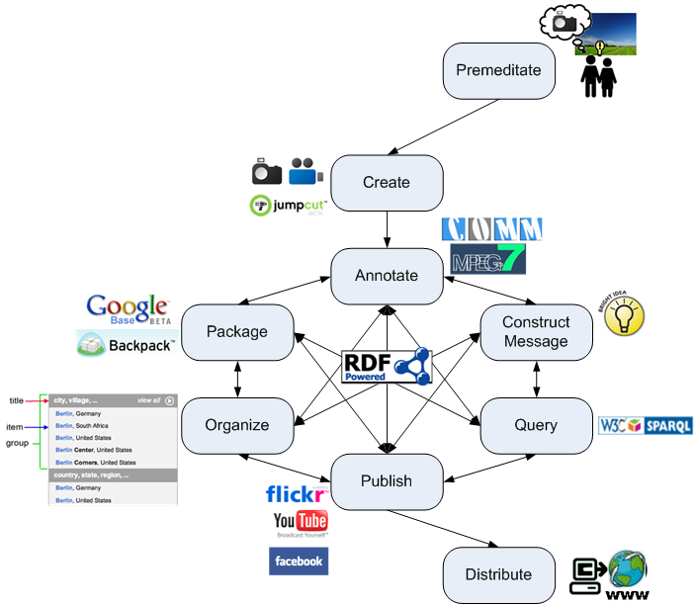
Canonical Processes
Notes:
[[Need “closure” of canonical processes story]]
The role of the canonical processes will hopefully become clearer during the rest of the talk, looking at how the semantics that we have can contribute to the interactive information “cycle”.
In an interactive application, the cycle of query, organise, publish is sub-second.
In the next part of the talk, we look at the role the canonical processes play in the example applications we have built. In particular:
premeditate, annotate, construct message, organise,
(publish & distribute as part of interactive process)

Slide 21
How can we use Semantics to support Interactive Information Access?
Long term goal to find and present information to end-users
In a way that is useful to them
We understand how to design information interfaces by hand.
How can metadata help us in giving more flexible access to media collections?
We can link media assets to existing linked data, and use this to improve presentation, e.g. by
Selecting a sub-set
Grouping, ordering and linking media assets
Influencing the presentation
Notes:
Too much for ICSC talk?
New search functionality
beyond fact-finding
And then we need to understand what good new interfaces are.
Evaluating an existing interface is relatively easy

Slide 22
How can semantics help?
What can be expressed explicitly?
the message to be conveyed
objects that are depicted in a media asset
domain information (e.g., art, painter)
human communication roles (discourse)
What can they be used for?
disambiguating queries
grouping similar items for conveying topic breadth
visualizing items for presentation, e.g. timeline, map
finding similar items
…

Slide 23
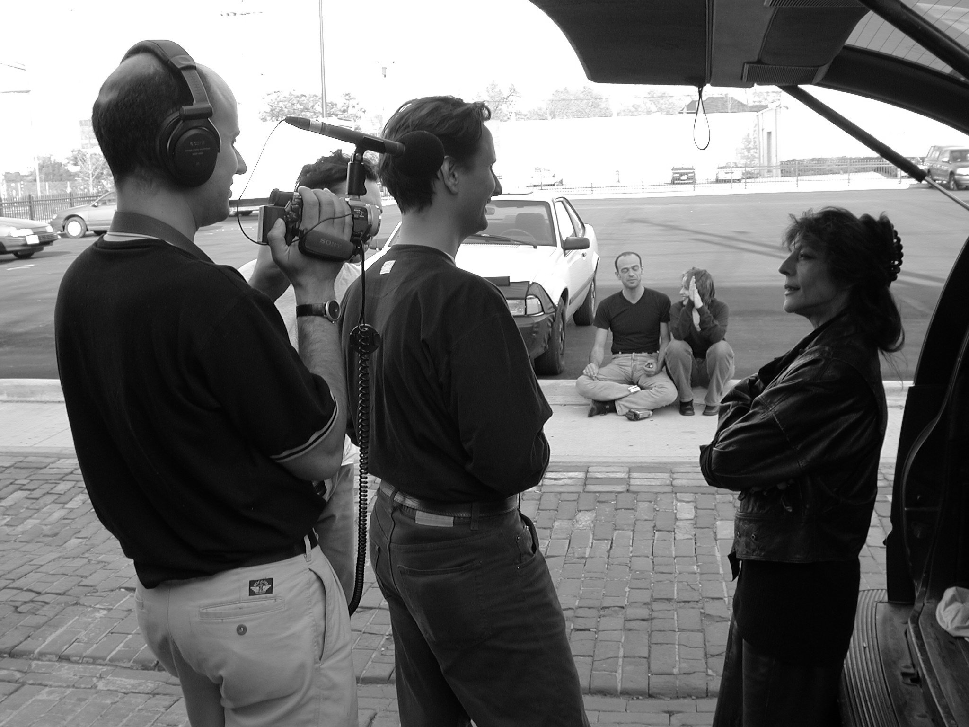
Generating video documentaries from annotated media repositories
Stefano Bocconi, Frank Nack (CWI, Amsterdam)

Slide 24
Outline
Motivation
Example
Scenarios
Technical details
Annotations
Editing Process
Conclusions

Slide 25
Video Documentaries on the Web
Traditional video authoring: there is only one final version, what is shown is the choice of the author/editor
Proposed video authoring:
Annotate the video material semantics
Show automatically what the user asks to see, using presentation forms a film editor would use
Notes:
Personal story?

Slide 26
Video material
Focus on video interviews about controversial issues
Interview with America video footage with interviews and background material about the opinion of American people after 9-11 www.interviewwithamerica.com
Notes:
Subject: the opinion of American people after 9-11
Shooting: from 27-10-2001 to 01-11-2001 in Stamford (CT), New York (NY), Boston (MA) and Cleveland (OH)

Slide 27
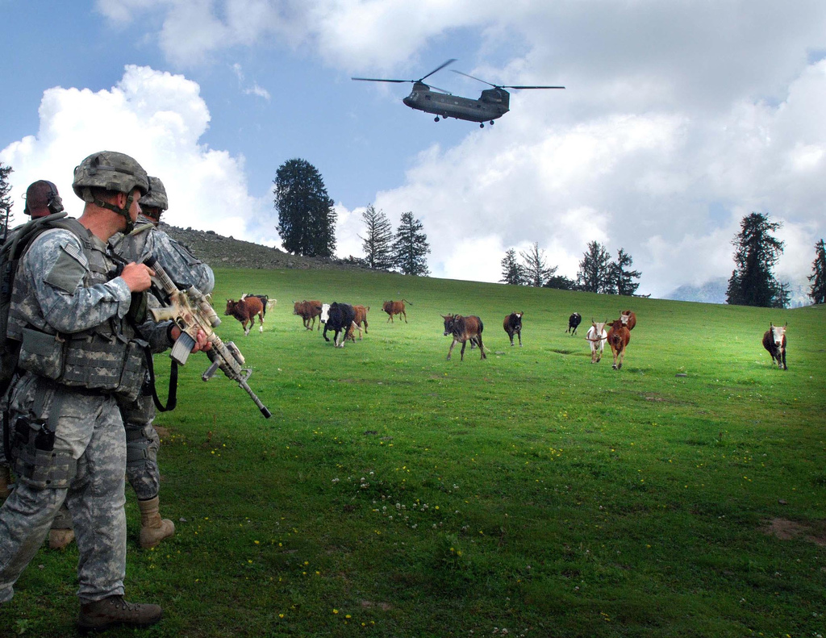
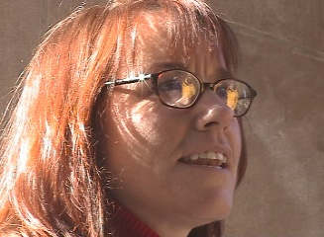
Example: What do you think of the war in Afghanistan?
“I am never a fan of military action, in the big picture I don’t think it is ever a good thing, but I think there are circumstances in which I certainly can’t think of a more effective way to counter this sort of thing…”
http://www.flickr.com/photos/soldiersmediacenter/1183836576

Slide 28
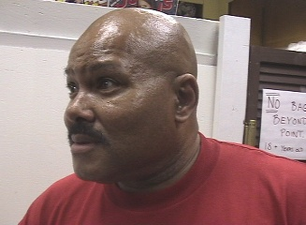
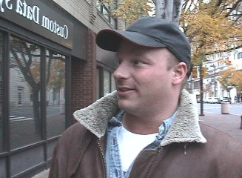
What do you think of the war in Afghanistan?
War has never solved
anything
Two billions
dollar bombs
on tents
I am not a fan of military
actions
I cannot think of a more effective solution

Slide 29
The annotations
Rhetorical
Rhetorical Statement (mostly verbal, but visual also possible)
Argumentation model: Toulmin model
Descriptive
Question asked
Interviewee (social)
Filmic next slide

Slide 30
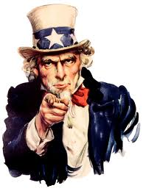
Filmic annotations
Continuity, e.g.
lighting conditions
background sound
gaze direction of speaker
left, centre, right
framing continuity
close-up, medium shot, long shot
camera movement
none, pan left/right, shaking, tilt up/down, zoom in/out
We need your metadata!
Notes:
This is where the automated tools would be of a great help for improving continuity.
Gaze direction(visual characteristic) was used to distinguish between different points of view.
Framing continuity was preserved. You would have noticed otherwise.
Lighting conditions weren’t taken into account – final speaker was filmed without daylight – which comes as a surprise.

Slide 31
Statement encoding
Statement formally annotated:
<subject> <modifier> <predicate>
E.g. “war best solution”
A thesaurus containing:
Terms (155)
Relations between terms: similar (72), opposite (108), generalization (10), specialization (10)
E.g. war opposite diplomacy

Slide 32
Connect statements
Using the thesaurus, generate related statements and query the repository “war best solution”, “diplomacy best solution”, “war not solution”
Create a graph of related statements
nodes are the statements (corresponding to video segments)
edges are either support or contradict

Slide 33
Semantic Graph
diplomacy best solution
war best solution
= support
war not solution
= contradict

Slide 34
Toulmin model
Data
Claim
Qualifier
Warrant
Condition
Concession
Backing
57 Claims, 16 Data, 4 Concessions, 3 Warrants, 1 Condition

Slide 35
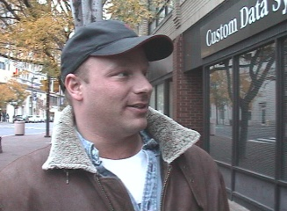
Analysis of the Example
Two billions dollar bombs on tents
Claim
contradict
Claim
I cannot think of a
more effective solution
weaken
Concession
I am not a fan
of military actions
support
Claim
War has never solved anything

Slide 36
Facts and features
Annotations: 1 hour annotated, 15 interviews, 60 interview segments, 120 statements
Partially tunable: examining the Segment graph gives feedback on the quality of the annotations and the thesaurus
S8
S1
S7
S10
= support
S2
S6
S9
= contradict
S4
S3
S5

Slide 37
Controlling the Bias
Video documentaries are not neutral account of reality: the selection and editing of the footage expresses a point of view
Editing strategy:
Balanced
Pro opinion X
Against opinion X
We use:
Logos (the statements)
Ethos (based on user profile)
Film editing (e.g. framing, gaze)

Slide 38
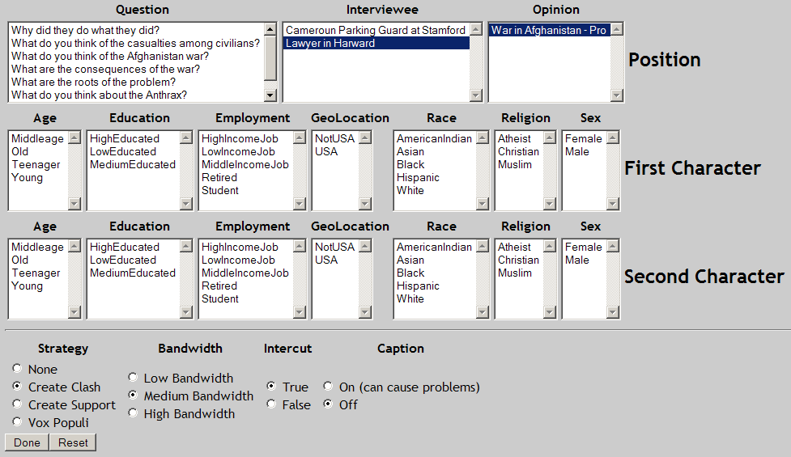
Vox Populi interface

Slide 39
Conclusions
Automatic generation of video interviews augmented with supporting and/or contradicting material
The user can determine the subject and the bias of the presentation
The documentarist can add material and let the system generate new documentaries

Slide 40
Pointers & Acknowledgments
Demo available at:
http://www.cwi.nl/~media/demo/VoxPopuli/
VoxPopuli research was funded by the Dutch national ToKeN I²RP and CHIME projects

Slide 41
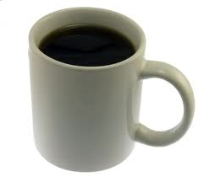

Slide 42
Semantic search derived from survey
35 systems
Search engine, faceted browser, wiki, question answering, portal
Analysis of search functionality and interface for
Query construction
Search algorithm
Presentation of search results
http://swuiwiki.webscience.org/index.php/Semantic_Search_Survey
http://en.wikipedia.org/wiki/Semantic_search

Slide 43
Query Construction
Interface components
Feature
Functionality
Free text input | Keyword, natural language | Single text-entry, Property specific field
Operators | Syntactic disambiguation, Semantic constraints
Controlled terms | Disambiguate input, Restrict output, Predefined queries | Value lists, Faceted browser, Graph
User feedback | Pre-query disambiguation | Autocompletion

Slide 44
Search algorithm
Syntactic matching
Exact, prefix or substring match
Minimal edit distance
Stemming
Semantic matching
Graph traversal
Query expansion
RDFS/OWL reasoning
Notes:
Feature: Syntactic matching; semantic matching
Functionality:
Interface n/a

Slide 45
Result Presentation
Interface components
Feature
Functionality
Data selection | Selected values, Template, Display vocabularies | Visualized by text, graph, tagcloud, map, timeline, calendar
Ordering | Content / link structure based ranking | Ordered list
Organization | Clustering by property, by result path or dynamic | Tree, nested box structure, clustermap
User feedback | Post-query disambiguation, Recommendation | Facets, tagcloud, value list

Slide 46
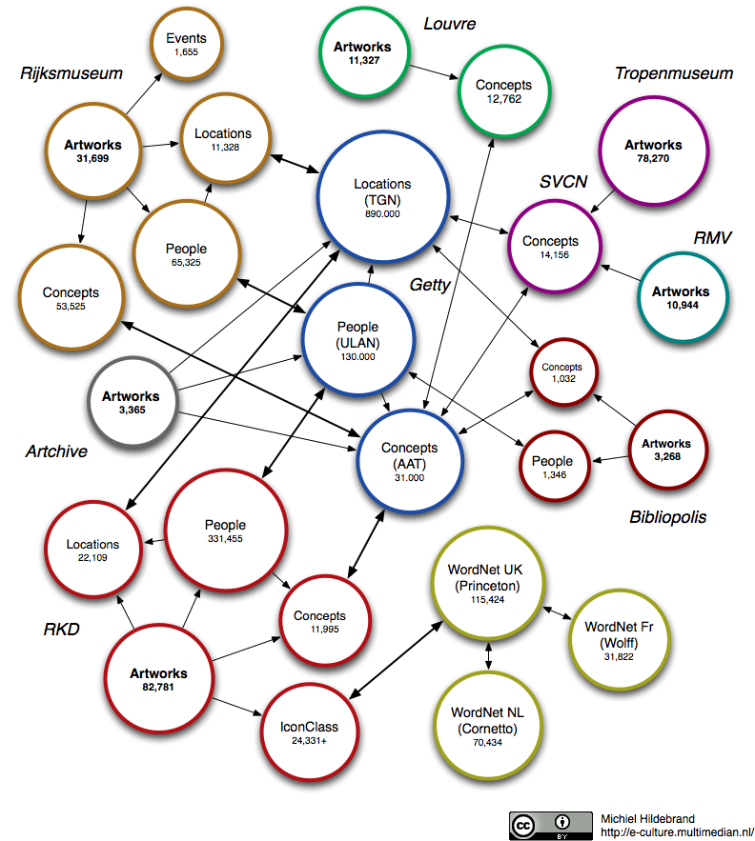
E-Culture Linked Data Cloud
Notes:
[[Some coloured circles would be nice for:]
Artworks: Rijksmuseum, Louvre, Tropenmuseum, RMV, Bibliopolis, RKD, Artchive
General concepts (thesauri): Wordnet – English, Dutch & French
Domain-specific thesauri: AAT, ULAN (people)
Links were created among these, by researchers in Guus Schreiber’s group (VUA)

Slide 47
Professional Artwork Annotation using Thesauri
Notes:
WHO: type in name Oldenbar…
Show different vocabularies; alphabetical
Same death date as description
WHAT: type onthoofdi… ; different vocabularies – prefer RMA and otherwise Wordnet
WHERE: type gravenhagen, see hierarchy of places (after alphabetical)
select binnenhof

Slide 48
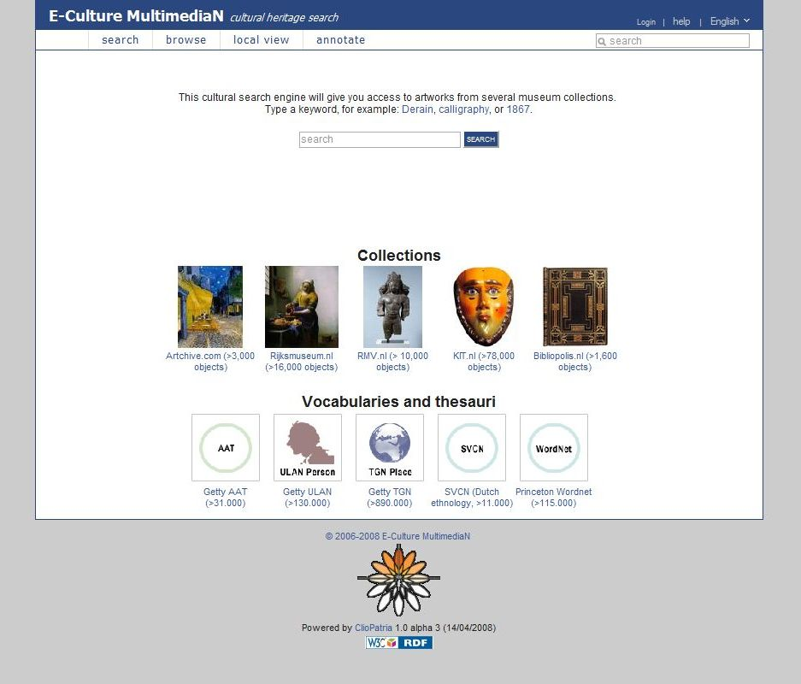
Browsing annotated collections of cultural heritage artefacts
Users interested in cultural heritage, exploring artefacts available in repository
Searching across multiple, linked collections
Thesaurus structure used for identifying topics
Artworks grouped into different topic structures to present results
Notes:
Dutch project with a number of partners, technical and cultural heritage, including the Rijksmuseum in Amsterdam.
Use canonical terms
Originally technology driven. The demo is to demonstrate the possibilities (2006-2008).
Currently in progress is a user centric design process to prototype and evaluate an interface that supports topic search for (semi-) expert users (2009)
http://eculture.cs.vu.nl/europeana/session/search

Slide 49
http://e-culture.multimedian.nl/demo/session/search
Notes:
Please don’t use demo during talk
http://eculture.multimedian.nl/demo/search Front page: Explain vocabularies and collections. Also mappings between ULAN and other thesauri. 20 million triples. Select help TYPE Picasso Explain autocompletion Explain the groupings scroll different topics vertical; scroll single horizontal - MENTION using visual grouping not yet implemented
Click on to show details of a single artwork this is OUR METADATA CLICK browse Explain facets CLICK Europe arrow (and not the word!) CLICK France arrow Then say you can also TYPE P a r show autocompletion again TYPE i s and hit return. Group results by When The scroll down groups of artworks until Montmartre paintings. CLICK "Boulevard Montmartre" painting label and show that Paris it not mentioned. Explain that part of TGN. (Took 17 minutes.)

Slide 50
Use of linked data in E-Culture
Query construction
auto-completion uses strings found in “data” and “concepts”
suggestions are grouped and ordered using links among items
Result set
uses empirical balance between “closeness” to search string and non-intuitive path
Result presentation
uses grouping of result set to show breadth of results
uses no particular ordering within each group

Slide 51
Comparison Search Preliminary Study
Goal
understand comparison search practice performed by Cultural Heritage experts
explore support for comparison search across multiple sources
7 experts (curators, art historians)
Semi-structured interview, natural environment, voice recording
Gather comparison search use cases
Get feedback on initial application ideas

Slide 52
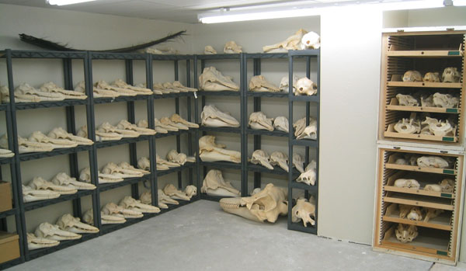
Preliminary Study: Key Findings
When do experts conduct comparison search?
Quantitative and qualitative comparisons
Learning about collections
Planning an exhibition
Collection management

Slide 53
Preliminary Study: Key Findings
Main challenges in comparison search
Search
Name aliases
Multiple languages
Multiple terms
Compare
…idem
Comparing many sets
Single and multiple property comparison

Slide 54
Design Requirements
Search
Need guided search to support:
name aliases, multiple languages, multiple terms
Select
Need to be able to select and group multiple artworks
Compare
Comparing many sets
Single and multiple property comparison
Notes:
Tasks identified were searching and comparing. However, in order to
be able to compare sets of results the artworks need to be first selected.
Therefore, a selection task prior to the comparison task is added.

Slide 58
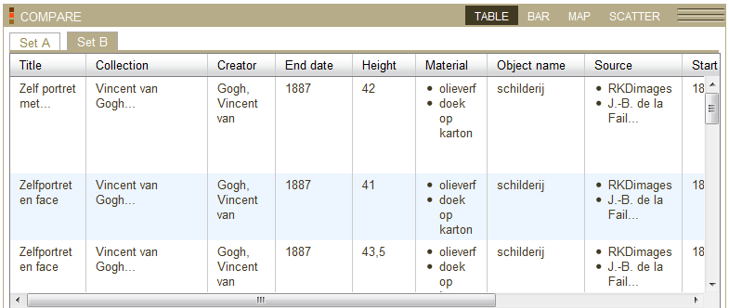

Slide 59
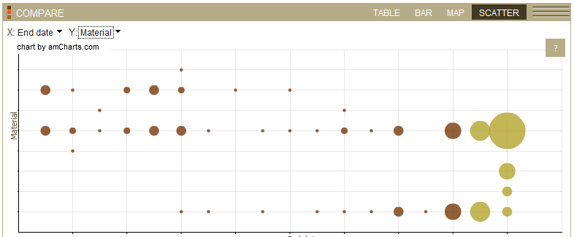

Slide 60
What are my messages?
Metadata associated with media assets can be used for different stages of interactive access
Metadata can be created and added by hand, linked automatically or automatically extracted
The message itself can be made explicit (more metadata)
Media content and metadata can be passed around and among systems
We need community agreement on how to do this (e.g. canonical processes)
Users can be given much richer and more flexible access to (semantically annotated) media content, but…
we need to understand why we are generating metadata and store it in a reusable way
60
Notes:
These interactive grouping, story telling at least as important as only search
Check the slide for details

Slide 61
Literature
Alia Amin, Michiel Hildebrand, Jacco van Ossenbruggen, Lynda Hardman, Designing a thesaurus-based comparison search interface for linked cultural heritage sources. In IUI ’10.
Alia Amin, Michiel Hildebrand, Jacco van Ossenbruggen, Vanessa Evers, Lynda Hardman, Organizing Suggestions in Autocompletion Interfaces. In ECIR ’09.
Alia Amin, Jacco van Ossenbruggen, Lynda Hardman, Annelies Nispen, Understanding Expert' Information Seeking Needs. In JCDL ’08.
Stefano Bocconi, Frank Nack and Lynda Hardman: Automatic generation of matter-of-opinion video documentaries. Journal of Web Semantics, 6(2), p139-150, 2008.
Michiel Hildebrand, Jacco van Ossenbruggen, Lynda Hardman, Geertje Jacobs, Supporting subject matter annotation using heterogeneous thesauri - a user study in Web data reuse. IJHCS, 2009, ISSN: 1071-5819.
Jan Wielemaker, Michiel Hildebrand, Jacco van Ossenbruggen and Guus Schreiber, Infrastructure for thesaurus-based search and annotation: evaluating the standards. In ISWC ’08.
Schreiber G., Amin A., Aroyo L., van Assem Mark, de Boer V., Hardman L., Hildebrand M., Omelayenko B., van Ossenbruggen J., Tordai A., Wielemaker J., Wielinga B., Semantic annotation and search of cultural-heritage collections: The MultimediaN E-Culture demonstrator, Journal of Web Semantics, 2008

Slide 62
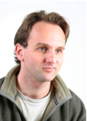
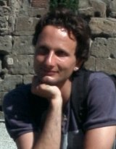
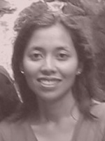
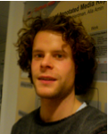
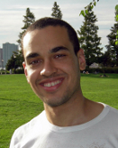
Acknowledgements
Jacco van Ossenbruggen
Frank Nack
Raphaël Troncy
Stefano Bocconi
Alia Amin
Michiel Hildebrand
Andre Fialho
Notes:
This presentation needs exactly what I am talking about – annotations for each slide as to who contributed to the work, and who edited the slide…

Slide 63
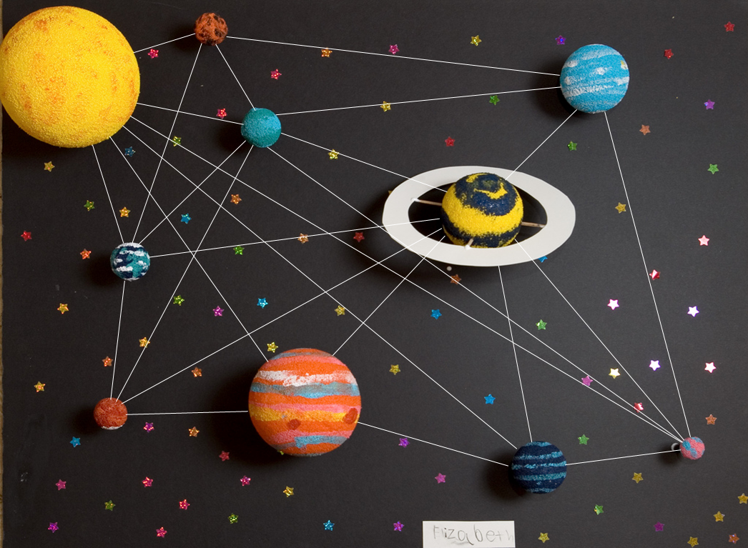
"I have seen the dark universe yawning Where the black planets roll without aim, Where they roll in their horror unheeded, Without knowledge or luster or name.” -- H. P. Lovecraft, Nemesis
http://www.flickr.com/photos/turbojoe/421680689/
Notes:
Independent worlds
of media analysis, knowledge representation and human computer interaction
will make links to
attain a state of cosmic harmony among the celestial spheres

