Slide 1


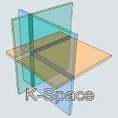
A Semantic Multimedia Web: Create, Annotate, Present and Share your Media
Lynda Hardman, Raphaël Troncy
Lynda.Hardman@cwi.nl
Raphael.Troncy@eurocom.fr
CWI, Interactive Information Access

Slide 2
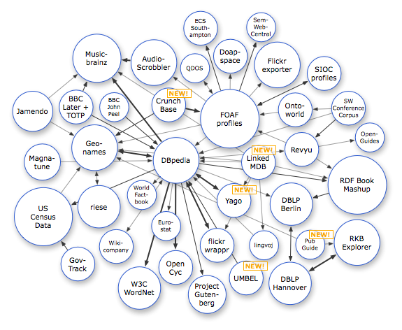
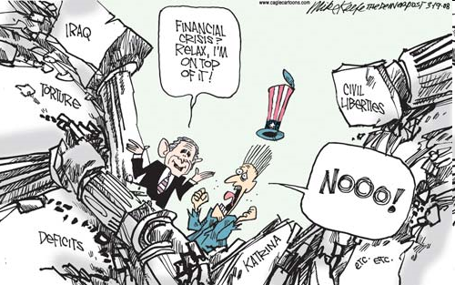
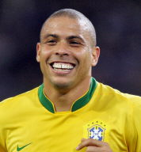
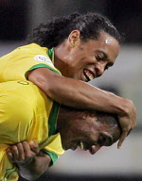
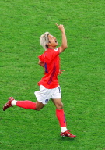
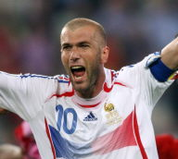
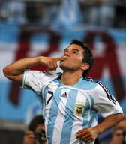
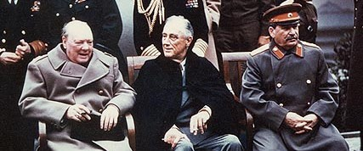
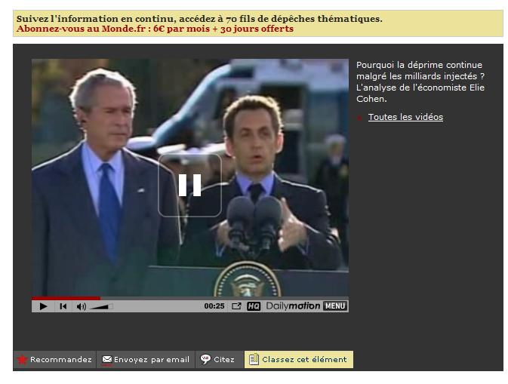
Motivation
Notes:
linked data, media
applications using these, interaction with the end-user (3)
therefore, need to link metadata with media (2)
when you do that, need a workflow that takes that into account (1)

Slide 3
Creating a semantic media web
Allocate URI to media asset
Attach metadata using RDF
But…
want to attach metadata to parts of a media asset
want to combine multiple (parts) of assets into new assets/presentations
each media type/format needs a different player (whereas everyone can display text)

Slide 4
We don’t even care about media!
We want to enable
  the processing of information-bearing content
  of one or more media types
  that can be interpreted by end users
End-users are primarily interested in
  the meaning conveyed by a combination of media assets
  interacting further with the media
    as part of complex search task
    passing it on to someone else in media “chain”
Notes:
E.g., in the context of a complex search task; or passing the media along to someone else in the

Slide 5
We can use the (semantic) web
Web enables the identification and delivery of units of information of different data types
Semantic web enables the association of metadata with each identified unit/fragment
To find and use them, we need mechanisms:
  for identifying (part of) an individual media asset
  for associating metadata with an identified fragment
  that enable larger meaningful structures to be composed, identified and annotated
Notes:
So we are done. What is the problem?

Slide 6
Really need…
to be aware of the human aspects of multimedia
multimedia assets are not created “in vacuo”, but by someone for a specific purpose
more than the information “expressed'' by the media asset itself, e.g.
  the creator and the intended purpose
  provenance also important on the semantic web,
  where a multimedia presentation may be composed of assets published by many different sources
  the context in which the media asset was created
  (e.g. before or after Obama was elected)
Notes:
I don’t like sub-bullet points 2 & 3 here.
I want to explain the background to annotating using the process in which information was created. (Who did the capture, who did the editing, who did the “organising”, who did the annotation?
create, annotate, distribute, publish, organise

Slide 7
Why are you here?
To do just this…
To understand the context in which information is used
Learn about different techniques that already exist
Understand how far media is part of the semantic web
And most importantly, what still needs to be done to get it to work!

Slide 8
Learning Objectives
Understand multimedia applications workflow
  Canonical processes of media production model
Explore multimedia metadata formats
  Be aware of the requirements for describing media
  Understand COMM, a Core Ontology for Multimedia
Discuss exploratory interfaces based on rich multimedia metadata semantics
  Know how to link and expose your data on the web
  See various multimedia presentation interfaces
Notes:
requirements for a model like COMM

Slide 9
Agenda
Understanding Multimedia Applications Workflow
  CeWe Color Photo Book creation application
  Vox Populi argumentation-based video sequences generation
  Canonical Processes of Media Production
Semantic Annotation of Multimedia Content
  Multimedia metadata formats: use cases and requirements
  Multimedia metadata interoperability issues
  MPEG-7 based ontologies
  COMM: A Core Ontology for MultiMedia
Semantic Search and Presentation of Multimedia Content
  Link your data!
  Searching and Browsing Multimedia Semantic Datasets with different user interfaces built on top of Cliopatria

Slide 10
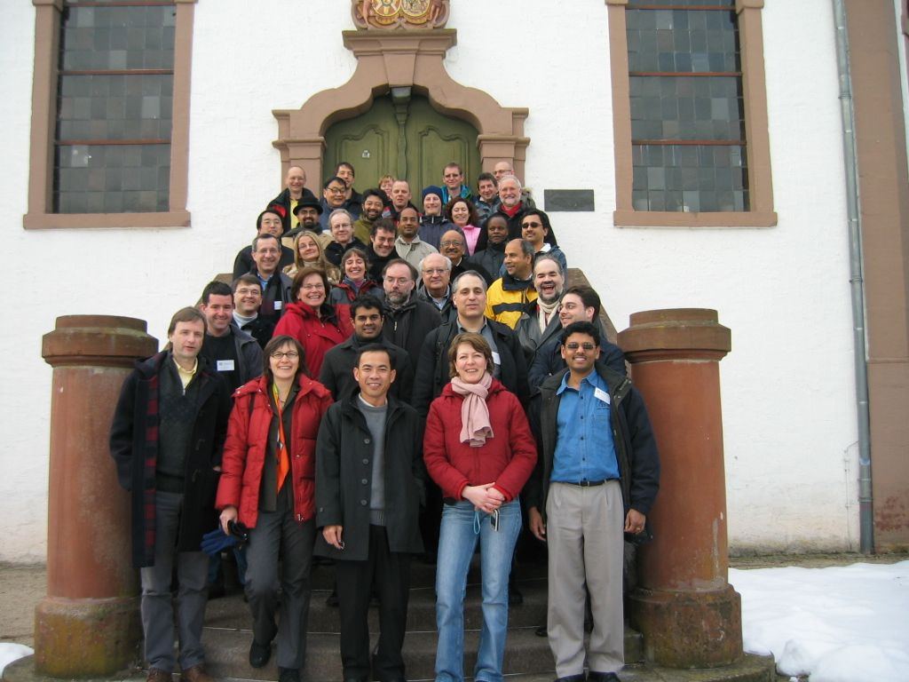
Understanding Multimedia Applications Workflow
Identify and define a number of canonical processes of media production
Community effort
  2005: Dagstuhl seminar
  2005: ACM MM Workshop on Multimedia for Human Communication
  2008: Multimedia Systems Journal Special Issue
  (core model and companion system papers)
  editors: Frank Nack, Zeljko Obrenovic and Lynda Hardman

Slide 11
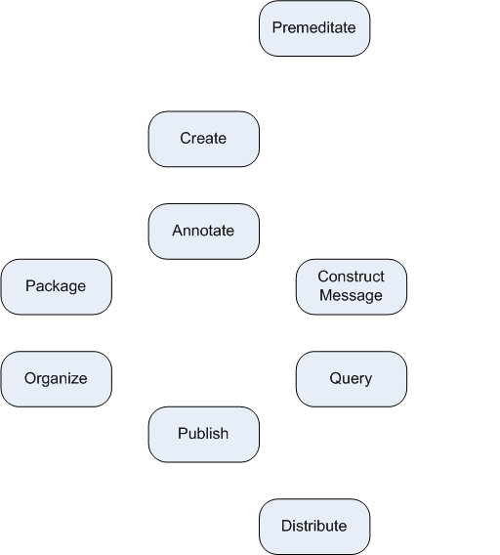
Overview of Canonical Processes

Slide 12
Example 1: CeWe Color PhotoBook
Application for authoring digital photo books
Automatic selection, sorting and ordering of photos
  Context analysis methods: timestamp, annotation, etc.
  Content analysis methods: color histograms, edge detection, etc.
Customized layout and background
Print by the European leader photo finisher company
http://www.cewe-photobook.com

Slide 13
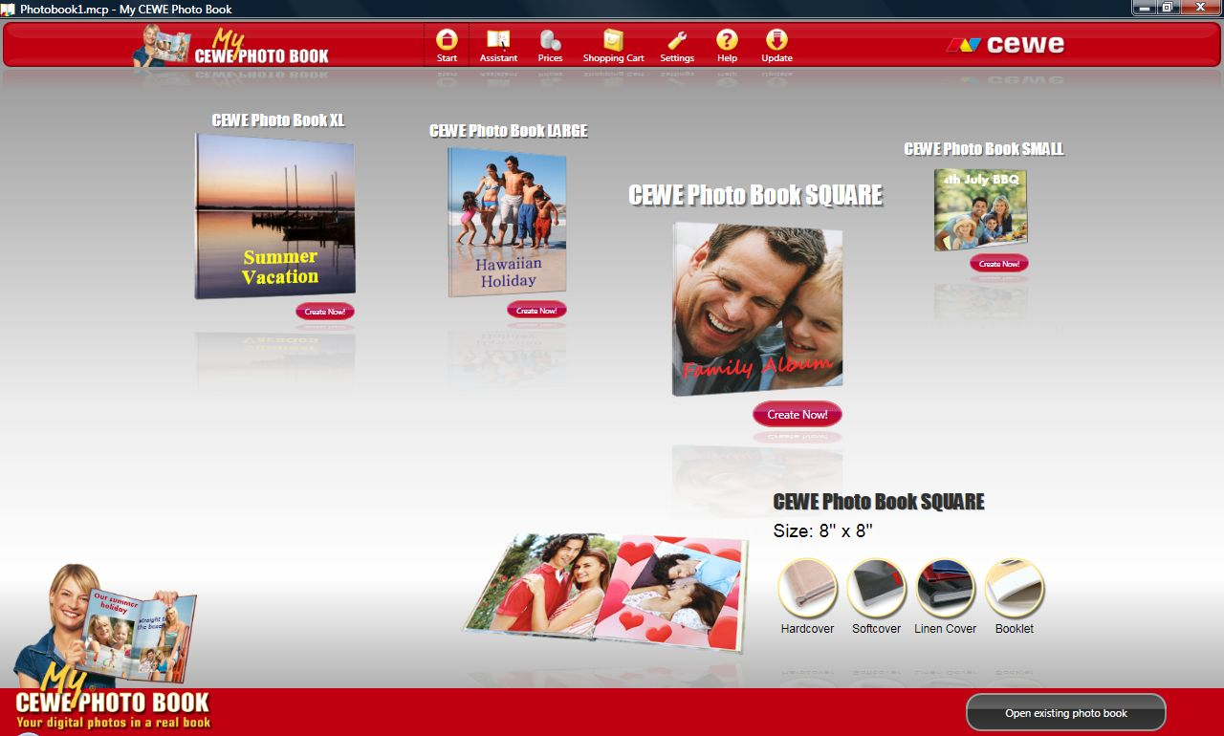
CeWe Color PhotoBook Processes
My winter ski holidays with my friends

Slide 14
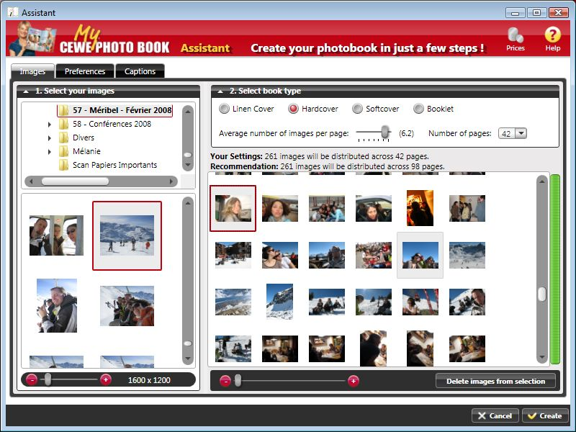
CeWe Color PhotoBook Processes

Slide 15
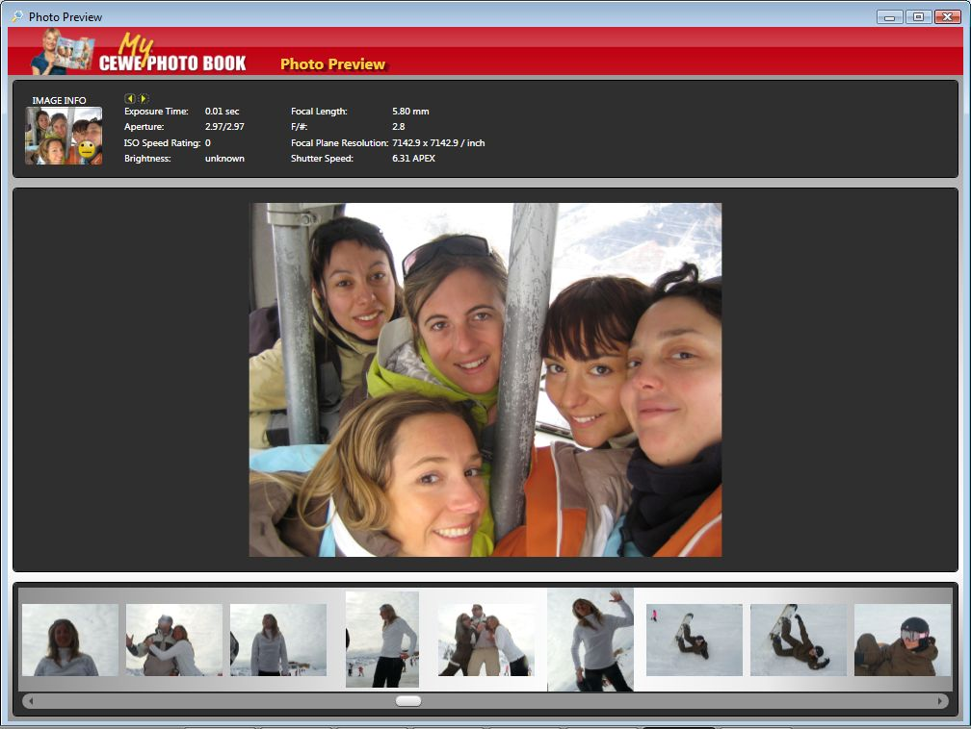
CeWe Color PhotoBook Processes

Slide 16
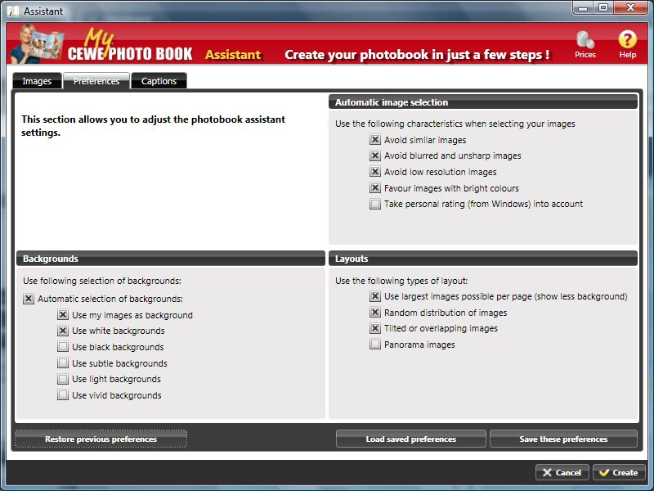
CeWe Color PhotoBook Processes

Slide 17
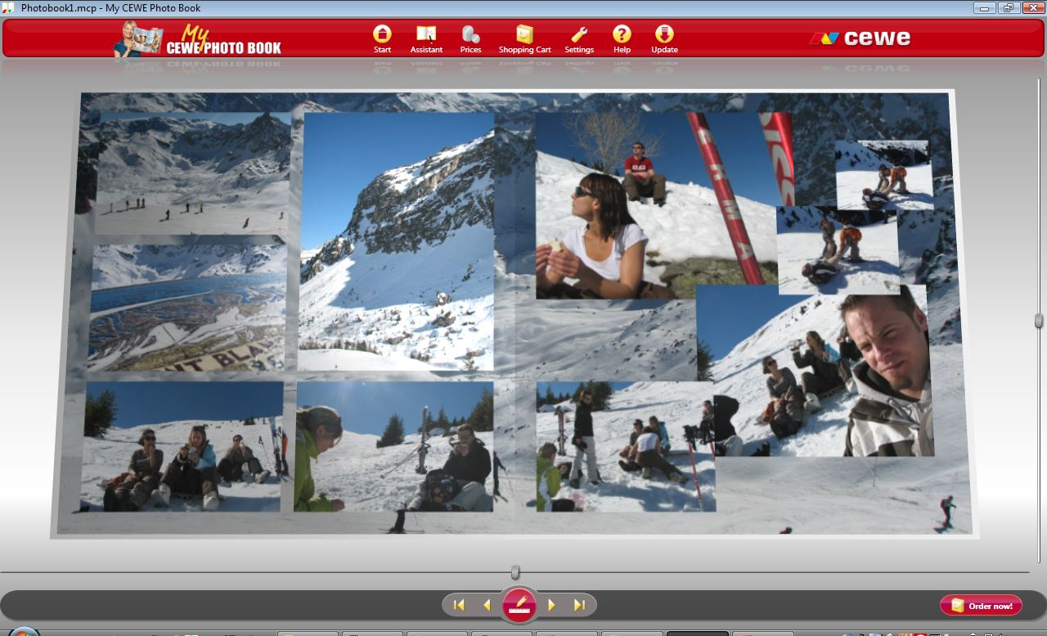
CeWe Color PhotoBook Processes

Slide 18
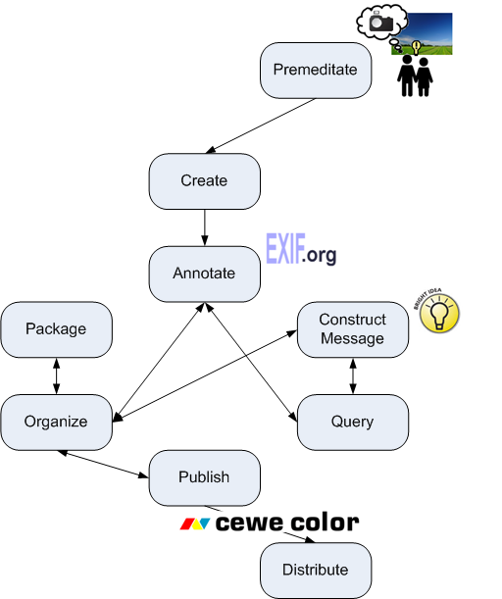
CeWe Color PhotoBook Processes

Slide 19
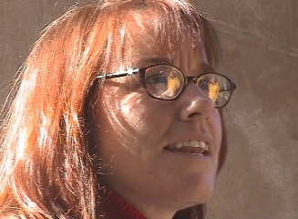
Example 2: Vox Populi Video Sequences Generation
Stefano Bocconi, Frank Nack
Interview with America
video footage with interviews and background material about the opinion of American people after 9-11
http://www.interviewwithamerica.com
Example question:
What do you think of the war in Afghanistan?
“I am never a fan of military action, in the big picture I don’t think it is ever a good thing, but I think there are circumstances in which I certainly can’t think of a more effective way to counter this sort of thing…”

Slide 20
Vox Populi Premeditate Process
Analogous to the pre-production process in the film industry
  Static versus dynamic video artifact
Output
  Script, planning of the videos to be captured
  Questions to the interviewee prepared
  Profiles of the people interviewed:
  education, age, gender, race
  Locations where the interviews take place
Notes:
Being VP a system that generates documentaries, the premeditation phase is analogous with the preproduction process used in film industry, with the difference that the goal is not to produce a static video artifact, but a dynamic one.
This implies that the planning of the material to be filmed (for example, the script) must tale into consideration the possibility to rearrange dynamically the content. In VP's application domain, namely matter-of-opinion documentaries based on interviews, the questions to ask during interviews must be planned so that they are the same for all interviewees (yielding the possibility to compare different answers), and to the point, so that hopefully also the answers will be to the point and clear to understand even when taken out of the flow of the interview to be put in a different sequence of clips. The questions are the main annotation output of this phase.
Other outputs are the profile of the people to be interviewed (education, age, gender, race) and the locations where to make the interviews. The actor involved is the documentary, and the ideas and decisions concern the subject of the documentary to be made.

Slide 21
Vox Populi Annotations
Contextual
  Interviewee (social), locations
Descriptive
  Question asked and transcription of the answers
  Filmic continuity, examples:
    gaze direction of speaker (left, centre, right)
    framing (close-up, medium shot, long shot)
Rhetorical
  Rhetorical Statement
  Argumentation model: Toulmin model
Notes:
Some of these are _about_ the video clip. Difficult to analyse directly from audiovisual material.
Some describe what is being said within the clip. Potentially possible to parse the language.
This process is very important in VP, and very cumbersome. Ideally, it starts together with the Create Media Asset process, when the question, the interviewee answering it, the location and the time could also be annotated while shooting. This is not enough for VP to work, as a formal transcript of the interviewees answers is also needed, and need to be done by a human annotator. Other annotations required are the filmic ones, such as gaze direction, framing. This could in principle be done by a feature analysis algorithm, even though they were done manually in VP.
Annotations are in RDF according to an ad-hoc VP ontology.

Slide 22
Vox Populi Statement Annotations
Statement formally annotated:
  <subject> <modifier> <predicate>
  E.g. “war best solution”
A thesaurus containing:
  Terms on the topics discussed (155)
  Relations between terms: similar (72), opposite (108), generalization (10), specialization (10)
  E.g. war opposite diplomacy
Notes:
Three thesauri had to be created: one on the topics about which were spoken (war, diplomacy, bombing), one describing the thesaurus relations (not, general, specific, similar to), one on something I need to look up (effective).
Also the argumentation model being used was created.
(Everything in Protege, in RDF(S) - need to check thesis.)
Available on web – still?

Slide 23
Toulmin Model
Data
Claim
Qualifier
Warrant
Condition
Backing
Concession
57 Claims, 16 Data, 4 Concessions, 3 Warrants, 1 Condition

Slide 24
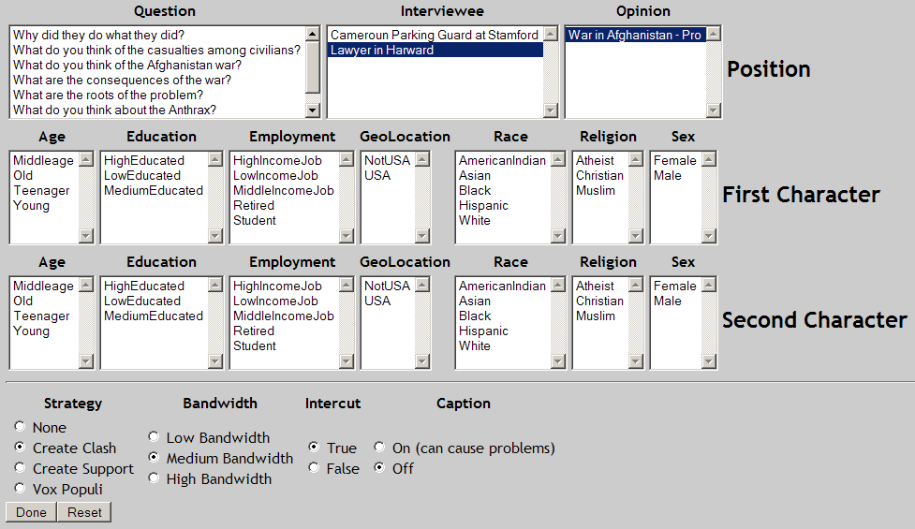
Vox Populi Query Interface
Notes:
Construct message:
End-user selects person in the interview and point of view and whether a clash should be generated (or pro/against).
Mention the caption (yes/no) and bandwidth … useful for the Publish process

Slide 25
Vox Populi Organize Process
Using the thesaurus, create a graph of related statements
  nodes are the statements
  (corresponding to video segments)
  “war best solution”,
  “diplomacy best solution”,
  “war not solution”
  edges are either support or contradict
diplomacy best solution
contradict
support
war best solution
war not solution

Slide 26
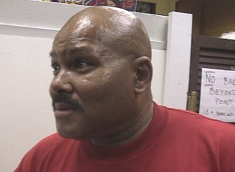
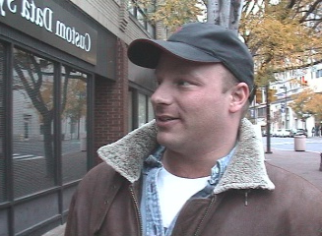
Result of Vox Populi Query
I am not a fan of military
actions
I cannot think of a more effective solution
War has never
solved
anything
Two billions
dollar bombs
on tents
Notes:
Publish:
The publish process linearizes the structure produced by the previous process. Related clips are shown in sequence, using also some well-formedness criteria for a filmic sequence, such as framing continuity or no jump cuts rules. The structure of the presentation is mainly a sequence of shots, even though VP uses links inside the generated documentaries to other possible documentaries. Further, other publishing issues as the user bandwidth are taken in consideration to select a particular rendering of the same clip. The format used to specify this structure is SMIL.
Distribute:
VP is a web application which uses a browser as the user interface and a SMIL player (such as Real) as the application viewer.

Slide 27
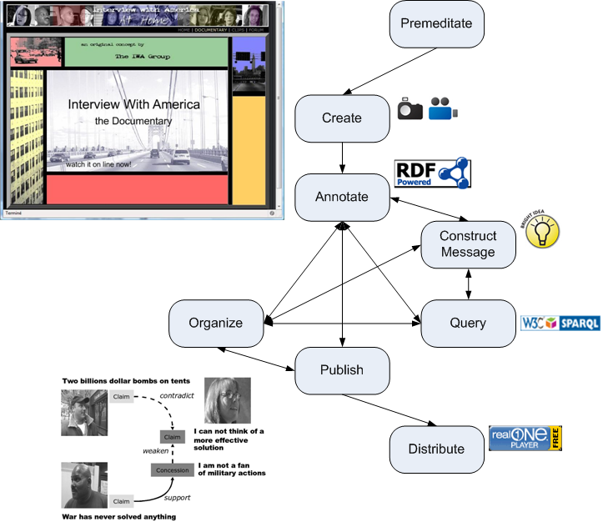
Vox Populi Processes
Notes:
No Package process
Publication of the annotations: RDF annotations are browsable from a triple store

Slide 28
Canonical Processes 101
28
Canonical: reduced to the simplest and most significant form possible without loss of generality
Each process
  short description
  illustrated with use cases
  input(s), actor(s) & output(s)
Formalization of processes in UML diagrams in paper (see literature list)
Notes:
28
Process actors vary from human to machine.

Slide 29
Premeditate
29
Establish initial ideas about media production
  Design a photo book of my last holidays for my family
  Create argument-based sequences of videos of interviews after September 11
Inputs: ideas, inspirations from human experience
Actors:
  camera owner
  group of friends
Outputs:
  decision to take camera onto ski-slope
  structured set of questions and locations for interviews
Notes:
29
Premeditate for a Hollywood movie is easy – script has been written, actors chosen and camera moves pre-specified. But even for a security camera, someone decided where to mount the camera. Metadata is already implicitly available: where is the camera situated; what is expected to be captured; who (will) own(s) the captured media.
On a holiday, photos capture happy or fun moments so that these can be shared with friends/family later. Even taking the camera on the ski-slopes is an act of premeditation.
Video in USA captured to show futility of war as solution and to collect wide range of opinion of different Americans.
The inputs to the premeditate process are ideas, decisions of the camera-owner/director. These may be captured in scripts
----- from paper:
Any media creation occurs because someone has made a decision to embark on the process of creating --- whether it be image capture with a personal photo camera, drawing in a drawing tool, professional news video, an expensive Hollywood film or a security video in a public transport system. In all cases there has been premeditation and a decision as to when, how and for how long creation should take place. In all these cases what is recorded is not value-free. A decision has been made to take a picture of this subject, conduct an interview with this person, make this take of the chase scene or position the security camera in this corner. Already there are many semantics that are implicitly present. Who is the ``owner'' of the media to be created? Why is the media being created? Why has this location/background been chosen? Whatever this information is, it should be possible to collect it and preserve it and be able to attach it to the media that is to be created. For this we need to preserve the appropriate information that can, at some later stage, be associated with one or more corresponding media assets.

Slide 30
Create Media Asset
Media assets are captured, generated or transformed
  Photos taken at unspecified moments at holiday locations
  Synchronized audio video of interviewees responding to fixed questions at many locations
Inputs:
  decision to take camera onto ski-slope;
  structured set of questions and locations for interviews
Actors:
  (video) camera, editing suite
Outputs:
  images, videos
30
Notes:
30
After a process of premeditation, however short or long, at some point there is a moment of media asset creation. Some device, for example, is used to collect images or sound for a period of time, be it photo or video camera, scanner, sound recorder, heart-rate monitor, MRI etc. Note that in this process, we do not restrict creation of a media asset to only newly recorded information. Media assets can also be created in other ways. For example, images can be created with image editing programs, such as, or generated by transforming one or more existing images. The essence is that a media asset comes into existence, we are not interested in the method of creation per se. If the method is considered as significant, however, then this information should be recorded as part of the annotation. In addition, annotations associated with any transformed media assets should be able to be copied over to the new asset.

Slide 31
Annotate
Q: “What do you
think of the
Afghanistan war?”
Speaker: Female, Caucasian…
31
Annotation is associated with asset
Inputs:
  photo, video, existing annotation
  optional thesaurus of terms
Actors:
  human, feature analysis program
Outputs:
  Complex structure associating annotations with images, videos
Notes:
31
Once a media asset exists we still need to be able to add extra information about it. This additional annotation may include information that could have been collected during the premeditation, message construction or capture processes, but is added later. Any information added does not change the original media asset. We use the term annotation, but wish to emphasize the breadth of our intended meaning. Annotation is often used to denote a single human user adding metadata to enable search at some later date. Here we see annotation as the broader process of adding partial (more easily machine-processable) descriptions of the content of the artifact. The annotation process can never be complete, since different aspects of the media asset may be made explicit in different contexts. The description assigned to it, however, can be viewed as providing ``potential for organisation'', or as a step prior to a cataloguing step. How the annotations are created is not of essence to the process description: they may be human-created or automatically generated, for example, from feature extraction processes. The meaning of the attribute in semantically rich media production systems can be obtained through its association with the ontology (recorded in the attribute). The value of the annotation may be one of those specified for the attribute. For example, for the attribute ``modality'' a value may be ``spoken language'' or ``sound effect''. The value may also be numeric, for example for the attribute ``colour'', in which case the units need to be specified. Note also that the annotations may not be explicitly assigned by a user, but may be assigned by an underlying system through interaction by the user with the media asset. The information gained in this way should be treated on an equal footing with the information assigned by a human user --- the difference being that different values for the ``assigner'' (if this is deemed significant) would indicate the difference. We do not prescribe the form of annotations, but require that they can be created and associated with one or more artifacts. We also do not impose limitations on the structure of annotations, due to high diversity of annotation format in practice. In most semantically-rich systems, however, the structure of an annotation may include a reference to a vocabulary being used, one of the terms from the vocabulary plus a value describing the media asset. The annotation can refer to any artifact as a whole, but the annotation could also be more specific. In this case, an anchor mechanism is needed to refer to the part of the media asset to which the annotation applies. An anchor is needed to give a media independent means of referring to the part of the media asset and a media-dependent anchor value is required to specify the part of the media asset. For example for an image this could be an area, for an object in a film a time-dependent description of an area of the image.

Slide 32
Semantic Annotate
Modifier thesaurus
Predicate thesaurus
Subject
war
best
solution
32
Annotation uses existing controlled vocabularies
  Subject matter annotations of your photos (COMM, XMP)
  Rhetorical annotations in Vox Populi
Notes:
32
schema: http://www.cwi.nl/~media/ns/VP/VoxPopuli.rdfs
instances: http://www.cwi.nl/~media/ns/IWA/IWA.rdf
Link to COMM…
Need to annotate term from vocabulary, to part of media.
This is _not_ specified within the annotate process.
Extensible Metadata Platform
http://en.wikipedia.org/wiki/Extensible_Metadata_Platform
http://www.adobe.com/products/xmp/index.html

Slide 33
Package
33
Process artifacts are packed logically or physically
Useful for storing collections
of media after capturing…
… before selecting
subset for further
stages
Notes:
33
Vox Populi does not really have Package (videos were entered manually into system)
PhotoBook Package is putting photos in a container to be further selected
The process of packaging provides a message independent grouping of produced artifacts, and assigning this grouping an identity so that it can be retrieved as a unit. Grouping produces a unit, called multimedia component, from more process artifacts. Components can be organized in hierarchical fashion, i.e. one component can encapsulate other components. We make a distinction between physical and logical packaging. In some cases physical and logical packaging are inseparable, for example, one when we put an image in one file, while organization of file directories can reflect the structure of presentation. However, in many situations physical and logical packaging are not equivalent. For example, SMIL presentation logically presents one unit, but links media components physically packaged in many files in a distributed environment. On the other hand, multimedia database can physically be packaged in one file, but contain many logical units. The component identity is equivalent to the component identity specified in hypertext literature.

Slide 34
Query
34
User retrieves a set of process artifacts based on a user-specified query
Inputs:
  user query, in terms of annotations or by example
  collection(s) of assets
Actors:
  human
Output:
  subset of assets
  plus annotations
  (in no order)
Notes:
34
The query process selects a number of artifacts from a repository of artifacts. Up until now the processes we describe concentrate on creating, storing and describing primarily media assets. These are needed for populating the media repository. Note that our definition of media repository does not necessarily imply the existence of a complex storage infrastructure, but we assume that systems have a repository where they keep media assets and other artifacts, in the most simple case a hierarchically organized file directories . Once there is a repository of artifacts (but not before) it can be queried for components whose associated media assets correspond to desired properties. Again, we do not wish to use a narrow definition of the term ``query'', but intend to include any interface that allows the artifacts to be searched, using query languages of choice or (generated) browsing interfaces that allow exploration of the content of the archive. It is worth noting that many systems that provide advanced query interfaces, also include other processes. For example, browsing interfaces in addition to simple query interface also organize intermediate results to present them to user for feedback, and create temporary presentations that are then published and distributed to the user. A query of the system may be in terms of media assets, or in terms of any of the annotations stored with the media assets. A query needs to specify (indirectly) the annotation(s) being used, and includes techniques such as query by example. The mechanisms themselves are not important for the identification of the process.

Slide 35
Construct Message
35
Author specifies the message they wish to convey
  Our holiday was sporty, great weather and fun
  Create clash about whether war is a good thing
Inputs: ideas, decisions, available assets
Actors:
  author
Outputs:
  the message that should be conveyed by the assets
Notes:
35
Construct message can feed into Premeditate process.
A query implicitly specifies a message, albeit a simple one, that an author may want to convey (since otherwise the author would not have been interested in finding those media assets). The query is, however, not itself the message that the author wishes to convey. Just as capturing a media asset is input into the system, so is the specification of the message an author wishes to convey. In some sense, there is no input into the process. However, the real input is the collection of knowledge and experience in the author her/himself. The output of the process is a description of the intended message, whether implicit or explicit, to either an author or the system. For example, a multimedia sketch system such as described in~\cite{bailey:demais} allows an author to gradually build up a description of the message. For the message to be machine processable the underlying semantics need to be expressed explicitly. While we do not exclude this process as being carried out by a system, we expect that, at least in the near future, it will predominantly be carried out by a human user. In general, we give no recommendation in this paper for the semantics of the message. We expect that it contains information regarding the domain and how this is to be communicated to the user, but we do not assign anything more than a means of identifying a particular message.

Slide 36
Organize
Process where process artifacts are organized according to the message
  Organize a number of 2-page layouts in photobook
  Use semantic graph to select related video clips to form linear presentation of parts of argument structure
Inputs: set of assets and annotations
(e.g. output from query process)
Actors: human or machine
Outputs: document structure with recommended groupings and orderings for assets
36
Notes:
36
While querying allows the selection of a subset of media assets, it imposes no explicit structure on the results of one or more queries. The process of organisation is to create some document structure for grouping and ordering the selected media assets for presentation to a user. How this process occurs is, again, not relevant, but includes the linear relevance orderings provided by most information retrieval systems. It certainly includes the complex human process of producing a linear collection of slides for a talk; creating multimedia documents for the web; ordering shots in a film; or even producing a static 2-dimensional poster. In the field of information retrieval, results are typically presented as a ranked list -- this is also an organisation of the query result. The document structure is guided by the message, in the sense that ifthe presentation is to convey the intended underlying message then the document structure should emphasise this, not work against it. The document structure may reflect the underlying domain semantics, for example a medical or cultural heritage application, but is not required to. The structure may be colour-based or rhythm based, if the main purpose of the message is, for example, aesthetic rather than informative. In the arena of text documents, the document structure resulting from organisation is predominantly a hierarchical structure of headings and subheadings. The document structure of a film is a hierarchical collection of shots. For more interactive applications, the document structure includes links from one ``scene'' to another. In a SMIL document, for example, par and seq elements form the hierarchical backbone of the document structure we refer to here.

Slide 37
Publish
37
Presentation is created
  associated annotations may be removed
  create proprietary format of photobook for upload
  create SMIL file containing videos and timing information
Inputs: set of assets and annotations
(e.g. output from organize process)
Actors: human or machine
Outputs:
  final presentation in specific document format, such as html, smil or pdf
Notes:
37
The output of the organize process is a prototypical presentation that can be communicated to an end-user. This serves as input to the publication process which selects appropriate parts of the document structure to present to the end-user. The publication process takes a generic document structure and makes refinements before sending the actual bits to the user. These may include selecting preferred modalities for the user and displayable by the user's device. The resulting presentation can be linear (non-interactive, e.g. a movie) or non-linear (interactive, e.g. web presentation). Publication can be seen as taking the document structure from the internal set of processes and converting it (with potential loss of information) for external use. Annotations may be added to describe the published document. For example, the device or bandwidth for which the publication is destined. Annotations and alternative media assets may be removed to protect internal information or just reduce the size of the data destined for the user. Once a document structure is published it is no longer part of the process set, becoming an input for distribution process. All that can happen is that the publication itself can be distributed to the end-user. If republication needs to take place, then this needs to start from the document structure used as input to the publish process.

Slide 38
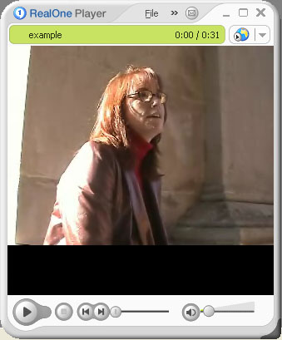
Distribute
38
Presentation is transported to end user,
end-user can view and interact with it
  photobook uploaded to printer, printed then posted to user
  SMIL file is downloaded to client and played
Inputs: published document
(output from publish process)
Actors: distribution hardware
and software
Outputs:
  media assets presented
  on user’s device
Notes:
38
Created content has to be, synchronously or asynchronously, transmitted to the end-user. This final processes involves some form of user interaction and requires interaction devices, while transmission of multimedia data to the user device goes through some of the transmission channels including the internet (streamed or file-based) non-networked medium (such as a CD-ROM or DVD) or even analog recording media (for example, film). It is important to note that the term "distribution" in our model has a much broader meaning than in classical linear production of media. It can also be used to describe interactive non-linear productions, such as games or other interactive presentations. The resulting system is, however, usually a complex process including query, organize and publish processes in addition to distribution (end-user interaction). For example, some systems can have a final presentation where the story line depends on the user feedback. In this case presentation system usually includes canonical processes query (to select next part of the story), organize (to organize selected items coherently), publish (to create internal document ready for presentation) and distribute (to present and expose control interface to user).

Slide 39
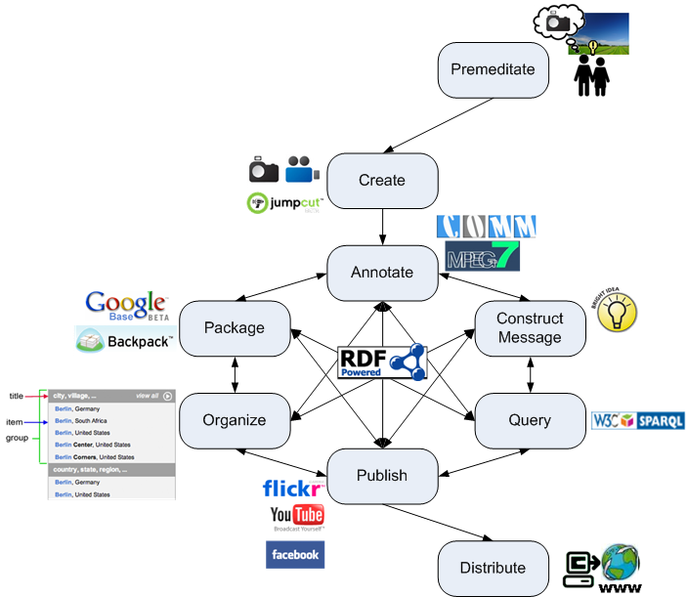
Canonical Processes Possible Flow

Slide 40
Sum Up
Community agreement, not “yet another model”
Large proportion of the functionality provided by multimedia applications can be described in terms of this model
Initial step towards the definition of open web-based data structures for describing and sharing semantically annotated media assets

Slide 41
Discussion
Frequently asked questions
  Complex processes
  Interaction
  Complex artifacts and annotations can be annotated
Notes:
The interaction turn to be a complex process
The canonical processes represent a distillation of our discussions on formulating them to help the multimedia community communicate about their systems at both a descriptive and computational level. During the course of our discussions we encountered questions that arose from different authors. We discuss these with the aim of clarifying potential misunderstandings. We also discuss how our descriptions of canonical processes fit in with more formal descriptions, in particular foundational ontologies, and what the boundaries of are achievements are --in particular we deliberately do not describe the form of the annotations. We see this rather as parallel, but closely related, work. The section gives an overview of advantages of specifying the canonical processes explicitly, some frequently asked questions and then how the process descriptions can be linked to more formal representations.
Much work in the multimedia community is geared to analysing visual or audio media and extracting higher-level representations of the features found. These are often geared to facilitating the query process. By identifying a number of other processes, we are now able to discuss the role of annotations in each of these. For example, the organise process can use semantics from both the message and the results retrieved by a query in order to impose more user-friendly ways of grouping and ordering material. The publish process can also benefit from information about the media characteristics (such as bandwidth required, or aspect ratio) for selecting items for a specific platform.
The companion papers illustrate the breadth of applicability of the processes, but are not intended to restrict its scope. Many other application areas of semantically annotated multimedia would potentially benefit from their consideration during the design process. For example, universal design advocates ``the design of products, services and environments to be usable by as many people as possible regardless of age, ability or circumstance'', is an area that could benefit to a great extent from more explicit management of multimedia and associated annotations. For example, annotations from a premeditate process, such as a script, can provide a basis for creating audio descriptions of movies for blind users, or textual descriptions of audio effects for deaf users. Information about organization of the content can make easier navigation for blind users.

Slide 42
Literature
Lynda Hardman: Canonical Processes of Media Production. In Proceedings of the ACM Workshop on Multimedia for Human Communication - From Capture to Convey (MHC 05), November 2005.
Special Issue on Canonical Processes of Media Production
http://www.springerlink.com/content/j0l4g337581652t1/
http://www.cwi.nl/~media/projects/canonical/
Lynda Hardman, Zeljko Obrenovic, Frank Nack, Brigitte Kerhervé and Kurt Piersol: Canonical Processes of Semantically Annotated Media Production. In Multimedia Systems Journal, 2008
Philipp Sandhaus, Sabine Thieme and Susanne Boll: Canonical Processes in Photo Book Production. In Multimedia Systems Journal, 2008
Stefano Bocconi, Frank Nack and Lynda Hardman: Automatic generation of matter-of-opinion video documentaries. In Journal of Web Semantics, 6(2), p139-150, 2008.

Slide 43
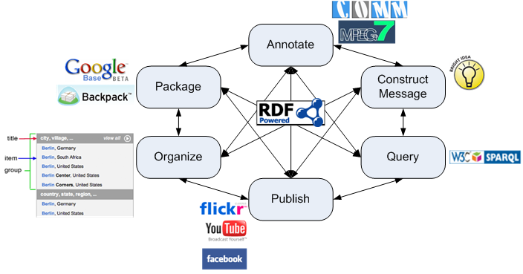
The Importance of the Annotations

Slide 44
Agenda
Understanding Multimedia Applications Workflow
  CeWe Color Photo Book creation application
  Vox Populi argumentation-based video sequences generation
  Canonical Processes of Media Production
Semantic Annotation of Multimedia Content
  Multimedia metadata formats: use cases and requirements
  Multimedia metadata interoperability issues
  MPEG-7 based ontologies
  COMM: A Core Ontology for MultiMedia
Semantic Search and Presentation of Multimedia Content
  Link your data!
  Searching and Browsing Multimedia Semantic Datasets with different user interfaces built on top of Cliopatria

Slide 45
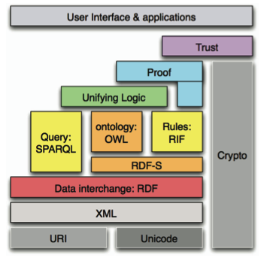
Multimedia: Description methods
MPEG-21
MPEG-7
MPEG-4
MPEG-2
MPEG-1
ISO
W3C

Slide 46
MPEG-7: a multimedia description language?
ISO standard since December of 2001
Main components:
  Descriptors (Ds) and Description Schemes (DSs)
  DDL (XML Schema + extensions)
Concern all types of media
Part 5 – MDS
Multimedia Description Schemes
Notes:
Diagram is messy. Try to show largest part of MPEG-7 in one slide.
From Alia and Michiel: MPEG-7 so far???

Slide 47
MPEG-7 and the Semantic Web
MDS Upper Layer represented in RDFS
  2001: Hunter
  Later on: link to the ABC upper ontology
MDS fully represented in OWL-DL
  2004: Tsinaraki et al., DS-MIRF model
MPEG-7 fully represented in OWL-DL
  2005: Garcia and Celma, Rhizomik model
  Fully automatic translation of the whole standard
MDS and Visual parts represented in OWL-DL
  2007: Arndt et al., COMM model
  Re-engineering MPEG-7 using DOLCE design patterns

Slide 48
Requirements [aceMedia, MMSEM XG]
MPEG-7 compliance
  Support most descriptors (decomposition, visual, audio)
Syntactic and Semantic interoperability
  Shared and formal semantics represented in a Web language (OWL, RDF/XML, RDFa, etc.)
Separation of concerns
  Domain knowledge versus multimedia specific information
Modularity
  Enable customization of multimedia ontology
Extensibility
  Enable inclusion of further descriptors (non MPEG-7)
Notes:
MPEG-7 embodies large amounts of knowledge/experience from multimedia annotation community.
Semantic – need to have shared understanding of meanings. Syntactic interoperability is insufficient but still necessary.
Separation: can re-use (other people’s) domain knowledge.
Modularity: minimize the execution overhead when used for multimedia annotation, e.g. audio only descriptors.

Slide 49
MPEG-7 Based Ontologies
 | Hunter | DS-MIRF | Rhizomik | COMM
Foundational Ontologies | ABC | None | None | DOLCE
Complexity | OWL-Full | OWL-DL | OWL-DL | OWL-DL
Coverage | MDS+Visual | MDS+CS | All | MDS+Visual
Applications | Digital Libraries | Digital Libraries | Digital Rights | MM Analysis

Slide 50
Common Scenario
The "Big Three" at the Yalta Conference (Wikipedia)

Slide 51
Common Scenario: Tagging Approach
Reg1
The "Big Three" at the Yalta Conference (Wikipedia)
Localize a region
  Draw a bounding box, a circle around a shape
Annotate the content
  Interpret the content
  Tag: Winston Churchill, UK Prime Minister, Allied Forces, WWII

Slide 52
Common Scenario: SW Approach
Reg1
The "Big Three" at the Yalta Conference (Wikipedia)
Localize a region
  Draw a bounding box, a circle around a shape
Annotate the content
  Interpret the content
  Link to knowledge on the Web
  :Reg1 foaf:depicts dbpedia:Winston_Churchill
  dbpedia:Winston_Churchill skos:altLabel
  "Sir Winston Leonard Spencer-Churchill"
  dbpedia:Winston_Churchill rdf:type foaf:Person

Slide 53
Hunter's MPEG-7 Ontology
Notes:
Skip a few slides – illustrations useful when reading ISWC07 paper.
Jane simplified xml path (so no blank nodes)

Slide 54
DS-MIRF MPEG-7 Ontology
Notes:
lots of blank nodes

Slide 55
Rhizomik MPEG-7 Ontology

Slide 56
COMM: Fragment Identification
Notes:
start with same media and with MPEG-7 and got 4 different ontologies, so MPEG-7 is ambiguous

Slide 57
Comparison
Link with domain semantics
  Hunter: ABC model + mpeg7:depicts relationship
  DS-MIRF: Domain ontologies needs to subclass the general MPEG-7 categories
  Rhizomik: Use the mpeg7:semantic relationship
  COMM: Semantic Annotation pattern
MPEG-7 coverage
  Hunter: extension of the MPEG-7 visual descriptors
  COMM:
    Formalization of the context of the annotation
    Representation of the method (algorithm) that provides the annotation

Slide 58
Comparison
Modeling Decisions:
  DS-MIRF and Rhizomik: 1-to-1 translation from MPEG-7 to OWL/RDF
  Hunter: Simplification and link to the ABC upper model
  COMM: NO 1-to-1 translation
    Need for patterns: use DOLCE, a well designed foundational ontology as a modeling basis
Scalability:
 | Hunter | DS-MIRF | Rhizomik | COMM
Triples | 11 | 27 | 20 | 19

Slide 59
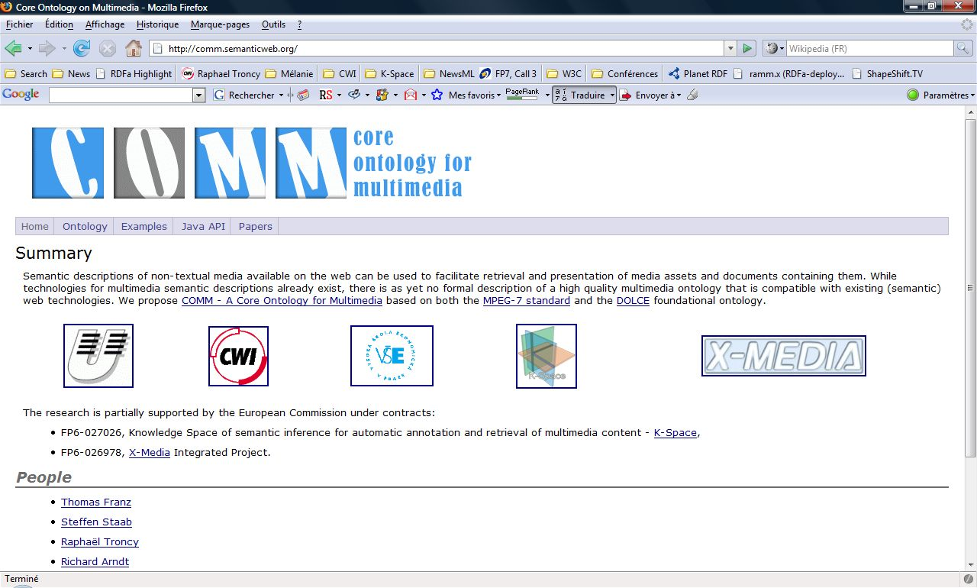

Slide 60
Scenario: Image
Reg1
The "Big Three" at the Yalta Conference (Wikipedia)
Localize a region (bounding box)
Annotate the content (interpretation)
  Tag: Winston Churchill, UK Prime Minister, Allied Forces, WWII
  Link to knowledge on the Web
  :Reg1 foaf:depicts dbpedia:Winston_Churchill
  dbpedia:Winston_Churchill skos:altLabel
  "Sir Winston Leonard Spencer-Churchill"
  dbpedia:Winston_Churchill rdf:type foaf:Person

Slide 61
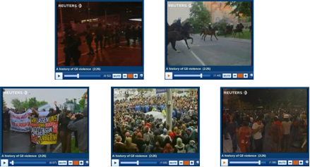
Scenario: Video
Seq4
Seq1
A history of G8 violence (video) (© Reuters)
Localize a region
Annotate the content
  Tag: G8 Summit, Heiligendamn, 2007
  Link to knowledge on the Web
EU Summit, Gothenburg, 2001
  :Seq1 foaf:depicts dbpedia:34th_G8_Summit
  :Seq4 foaf:depicts dbpedia:EU_Summit
  geo:Heilegendamn skos:broader geo:Germany

Slide 62
Research Problem
Seq4
Reg1
Seq1
The "Big Three" at the Yalta Conference (Wikipedia)
A history of G8 violence (video) (© Reuters)
⇨ MPEG-7
Multimedia objects are complex
  Compound information objects, fragment identification
Semantic annotation
  Subjective interpretation, context dependent
Linked data principle
  Open to reuse existing knowledge
⇨ D&S | OIO
⇨ RDF
Notes:
MPEG-7 allows you to express fragment identifiers.
Linked data is RDF giant global graph
Semantic annotation subjective interpretation, useful to represent so COMM uses upper level ontology, DOLCE patterns, D&S & OIO describe context of description

Slide 63
COMM: Design Rationale
Approach:
  NOT 1-to-1 translation from MPEG-7 to OWL/RDF
  Need for patterns: use DOLCE, a well designed foundational ontology as a modeling basis
Design patterns:
  Ontology of Information Objects (OIO)
    Formalization of information exchange
    Multimedia = complex compound information objects
  Descriptions and Situations (D&S)
    Formalization of context
    Multimedia = contextual interpretation (situation)
Define multimedia patterns that translate MPEG-7 in the DOLCE vocabulary

Slide 64
COMM: Core Functionalities
Most important MPEG-7 functionalities:
  Decomposition of multimedia content into segments
  Annotation of segments with metadata
    Administrative metadata: creation & production
    Content-based metadata: audio/visual descriptors
    Semantic metadata: interface with domain specific ontologies
⇨ Note that all are subjective and context dependent situations

Slide 65
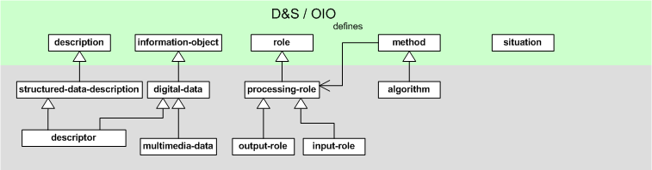
COMM: D&S / OIO Patterns
Definition of design patterns for decomposition and annotation based on D&S and OIO
  MPEG-7 describes digital data (multimedia information objects) with digital data (annotation)
  Digital data entities are information objects
  Decompositions and annotations are situations that satisfy the rules of a method or algorithm
Notes:
D&S = Descriptions & Situations
Ontology of Information Objects = OIO
- decomposing a media object (structure) or annotating it (semantic) is always subjective, context-dependent; this context should be represented formally since it allows to distinguish real object from the ones depicted in a media => D&S formalize the representation (description) of context (situation)
- both the media and the annotations are at the end considered as digital data, i.e. allows to bootstrap the model or metamodel introducing some recursivity; for example, you want to annotate annotations (cf canonical processes); OIO allows to treat equally any kind of information objects, in our case, both the media and the annotations
- D&S + OIO = DOLCE !

Slide 66
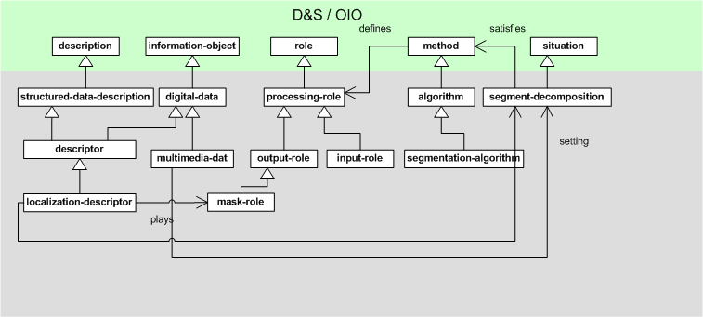
COMM: Decomposition Pattern
MPEG-7
MPEG-7
Notes:
mask-role is basically a multi-ended anchor
Green is DOLCE
Red colour is COMM which describes the fragment.

Slide 67
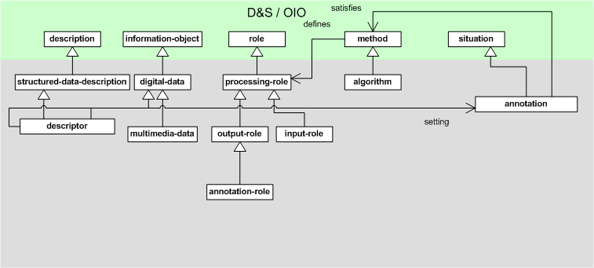
COMM: Annotation Pattern
MPEG-7
Notes:
(New) Green is semantic annotation (cf Canonical processes semantic annotation)

Slide 68
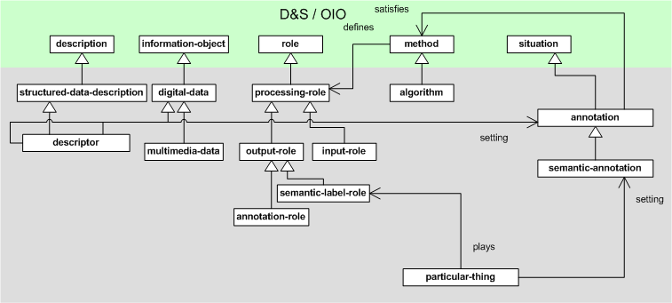

COMM: Semantic Pattern
Domain Ontologies

Slide 69
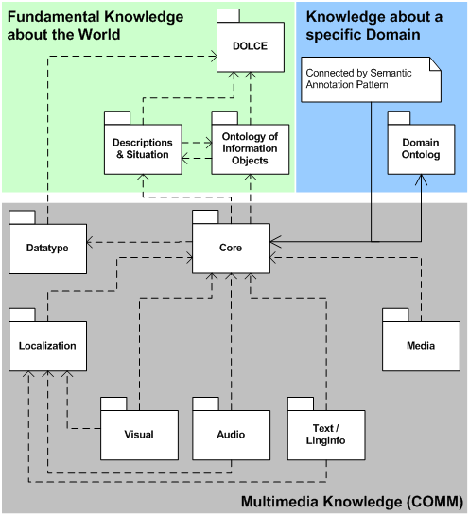
COMM: Modules
Annotation Pattern
Decomposition Pattern

Slide 70
Example 1: Fragment Identification

Slide 71
Example 1: Region Annotation

Slide 72
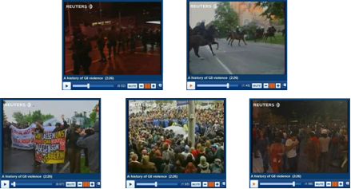
Example 2: Fragment Identification

Slide 73
Example 2: Sequence Annotation

Slide 74
Implementation
COMM fully formalized in OWL DL
  Rich axiomatization, consistency check (Fact++v1.1.5)
  OWL 2.0: qualified cardinality restrictions for number restrictions of MPEG-7 low-level descriptors
JAVA API available
  MPEG-7 class interface for the construction of meta-data at runtime

Slide 75
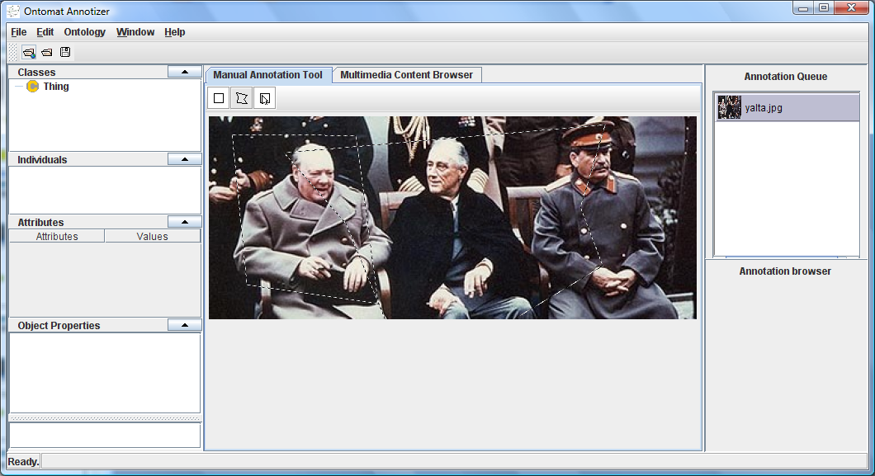
KAT Annotation Tool
Notes:
open source framework with number of plugins.
Many available.
Load images or video. Load ontologies. Drag & drop annotations on fragments.
linkeddata plugin – preload linked data cloud

Slide 76
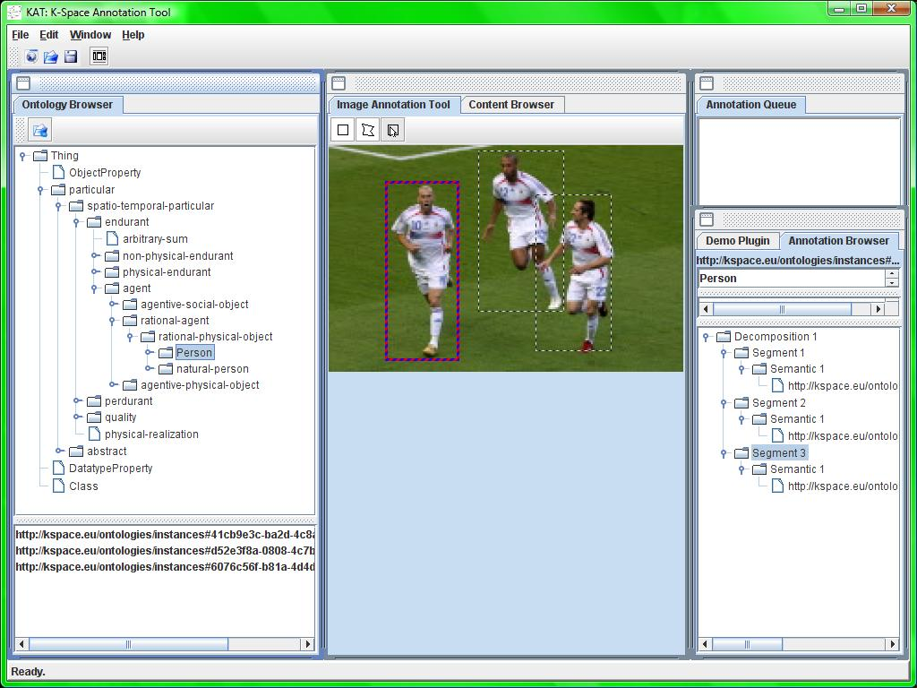

Slide 77
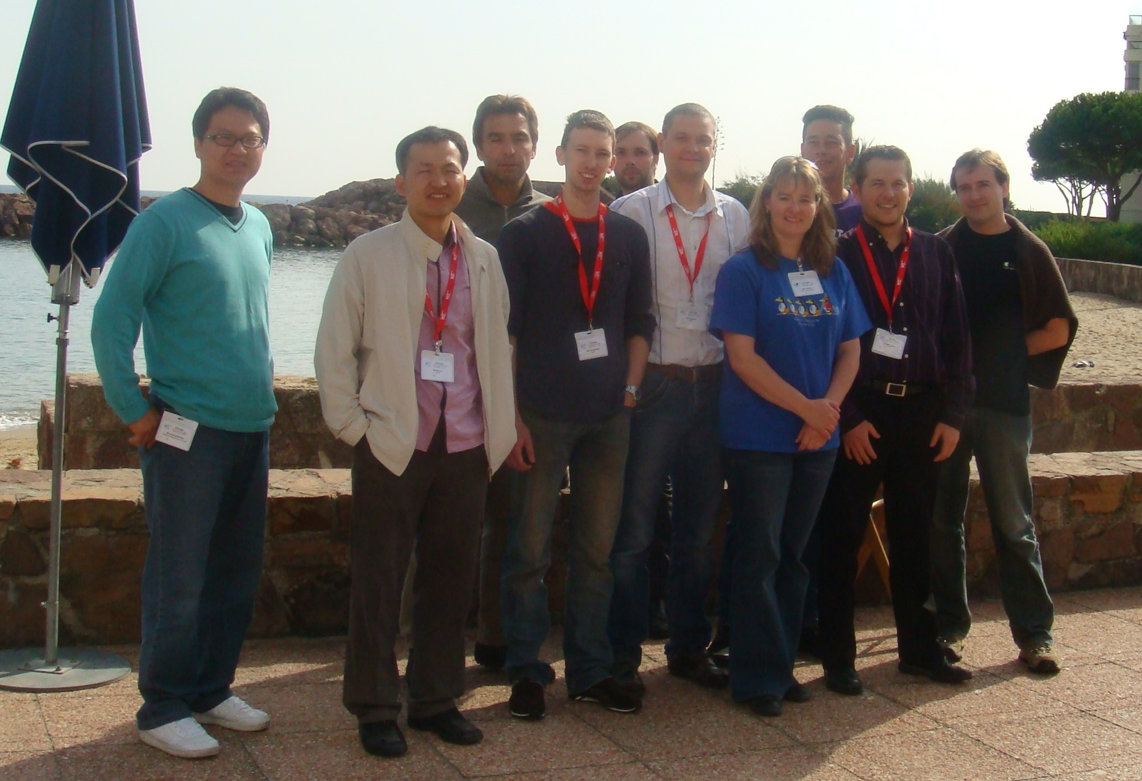
W3C Media Fragments WG
W3C Media Fragments WG
http://www.w3.org/2008/WebVideo/Fragments/

Slide 78
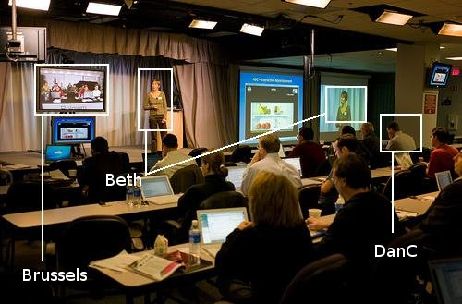
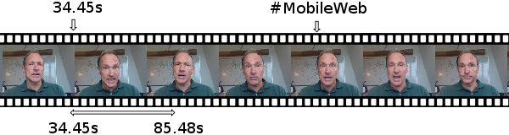
W3C Media Fragments WG
Provide URI-based mechanisms for uniquely identifying fragments for media objects on the Web, such as video, audio, and images.

Slide 79
W3C Media Fragments WG
Research question:
How to access media fragments
without retrieving the whole resource?
Use Case and Requirements
  Link to, Display, Bookmark, Annotate, Search
Four dimensions considered
  time, space, track, id
Protocols covered: HTTP(S), RTSP
http://www.w3.org/TR/media-frags-reqs

Slide 80
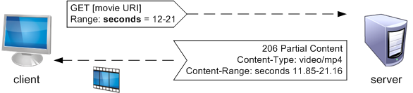
Media Fragment Processing (1)
User Agent (media fragment conforming):
http://www.youtube.com/watch?v=sxoh1z6s_Cw#t=12,21
  GET /watch?v=sxoh1z6s_Cw HTTP/1.1
  Host: www.youtube.com
  Accept: video/*
  Range: seconds=12-21 [HTTPBis clarification]
Server:

Slide 81
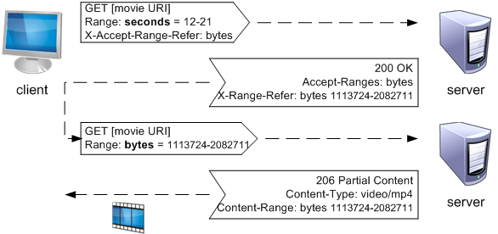
Media Fragment Processing (2)
User Agent (media fragment conforming):
http://www.youtube.com/watch?v=sxoh1z6s_Cw#t=12,21
Server:

Slide 82
Literature
Michael Hausenblas et al.: Multimedia Vocabularies on the Semantic Web. W3C Multimedia Semantics Incubator Group Report (XGR), 24 July 2007.
Raphaël Troncy, Jacco van Ossenbruggen, Jeff Z. Pan and Giorgos Stamou. Image Annotation on the Semantic Web. W3C Multimedia Semantics Incubator Group Report (XGR), 14 August 2007.
Vassilis Tzouvaras, Raphaël Troncy and Jeff Z. Pan. Multimedia Annotation Interoperability Framework. W3C Multimedia Semantics Incubator Group Report Editor's Draft, 14 August 2007.
Richard Arndt, Raphaël Troncy, Steffen Staab, Lynda Hardman and Miroslav Vacura: COMM: Designing a Well-Founded Multimedia Ontology for the Web. In 6th International Semantic Web Conference (ISWC'2007), Busan, Korea, November 11-15, 2007.
Raphaël Troncy, Oscar Celma, Suzanne Little, Roberto Garcia, Chrisa Tsinaraki: MPEG-7 based Multimedia Ontologies: Interoperability Support or Interoperability Issue? In 1st Workshop on Multimedia Annotation and Retrieval enabled by Shared Ontologies (MAReSO'2007), Genoa, Italy, December 2007.

Slide 83
Agenda
Understanding Multimedia Applications Workflow
  CeWe Color Photo Book creation application
  Vox Populi argumentation-based video sequences generation
  Canonical Processes of Media Production
Semantic Annotation of Multimedia Content
  Multimedia metadata formats: use cases and requirements
  Multimedia metadata interoperability issues
  MPEG-7 based ontologies
  COMM: A Core Ontology for MultiMedia
Semantic Search and Presentation of Multimedia Content
  Link your data!
  Searching and Browsing Multimedia Semantic Datasets with different user interfaces built on top of Cliopatria

Slide 84
What is linked data?
URIs, possibly identifying media fragments
+ annotations (tags)
+ links among fragments & annotations
wp:2006_FIFA_World_Cup#Final
events:id
geonames:2950159
nar:subject
nar:location
nc:15054000
foaf:depicts
dbpedia:Zidane
84

Slide 85
Linked Data Principles
Tim Berners Lee [2006] (Design Issues)
  Use URIs to name (identify) things
  (anything, not just documents)
  Use HTTP URIs
  (globally unique names, distributed ownership)
  so people can look up the names
  Provide useful information, e.g. in RDF,
  when someone looks up a URI
  Include RDF links to other URIs
  to enable discovery of related information

Slide 86

Linking Open Data Project
Expose open datasets in RDF
Set RDF links among the data items for different datasets
Over 2 billion triples,
3 millions links
(March 2008)
Many many
many more ... now
http://www4.wiwiss.fu-berlin.de/bizer/pub/lod-datasets_2008-09-18.html

Slide 87




DBpedia
DBpedia is a community effort to:
  extract structured "infobox" information from Wikipedia
  interlink DBpedia with other datasets on the Web

Slide 88
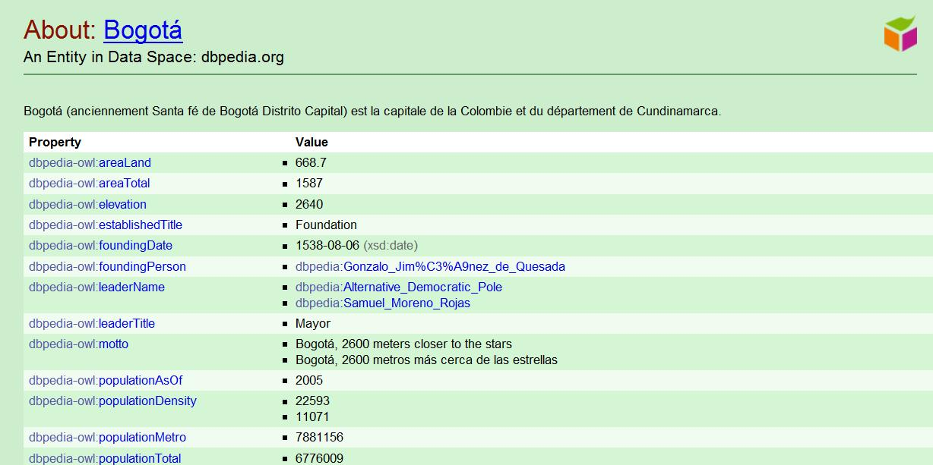
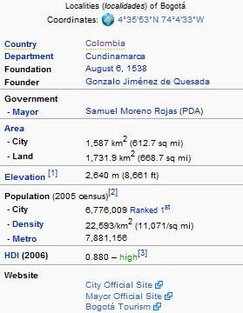
Scraping infobox data
http://dbpedia.org/resource/Bogotá

Slide 89
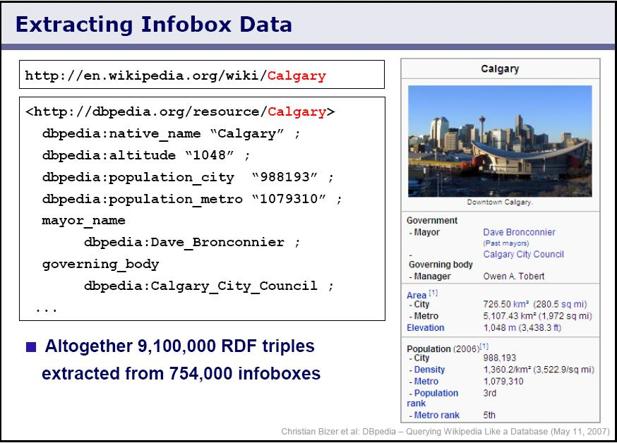
DBpedia

Slide 90
Automatic Links Among Open Datasets
<http://dbpedia.org/resource/Bogotá>
owl:sameAs <http://sws.geonames.org/3688689/>
owl:sameAs <http://rdf.freebase.com/ns/guid.9202a8c04000641f8000000000167bab>
dbpedia:population "6776009"
...
DBpedia
<http://sws.geonames.org/3688689/>
owl:sameAs <http://dbpedia.org/resource/Bogotá>
wgs84_pos:lat "4.6"
wgs84_pos:long "-74.0833333"
geo:population "7102602"
...
Geonames
Notes:
Processors can switch automatically

Slide 91
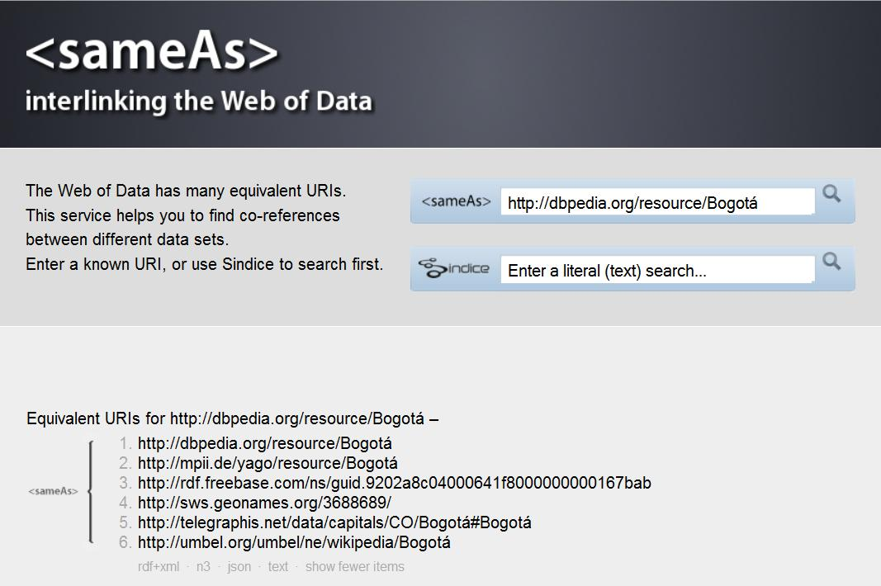
sameAs.org

Slide 92
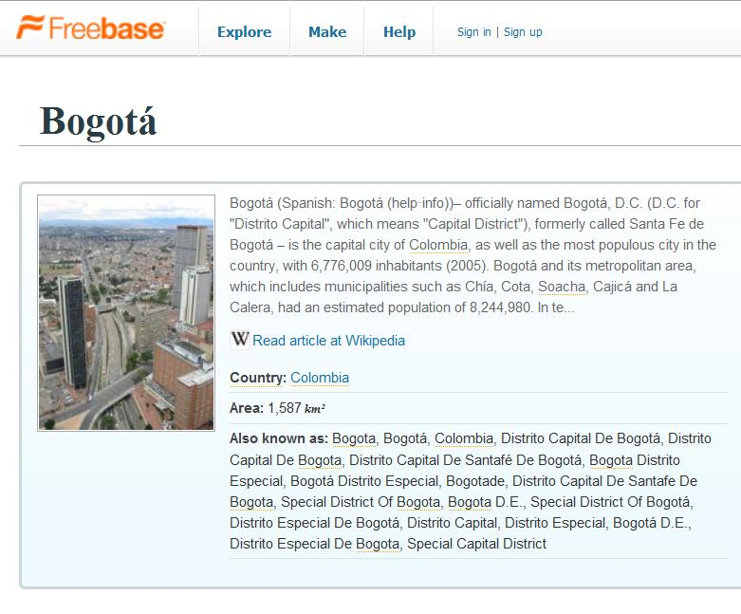
Bogotá on Freebase

Slide 93
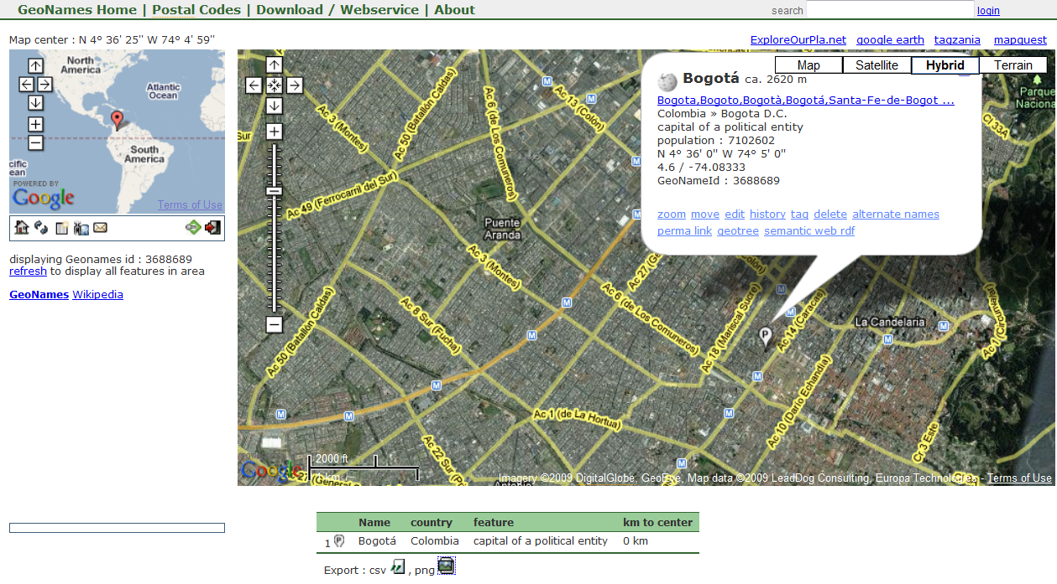
Bogotá on Geonames

Slide 94
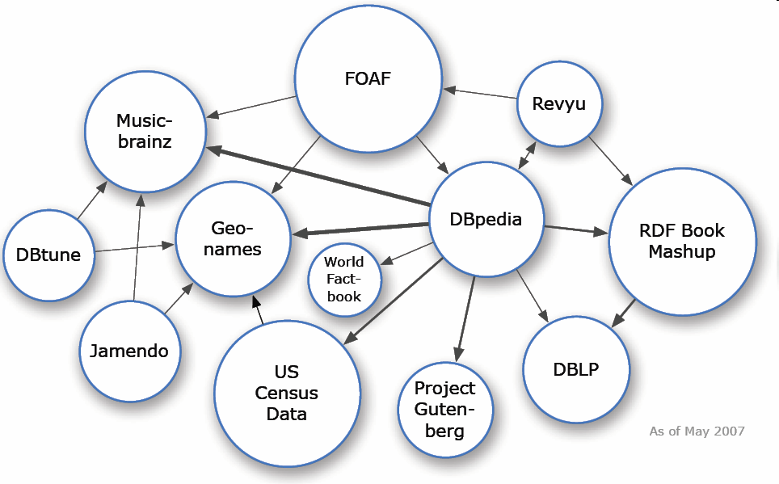
How Much Linked Data is there ?

Slide 95
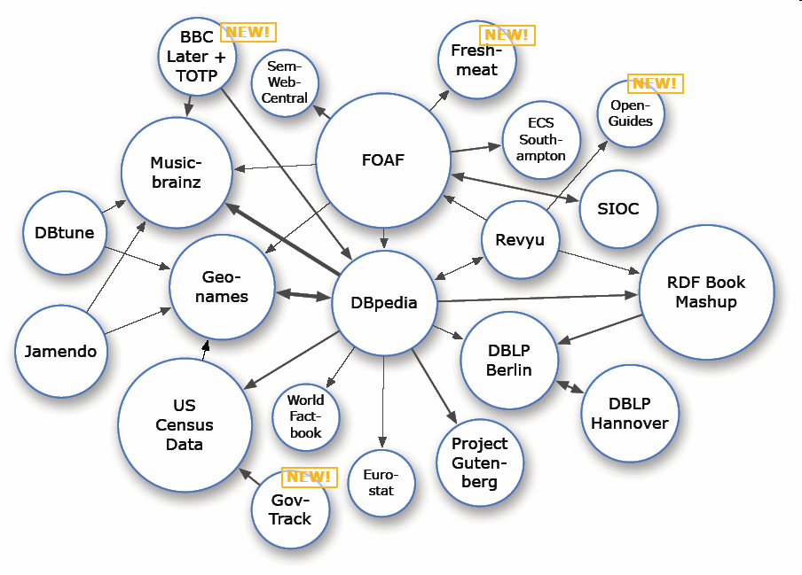
Linked Data Cloud – August 2007

Slide 96

Linked Data Cloud – March 2008

Slide 97

Linked Data Cloud – September 2008

Slide 98

Linked Data Cloud – March 2009

Slide 99
The Web of Data
Expose open datasets in RDF
Set RDF links among the data items for different datasets
Over 4.5 billion triples, 5 millions links
(March 2009)
... still counting

Slide 100

Populating the linked data cloud
Reuse what is there
  Of course, one could create RDF data manually …
  … but that is unrealistic on a large scale
  Goal is to generate RDF data automatically when possible and "fill in" by hand only when necessary
    service to get RDF from flickr images
    http://www.kanzaki.com/works/2005/imgdsc/flickr2rdf
    service to get RDF from XMP
    http://www.ivan-herman.net/cgi-bin/blosxom.cgi/WorkRelated/SemanticWeb/xmpextract.html
Expose what you make

Slide 101

Who are the users?
Why would they use the cloud?
What tasks can be supported?
How will the semantics help?
Notes:
Have had all the technical infrastructures – what can we do with media on the semantic web?
Who? experts, lay persons
Why? information searching, annotation tasks,
How? entering query, finding items of interest, displaying results
What? fact finding, information gathering, sensemaking, location-based mobile search (Pub Canary Wharf)
101

Slide 102
How can semantics help?
102
Semantic search survey by Michiel Hildebrand
Query construction
  disambiguate input (auto-completion)
  selection of available terms (grouping and ranking algorithms)
(Semantic) search algorithm
  graph traversal
  query expansion
  RDFS/OWL reasoning
Presentation of search results
  grouping by property
  visualization on timeline, map, etc.
Notes:
102

Slide 103
Query Construction
Interface
components
Feature
Functionality
Free text input | Keyword, natural language | Single text-entry, Property specific field
Operators | Syntactic disambiguation, Semantic constraints
Controlled terms | Disambiguate input, Restrict output, Predefined queries | Value lists, Faceted browser, Graph
User feedback | Pre-query disambiguation | Autocompletion

Slide 104
Search algorithm
Syntactic matching
  Exact, prefix or substring match
  Minimal edit distance
  Stemming
Semantic matching
  Graph traversal
  Query expansion
  RDFS/OWL reasoning
Notes:
Feature: Syntactic matching; semantic matching
Functionality:
Interface n/a

Slide 105
Result Presentation
Interface
components
Feature
Functionality
Data selection | Selected values, Template, Display vocabularies | Visualized by text, graph, tagcloud, map, timeline, calendar
Ordering | Content / link structure based ranking | Ordered list
Organization | Clustering by property, by result path or dynamic | Tree, nested box structure, clustermap
User feedback | Post-query disambiguation, Recommendation | Facets, tagcloud, value list
Notes:
Michiel’s print room experiment?

Slide 106
basic search
facet browsing (news?)
pkannotate
New tasks:
Comparison search
Notes:
slides from USI??

Slide 107
Example Property-driven UIs
CHIP demo
  exploring both artifacts and properties
  artifacts are artworks, but could be, e.g., books or movies
Parallax video

Slide 108

Cultural Heritage Data Cloud

Slide 109

Professional Art Annotation with Thesauri from the Web
Interviewed cultural heritage experts about annotating prints using terms from multiple thesauri
Created series of prototypes in consultation with experts
Provided single interface with access to multiple thesauri
Different fields required different thesauri and orderings
Notes:
WHO: type in name Oldenbar…
Show different vocabularies; alphabetical
Same death date as description
WHAT: type onthoofdi… ; different vocabularies – prefer RMA and otherwise Wordnet
WHERE: type gravenhagen, see hierarchy of places (after alphabetical)
select binnenhof

Slide 110
Professional Art Annotation with Thesauri from the Web
Notes:
Live demo

Slide 111

Notes:
http://eculture.multimedian.nl/demo/search
Front page:
Explain vocabularies and collections.
20 million triples.
Select help
TYPE Derain
Explain autocompletion
Explain the groupings
CLICK The Turning Road
"created by" Andre Derain
CLICK Derain Andre
Link to Chatou and Garches - TGN vocabulary.
Artworks he created at bottom of window.
SEARCH Tokugawa
Explain (different) groupings
Works not annotated with Tokugawa but found through Edo in SVCN thesaurus and link made (by hand) between thesauri.
CLICK View Map
Explain going to display results on map (and map has to be scaled).
CLICK Chiba and mention image.
(I didn't know what to say about searching on 1867.)
CLICK browse
Explain facets
CLICK Europe arrow (and not the word!)
CLICK France arrow
Then say you can also TYPE P a r
show autocompletion again
TYPE i s and hit return.
Group results by When
The scroll down groups of artworks until Montmartre paintings.
CLICK "Boulevard Montmartre" painting label and show that Paris it not mentioned.
Explain that part of TGN.
(Took 17 minutes.)

Slide 112
Notes:
http://www.europeana.eu/portal/thought-lab.html

Slide 113



videos
cartoons

Slide 114

animations
blogs

Slide 115











News Workflow Interoperability
NAR Schema
Broadcaster Schema
User Vocabulary
NewsCodes
Controlled Vocabularies
115
No integration of media (stories, photo, animation, video)
Little (or no) context in the news presentation
Lack of interoperability in the current workflow
Notes:
115

Slide 116
Metadata is Key
116
(Ultimate) Goal:
  Provide an environment for searching and browsing contextualized multimedia news information
Required integration:
  Data: various media, different forms, various sources
  Metadata: schema integration, semantic models
Influence and implications of UI:
  How to represent semantic multimedia metadata
  to facilitate presenting information?
  in other words ... What constraints do end-user interfaces put on the modeling of the metadata?

Slide 117








News and Multimedia Formats
NewsML
G2
EventsML
G2
SportsML
G2
News Architecture
(NAR)

Slide 118
Porting Schemas and Thesauri to the Semantic Web
⇨ Lack of best practices for
modeling ontologies from UML diagrams,
integrating ontologies with various thesauri,
while taking the end-user interface into account
118
Methodologies and tools for building ontologies:
... from scratch
ʺSKOSificationʺ of thesauri in the CH domain:
  preparation, syntactic and semantic conversion, standardization

Slide 119
Building a Semantic Web Infrastructure for News
1
2
3
4
Modeling the NAR ontology
Linking with media ontologies
Building SKOS thesauri
Enriching the metadata
119

Slide 120
Step 1: Modeling the NAR Ontology
⇨ focus on reuse of XML types leading to multiple repetition
resulting in overly complex nested XML structures

Slide 121

Step 1: Modeling the NAR Ontology
Flattening the XML structure
NewsItem
PhotoNewsItem

Slide 122
Step 1: Modeling the NAR Ontology
Modeling unique identifiers
  Use of dereferencable URIs for any resources
  (news items + vocabularies)
  Future: Use of URIs for resource fragments
  http://www.youtube.com/watch?v=1bibCui3lFM#t=1m45s
Modeling the provenance of the information
  Reification
  Named (and Networked) Graphs
{<> nar:subject cat:11002000}
dc:creator team:md ;
dc:modified ‘‘2005-11-11T08:00:00Z’’.

Slide 123






Step 2: Linking with Media Ontologies
dc:Subject ≈ nar:Subject
foaf:Person ≈ nar:Person
sioc:Item ≈ nar:Item
+
geo:lat geo:long

Slide 124

Step 3: Getting SKOS Vocabularies

Slide 125

Step 3: Getting SKOS Vocabularies

Slide 126


Step 4: Enriching the News Metadata
Concepts/Entities that are subject of news
  Thematic categories
  People
  Organizations
  Geopolitical Areas
  Points of Interest
  Events
  Products or artefacts

Slide 127





Step 4: Enriching the News Metadata
Named Entity Recognition
Domain Ontologies
NAR Ontology
NewsCodes Thesaurus

Slide 128



Step 4: Enriching the News Metadata
Concept Detectors
Domain Ontologies
NAR Ontology
NewsCodes Thesaurus

Slide 129
Web of Data and Linked Data
wp:2006_FIFA_Wolrd_Cup#Final
nc:15054000
nar:subject
events:id
nar:location
foaf:depicts
geonames:2950159
dbpedia:Zidane

Slide 130





Presenting News Information
Dimensions used for searching news items
  When time 10/07/2006
  Where location Paris
  What is depicted J. Chirac, Z. Zidane
  Why event WC 2006
  Who photographer Bertrand Guay, AFP
Metadata

Slide 131
Semantic Search of Multimedia News
Description | Number of RDF Triples
General Ontologies: NAR, DC, FOAF | 7,336
Domain Specific Ontologies: football | 104,358
Thesauri: newscodes | 34,903
DBpedia, Geonames | 53,468
AFP News Feed (June/July 2006) | 804,446
AFP Photos (June/July 2006) | 61,311
INA Broadcast Video (June/July 2006) | 1,932
Total | 1,067,754
Powered by ClioPatria 1.0 alpha 3

Slide 132


Slide 133

Provide new dimensions for browsing
Distinguish field images vs stadium and street images with a grass detector for the World Cup dataset

Slide 135


Slide 136


Slide 137


Slide 138










K-Space News demo credits
Datasets:
People:
More info: http://newsml.cwi.nl

Slide 139
SW-driven interfaces
Interesting interfaces:
SemaPlorer shows an interface to a billion plus rdf triples.
openAcademia shows several visualizations of search results (tagcloud, topic graph, relation browser.
OntoWiki follows the wiki style with faceted navigation, map and calendar visualization.
Tabulator (Tim Berners-Lee) is available as a Firefox extension. Very simple interface, which effectively shows (and allows navigation) of the raw graph structure (not included in the survey).
More oriented to search.
Swoogle, best known semantic web search engine.
Squiggle is a simple but effective interface for recommendation and search in music.
SemSearch allows simple semi-structured input queries.
Freebase, an open shared database of the world's knowledge (not strictly semantic web, but similar goals).

Slide 140
Literature user tasks/interfaces
Michiel Hildebrand, Jacco van Ossenbruggen and Lynda Hardman: /facet: A Browser for Heterogeneous Semantic Web Repositories. In 5th International Semantic Web Conference (ISWC'2006), pages 272-285, Athens (GA), USA, November 5-9, 2006.
Alia Amin, Jacco van Ossenbruggen, Lynda Hardman, Annelies Nispen: Understanding Expert' Information Seeking Needs. In Proc. Joint Conference no Digital Libraries (JCDL'08)
Alia Amin, Michiel Hildebrand, Jacco van Ossenbruggen, Vanessa Evers, Lynda Hardman. Organizing Suggestions in Autocompletion Interfaces. In ECIR ’09
Michiel Hildebrand, Jacco van Ossenbruggen, Lynda Hardman, Geertje Jacobs: Supporting subject matter annotation using heterogeneous thesauri - a user study in Web data reuse. International Journal of Human-Computer Studies, 2009, ISSN: 1071-5819

Slide 141
Literature semantic web building blocks
Jan Wielemaker, Michiel Hildebrand, Jacco van Ossenbruggen and Guus Schreiber: Infrastructure for thesaurus-based search and annotation: evaluating the standards. In 7th International Semantic Web Conference (ISWC'2008), Karlsruhe, Germany, October 26-30, 2008.
Raphaël Troncy: Bringing the IPTC News Architecture into the Semantic Web. In 7th International Semantic Web Conference (ISWC'2008), pages 483-498, Karlsruhe, Germany, October 26-30, 2008.
Raphaël Troncy, Lynda Hardman, Jacco van Ossenbruggen and Michael Hausenblas: Identifying Spatial and Temporal Media Fragments on the Web. In W3C Video on the Web Workshop, San Jose (California) and Brussels (Belgium), December 2007.
W3C Video on the Web Activity, April 2008
http://www.w3.org/2008/01/video-activity.

Slide 142
What are the messages?
Features can be extracted and used to describe
multimedia content (metadata)
The message can be made explicit (more metadata)
Media content and metadata can be passed around and
among systems
We need to agree on how to do this
(e.g. canonical processes, COMM,
W3C working groups, IPTC)
Users can be given much richer and more flexible access to
(semantically annotated) content, but…
we are still figuring out how to do this.
142

Slide 143

Thanks for your attention
http://www.cwi.nl/~media/samt09/
Notes:
Web page needs to be created.
samt08 is currently available.

