Slide 1
Towards interactive and coherent linked media presentations
Lynda Hardman, Raphaël Troncy
Interactive Information Access
Notes:
The "narrative" needs to form around the user: back-end supports decentralized content and links, front-end ensures local coherence.
Breaking linearity, enhancing interactivity, without destroying narrative. Difficult but not impossible
(NM2 project)

Slide 2
Browse, search and share linked media
Back-end
support for connecting semantics with media
support for expressing semantics
support for search using semantics
Front-end
examples of (interactive) interfaces
for videos and images

Slide 3
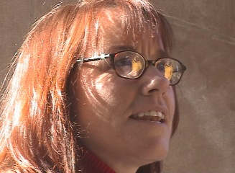
Vox Populi Video Sequence Generation
Stefano Bocconi, Frank Nack
Interview with America video footage with interviews and background material about the opinion of American people after 9-11 http://www.interviewwithamerica.com
Example question: What do you think of the war in Afghanistan?
“I am never a fan of military action, in the big picture I don’t think it is ever a good thing, but I think there are circumstances in which I certainly can’t think of a more effective way to counter this sort of thing…”
Notes:
Video
rich annotations
generate sequences

Slide 4
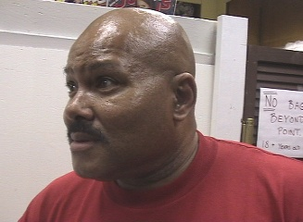
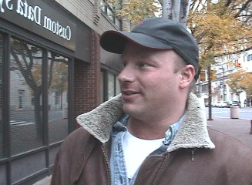
Vox Populi Generated video sequence
I am not a fan of military
actions
I cannot think of a more effective solution
War has never
solved
anything
Two billions
dollar bombs
on tents
Notes:
Videos annotated with different types of information:
Contextual
Interviewee (social), locations
Descriptive
Question asked and transcription of the answers
Filmic continuity, examples:
gaze direction of speaker (left, centre, right)
framing (close-up, medium shot, long shot)
Rhetorical
Rhetorical Statement
Argumentation model: Toulmin model

Slide 5
Interactive interface Vox Populi

Slide 6
Notes:
http://eculture.multimedian.nl/demo/search Front page: Explain vocabularies and collections. 20 million triples. Select help TYPE Derain Explain autocompletion Explain the groupings CLICK The Turning Road "created by" Andre Derain CLICK Derain Andre Link to Chatou and Garches - TGN vocabulary. Artworks he created at bottom of window. SEARCH Tokugawa Explain (different) groupings Works not annotated with Tokugawa but found through Edo in SVCN thesaurus and link made (by hand) between thesauri. CLICK View Map Explain going to display results on map (and map has to be scaled). CLICK Chiba and mention image. (I didn't know what to say about searching on 1867.) CLICK browse Explain facets CLICK Europe arrow (and not the word!) CLICK France arrow Then say you can also TYPE P a r show autocompletion again TYPE i s and hit return. Group results by When The scroll down groups of artworks until Montmartre paintings. CLICK "Boulevard Montmartre" painting label and show that Paris it not mentioned. Explain that part of TGN. (Took 17 minutes.)

Slide 7
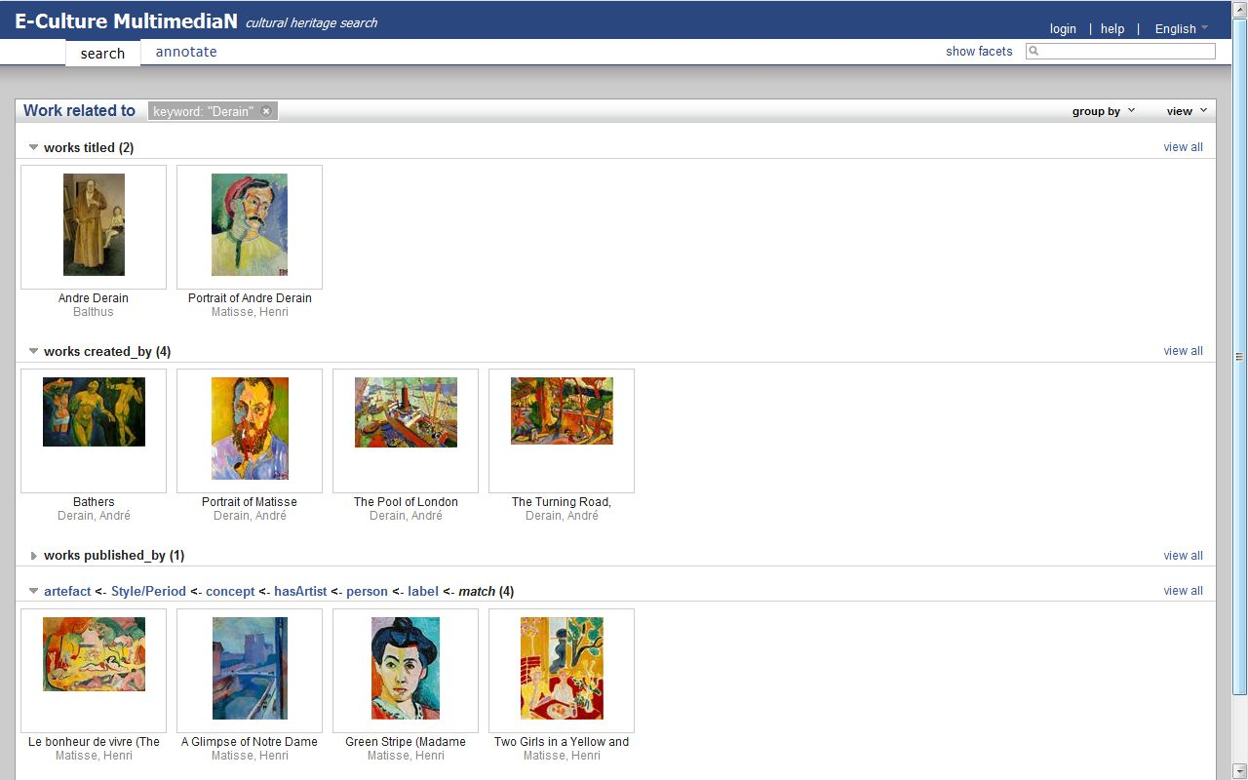

Slide 8
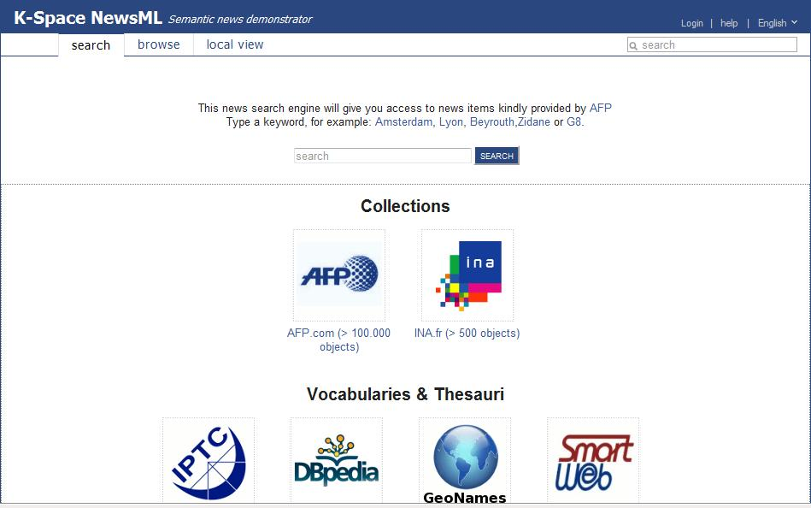

Slide 9
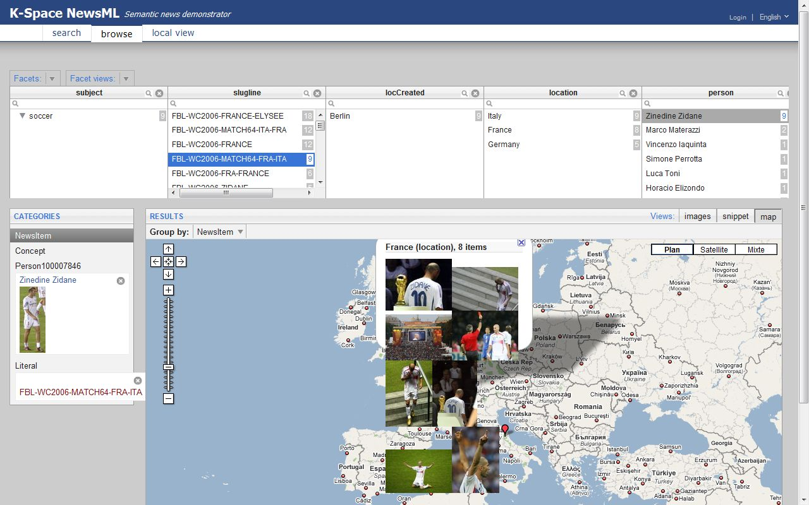
Notes:
browsing using explicit properties
image analysis for most different images

Slide 10
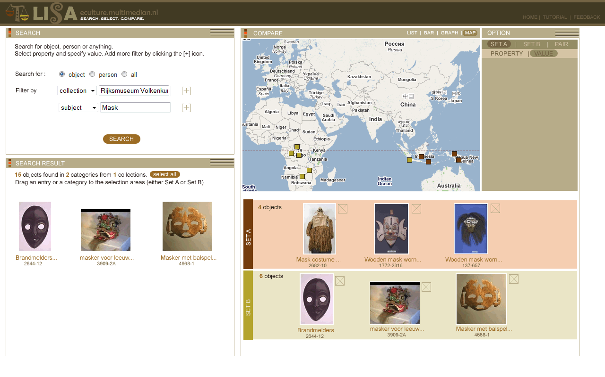
Specific support for comparing sets
MultimediaN E-Culture project
Notes:
eCulture Comparison Search
more specific task
expert users
complex interface
specialist support more complex interface

Slide 11
Towards WWW back-end support
specify media fragment
build support for intelligent network
specify (semantic) annotations
connect fragments with annotations
use background knowledge in linked data cloud
Notes:
?Search for objects in streaming media (real time???)

Slide 12
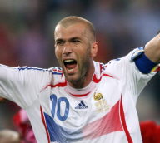
A Giant Graph Open to the World
wp:2006_FIFA_Wolrd_Cup#Final
nc:15054000
nar:subject
events:id
nar:location
foaf:depicts
geonames:2950159
dbpedia:Zidane
Notes:
Linked data cloud gives background knowledge, enabling new richer applcations
nar:subject is a unique number, which is language independent “soccer’

Slide 13
Media fragments + annotations: COMM
Richard Arndt, Raphaël Troncy, Steffen Staab, Lynda Hardman and Miroslav Vacura: COMM: Designing a Well-Founded Multimedia Ontology for the Web. ISWC'2007.
Notes:
Attach media to semantics. Separate concerns in annotations model.
Core Ontology for Multimedia

Slide 14
Video Fragments
http://video.google.com/myvideo#t=3016,3076
Notes:
Network issues of communication between client and server. Intelligence in network.
W3C group will specify how server serve fragments of media resources
Consortium will influence the recommendation (Raphael) and WG will disseminate results of project.
Spatio-temporal segment, media fragment URI specifying a clip.
(So can specify where a link goes to and how long clip should play.)
By defining fragments we become more flexible in presenting fragments in existing context, with links to other fragments;
and also possible to combine selections of fragments in new contexts (e.g. Vox Populi)

Slide 15
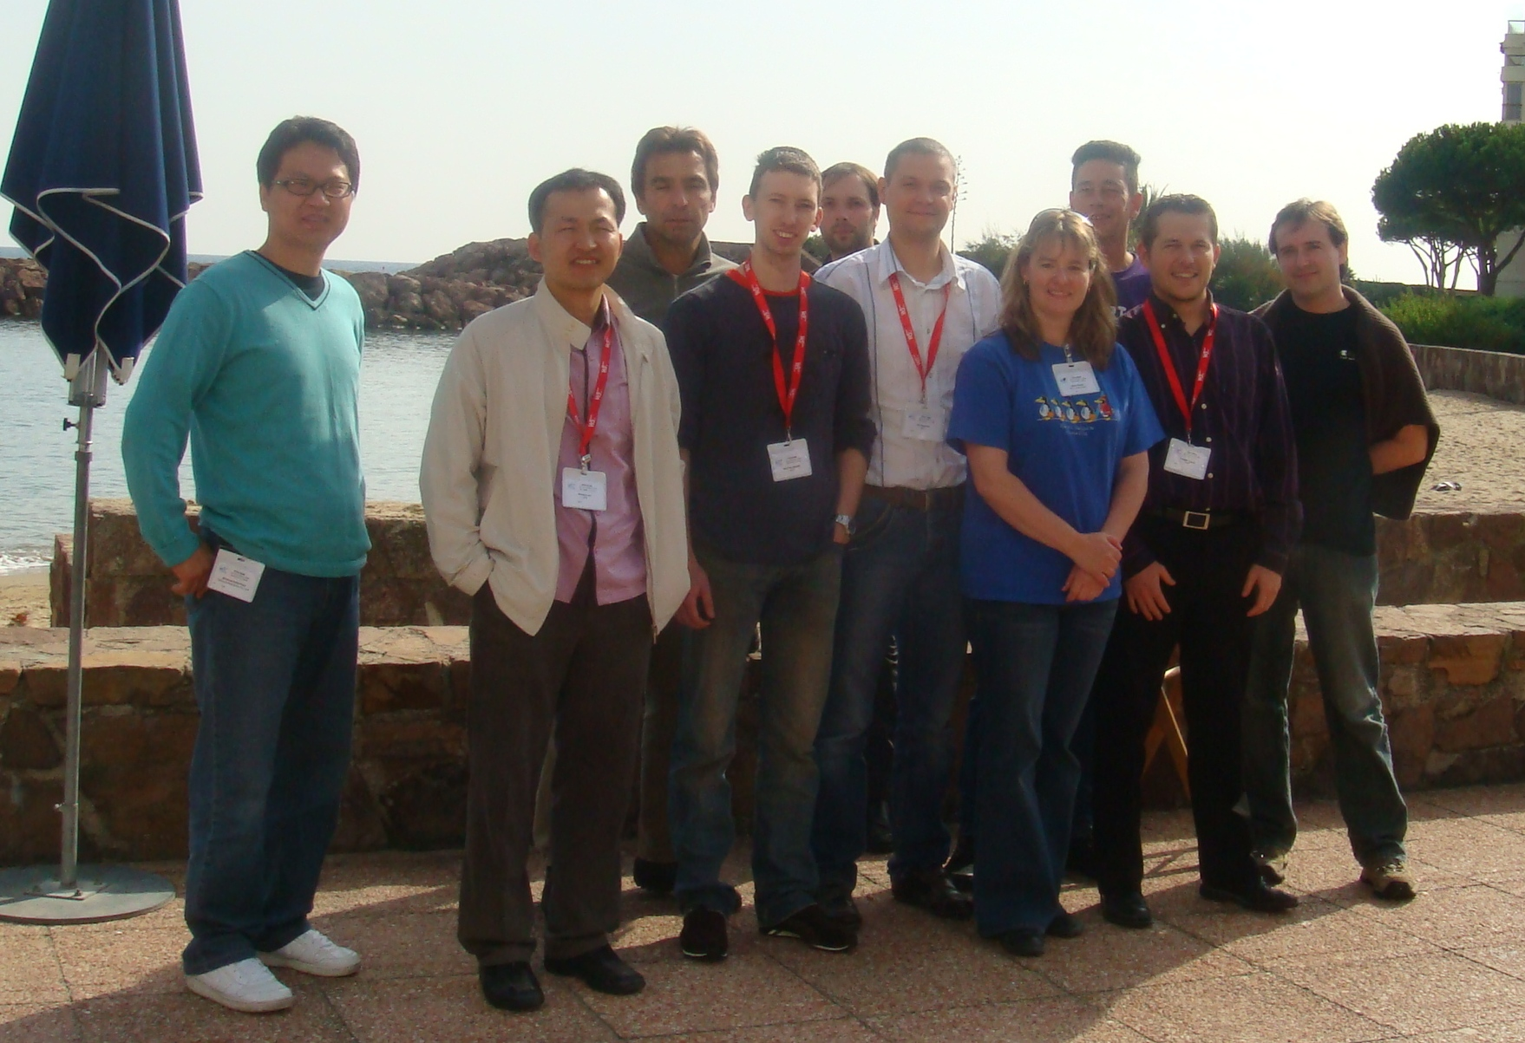
W3C Media Fragments WG
W3C Media Fragments WG
http://www.w3.org/2008/WebVideo/Fragments/
Notes:
Raphael co-chair

Slide 16
W3C Media Annotations WG
W3C Media Annotations WG
http://www.w3.org/2008/WebVideo/Annotations/
Notes:
ontology for describing annotations on SW.
Mapping between all media metadata formats
Raphael involved

Slide 17
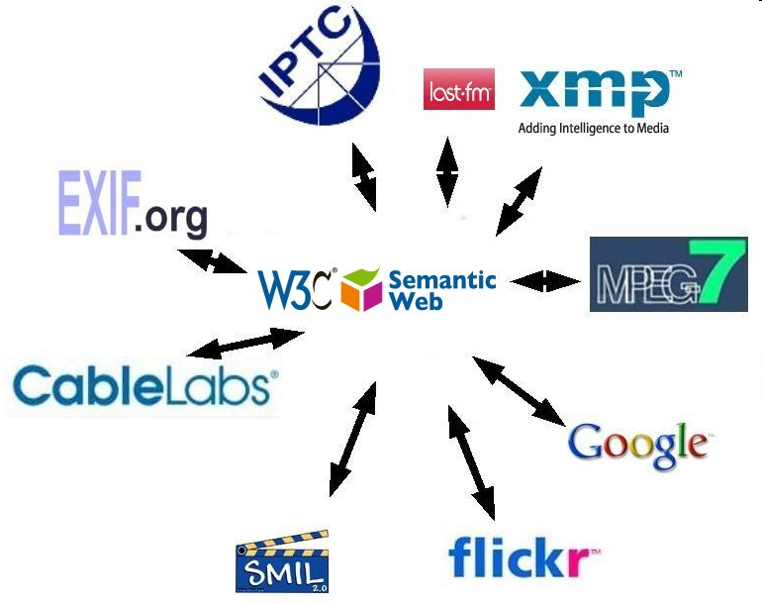
Notes:
Web 2.0
TV standards
mashup TV broadcast with Web 2.0 metadata (flickr tags)
Annotation group provide glue.
Raphael member.

Slide 18
Front-end support research
Build up context of multiple generated video sequences
e.g. aesthetic coherence
narrative flows
Give user more guidance about what is available when browsing information
Allow (simple) direct manipulation of annotations
Make it easy to share information with other users
Identify specific tasks for which we can develop specialist support (c.f. set comparison)
Notes:
I don’t mean we should support set comparison (unless a use case can be identified) but as an example of specialist interface for a specific task.
How find links between varous pieces of info on the web and semantic web.
News story process data extract names entity and link to background knowledge.
Browse TV analyse content and link to personal phtoto of place

Slide 19
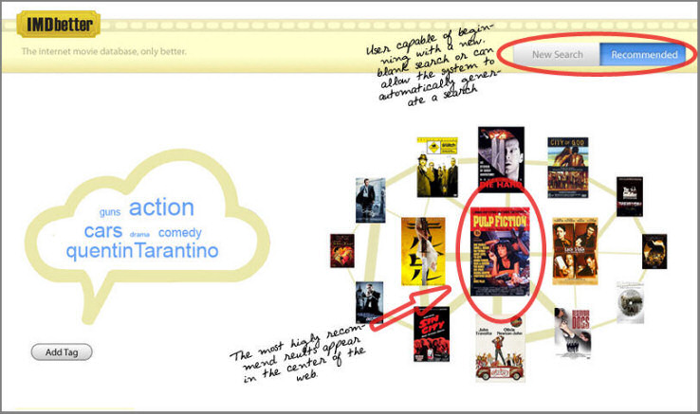
Direct manipulation of annotations
Jennifer Curtis, Herjan van den Heuvel, Li Li and Robert Winters, USI TU/e NL
Notes:
direct manipulation of annotations
Browsing data through manipulating metadata.
Browse actors, directors, films, jump to wikipedia about actor.
Communicate to friends which selections of films, or indeed a set of tags, am interested in.

Slide 20
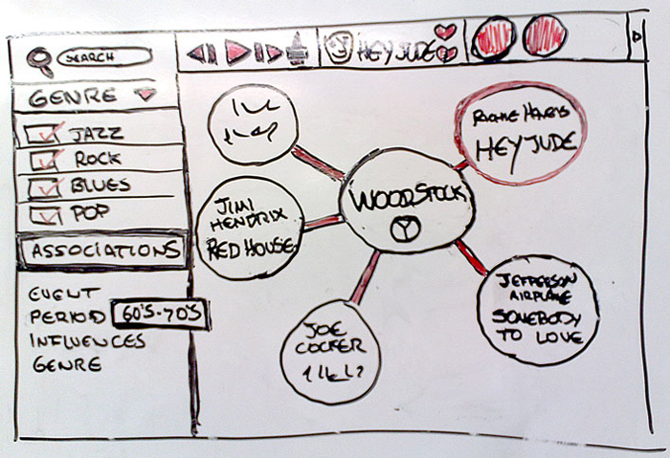
semantic song surfer interface?
Notes:
Play list
Hover over for more info
http://www.slideshare.net/guest965ec2/semantic-song-surf-presentation?type=powerpoint

Slide 21
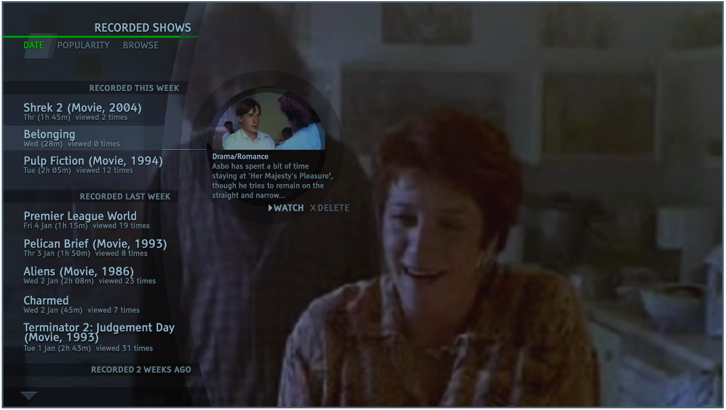
Browsing recorded video content
Balancing the Power of Multimedia Information Retrieval and Usability in Designing Interactive TV, Hyowon Lee et al. , uxTV 2008
Notes:
While watching movie of place in Greece, make links to own photos of photos from Greek holiday.

Slide 22
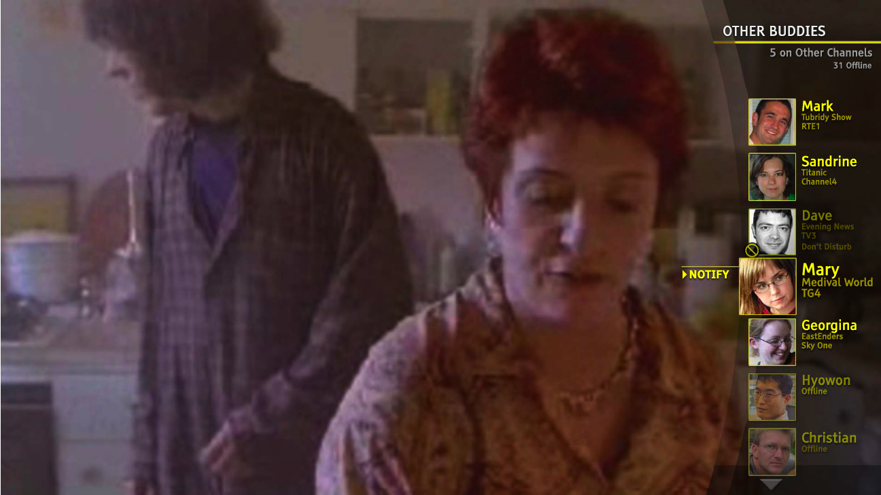
Communicating with friends
Balancing the Power of Multimedia Information Retrieval and Usability in Designing Interactive TV, Hyowon Lee et al. , uxTV 2008

