Slide 1

Quantum Cryptography
Christian Schaffner
Institute for Logic, Language and Computation (ILLC)
University of Amsterdam
Centrum Wiskunde & Informatica
Amsterdam University College
Monday, 24 February 2014

Slide 2
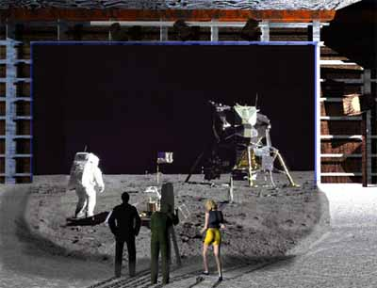
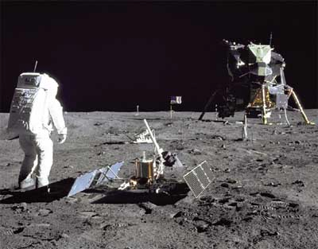
1969: Man on the Moon
The Great Moon-Landing Hoax?
NASA
http://www.unmuseum.org/moonhoax.htm
How can you prove that you are at a specific location?
Notes:
In 1969, man has first set foot on the moon, as you can see here on this picture sent around the world by NASA...
Or not? Maybe it was all just a “great moon-landing hoax”, as speculated on various conspiracy-theory websites on the internet?
One fascinating cryptographic question I want to study in my project is: “How can you prove that you are at a specific location?”
More about it later…

Slide 3
What will you learn from this Talk?
Classical Cryptography
Introduction to Quantum Mechanics
Quantum Key Distribution
Position-Based Cryptography
Notes:
only scattered relations to logic, I’m afraid

Slide 4
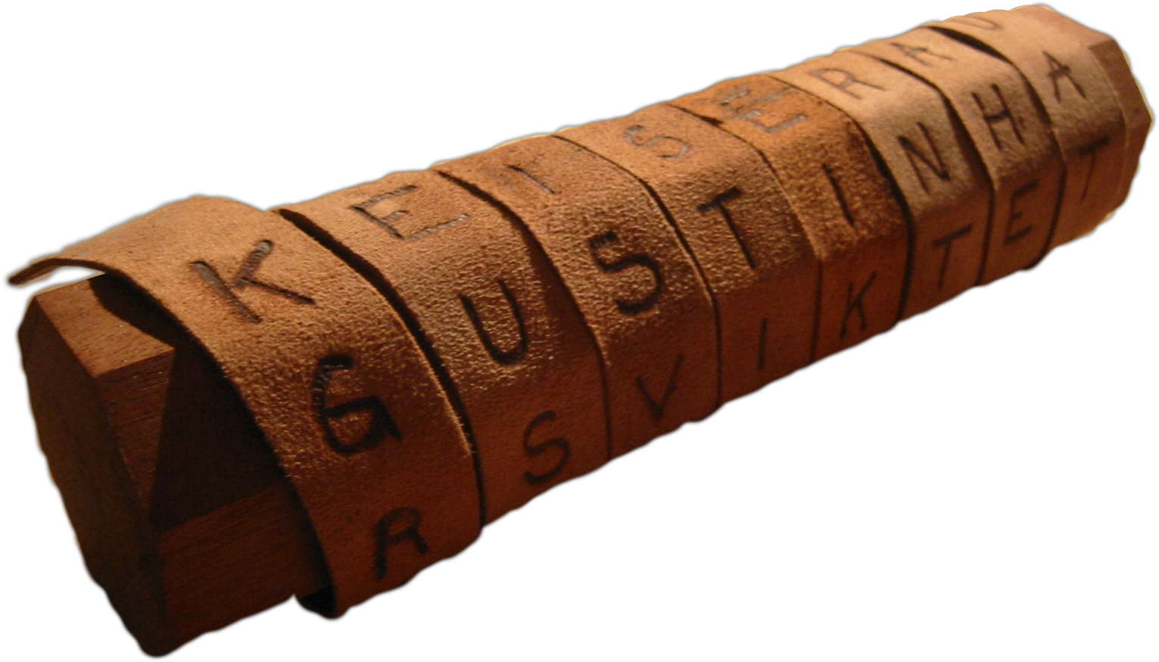
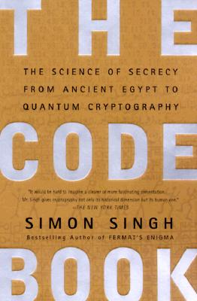
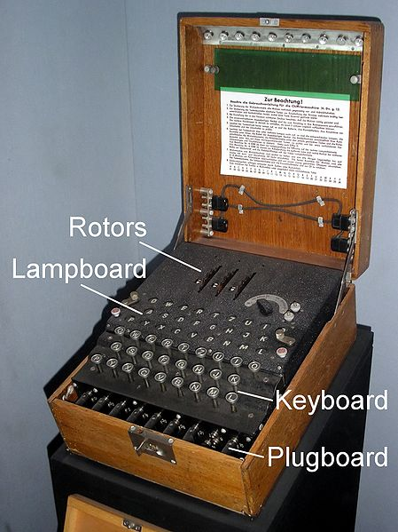
Classical Cryptography
3000 years of fascinating history
Until 1970: private communication was the only goal
Scytale
Enigma

Slide 5
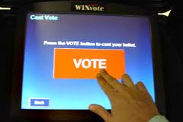
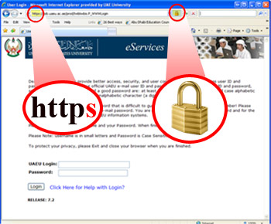
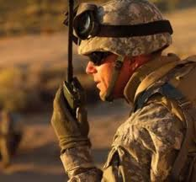
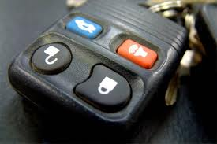
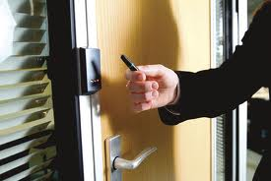
Modern Cryptography
is everywhere!
is concerned with all settings where people do not trust each other

Slide 6


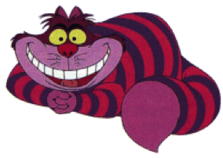
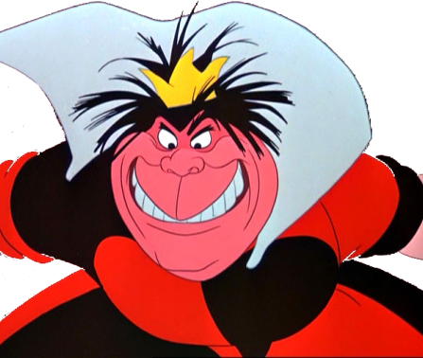
Secure Encryption
m = “I love you”
m = 0000 1111
Alice
Bob
k = ?
Eve
k = 0101 1011
k = 0101 1011
Goal: Eve does not learn the message
Setting: Alice and Bob share a secret key k

Slide 7
eXclusive OR (XOR) Function
7
x | y | x © y
0 | 0 | 0
1 | 0 | 1
0 | 1 | 1
1 | 1 | 0
Some properties:
  8 x : x © 0 = x
  8 x : x © x = 0
  ) 8 x,y : x © y © y = x
Notes:
quick check: please raise your hand if you have NOT seen this function before.
Please raise your hand if you HAVE seen this function before.
Now raise your hand if you have not raised your hand yet. For the people raising their hand now: you should seriously double-check the logic “axiom of the excluded middle”, asserting that either you HAVE seen this function before, or that you have NOT.

Slide 8
One-Time Pad Encryption
8
m = 0000 1111
c = m © k = 0101 0100
m = c © k = 0000 1111
Alice
Bob
k = ?
Eve
k = 0101 1011
k = 0101 1011
Goal: Eve does not learn the message
Setting: Alice and Bob share a key k
Recipe:
Is it secure?
x | y | x © y
0 | 0 | 0
0 | 1 | 1
1 | 0 | 1
1 | 1 | 0
m = 0000 1111
c = 0101 0100
k = 0101 1011
k = 0101 1011
c = m © k = 0101 0100
c © k = 0000 1111
c © k = m © k © k = m © 0 = m

Slide 9
Perfect Security
9
m = ?
c = m © k = 0101 0100
m = c © k = ?
Alice
Bob
k = ?
Eve
k = ?
k = ?
Given that c = 0101 0100,
  is it possible that m = 0000 0000 ?
    Yes, if k = 0101 0100.
  is it possible that m = 1111 1111 ?
    Yes, if k = 1010 1011.
  it is possible that m = 0101 0101 ?
    Yes, if k = 0000 0001
In fact, every m is possible.
Hence, the one-time pad is perfectly secure!
x | y | x © y
0 | 0 | 0
0 | 1 | 1
1 | 0 | 1
1 | 1 | 0

Slide 10
Problems With One-Time Pad
10
m = 0000 1111
c = m © k = 0101 0100
m = c © k = 0000 1111
Alice
Bob
k = ?
Eve
k = 0101 1011
k = 0101 1011
The key has to be as long as the message.
The key can only be used once.
In practice, other encryption schemes (such as AES) are used which allow to encrypt long messages with short keys.
One-time pad does not provide authentication:
Eve can easily flip bits in the message
Notes:
for encrypting internet traffic

Slide 11
Symmetric-Key Cryptography
11
Alice
Bob
Eve
Encryption insures secrecy:
Eve does not learn the message, e.g. one-time pad
Authentication insures integrity:
Eve cannot alter the message
General problem: players have to exchange a key to start with

Slide 12
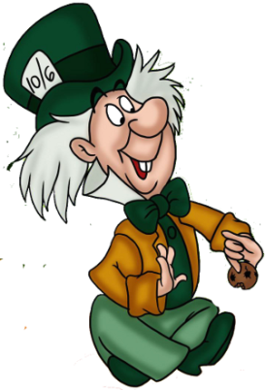
Public-Key Cryptography
12
Alice
Charlie
Bob
secret key
Eve
public key
Solves the key-exchange problem.
Everyone can encrypt using the public key.
Only the holder of the secret key can decrypt.
Digital signatures: Only secret-key holder can sign, but everyone can verify signatures using the public-key.

Slide 13
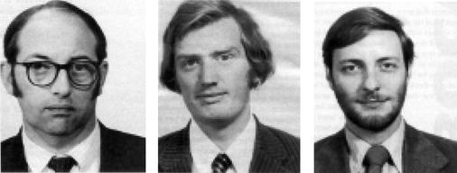


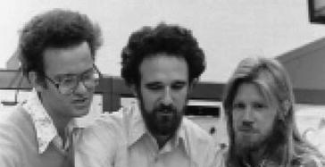
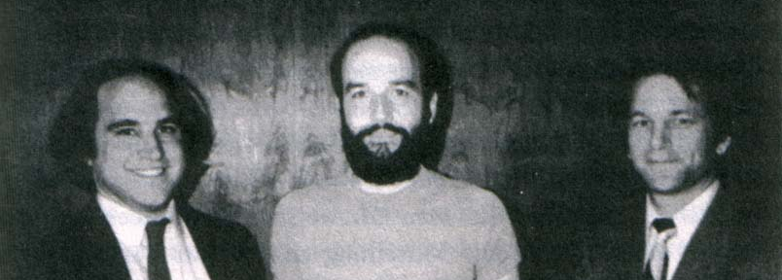
History of Public-Key Crypto
13
Early 1970s: invented in the „classified world“ at the
British Government Communications Head Quarters (GCHQ) by Ellis, Cocks, Williamson
Mid/late 1970s: invented in the „academic world“
by Merkle, Hellman, Diffie, and Rivest, Shamir, Adleman
Notes:
picture: http://link.springer.com/referenceworkentry/10.1007%2F978-1-4419-5906-5_210/fulltext.html#Fig2_210
James H. Ellis, Clifford C. Cocks, Malcolm J. Williamson (from left to right)
Ralph Merkle, Martin Hellman, Whitfield Diffie, (at Stanford)
and Ron Rivest, Adi Shamir, Leonard Adleman (at MIT)

Slide 14
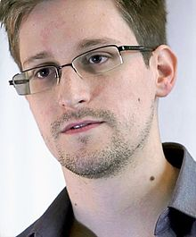
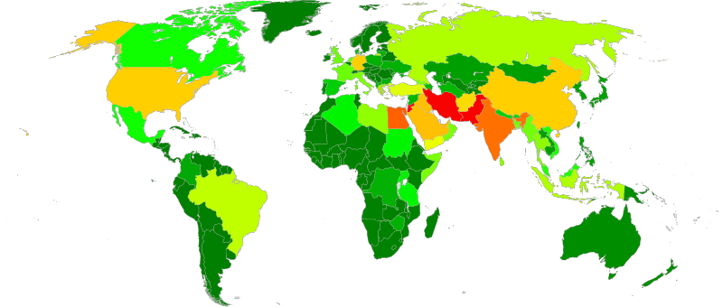
Politics of Cyberwar
14
Edward Snowden, former CIA and NSA employee,
now whistleblower and on (temporary) asylum in Russia
leaked many thousand top secret documents to various media, documenting a
mass surveillance programs by secret services from all over the world
Notes:
heat map of where NSA data collection is performed. Screenshot of the https://en.wikipedia.org/wiki/Boundless_Informant big data analysis system

Slide 15
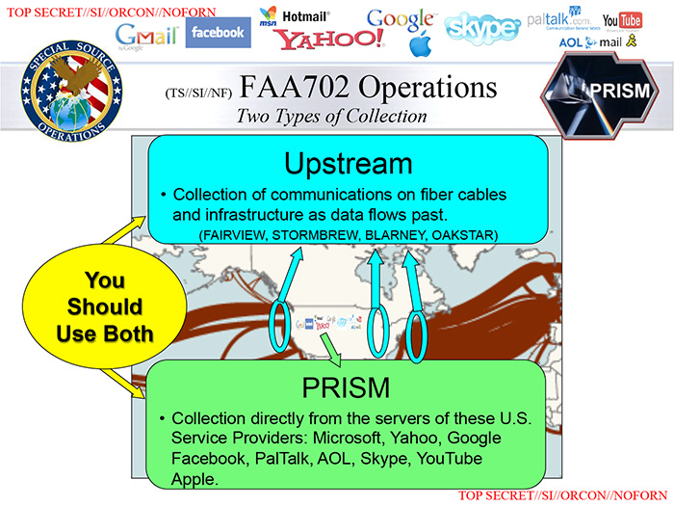
Politics of Cyberwar
15

Slide 16
Politics of Cyberwar
16
Methods:
  Break cryptography
  Influence industrial standards
  Pressure manufacturers to make insecure devices
  Infiltrate hardware and software (communication infrastructure, computers, smartphones etc.)
Why mass surveillance?
  Other than to combat terrorism, these surveillance programs have been employed to assess the foreign policy and economic stability of other countries, and to gather "commercial secrets“.

Slide 17
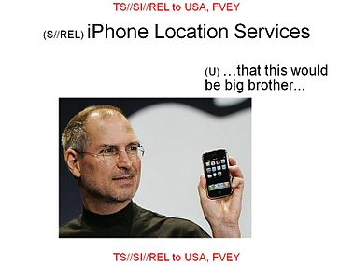
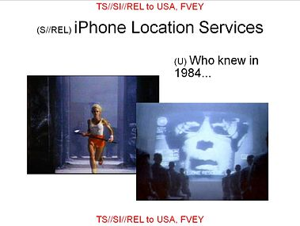
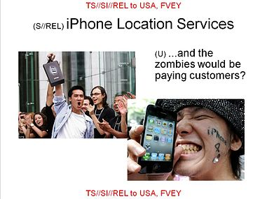

Why worry?
17
„I have nothing to hide“ is a very naive reaction.
Think about what your smartphone knows about you.
Think about what your smartphone does not know about you.
Notes:
when, where, with whom, how you look, websites visited, documents downloaded, pictures you posted

Slide 18
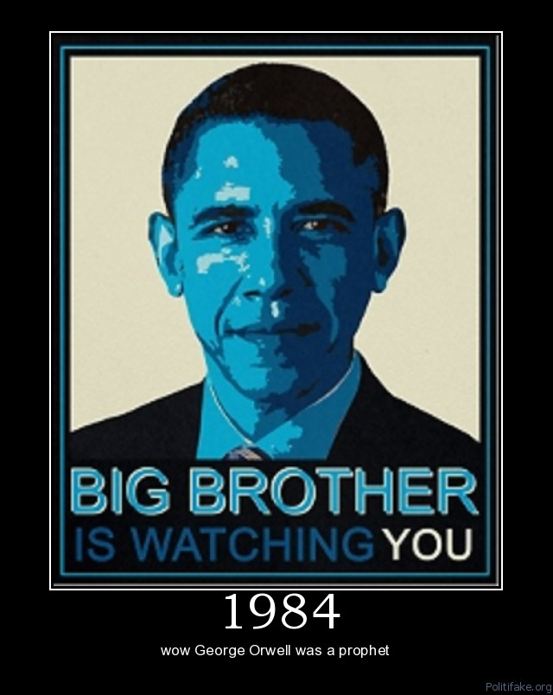
Why worry?
18
„I have nothing to hide“ is a very naive reaction.
Everyone‘s personal privacy is at stake!
George Orwell‘s surveillance state from his book 1984 is coming true...
"They (the NSA) can use the system to go back in time and scrutinize every decision you've ever made, every friend you've ever discussed something with, and attack you on that basis to sort of derive suspicion from an innocent life and paint anyone in the context of a wrongdoer." – Edward Snowden

Slide 19
Cryptography and Logic
19
Crypto-Toolbox
electronic voting system
Encryption
Hash function
Signature
Key establishment
Cryptographic protocols for advanced tasks are built from basic building blocks
Problem: security proofs become very hard to verify
Solution:
  Logic provides formal methods to specify tools and task
  Use automatic proof checkers to verify security
Notes:
pictures from an overview presentation by Michael Backes: http://www.infsec.cs.uni-saarland.de/~backes/
http://www.zurich.ibm.com/security/publications/2004/BaPfWa2004aCryptoLibSlides.ppt

Slide 20
What will you Learn from this Talk?
Classical Cryptography
Introduction to Quantum Mechanics
Quantum Key Distribution
Position-Based Cryptography

Slide 21
Quantum Bit: Polarization of a Photon
q
u
b
i
t
a
s
u
n
i
t
v
e
c
t
o
r
i
n
C
2

Slide 22
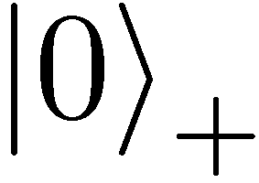
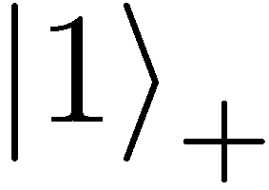
Qubit: Rectilinear/Computational Basis

Slide 23
Detecting a Qubit
No photons: 0
Alice
Bob

Slide 24
Measuring a Qubit
No photons: 0
Photons: 1
Alice
Bob
Measurement:
with prob. 1 yields 1
0/1

Slide 25
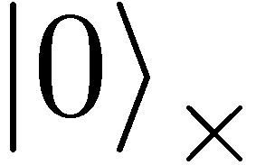
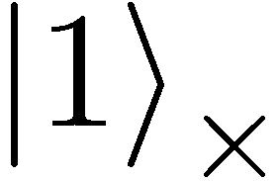

Diagonal/Hadamard Basis
Measurement:
with prob. ½ yields 0
=
with prob. ½ yields 1
0/1

Slide 26
Measuring Collapses the State
Measurement:
with prob. ½ yields 0
=
with prob. ½ yields 1
0/1

Slide 27
Measuring Collapses the State
=
=

Slide 28
Quantum Mechanics
+ basis
£ basis
Measurements:
with prob. 1 yields 1
0/1
with prob. ½ yields 0
0/1
with prob. ½ yields 1

Slide 29
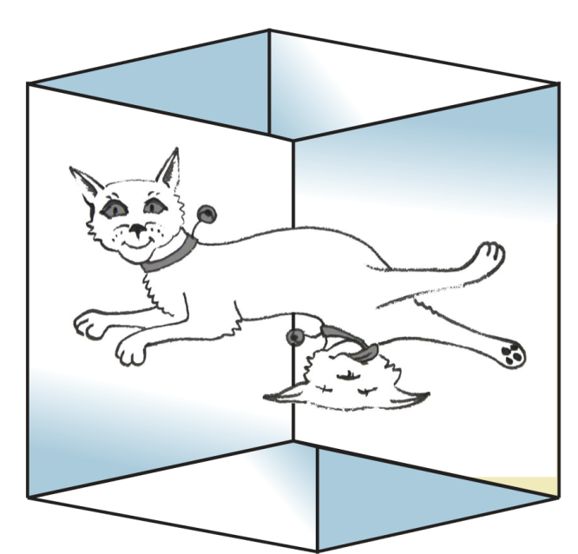
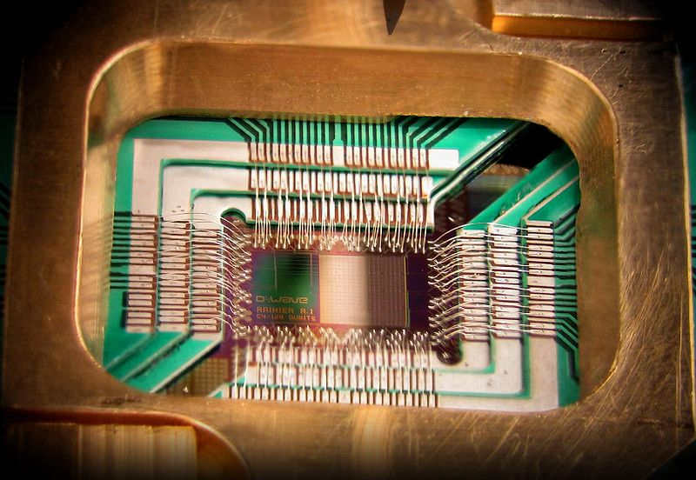
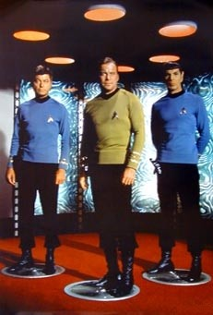
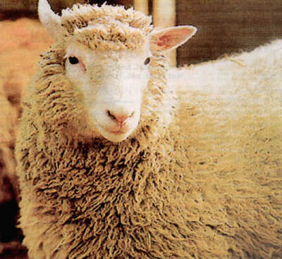
Wonderland of Quantum Mechanics

Slide 30
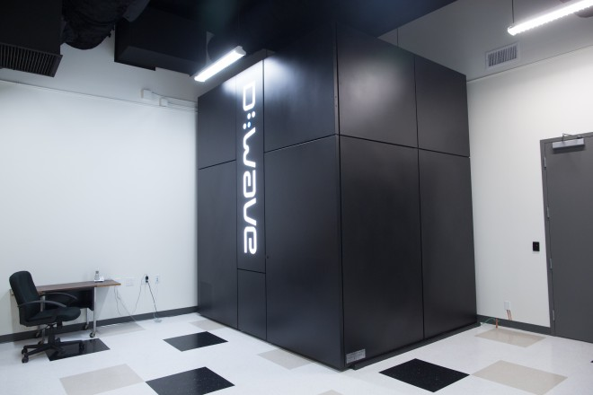
Quantum Computer
[Shor ’94] Efficient quantum algorithm for factoring which breaks public-key cryptography (RSA)
[Grover ’96] Fast quantum search algorithm
Possible to build in theory, no fundamental theoretical obstacles have been found yet.
Canadian company “D-Wave” claims to have build one. Did they?

Slide 31
No-Cloning Theorem
U
Quantum operations:
?
?
?
Proof: copying is a non-linear operation

Slide 32
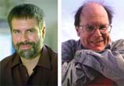
Quantum Key Distribution (QKD)
32
[Bennett Brassard 84]
Alice
Bob
k = ?
k = 0101 1011
Eve
k = 0101 1011
Offers an quantum solution to the key-exchange problem
Puts the players into the starting position to use symmetric-key cryptography (encryption, authentication etc.).

Slide 33
Quantum Key Distribution (QKD)
33
[Bennett Brassard 84]
0 1 1 1 0
0 0 1 1 0
k = 110
k = 110

Slide 34
Quantum Key Distribution (QKD)
34
[Bennett Brassard 84]
?
?
?
?
?
0 1 1 1 0
0 0 1 1 0
k = ?
k = 10
k = 10
Quantum states are unknown to Eve, she cannot copy them.
Honest players can test whether Eve interfered.

Slide 35
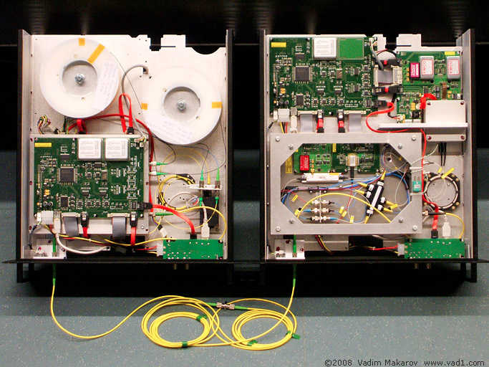

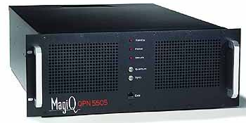
Quantum Key Distribution (QKD)
35
[Bennett Brassard 84]
Alice
Bob
Eve
technically feasible: no quantum computer required,
only quantum communication

Slide 36
What will you Learn from this Talk?
Classical Cryptography
Introduction to Quantum Mechanics
Quantum Key Distribution
Position-Based Cryptography

Slide 37
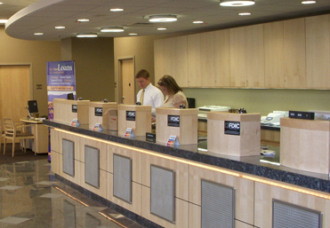
Position-Based Cryptography
Typically, cryptographic players use credentials such as
  secret information (e.g. password or secret key)
  authenticated information
  biometric features
Can the geographical location of a player be used
as cryptographic credential ?

Slide 38
Position-Based Cryptography
Can the geographical location of a player be used as sole cryptographic credential ?
Possible Applications:
  Launching-missile command comes
  from within the military headquarters
  Talking to the correct country
  Pizza-delivery problem /
  avoid fake calls to emergency services
  …

Slide 39


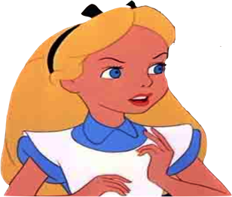

Basic task: Position Verification
Verifier1
Prover
Verifier2
Prover wants to convince verifiers that she is at a particular position
no coalition of (fake) provers, i.e. not at the claimed position, can convince verifiers
assumptions:  communication at speed of light
            instantaneous computation
            verifiers can coordinate

Slide 40




Position Verification: First Try
Verifier1
Prover
Verifier2
time
distance bounding [Brands Chaum ‘93]

Slide 41
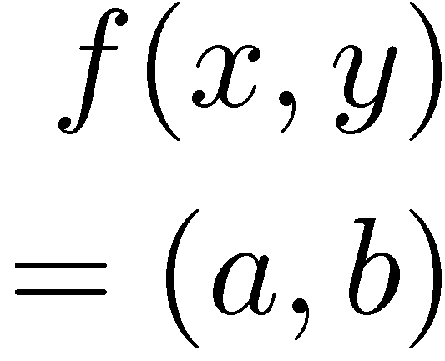


Position Verification: Second Try
Verifier1
Prover
Verifier2
position verification is classically impossible !
Notes:
classical impossibility proof by [Chandran Goyal Moriarty Ostrovsky: CRYPTO ’09]

Slide 42


The Attack
copying classical information
this is impossible quantumly

Slide 43


Position Verification: Quantum Try
[Kent Munro Spiller 03/10]
?
?
?
Can we brake the scheme now?

Slide 44




Attacking Game
?
?
?
?
?
Impossible to cheat due to non-cloning theorem
Or not?

Slide 45
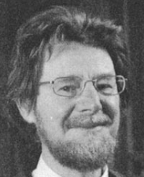
Teleportation Attack
?
?
?
[Bell]
[Bell]
?
?
It is possible to cheat with entanglement !!
Quantum teleportation allows to
break the protocol perfectly.

Slide 46
No-Go Theorem
[Buhrman, Chandran, Fehr, Gelles, Goyal, Ostrovsky, Schaffner 2010]
Any position-verification protocol can be broken using a very large number of entangled qubits.
Question: Are so many quantum resources really necessary?
Does there exist a protocol such that:
  honest prover and verifiers are efficient, but
  any attack requires lots of entanglement

Slide 47
What Have You Learned from this Talk?
Classical Cryptography
  Long history
  One-time pad
  Public-key cryptography
  Links to Logic and Politics
m = 0000 1111
c = m © k = 0101 0100
Alice
Bob
k = ?
Eve
k = 0101 1011
k = 0101 1011

Slide 48
What Have You Learned from this Talk?
Quantum Mechanics
  Qubits
  Quantum Computer
  No-cloning
  Entanglement
  Quantum Teleportation

Slide 49
What Have You Learned from this Talk?
Quantum Key Distribution (QKD)
Position-Based Cryptography

Slide 50
Thank you for your attention!
Questions

Slide 51
Are There Secure Schemes?
Different quantum schemes proposed by
  Chandran, Fehr, Gelles, Goyal, Ostrovsky [2010]
  Malaney [2010]
  Kent, Munro, Spiller [2010]
  Lau, Lo [2010]
Unfortunately they can all be broken!
  General no-go theorem
  [Buhrman, Chandran, Fehr, Gelles, Goyal, Ostrovsky, Schaffner 2010]

Slide 52

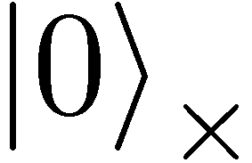
Quantum Operations
are linear isometries
can be described by a unitary matrix:
examples:
  identity
  bitflip (Pauli X): mirroring at axis
X
X
X
X

Slide 53

Quantum Operations
are linear isometries
can be described by a unitary matrix:
examples:
  identity
  bitflip (Pauli X): mirroring at axis
  phase-flip (Pauli Z): mirroring at axis
  both (Pauli XZ)
Z

Slide 54
Most General Single-Round Scheme
U
Let us study the attacking game

Slide 55
Distributed Q Computation in 1 Round
U
using some form of back-and-forth teleportation, players succeed with probability arbitrarily close to 1
requires an exponential amount of EPR pairs

