Slide 1

Position-Based
Quantum Cryptography
Christian Schaffner
ILLC, University of Amsterdam
Centrum Wiskunde & Informatica
Advances in Quantum Cryptography Workshop
Institut Henri Poincaré, Paris
Tuesday, 24 March 2015

Slide 2
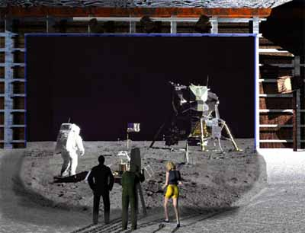
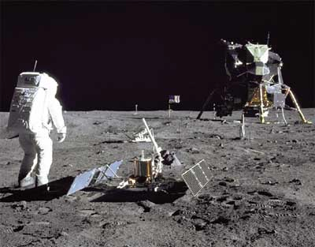
1969: Man on the Moon
The Great Moon-Landing Hoax?
NASA
http://www.unmuseum.org/moonhoax.htm
How can you prove that you are at a specific location?

Slide 3
Position-Based Cryptography
ongoing project with:
Harry Buhrman
Serge Fehr
Nicolas Gisin
Adrian Kent
Florian Speelman
Hugo Zbinden
Nishanth Chandran
Ran Gelles
Vipul Goyal
Rafail Ostrovsky
…

Slide 4

Outline of the Talk
Notation & Quantum Teleportation
Position-Based Cryptography
No-Go Theorem
Garden-Hose Model

Slide 5
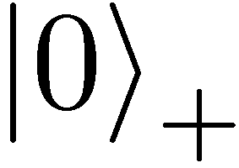
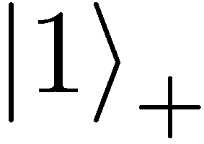
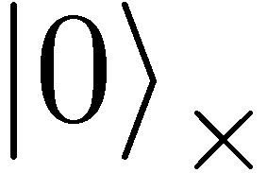
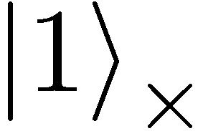
Quantum Mechanics
+ basis
£ basis
Measurements:
with prob. 1 yields 1
0/1
with prob. ½ yields 0
0/1
with prob. ½ yields 1

Slide 6
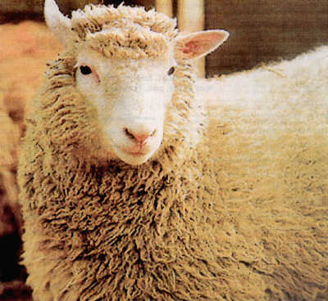
No-Cloning Theorem
U
quantum operations:
?
?
?
Proof: copying is a non-linear operation

Slide 7
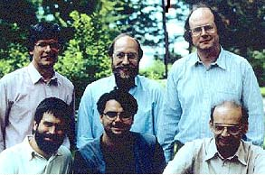

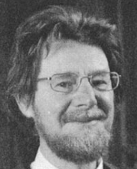





Quantum Teleportation
[Bennett Brassard Crépeau Jozsa Peres Wootters 1993]
?
[Bell]
?
?
does not contradict relativity theory
teleported state can only be recovered
once the classical information ¾ arrives

Slide 8



Port-Based Teleportation
[Ishizaka Hiroshima 2008]
?
?
no correction operation required
works only approximately
requires 2^{n} EPR pairs for teleporting n qubits
Notes:
no correction = correction by tracing out the other qubits

Slide 9
Outline of the Talk
Notation & Quantum Teleportation
Position-Based Cryptography
No-Go Theorem
Garden-Hose Model

Slide 10
How to Convince Someone of Your Presence at a Location
The Great Moon Landing Hoax
http://www.unmuseum.org/moonhoax.htm

Slide 11
Basic Task: Position Verification
Prove you are at a certain location:
  launching-missile command comes from within the military headquarters
  talking to the correct country
  pizza delivery problem
  …
building block for advanced cryptographic tasks:
  authentication, position-based key-exchange
  can only decipher message at specific location
Can the geographical location of a player be used as cryptographic credential ?

Slide 12





Basic task: Position Verification
Verifier1
Prover
Verifier2
Prover wants to convince verifiers that she is at a particular position
no coalition of (fake) provers, i.e. not at the claimed position, can convince verifiers
assumptions:  communication at speed of light
            instantaneous computation
            verifiers can coordinate

Slide 13




Position Verification: First Try
Verifier1
Prover
Verifier2
time
distance bounding [Brands Chaum ‘93]

Slide 14
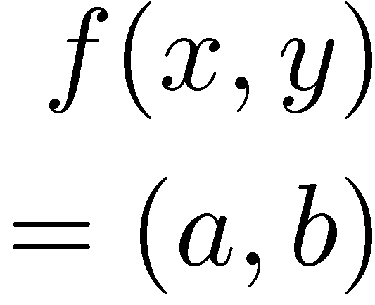


Position Verification: Second Try
Verifier1
Prover
Verifier2
position verification is classically impossible !
[Chandran Goyal Moriarty Ostrovsky: CRYPTO ’09]

Slide 15




Equivalent Attacking Game
independent messages m_{x} and m_{y}
copying classical information
this is impossible quantumly

Slide 16

Position Verification: Quantum Try
[Kent Munro Spiller 03/10]
?
?
?
Let us study the attacking game

Slide 17




Attacking Game
?
?
?
?
?
impossible
but possible with entanglement!!

Slide 18


Entanglement attack
?
?
[Bell]
done if b=1
?
Notes:
appears INSTANTANEOUSLY on the other side

Slide 19

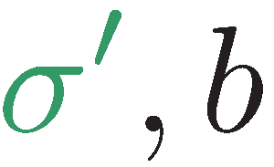
Entanglement attack
?
?
?
[Bell]
[Bell]
the correct person can reconstruct the qubit in time!
the scheme is completely broken

Slide 20
more complicated schemes?
Different schemes proposed by
  Chandran, Fehr, Gelles, Goyal, Ostrovsky [2010]
  Malaney [2010]
  Kent, Munro, Spiller [2010]
  Lau, Lo [2010]
Unfortunately they can all be broken!
  general no-go theorem [Buhrman, Chandran, Fehr, Gelles, Goyal, Ostrovsky, S 2010]

Slide 21
Most General Single-Round Scheme
U
Let us study the attacking game

Slide 22
Distributed Q Computation in 1 Round
U
tricky back-and-forth teleportation [Vaidman 03]
using a double exponential amount of EPR pairs, players succeed with probability arbitrarily close to 1
improved to exponential in [Beigi König ‘11]

Slide 23
Using Port-Based Teleportation
[Beigi König ‘11]
[Bell]
U
U
U
U
Notes:
appears INSTANTANEOUSLY on the other side

Slide 24
Using Port-Based Teleportation
[Beigi König ‘11]
[Bell]
U
U
U
U
output:
Notes:
appears INSTANTANEOUSLY on the other side

Slide 25
No-Go Theorem
Any position-verification protocol can be broken
  using a double-exponential number of EPR-pairs
  reduced to single-exponential [Beigi, König‘11]
Question: is this optimal?
Does there exist a protocol such that:
  any attack requires many EPR-pairs
  honest prover and verifiers efficient

Slide 26

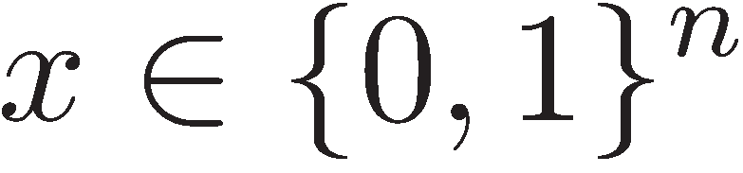
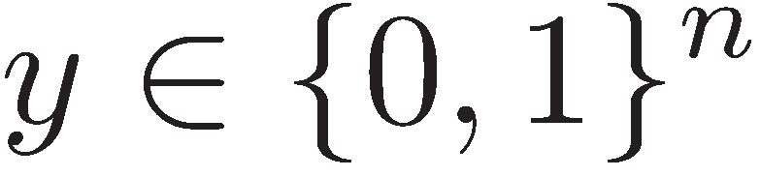
Single-Qubit Protocol: SQP_{f}
[Kent Munro Spiller 03/10]
?
?
?
if f(x,y)=0
if f(x,y)=1
efficiently computable

Slide 27
Attacking Game for SQP_{f}
x
y
?
?
?
if f(x,y)=0
if f(x,y)=1
Define E( SQP_{f} ) := minimum number of EPR pairs required for attacking SQP_{f}

Slide 28
Outline of the Talk
Notation & Quantum Teleportation
Position-Based Cryptography
No-Go Theorem
Garden-Hose Model
Buhrman, Fehr, S, Speelman:
The Garden-Hose Model
Innovations in Theoretical Computer Science 2013,
arXiv:1109.2563

Slide 29





The Garden-Hose Model
share s waterpipes

Slide 30



The Garden-Hose Model
if water exits @ Alice
if water exits @ Bob
based on their inputs, players connect pipes with pieces of hose
Alice also connects a water tap

Slide 31
The Garden-Hose Model
if water exits @ Alice
if water exits @ Bob
Garden-Hose complexity of f:
GH(f) := minimum number of pipes needed to compute f

Slide 32














Demonstration: Inequality on Two Bits

Slide 33
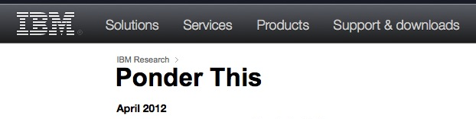
n-Bit Inequality Puzzle
GH( Inequality ) ·
  demonstration: 3n
  [Margalit Matsliah ‘12]: ~1.547n (using IBM’s SAT solver)
  ~1.536n, ~1.505n, ~1.457n [Dodson ‘12], ~1.448n
  current world-record: ~1.359n [Chiu Szegedy et al 13]
GH( Inequality ) ¸ n [Pietrzak ‘11]

Slide 34


Inequality with 4 Pipes and 6 Inputs
Alice knows where water exits if x=y
yields 4 / log(6) ¼ 1.547 pipes per bit
1,4,6
2
3
1
5
4
2
6
6
2
4
5
1
3
3,5

Slide 35
Any f has GH(f)· 2^{n+1}
y₁y₂…y_{n}
x₁x₂…x_{n}
00… 0
connects iff
f(00…0,y)=0
x₁x₂…x_{n}
connects iff
f(x,y)=0
f(x,y)=1
11… 1
connects iff
f(11…1,y)=0
f(x,y)=0
2^{n+1} pipes
f(x,y)=1

Slide 36
Any f has GH(f)· 2^{n+1}
y₁y₂…y_{n}
x₁x₂…x_{n}
n
00… 0
connects iff
f(00…0,y)=0
x₁x₂…x_{n}
connects iff
f(x,y)=0
f(x,y)=0
n
11… 1
connects iff
f(11…1,y)=0
f(x,y)=0
2^{n+1} pipes
f(x,y)=1

Slide 37
Relationship between
E(SQP_{f}) and GH(f)

Slide 38




GH(f) ¸ E(SQP_{f})
Garden-Hose
Attacking Game
?
teleport
teleport
teleport
teleport

Slide 39
GH(f) ¸ E(SQP_{f})
Garden-Hose
Attacking Game
?
teleport
teleport
teleport
teleport
using x & y, can follow the water/qubit
correct water/qubit using all measurement outcomes
x, Alice’s
telep. keys
y, Bob’s
telep. keys

Slide 40
GH(f) = E(SQP_{f}) ?
last slide: GH(f) ¸ E(SQP_{f})
The two models are not equivalent:
  exists f such that GH(f) = n , but E(SQP_{f}) · log(n)
Quantum garden-hose model:
  give Alice & Bob also entanglement
  research question: are the models now equivalent?

Slide 41
Garden-Hose Complexity Theory
every f has GH(f) · 2^{n+1}
if f in logspace, then GH(f) · polynomial
  efficient f & no efficient attack ) P≠ L
exist f with GH(f) exponential (counting argument)
for g 2 {equality, IP, majority}: GH(g) ¸ n log(n)
  techniques from communication complexity
Many open problems!
recent results by Klauck, Podder
in arxiv:1412.4904

Slide 42
What Have You Learned from this Talk?
Port-Based Quantum Teleportation
Position-Based Cryptography
?

Slide 43
What Have You Learned from this Talk?
No-Go Theorem
  Impossible unconditionally, but attack requires unrealistic amounts of resources
Garden-Hose Model
  Restricted class of single-qubit schemes: SQP_{f}
  Easily implementable
  Garden-hose model to study attacks
  Connections to complexity theory

Slide 44
Open Problems
Is Quantum-GH(f) equivalent to E(SQP_{f})?
Find good lower bounds on E(SQP_{f})
Are there other position-verification schemes? Connection with non-local games
Position verification in higher dimensions
Experimental problems: handle losses and measurement errors
Can we achieve other position-based primitives?
…

Slide 45
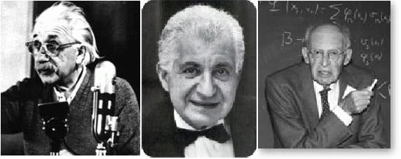
EPR Pairs
[Einstein Podolsky Rosen 1935]
prob. ½ : 0
prob. ½ : 1
EPR magic!
prob. 1 : 0
“spukhafte Fernwirkung” (spooky action at a distance)
EPR pairs do not allow to communicate
(no contradiction to relativity theory)
can provide a shared random bit
(or other non-signaling correlations)

Slide 46

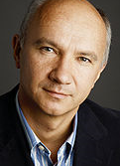
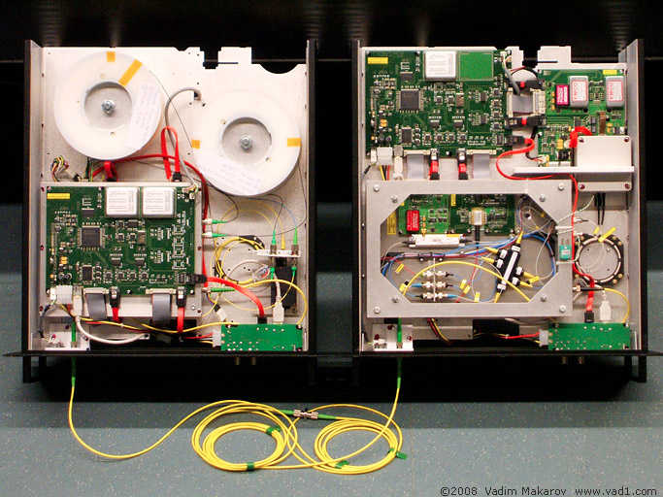

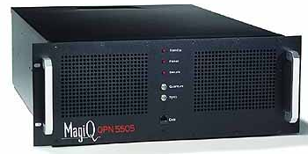

Quantum Key Distribution (QKD)
[Bennett Brassard 84, Ekert 91]
Alice
Bob
Eve
inf-theoretic security against unrestricted eavesdroppers:
  quantum states are unknown to Eve, she cannot copy them
  honest players can check whether Eve interfered
technically feasible: no quantum computation required,
only quantum communication

